Slide 1
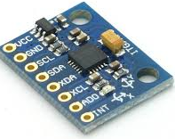
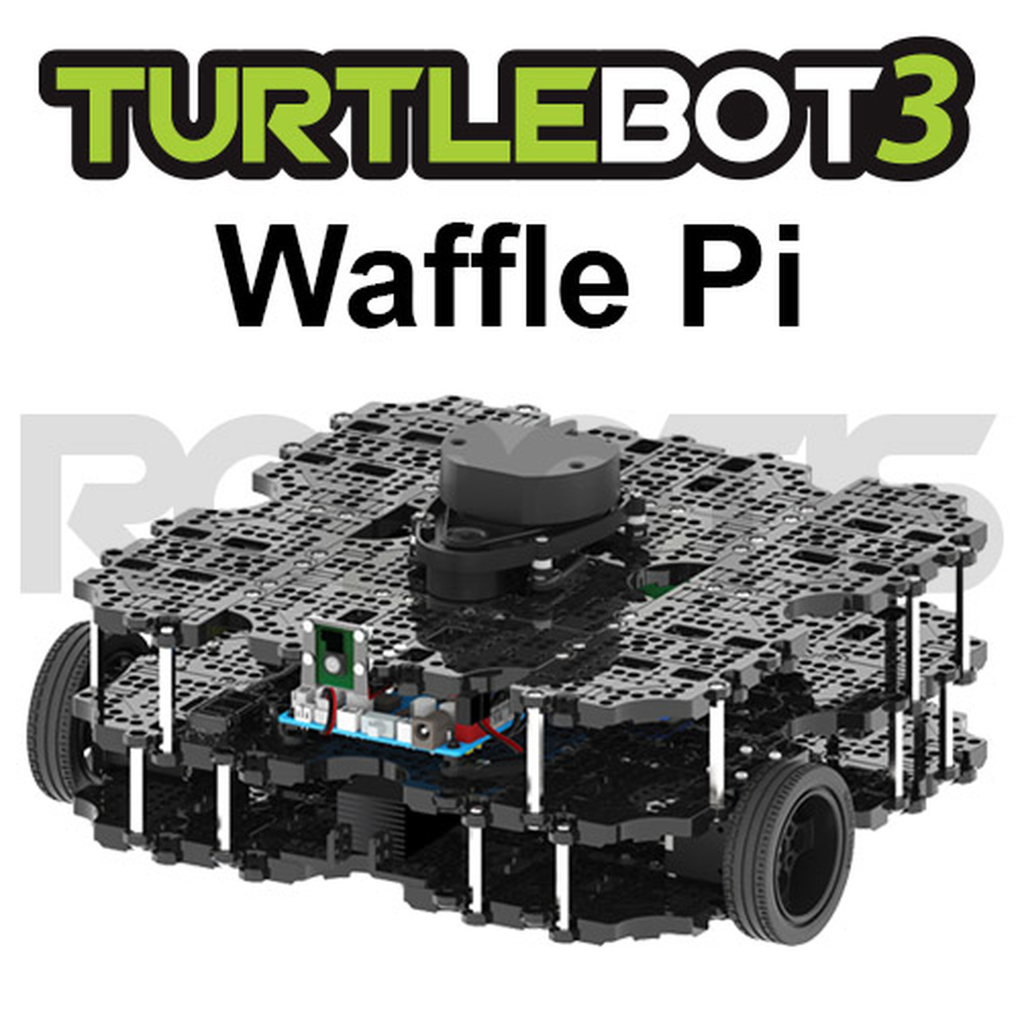
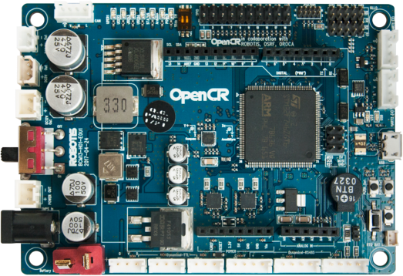
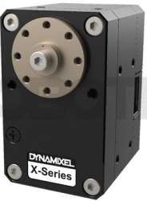
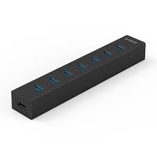
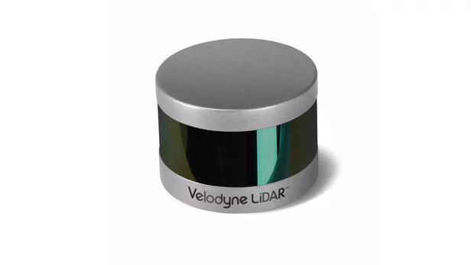
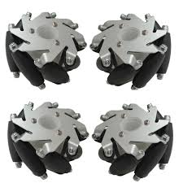
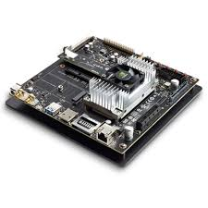
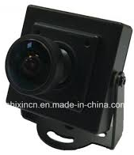
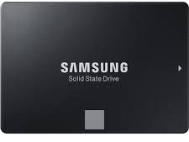
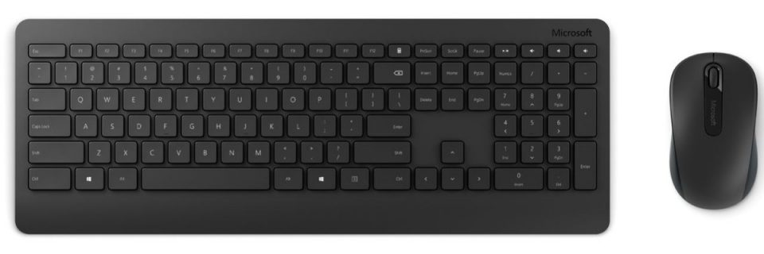
시스템 구성도
sensing
control
IMU sensor
usb3.0
Hub
usb3.0
OpenCR
sensing
usb3.0
Dynamixel
main control
usb3.0
LIDAR
usb3.0
usb3.0
mecanum
wheel
USB Camera
NVIDIA TX2
SSD 250GB
Input device

Slide 2
구성 부품
OpenCR
IMU sensor
Dynamixel
메카넘휠(옴니휠)
TurtleBot3 Waffle Pi
usb3.0 Hub
LIDAR
USB Camera
SSD 250GB
Input Device
NVIDIA TX2

