Slide 1
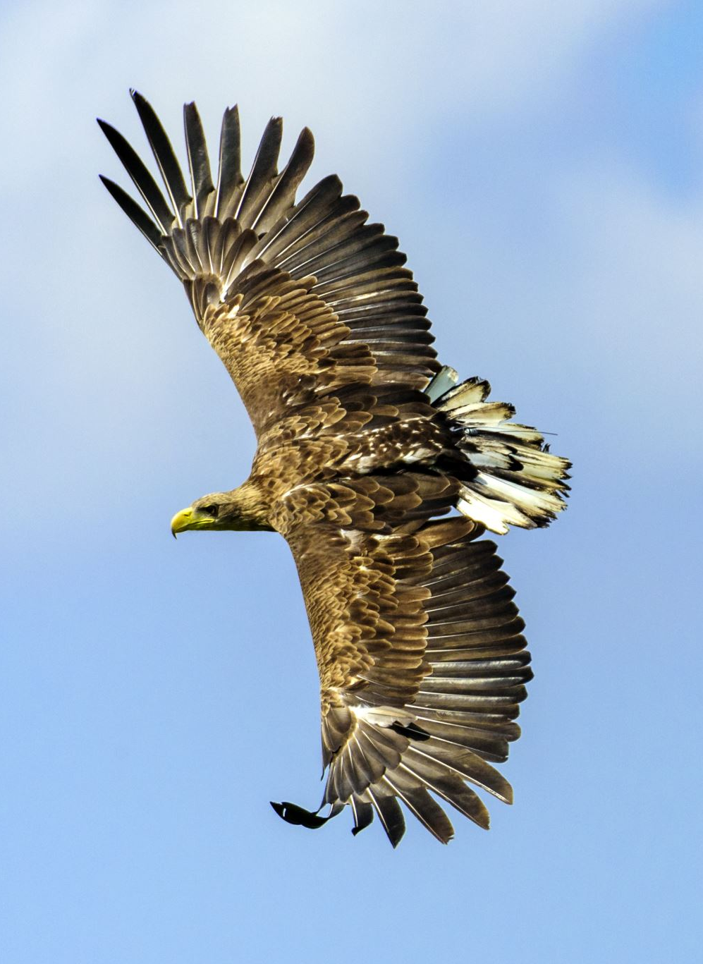
Green Eagles Team

Slide 2
Column Widget

Slide 3
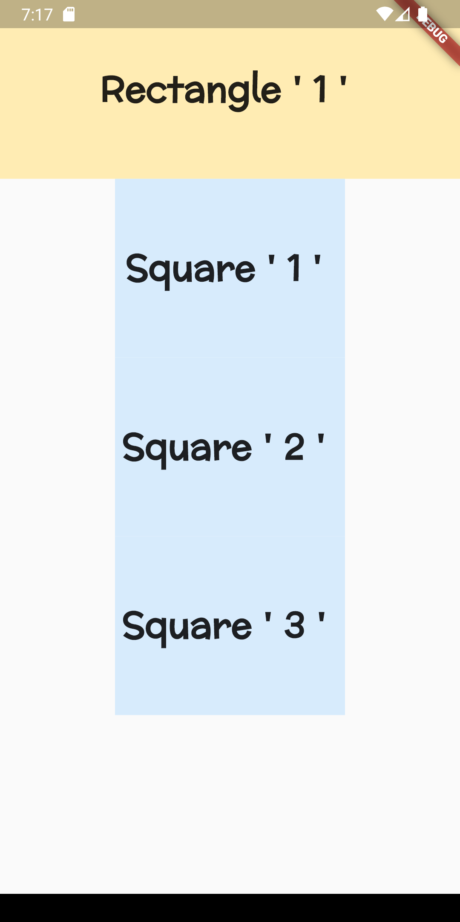
class Columnn extends StatelessWidget {
const Columnn({super.key}); @override
Widget build(BuildContext context) {
return Scaffold(
body: Column( children: [
Rectangle(name: "Rectangle ' 1 ' "),
Square(name: "Square ' 1 ' "),
Square(name: "Square ' 2 ' "),
Square(name: "Square ' 3 ' "),
],
),
);
}
}

Slide 4
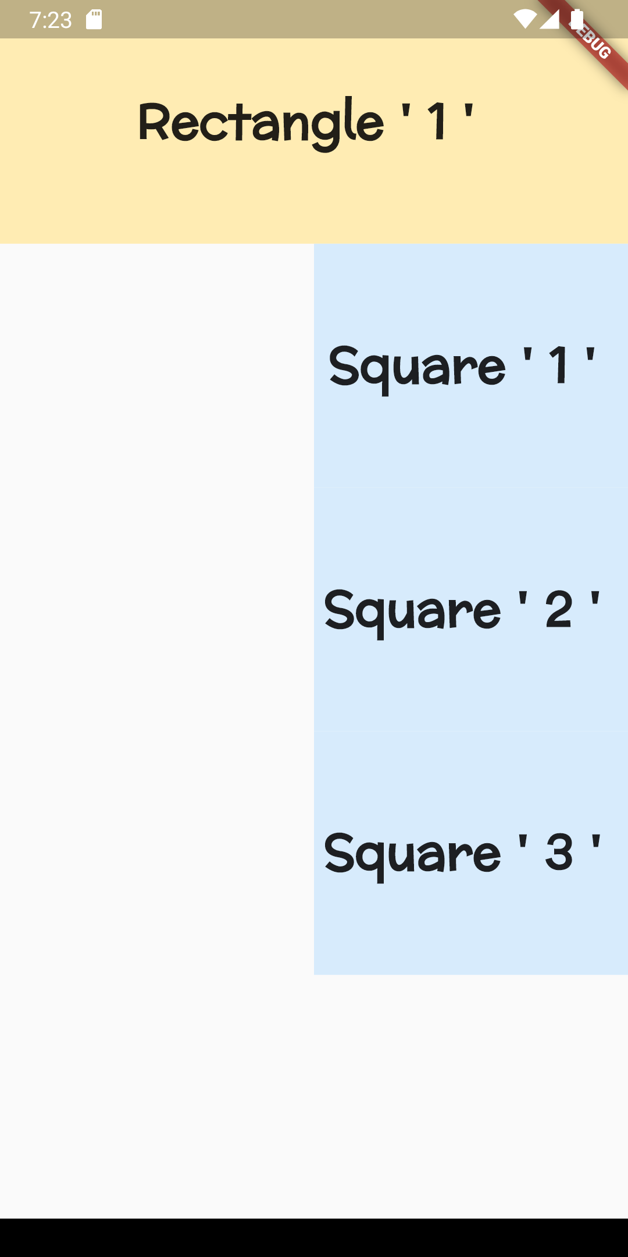
class Columnn extends StatelessWidget {
const Columnn({super.key}); @override
Widget build(BuildContext context) {
return Scaffold(
body: Column(
crossAxisAlignment: CrossAxisAlignment.end, children: [
Rectangle(name: "Rectangle ' 1 ' "),
Square(name: "Square ' 1 ' "),
Square(name: "Square ' 2 ' "),
Square(name: "Square ' 3 ' "),
],
),

Slide 5
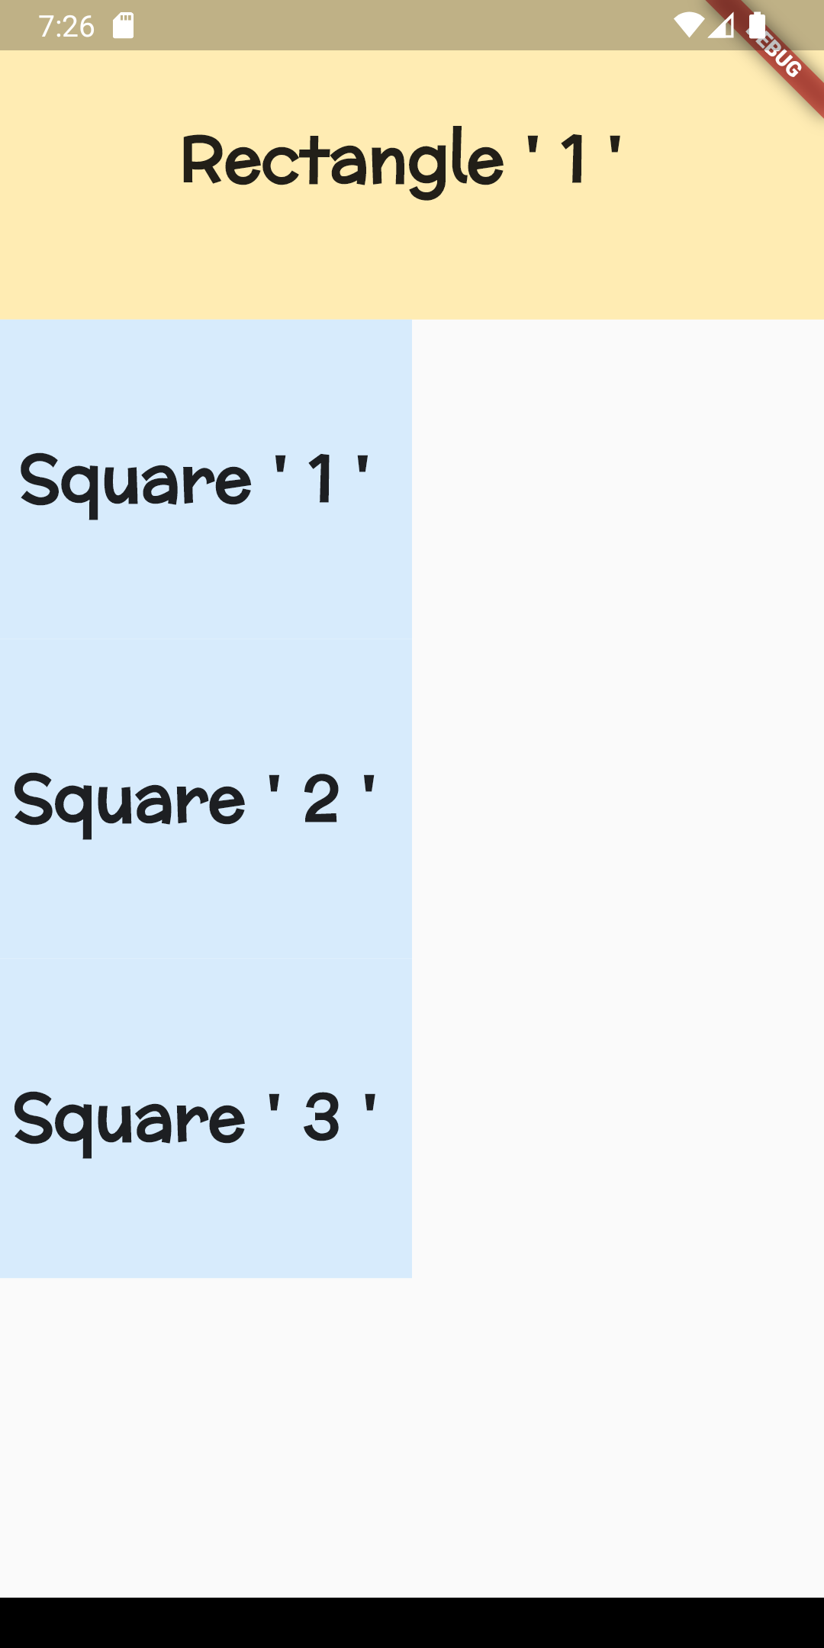
class Columnn extends StatelessWidget {
const Columnn({super.key}); @override
Widget build(BuildContext context) {
return Scaffold(
body: Column(
crossAxisAlignment: CrossAxisAlignment.start, children: [
Rectangle(name: "Rectangle ' 1 ' "),
Square(name: "Square ' 1 ' "),
Square(name: "Square ' 2 ' "),
Square(name: "Square ' 3 ' "),
],
),

Slide 6
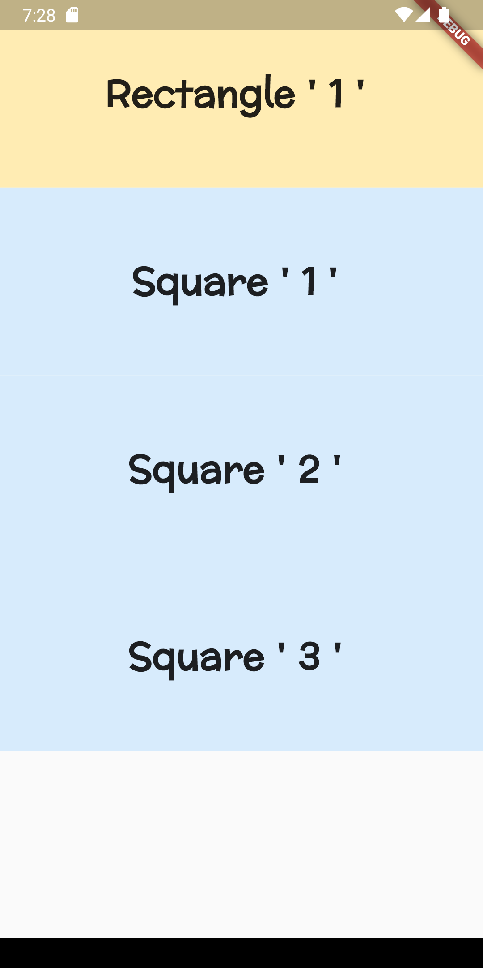
class Columnn extends StatelessWidget {
const Columnn({super.key}); @override
Widget build(BuildContext context) {
return Scaffold(
body: Column(
crossAxisAlignment: CrossAxisAlignment. stretch, children: [
Rectangle(name: "Rectangle ' 1 ' "),
Square(name: "Square ' 1 ' "),
Square(name: "Square ' 2 ' "),
Square(name: "Square ' 3 ' "),
],
),

Slide 7
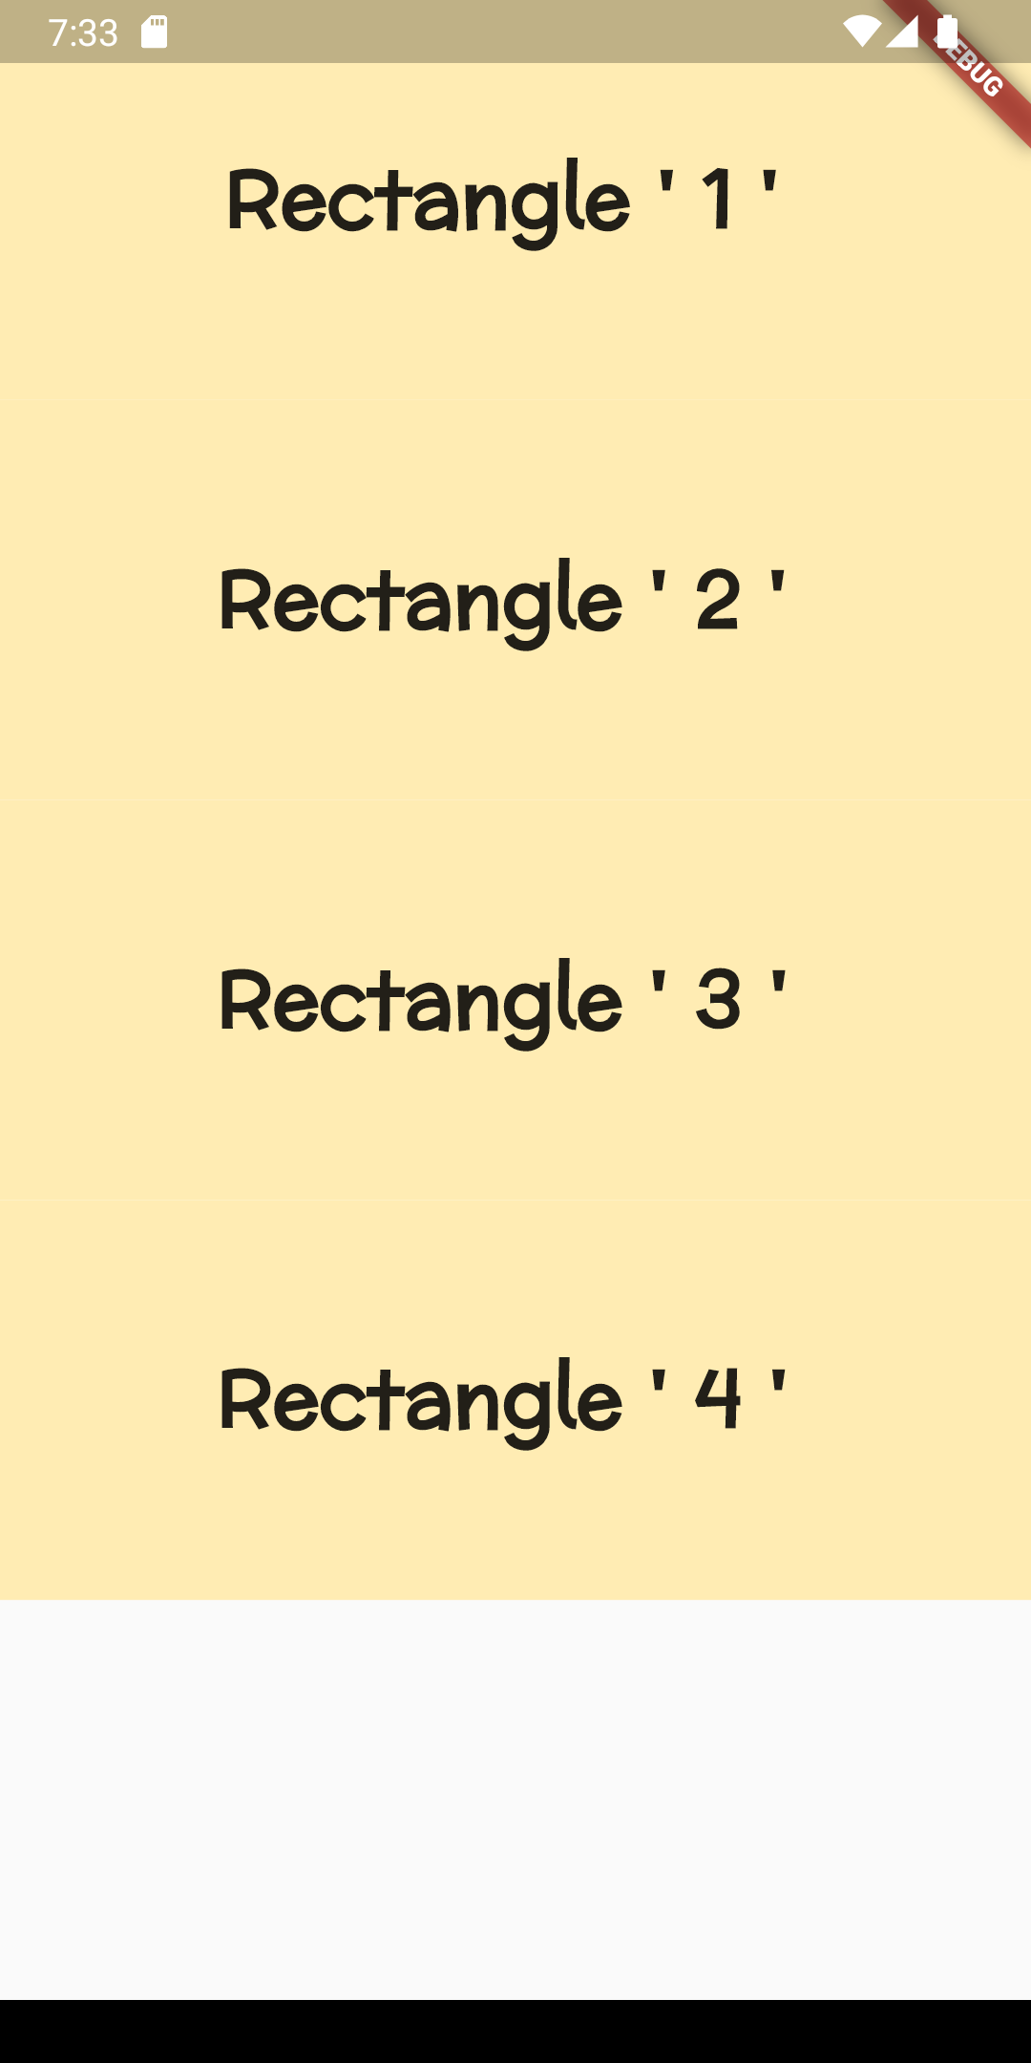
class Columnn extends StatelessWidget {
const Columnn({super.key}); @override
Widget build(BuildContext context) {
return Scaffold(
body: Column(
mainAxisAlignment: MainAxisAlignment.start, children: [
Rectangle(name: "Rectangle ' 1 ' "),
Rectangle(name: "Rectangle ' 2 ' "),
Rectangle(name: "Rectangle ' 3 ' "),
Rectangle(name: "Rectangle ' 4 ' "),
],
),
);
}
}

Slide 8
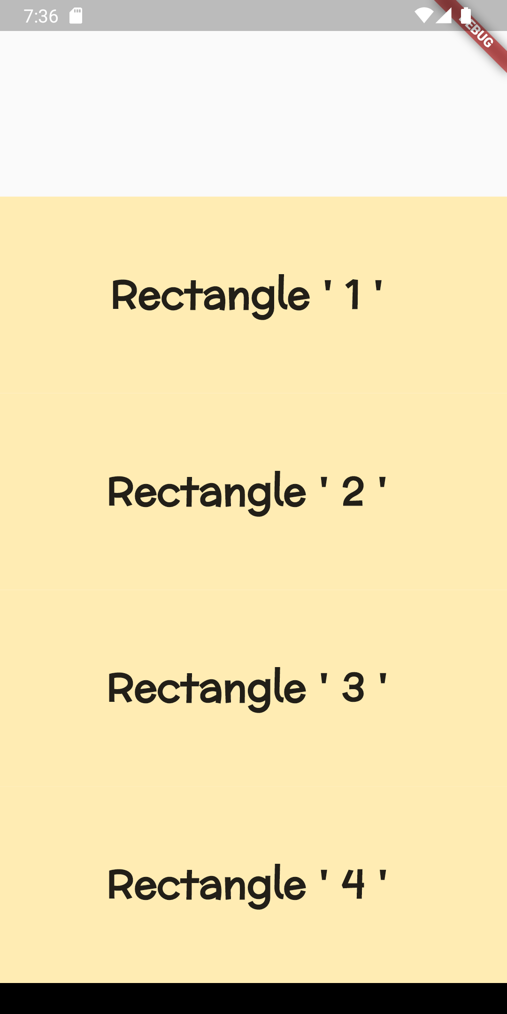
class Columnn extends StatelessWidget {
const Columnn({super.key}); @override
Widget build(BuildContext context) {
return Scaffold(
body: Column(
mainAxisAlignment: MainAxisAlignment.end, children: [
Rectangle(name: "Rectangle ' 1 ' "),
Rectangle(name: "Rectangle ' 2 ' "),
Rectangle(name: "Rectangle ' 3 ' "),
Rectangle(name: "Rectangle ' 4 ' "),
],
),
);
}
}

Slide 9
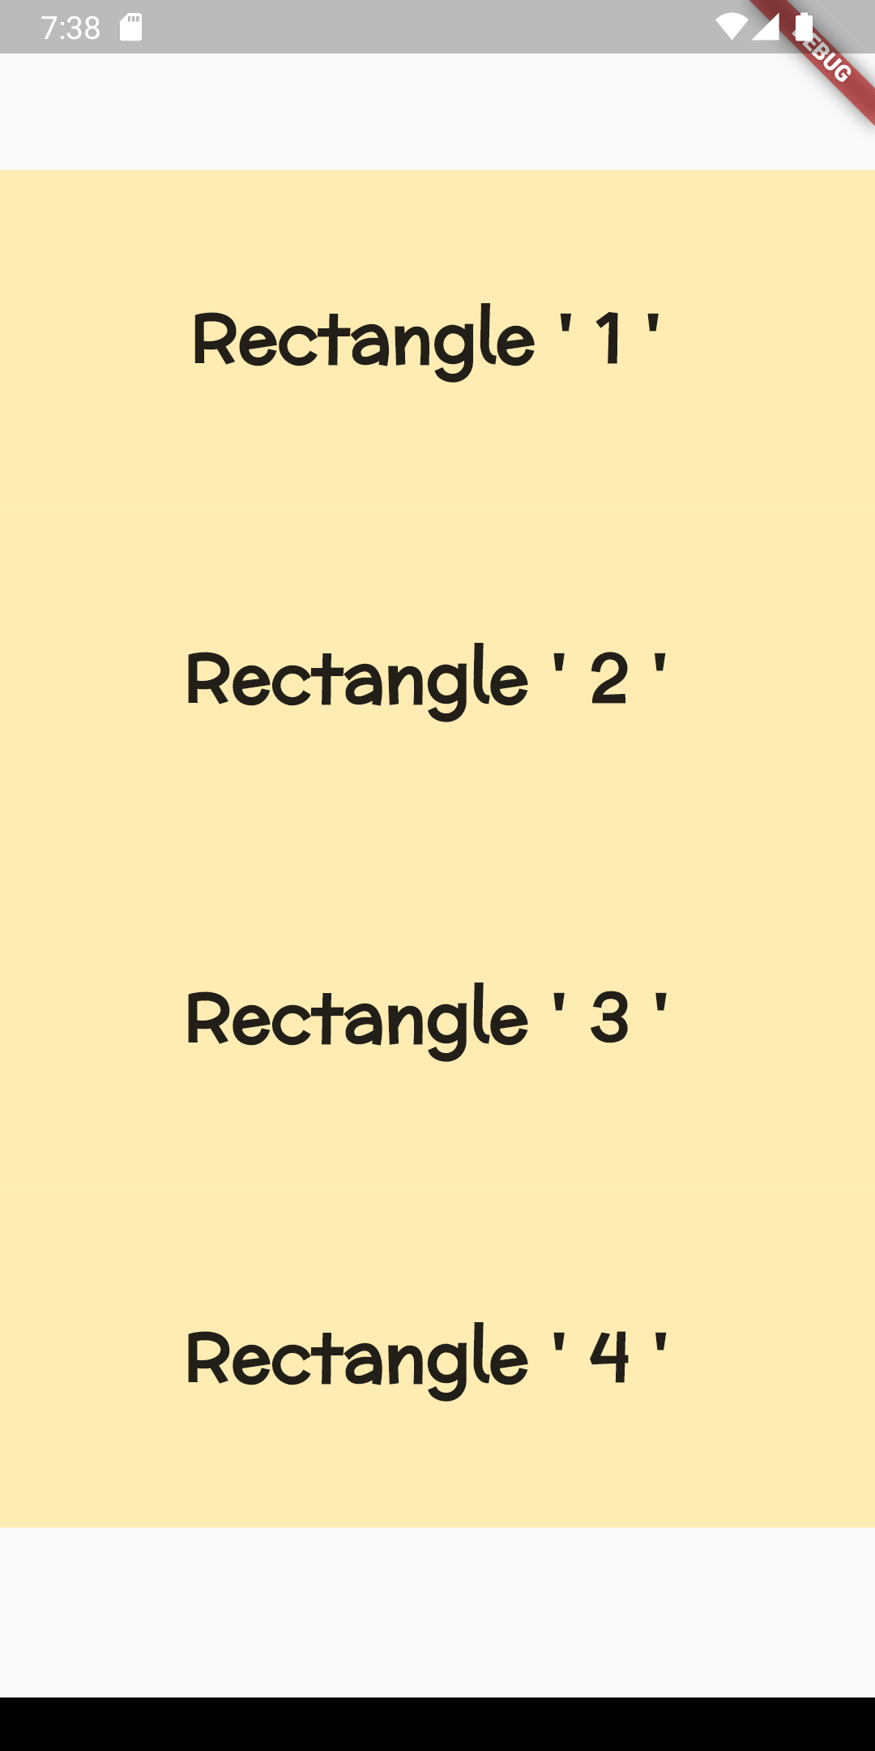
class Columnn extends StatelessWidget {
const Columnn({super.key}); @override
Widget build(BuildContext context) {
return Scaffold(
body: Column(
mainAxisAlignment: MainAxisAlignment.center, children: [
Rectangle(name: "Rectangle ' 1 ' "),
Rectangle(name: "Rectangle ' 2 ' "),
Rectangle(name: "Rectangle ' 3 ' "),
Rectangle(name: "Rectangle ' 4 ' "),
],
),
);
}
}

Slide 10
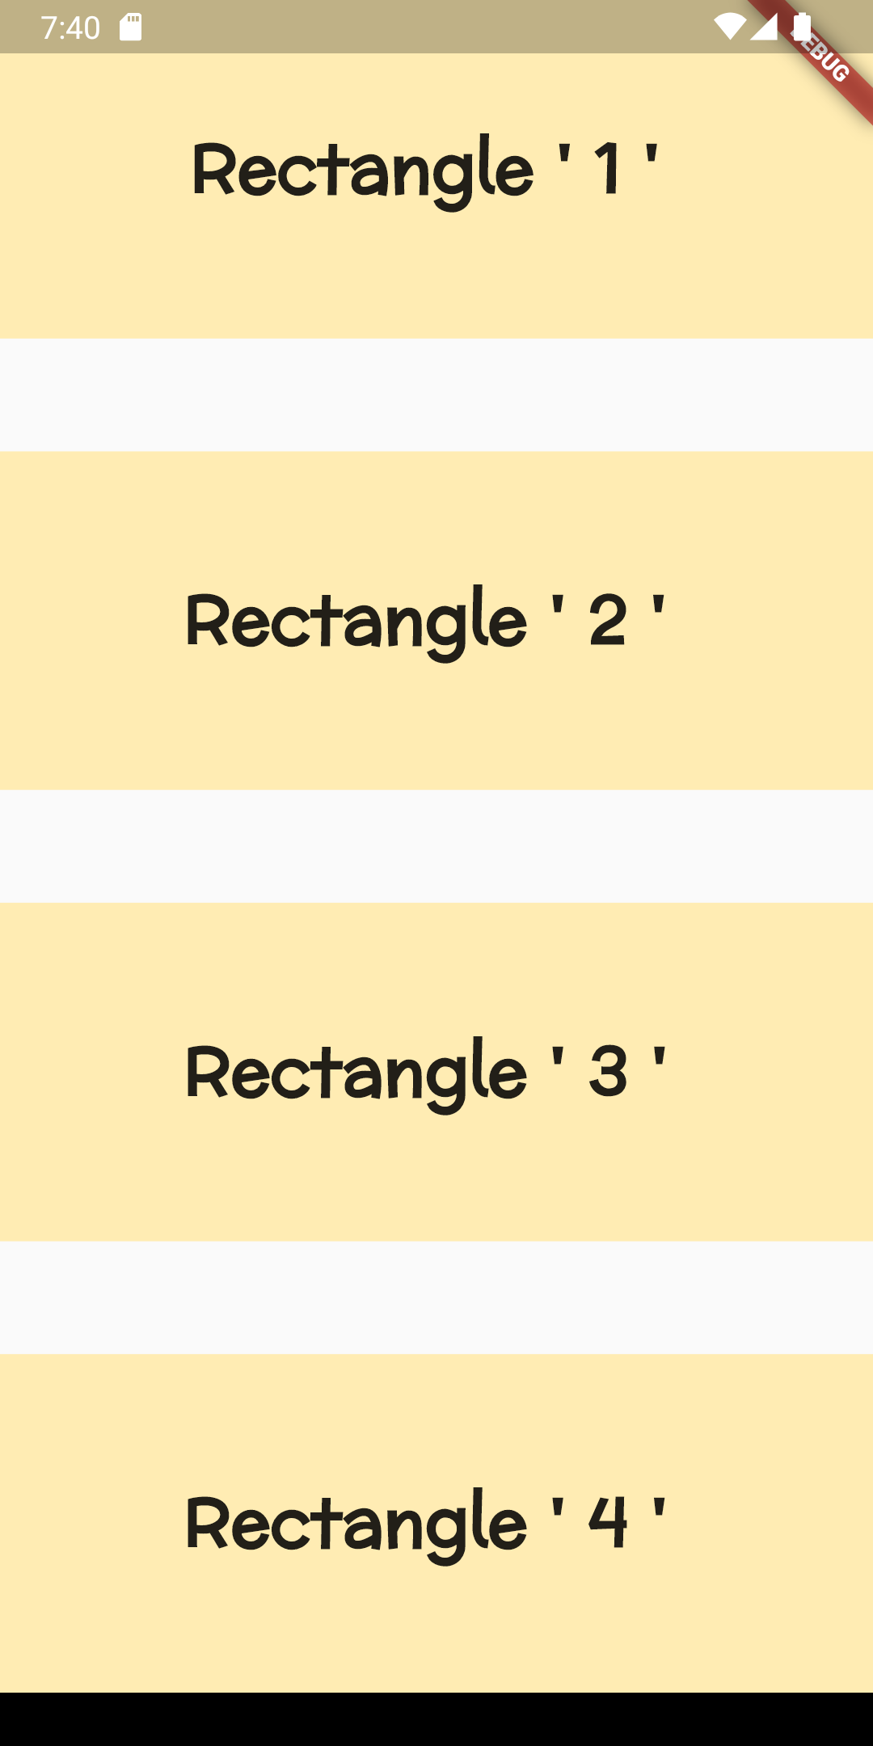
class Columnn extends StatelessWidget {
const Columnn({super.key}); @override
Widget build(BuildContext context) {
return Scaffold(
body: Column(
mainAxisAlignment: MainAxisAlignment.spaceBetween, children: [
Rectangle(name: "Rectangle ' 1 ' "),
Rectangle(name: "Rectangle ' 2 ' "),
Rectangle(name: "Rectangle ' 3 ' "),
Rectangle(name: "Rectangle ' 4 ' "),
],
),
);
}

Slide 11
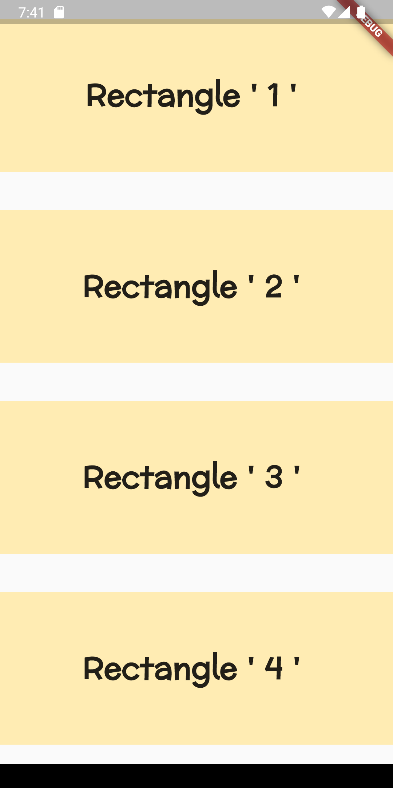
class Columnn extends StatelessWidget {
const Columnn({super.key}); @override
Widget build(BuildContext context) {
return Scaffold(
body: Column(
mainAxisAlignment: MainAxisAlignment.spaceAround, children: [
Rectangle(name: "Rectangle ' 1 ' "),
Rectangle(name: "Rectangle ' 2 ' "),
Rectangle(name: "Rectangle ' 3 ' "),
Rectangle(name: "Rectangle ' 4 ' "),
],
),
);
}

Slide 12
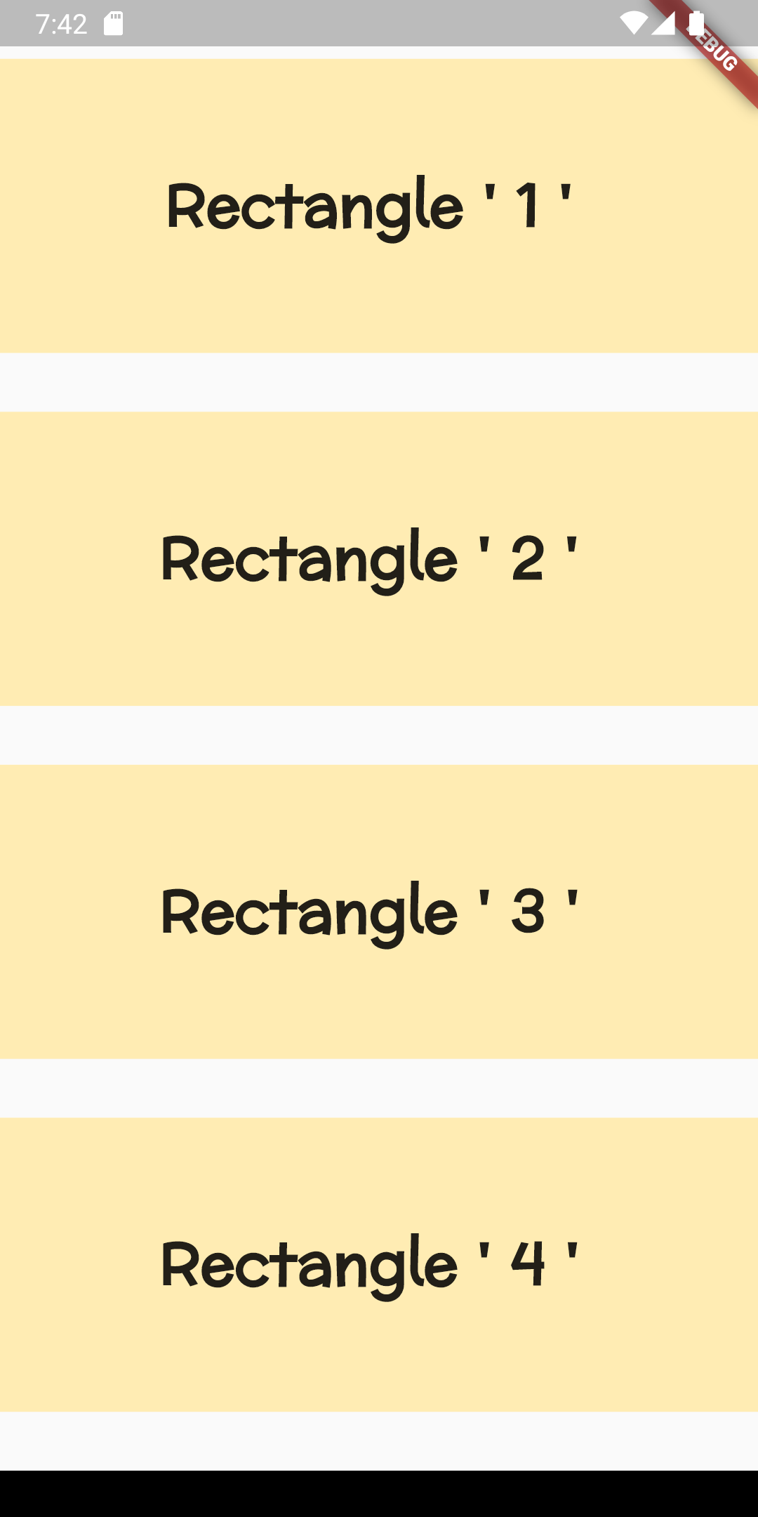
class Columnn extends StatelessWidget {
const Columnn({super.key}); @override
Widget build(BuildContext context) {
return Scaffold(
body: Column(
mainAxisAlignment: MainAxisAlignment.spaceEvenly, children: [
Rectangle(name: "Rectangle ' 1 ' "),
Rectangle(name: "Rectangle ' 2 ' "),
Rectangle(name: "Rectangle ' 3 ' "),
Rectangle(name: "Rectangle ' 4 ' "),
],
),
);
}
}

Slide 13
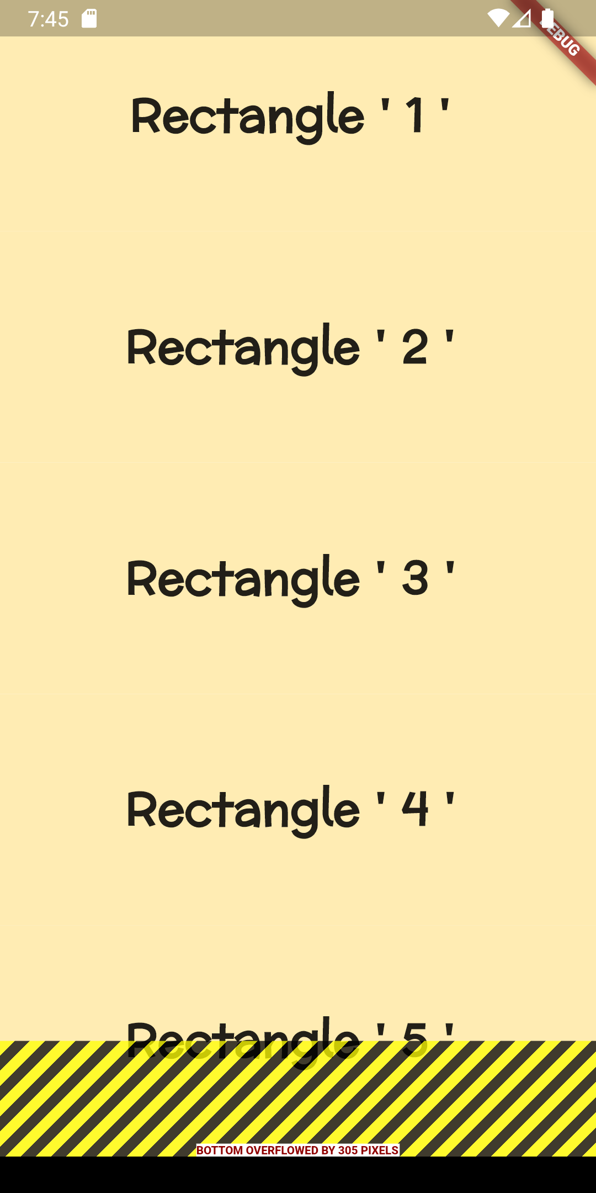
class Columnn extends StatelessWidget {
const Columnn({super.key}); @override
Widget build(BuildContext context) {
return Scaffold(
body: Column(
mainAxisAlignment: MainAxisAlignment. spaceBetween, children: [
Rectangle(name: "Rectangle ' 1 ' "),
Rectangle(name: "Rectangle ' 2 ' "),
Rectangle(name: "Rectangle ' 3 ' "),
Rectangle(name: "Rectangle ' 4 ' "),
Rectangle(name: "Rectangle ' 5 ' "),
Rectangle(name: "Rectangle ' 6 ' "),
Rectangle(name: "Rectangle ' 7 ' "),
],

Slide 14
List View Widget

Slide 15
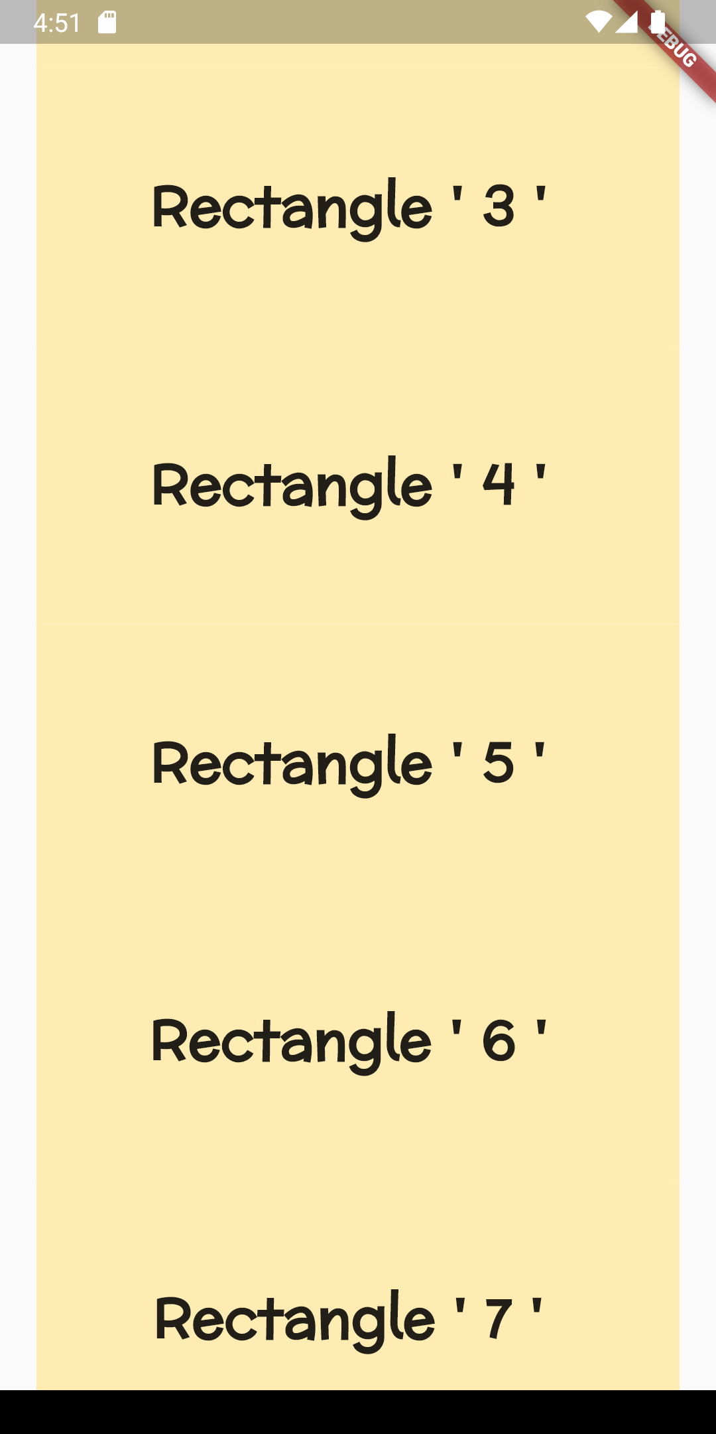
class Columnn extends StatelessWidget {
const Columnn({super.key}); @override
Widget build(BuildContext context) {
return Scaffold(
body: ListView( children: [
Rectangle(name: "Rectangle ' 1 ' "),
Rectangle(name: "Rectangle ' 2 ' "),
Rectangle(name: "Rectangle ' 3 ' "),
Rectangle(name: "Rectangle ' 4 ' "),
Rectangle(name: "Rectangle ' 5 ' "),
Rectangle(name: "Rectangle ' 6 ' "),
Rectangle(name: "Rectangle ' 7 ' "),
],
),

Slide 16
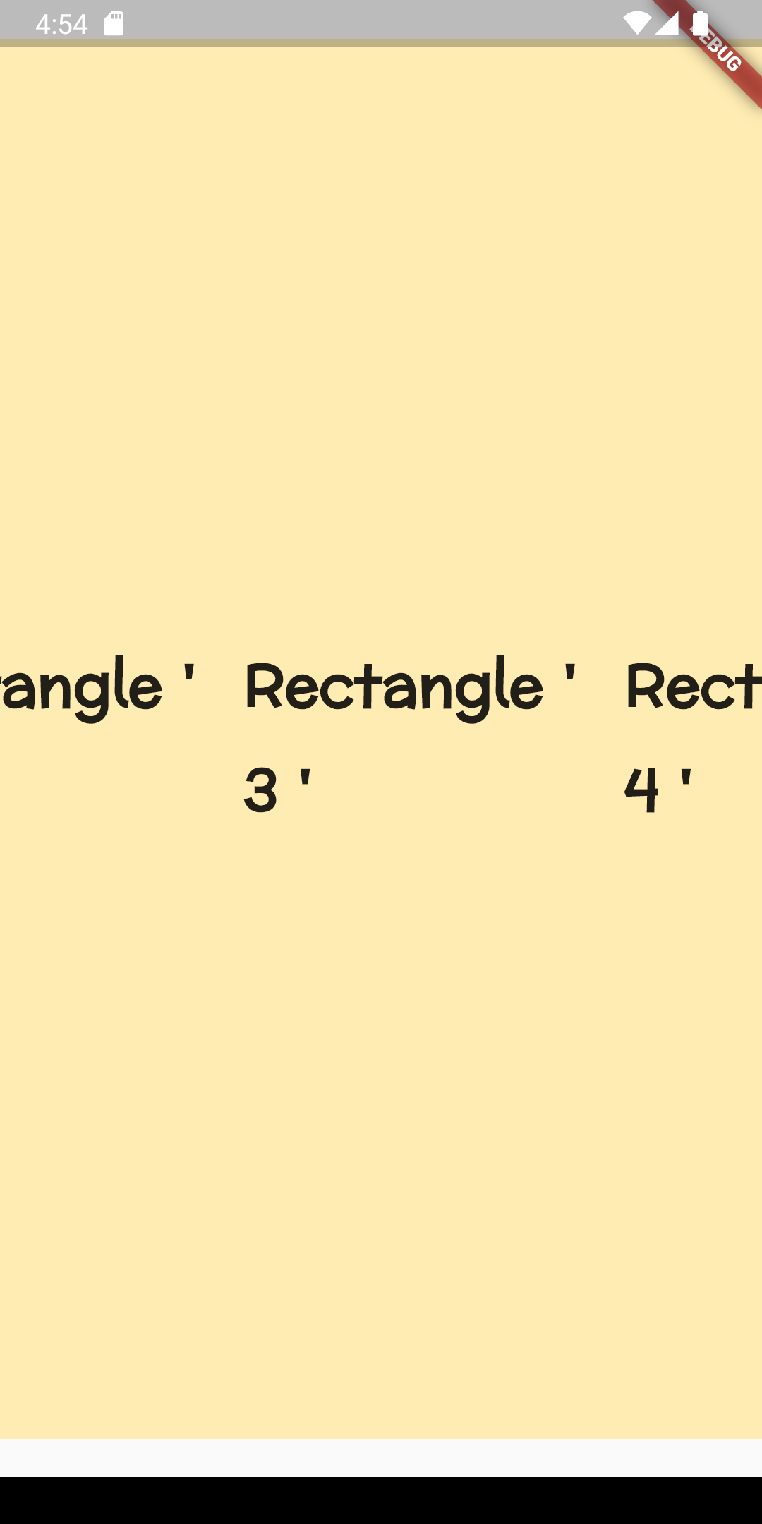
class Columnn extends StatelessWidget {
const Columnn({super.key}); @override
Widget build(BuildContext context) {
return Scaffold(
body: ListView(
scrollDirection: Axis.horizontal, children: [
Rectangle(name: "Rectangle ' 1 ' "),
Rectangle(name: "Rectangle ' 2 ' "),
Rectangle(name: "Rectangle ' 3 ' "),
Rectangle(name: "Rectangle ' 4 ' "),
Rectangle(name: "Rectangle ' 5 ' "),
Rectangle(name: "Rectangle ' 6 ' "),
Rectangle(name: "Rectangle ' 7 ' "),
],
),

Slide 17
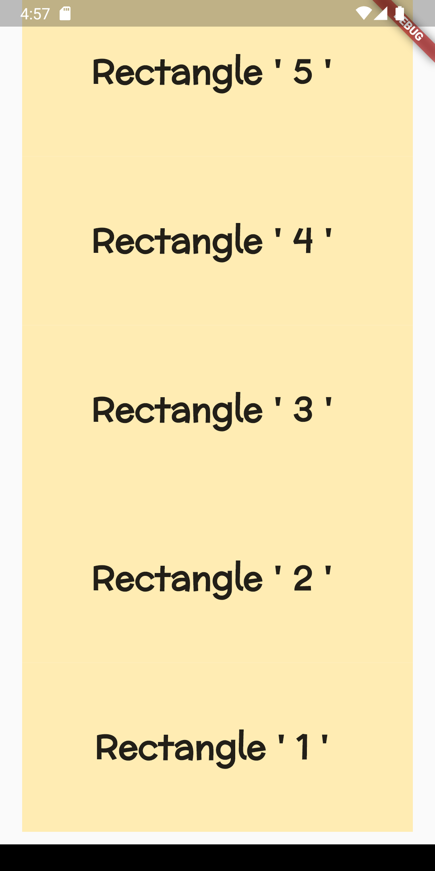
class Columnn extends StatelessWidget {
const Columnn({super.key}); @override
Widget build(BuildContext context) {
return Scaffold(
body: ListView(
reverse: true, children: [
Rectangle(name: "Rectangle ' 1 ' "),
Rectangle(name: "Rectangle ' 2 ' "),
Rectangle(name: "Rectangle ' 3 ' "),
Rectangle(name: "Rectangle ' 4 ' "),
Rectangle(name: "Rectangle ' 5 ' "),
Rectangle(name: "Rectangle ' 6 ' "),
Rectangle(name: "Rectangle ' 7 ' "),
],
),

Slide 18
class Columnn extends StatelessWidget {
const Columnn({super.key}); @override
Widget build(BuildContext context) {
return Scaffold(
body: ListView(
physics: NeverScrollableScrollPhysics(), children: [
Rectangle(name: "Rectangle ' 1 ' "),
Rectangle(name: "Rectangle ' 2 ' "),
Rectangle(name: "Rectangle ' 3 ' "),
Rectangle(name: "Rectangle ' 4 ' "),
Rectangle(name: "Rectangle ' 5 ' "),
Rectangle(name: "Rectangle ' 6 ' "),
Rectangle(name: "Rectangle ' 7 ' "),
],
),

Slide 19
Check Box

Slide 20
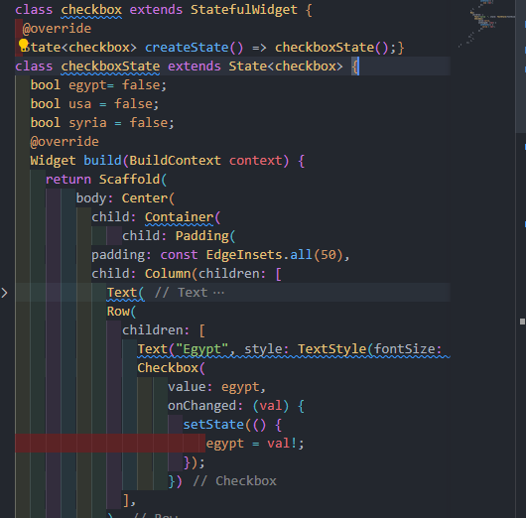
Check Box

Slide 21
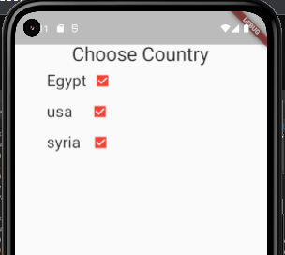
Check Box

Slide 22
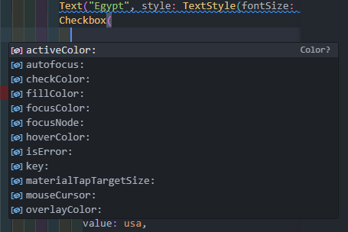
Check Box

Slide 23
switch

Slide 24
