Slide 1





W13 · THE FOURTH ARABIC NLP CONFERENCE (ArabicNLP 2026) · EMNLP 2026 · BUDAPEST
ARABIC DIALECT SENTIMENT ANALYSIS · DIALECTSENTEVAL 2026 SUBTASK 1
Adversarial Training and Iterative Self-Training
for Zero-Shot Dialect Sentiment Analysis
Momen Ibrahim · Mariam E. Hassib · Ahmed Salem · Marwan Torki
Computer and Systems Engineering Department, Faculty of Engineering, Alexandria University, Egypt | Team ALEXIS
Rank #1 of 12 teams · Macro F1 0.8667 · Accuracy 0.8857
Notes:
Hello everyone. I'm Momen Ibrahim from the Faculty of Engineering at Alexandria University. This is joint work with Mariam Hassib, Ahmed Salem and Marwan Torki. I'm presenting Team ALEXIS's system for Subtask 1 of the DialectSentEval 2026 shared task at ArabicNLP 2026.
Our paper is titled: Adversarial Training and Iterative Self-Training for Zero-Shot Dialect Sentiment Analysis. Our system ranked first of twelve teams.

Slide 2


First of twelve teams on an unseen dialect
RESULTS AT A GLANCE
0.8667
+4.6 pts
0.8857
52.0%
Macro F1
Ahead of the runner-up
Accuracy
Lebanese OOV word types
official test set, rank 1 of 12
0.8667 vs 0.8210 Macro F1
official test set
a dialect with zero training rows
The setting
Our approach
Classify hotel-review sentences as positive, negative or neutral. Training covers four Arabic dialects; the test set adds a fifth, Lebanese, with no labeled data at all.
Treat the task as zero-shot transfer: validate leave-one-dialect-out, and choose interventions that match the lexical and orthographic shift.
Notes:
On the official test set we reached a Macro F1 of 0.8667, four point six points ahead of the runner-up.
Accuracy was 0.8857. The number on the right shows why the task is hard: fifty-two percent of Lebanese word types never appear in the training data.

Slide 3

Three-way sentiment of dialectal hotel reviews
THE TASK
Classify MDS-3 hotel-review sentences as positive, negative or neutral. Training covers four dialects; the released test set adds a fifth, Lebanese, with no labeled training data at all.
Dialect | Train | Test
Darija (Moroccan) | 433 | 105
Egyptian | 432 | 105
Jordanian | 433 | 105
Saudi | 433 | 105
Lebanese (unseen) | 0 | 105
Total | 1,731 | 525
38.0%
35.2%
26.9%
negative
positive
neutral
Classes are near-balanced and near-uniform across dialects, so dialect gaps reflect transfer difficulty, not label shift.
MDS-3 splits per dialect (rows). Lebanese has zero training examples.
Notes:
The task is three-way sentiment classification, positive, negative or neutral, on hotel-review sentences from the MDS-3 dataset. Training covers four dialects: Moroccan Darija, Egyptian, Jordanian and Saudi. But the released test set adds a fifth dialect, Lebanese, with no labeled training data at all. The classes are close to balanced across dialects, so any gap between dialects reflects transfer difficulty, not label shift.

Slide 4
A zero-shot transfer problem,
not a classification problem
THE DIAGNOSIS
k-fold scores on seen dialects look excellent, but the test set measures something else: transfer to a dialect the model has never seen.
0
34.3%
44.4% / 37.8%
training rows for Lebanese
OOV token occurrences
negation in negative / neutral
It appears only in the test set: 105 of the 525 test rows.
Lebanese, against 10.9–21.8% for the seen dialects; 52.0% of its word types are unseen.
Surface cues separate the classes poorly, so we use contextual encoders, not lexicons or rules.
Notes:
This led to our main diagnosis: the task is a zero-shot transfer problem, not just a classification problem.

Slide 5




Lebanese words are mostly unseen in training
VOCABULARY OVERLAP
Reading the chart
Lebanese reaches 34.3% of token occurrences, more than 1.5× any seen dialect.
Over word types the rate is 52.0%, against 19.5–41.0% for the seen dialects.
A model that memorises dialect-specific function words will fail on Lebanese.
Median length is 16–19 words, so a 128 sub-word cap discards almost nothing.
Notes:
The chart shows the out-of-vocabulary rate for each test dialect. Lebanese reaches thirty-four point three percent of token occurrences, more than one and a half times any seen dialect. Negation markers also appear in both negative and neutral sentences, so surface cues separate the classes poorly. That is why we use contextual transformers rather than lexicons or rules.

Slide 6


k-fold cross-validation cannot see an unseen dialect
VALIDATION PROTOCOL
 | Dar. | Egy. | Jor. | Sau. | Leb.
LODO 1 | test | train | train | train | –
LODO 2 | train | test | train | train | –
LODO 3 | train | train | test | train | –
LODO 4 | train | train | train | test | –
Official | train | train | train | train | test
5-fold cross-validation
StratifiedGroupKFold, grouped by exact text so the 17 duplicated training sentences never straddle folds. Measures generalization to new sentences from seen dialects only.
Leave-one-dialect-out (LODO)
Train on three seen dialects, test on the fourth: simulates the official unseen-dialect condition. Our primary diagnostic; every component is also scored on the leaderboard.
Blue: held-out seen dialect in each LODO fold. Amber: the official condition, test on unseen Lebanese.
Notes:
The diagnosis also changed how we validate. Ordinary k-fold cross-validation measures generalization to new sentences from dialects the model has already seen, so it cannot see this problem. We therefore added leave-one-dialect-out validation. Each fold trains on three seen dialects and tests on the fourth, simulating the official condition: train on all four, and test on unseen Lebanese.

Slide 7
The System
01
Five components, each aimed at the diagnosed failure
Notes:
Section transition: the system.

Slide 8






ALEXIS at a glance
ARCHITECTURE
1
2
3
4
5
Diverse encoders
FGM adversarial training
Iterative self-training
Character noise
Uniform ensemble
MARBERTv2, CAMeLBERT-DA and AraBERTv2; masked-mean pooling; class-weighted cross-entropy
Perturb word embeddings along the loss gradient (ε = 1.0). Largest single gain
Three rounds on the unlabeled test set; confident committee agreements become pseudo-labels
Arabic letter-variant swaps plus delete, duplicate and swap at ≈6% per character
Softmax average of the three backbones; exact-match lookup for overlapping test rows
Every component was validated leave-one-dialect-out and scored independently on the official leaderboard.
Notes:
Our system has five components, each aimed at the diagnosed failure. Here they are at a glance; the next two slides go through them.

Slide 9

Diverse encoders and adversarial training
ROBUSTNESS TO THE UNSEEN DIALECT
MARBERTv2
Fast Gradient Method (FGM)
Strongest single model on the AHASIS pilot of a related dataset
At every step a bounded perturbation (ε = 1.0) is added to the word-embedding layer along the direction of the loss gradient, and the model back-propagates through the perturbed pass as well as the clean one.
CAMeLBERT-DA
Pretrained on dialectal Arabic; the organizers’ sentiment classifier for Subtask 2
We read it as a proxy for the robustness a model needs when moving from a seen dialect’s embedding neighborhood to an unseen one’s.
AraBERTv2
+0.040 Macro F1 over the gold-only ensemble: the largest single gain
MSA-centric, included precisely because it errs differently from the other two
Masked-mean pooling, not [CLS]: a few unfamiliar Lebanese sub-words cannot dominate a single aggregation point.
Notes:
First, three dialectally diverse encoders, MARBERT version 2, CAMeLBERT-DA and AraBERT version 2, with masked mean pooling and class-weighted cross-entropy. Second, Fast Gradient Method adversarial training. At every step we perturb the word embeddings along the loss gradient. We read this as a proxy for moving from a seen dialect's embedding neighborhood to an unseen one, and it was our largest single gain.

Slide 10
Self-training and character noise
USING THE UNLABELED TEST SET
Iterative self-training (3 rounds)
Character-level noise augmentation
A committee of the current best models labels the test set; rows where it agrees above confidence 0.55 join training at 0.7× loss weight.
Round 3 adds a per-class filter that trims each class’s least-confident 10%: a flat threshold under-represents neutral.
ة
↔
ه
ى
↔
ي
One noised copy of every gold row: Arabic letter-variant swaps (real orthographic variation) plus delete, duplicate and swap at ≈6% per character.
Attacks the Lebanese OOV gap directly and makes no assumption about Lebanese class proportions.
386
of 525 rows
round 1
499
of 525 rows
round 3
Coverage of the test set by pseudo-labels
Uniform softmax ensemble of the three backbones. The 58 test rows (11.0%) byte-identical to training get an exact-match lookup; models and ablations are judged on the other 89.0%.
Notes:
Third, iterative self-training on the unlabeled test set. Over three rounds, a committee labels the test set, and confident agreements become pseudo-labels with a reduced loss weight. In the last round a per-class filter keeps the neutral class from being under-represented. Coverage grew from 386 to 499 of the 525 test rows. Fourth, character-level noise with Arabic letter-variant swaps, which attacks the vocabulary gap directly. Finally, a uniform softmax ensemble of the three backbones. The 58 test sentences that are byte-identical to training sentences are handled by an exact-match lookup.

Slide 11
Results
02
Official leaderboard, ablation and error analysis
Notes:
Section transition: results.

Slide 12
DialectSentEval 2026 Subtask 1 leaderboard
OFFICIAL TEST SET
# | Team / participant | Macro F1
1 | ALEXIS (ours) | 0.8667
2 | ajwad_hossain | 0.8210
3 | tasneemduridi | 0.8174
4 | habiba_ayman | 0.8140
5 | normalman159 | 0.8010
6 | ahmadalmoustafa | 0.7977
7 | mona_ | 0.7953
8 | faisalm93 | 0.7939
9 | hoanguitcs | 0.7936
10 | shadenalzeer | 0.7894
11 | hh03112005 | 0.7859
12 | 23020073 | 0.7722
#1
of 12 teams
first place overall
0.8667
Macro F1
accuracy 0.8857
+4.6
points
ahead of the runner-up (0.8210)
Submission IDs omitted.
Notes:
On the official leaderboard our final submission ranked first of twelve teams, with a Macro F1 of 0.8667 against 0.8210 for the runner-up.

Slide 13

Every step scored on the real leaderboard
ABLATION
Configuration (each row an independent leaderboard submission) | Macro F1 | Δ
Baseline: gold-only ensemble | 0.7806 | –
+ FGM adversarial training (single backbone) | 0.8204 | +0.040
+ Self-training, 3 rounds | 0.8477 | +0.027
Forced class-proportion pseudo-label filter (reverted) | 0.8336 | −0.014
+ Mild per-class pseudo-label filter | 0.8656 | +0.018
+ Character-noise augmentation (final system) | 0.8667 | +0.001
Δ against the previous retained row; the mild filter is measured from 0.8477 because the forced filter was reverted.
Adversarial training, self-training and the per-class filter each earn their place: +0.040, +0.027 and +0.018 Macro F1.
Notes:
Every step of the system was scored on the real leaderboard. Starting from a gold-only ensemble at 0.7806, adversarial training added 0.040, self-training another 0.027, the per-class pseudo-label filter 0.018, and character noise brought us to the final 0.8667.

Slide 14


Failures that confirm the diagnosis
WHAT DID NOT WORK
An instructive failure
Tried, not deployed
An aggressive filter forced pseudo-label class proportions to match the four seen dialects. It regressed on the leaderboard (0.8336 vs 0.8477): it assumed Lebanese shares the seen dialects’ distribution. The milder, dialect-agnostic filter makes no such assumption, and is what we deployed.
Single-backbone alternative | Score
R-Drop, SWAD, IRM, CORAL, SupCon, MixStyle, char-CNN/BiLSTM | 0.785–0.807
Fish (gradient matching) | 0.3215
ByT5 backbone (5-fold CV; never submitted) | 0.376
None beat FGM’s 0.8204, consistent with our diagnosis: they target generic regularization or domain invariance, not the OOV mechanism.
Notes:
One result was an instructive failure. A more aggressive filter that forced the pseudo-labels to match the class proportions of the seen dialects dropped to 0.8336, because it assumed Lebanese behaves like the seen dialects. We also tried many generic regularizers and domain-invariance methods. None of them beat adversarial training, which is consistent with our diagnosis.

Slide 15

Neutral is the hardest class to recover
ERROR ANALYSIS
Held-out dialect | Neg. F1 | Neu. F1 | Pos. F1
Jordanian | 0.988 | 0.970 | 0.983
Saudi | 0.976 | 0.950 | 0.984
Darija | 0.911 | 0.888 | 0.933
Egyptian | 0.928 | 0.856 | 0.914
0.980
Easiest: Jordanian (mean F1)
the Levantine relative of Lebanese
0.899
Hardest: Egyptian (mean F1)
dialect family alone does not fully predict difficulty
An optimistic proxy
LODO per-class F1 when each seen dialect is held out.
LODO rows come from the same translated-review pipeline as training. Seen-dialect CV exceeds 0.93 Macro F1; the official score is 0.8667.
Notes:
Our leave-one-dialect-out error analysis shows that neutral is the hardest class to recover in every split. Jordanian, the Levantine relative of Lebanese, is the easiest held-out dialect, and Egyptian is the hardest. This proxy is optimistic, though: seen-dialect cross-validation exceeds 0.93 Macro F1, while the official score is 0.8667.

Slide 16



What to take away
CONCLUSION
Diagnose the failure mode first
OPEN CHALLENGE
An unseen test dialect makes this zero-shot transfer: validate leave-one-dialect-out, which k-fold cannot provide.
Lebanese remains the dominant error source, even for the best system.
Seen-dialect CV is above 0.93 Macro F1; the official score is 0.8667.
Closing the gap will likely require genuine Lebanese-domain signal rather than more regularization.
Match interventions to the shift
FGM and character noise target the lexical and orthographic distance; self-training uses the unlabeled test set.
Rank #1 of 12 teams
Macro F1 0.8667 and accuracy 0.8857, 4.6 points ahead of the runner-up.
github.com/Momen-Ibrahim-Fawzy/ALEXIS-DialectSentEval-Subtask1-SentimentAnalysis-
Notes:
To sum up: diagnose the failure mode first. With an unseen dialect at test time, validate leave-one-dialect-out, and choose interventions that match the lexical and orthographic shift. Lebanese is still the dominant error source, and closing that gap will likely need genuine Lebanese-domain data.

Slide 17
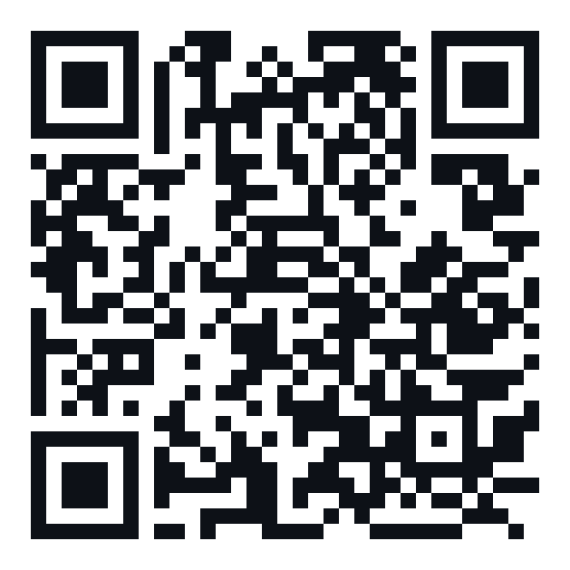
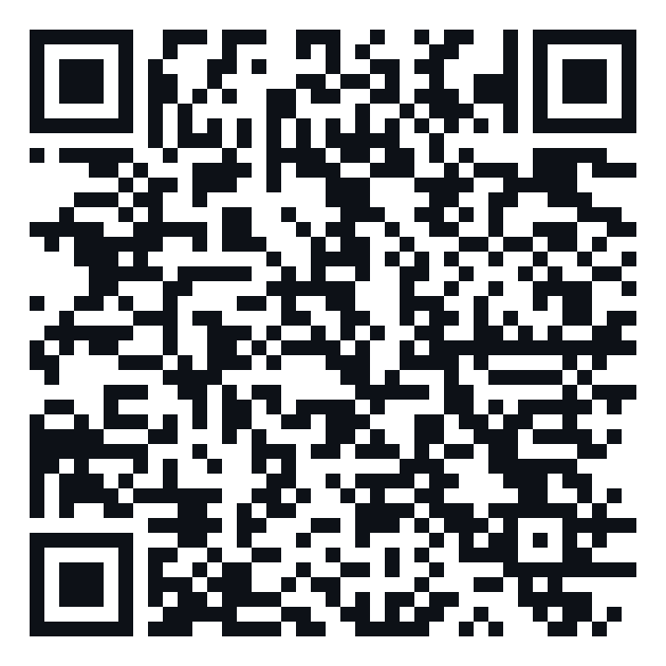
Thank You
Questions welcome
PAPER
CODE
Momen Ibrahim · es-momen.ibrahim2019@alexu.edu.eg
ACL Anthology
GitHub
Team ALEXIS · Alexandria University, Egypt
aclanthology.org/2026.arabicnlp-sharedtasks.187
github.com/Momen-Ibrahim-Fawzy/ALEXIS-DialectSentEval-Subtask1-SentimentAnalysis-
Notes:
The paper is on the ACL Anthology and our code is on GitHub. You can reach both through these QR codes. Thank you for listening.

Slide 18
Key hyperparameters of the deployed system
BACKUP
Hyperparameter | Value
Max sequence length | 128 sub-words
Pooling | Masked mean
Loss | Class-weighted cross-entropy
Class weights (neg. / pos. / neu.) | ≈ 0.88 / 0.95 / 1.24 (sklearn ‘balanced’, per fold)
FGM perturbation norm ε | 1.0
Self-training rounds | 3
Committee confidence threshold | 0.55
Pseudo-label loss weight | 0.7×
Char-noise rate (per character) | ≈ 6%
Ensemble combination | Uniform softmax average
Notes:
The key hyperparameters are listed here for reproducibility.

