Slide 1





W13 · THE FOURTH ARABIC NLP CONFERENCE (ArabicNLP 2026) · EMNLP 2026 · BUDAPEST
ARABIC SENTIMENT SWAP · DIALECTSENTEVAL 2026 SUBTASK 2
Retrieval-Augmented, Preference-Tuned Generation
for Arabic Sentiment Swap
Momen Ibrahim · Mariam E. Hassib · Ahmed Salem · Marwan Torki
Computer and Systems Engineering Department, Faculty of Engineering, Alexandria University, Egypt | Team ALEXIS
Rank #1 of 15 submissions · SSA 0.9581 · BLEU 56.91 · chrF 72.18
Notes:
Hello everyone. I'm Momen Ibrahim from the Faculty of Engineering at Alexandria University. This is joint work with Mariam Hassib, Ahmed Salem and Marwan Torki. I'm presenting Team ALEXIS's system for Subtask 2 of the DialectSentEval 2026 shared task: Arabic sentiment swap.
Our paper is titled: Retrieval-Augmented, Preference-Tuned Generation for Arabic Sentiment Swap. It ranked first of fifteen submissions.

Slide 2


First of fifteen, by 17.3 points of style accuracy
RESULTS AT A GLANCE
0.9581
+17.3 pts
56.91 / 72.18
+0.155
Sentiment Style Accuracy
SSA ahead of 2nd place
BLEU / chrF
SSA from one fix
official test set, rank 1 of 15
0.9581 vs 0.7851
against the human rewrites
a dedicated source-polarity classifier
The setting
Our approach
Rewrite a Modern Standard Arabic sentence so it carries the opposite polarity while its topic stays the same.
Constrained editing: a pool of four generators plus retrieval, one score balancing polarity and content, and an explicit, well-predicted target polarity.
Notes:
We reached a Sentiment Style Accuracy of 0.9581, seventeen point three points ahead of second place.
Our BLEU was 56.91 and our chrF was 72.18. As I will show, much of our margin came from one fix worth 0.155 Sentiment Style Accuracy.

Slide 3
Flip the polarity, keep everything else
THE TASK
Two objectives pull against each other: the output must land firmly on the opposite side of the polarity boundary, yet stay close to the source, because content is scored against a human rewrite that is itself a small edit.
SOURCE
تجربة جميلة سعر كتير مناسب شكرا لكم
‘a nice experience, reasonable price, thank you’
REWRITE
تجربة سيئة سعر كتير غير مناسب لا شكرا عليكم
‘a bad experience, unreasonable price, no thanks’
A training pair from MA’AKS: a few words change (coloured); the structure and length do not.
Notes:
Sentiment swap means rewriting a sentence so it carries the opposite polarity while its topic stays the same. Here is a training pair from the MA'AKS dataset. 'A nice experience, reasonable price, thank you' becomes 'a bad experience, unreasonable price, no thanks'. Only a few words change; the structure and length stay the same.

Slide 4

MA’AKS: Modern Standard Arabic swap pairs
THE DATA
MA’AKS | Train | Val | Test
Pairs | 6,752 | 964 | 1,931
Unique sources | 5,517 | – | –
Has source_polarity | Yes | Yes | No
Exact duplicate of a train source | – | 20.4% | 22.8%
How systems are scored
SSA
Sentiment Style Accuracy: the fraction of outputs a fixed CAMeLBERT sentiment classifier assigns to the target polarity.
BLEU
n-gram overlap with the human rewrite.
Unlike train and validation, the test file carries no source_polarity column.
chrF
character n-gram F-score against the human rewrite.
3,731 / 3,021
60.7–63.7%
negative / positive training sources
of sentences contain emoji
Notes:
MA'AKS has about nine thousand six hundred Modern Standard Arabic pairs. One detail matters a lot: the training and validation files include the source polarity, but the test file does not. Outputs are scored by Sentiment Style Accuracy, judged by a fixed CAMeLBERT classifier, plus BLEU and chrF against the human rewrite.

Slide 5




Three data properties, three components
CORPUS ANALYSIS
91.0%
of training pairs stay within two words of the source’s length; character similarity has median 0.82 (IQR 0.75–0.88)
Local edit, not paraphrase
An edit-tagging pool member and a chrF content term in the reranker
22.8%
of test sentences are byte-identical to a train or validation source
Retrieval index
A gold rewrite already exists: a strong candidate at no modelling cost
323
aligned emoji flips; short antonym pairs such as كريهة → جميلة (115 occurrences)
Polarity-flip lexicons
A deterministic safety net for markers the neural models leave behind
Notes:
Three properties of the data each shaped a component. Ninety-one percent of pairs stay within two words of the source length, so this is local editing, not paraphrasing. That motivated an edit-tagging model and a content term in our reranker. Twenty-two point eight percent of test sentences repeat an earlier source, so we built a retrieval index. And the same polarity markers flip again and again, so we mined flip lexicons as a safety net.

Slide 6
The test set omits the source polarity
THE HIDDEN CATCH
The task description says it is given, and the training files contain it, but the test file does not: the target polarity has to be predicted first.
74.3%
96.7%
97.3%
the grading classifier, zero-shot
our fine-tuned classifier
a 50/50 vote of both
Roughly a quarter of the test set was being rewritten toward the wrong target, and no generator tuning could see it.
Trained on the 7,716 labeled train + validation pairs.
The two fail in different places, so the vote beats either one.
Notes:
Now the hidden catch. The test set omits the source polarity, so it has to be predicted. 3 percent of the time, so roughly a quarter of the test set was being rewritten toward the wrong target.

Slide 7

A dedicated classifier fixes the target
SOURCE-POLARITY DETECTION
+0.155
SSA, our largest single gain
0.7887 → 0.9436 on the official leaderboard
Why it matters
If the source polarity is wrong, the system rewrites a negative sentence to be more negative, and no beam width or reranking weight recovers from that.
Notes:
3 percent. 155, our largest gain.

Slide 8
The System
01
Detect the polarity, pool candidates, rerank, repair
Notes:
Section transition: the system.

Slide 9


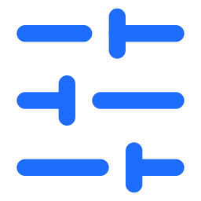
Three stages
ARCHITECTURE
1 Detect
2 Candidate pool
3 Rerank, repair
Predict the source polarity (dedicated + official classifier vote, 97.3%). The opposite label is the target t that everything downstream aims at.
mT5-base
10 beams; 13 if source predicted negative; fine-tuned + DPO
Every candidate, retrieved ones included, is scored with one function; the best is returned. A deterministic pass then flips any emoji or antonym that still carries the source polarity.
mT5-large
6 beams
NLLB-200 (600M)
3 beams; Arabic → Arabic “translator”
Edit tagger
KEEP / DELETE / REPLACE; reaches the reference for 90.6% of validation sources
Retrieval
gold rewrite of any training source within 0.90 cosine
Retrieved near-duplicates are ordinary candidates, not a bypass: they must win on the same terms as generated ones.
Notes:
The system has three stages. First, we detect the source polarity, which fixes the target. Second, we pool candidates from four generators, mT5-base refined with DPO, mT5-large, NLLB-200 and an edit tagger, plus the retrieval index. Third, we rerank every candidate, and a deterministic pass repairs any emoji or antonym that still carries the source polarity.

Slide 10


The same score reranks candidates and rewards DPO
ONE SCORING FUNCTION
s(y) = α · p_t(y) + (1 − α) · chrF(y, x)
α = 0.85 when reranking · p_t: the grading classifier’s raw three-way softmax probability of the target polarity · x: source, y: candidate
Reranker
DPO reward
Every candidate from the pool is ranked by s(y) and the top one is returned. Putting the grading classifier inside the score is deliberate: from here on, agreeing with the grader is the objective.
4,500 preference examples, 7 epochs: sample 4 candidates, add the gold rewrite, score all five with s(y). An early reward dropped neutral and renormalised two classes, which the model exploited; the raw three-way probability closes the loophole.
Optimising hard against an imperfect proxy degrades true performance (reward over-optimisation, Gao et al., 2023).
Notes:
One score ties it together: alpha times the grader's probability of the target polarity, plus one minus alpha times chrF to the source, with alpha set to 0.85. The same form of score is our DPO reward. An early version of the reward dropped the neutral class, and the model learned to exploit that. Keeping the raw three-way probability closed the loophole.

Slide 11



Details that mattered for mT5-base
PRIMARY GENERATOR
Direction (validation) | chrF | SSA
Negative → positive | 78.94 | 94.37%
Positive → negative | 84.27 | 96.06%
Asymmetric decoding
13 beams instead of 10 when the source is predicted negative.
Select checkpoints by beam-search chrF
Negative-to-positive is the harder direction, an asymmetry also reported for sentiment transfer more broadly.
Not by teacher-forced loss: the lowest-loss checkpoint wrote measurably worse text once it had to decode freely.
Fully fine-tuned on all 7,716 pairs
Arabic T5 checkpoints discarded
Train + validation pairs; validation figures quoted during development come from the held-out 964-row split.
Two were tried: one had an unparseable tokenizer format, the other gave incoherent zero-shot output.
Notes:
A few details mattered for the main generator. Negative-to-positive is the harder direction, so we use thirteen beams instead of ten when the source is predicted negative. And we select checkpoints by the chrF of beam-search output, not by loss: the lowest-loss checkpoint wrote measurably worse text.

Slide 12
Results
02
Official leaderboard, ablation and lessons
Notes:
Section transition: results.

Slide 13
DialectSentEval 2026 Subtask 2 leaderboard
OFFICIAL TEST SET
# | Team / participant | SSA | BLEU | chrF
1 | ALEXIS (ours) | 0.9581 | 56.91 | 72.18
2 | akarrouch | 0.7851 | 49.82 | 70.12
3 | ahmadalmoustafa | 0.7789 | 41.48 | 64.45
4 | mona_ | 0.7597 | 51.58 | 71.02
5 | melmoussaoui | 0.7530 | 49.03 | 69.53
6 | mohamedsabaa | 0.7447 | 49.07 | 69.33
7 | hsnhb7 | 0.7343 | 46.80 | 67.10
8 | areejkhaled | 0.6898 | 54.63 | 72.61
9 | mohammed_bahgat | 0.6732 | 41.38 | 65.84
10 | ehabashraf | 0.6732 | 41.38 | 65.84
11 | ahmad_alshattha | 0.6354 | 25.07 | 56.33
12 | hoanguitcs | 0.6220 | 49.27 | 68.26
13 | normalman159 | 0.5997 | 11.31 | 38.22
14 | mustafaelkady | 0.4772 | 0.03 | 10.04
15 | mohamedmhaouach | 0.2807 | 43.06 | 64.61
#1
of 15 submissions
first place overall
0.9581
SSA
BLEU 56.91 · chrF 72.18
+17.3
SSA points
ahead of second place (0.7851)
The margin is specific to SSA: several systems are within a few points on BLEU and chrF.
Notes:
On the official leaderboard we ranked first of fifteen. The margin is specific to Sentiment Style Accuracy: several systems are close on BLEU and chrF, and the main difference is whether the polarity actually flipped.

Slide 14
Where the gains came from
ABLATION
Configuration (each row an independent leaderboard submission) | SSA | Δ
mT5-base + retrieval + reranking | 0.7452 | –
+ Edit tagger, wider pool | 0.7618 | +0.017
+ DPO, NLLB-200 & mT5-large | 0.7887 | +0.027
+ Dedicated polarity classifier | 0.9436 | +0.155
+ Hard polarity gate (reverted) | 0.8933 | −0.050
+ Raw-softmax reranking | 0.9498 | +0.006
+ DPO reward fix (final system) | 0.9581 | +0.008
+0.044
Generation-side additions
tagger, wider pool, DPO, NLLB-200, mT5-large
+0.155
Polarity classifier alone
more than three times the generation-side gains
Δ against the previous retained configuration: the hard gate was reverted, so the next row is measured from 0.9436.
Notes:
Every row of our ablation is a real leaderboard submission. The generation-side additions, the edit tagger, a wider pool, DPO and the extra generators, added about 0.044 in total. The dedicated polarity classifier added 0.155 on its own.

Slide 15



Changes that looked safe and were not
LESSONS
The hard gate: −0.050
Validation preferred α = 1
Cost-aware deployment
Discarding candidates the classifier did not label with the target polarity appeared to cost nothing on validation, then lost 0.050 on the leaderboard: the same classifier chose and judged the candidates. A rule validated only against the signal it optimizes will always look correct.
All weight on polarity and none on content. Submitted, it lowered BLEU and chrF on the leaderboard, so we moved only part of the way toward each validation optimum (α = 0.85).
Four generators, a tagger and a retrieval index are expensive at inference. The pooled generators add about +0.044 against +0.155 for the classifier: a latency-sensitive deployment could keep only mT5-base and the classifier.
Both regressions looked safe on validation and only showed up on the official leaderboard: score every change on the real test signal.
Notes:
Two lessons came from failures. A hard gate that discarded off-target candidates appeared to cost nothing on validation, but lost 0.050 on the leaderboard, because the same classifier both chose and judged the candidates. And validation preferred putting all the weight on polarity, which hurt BLEU and chrF, so we moved only part of the way.

Slide 16




What to take away
CONCLUSION
Treat the swap as constrained editing
TAKE-HOME
91% of rewrites are local edits: retrieval, an edit tagger and a content term keep outputs close to the source.
The largest gain came from predicting a label the task assumed would be given.
When a shared task is built around an auxiliary classifier, measure that classifier on the sub-task it is asked to perform before trusting it.
One score, two jobs
Polarity and content balanced in one function, used as the reranker and as the DPO reward, on the raw three-way probability.
Rank #1 of 15 submissions
SSA 0.9581, BLEU 56.91, chrF 72.18: 17.3 SSA points ahead of second place.
github.com/Momen-Ibrahim-Fawzy/ALEXIS-DialectSentEval-Subtask2-SentimentSwap-
Notes:
The take-home message: our largest gain came from predicting a label the task assumed would be given. When a shared task is built around an auxiliary classifier, measure that classifier on the job it is asked to do before trusting it.

Slide 17

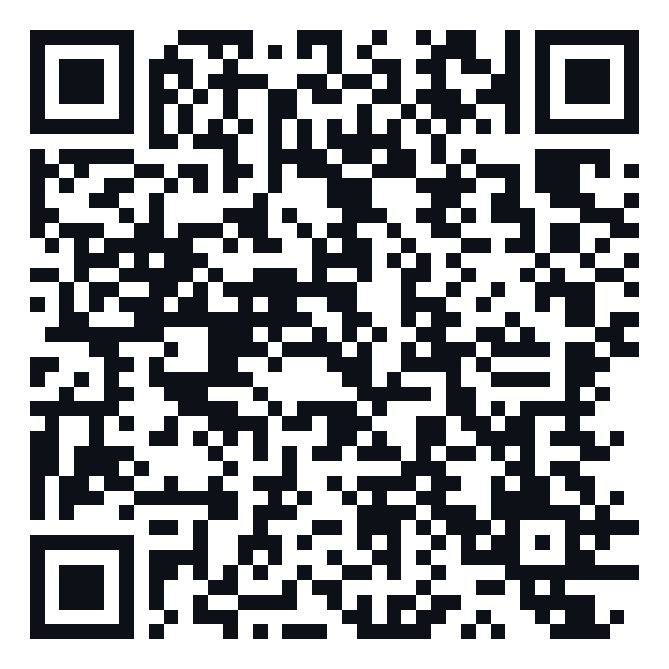
Thank You
Questions welcome
PAPER
CODE
Momen Ibrahim · es-momen.ibrahim2019@alexu.edu.eg
ACL Anthology
GitHub
Team ALEXIS · Alexandria University, Egypt
aclanthology.org/2026.arabicnlp-sharedtasks.188
github.com/Momen-Ibrahim-Fawzy/ALEXIS-DialectSentEval-Subtask2-SentimentSwap-
Notes:
The paper is on the ACL Anthology and our code is on GitHub. You can reach both through these QR codes. Thank you for listening.

Slide 18
Key hyperparameters of the deployed system
BACKUP
Hyperparameter | Value
Primary generator | mT5-base
Primary beams (standard / hard direction) | 10 / 13
NLLB-200 beams (pooled) | 3
mT5-large beams (pooled) | 6
DPO preference examples | 4,500
DPO candidates per example | 4 sampled + gold
DPO epochs | 7
Reranking weight α (polarity) | 0.85
Reranking weight 1 − α (chrF) | 0.15
Retrieval similarity threshold | ≥ 0.90 (cosine)
Notes:
Backup slide: deployed configuration, from Table 2 of the paper.

