Slide 1





TEXT WATERMARKING · PAN TASK 3
Post-Hoc Synonym Watermarking
Dual-Key Type-Level Detection, and the
precision–robustness trade-off it reveals
Momen Ibrahim · Nagwa El-Makky · Marwan Torki
Alexandria University, Egypt | Team aimoment | CLEF 2026, Jena
Rank #2 of 8 teams · Best spot-check TWF 0.971 (dual-key) · Best official TWF 0.775 (single-key) — a trade-off story

Slide 2








THE TASK
Post-hoc watermarking under attack
Embed an invisible, detectable signal into pre-existing human EU-Parliament speeches — not during generation. Survive an automated obfuscation attack, then detect the watermark.
Original text
Embed
Attack
Detect
Human EU speech
Hidden watermark
TIRA obfuscation
Watermark or not?
THE METRIC — Text Watermarking Fidelity
TWF = max(BLEU, BERTScore) × Balanced Accuracy
Fidelity — how little the text changed × Detection — did we get it right, penalising misses & false alarms equally
Post-Hoc Synonym Watermarking · PAN@CLEF 2026
02

Slide 3



THE CORE CHALLENGE
A three-way tension — sharpened by attack.
Post-hoc watermarking must satisfy three goals at once — and an obfuscation attack that removes part of the signal makes the balance harder.
High TP
Near-zero FP
Semantic fidelity
Detect the watermark reliably, even after attack
Never flag an un-watermarked original
Preserve the original meaning & wording
Post-Hoc Synonym Watermarking · PAN@CLEF 2026
03

Slide 4

01
How It Works
Cryptographic partitioning, synonym substitution, type-level detection
Post-Hoc Synonym Watermarking · PAN@CLEF 2026

Slide 5

THE PRIMITIVE
Green / red vocabulary via HMAC
A secret key deterministically splits the English vocabulary into green and red word types. We globally replace red words with green synonyms — pushing the green fraction up in a detectable, key-specific way.
bit(w; K) = HMAC-SHA256(K, w) mod 2
Example substitution
important
significant
bit = 1 → green · bit = 0 → red
problem
issue
Same word + same key → same color; different key → independent partition
begin
start
Two design choices set this apart:
Type-level detection — count each unique word once, not per occurrence.
Dual-key AND detection — require two independent keys to pass.
Post-Hoc Synonym Watermarking · PAN@CLEF 2026
05

Slide 6


DESIGN CHOICE 1
Type-level detection
The detector runs a one-sided Z-test on the green fraction. Crucially, we count unique word types — each identity once — rather than token occurrences.
Token-level (the problem)
Type-level (our fix)
Repetitive political terms (parliament, committee, member) appear dozens of times.
Each word identity counts exactly once, regardless of repetition.
One substitution of such a word dominates the Z-statistic.
Every substitution gets equal statistical weight.
The null distribution becomes unstable & skewed.
A stable, well-centred null — ideal for repetitive EU-speech vocabulary.
Expanding POS coverage {NN, JJ} → {NN, NNS, JJ, VB, VBP} raised avg. scoreable types 11.6 → 24.6 (28 failure cases → 0 failure cases), eliminating all 28 undetectable texts.
Post-Hoc Synonym Watermarking · PAN@CLEF 2026
06

Slide 7

DESIGN CHOICE 2 · THE KEY IDEA
Dual-key AND detection
Classify as watermarked only if BOTH independent Z-tests pass. Two chances to raise a false alarm become one joint, far rarer event.
Z(K1) ≥ 1.5 AND Z(K2) ≥ 1.5
The catch
P(FP) drops 15× — extremely precise.
Single key
Dual key (AND)
But AND fails if the attack suppresses EITHER key below threshold.
≈6.7%
≈0.45%
One weak signal sinks the whole detection — even if the other survives strongly.
P(false positive)
P(false positive)
Post-Hoc Synonym Watermarking · PAN@CLEF 2026
07

Slide 8




EMBEDDING
Three sequential stages
Stage 1 — Key-1
Stage 2 — Key-2
Stage 3 — Restoration
Select top-12 red types (frequency-first), replace globally with green synonyms. Prefer double-green synonyms to pre-boost Key-2.
Repeat for the second key, skipping types already used. May lower the Key-1 signal.
Up to 3 rounds alternate between keys to a conservative target, restoring both Z-scores above threshold.
Robustness safeguards built in
Frequency-first ranking
Text hardening
Semantic fallback
High-frequency types are harder to erase → embedded first
NFKC normalisation, homoglyph remap, zero-width removal
BERT fill-mask when WordNet lacks a green synonym (SBERT sim ≥ 0.45)
Post-Hoc Synonym Watermarking · PAN@CLEF 2026
08

Slide 9
02
Results & The Trade-off
Where dual-key wins, where single-key wins
Post-Hoc Synonym Watermarking · PAN@CLEF 2026

Slide 10
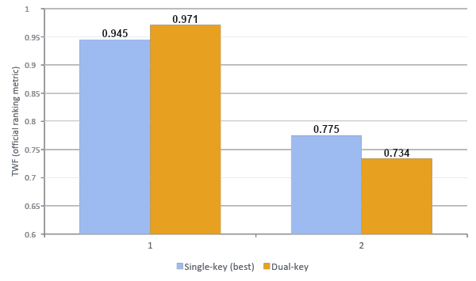
THE CENTRAL FINDING
A stark inversion between attacks
Read the crossover
Mild attack: dual-key wins (0.971) — both signals survive, precision pays off.
Strong attack: single-key wins (0.775) — dual-key TP collapses 0.496 → 0.254.
The same design flips from best to worst as the attack hardens.
Post-Hoc Synonym Watermarking · PAN@CLEF 2026
10

Slide 11
WHY IT HAPPENS
The precision–robustness trade-off
The mechanism
A structural law
Shuffling is position-based; our bit(w;K) depends only on word identity → zero signal loss, AND holds easily.
P(detect) = ∏ P(key i survives)
Each added key multiplies in another survival probability < 1. Under uniform attack degradation, more keys strictly lowers TP.
The strong attack substitutes words, removing embedded green types.
With margin 1.0 above threshold, the attack still suppresses ≥1 key in ~half of texts.
Dual-key TN stayed 0.499 on BOTH datasets — it never false-detects. Precision is bought at the cost of missed detections once both signals cannot survive together.
AND then fails — one downed key sinks detection.
Zero false positives, always — the precision promise held.
Post-Hoc Synonym Watermarking · PAN@CLEF 2026
11

Slide 12



IMPLICATIONS
A design space, not a winner
The lesson generalises to any multi-key AND scheme. The choice of detection logic should match the expected attack strength.
AND condition
OR condition
Hybrid
Two keys must pass
Either key suffices
AND at lower threshold, or switch to OR on a very high Z
Lowest FP (0.45%) · brittle under strong attack
More robust · higher FP (≈12.9%)
Recovers detection without losing all precision
Best for mild / no attack
Best when robustness dominates
A promising middle ground
Post-Hoc Synonym Watermarking · PAN@CLEF 2026
12

Slide 13


CONCLUSION
What to take away
Two design choices Type-level Z-test detection + a dual-key AND criterion, over cryptographic HMAC synonym substitution.
FUTURE WORK
A characterised trade-off Dual-key cuts FP 15× (6.7% → 0.45%) but is brittle: TWF 0.971 spot-check vs 0.734 official.
Hybrid AND/OR detection logic
Higher embedding targets (3.0–3.5) for more margin
Single-key won official Best official TWF 0.775 — only one signal must survive, so it is structurally more robust.
Richer synonym sources beyond WordNet + BERT-LS
github.com/Momen-Ibrahim-Fawzy/posthoc-dualkey-watermarking--PAN2026
Post-Hoc Synonym Watermarking · PAN@CLEF 2026
13

Slide 14
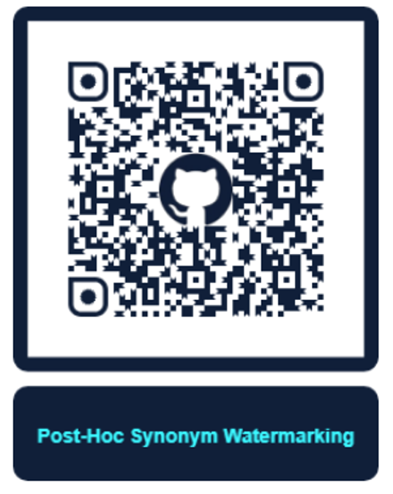
Thank You
Questions welcome
Momen Ibrahim · es-momen.ibrahim2019@alexu.edu.eg
Post-Hoc Synonym Watermarking · PAN@CLEF 2026

