Slide 1
Graduation project presentation Presented by:
1- Mai Emad Hamdy
2-Momen Abdul Hay Mustafa
3-Mohamed Ahmed Abdelsatar
4-Mohamed Gamal
5-Khaled Mohamed
6-Abdelrahman Sameh Mohamed

Slide 2

Cars showroom
Here is where your presentation begins

Slide 3
Table of contents
01
02
03
Project & strategy
Consulting proposal
streamlining sales, improving customer relationship management, enhancing operational efficiency
Needs assessment
System customization
Training and support
Implementing changes
We will customize the Odoo CRM to enhance user experience, streamline sales workflows, and integrate automated reporting, along with training for effective adoption.

Slide 4

01
Project & strategy

Slide 5
Strategic planning project plan
Mission
Our mission is to implement a comprehensive CRM system in Odoo for the automotive sector enhancing customer relationships and streamlining sales processes to drive operational efficiency.
Vision
Our vision is to lead the automotive sector by utilizing advanced CRM solutions in Odoo to deliver exceptional customer experiences, strengthen relationships, and drive sustainable growth through enhanced operational efficiency.

Slide 6

Project &
strategy definition
Our strategy for implementing the CRM system in Odoo for the automotive sector focuses on analyzing customer needs, customizing the system for automotive businesses, automating sales and after-sales processes, and providing training to ensure optimal usage, aiming to enhance customer satisfaction and improve operational efficiency.

Slide 7
Problem Statement
The car showroom is currently facing multiple operational challenges that hinder its ability to efficiently manage sales, customer relationships, and inventory. These challenges have resulted in decreased sales performance, poor customer engagement, and operational inefficiencies. The existing processes are mostly manual or supported by outdated systems, leading to several key problems
Proposed Solution
Technologies Used:
involve a combination of Odoo's platform capabilities and various tools to ensure seamless integration Odoo Sales Module, Odoo CRM Module.

Slide 8
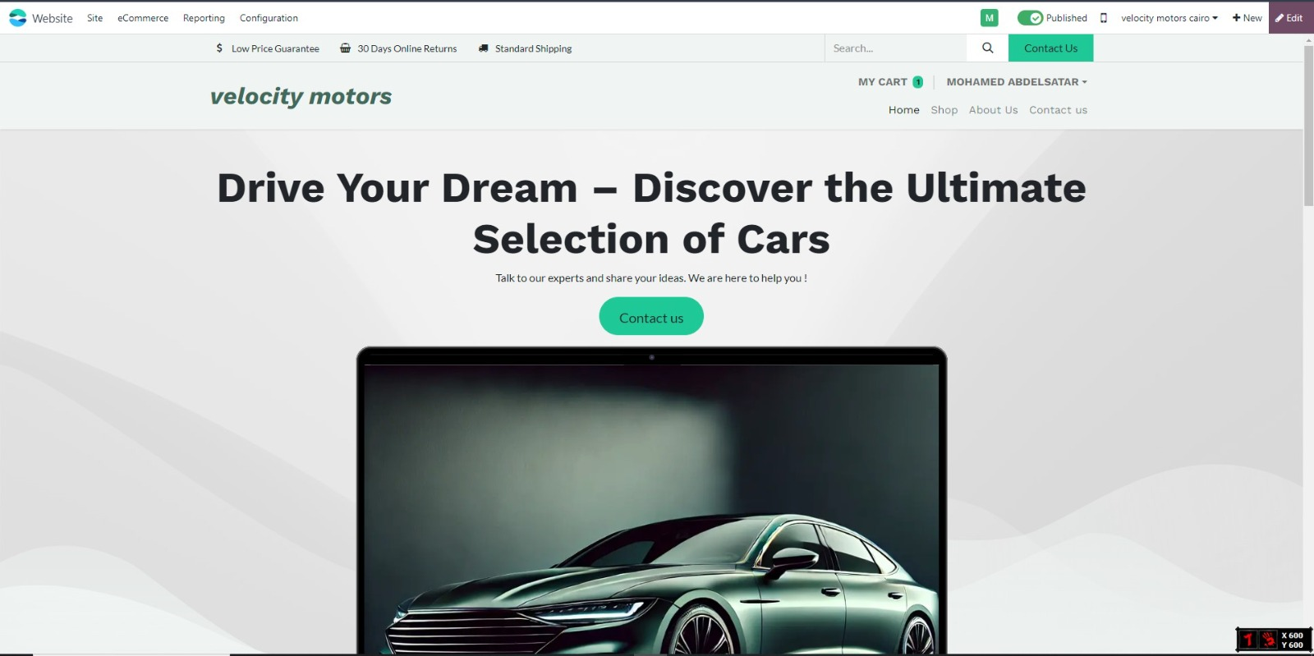
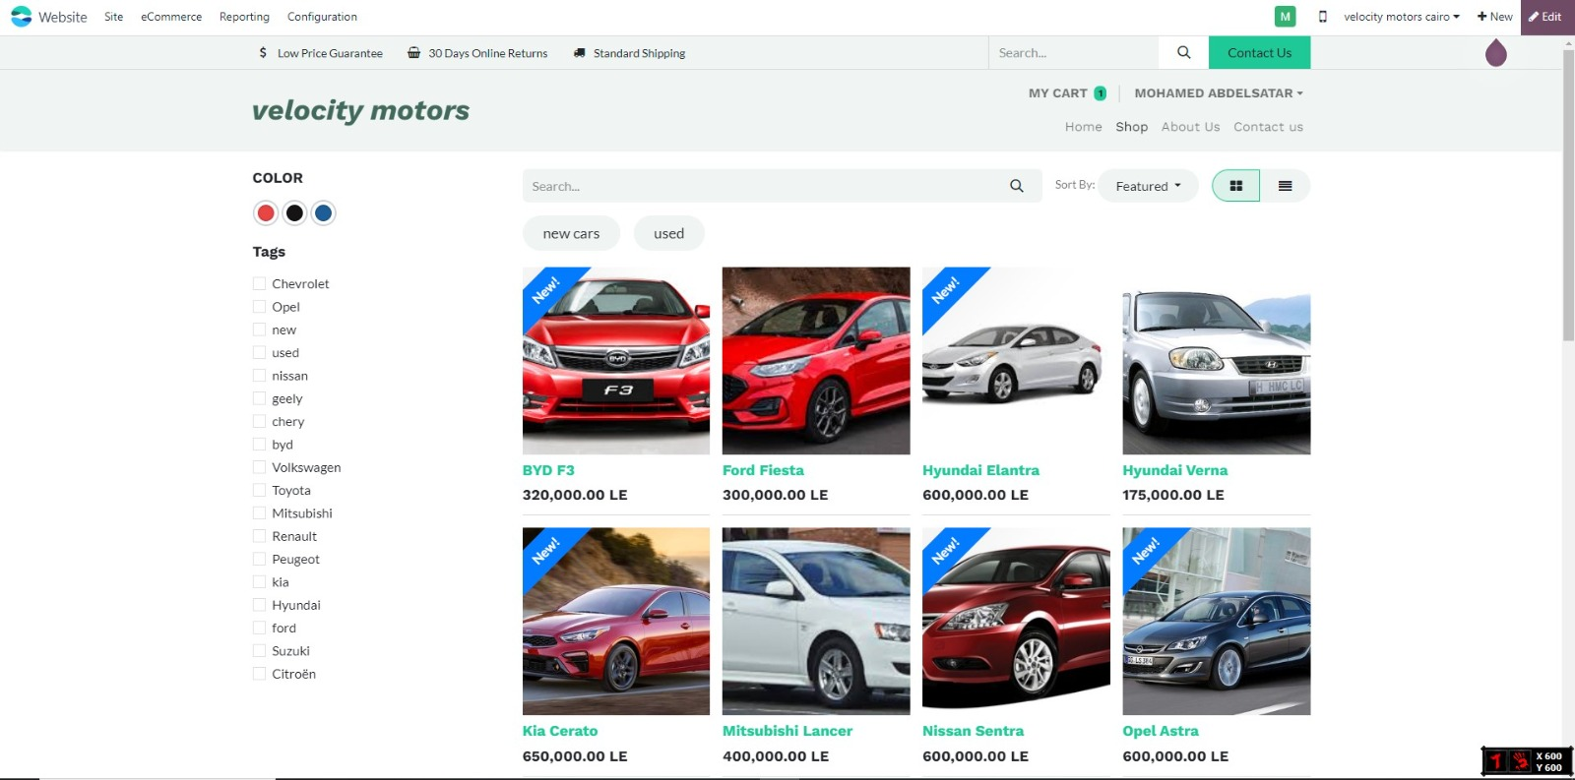
To improve the quality of customer management work, we created a customer website for Odoo.

Slide 9
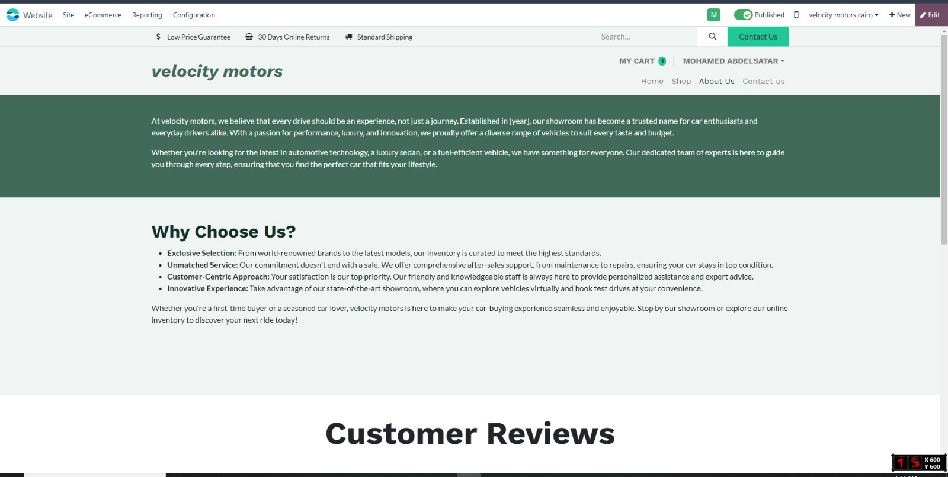
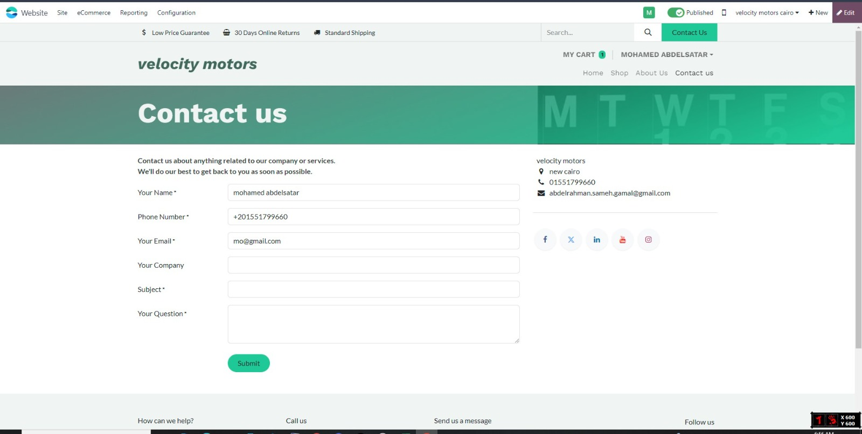

Slide 10
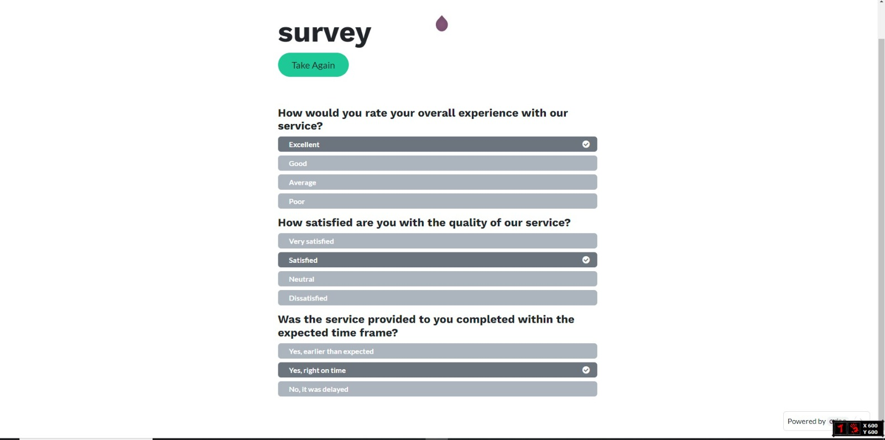
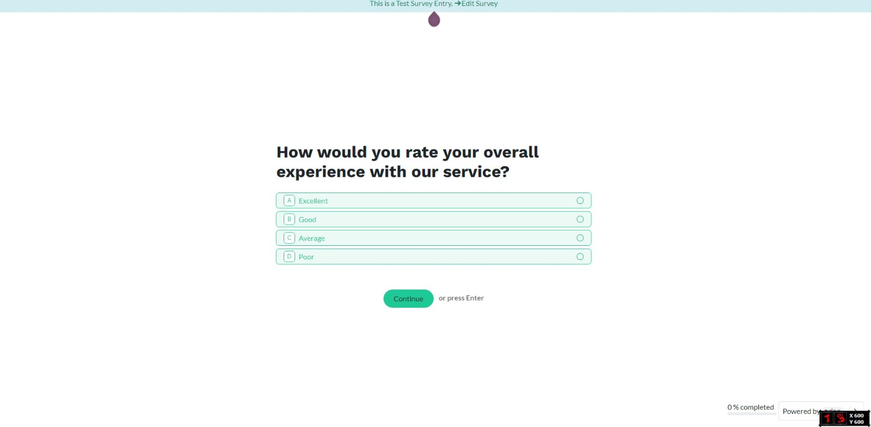
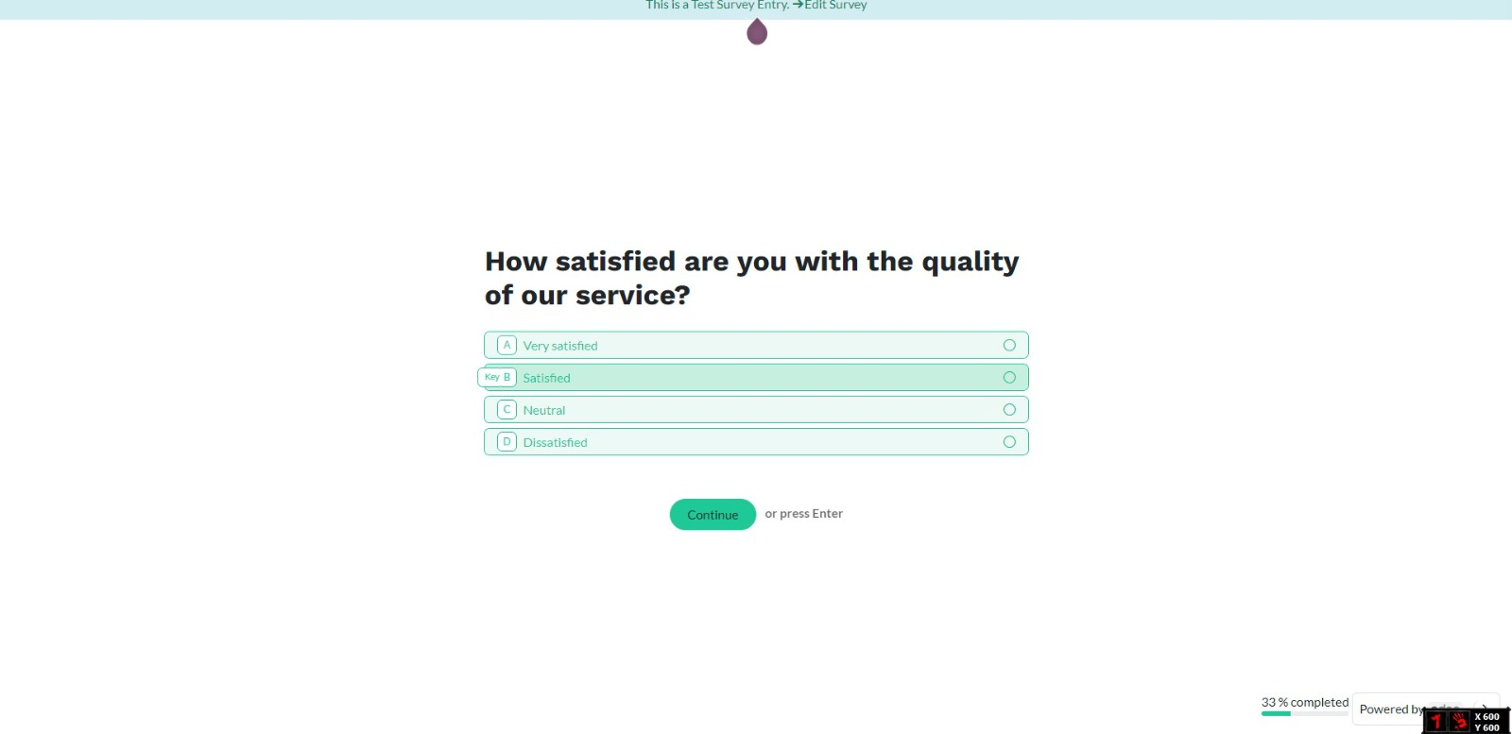
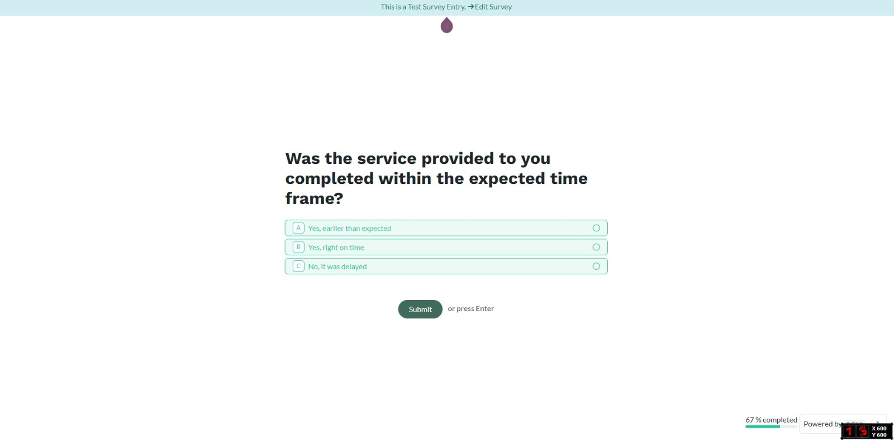

Slide 11

02
Consulting proposal
You can enter a subtitle here if you need it

Slide 12
Consulting proposal
Services
We provide consulting services for Odoo CRM implementation in the automotive sector, including needs assessment, customization, training, and ongoing support.
Expenses
The estimated expenses for the Odoo CRM implementation project include software licensing fees, customization costs, training sessions, and ongoing support services, ensuring a comprehensive and effective deployment.
Training
We will provide comprehensive training sessions for staff to ensure effective use of the Odoo CRM system, covering system navigation, feature utilization, and best practices for managing customer relationships.

Slide 13

03
Implementing changes

Slide 14
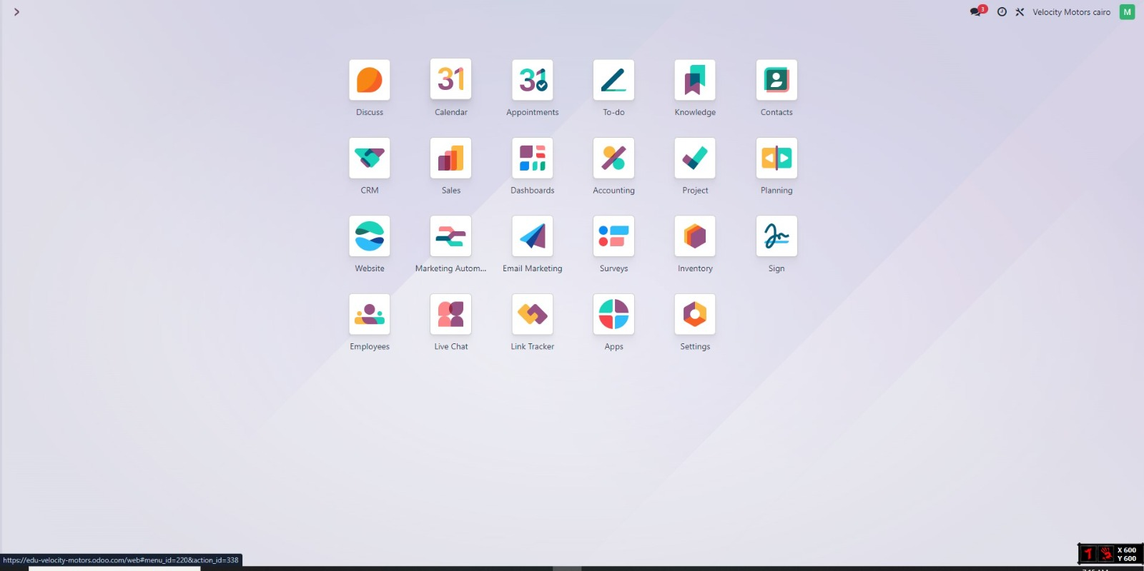
Models logged into the project

Slide 15
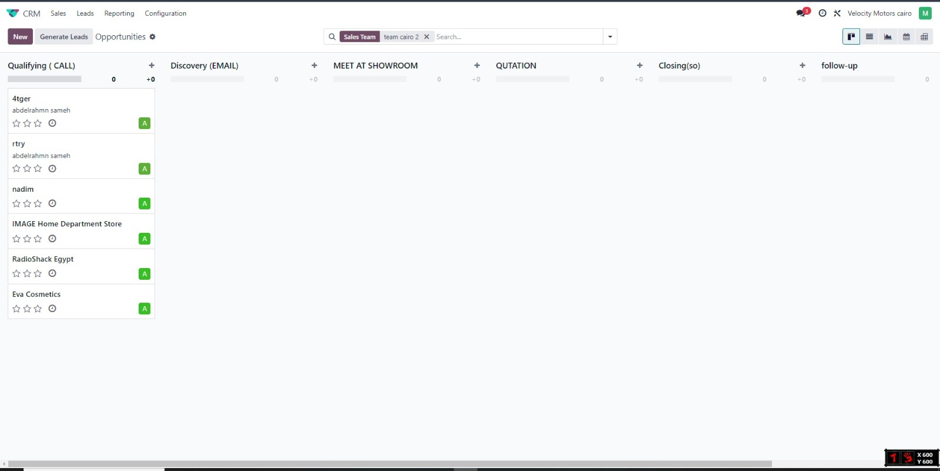
The stages of the sales process for all customers until the sale process is completed

Slide 16
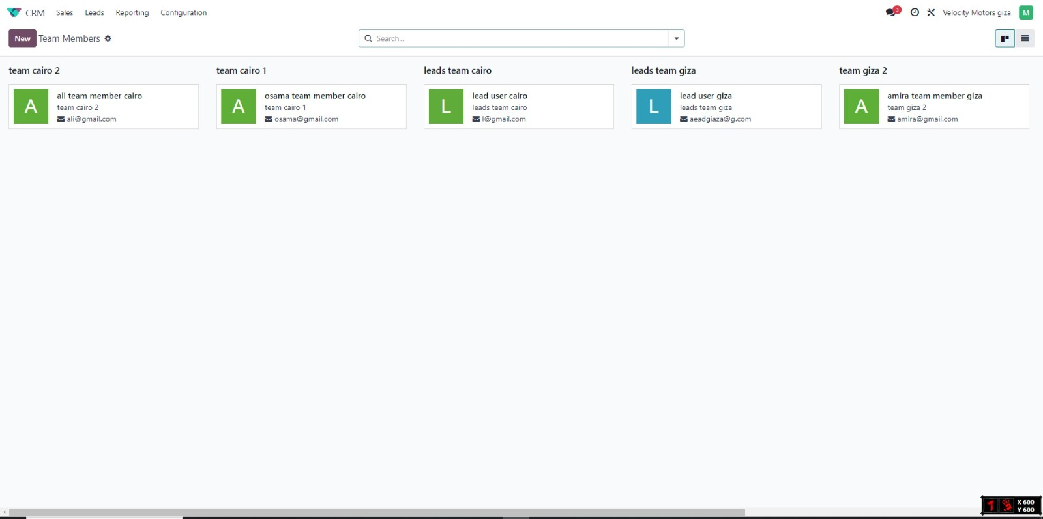
Here we create 2 teams every one of them as a team leader in the Cairo and Giza governorate

Slide 17
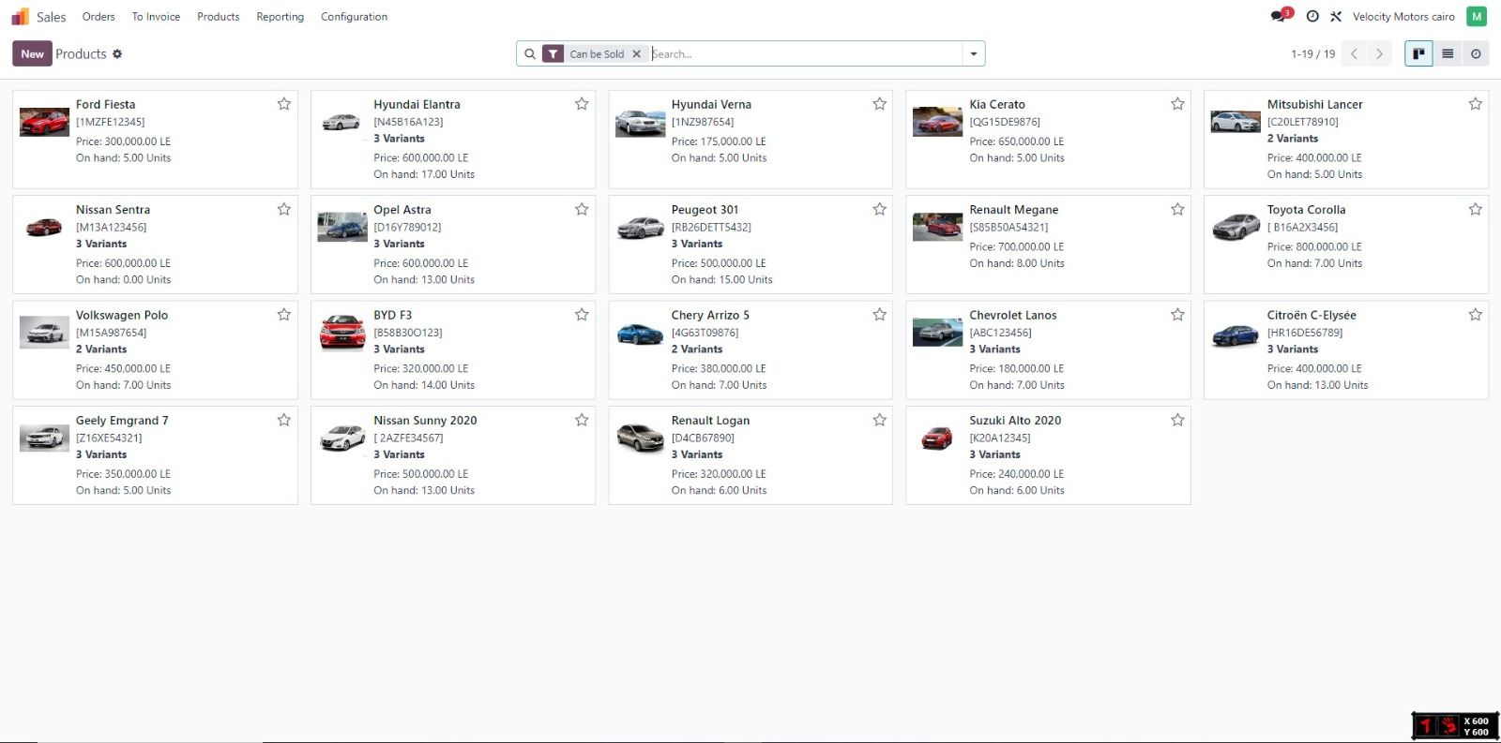
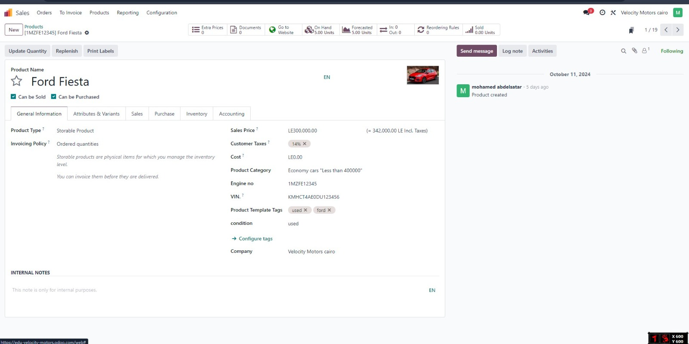
These are the products that are available on the website and customers can appreciate and order them from the website, as we saw at first.

Slide 18
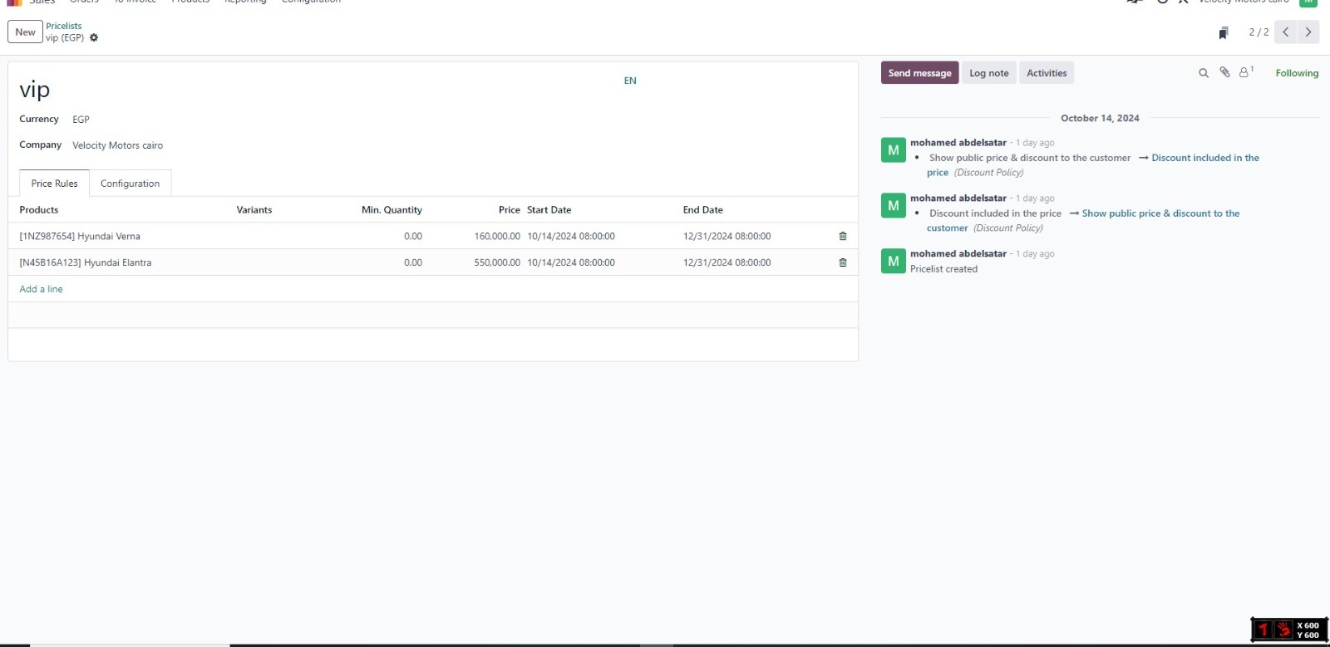
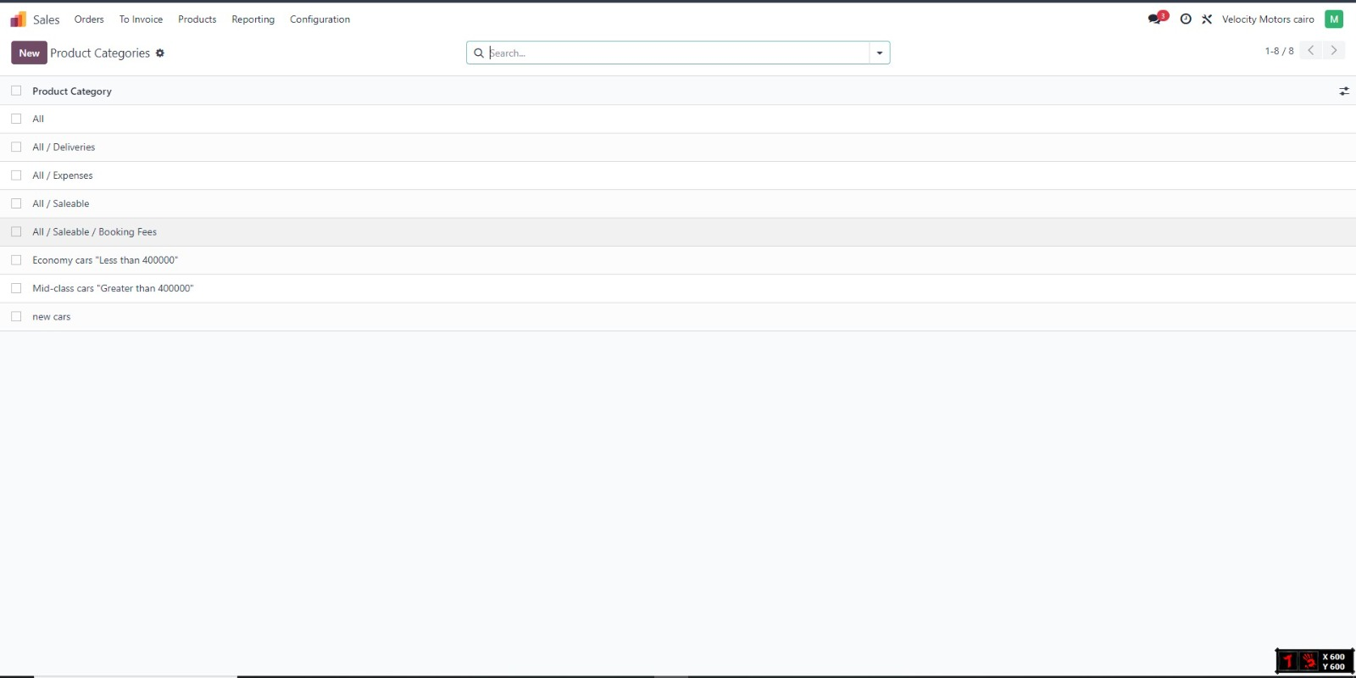
Also in product classification

Slide 19
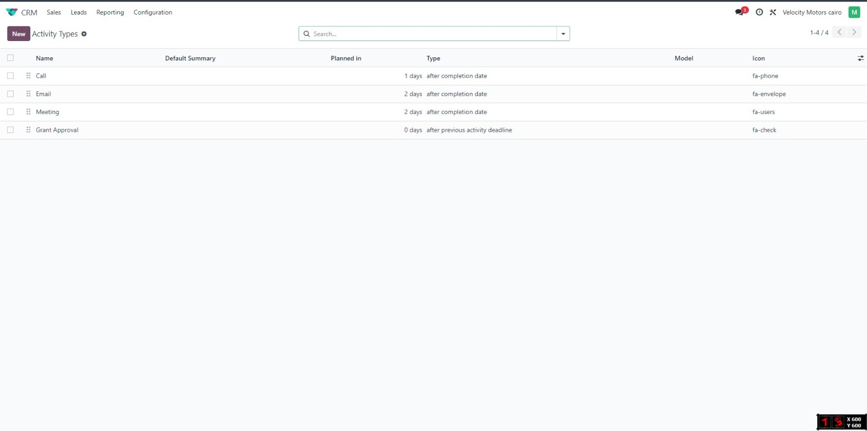
activity type To facilitate communication with the customer and respond to problems as quickly as possible

Slide 20
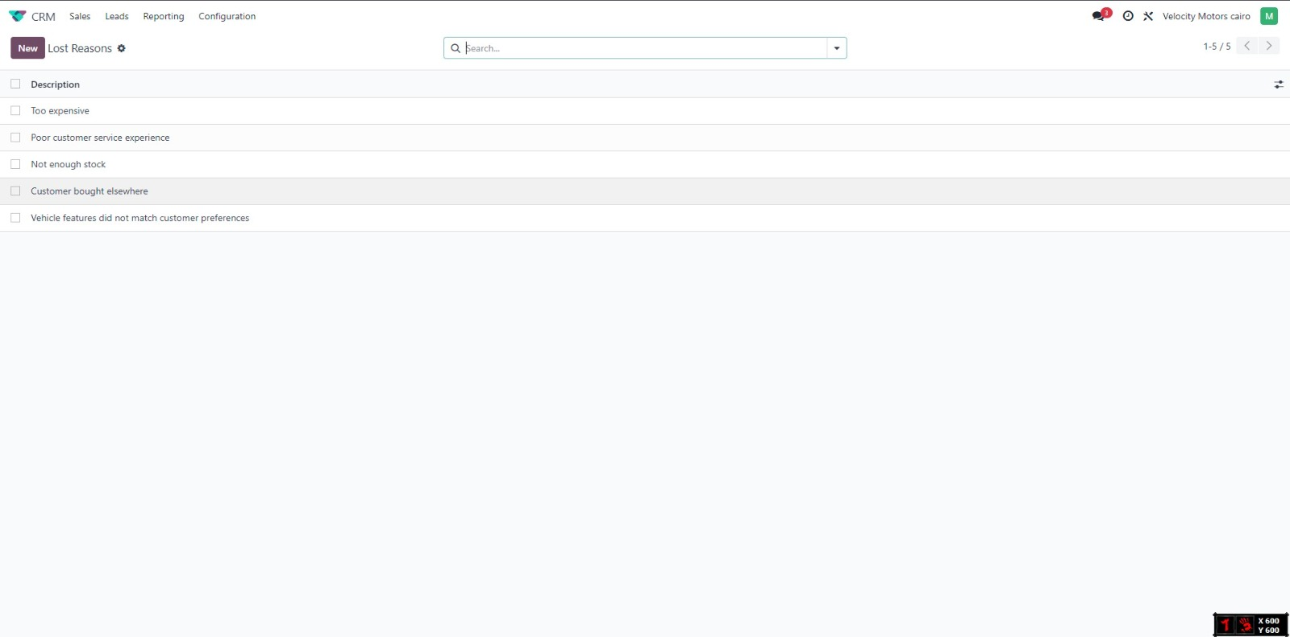
Reasons for the final result to improve and manage sales

Slide 21
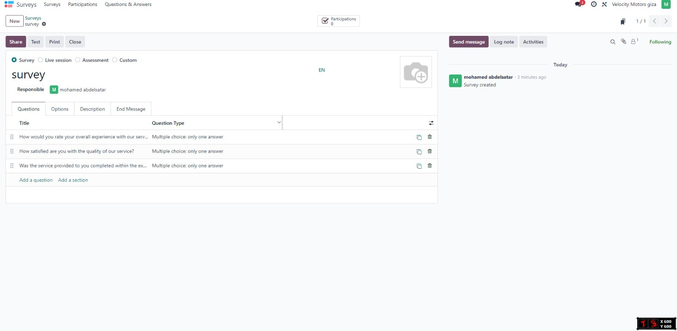
In the end, it is about providing the service so that if there is something we can improve it

Slide 22

Thanks

