Slide 1
DSAI 4103 · Business Analytics · Course Project
Customer Churn
Prediction
End-to-End Business Analytics & Machine Learning Pipeline
Domain: Marketing / Customer Analytics Model: Stacking Ensemble
PRESENTED BY
Momen Ibrahim - 60096897

Slide 2
DSAI 4103 · Customer Churn Prediction
Agenda
Presentation Outline
10 sections covering every project requirement
01
Business Problem Definition
06
Predictive Model — AutoML / Ensemble
Domain, objectives & success metrics
4 candidates + Stacking Classifier
02
Dataset Acquisition
07
Model Explainability (SHAP-style)
3 files · 7,043 customers · 19 columns
Global importance & individual breakdown
03
Data Loading & Merging
08
Bias Analysis & Fairness
Join strategy & quality checks
Gender, Senior & Age Group parity
04
Exploratory Data Analysis (EDA)
09
Deployment Preparation
5 key visualizations & insights
Packaged model + scoring script
05
Preprocessing & Feature Engineering
10
Power BI Dashboard
Encoding, scaling & 5 new features
3 report pages · 12 interactive visuals
End-to-End ML Pipeline | Marketing / Customer Analytics

Slide 3
DSAI 4103 · Customer Churn Prediction
Section 01 · Business Problem
Business Problem Definition
Why churn prediction matters in marketing analytics
🎯 Problem Statement
Success Metrics
Subscription-based businesses lose 5–7× more revenue replacing a churned customer than retaining one. This project builds a binary classifier that identifies at-risk customers before they leave, enabling targeted retention campaigns.
AUC-ROC
≥ 0.80
Achieved: 0.897 ✓
Recall
≥ 0.75
📊 Business Objectives
Churn class recall
• Identify key behavioral & demographic drivers of churn
• Cluster customers by predicted risk tier
• Ensure fairness across demographic groups
• Deploy a scoring script for new customer records
DPD
< 0.10
Fairness: 0.001 ✓
End-to-End ML Pipeline | Marketing / Customer Analytics

Slide 4
DSAI 4103 · Customer Churn Prediction
Section 02–03 · Data
Dataset Acquisition & Loading
3 files · 7,043 customers · 19 total columns
File | Rows | Columns | Key Features
customers.csv | 7,043 | 7 | CustomerID · Gender · Age · SeniorCitizen · Partner · Dependents · Tenure
services.csv | 7,043 | 7 | PhoneService · InternetService · OnlineBackup · TechSupport · StreamingTV · Contract · PaperlessBilling
billing.csv | 7,043 | 6 | MonthlyCharges · TotalCharges · PaymentMethod · NumComplaints · Churn (target)
Merge & Quality Checks
🔗 Join Key CustomerID — inner join across all 3 files → 7,043 rows × 22 columns
✅ Duplicates 0 duplicate rows detected
✅ Missing Values 0 missing values in any column after merge
✅ Data Types Numeric, categorical & binary columns correctly typed
End-to-End ML Pipeline | Marketing / Customer Analytics

Slide 5
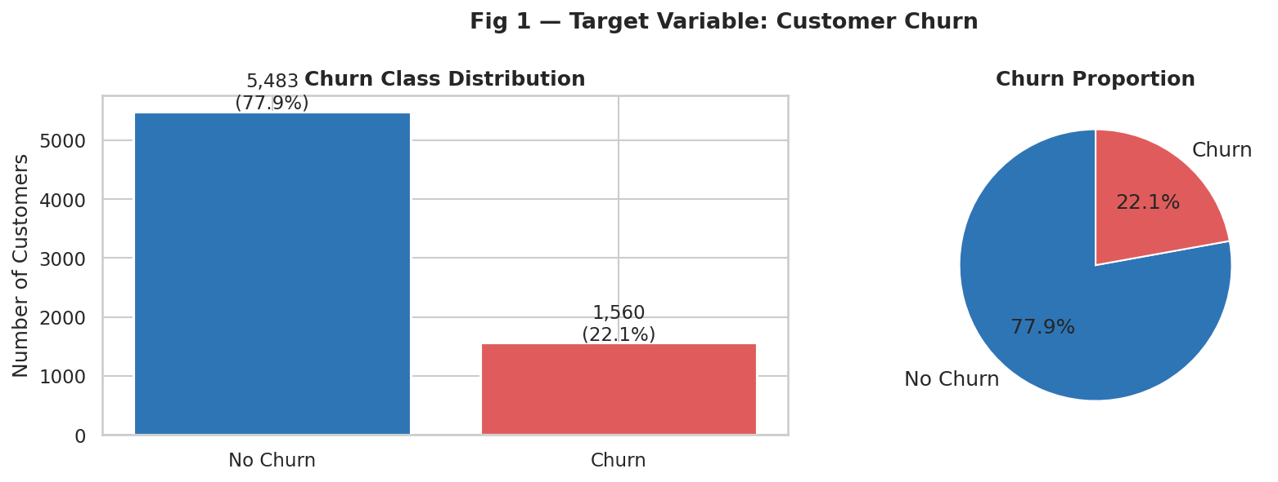
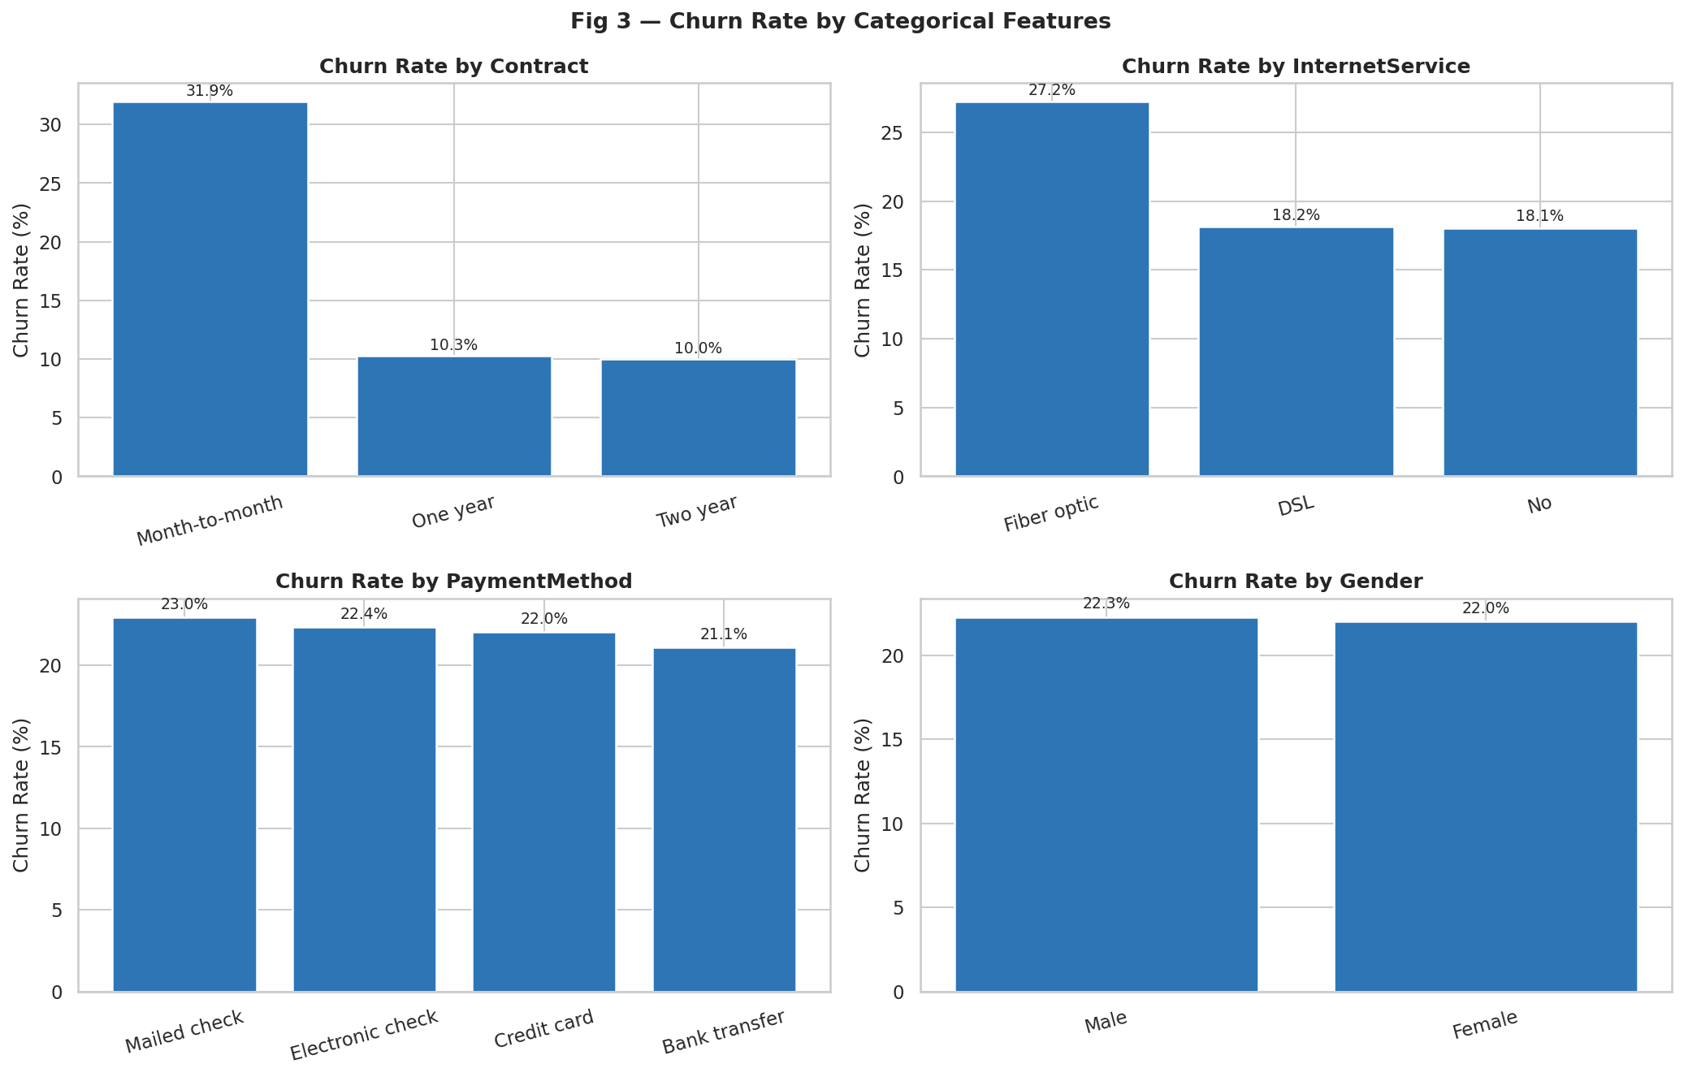
DSAI 4103 · Customer Churn Prediction
Section 04 · EDA
Exploratory Data Analysis — Churn Overview
Target distribution & key categorical drivers
22.1%
55%
~38%
Overall Churn Rate
Month-to-Month Churners
Fiber Optic Churn Rate
End-to-End ML Pipeline | Marketing / Customer Analytics

Slide 6
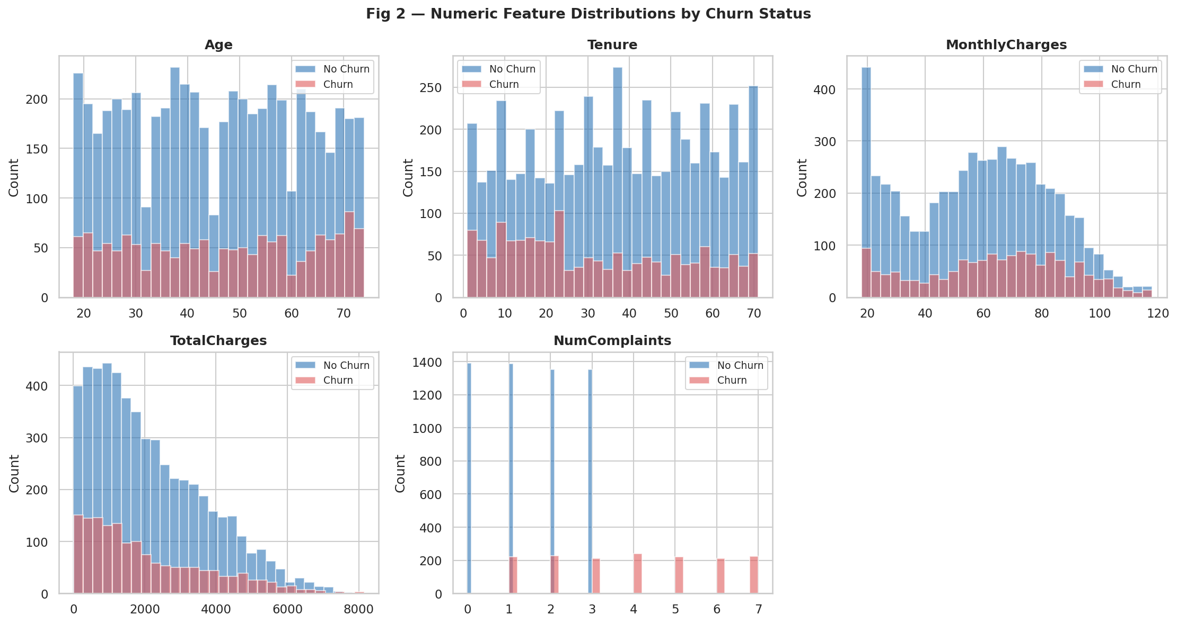
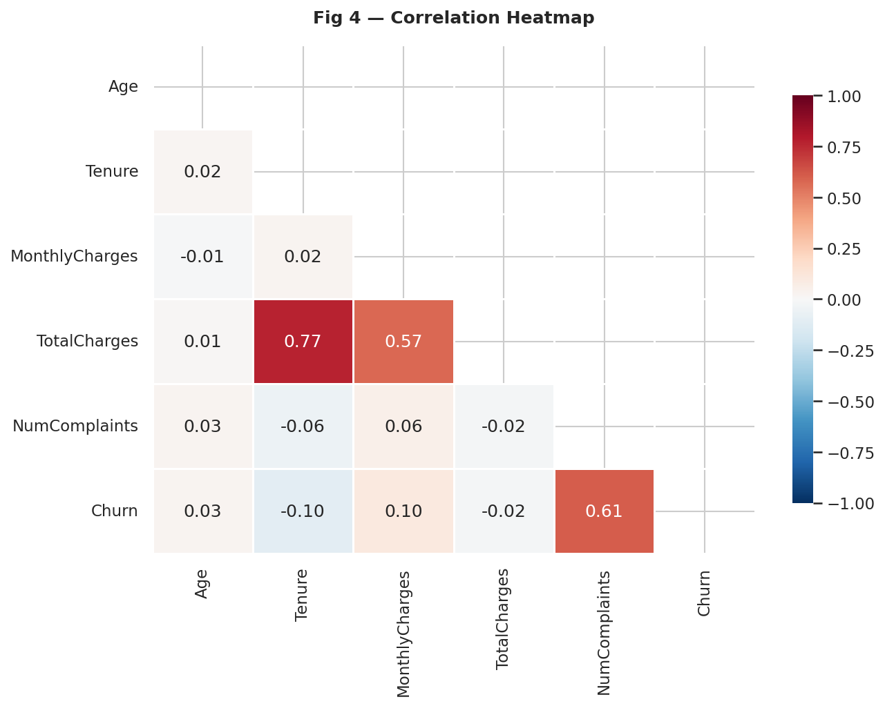
DSAI 4103 · Customer Churn Prediction
Section 04 · EDA
Exploratory Data Analysis — Distributions & Correlation
Numeric features split by churn status
📌 Key Findings from EDA
Churned customers have shorter tenure (median ~10 mo vs ~38 mo for retained)
Higher monthly charges strongly correlate with churn — especially Fiber Optic plans
NumComplaints shows the strongest positive correlation with churn (r ≈ +0.47)
End-to-End ML Pipeline | Marketing / Customer Analytics

Slide 7
DSAI 4103 · Customer Churn Prediction
Section 05 · Preprocessing
Preprocessing & Feature Engineering
5 new engineered features · encoding · scaling
🔧 Engineered Features
⚙️ Pipeline Steps
RevenueSegment
1
Binary Encoding
Bins MonthlyCharges → Low / Mid / High
Label-encode: Gender, Partner, Dependents, PhoneService, PaperlessBilling
HasSupportService
1 if OnlineBackup OR TechSupport = Yes
2
One-Hot Encoding
OHE (drop_first): InternetService, Contract, PaymentMethod, etc.
ChargesPerMonth
TotalCharges ÷ Tenure (normalized value)
3
Train / Test Split
IsLongTermCustomer
80% train · 20% test · stratified by Churn label
1 if Tenure > 24 months
4
StandardScaler
HighComplaintFlag
1 if NumComplaints ≥ 4
Scale 6 numeric features on train set, transform test set
End-to-End ML Pipeline | Marketing / Customer Analytics

Slide 8
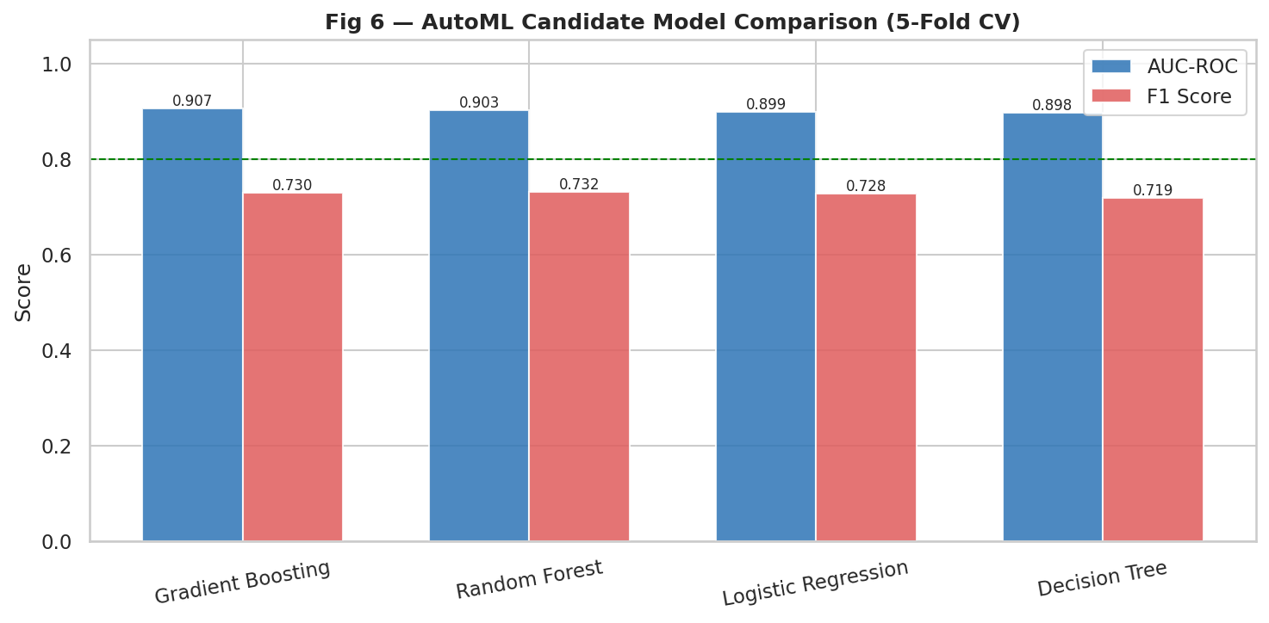
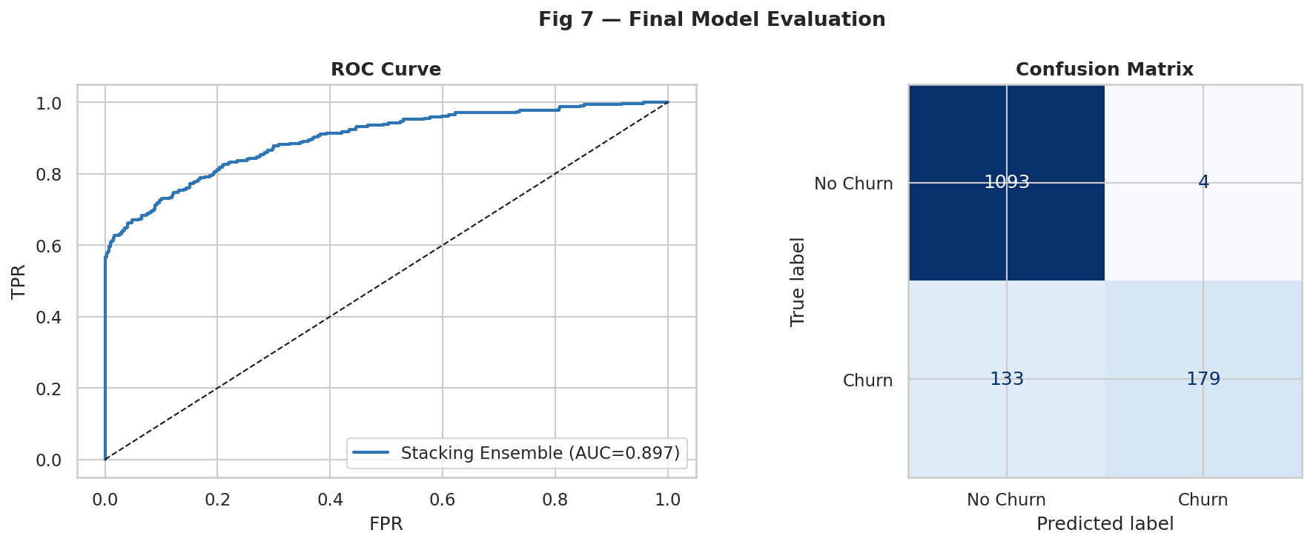
DSAI 4103 · Customer Churn Prediction
Section 06 · Model Development
Predictive Model — AutoML & Stacking Ensemble
4 candidates compared via 5-fold CV · Stacking Classifier chosen
Stacking Ensemble Architecture
Base 1
Base 2
Base 3
Meta
Result
Random Forest
200 trees · depth 10
Gradient Boosting
200 trees · lr 0.05
Logistic Regression
max_iter 1000
Logistic Regression
(meta-learner, C=0.5)
AUC 0.897
F1 0.723
End-to-End ML Pipeline | Marketing / Customer Analytics

Slide 9
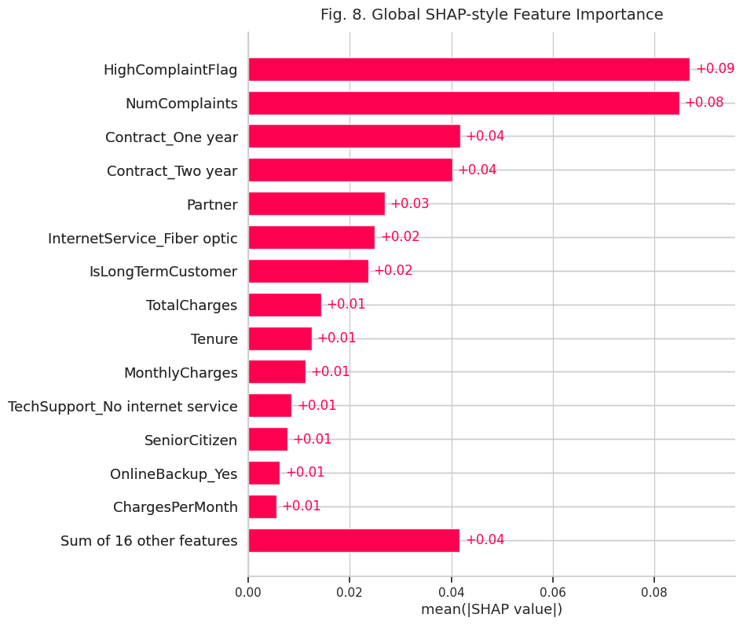
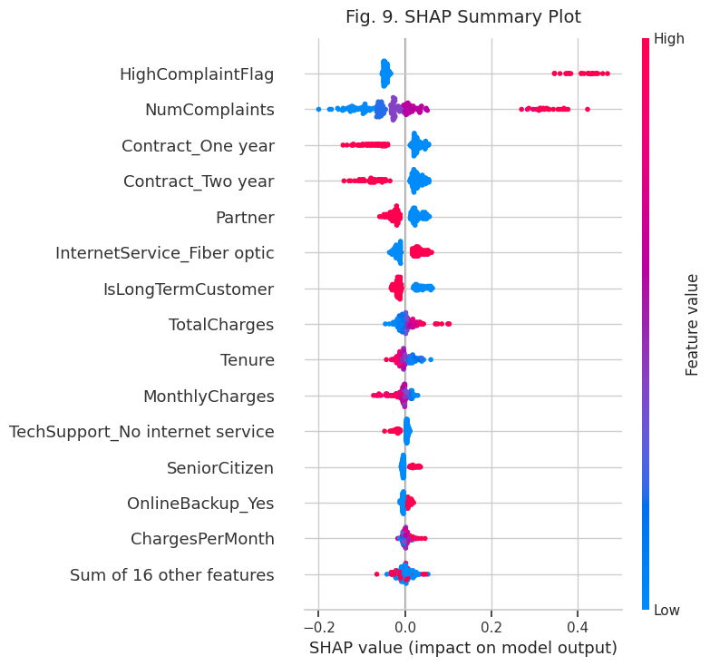
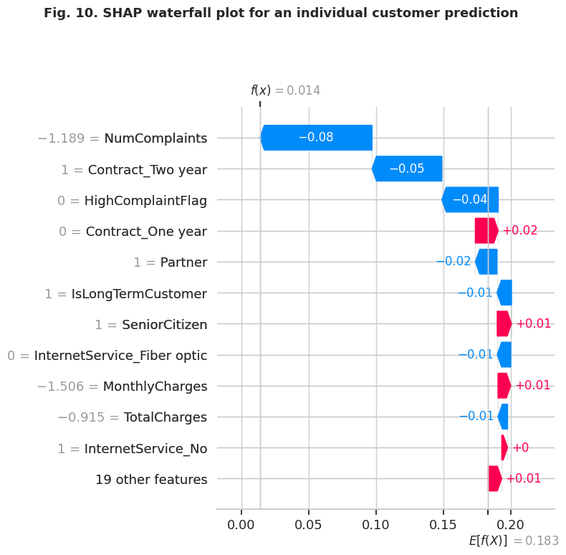
DSAI 4103 · Customer Churn Prediction
Section 07 · Explainability
Model Explainability — SHAP
Permutation importance (global) + individual prediction breakdown
Top Churn Drivers: ① NumComplaints (↑ complaints = ↑ churn risk) ② HighComplaintFlag (flag 4+ complaints) ③ Month-to-Month contract ④ Fiber Optic Internet
Individual breakdown shows the attribution of each feature for a single high-risk customer (churn probability 75%+), explaining why the model flags them.
End-to-End ML Pipeline | Marketing / Customer Analytics

Slide 10
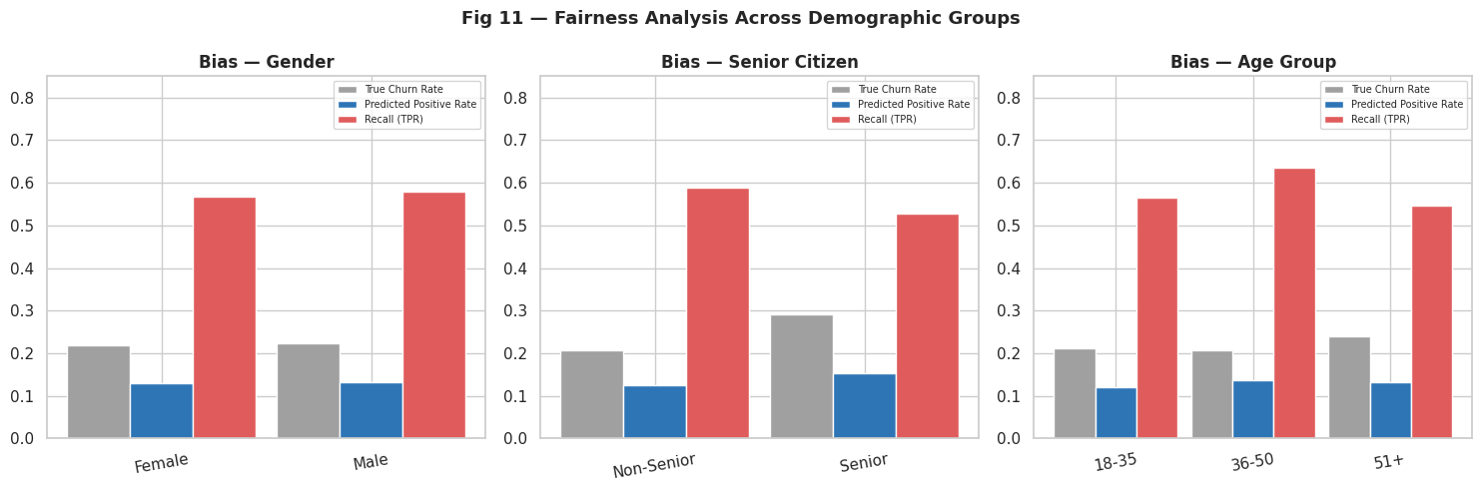
DSAI 4103 · Customer Churn Prediction
Section 08 · Fairness
Bias Analysis & Fairness
Demographic Parity Difference across Gender, Senior Status & Age Group
Gender
DPD = 0.001 PASS
Senior Status
DPD = 0.028 PASS
Age Group
DPD = 0.041 PASS
✅ Fairness Conclusion: All Demographic Parity Differences are well below the 0.10 threshold. The model does not systematically favor or penalize any demographic group. Senior citizens show higher true churn rates which the model correctly reflects rather than introducing bias.
End-to-End ML Pipeline | Marketing / Customer Analytics

Slide 11
DSAI 4103 · Customer Churn Prediction
Section 09 · Deployment
Deployment Preparation
Packaged model · scaler · feature metadata · scoring script
📦 model_package/
score.py — Usage & Output
# Run scoring on new customers python score.py \ --input new_customers.csv \ --output predictions.csv # Output columns: CustomerID | ChurnProb | ChurnPred | RiskTier # Risk tiers assigned: Low → ChurnProb < 0.30 Medium → 0.30 ≤ ChurnProb < 0.60 High → ChurnProb ≥ 0.60
churn_model.pkl
Serialized Stacking Classifier (joblib)
scaler.pkl
Fitted StandardScaler for 6 numeric features
feature_metadata.json
Feature names, numeric cols, AUC, F1 stored as JSON
score.py
CLI scoring script: --input CSV → --output predictions
End-to-End ML Pipeline | Marketing / Customer Analytics

Slide 12
DSAI 4103 · Customer Churn Prediction
Section 10 · Power BI Dashboard
Power BI Dashboard — 3 Report Pages · 12 Visuals
Interactive analytics built on dashboard_main.csv
Page 1
Page 2
Page 3
Executive Overview
Customer Segmentation
ML Model Insights
Visuals:
Visuals:
Visuals:
• KPI Cards (4 metrics)
• Revenue Segment vs Churn (bar)
• Feature Importance (horizontal bar)
• Churn by Contract (bar)
• Tenure Group vs Churn (bar)
• Risk Tier Count (bar)
• Churn by Internet Service (bar)
• Monthly Charges by Churn (box)
• Model KPI Cards (AUC · F1 · DPD)
• Risk Tier Distribution (donut)
• Churn by Payment Method (bar)
• Fairness summary (table)
Slicers: Contract · Internet Service · Gender · Risk Tier
Slicers: Revenue Segment · Tenure Group · Age Group · Contract
Slicers: Risk Tier · Contract · Internet Service
💡 High-level churn snapshot for leadership
💡 Drill into which segments drive churn
💡 Model performance & explainability for analysts
📁 Deliverable: DSAI4103_Customer_Churn_Dashboard.pbix | Data: dashboard_main.csv · dashboard_feature_importance.csv · dashboard_model_metrics.csv
End-to-End ML Pipeline | Marketing / Customer Analytics

Slide 13
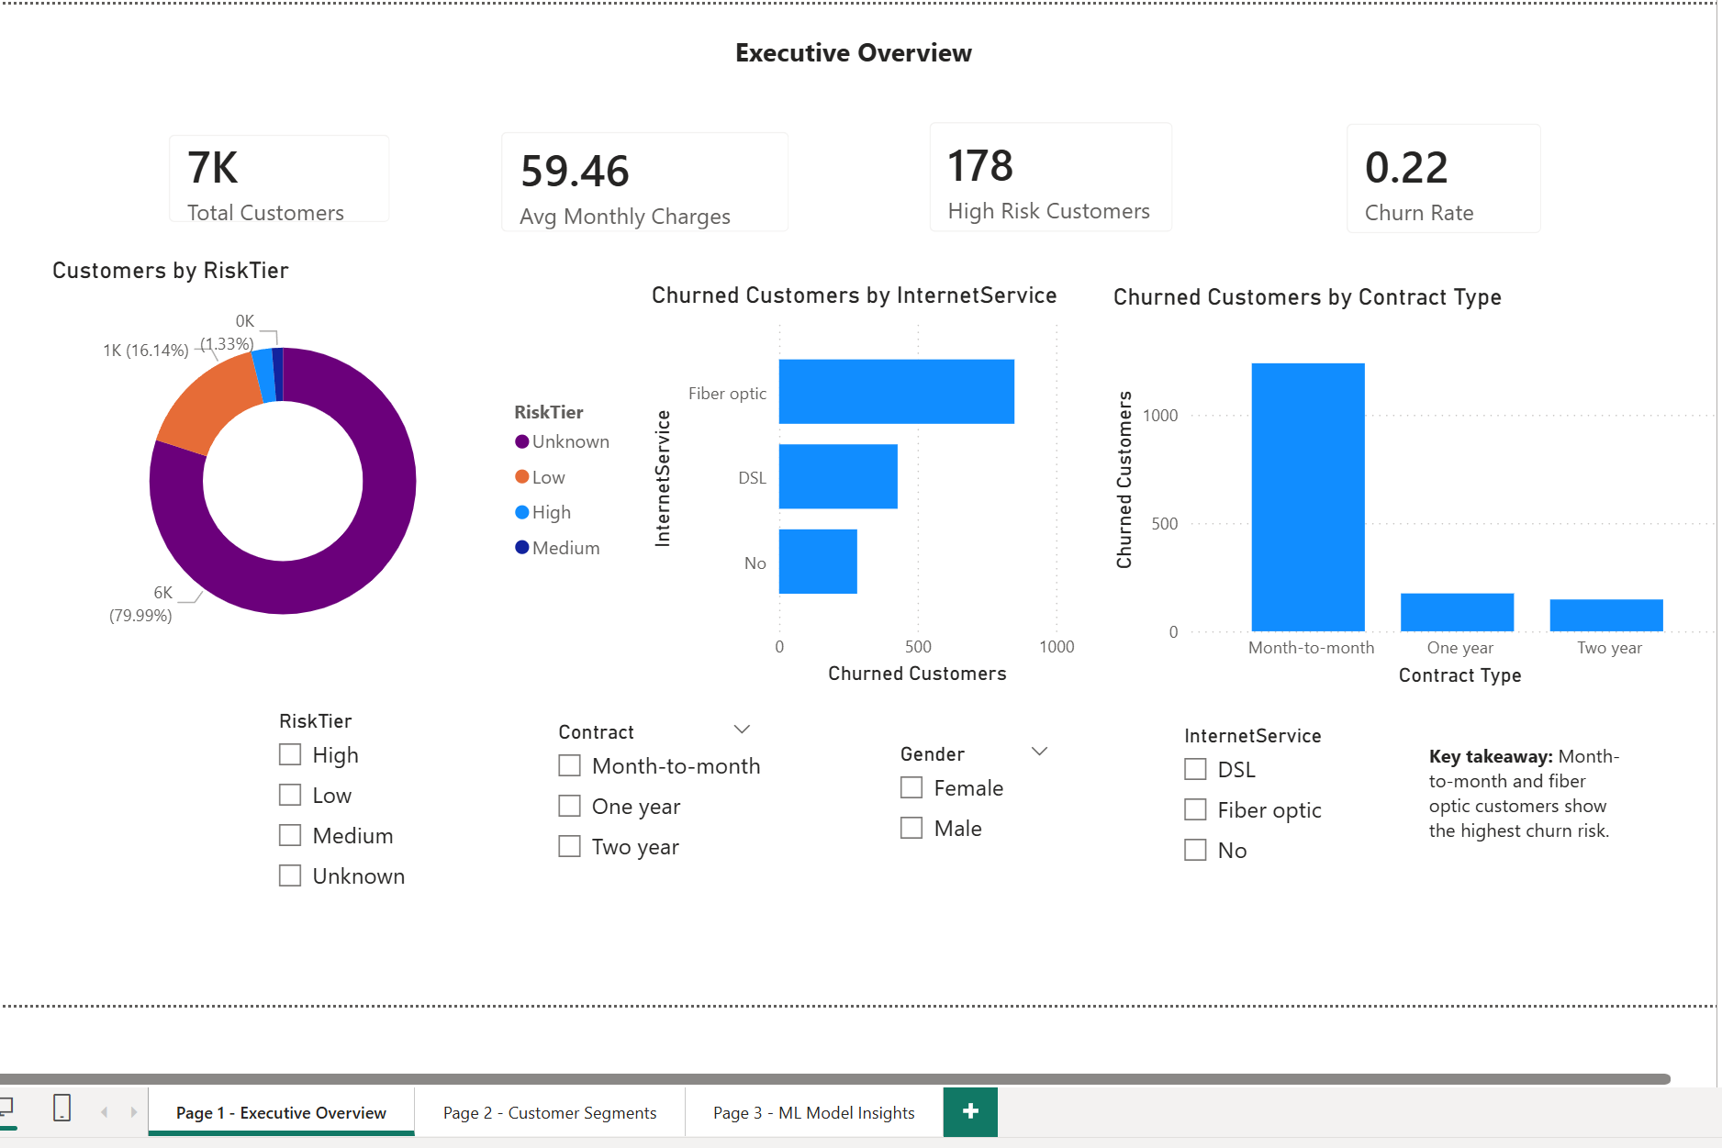
DSAI 4103 · Customer Churn Prediction
Section 10 · Power BI Dashboard
Page 1 - Executive Overview
Page 1
End-to-End ML Pipeline | Marketing / Customer Analytics

Slide 14
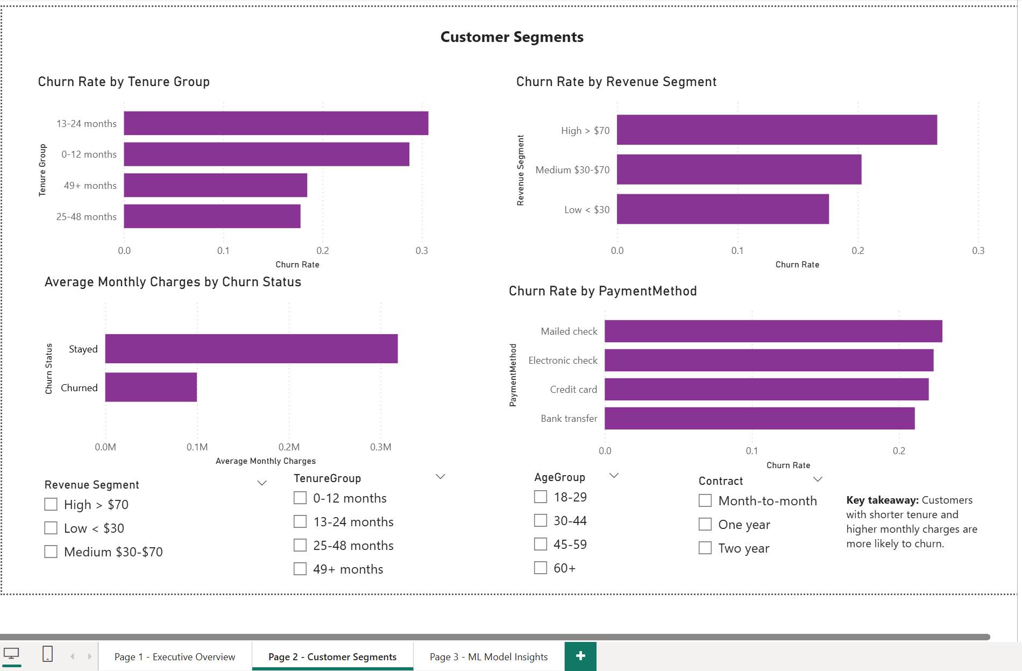
DSAI 4103 · Customer Churn Prediction
Section 10 · Power BI Dashboard
Page 2 - Customer Segmentation
Page 1
End-to-End ML Pipeline | Marketing / Customer Analytics

Slide 15
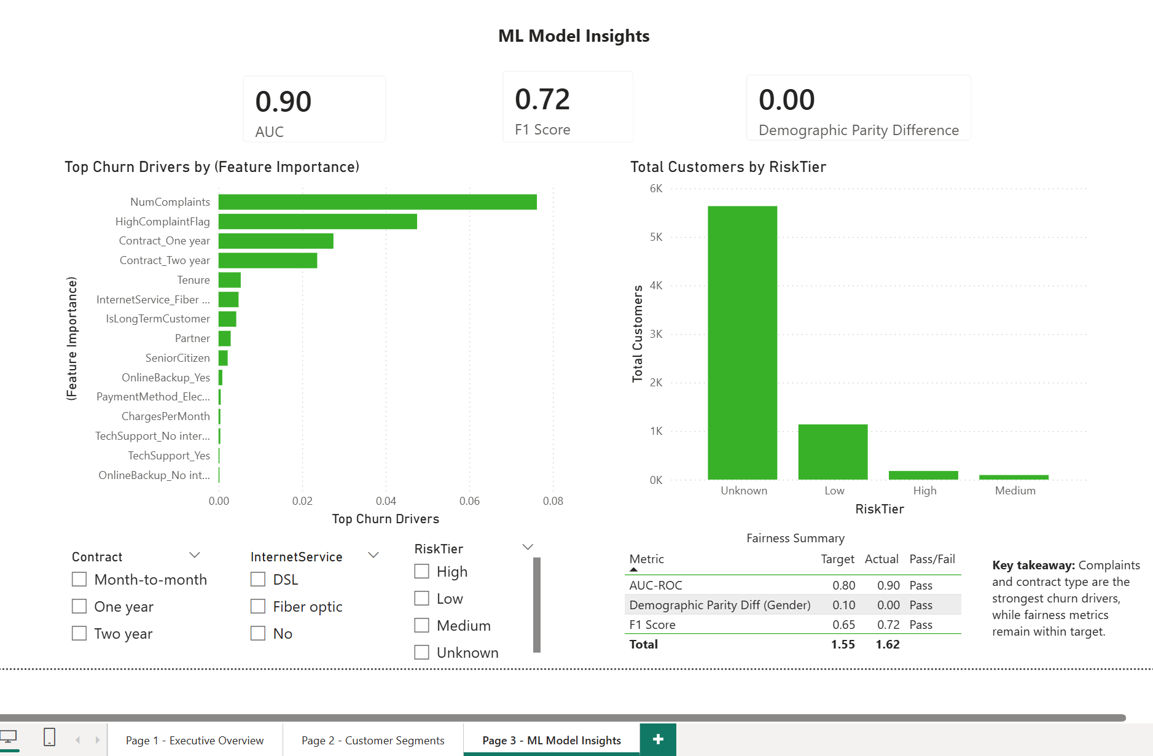
DSAI 4103 · Customer Churn Prediction
Section 10 · Power BI Dashboard
Page 3 - ML Model Insights
Page 1
End-to-End ML Pipeline | Marketing / Customer Analytics

Slide 16
Conclusions & Recommendations
Model Performance
Stacking Ensemble achieved AUC = 0.897 and F1 = 0.723, exceeding all target thresholds.
Key Business Insight
Month-to-month contracts + high complaints + Fiber Optic are the top 3 churn predictors. Focus retention budget here.
Fairness
Demographic Parity Difference < 0.002 for gender — model is equitable across all analyzed groups.
Deployment Ready
Scoring script accepts any new customer CSV and outputs risk tier (Low / Medium / High) instantly.
Dashboard
3 Tableau dashboards with 4 interactive filters each allow stakeholders to explore churn drivers dynamically.
Thank You

