Slide 1
CSE 3213
Computer graphics
Drawing Elementary Figures

Slide 2
Bresenham ’s Line Drawing Algorithm
p_{k+1} = p_{k} + 2∆y – 2∆x( y_{k+1}– y_{k} )
Input the two line end-points, storing the left end-point in (x₀,y₀)
Plot the point (x₀, y₀)
Calculate the constants Δx, Δy, 2Δy, and (2Δy - 2Δx) and get the first value for the decision parameter as:
P₀ = 2∆y – ∆x
At each x_{k} along the line, starting at k=0, perform the following test:
If p_{k} < 0, the next point to plot is (x_{k}+1, y_{k}) and
p_{k+1} = p_{k} + 2∆y
Otherwise, the next point to plot is (x_{k}+1, y_{k}+1) and
p_{k+1} = p_{k} + 2∆y – 2∆x
Repeat step 4 (Δx ) times

Slide 3
Bresenham ’s Line Drawing Algorithm
Bresenham’s Line Drawing Example
To illustrate the algorithm, we digitize the line with endpoints(20,10) and (30, 18). This line has a slope of 0.8, with
Δx =10, Δy = 8
The initial decision parameter has the value P₀ = 2∆y – ∆x = 6
And the increments for calculation successive decision parameters are:
2Δy = 16,
2Δy – 2Δx= – 4
We plot the initial point (20, 10) , and determine successive pixel positions along the line path from the decision parameters as:

Slide 4
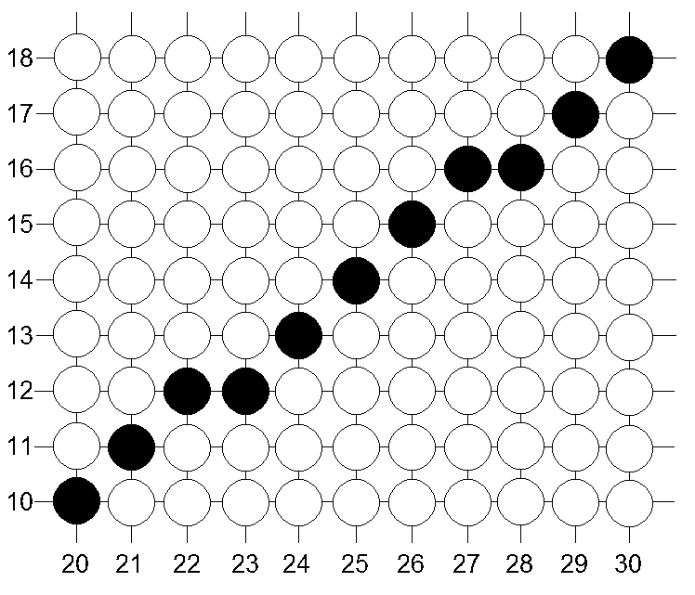
Bresenham ’s Line Drawing Algorithm
Bresenham’s Line Drawing Example
k | p_{k} | (x_{k}+1, y_{k}+1)
0 | 6 | (20,10)

Slide 5
Bresenham ’s Line Drawing Algorithm
Bresenham’s Line Drawing Example
k | p_{k} | (x_{k}+1, y_{k}+1)
0 | 6 | (20,10)
1 | 2 | (21, 11)
∆x=10 , ∆y=8
p₁ = p₀ + 2∆y – 2∆x
= 6 + 16 – 20
= 2

Slide 6
Bresenham ’s Line Drawing Algorithm
Bresenham’s Line Drawing Example
k | p_{k} | (x_{k}+1, y_{k}+1)
0 | 6 | (20,10)
1 | 2 | (21, 11)
∆x=10 , ∆y=8
p₁ = p₀ + 2∆y – 2∆x
= 6 + 16 – 20
= 2

Slide 7
Bresenham ’s Line Drawing Algorithm
Bresenham’s Line Drawing Example
k | p_{k} | (x_{k}+1, y_{k}+1)
0 | 6 | (20,10)
1 | 2 | (21, 11)
2 | -2
∆x=10 , ∆y=8
p₁ = p₀ + 2∆y – 2∆x
= 2 + 16 – 20
= -2

Slide 8
Bresenham ’s Line Drawing Algorithm
Bresenham’s Line Drawing Example
k | p_{k} | (x_{k}+1, y_{k}+1)
0 | 6 | (20,10)
1 | 2 | (21, 11)
2 | -2 | (22, 11)
∆x=10 , ∆y=8
p₁ = p₀ + 2∆y – 2∆x
= 6 + 16 – 20
= 2

Slide 9
Bresenham ’s Line Drawing Algorithm
Bresenham’s Line Drawing Example
k | p_{k} | (x_{k}+1, y_{k}+1)
0 | 6 | (20,10)
1 | 2 | (21, 11)
2 | -2 | (22, 11)
3 | 14 | (23, 12)
4 | 10 | (24, 13)
5 | 6 | (25, 14)
6 | 2 | (26, 15)
7 | -2 | (27, 15)
8 | 14 | (28, 16)
9 | 10 | (29, 17)
10 | 6 | (30, 18)

Slide 10
End

