Slide 1
CSE 3213
Circle Drawings

Slide 2



Mid-Point Circle Algorithm
2
p_{k+1} = p_{k}+ 2(x_{k} +1) + (y_{k+1}² – y_{k} ) – (y_{k+1} – y_{k})+1
Initial decision parameter p_{k}=1 – r
If p_{k} ≥ 0 ; y_{k+1}=y_{k}-1
So Next Pixel=(x_{k} + 1, y_{k} – 1)
If p_{k} < 0 ; y_{k+1}=y_{k}
So Next Pixel=(x_{k} + 1, y_{k})
p_{k+1}
k | (x_{k}, y_{k}) | p_{k} | ^{(x}k+1 ^{, y}k+1⁾
0 | (0,8) | -7 | (1,8)
Example, r=8 P₀=1- r =1- 8 =-7

Slide 3
Mid-Point Circle Algorithm
p_{k+1} = p_{k}+ 2(x_{k} +1) + (y_{k+1}² – y_{k} ) – (y_{k+1} – y_{k})+1
2
Initial decision parameter p_{k}=1 – r
If p_{k} ≥ 0 => y_{k+1}=y_{k}-1
So Next Pixel=(x_{k} + 1, y_{k} – 1)
If p_{k} < 0 => y_{k+1}=y_{k}
So Next Pixel=(x_{k} + 1, y_{k})
Example, r=8 P₀=1- r =1- 8 =-7
k | (x_{k}, y_{k}) | p_{k} | ^{(x}k+1 ^{, y}k+1⁾
0 | (0, 8) | -7 | (1, 8)
1 | (1, 8) | -4 | (2, 8)
p = p + 2(x +1) + (y – y ) – (y
– y )+1
k+1
2
2
k k k+1 k k+1
k
= -7 + 2(0+1) + (8² – 8² ) –(8 – 8)+1
= - 7+ 2+1 = -4

Slide 4
Mid-Point Circle Algorithm
p_{k+1} = p_{k}+ 2(x_{k} +1) + (y_{k+1}² – y_{k} ) – (y_{k+1} – y_{k})+1
2
Initial decision parameter p_{k}=1 – r
If p_{k} ≥ 0 => y_{k+1}=y_{k}-1
So Next Pixel=(x_{k} + 1, y_{k} – 1)
If p_{k} < 0 => y_{k+1}=y_{k}
So Next Pixel=(x_{k} + 1, y_{k})
Example, r=8 P₀=1- r =1- 8 =-7
k | (x_{k}, y_{k}) | p_{k} | ^{(x}k+1 ^{, y}k+1⁾
0 | (0, 8) | -7 | (1, 8)
1 | (1, 8) | -4 | (2, 8)
2 | (2, 8) | 1 | (3, 7)
p = p + 2(x +1) + (y
2
– y ) – (y
– y )+1
k+1
k k k+1
2
k k+1
k
= -4 + 2(1+1)
= - 4+ 4+1 = 1
+ (8² – 8² ) –(8 – 8)+1

Slide 5
Mid-Point Circle Algorithm
p_{k+1} = p_{k}+ 2(x_{k} +1) + (y_{k+1}² – y_{k} ) – (y_{k+1} – y_{k})+1
2
Initial decision parameter p_{k}=1 – r
If p_{k} ≥ 0 => y_{k+1}=y_{k}-1
So Next Pixel=(x_{k} + 1, y_{k} – 1)
If p_{k} < 0 => y_{k+1}=y_{k}
So Next Pixel=(x_{k} + 1, y_{k})
Example, r=8 P₀=1- r =1- 8 =-7
k | (x_{k}, y_{k}) | p_{k} | ^{(x}k+1 ^{, y}k+1⁾
0 | (0, 8) | -7 | (1, 8)
1 | (1, 8) | -4 | (2, 8)
2 | (2, 8) | 1 | (3, 7)
3 | (3, 7) | -6 | (4, 7)
p = p + 2(x +1) + (y
2
– y ) – (y
– y )+1
k+1
2
k k k+1 k k+1
k
= 1 + 2(2+1) + (7² – 8² ) –(7 – 8)+1
= 1+ 6 – 15 +1 +1 = – 6

Slide 6
Mid-Point Circle Algorithm
p_{k+1} = p_{k}+ 2(x_{k} +1) + (y_{k+1}² – y_{k} ) – (y_{k+1} – y_{k})+1
2
Initial decision parameter p_{k}=1 – r
If p_{k} ≥ 0 => y_{k+1}=y_{k}-1
So Next Pixel=(x_{k} + 1, y_{k} – 1)
If p_{k} < 0 => y_{k+1}=y_{k}
So Next Pixel=(x_{k} + 1, y_{k})
Example, r=8 P₀=1- r =1- 8 =-7
k | (x_{k}, y_{k}) | p_{k} | ^{(x}k+1 ^{, y}k+1⁾
0 | (0, 8) | -7 | (1, 8)
1 | (1, 8) | -4 | (2, 8)
2 | (2, 8) | 1 | (3, 7)
3 | (3, 7) | -6 | (4, 7)
4 | (4, 7) | 3 | (5, 6)
p = p + 2(x +1) + (y – y ) – (y
– y )+1
k+1
2
2
k k k+1 k k+1
k
= - 6 + 2(3+1) + (7² – 7² ) – (7 – 7)+1
= - 6 + 8 + 0 - 0 +1 = 3

Slide 7
Mid-Point Circle Algorithm
p_{k+1} = p_{k}+ 2(x_{k} +1) + (y_{k+1}² – y_{k} ) – (y_{k+1} – y_{k})+1
2
Initial decision parameter p_{k}=1 – r
If p_{k} ≥ 0 => y_{k+1}=y_{k}-1
So Next Pixel=(x_{k} + 1, y_{k} – 1)
If p_{k} < 0 => y_{k+1}=y_{k}
So Next Pixel=(x_{k} + 1, y_{k})
Example, r=8 P₀=1- r =1- 8 =-7
k | (x_{k}, y_{k}) | p_{k} | ^{(x}k+1 ^{, y}k+1⁾
0 | (0, 8) | -7 | (1, 8)
1 | (1, 8) | -4 | (2, 8)
2 | (2, 8) | 1 | (3, 7)
3 | (3, 7) | -6 | (4, 7)
4 | (4, 7) | 3 | (5, 6)
5 | (5, 6) | 2 | (6,5)
p = p + 2(x +1) + (y
2
– y ) – (y
– y )+1
k+1
2
k k k+1 k k+1
k
= 3 + 2(4+1) + (6² – 7² ) – (6 – 7)+1
= 3 + 10 - 13 + 1 +1 = 2

Slide 8
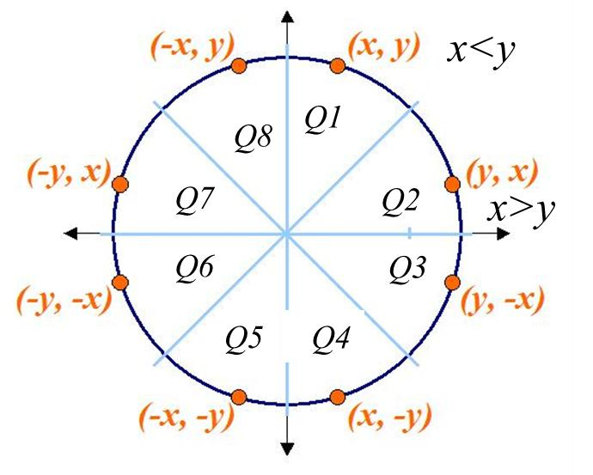
Mid-Point Circle Algorithm
p_{k+1} = p_{k}+ 2(x_{k} +1) + (y_{k+1}² – y_{k} ) – (y_{k+1} – y_{k})+1
2
Initial decision parameter p_{k}=1 – r
If p_{k} ≥ 0 => y_{k+1}=y_{k}-1
So Next Pixel=(x_{k} + 1, y_{k} – 1)
If p_{k} < 0 => y_{k+1}=y_{k}
So Next Pixel=(x_{k} + 1, y_{k})
k | (x_{k}, y_{k}) | p_{k} | ^{(x}k+1 ^{, y}k+1⁾
0 | (0, 8) | -7 | (1, 8)
1 | (1, 8) | -4 | (2, 8)
2 | (2, 8) | 1 | (3, 7)
3 | (3, 7) | -6 | (4, 7)
4 | (4, 7) | 3 | (5, 6)
5 | (5, 6) | 2 | (6,5)
Outside Q1 as x>y

Slide 9
Mid-Point Circle Algorithm
Q1 (x , y) | Q2 (x , y) | Q3 (x , y) | Q4 (x , y) | Q5 (x , y) | Q6 (x , y) | Q7 (x , y) | Q8 (x , y)
(0, 8) | (8, 0) | (8, -0) | (0, -8) | (-0, -8) | (-8, -0) | (-8, 0) | (-0, 8)
(1, 8) | (8, 1) | (8, -1) | (1, -8) | (-1,- 8) | (-8, -1) | (-8, 1) | (-1, 8)
(2, 8) | (8, 2) | (8, -2) | (2, -8) | (-2,- 8) | (-8, -2) | (-8, 2) | (-2, 8)
(3, 7) | (7, 3) | (7, -3) | (3, -7) | (-3, -7) | (-7, -3) | (-7, 3) | (-3, 7)
(4, 7) | (7, 4) | (7, -4) | (4, -7) | (-4, -7) | (-7, -4) | (-7, 4) | (-4, 7)
(5, 6) | (6, 5) | (6, -5) | (5, -6) | (-5, -6) | (-6, -5) | (-6, 5) | (-5, 6)
Quadrant-wise pixel distribution

