Slide 1

NoteKhata App
Bangladesh Army University of Engineering & Technology ( BAUET)
Qadirabad Cantonment, Natore-6431
Department of Computer Science and Engineering
Course Code: CSE-4216
Course Title: Mobile and Ubiquitous Computing Sessional
Submitted by:
ID:18104050 (Md. Momenul Haque)
ID:18104038 (Rokibul Hasan Saimun)
ID:18104034 (Md. Shaimum Sultan Tusar)
ID:18104010 (Md. Ashikur Rahman Lemon)
ID:18104004 (Md. Rakibul Islam)
CSE 7th Batch
Submitted to:
Mst. Irin Sultana
Lecturer
Dept. of CSE, BAUET
Aroni Saha Prapty
Lecturer
Dept. of CSE, BAUET
Dept. of CSE, BAUET

Slide 2

Outline
Implementation
Market Analysis
Result & Discussion
Introduction
Conclusion
& Future work
Problem statement and objective
Proposed Method
Methodology
17-Apr-2022 NoteKhata App

Slide 3


Introduction (1/2)
E-learning mobile apps have not only been for the growth of students but e-learning apps also take teachers under their consideration. It is true that e-learning has proved to be hugely beneficial for the students but that is not the whole picture. These e-learning apps have also helped the teachers to grow leaps and bounds.
Figure 1: NoteKhata
MD. RAZAUL KARIM [CE-15004] MD. ASHEF SHAHRIOR [CE-15007] Dept. of CSE, MBSTU
17-Apr-2022 NoteKhata App

Slide 4
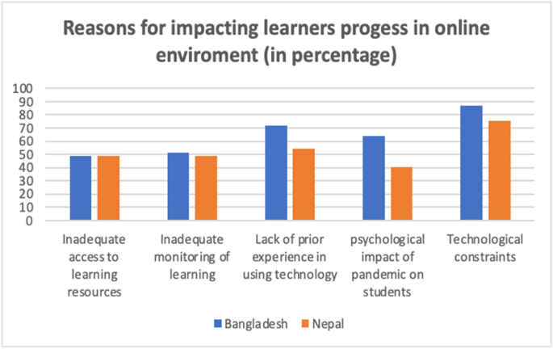
Introduction (2/2)
Figure 2: Voting Age Population turnout
Motivation, simply put, is the reason one has for doing something. Consequently, learning motivation is the reason, or the desire, for learning. And in our case, in the E-learning universe that is, learning motivation is the reason learners need in order to fully experience our E-learning courses. Motivation is a corner stone in online distance learning.
MD. RAZAUL KARIM [CE-15004] MD. ASHEF SHAHRIOR [CE-15007] Dept. of CSE, MBSTU
17-Apr-2022 NoteKhata App

Slide 5
Problem Statement & Objectives
The major aim of Notekhata app is enhance the quality of learning and teaching. Meet the learning style or needs of students. Improve the efficiency and effectiveness. Improve user-accessibility and time flexibility to engage learners in the learning process. The major objectives are-
NoteKhata saves time and money.
NoteKhata leads to better relation.
NoteKhata is consistent for learner.
NoteKhata offers personalization.
NoteKhata is scalable.
17-Apr-2022 NoteKhata App

Slide 6
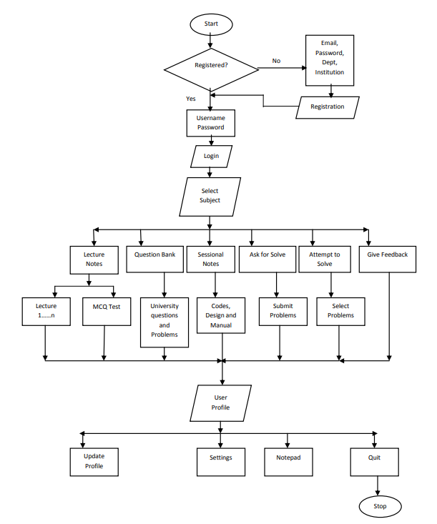
Flowchart
Figure 3: Flowchart
17-Apr-2022 NoteKhata App

Slide 7
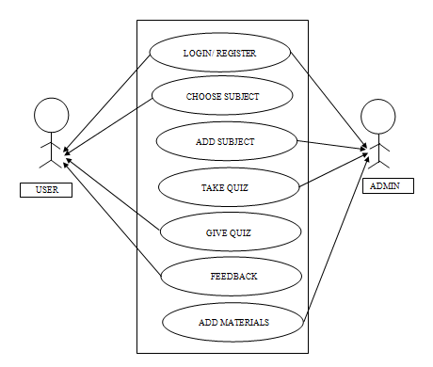
Use-case Diagram
Figure 4: Use-case Diagram
17-Apr-2022 NoteKhata App

Slide 8
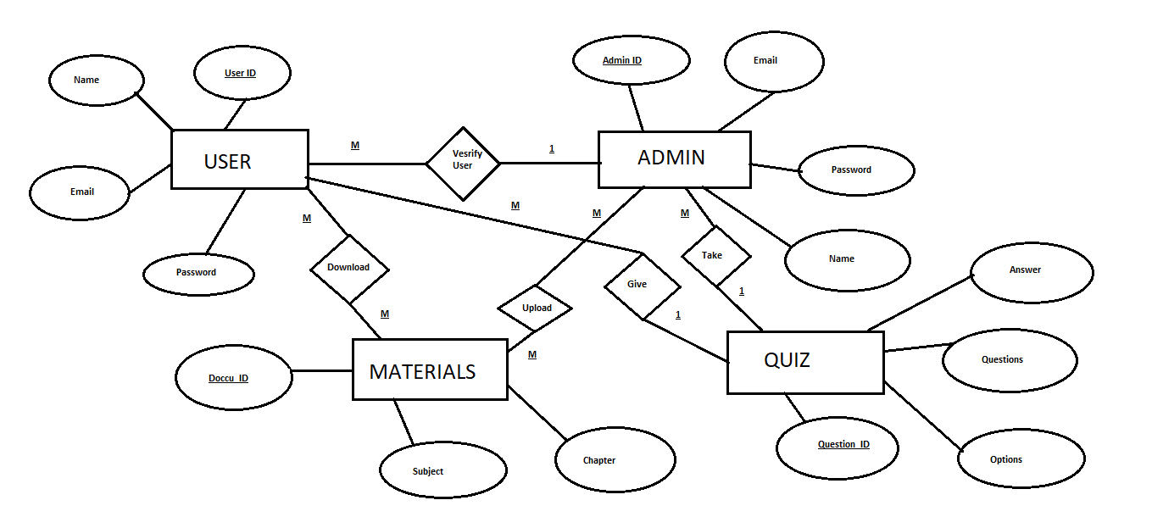
ER Diagram
Figure 5: ER Diagram
17-Apr-2022 NoteKhata App

Slide 9
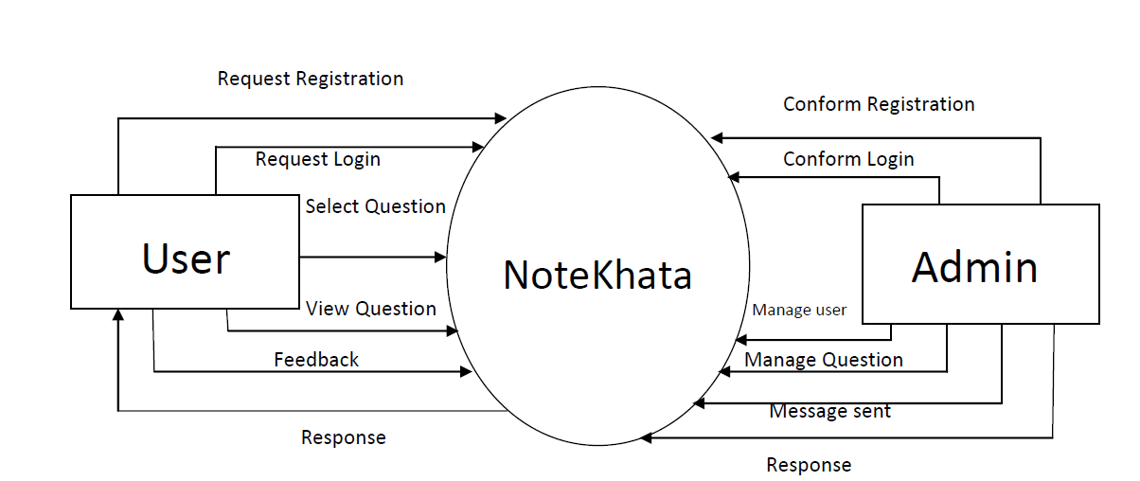
Data Flow Diagram
Figure 6: DFD
17-Apr-2022 NoteKhata App

Slide 10
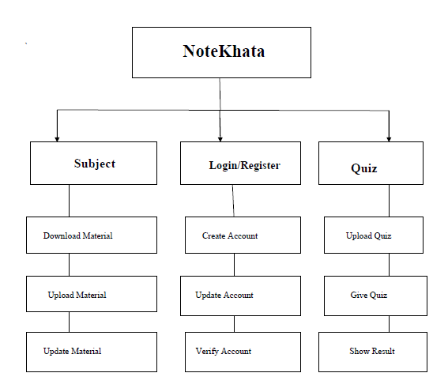
Functional Decomposition
Figure 7: Functional Decomposition
17-Apr-2022 NoteKhata App

Slide 11
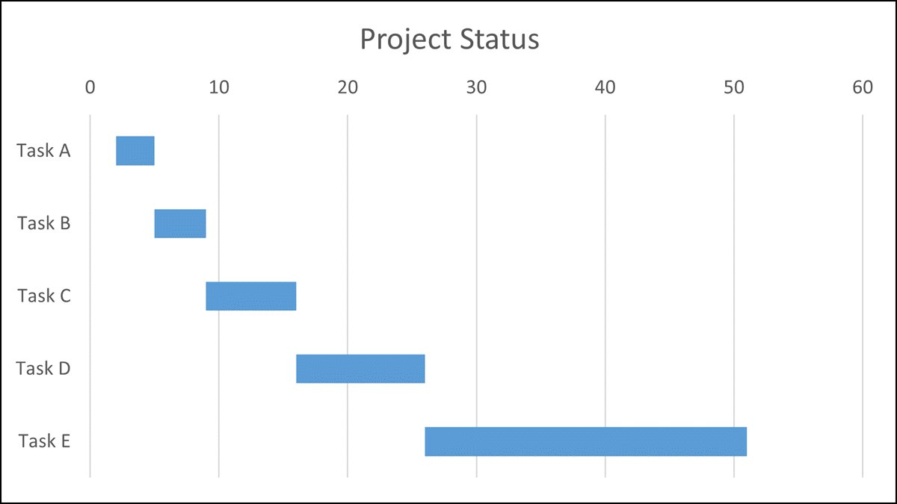
Project Gantt Chart
Figure 8: Gantt Chart
17-Apr-2022 NoteKhata App

Slide 12



Competitors
Figure 9: Market Competitors
17-Apr-2022 NoteKhata App

Slide 13
Market Analysis
Data provider, the worldwide e-learning market is estimated to be worth $398 billion in 2026. That is a 300% boost from 2015’s 107 billion.
The online education market is developing rapidly and is being encouraged by raising capital. In 2019, the global investment in EdTech (the development of technological solutions for education) reached $18.66 billion, which is 14.2% more than in 2018.
17-Apr-2022 NoteKhata App

Slide 14
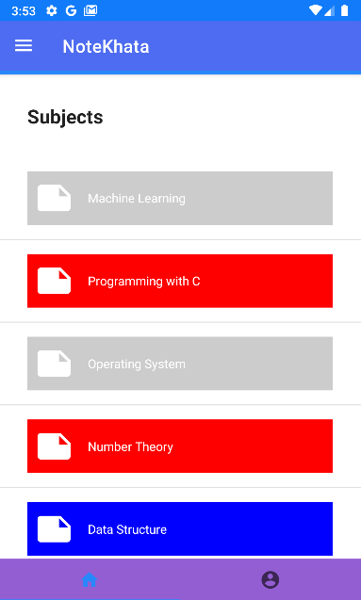
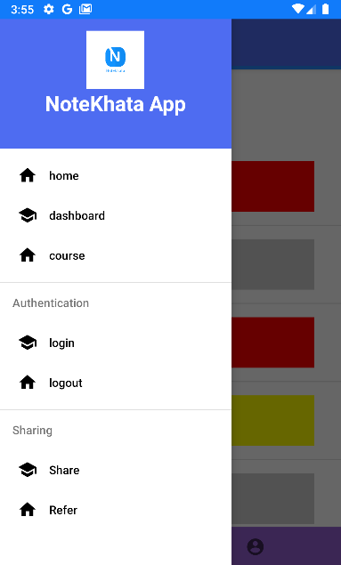
Implementation (1/3)
Figure 10: Main Page
17-Apr-2022 NoteKhata App

Slide 15
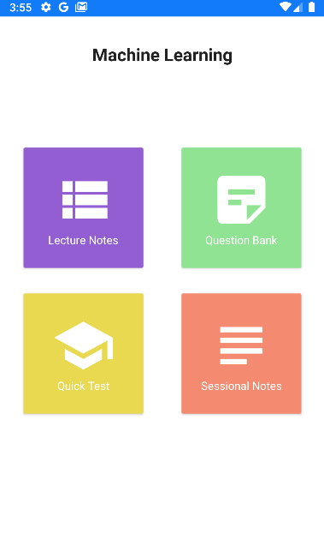
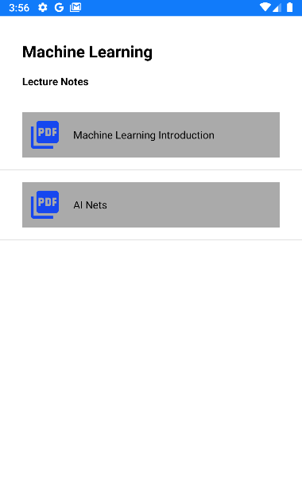
Implementation (2/3)
Figure 11: Category
17-Apr-2022 NoteKhata App

Slide 16
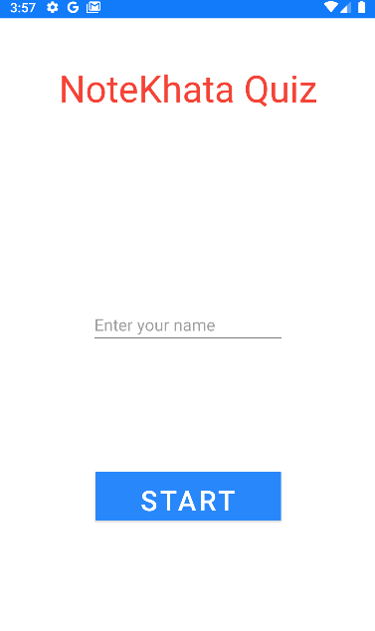
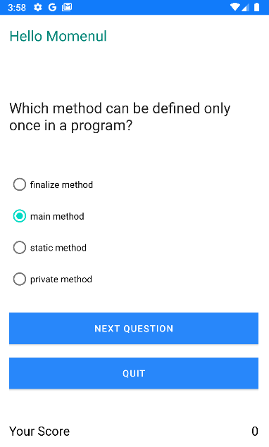
Implementation (3/3)
Figure 12: Quiz
17-Apr-2022 NoteKhata App

Slide 17
Conclusion & Future Work
In conclusion, we can see that culture is a key contributor to the success of e-learning. It is important for e-learning course providers to include a study and analysis of the culture of the target student group in the planning stage.
There still has to be a vast development of the infrastructure to support the delivery of e-learning. The education system in these countries requires a change in the methods of teaching to empower the student to study on his or her own.
In the future we want to develop a freelancing education system in the ask to solve section. Where student can solve problems to earn some points. With these points he/she can unlock some other study materials.
17-Apr-2022 NoteKhata App

Slide 18
References
[1] http://dl.lib.uom.lk/bitstream/handle/123/899/post-text.pdf?sequence=5&isAllowed=y
[2] https://www.rishabhsoft.com/blog/android-app-development-process-steps-towards your-business-app
[3] http://agilemodeling.com/
[4] https://link.springer.com/article/10.1007/s10639-021-10659-0
[5] https://www.tutorialspoint.com/android/index.htm\
[6] https://www.udemy.com/course/learn-android-application-development-y/\
[7] https://www.guru99.com/android-tutorial.html
[8] https://riseuplabs.com/android-app-development-the-complete-guide/
[9] https://www.mindbowser.com/a-step-by-step-guide-to-mobile-app-development/
17-Apr-2022 NoteKhata App

Slide 19
Thank You ☺

Slide 20
ANY QUESTIONS?

