Slide 1
FIFA MANAGEMENT SYSTEM

Slide 2
Project Distrubtion
Momin Rauf
Jazib
Ahsan Ullah

Slide 3
Problem
For international-level tournaments like FIFA, there is a huge population around the world, that buys match tickets.
There are systems that can handle match ticketing. But what about the smooth accommodation and flight reservation for the person who is coming from another country?

Slide 4
Solution
So, our idea for the End Semester DBS project was to implement an Accommodation Reservation System along with the Flight Reservation System.
We also added a third system i.e. FIFA Store Management from which the clients can buy any accessories to support their teams

Slide 5
Our System
Our system consists of three modules:
Accommodation Reservation System
Flight Reservation System
FIFA Store Management

Slide 6
Data Base Stats
Tables: 26
Views: 9
Stored Procedures: 8
Triggers: 2
Users: 4

Slide 7
Authorization
Four Users
Customers: Can VIEW ONLY
Accommodation Manager: Can VIEW, INSERT, DELETE, and UPDATE the tables related to Accommodation Module Only
Flight Manager: Can VIEW, INSERT, DELETE, and UPDATE the tables related to Flight Module Only
FIFA Store Manager: Can VIEW, INSERT, DELETE, and UPDATE the tables related to FIFA Store Module Only

Slide 8
TOOLS USED
1
2
3
4
Python
PyQt5
For Connecting MySQL Workbench
For Backend
PyQt5 Creator
MySQL
For Front-end (UI)
For Database

Slide 9
DEMONSTRATION

Slide 10
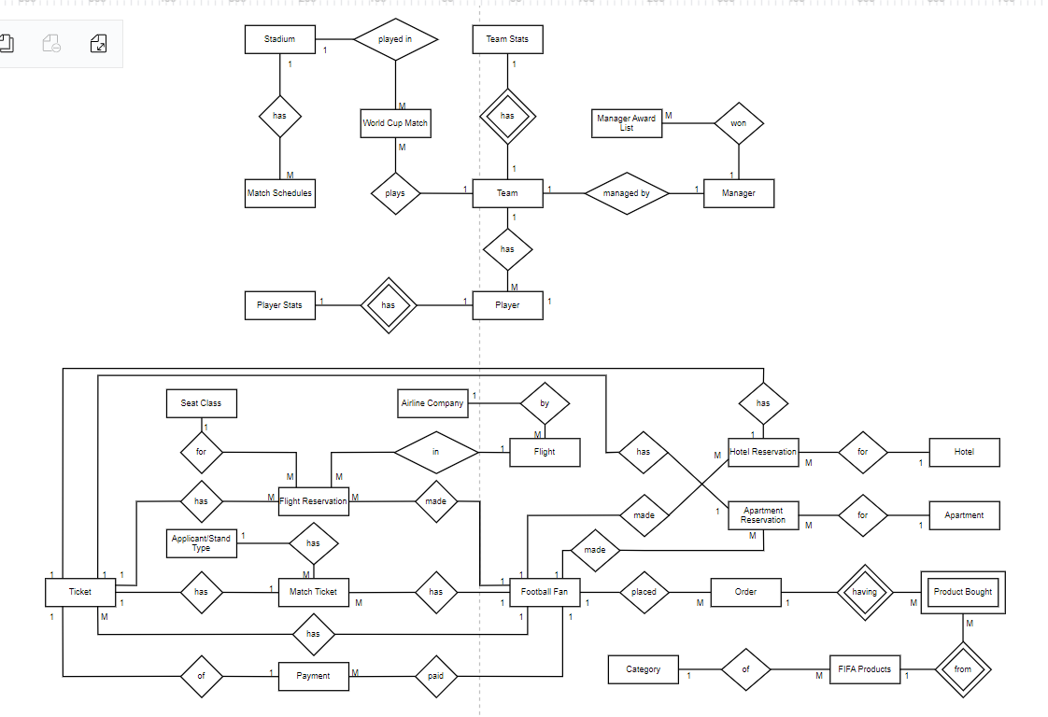
ERD
ERD

Slide 11
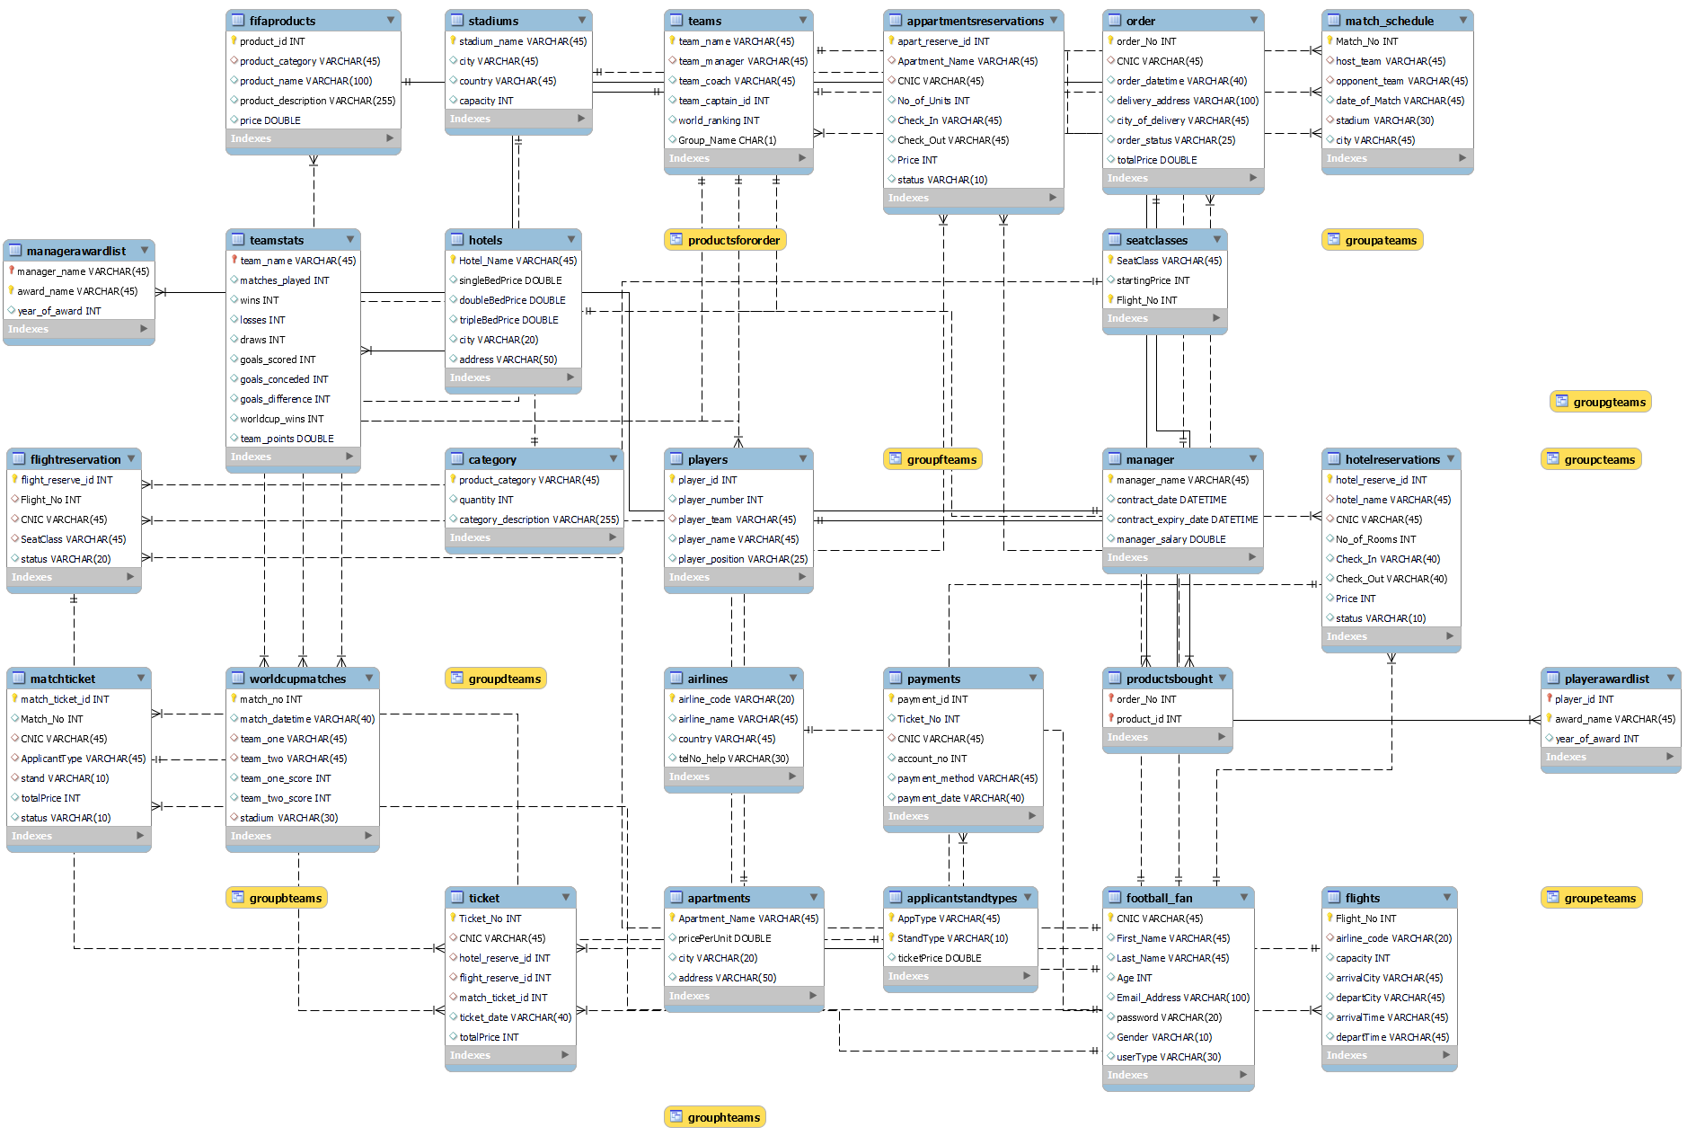
EER

Slide 12
THANK YOU!

