Slide 1


Username
Password
LOG IN
Forget Password?
New? Create Account

Slide 2
Username
Full name
Gender
Mobile no
Enter Password
Re-Enter Password
CREATE

Slide 3
Username
Mobile no
New Password
Re-Enter Password
RESET

Slide 4





Package
Facilities
Gallery
About us

Slide 5
Luxury
Complementary welcome dinks.
Complementary Buffet Breakfast for
Complementary swimming pool
bdt.16,000 per night
BOOK NOW
Premium
Complementary welcome dinks.
Complementary Buffet Breakfast for
Children above 5 to 10 years old half charge/children
Complementary swimming pool
bdt.10,000per night
BOOK NOW
Standard
Complementary welcome dinks.
Breakfast for 02 Children above 5 to 10 years old half charge/children
swimming pool
bdt.8,000
per night
BOOK NOW
Basic
Complementary welcome dinks.
Breakfast for 02 Children above 5 to 10 years old half charge/children
3 hour swimming pool per day
bdt.5,000
per night
BOOK NOW
Back

Slide 6
Full name
NID No
Marital Status
Gender
Mobile no
Address
Book
Back

Slide 7
Thanks for Booking!
Stay with us
dashboard

Slide 8
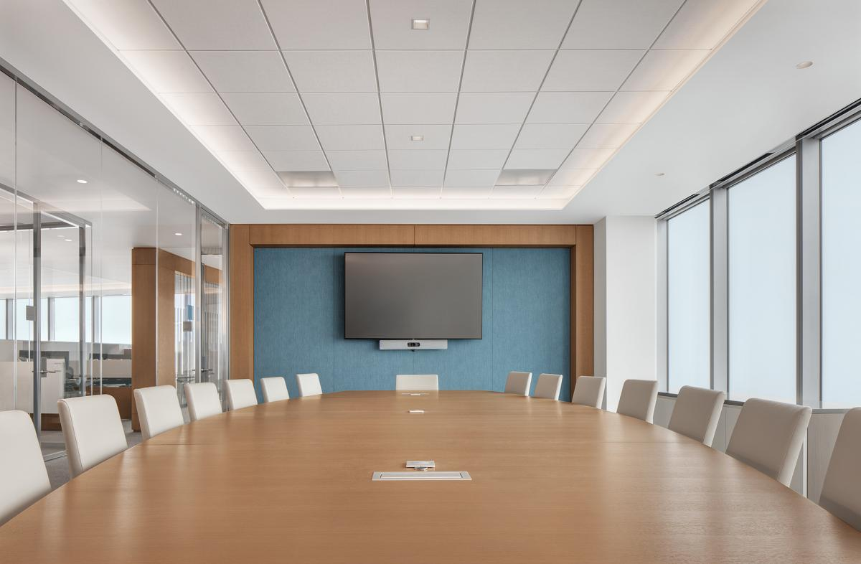
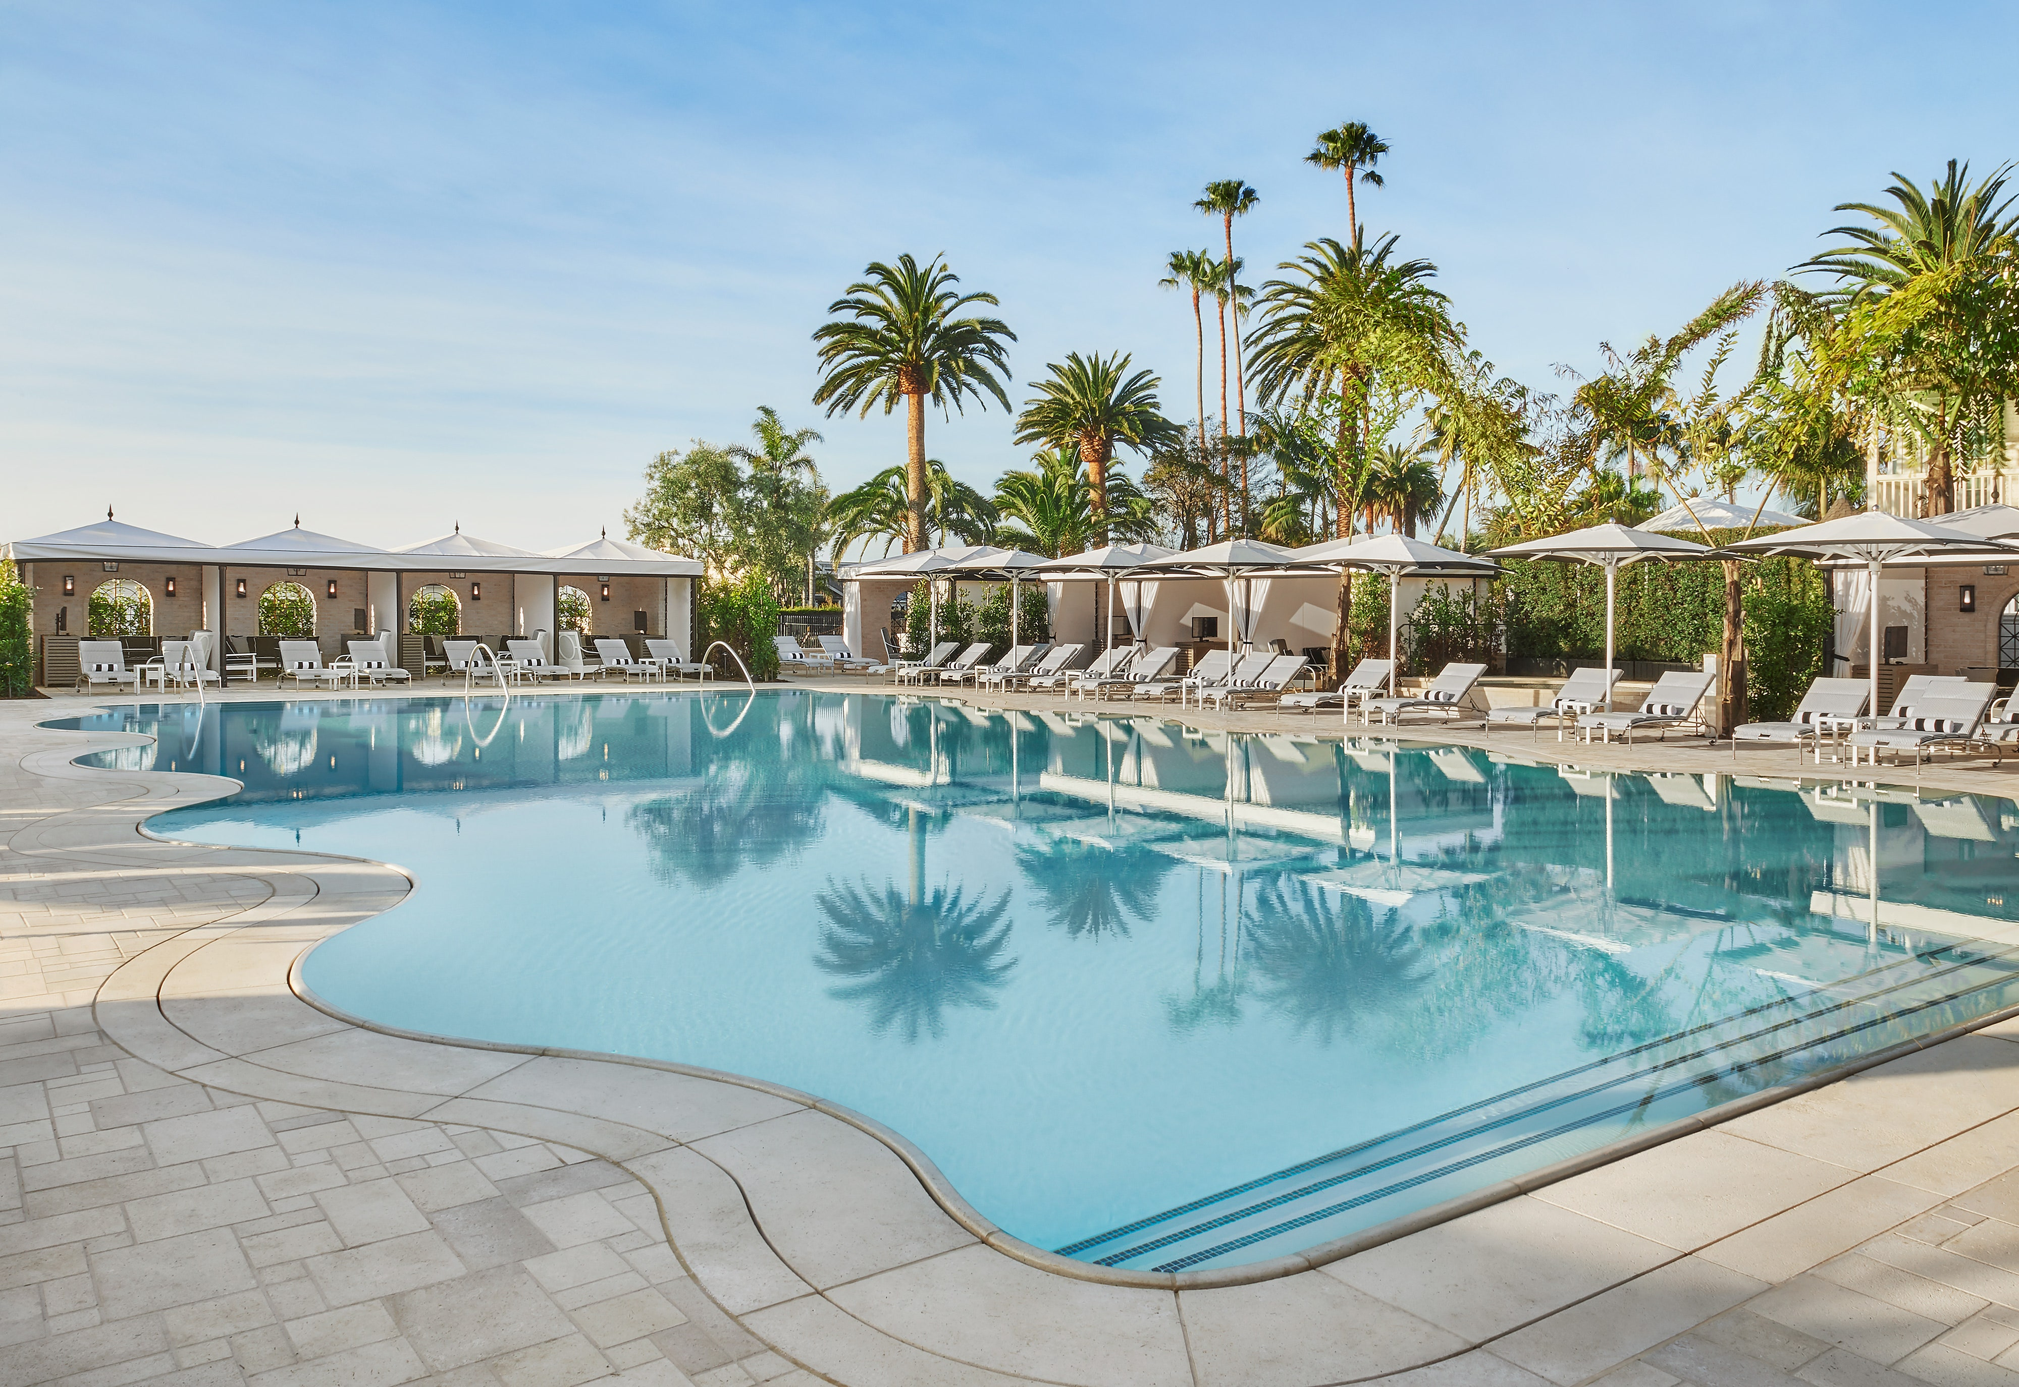
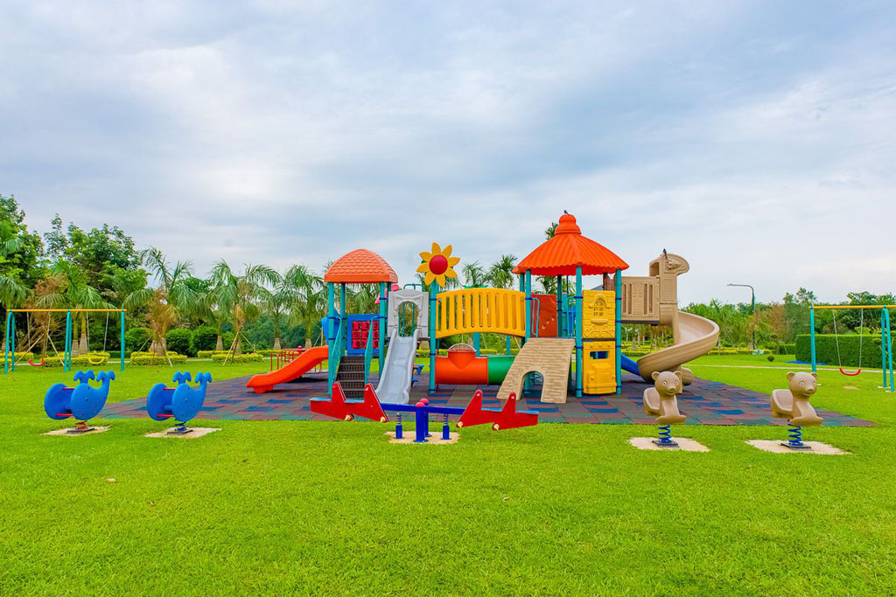
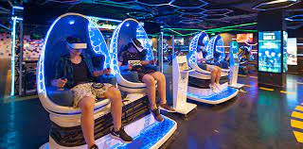
Conference Room
Swimming pool
Facilities
Kids zone
About us
VR Games
dashboard

Slide 9
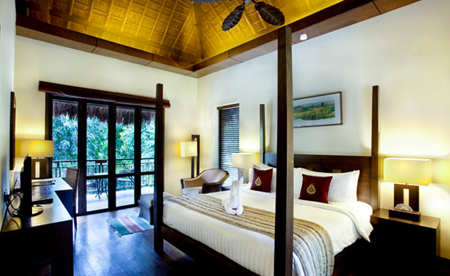
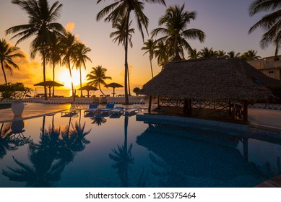
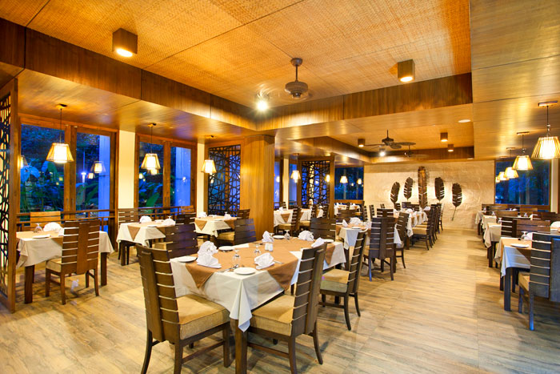
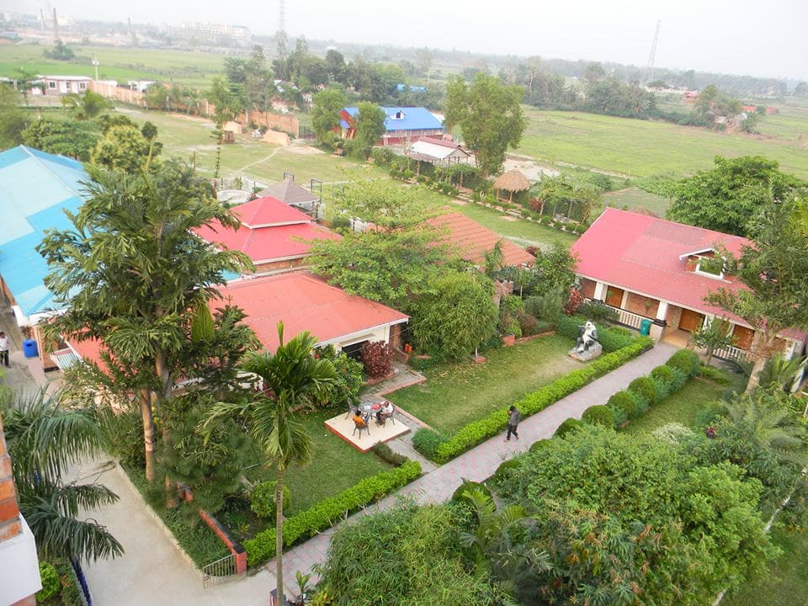
dashboard

Slide 10





44,Rupnagar,Mirpur,
Dhaka,Bangladesh.
info@heritagebd.com
+8801650078352
@heritagebd
www.hetitagebd.com
dashboard

