Slide 1

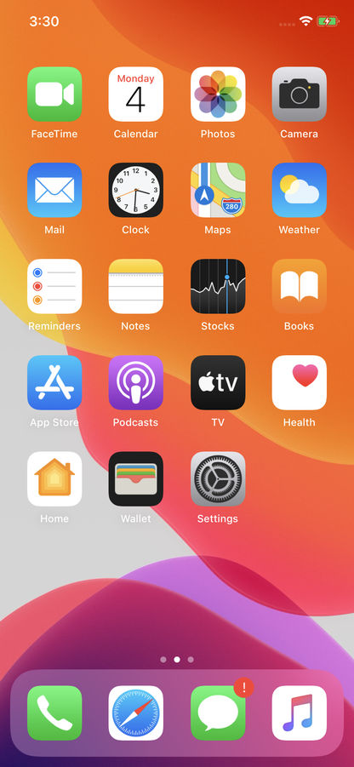


Slide 2
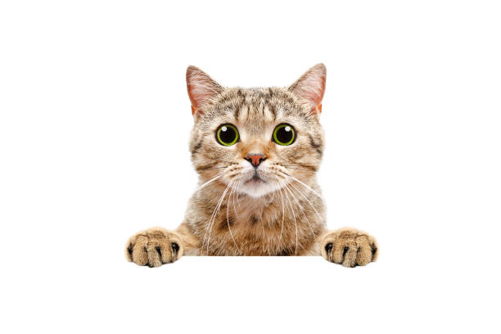




UNO
My profile
Change password
Upgrade to Premium
Logout

Slide 3
Create account
Username
Password
Login
Forgot password? Of course you did you dumb creature. Click here to reset

Slide 4

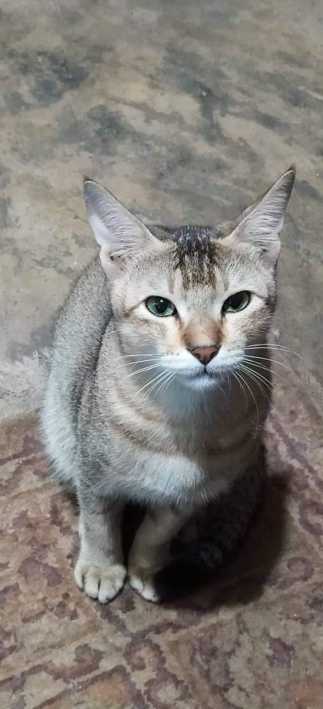
UNO
@yourworstnightmare
Date of birth: 14-02-2021
Breed: Lucifer
Characteristics: Professional assasin

Slide 5
Chats
Uno
Little devil

Slide 6
Search by category
category
category
category
category
category

Slide 7
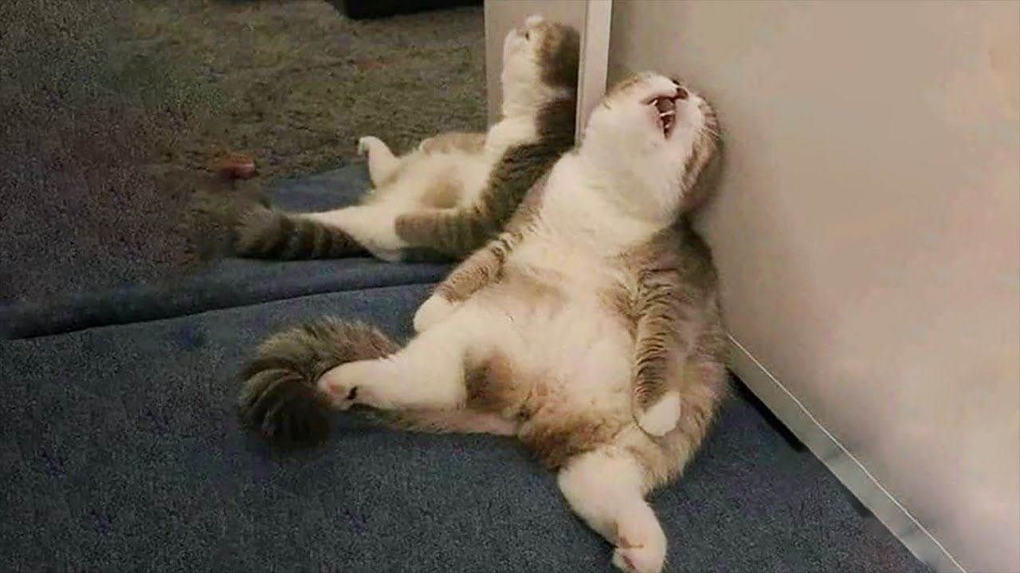

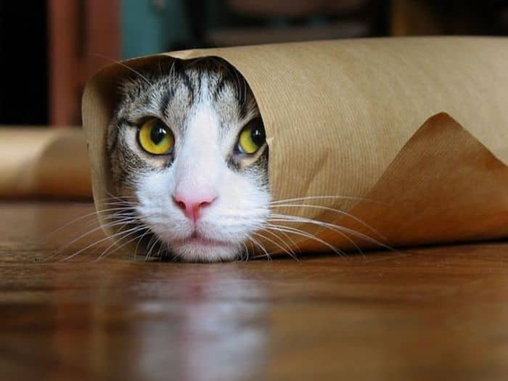

Slide 8
NO MATCH!! Nobody wants you.

