Slide 1
Video Games Sales Analysis
Final Project Database Systems
Momina Humayun (24L-7349)
FAST-NU Lahore

Slide 2
TABLE OF CONTENTS
01
02
03
Intro
Dashboard
SQL Queries
What is the data about?
Analysis of the dashboard through visual elements
What was found/extracted from the data?

Slide 3
01
Introduction to the Data

Slide 4
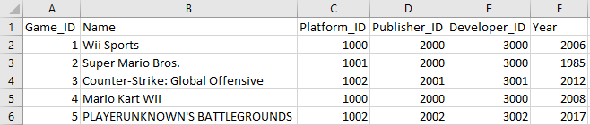
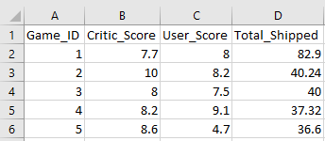
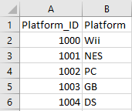
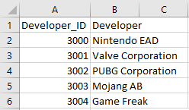
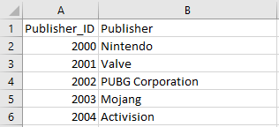
Tables
games.csv
scores.csv
platforms.csv
developers.csv
publishers.csv

Slide 5
Purpose of the Data
This data file contains over 13,000 games which includes games ranging from 1977 to the middle of 2020.
This data was created to try to answer the question "are video games getting worse?" There is a lot of talk about video games getting worse every year due to companies trying to maximize profits instead making quality game.

Slide 6
Working Process
01
02
03
04
Adding primary and foreign keys to tables and then importing to SSMS
Altering queries to make proper references and foreign keys in SSMS
Answering queries as outlines in the project proposal
Using those queries as separate tables and then importing them in Power BI to make a dashboard

Slide 7
02
SQL Queries w/ Visualization

Slide 8
Question 1
Display total units shipped, average critic score, and user score for the games, providing a snapshot of overall industry performance.
-- Task 1 (Sum of total units shipped, average critic score, average user score)
SELECT COUNT (DISTINCT(games.Name)) AS Number_Of_Games, SUM(scores.Total_Shipped) AS Total_Units_Shipped, AVG(scores.Critic_Score) AS Average_Critic_Score, AVG(scores.User_Score) AS Average_User_Score
FROM games
JOIN scores ON games.Game_ID = scores.Game_ID
WHERE scores.Critic_Score IS NOT NULL AND scores.User_Score IS NOT NULL

Slide 9
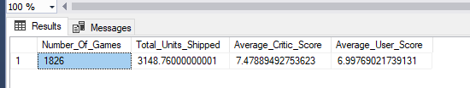
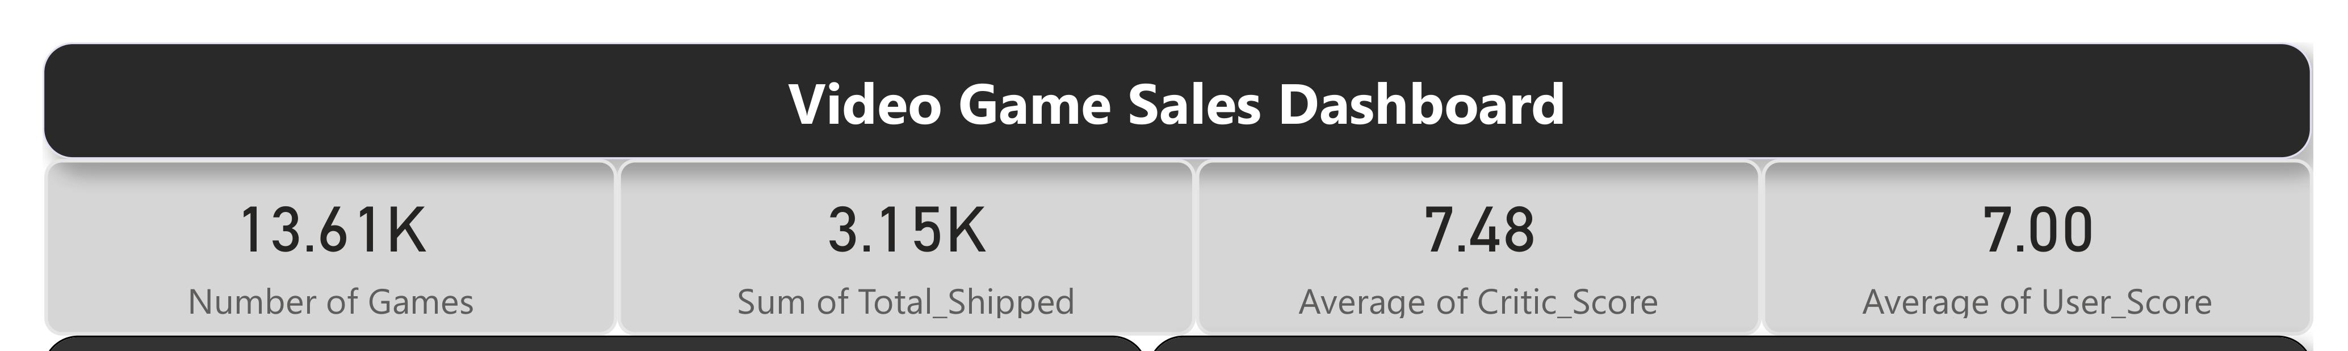

Slide 10
Question 2
Identify the top-selling games based on total shipped across different years and platforms, offering insights into the most commercially successful titles.
-- Task 2 (Identify the top-selling games based on total shipped across different years and platforms)
SELECT games.Year, platforms.Platform, games.Name AS Most_Shipped_Game, scores.Total_Shipped
FROM games
JOIN scores ON games.Game_ID = scores.Game_ID
JOIN platforms ON games.Platform_ID = platforms.Platform_ID
WHERE scores.Total_Shipped IN (SELECT MAX(s1.Total_Shipped) FROM games g1
JOIN scores s1 ON g1.Game_ID = s1.Game_ID
WHERE g1.Year = games.Year OR g1.Platform_ID = games.Platform_ID
GROUP BY g1.Year, g1.Platform_ID)
ORDER BY scores.Total_Shipped DESC

Slide 11
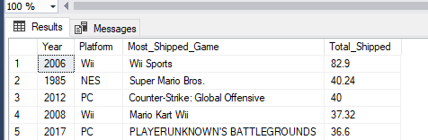
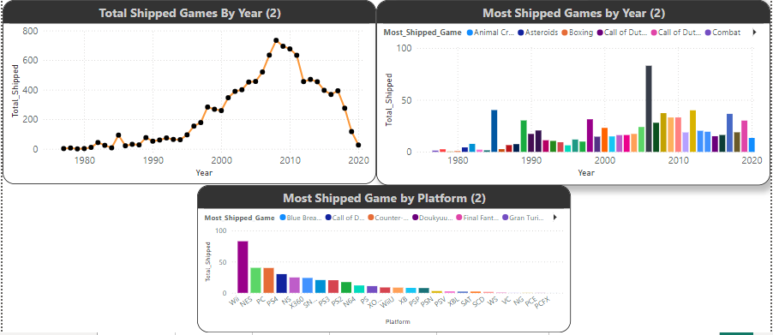
2,260 rows

Slide 12
Question 3
Compare average critic and user scores across various platforms (e.g., PC, NES, Wii), revealing which platforms host higher-rated games
-- Task 3 (Average critic and user scores across different platforms)
SELECT platforms.Platform,
ROUND(AVG(scores.Critic_Score), 2) AS Avg_Critic_Score,
ROUND(AVG(scores.User_Score), 2) AS Avg_User_Score
FROM games
JOIN scores ON games.Game_ID = scores.Game_ID
JOIN platforms ON games.Platform_ID = platforms.Platform_ID
WHERE scores.Critic_Score IS NOT NULL AND scores.User_Score IS NOT NULL
GROUP BY platforms.Platform
ORDER BY Avg_Critic_Score DESC

Slide 13
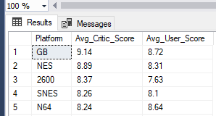
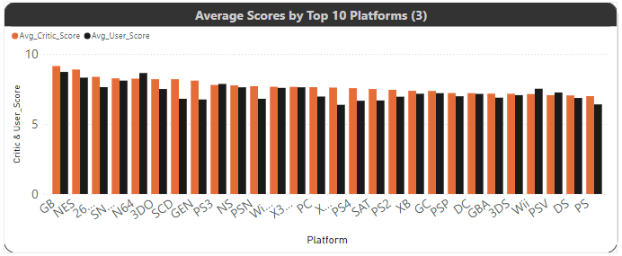
28 rows

Slide 14
Question 4
Examine the top publishers and developers based on the number of games released and their average scores, highlighting those with the highest-rated and most successful games.
SELECT developers.Developer, publishers.Publisher, COUNT(games.Game_ID) AS Games_Released, ROUND(AVG(ISNULL(scores.Critic_Score, 0)), 2)
AS Avg_Critic_Score, ROUND(AVG(ISNULL(scores.User_Score, 0)), 2) AS Avg_User_Score, ROUND(SUM(ISNULL(scores.Total_Shipped, 0)), 2) AS Total_Shipped
FROM games JOIN developers ON games.Developer_ID = developers.Developer_ID JOIN publishers ON games.Publisher_ID = publishers.Publisher_ID
JOIN scores ON scores.Game_ID = games.Game_ID
WHERE scores.Critic_Score IS NOT NULL AND scores.User_Score IS NOT NULL
GROUP BY developers.Developer, publishers.Publisher
ORDER BY Games_Released DESC

Slide 15
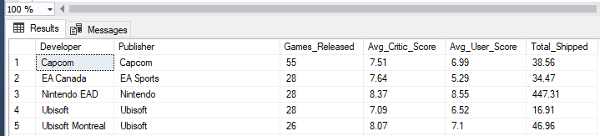
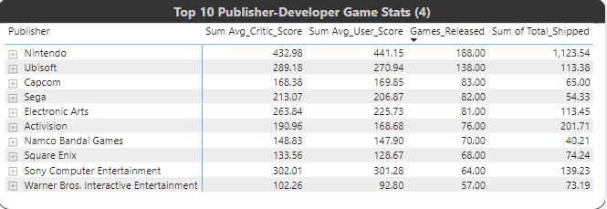
1,132 rows

Slide 16
Question 5
Analyse total units shipped and the number of games released per year to identify peak periods in the video game industry.
-- Task 5 (Analyse total units shipped and the number of games released per year to identify peak periods in the video game industry.)
SELECT SUM(scores.Total_Shipped) AS Total_Units_Shipped, COUNT(games.Game_ID) AS Games_Released, games.Year
FROM games JOIN scores ON scores.Game_ID = games.Game_ID
GROUP BY games.Year
ORDER BY games.Year DESC

Slide 17
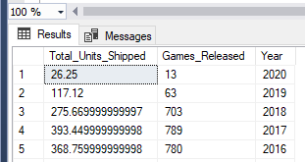
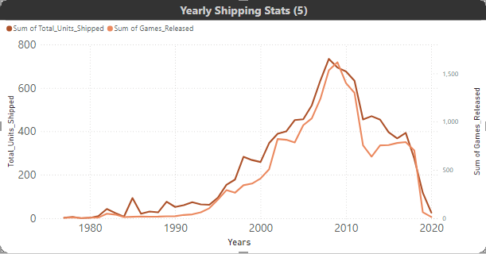
44 rows

Slide 18
Question 6
Visualize and compare critic scores with user scores for each game to spot trends and discrepancies in perception.
-- Task 6 (Compare Critic vs. User scores)
SELECT games.Name AS Game_Name, platforms.Platform, developers.Developer, scores.Critic_Score, scores.User_Score, (scores.Critic_Score - scores.User_Score) AS Score_Discrepancy
FROM games JOIN scores ON games.Game_ID = scores.Game_ID JOIN platforms ON games.Platform_ID = platforms.Platform_ID
JOIN developers ON developers.Developer_ID = games.Developer_ID
WHERE scores.Critic_Score IS NOT NULL AND scores.User_Score IS NOT NULL
ORDER BY Score_Discrepancy DESC, Game_Name

Slide 19
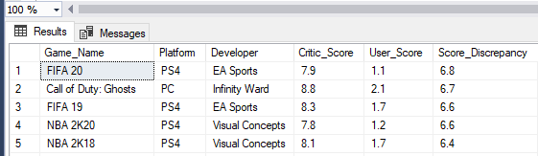
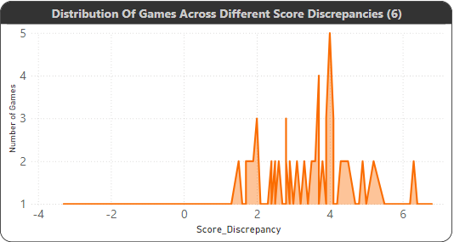
2,208 rows

Slide 20
Question 7
If applicable, group games into broad categories based on their titles or known genres and analyse sales distribution among these groups.
CREATE TABLE GameCategories (
Total_Sales FLOAT,
Category NVARCHAR(150)
)
-- Inserting data for 'Sports Games'
INSERT INTO GameCategories (Total_Sales, Category)
SELECT SUM(scores.Total_Shipped), 'Sports Games'
FROM games
JOIN scores ON games.Game_ID = scores.Game_ID
WHERE games.Name LIKE '%Sports%';

Slide 21
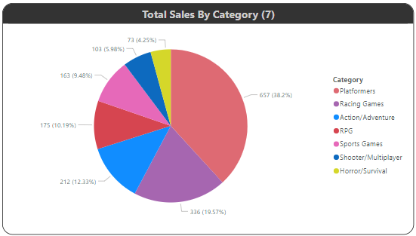
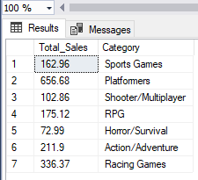

Slide 22
Question 8
Identify games with the highest and lowest scores, providing insights into what might have contributed to their critical and commercial success or failure.
SELECT TOP 5 games.Name, scores.Critic_Score, scores.User_Score, scores.Total_Shipped
FROM games INNER JOIN scores ON games.Game_ID = scores.Game_ID
WHERE scores.Critic_Score IS NOT NULL AND scores.User_Score IS NOT NULL
ORDER BY scores.Critic_Score DESC/ASC

Slide 23
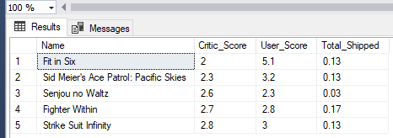
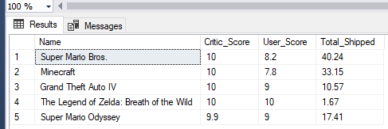
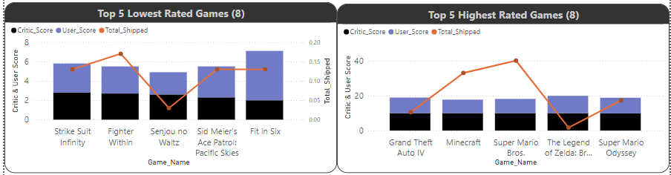

Slide 24
Question 9
Explore whether there is a relationship between high critic/user scores and higher sales, helping to understand the impact of quality on commercial success.
SELECT games.Name, scores.Critic_Score, scores.User_Score, scores.Total_Shipped
FROM games JOIN scores ON games.Game_ID = scores.Game_ID
WHERE (scores.Critic_Score >= 9.0 OR scores.User_Score >= 9.0)
AND scores.Critic_Score IS NOT NULL
AND scores.User_Score IS NOT NULL
ORDER BY scores.Total_Shipped DESC

Slide 25
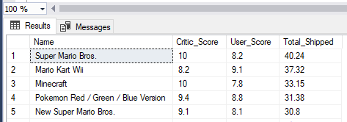
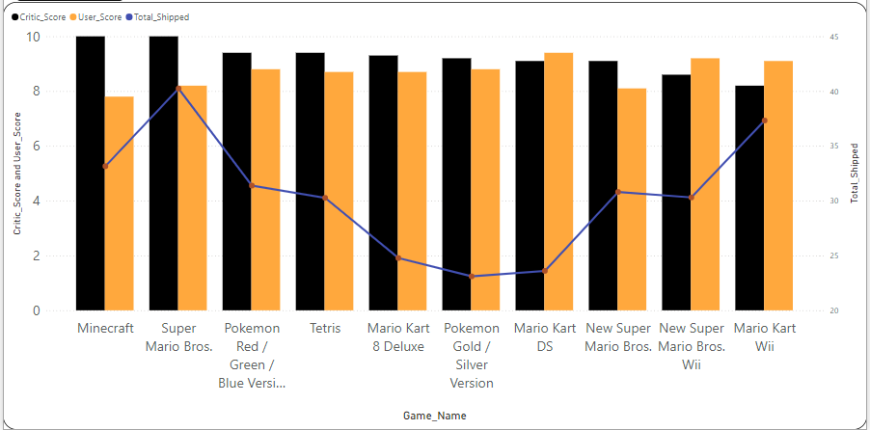
263 rows

Slide 26
Question 10
Track the performance of individual developers over time by examining their average critic and user scores for each year.
SELECT developers.Developer, games.Year, ROUND(AVG(scores.Critic_Score), 2) AS Avg_Critic_Score, ROUND(AVG(scores.User_Score), 2) AS Avg_User_Score
FROM games
JOIN scores ON games.Game_ID = scores.Game_ID
JOIN developers ON games.Developer_ID = developers.Developer_ID
WHERE scores.Critic_Score IS NOT NULL AND scores.User_Score IS NOT NULL
GROUP BY developers.Developer, games.Year
ORDER BY games.Year DESC

Slide 27
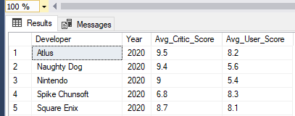
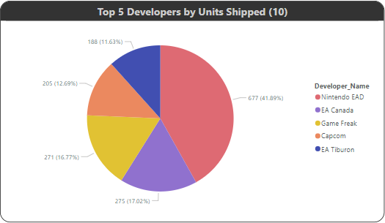
1,570 rows

Slide 28
Question 11
Highlight standout years for the gaming industry by reviewing the number of high-scoring games and total units shipped.
SELECT games.Year, COUNT(*) AS High_Scoring_Games, ROUND(SUM(scores.Total_Shipped), 2) AS Total_Units_Shipped
FROM games
JOIN scores ON games.Game_ID = scores.Game_ID
WHERE (scores.Critic_Score >= 8.0 OR scores.User_Score >= 8.0)
AND scores.Critic_Score IS NOT NULL
AND scores.User_Score IS NOT NULL
GROUP BY games.Year
ORDER BY High_Scoring_Games DESC, Total_Units_Shipped DESC

Slide 29
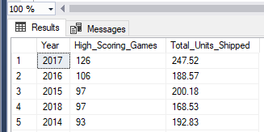
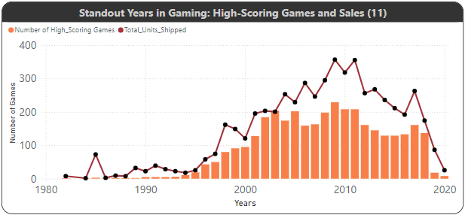
38 rows

Slide 30
Question 12
Analyse how the popularity of different platforms has evolved by looking at the number of games released and their respective sales over the years.
SELECT platforms.Platform, games.Year, COUNT(games.Game_ID) AS Games_Released, ROUND(SUM(scores.Total_Shipped), 2) AS Total_Units_Shipped
FROM games JOIN scores ON games.Game_ID = scores.Game_ID JOIN platforms ON games.Platform_ID = platforms.Platform_ID
GROUP BY platforms.Platform, games.Year
ORDER BY Games_Released DESC

Slide 31
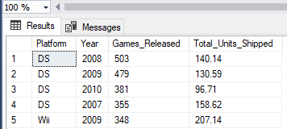
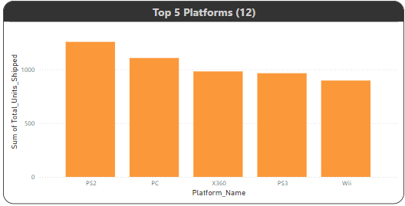
294 rows

Slide 32
Question 13
Segment the data by decade to see which platforms were leaders in their respective time periods.
SELECT (games.Year/10) * 10 AS Decade, games.Name AS Leading_Game, platforms.Platform AS Leading_Platform, publishers.Publisher AS Leading_Publisher, ROUND(scores.Total_Shipped, 2) AS Units_Shipped
FROM games JOIN scores ON games.Game_ID = scores.Game_ID JOIN platforms ON games.Platform_ID = platforms.Platform_ID
JOIN publishers ON games.Publisher_ID = publishers.Publisher_ID
WHERE scores.Total_Shipped = (SELECT MAX(s1.Total_Shipped) FROM games g1 JOIN scores s1 ON g1.Game_Id = s1.Game_ID
WHERE (g1.Year/10) * 10 = (games.Year / 10) * 10)
ORDER BY Decade

Slide 33
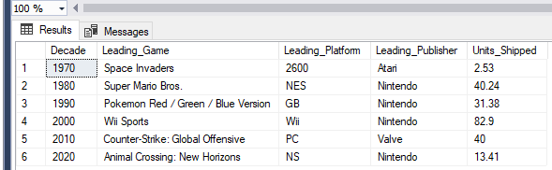
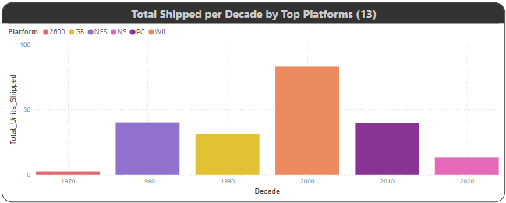

Slide 34
Question 14
Focus on games with high user scores to understand which titles resonate most with players, offering potential insights into customer preferences.
SELECT TOP 10 games.Name AS Game_Name, platforms.Platform AS Platform, ROUND(scores.User_Score, 2) AS User_Score, ROUND(scores.Total_Shipped, 2) AS Units_Shipped
FROM games JOIN scores ON games.Game_ID = scores.Game_ID JOIN platforms ON platforms.platform_ID = games.Platform_ID
WHERE scores.User_Score IS NOT NULL
ORDER BY scores.User_Score DESC

Slide 35
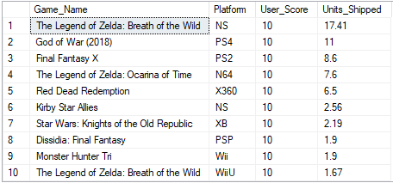
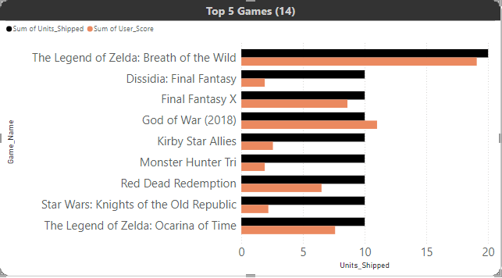

Slide 36
Question 15
What is the correlation between user_score and critic score with total shipped?
SELECT
games.Name AS Game_Name,
platforms.Platform AS Platform,
ROUND(scores.Critic_Score, 2) AS Critic_Score,
ROUND(scores.User_Score, 2) AS User_Score,
ROUND(scores.Total_Shipped, 2) AS Units_Shipped
FROM games
JOIN scores ON games.Game_ID = scores.Game_ID
JOIN platforms ON games.Platform_ID = platforms.Platform_ID
WHERE scores.Critic_Score IS NOT NULL AND scores.User_Score IS NOT NULL
ORDER BY scores.Total_Shipped DESC

Slide 37
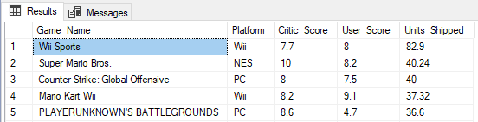
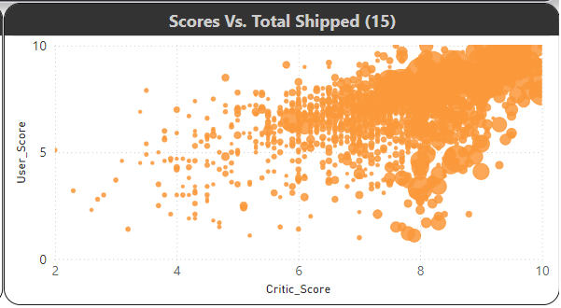

Slide 38
Conclusion
This project provided a comprehensive analysis of video game data using SQL, allowing for meaningful insights into trends, performance, and patterns in the gaming industry.
By leveraging SQL's capabilities, we were able to extract, manipulate, and analyze data effectively, shedding light on critical aspects such as sales performance (total shipped), category popularity, platform trends, and developer analysis.

Slide 39
THANKS

Slide 40
ALTERNATIVE RESOURCES
Here’s an assortment of alternative resources whose style fits that of this template:
VECTORS:
Pixel art dia de muertos elements collection

