Slide 1
Lorenzo Tibaldi Arezou Ranjbarpour Maralani Momina Sajid
Question-based Data Analysis with Spark

Slide 2
Starting point
Our objective was to perform some data analysis on a dataset using spark.
We decided to do such analysis by implementing different questions that could then be translated in map-reduce tasks.
We then tested questions of varying complexities timing the executions on both a local machine and on the cluster provided.
We only used the pyspark library, for personal preference we decided to implement the tasks on RDDs and not on DataFrames, we also avoided using SQL commands.Testing on a local machine was done on a jupyter notebook.

Slide 3
The dataset
We took a dataset from Kaggle that caught our attention.
Summer-Olympics-Medals-1976-to-2008
It consisted of a single csv file composed of 11 columns and around 15 thousands entries.
Each entry specifies a won medal during the 9 summer olympics held between 1976 and 2008.

Slide 4
First doubts
Since the size of our dataset is around 2 megabytes, it could've been possible that we would reach to an unsatisfying conclusion:
Our dataset is too small and as such the spark overhead in the distributed cluster could slow down the execution so much that it would take as much time or maybe even more time than the execution on the local machine.
It turns out that the dataset might be small but the questions we asked were just complex enought to actually observe a speed up during the distributed execution.

Slide 5
The questions
#Q1: How many gold medals did each country win?
#Q2: How many gold,silver and bronze medals did each country win?
#Q3: What disciplines are mixed (both male and female compete against each other)?
#Q4: In mixed sports, are the gold medals winners composed of more male or female athletes?
#Q5: Which disciplines are only for man or only for women?
#Q6: Top 3 countries which gained most and least medals in team sports?
#Q7: Which countries didn't gain any medals from team sports?
#Q8: Top 3 countries that had the greatest increase and decrease of medals in 2 consecutive olympics?
#Q9: Which country won more medals for each discipline?
#Q10: Which country won the most gold medals the year it hosted the olympics?
#Q11: Which athletes won at a medal in more than 3 different olympics?

Slide 6
The questions
#Q12: How long is the career of atlethes that performed well even after 15 years?
#Q13: Which countries won both gold medals in the same olympic in an event that was held for men and women?
#Q14: What is the average number of medals that each country won?
#Q15: Which athletes won the most medals for each sport?
#Q16: Women of which country had better performance than men in mixed sports?
#Q17: Which are the Top 3 countries that have the least difference between percentages of female and male winners?
#Q18: Which country has the most gold medals won by female athletes, which one for males?
#Q19: Which countries have female athletes that didn't win any gold medals?
#Q20: Which are the top 5 countries that won the most medals in Taekwondo for Men?
#Q21: Which year did Canada win the most medals?
#Q22: In which discipline does the United States have more medals?

Slide 7
General overview
The questions range from being able to be answered with a single map reduce to requiring multiple joins and aggregations.
During our performance evaluation we observed (as expected) that the time for the execution would increase the most when a join needed to be executed (because of the size of the RDDs involved) and when a question required many shuffles.
The local machine was composed of:
Operating System: Windows 10
Processor: Intel(R) Core(TM) i5-8250U CPU @ 1.60GHz
RAM: 8 GB

Slide 8
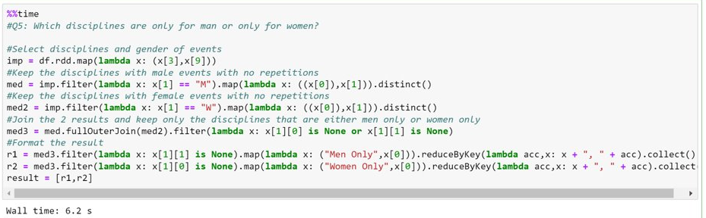
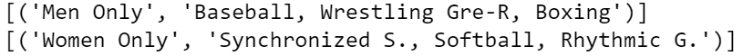
Interesting Questions
To answer this question we needed to create a list of all the men sports and another of all the women sports, after that we performed a full outer join, so that we could take advantage of the default None that gets returned when an entry isn't in both lists, we then separated the 2 types of result and applyed a reduce that is a bit different, it's concatenating strings.

Slide 9
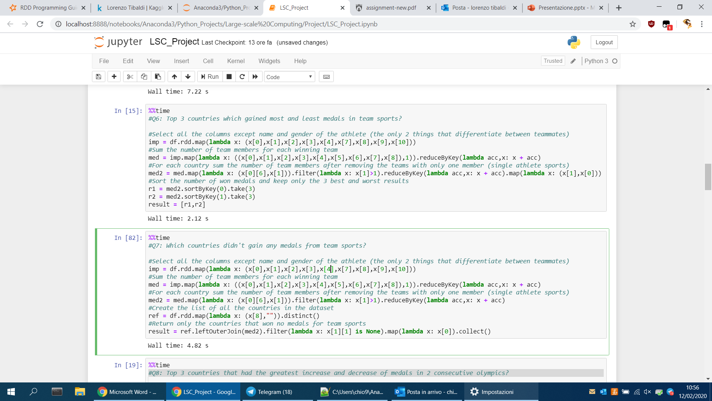
Interesting Questions
When we want to find out which sports are team sport we need to find the entries where every column is the same except for name and gender of the athlete, in the second question we also needed a list of all the countries, so we could use the same trick with join as before.

Slide 10
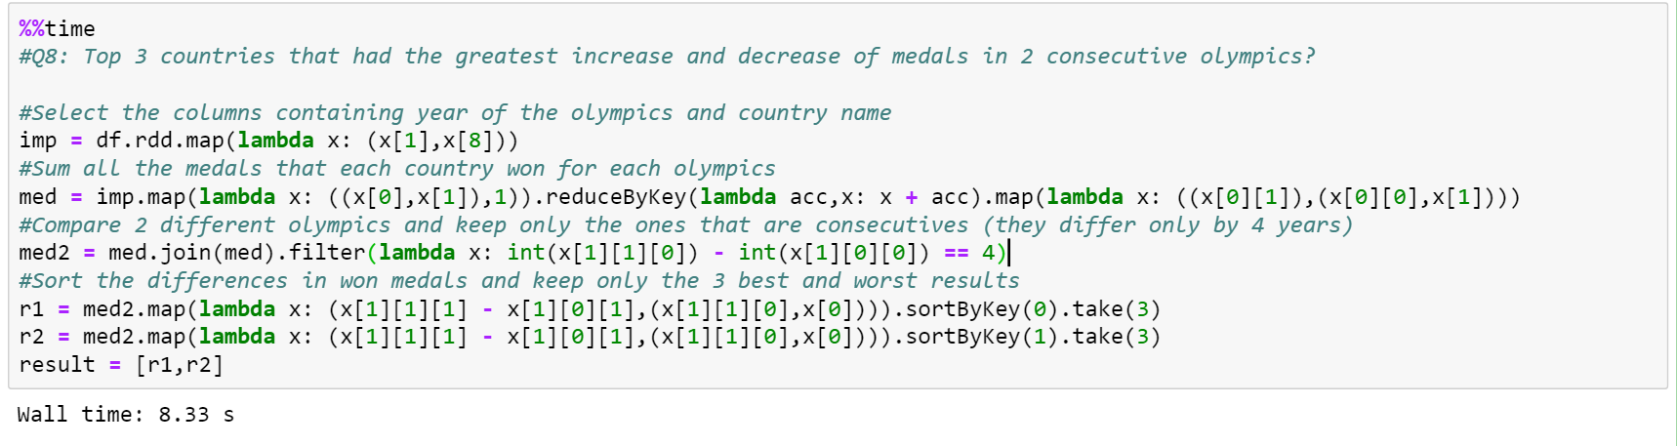
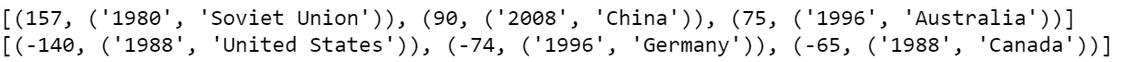
Interesting Questions
Here we join an RDD with itself and then check if the difference between the second year and the first is 4, since the olympics are held every 4 years, this filter is returning only consecutive olympics.
To note how the United States had the biggest drop in medals won recorded between 1976 and 2008 even if that year they still won a lot of medals, it's just that the Los Angeles 1984 was the best olympics for the United States.

Slide 11
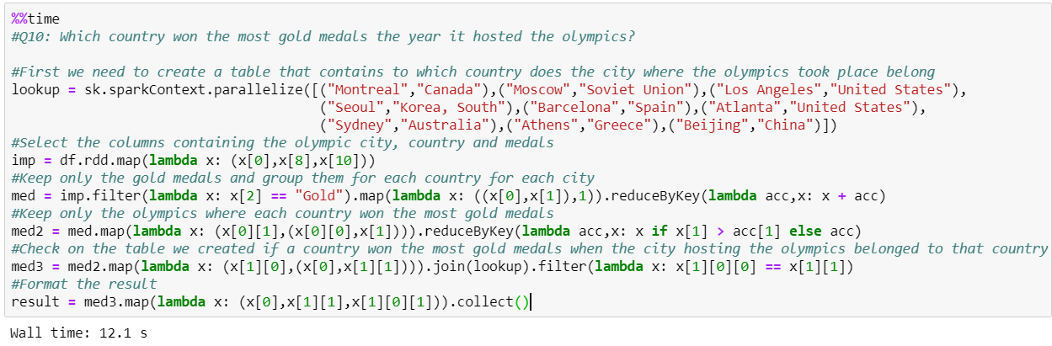
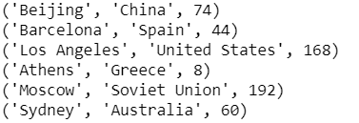
Interesting Questions
To answer this question we needed additional external information, in which country is the city hosting the olympics?
We added this information once as a list and then transformed it in an RDD using Spark's built-in function parallelize.

Slide 12
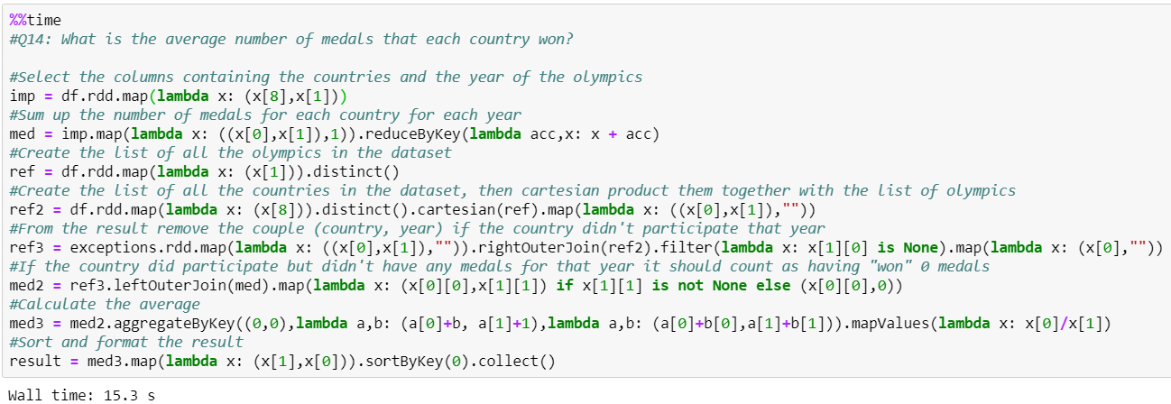
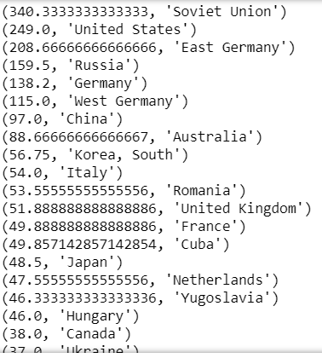
Interesting Questions
Here we also had to insert some external data, we checked on Wikipedia which years each country didn't participate to an olympic and created a csv with 2 columns, Country and Year, we called it exceptions and then used it to answer the question, once again we used the trick with outer joins (twice here) and then we used the aggregation to calculate the average.
We also found a use for the function cartesian() that was used to create combinations (Country,Year) that never appeared in the dataset, if they then don't appear in the exception table it means that they did participate but won 0 medals, without this distinction the averages would favor heavily countries that win many medals all in one year.

Slide 13
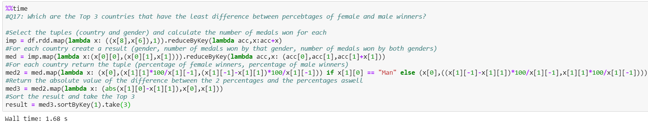
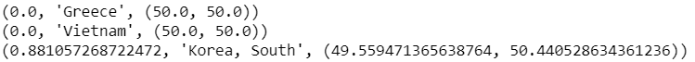
Interesting Questions
The interesting questions were usually the ones that would also take the longest computational time, this one however is very fast, what it's interesting about it is a showcase of a behaviour of the ReduceByKey() function.
We took advantage of one possibility that reduceByKey offers, taking an input of a certain length and returning an output of a different length, usually smaller so there are no problems.
However in that lambda function we return alongside the number of medals for one gender the number of medals for both genders, leaving the calculations for the other gender in a later map.
Possibly due to either a Spark, Jupyter Notebook or even Python bug, we are unable to access that item with x[2] even if it is in the third position of the tuple x, we are sure that the reduce created it however because we can access it with x[-1] since it is the last item of the tuple x.

Slide 14
Local vs HDFS
We adapted the Jupyter Notebook file into code.py that would be able to run on the cluster.
Starting on the local machine, excluding the loading of Spark and printing all the results the code that would answer all 22 questions took around 88-90 seconds.
On the cluster, after having loaded the two csv, an execution that also prints all the results took around
82-85 seconds.
We then tried removing all the prints from both executions, but the speed up was less than a tenth of a second.
Lastly we revised the code to check if we could use the RDD persist() function, most of our questions utilize between 1 and 3 actions, and between each question there is enough difference that we didn't find many places where persist() could be used inbetween two questions.
We were able to use one between the first and second question, by answering the second one first and then applying a filter to the RDD that we asked to persist.
The local execution decreased by about 1 second and so did the execution on the cluster.
In the end a speed up of about 5-6 seconds out of 90 is a performance increase of around 6%.
In comparison 6 seconds are about 5 easy questions, but the speedup is still limited because of the size of the dataset.

Slide 15
Couple of Last Words
The project consisted in a bit of preprocessing on the dataset, creation of supplementary datapoints, creation of different questions in type and complexity to have an interesting analysis of the dataset, implementation of the questions in the Apache Spark map-reduce framework, testing of the performance both in a local machine and in the cluster provided.
Each step took between 5 and 15 hours, in total around 40-50 hours of work distributed in 10 days.

