Slide 1
Sales Data Analysis Report
Prepared by: Momina Saqlain
Internship Task - Brainwave Matrix Solutions

Slide 2
Introduction
This project analyzes sales data from a commercial store.
Objectives:
- Identify monthly sales trends
- Find top-performing products
- Analyze profitability
- Provide business recommendations

Slide 3
Dataset Overview
Dataset contains 500 rows and 10 columns.
Key Fields:
- Date: Order date
- Product: Item sold
- Sales: Revenue generated
- Quantity: Units sold
- Profit: Earnings after cost

Slide 4
Data Preparation
Steps taken:
- Removed duplicate orders
- Handled missing values
- Converted dates to proper format
- Ensured numeric columns for Sales & Profit

Slide 5
Summary Statistics
Total Sales: 198,956.07
Average Sales: 397.91
Highest Sale: 2,799.96
Lowest Sale: 5.99
This shows the store’s overall performance.

Slide 6
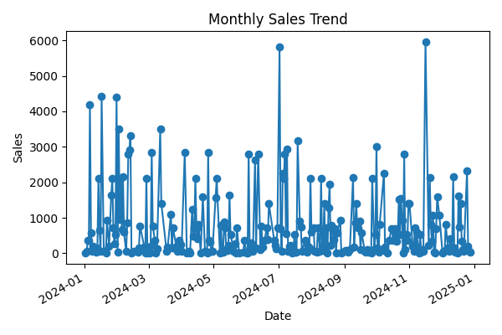
Monthly Sales Trend

Slide 7
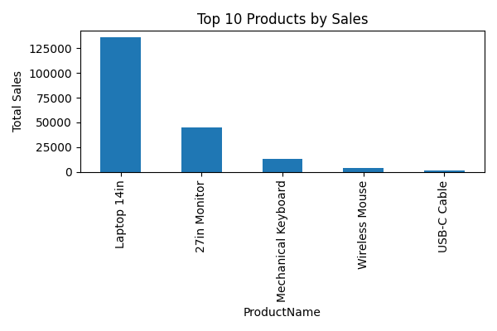
Top 10 Products

Slide 8
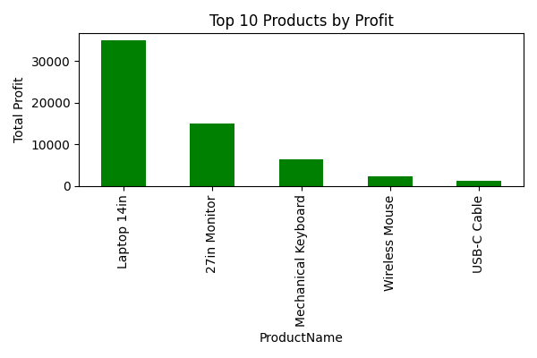
Top 10 Profitable Products

Slide 9
Recommendations
- Run promotions in low-sales months
- Increase stock for top 5 products
- Focus marketing on profitable items
- Consider customer loyalty programs

Slide 10
Thank You!
Questions & Discussion

