Slide 1
Attendance Monitoring System
Face Recognition using CNN

Slide 2
Our Team
GUIDE:
Shugufta Fatima
(Assistant Professor)
Department Of Computer Science and Engineering
Chennu Vaishnavi Priya
(160618733137)
Masrath Jahan
(160618733154)
Sri Momitha Chiluveru
(160618733167)

Slide 3
Introduction
Face Recognition is a biometric method of identifying an individual by comparing live capture or digital image data with the stored record for that person. Image recognition is playing an important role in modern living like driver assistance systems, medical imaging system, quality control system to name a few.
A Convolutional Neural Network along with image recognition used to enhance the reliability of the system.
The implementation basically consists of three components:
1) Face scanning and detection using HAAR cascade method
2) Training the CNN-ANN model
3) Recognize the face back and update the attendance.

Slide 4
Introduction cont…
Face recognition is a computer application for automatically identifying or verifying a person from a digital image or a video frame from a video source.
One of the ways to do this is by comparing selected facial features from the image and a facial database.
Face recognition is marking of attendance based on this technology.
The application of facial recognition involves in various individual fields as
Education field-student or teacher
Business field-client or workers
Medicine field
To mark the attendance.

Slide 5
Scope
Problem Statement
Manually taking attendance and registering it in files & musters makes the daily attendance a mundane task for the faculty and unnecessarily consumes classroom time.
Solution
The objective of the attendance software is to reduce the time that is consumed when attendance is taken manually. Unlike the manual process, an online system easily helps management to analyse student’s attendance details as per requirement

Slide 6
Existing System
The attendance systems are manual.
There's a chance of one person signing the presence of other. So there is great risk of error.
Difficult to maintain a database or register in manual systems.
More manpower is required
This method could easily allow for impersonation.
The attendance sheet could be lost or stolen.

Slide 7
Proposed System
An end-to-end face identification and attendance approach using Convolutional Neural Networks (CNN), which processes the video of the student and mark the attendance of the student in the excel sheet.
Open Computer vision is used for image processing technique and the model is pretrained using CNN.
One of the main advantages of the proposed solution is its robustness against usual challenges like occlusion (partially visible/covered faces), orientation, alignment and luminescence of the surrounding environment.

Slide 8
Requirements
Hardware Requirements
Processor : Intel(R) Core(TM) i5 CPU
RAM : 4.00 GB
System Type: 64bit operating sytem, x64- based processor
Software Requirements
Text Editor : Google Collaboratory
Operating System : 64 bit
Programming Language : Python
Back-end : Javascript

Slide 9
Motivation
The main motivation for us to go for this project is the unsatisfactory scenario of traditional manual attendance system. These made us think why not make a automated, efficient and fast approach which can even meet covid-19 protocols.
Also such face detection techniques are in use by department like crime investigation where they use CCTV footages and detect the faces from the crime scene and compare those with criminal database to recognize them. Hence this method is quite advantageous and can be implemented in various fields.

Slide 10
Literature Survey
Face Detection Method based on Cascaded convolutional networks by RONG QI1, RUI-SHENG JIA 1,2, QI-CHAO MAO1, HONG-MEI SUN 1,2, AND LING-QUN ZUO1 in 2019
Deep Unified Model For Face Recognition Based on Convolution Neural Network and Edge Computing by MUHAMMAD ZEESHAN KHAN1, SAAD HAROUS 2, SALEET UL HASSAN1, MUHAMMAD USMAN GHANI KHAN1, RAZI IQBAL 3, (Senior Member, IEEE), AND SHAHID MUMTAZ in 2019
Hao yang and xiaofeng han in 2020 have developed a model which catches the live images from camera. Then it applies different algorithms for face recognition and face detection

Slide 11

Architecture
CNN Architecture

Slide 12
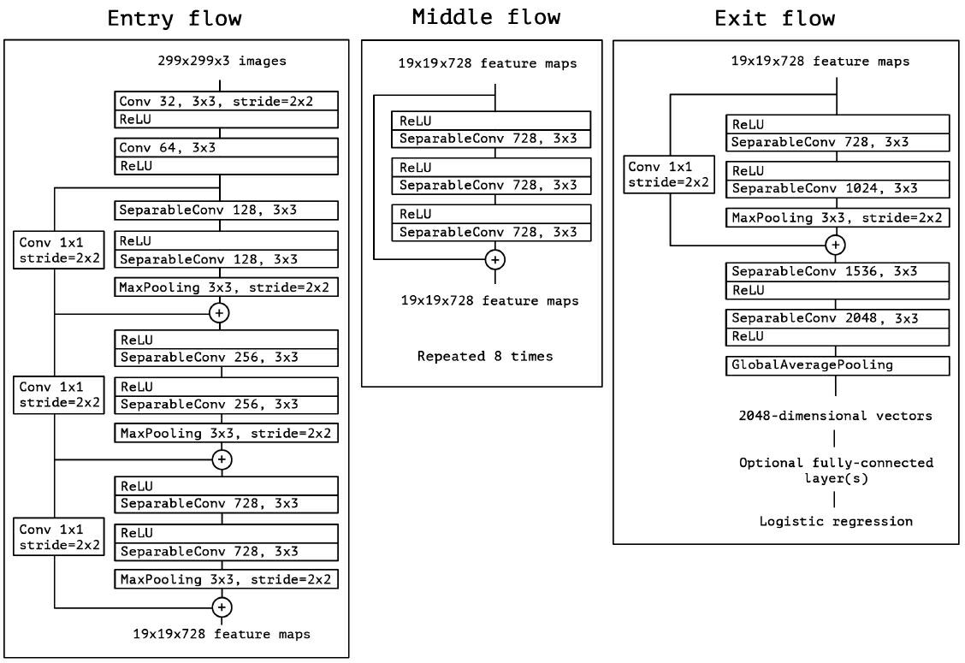
Cont...

Slide 13
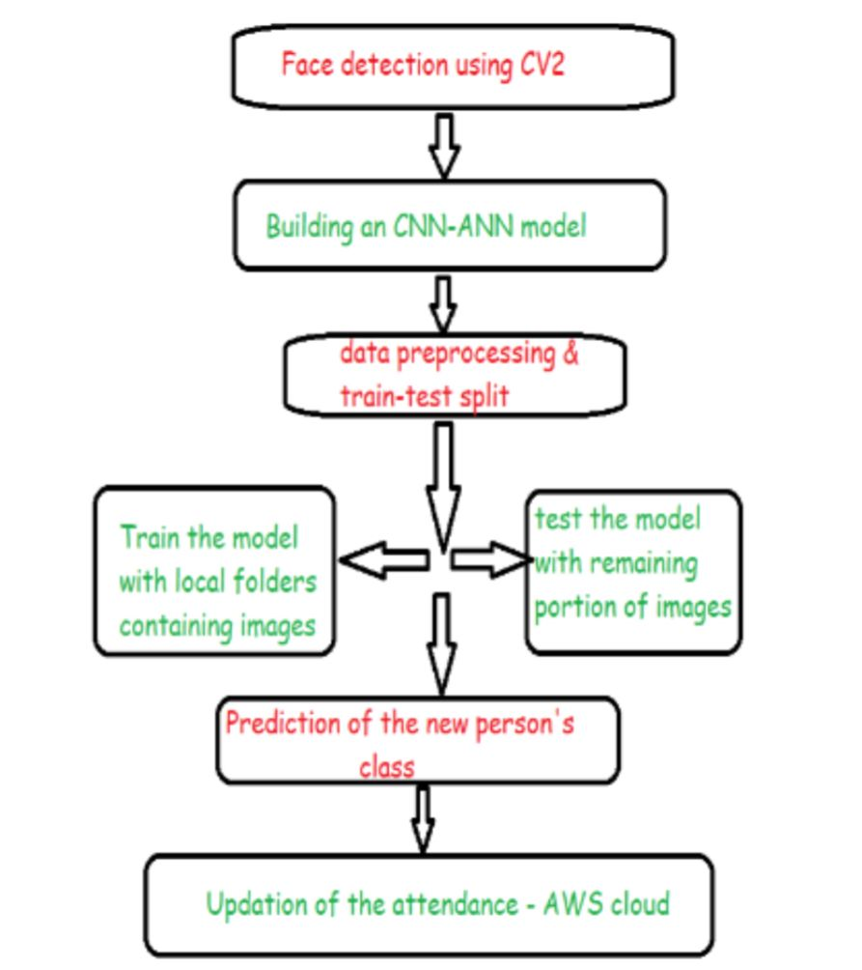
Implementation Steps
Block diagram

Slide 14
Cont…
For implementing the attendance monitoring system using face recognition system, we have to follow the following steps in the same order. Those steps are as follows:
1. Enrollment of students (face detection)
2. Data pre-processing and building the model.
3. Train the CNN-ANN model, apply Test image
4. Face recognition
5. Face Encoding ( displaying the label of the face)
6. Store attendance in database

Slide 15
Cont…
Data Collection is divided into 3 main steps:
Data Generation: Collects the images, modifies them and iterate the process until it reaches desired count of data.
Data Augmentation: Used to generate new samples by manipulating the existing data.
Train and Test the model: Training to boost up the processing and the train data is augmented automatically.

Slide 16
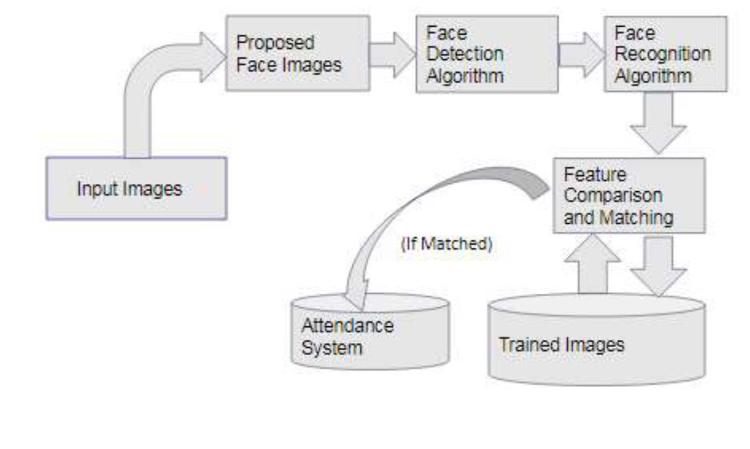
Cont…
Proposed Model Steps

Slide 17
Advantages Disadvantages
For saving the time in the classroom and accuracy in attendance will be maintained
Second is availability of advanced technology
It is more useful for the future generation
Creates a CSV file everyday, so this can take more storage however we can integrate all the files into one at the end of a month or so using MS excel tools

Slide 18
Outcome
To get registered we can either use the live web camera for taking the pictures or upload the pictures from the laptop as well.
Once a student is registered, he/she must click a picture with the web camera while taking the attendance to check the accuracy and for face prediction.
Once the person is predicted, he/she can give his attendance using live video capture.
Finally, a CSV file is created with the present date as the file name consisting of roll number, student’s name, date and time as columns.
We can directly download that CSV file as an excel sheet.

Slide 19
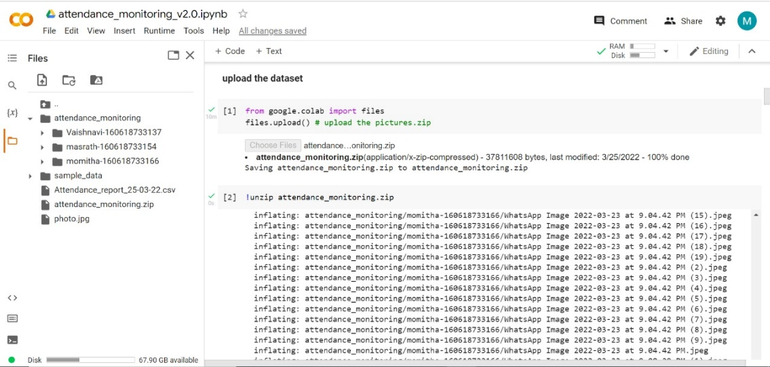
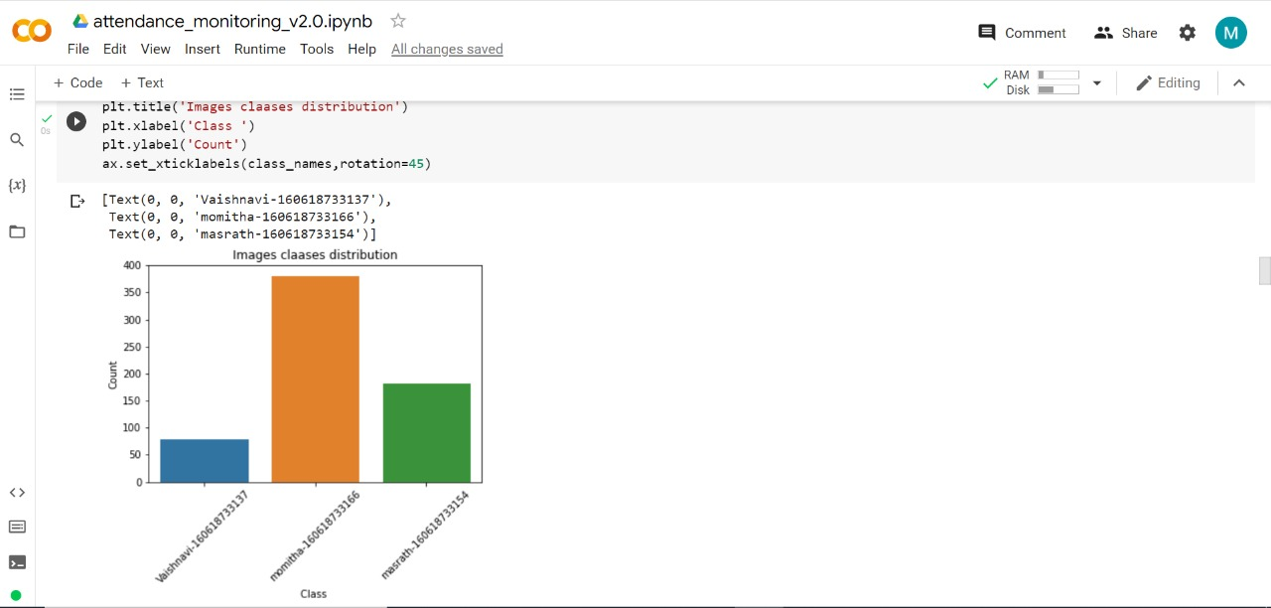
Output Screens

Slide 20
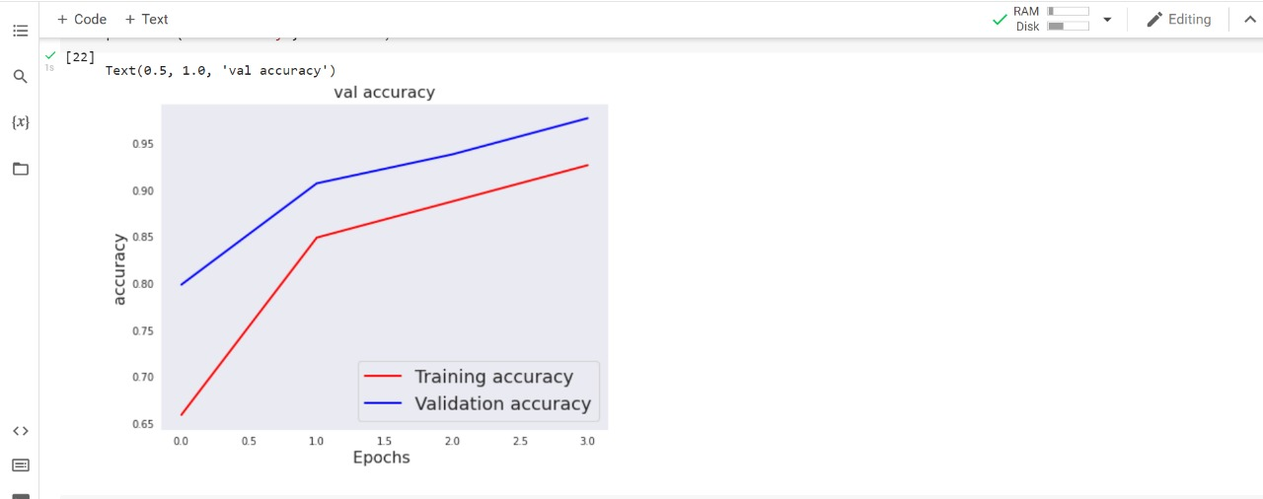
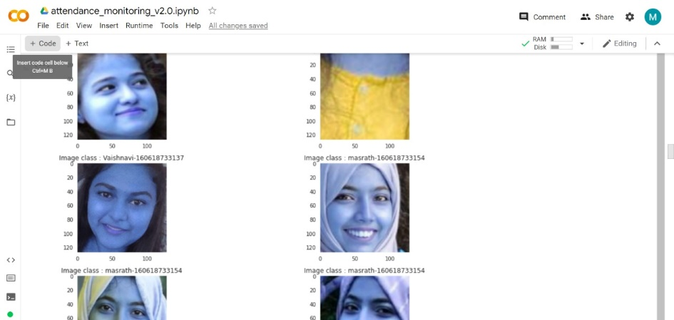
Output Screens

Slide 21
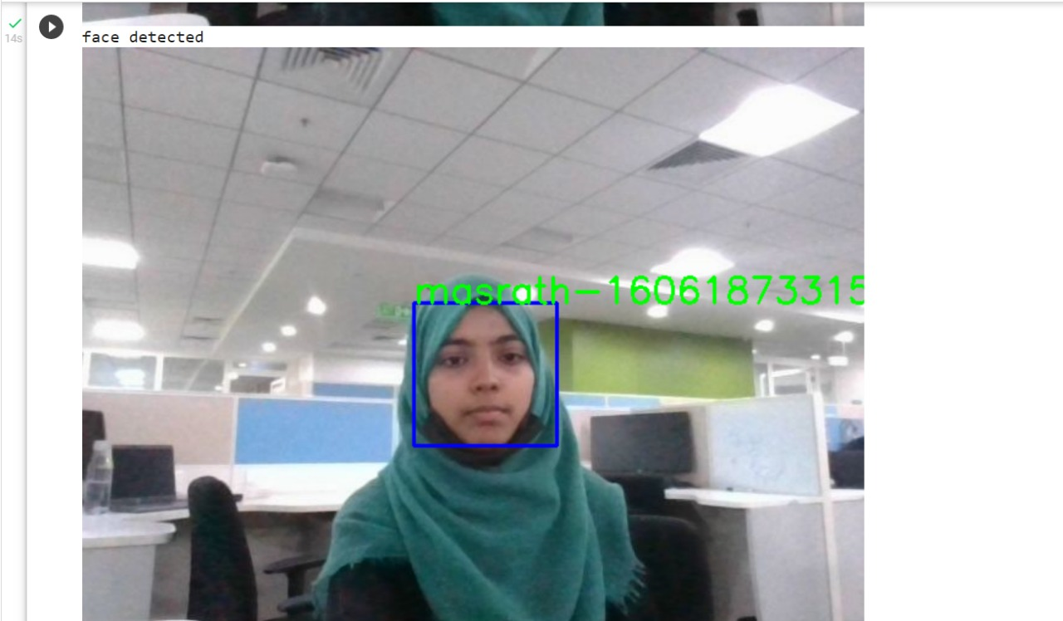
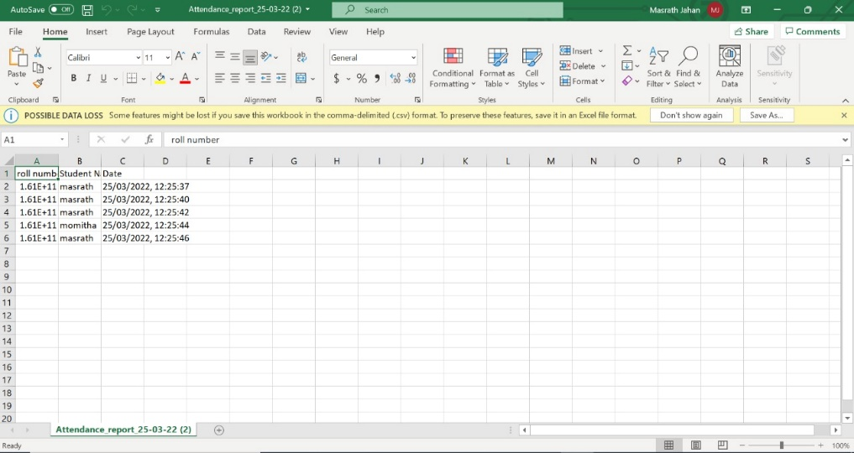
Output Screens

Slide 22
Thank You

