Slide 1
MINI PROJECT ON TRANSMOGRIFY GUIDE
BY :
C VAISHNAVI PRIYA 160618733137
MASRATH JAHAN 160618733154
SRI MOMITHA C 160618733166

Slide 2
INTRODUCTION
Now a days everybody is concerned about health and diet hence Transmogrify Guide is the best online option to prefer.
Customers can check their updates online anytime about weight loss programs or diet plans etc.
This is the best platform for customers and service providers to interact.

Slide 3
Domain description
The most pivotal role in site development is user experience. A site should be user-friendly.
Advantages of AI in Web Development:
It has granted with relevant user experience & interaction.
It has enabled productive digital marketing activities to target customers.

Slide 4
EXISTING SYSTEM
Chances of losing users’ data.
Time consuming system.
No proper system to make an announcement.
Message update is not there.
Inefficient and slow search.
Includes much manual process.
It is not user friendly.

Slide 5
PROPOSED SYSTEM
Build a simple and interactive real time chat system.
Dedicated system which is able to solve all the queries regarding diet.
Suggests the need to meet a doctor if necessary.
Suitable diet suggestion based calorie intake prediction.
Less manpower.
Saves accurate multiple details of multiple customers in database.

Slide 6
SYSTEM specifications
SOFTWARE REQUIREMENTS:
Operating system: Windows 7/8/8.1/10
Front-End: HTML, CSS, JavaScript/Jquery.
BootStrap.
Text editor: Atom.
HARDWARE REQUIREMENTS:
Processor: Intel i3 or more.
RAM: 8GB
Motherboard: Intel Chipset Motherboard.
Hard Disk: 16GB Hard Disk recommended.

Slide 7
SCOPE
With advanced AI platforms, there is still room for improvement.
Chatbot designers have to craft the logical steps to follow so to achieve the goal set for the bot without falling into dead-ends.
The logic behind the chatbot system depends a lot on the domain, its expected users.

Slide 8
OBJECTIVE
To support and scale business teams in their relations with customers.
75% of internet users are adopting one or more messenger platforms.
bots that work 24/7 for its owner without having a break.
And with new advancements like AI, NLP and Machine Learning which makes the bot more intelligent to a point where it does not need to be told by an employee what to do.

Slide 9
Project goal
To replace manual or paper work with convenient online chatting and to provide a supportive webpage for better understanding.
Provides a platform with interactive user interface for both customer and admin.
Saves times of the service provider as well as the customer.
Provides online plans in an efficient manner.
Less/ No investment.
User friendly.
Users’ data is safely stored in the database with an encrypted password making it secure to use.

Slide 10
architecture
Registration form.
Login page.
Webpage.
Diet recipes.
Types of weight loss packages.
Chatbot.
What is diet and it’s uses?
Calorie calculation/Diet Suggestions.
Weight loss programs.
Types of diets.
Comment section.
Logout.

Slide 11
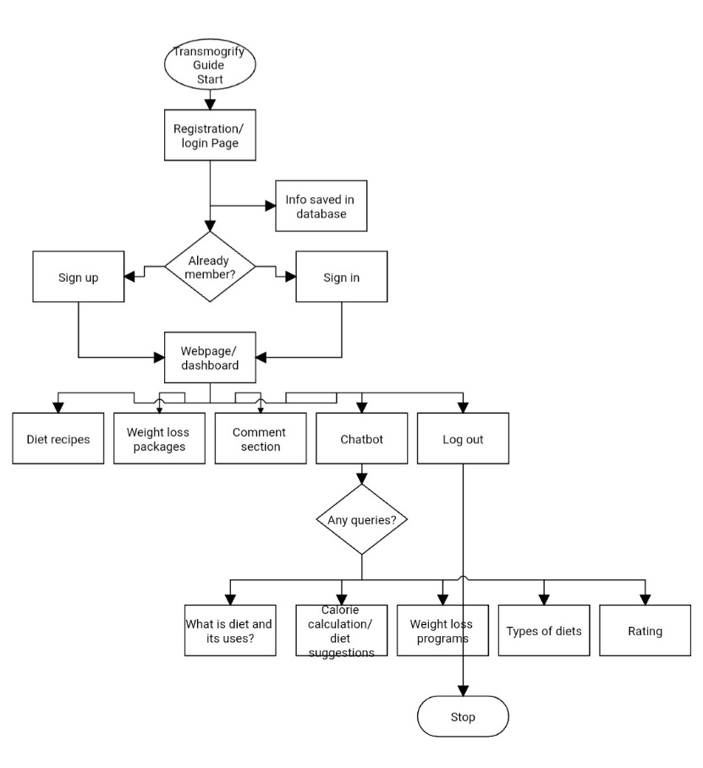
FLOWCHART:

Slide 12
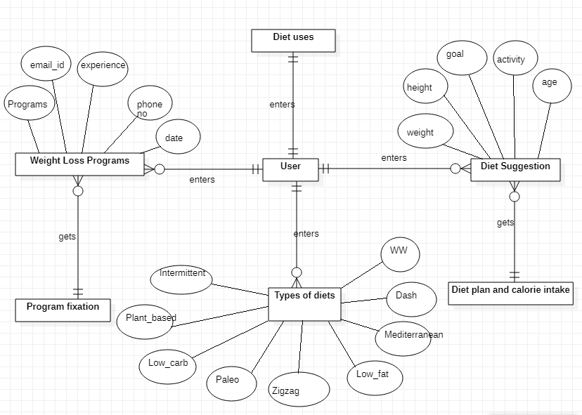
E-R DIAGRAM

Slide 13
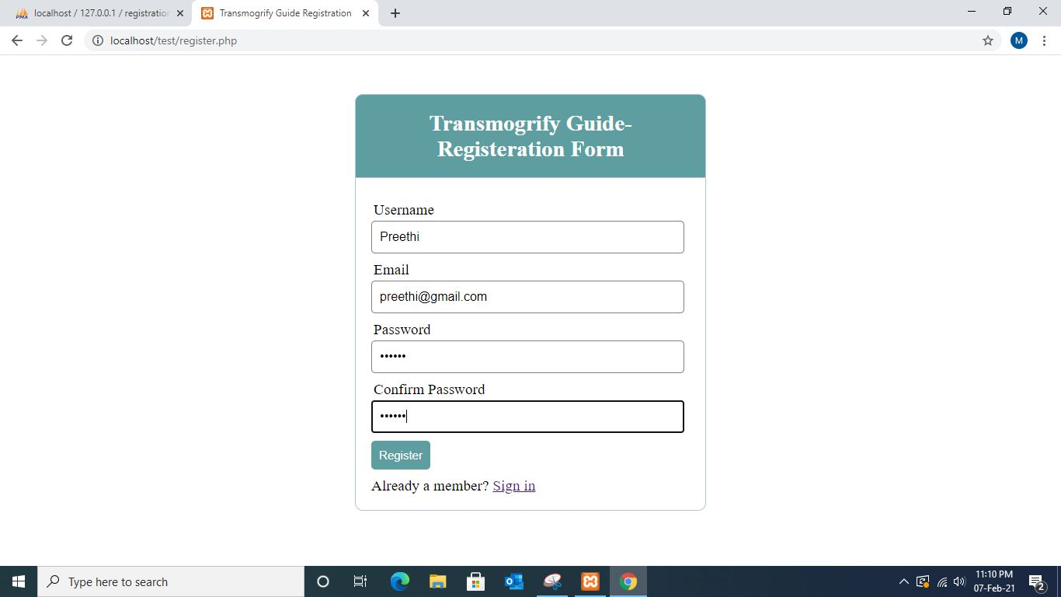
OUTPUT SCREENS:
PAGE NAME: User Login Page.
PROCESS: Inserting data.

Slide 14
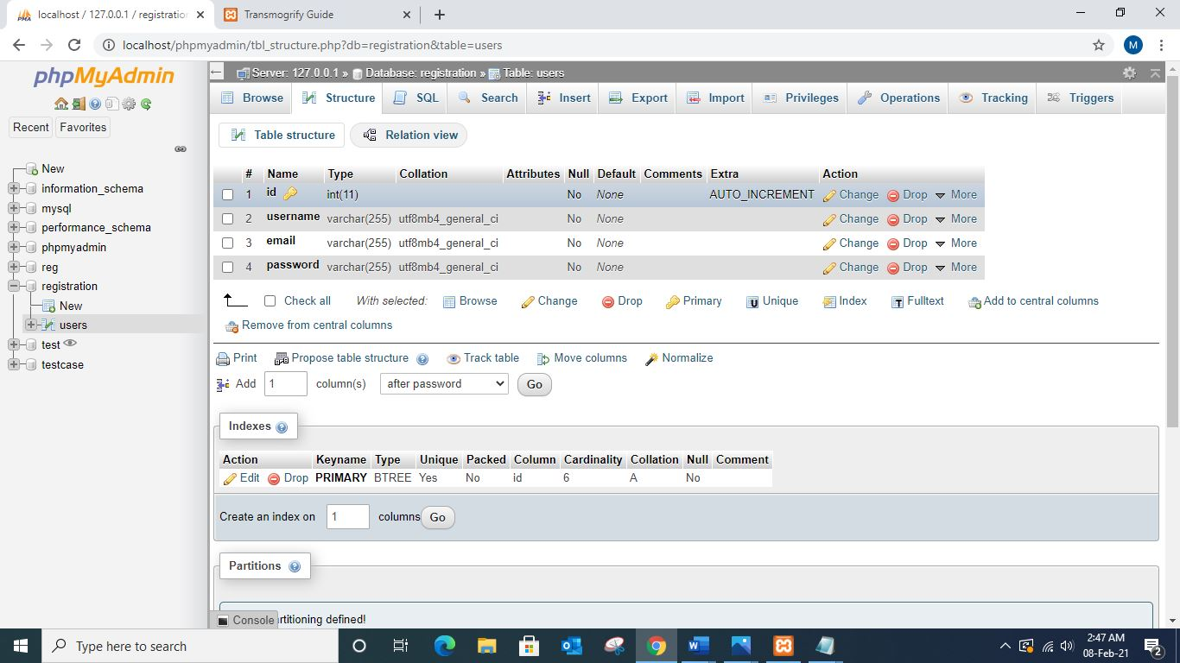
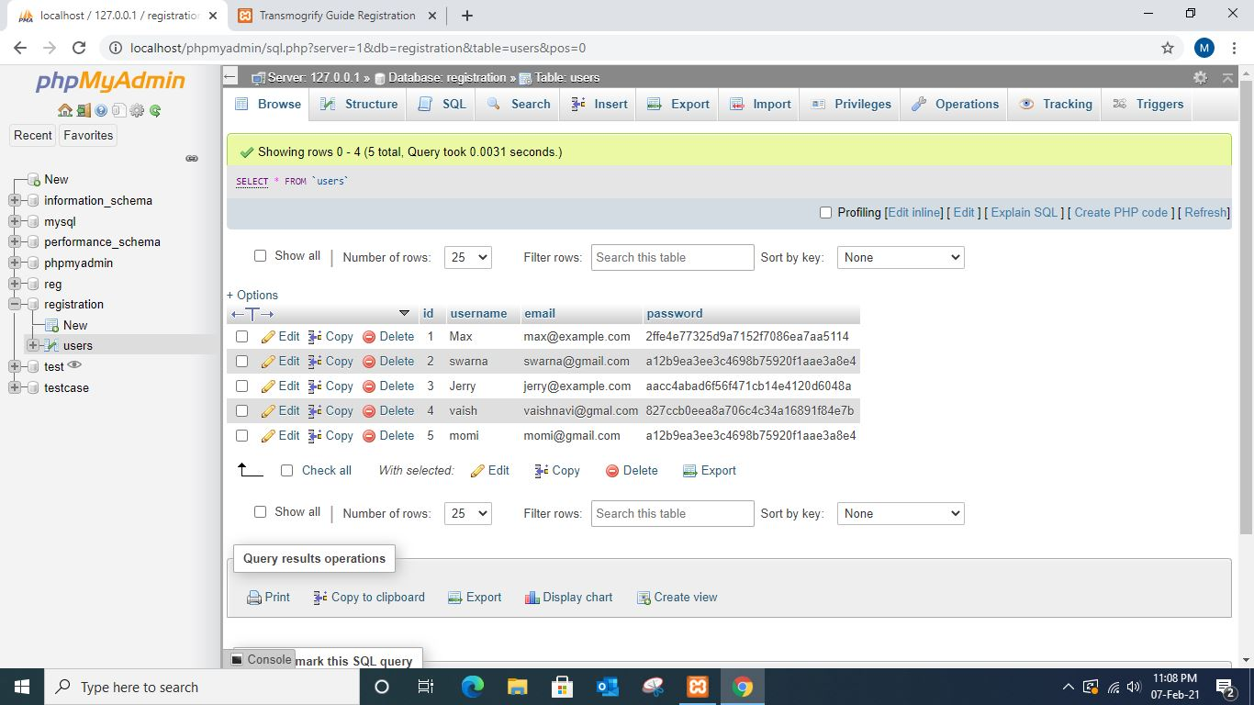
DataBase.
PAGE NAME: phpMyAdmin
PROCESS: Stored data

Slide 15
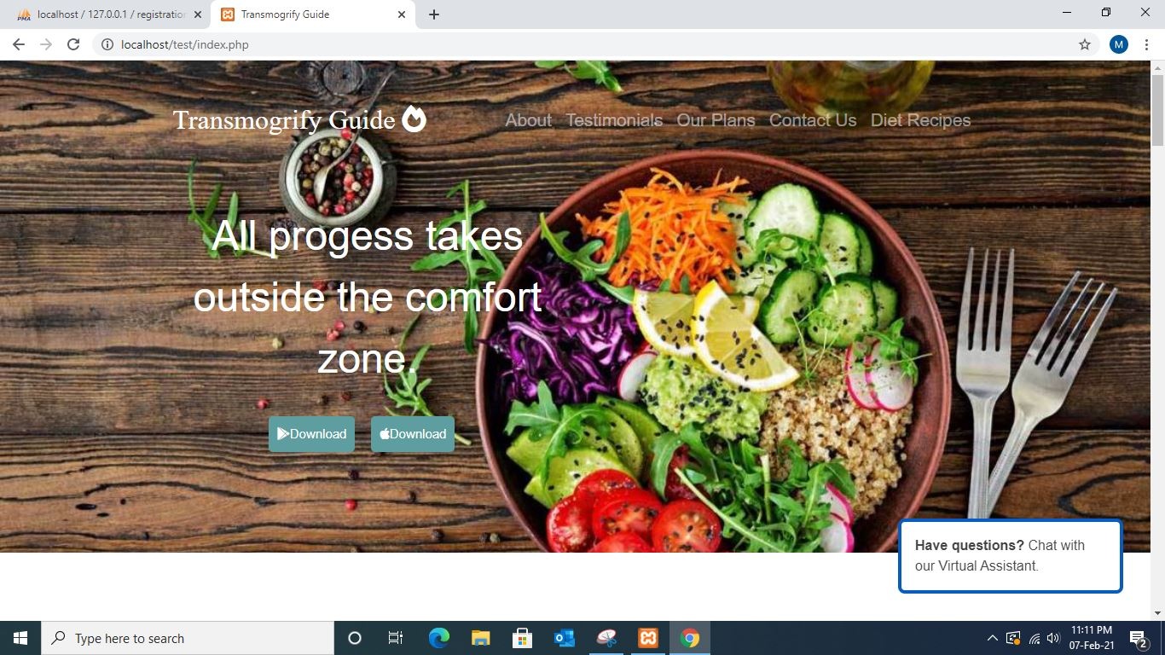
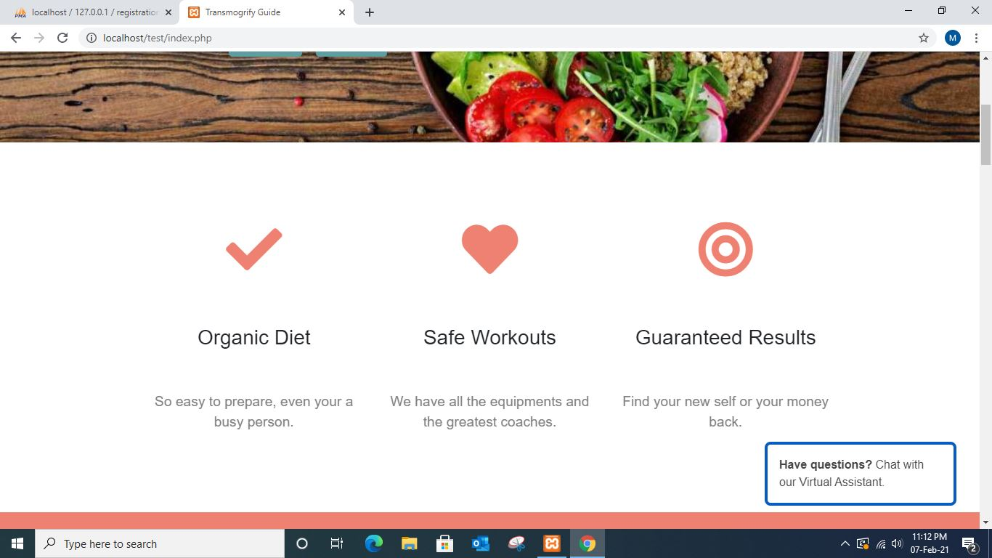
Continuation…
PAGE NAME: WebPage.
PROCESS: Retrieving data.

Slide 16
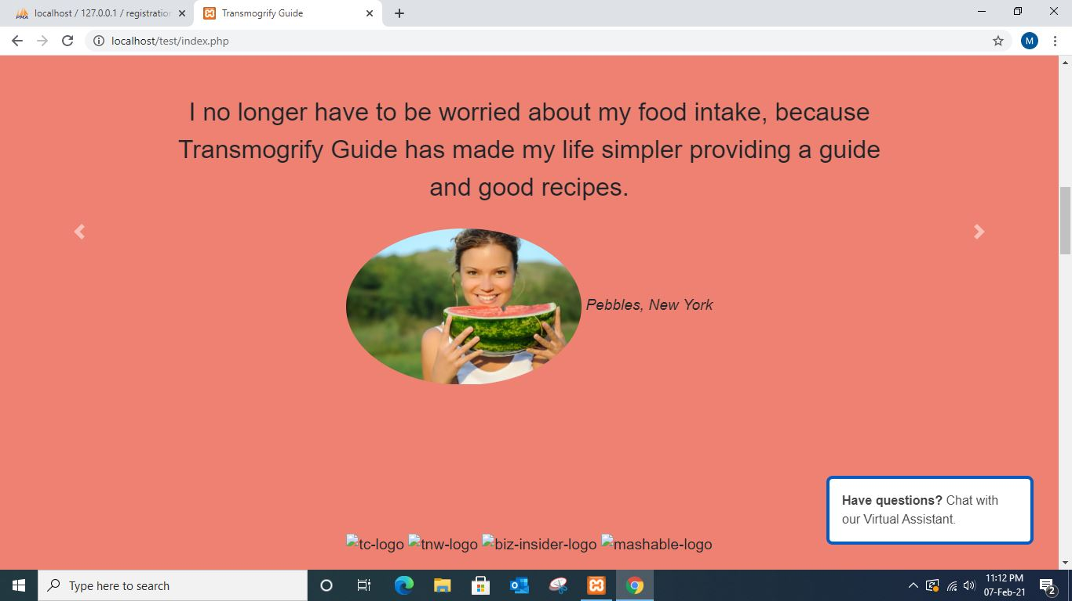
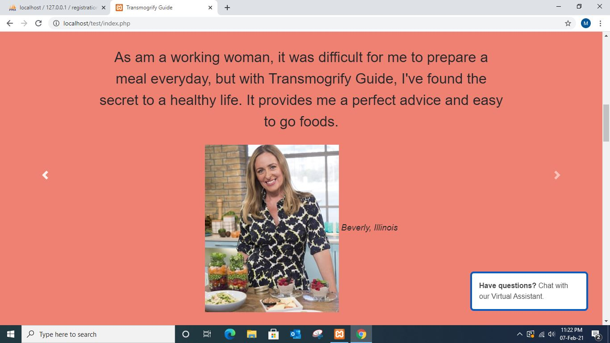
Continuation…
PAGE NAME: Webpage
PROCESS: Retrieving data.

Slide 17
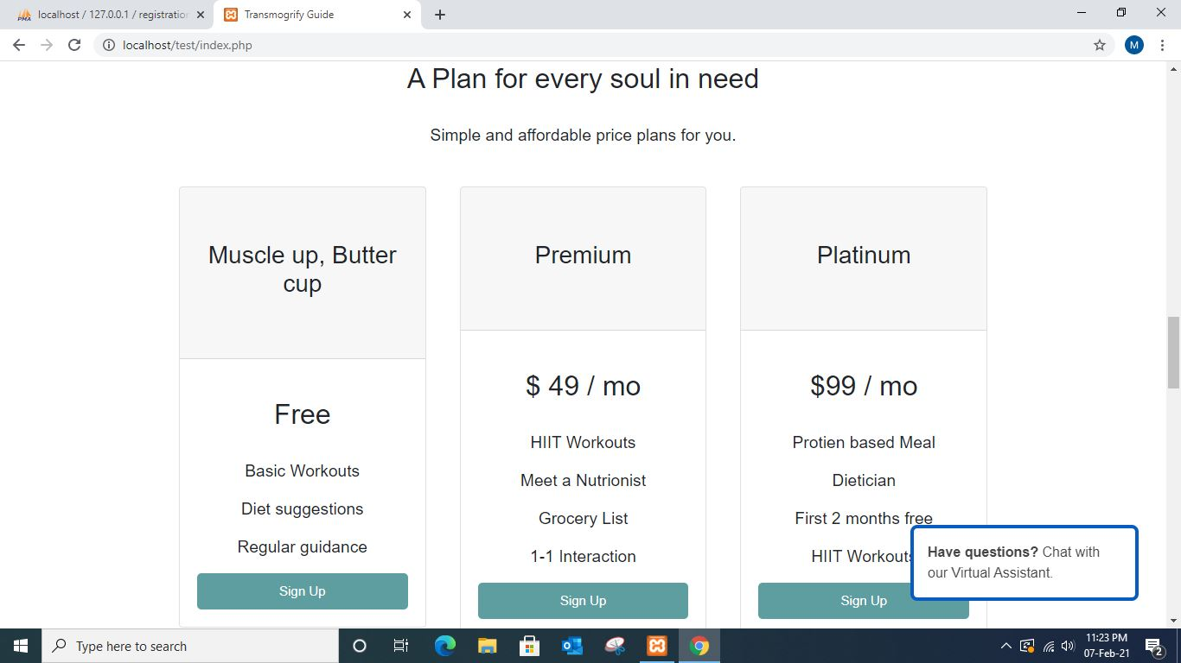
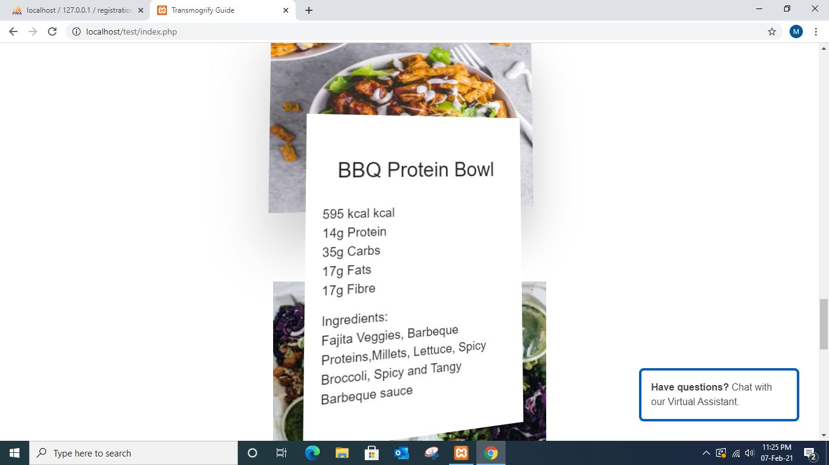
Continuation…
PAGE NAME: WebPage.
PROCESS: Retrieving data.

Slide 18
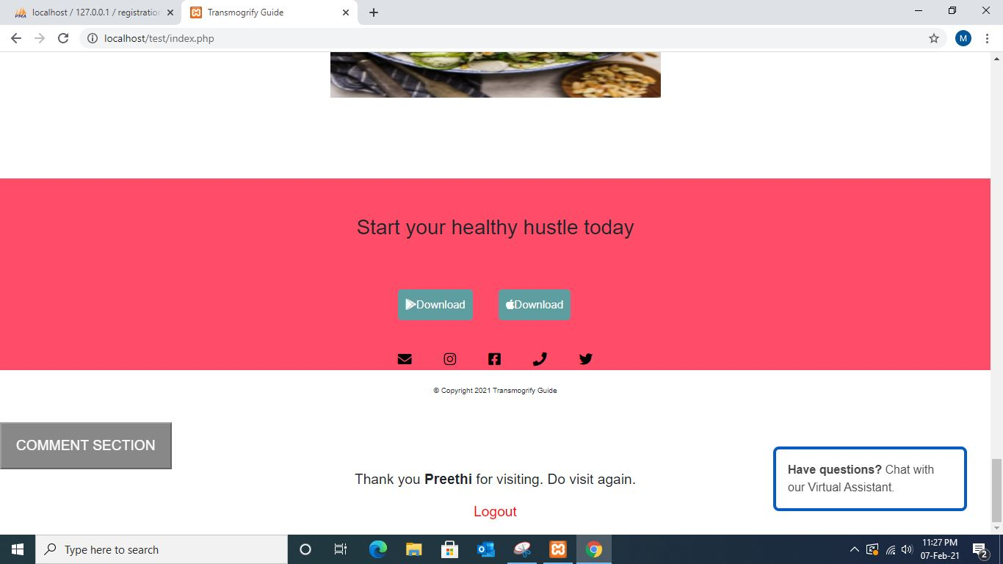
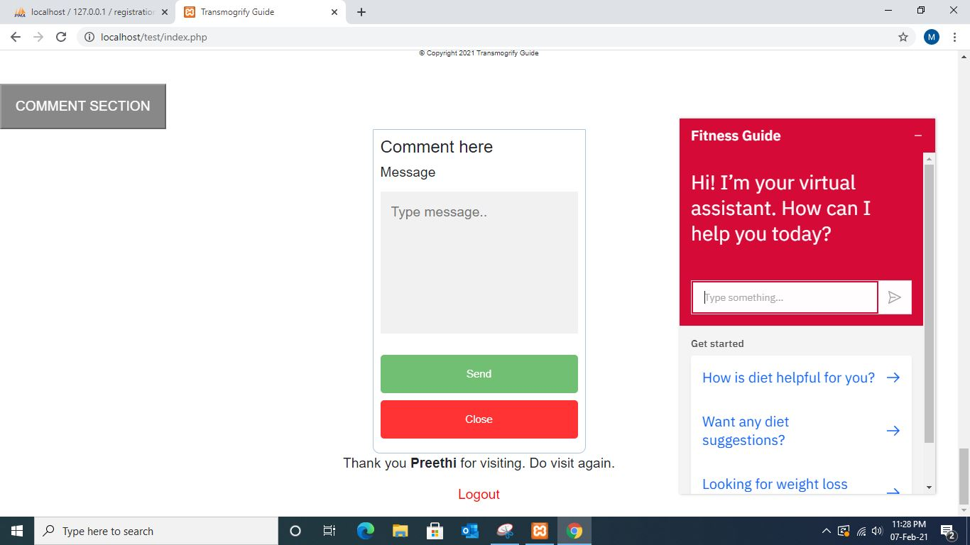
Continuation…
PAGE NAME: WebPage.
PROCESS: Retrieving data.

Slide 19
FUTURE SCOPE
In future scope of this project, we can include voice based queries in addition to text based inputs.
The users will have to give voice input and the system can generate either a text output or even a voice based output.
Since the system is scalable, each module can be upgraded by adding more functionalities, and increasing the information content in the knowledge base.

Slide 20
CONCLUSION
Transmogrify guide provides the facility to stay fit and lose weight by following beneficial diet plans and exercises according to your convenience.
Transmogrify guide provides online weight loss and fitness plans in an efficient manner.

Slide 21

Any queries?

Slide 22
THANK YOU!

