Slide 1
SPACE
SHOOTER
C# / PROJET MONOGAME / Bastien JCLN / 26:10:2026
PRESS START
01
INSERT COIN • C# / MONOGAME • 1 PLAYER

Slide 2
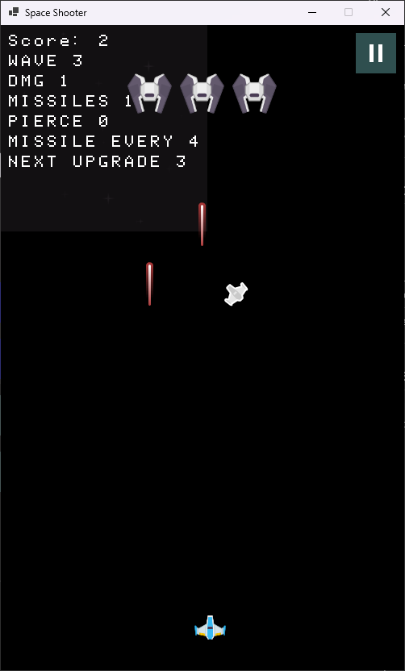
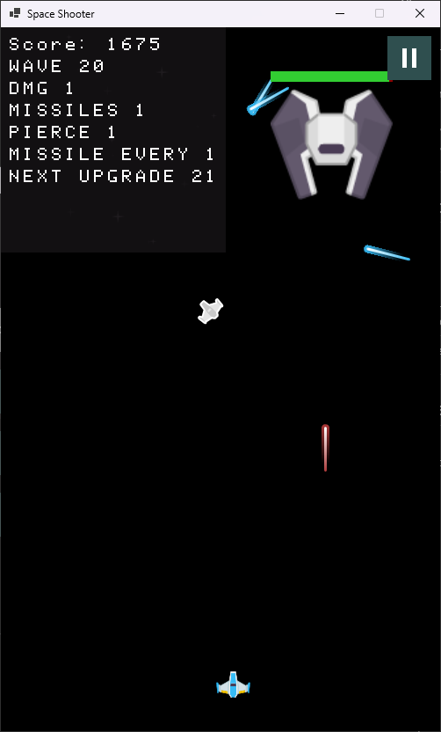
PROJECT OVERVIEW
REPLACE WITH YOUR INTRODUCTION
THE GAME
SCREENSHOT
▸ Space Shooter / arcade gameplay
▸ Built with C# and MonoGame
▸ Wave-based enemy system
▸ Upgrades, projectiles and bosses
▸ Save / load and score progression
02
INSERT COIN • C# / MONOGAME • 1 PLAYER

Slide 3
FEATURES
WHAT MAKES THE GAME FUN
01
WAVES
02
UPGRADES
Add a short explanation here.
Add a short explanation here.
03
BOSSES
04
SAVES
Add a short explanation here.
Add a short explanation here.
03
INSERT COIN • C# / MONOGAME • 1 PLAYER

Slide 4
ARCHITECTURE
C# / MONOGAME STRUCTURE
GAME
SCREENS
ENTITIES
SYSTEMS
CONTENT
Example: Game → PlayScreen → Player / Enemy / Boss → Projectiles
04
INSERT COIN • C# / MONOGAME • 1 PLAYER

Slide 5
GAMEPLAY
SHOW THE GAME IN ACTION
CONTROLS
WASD / ARROWS
SPACE = FIRE
ESC = MENU
GAMEPLAY SCREENSHOT
OBJECTIVE
Survive waves,
defeat enemies,
and improve your ship.
05
INSERT COIN • C# / MONOGAME • 1 PLAYER

Slide 6
CODE HIGHLIGHT
REPLACE WITH YOUR OWN CODE
// GAME LOOP
public void Update(GameTime gameTime)
{
HandleInput();
UpdatePlayer();
UpdateEnemies();
UpdateProjectiles();
CheckCollisions();
}
06
INSERT COIN • C# / MONOGAME • 1 PLAYER

Slide 7
CHALLENGES & SOLUTIONS
DEVELOPMENT HIGHLIGHTS
CHALLENGE
SOLUTION
▸ Enemy movement
▸ Boss behaviour
▸ Projectile collisions
▸ Save system
▸ Dedicated manager classes
▸ State-based behaviour
▸ Hitbox / collision checks
▸ Serializable game state
07
INSERT COIN • C# / MONOGAME • 1 PLAYER

Slide 8
DEMO
LIVE GAMEPLAY
INSERT VIDEO / GIF / SCREENSHOT
▶ START DEMO
08
INSERT COIN • C# / MONOGAME • 1 PLAYER

Slide 9
RESULTS
WHAT WAS ACHIEVED
XX
XX
XX
XX
WAVES
ENEMIES
UPGRADES
BOSSES
Replace the values with your real project statistics.
09
INSERT COIN • C# / MONOGAME • 1 PLAYER

Slide 10
GAME OVER?
NOPE.
THANK YOU FOR PLAYING
QUESTIONS?
C# • MONOGAME • SPACE SHOOTER
10
INSERT COIN • C# / MONOGAME • 1 PLAYER

