Slide 1
实验三 汇编程序设计
2022春季
zjx@ustc.edu.cn

Slide 2
实验目标
了解汇编程序的基本结构，以及汇编程序仿真和调试的基本方法
熟悉RISC-V常用32位整数指令的功能，掌握简单汇编程序的设计，以及CPU下载测试方法和测试数据 (COE文件) 的生成方法

Slide 3
实验内容
设计汇编程序：逐条简单测试以下10条指令功能
add, addi, sub, auipc
lw, sw
beq, blt, jal, jalr
设计汇编程序：排序256个无符号数据
排序算法不限
仅使用上述10条指令实现

Slide 4
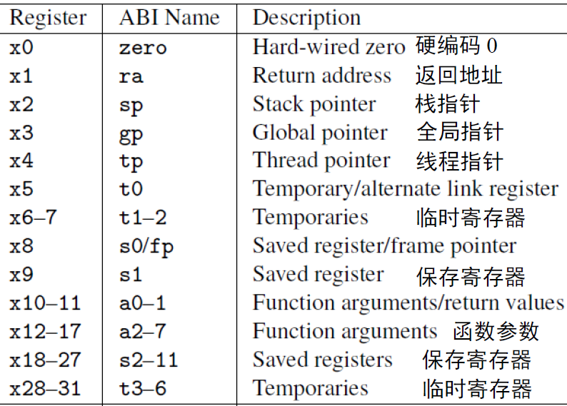
RISC-V寄存器
PC和32个通用寄存器（合称寄存器堆）
Notes:
In practice, the programmer doesn't use this notation for the registers. Though x1 to x31 are all equally general-use registers as far as the processor is concerned, by convention certain registers are used for special tasks. In assembler, they are given standardized names as part of the RISC-V application binary interface (ABI). This is what you will usually see in code listings. If you really want to see the numeric register names, the -M argument to objdump will provide them.
As a general rule, the saved registers s0 to s11 are preserved across function calls, while the argument registers a0 to a7 and the temporary registers t0 to t6 are not. The use of the various specialized registers such as sp by convention will be discussed later in more detail.

Slide 5
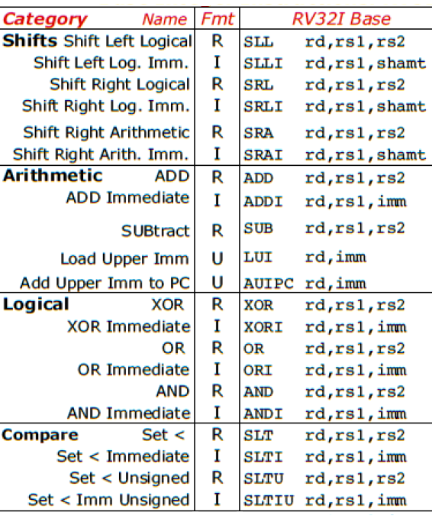
RV32I指令类型
运算类
算术：add, sub, addi, auipc, lui
逻辑：and, or, xor, andi, ori, xori
移位(shift)：sll, srl, sra, slli, srli, srai
比较(set if less than)：slt, sltu, slti, sltiu

Slide 6
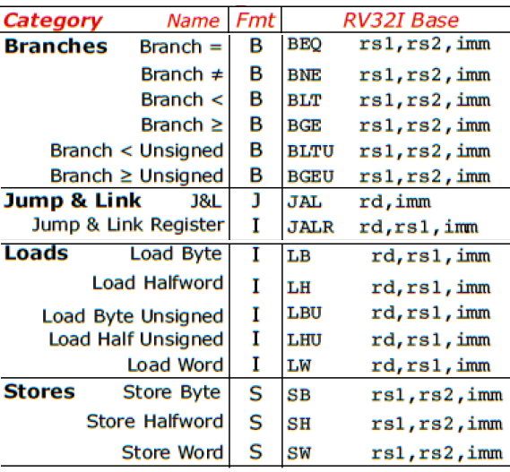
RV32I指令类型 (续)
访存类
加载(load)：lw, lb, lbu, lh, lhu
存储(store)：sw, sb, sh
转移类
分支(branch)：beq, blt, bltu, bne, bge, bgeu
跳转(jump)：jal, jalr
Notes:
RV32I provides two types of control transfer instructions: unconditional jumps and conditional branches. Control transfer instructions in RV32I do not have architecturally visible delay slots.

Slide 7
RV32I指令功能
add rd, rs1, rs2 # x[rd] = x[rs1] + x[rs2]
addi rd, rs1, imm # x[rd] = x[rs1] + sext(imm)
sub rd, rs1, rs2 # x[rd] = x[rs1] - x[rs2]
auipc rd, imm # x[rd] = pc + sext(imm[31:12] << 12)
lw rd, offset(rs1) # x[rd] = M[x[rs1] + sext(offset)]
sw rs2, offset(rs1) # M[x[rs1]+sext(offset)=x[rs2]
beq rs1, rs2, offset # if (rs1 == rs2) pc += sext(offset)
blt rs1, rs2, offset # if (rs1 < _{s} rs2) pc += sext(offset)
jal rd, offset # x[rd] = pc+4; pc += sext(offset)
jalr rd, offset(rs1) # t =pc+4; pc=(x[rs1]+sext(offset))&~1; x[rd]=t

Slide 8
汇编指示符和伪指令
汇编指示符（Assembly Directives）
.data, .text
.word, .half, .byte, .string
.align
……
伪指令（Pseudo Instructions）
li, la, mv
nop, not, neg
j, jr, call, ret
……
参考资料：RISC-V Assembly Programmer's Manual
https://github.com/riscv-non-isa/riscv-asm-manual/blob/master/riscv-asm.md#risc-v-assembly-programmers-manual
Notes:
RISC-V Assembly Programmer's Manual
https://github.com/riscv/riscv-asm-manual

Slide 9
简单测试指令功能
指令功能检查
人工检查指令执行结果，正确则继续下条指令测试
或者自动判断指令测试结果
指令测试顺序
根据待测试指令与已测试指令的依赖关系确定测试先后顺序
开始
测试第1条指令
错误
功能检查
结束
正确
测试第2条指令
… …

Slide 10
示例：测试程序
.data #假定起始地址为0
led_data: .word 0xffff #led指示灯状态，初始全亮
swt_data: .word 0xaa55 #开关(switch)状态
.text
sw x0, 0(x0) #test sw: 全灭led
addi t0, x0, 0xfff #test addi: 全亮led
sw t0, 0(x0)
lw t0, 4(x0) #test lw: 由switch设置led
sw t0, 0(x0)
… …

Slide 11
数据排序
实现类似Lab2功能
数据排序
输出排序结果
仿真输入/输出
MMIO：Memory-Mapped Input and Output
例如，输出显示 (Display) 外设
0x7f08: 状态地址
0x7f0c: 数据地址
开始
读取外设状态
数据排序
外设准备好?
N
Y
输出结果
输出一个结果
全部完毕?
N
结束
Y
Notes:
While the tool is connected to the program, each keystroke in the text area causes the corresponding ASCII code to be placed in the Receiver Data register (low-order byte of memory word 0x00007f04), and the Ready bit to be set to 1 in the Receiver Control register (low-order bit of 0x00007f00). The Ready bit is automatically reset to 0 when the program reads the Receiver Data using an 'lw' instruction.
A program may write to the display area by detecting the Ready bit set (1) in the Transmitter Control register (low-order bit of memory word 0x00007f08), then storing the ASCII code of the character to be displayed in the Transmitter Data register (low-order byte of 0x00007f0c) using a 'sw' instruction. This triggers the simulated display to clear the Ready bit to 0, delay awhile to simulate processing the data, then set the Ready bit back to 1. The delay is based on a count of executed instructions.

Slide 12
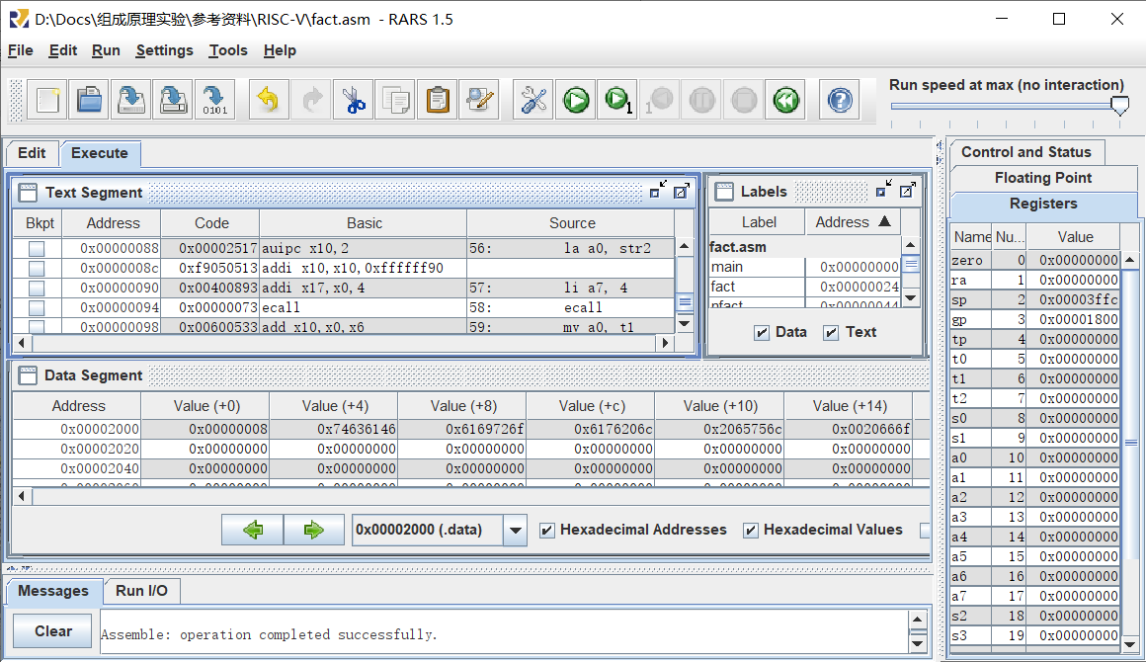
RARS
RISC-V Assembler & Runtime Simulator

Slide 13
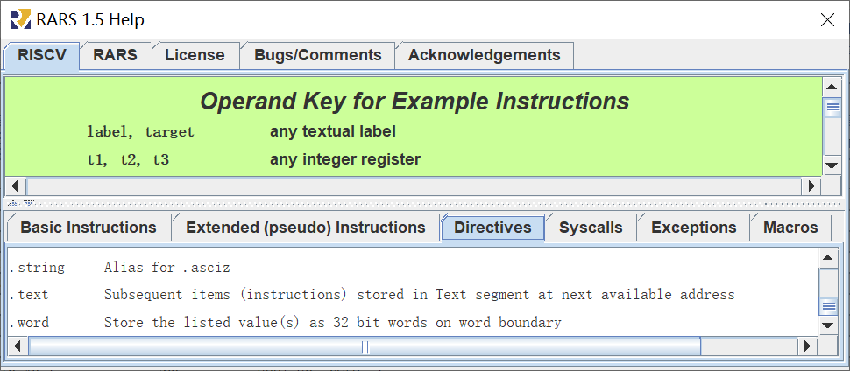
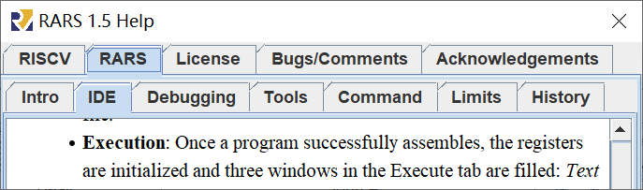
Help
RISCV：指令、伪指令、指示符、系统调用……
RARS：IDE、调试、工具……

Slide 14
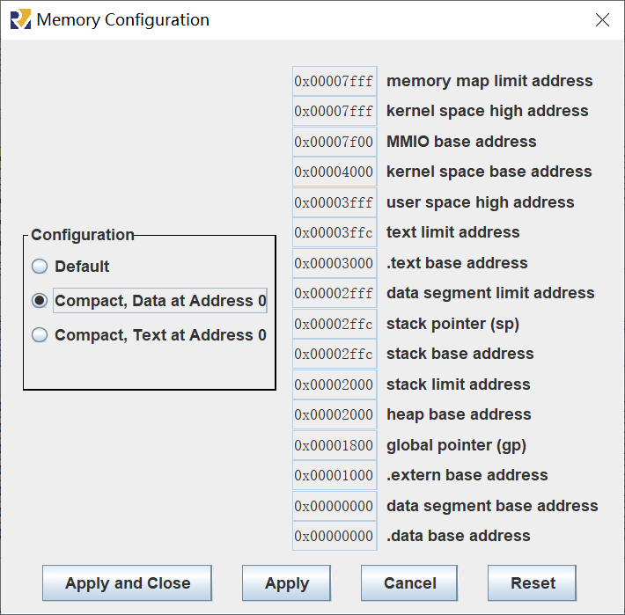
存储器配置
Setting >> Memory Configuration…
假定设置为紧凑型
数据地址：
0x0000_0000 ~ 0x0000_2ffff
代码地址：
0x0000_3000 ~ 0x0000_3fff
MMIO地址：
0x0000_7f00 ~

Slide 15
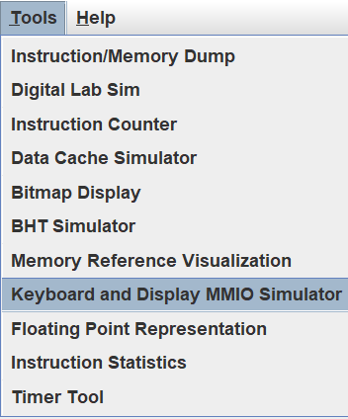
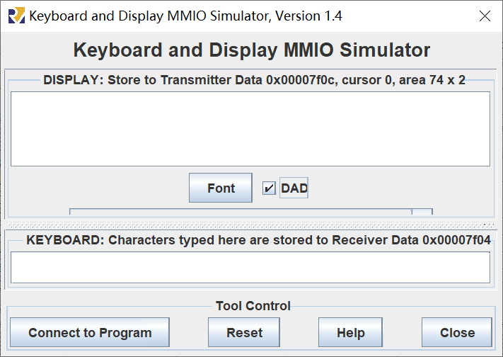
MMIO
Memory-Mapped Input and Output

Slide 16
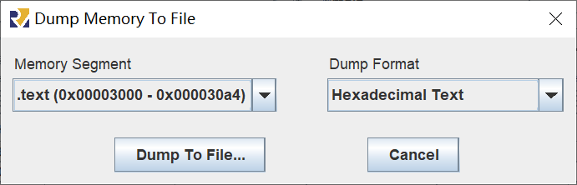
汇编程序转COE文件
配置存储器：Setting >> Memory Configuration…
汇编程序：Run >> Assemble
导出代码和数据：File >> Dump Memory…
生成COE文件：导出文本的开头添加以下两行
memory_initialization_radix = 16;
memory_initialization_vector =

Slide 17
实验步骤
设计汇编程序，实现对10条指令功能的逐条简单测试和人工检查，并生成COE文件
选项：实现若干条指令功能的充分测试和自动检查
设计汇编程序，实现数组排序，并生成COE文件
对存储器例化时初始化的数组排序，并将结果输出到显示器
选项：随机生成或键盘输入数组（第一个数是数组的大小，随后为数组的数据）

Slide 18
The End

