Slide 1
{{P_MW}} MW/{{E_MWH}} MWh DC-side Utility BESS Proposal
{{DATE}}

Slide 2
01
Customer Requirement
02
Project Proposal
03
Project Delivery Scope

Slide 3
1 Customer Requirement — Project 1
No. | Item | Customer requirement | EVE proposal | Meet or not meet
1 | Application scenario | Utility BESS | Utility BESS | {{MEET_1}}
2 | Supply scope | 20ft HC container | 20ft HC container | {{MEET_2}}
3 | Required power | {{REQ_POWER}} | {{EVE_POWER}} | {{MEET_3}}
4 | Required energy | {{REQ_ENERGY}} | {{EVE_ENERGY_AC}} | {{MEET_4}}
5 | Charge/discharge rate | {{REQ_RATE}} | {{EVE_RATE}} | {{MEET_5}}
6 | Operating cycles | {{REQ_CYCLES}} | {{EVE_CYCLES}} | {{MEET_6}}
7 | Operating DOD | {{REQ_DOD}} | {{EVE_DOD}} | {{MEET_7}}
8 | Standard warranty | {{REQ_STD_WARRANTY}} | {{EVE_STD_WARRANTY}} | {{MEET_8}}
9 | Extended warranty | {{REQ_EXT_WARRANTY}} | {{EVE_EXT_WARRANTY}} | {{MEET_9}}
10 | Communication mode | {{REQ_COMM}} | {{EVE_COMM}} | {{MEET_10}}
11 | Certifications | To be discussed | {{EVE_CERT_LIST}} | //To be discussed

Slide 4
2 Project Proposal — Sizing and Augmentation Plan
Project sizing plan | Project {{P_MW}}MW/{{E_MWH_DC}}MWh @BOL @DC @Nameplate energy
 | Nameplate energy (MWh) | 20ft HC container qty. (pcs)
Initial project | {{E_MWH_DC}} | {{CONTAINER_QTY}}
1st Augmentation @5th year | {{AUG1_MWH}} | {{AUG1_QTY}}
2nd Augmentation @10th year | {{AUG2_MWH}} | {{AUG2_QTY}}
3rd Augmentation @15th year | {{AUG3_MWH}} | {{AUG3_QTY}}
Total installation | {{E_MWH_DC}} | {{CONTAINER_QTY}}
Note:
Above proposed project sizing and augmentation plan is made by simulation data based on existing information.
Reserve the right to change the plan as the deeper information change.
Detailed calculation pls. refer to page 15 project sizing and augmentation calculation>.

Slide 5
2 Project Proposal — System Description of Project 1
1. The initial project proposal is consisted of {{CONTAINER_QTY}} BESS units as {{P_MW}}MW/{{E_MWH_DC}}MWh in total.
One BESS unit includes components as following:
1 pc {{CONTAINER_ENERGY_MWH}}MWh 20ft HC battery container system. (EVE supply)
1 pc {{SKID_MW}}MW 45ft skid configure with {{PCS_PER_SKID}} PCS rated power is {{PCS_KW}} kW. (EVE's partner supply)
2. One {{CONTAINER_ENERGY_MWH}}MWh 20ft HC container system includes key components as following:
1 pc 20ft HC container.
{{CLUSTERS_PER_CONTAINER}} pcs battery cluster; 1 battery cluster consists {{PACKS_PER_CLUSTER}} pcs battery packs.
1 pack consists {{CELLS_PER_PACK}} pcs LFP {{CELL_AH}}Ah ({{CELL_MODEL}}) battery cells in {{PACK_CONFIG}} configuration.
1 pc {{COOLING_KW}}kW liquid cooling machine.
1 pc DC combiner(also called as BCP). 1 pc DC combiner consists {{CLUSTERS_PER_CONTAINER}} channels DC access.
1 pc fire suppression system (water spray + chemical agent on system level).

Slide 6
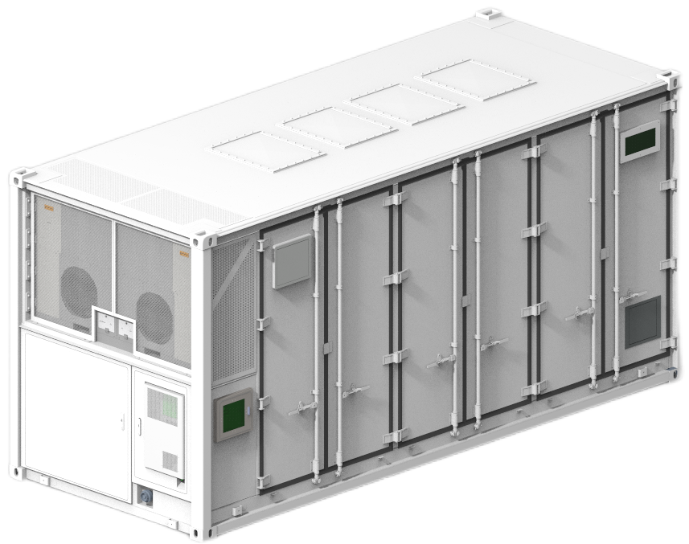
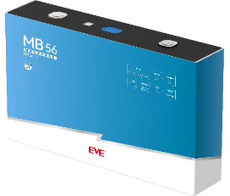
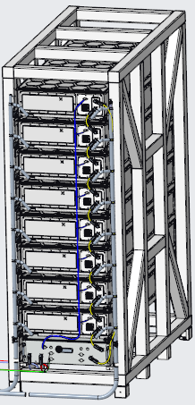
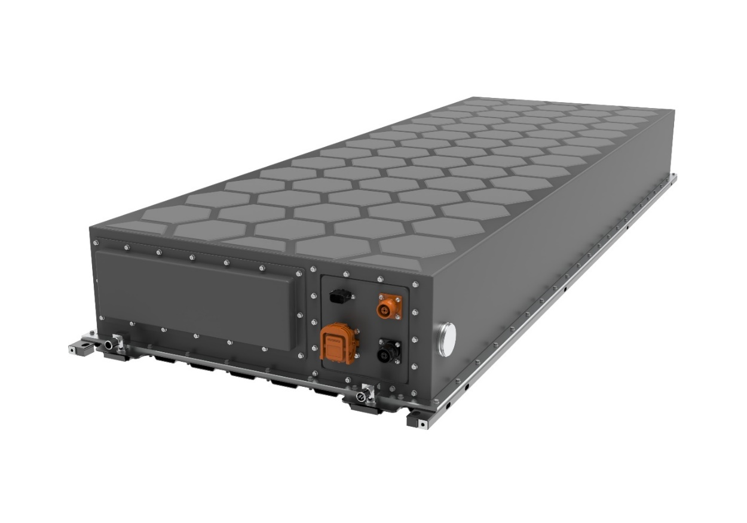
2 Project Proposal — System Structure
Cell – {{CELL_MODEL}} ({{CELL_AH}}Ah)
Container – Standard 20ft HC
Prismatic LFP cell
Voltage {{CELL_V}}V
Capacity {{CELL_AH}}Ah
Energy {{CELL_WH}}Wh
Density {{CELL_WH_KG}}Wh/kg
Energy {{CONTAINER_ENERGY_MWH}}MWh
Duration ≥{{DURATION_H}}h
1 BCP with {{CLUSTERS_PER_CONTAINER}} clusters
MBMU inside BCP
Pack - {{PACK_CONFIG}}
Cluster - {{CLUSTER_CONFIG}}
Voltage {{PACK_V}}V
Capacity {{CELL_AH}}Ah
Energy {{PACK_ENERGY_KWH}}kWh
Duration ≥{{DURATION_H}}h
Integrated VCMU
Liquid cooling
Voltage {{CLUSTER_V}}V
Energy {{CLUSTER_ENERGY_KWH}}kWh
Duration ≥{{DURATION_H}}h
1 PDU with {{CLUSTERS_PER_PDU}} clusters
SBMU inside PDU
Note: The structure is for reference and subject to the actual scope of supply.

Slide 7
2 Project Proposal — Topology Diagram
Ethernet
u
v
w
*Can be customized as required.
CAN/Dry contact
PCS
{{DC_BUS_V}}
Ethernet
EMS
Liquid cooling
CAN
Fire suppression
Dry contact
Isolating switch
DC Combiner
MBMU
CAN
HMI
Dehumidifier
RS485
CAN
CAN
SBMU01
Contactor
SBMU04
Contactor
Fuse
Fuse
CAN
Fuse
Shunt
CAN
Fuse
Shunt
PDU01
Hall sensor
PDU04
Hall sensor
VCMU1
Pack 1
{{PACK_CONFIG}}
VCMU1
Pack 1
{{PACK_CONFIG}}
VCMU2
Pack 2
{{PACK_CONFIG}}
VCMU2
Pack 2
{{PACK_CONFIG}}
CAN
CAN
Battery system: {{CLUSTER_CONFIG}}×{{CLUSTERS_PER_CONTAINER}}
{{CLUSTER_V}}V/{{CELL_AH}}Ah×{{CLUSTERS_PER_CONTAINER}} {{CONTAINER_ENERGY_MWH}}MWh
Pack 4
{{PACK_CONFIG}}
Pack 4
{{PACK_CONFIG}}
Cluster 1: {{CLUSTER_CONFIG}}
{{CLUSTER_V}}V/{{CELL_AH}}Ah {{CLUSTER_ENERGY_KWH}}kWh
Cluster {{CLUSTERS_PER_CONTAINER}}: {{CLUSTER_CONFIG}}
{{CLUSTER_V}}V/{{CELL_AH}}Ah {{CLUSTER_ENERGY_KWH}}kWh
20HC Container

Slide 8

2 Project Proposal —Cell
No. | Description |  | Unit | Parameter | Remark
1 | Dimension (w/ blue film) | Height (H) | mm | {{CELL_H_MM}} | Pole center distance {{CELL_POLE_MM}} mm
 |  | Length (L) |  | {{CELL_L_MM}}
 |  | Thickness (T) |  | {{CELL_T_MM}}
2 | Nominal capacity |  | Ah | {{CELL_AH}} | 25℃±2℃, 0.5P, BOL
3 | Nominal energy |  | Wh | {{CELL_WH}} | {{CELL_AH}} Ah × {{CELL_V}} V
4 | Gravimetric energy density |  | Wh/kg | {{CELL_WH_KG}} | Derived: {{CELL_WH}} Wh / {{CELL_WEIGHT_KG}} kg
5 | ACR / DCR |  | mΩ | {{CELL_ACR_DCR}} | ACR: AC 1kHz; DCR: 50% SOC, 1C, 10s, 25℃
6 | Nominal voltage |  | V | {{CELL_V}} | Operating range {{CELL_V_MIN}}~{{CELL_V_MAX}} V/cell
7 | Standard power |  | W | {{CELL_STD_POWER_W}} | {{RATE}} ({{CELL_WH}} Wh × {{RATE_NUM}})
8 | Cycle life |  | cycle | {{CELL_CYCLE_LIFE}} | 25℃±2℃, 0.5P, {{EOL_SOH}} SOH; 45℃ {{CYCLES_45C}} cycles @80% SOH
9 | Weight |  | g | {{CELL_WEIGHT_G}} | Incl. blue film
10 | Shipment SOC |  | % | {{SHIPMENT_SOC}} | Ex-factory state
11 | Certification (Ongoing) |  |  | {{CERT_CELL}} | {{CERT_CELL_NOTE}}

Slide 9
2 Project Proposal —Pack
Item |  | Specification
Pack type |  | {{PACK_MODEL}}
Battery cell |  | {{CELL_MODEL}} ({{CELL_AH}}Ah)
Capacity / Ah |  | {{CELL_AH}}
Rated energy / kWh |  | {{PACK_ENERGY_KWH}}
Configuration |  | {{PACK_CONFIG}}
Nominal voltage / V |  | {{PACK_V}}
Voltage range / V |  | {{PACK_V_MIN}} – {{PACK_V_MAX}}
Duration / h |  | ≥{{DURATION_H}}
Operation temperature / ℃ | Charge | {{CHG_T_MIN}} – {{CHG_T_MAX}}
 | Discharge | {{DISCHG_T_MIN}} – {{DISCHG_T_MAX}}
Dimension (D×W×H) / mm |  | {{PACK_DIM_MM}}
Weight / kg |  | {{PACK_WEIGHT_KG}}
IP level |  | {{PACK_IP}}
Thermal management |  | Liquid cooling ({{PACK_FLOW_LPM}} L/min)
Certification (Ongoing) |  | {{CERT_PACK}}
Communication interface
Maintenance window
Positive
Safety valve
Cold plate
Coolant outlet
MSD
Negative
Coolant inlet

Slide 10
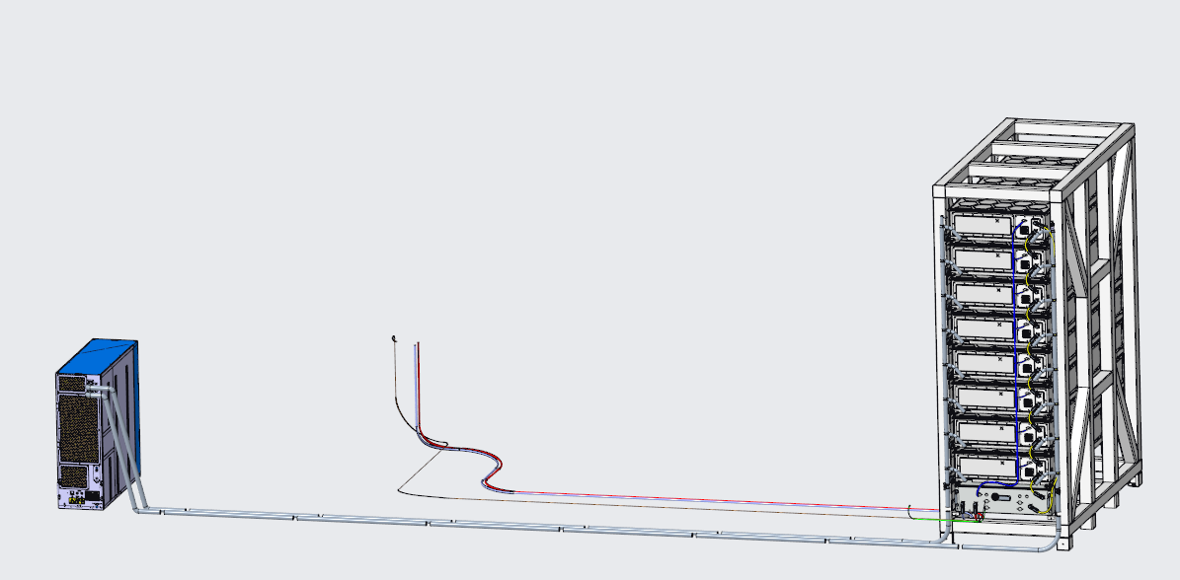
2 Project Proposal —Cluster
Item |  | Specification
Cluster type |  | {{CLUSTER_MODEL}}
Battery cell |  | {{CELL_AH}}Ah ({{CELL_MODEL}}
Capacity / Ah |  | {{CELL_AH}}
Rated energy / kWh |  | {{CLUSTER_ENERGY_KWH}}
Configuration |  | {{CLUSTER_CONFIG}} ({{PACKS_PER_CLUSTER}} × {{PACK_MODEL}} in series)
Nominal voltage / V |  | {{CLUSTER_V}}
Voltage range / V |  | {{CLUSTER_V_MIN}} – {{CLUSTER_V_MAX}}
Duration / h |  | ≥{{DURATION_H}}
Operation temperature / ℃ | Charge | {{CHG_T_MIN}} – {{CHG_T_MAX}}
 | Discharge | {{DISCHG_T_MIN}} – {{DISCHG_T_MAX}}
Dimension (D×W×H) / mm |  | {{CLUSTER_DIM_MM}}
Weight / T |  | {{CLUSTER_WEIGHT_T}}
Thermal management |  | {{CLUSTER_THERMAL}}
Certification (Ongoing) |  | {{CERT_CLUSTER}}

Slide 11
2 Project Proposal —20HC Container
Item | Specification
System type | {{SYS_MODEL}}
Battery cell | {{CELL_MODEL}} ({{CELL_AH}}Ah)
Configuration | {{CLUSTERS_PER_CONTAINER}} × {{CLUSTER_CONFIG}}
Rated energy / kWh | {{CONTAINER_ENERGY_KWH}}
Nominal voltage / V | {{CLUSTER_V}}
Voltage Range / V | {{CLUSTER_V_MIN}} – {{CLUSTER_V_MAX}}
Duration / h | ≥{{DURATION_H}}
Thermal management | Liquid cooling + heating ({{COOLING_KW}} kW / {{HEATING_KW}} kW, {{REFRIGERANT}})
Dimension (L×W×H) / mm | {{CONTAINER_DIM_MM}}
Weight / T | {{CONTAINER_WEIGHT_T}}
Operation temperature / ℃ | {{CONTAINER_T_MIN}} – {{CONTAINER_T_MAX}}
IP level | {{CONTAINER_IP}}
Corrosion resistance level | {{CORROSION_CLASS}}
Noise level / dB@1m | {{NOISE_DB}}
Certification (Ongoing) | {{CERT_CONTAINER}}

Slide 12
2 Project Proposal —System Layout
Exhaust fan
Explosion venting panel*4
Horn/strobes
Bell
Liquid chiller
Air inlet fan
DC combiner cabinet
(integrated power distribution unit)
FSS
Battery compartment
DN65 FSS interface for water spray
Emergency stop /Agent release

Slide 13


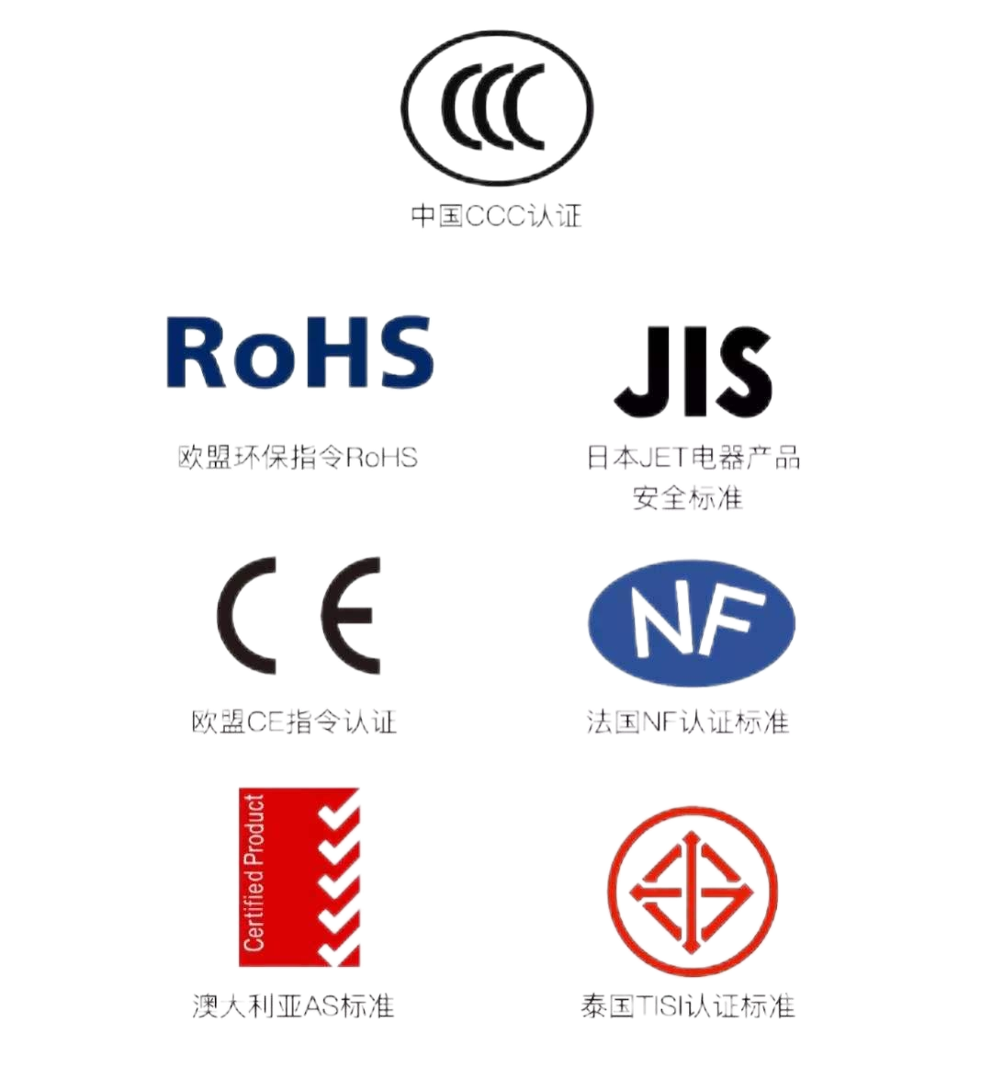


2 Project Proposal —Certification Plan
No. | Level | Standard (Plan)
1 | Liquid cooling cell {{CELL_MODEL}} | {{CERT_STD_01}}
 |  | {{CERT_STD_02}}
 |  | {{CERT_STD_03}}
 |  | {{CERT_STD_04}}
 |  | {{CERT_STD_05}}
 |  | {{CERT_STD_06}}
 |  | {{CERT_STD_07}}
2 | Liquid cooling pack {{PACK_MODEL}} | {{CERT_STD_08}}
3 | Liquid cooling cluster {{CLUSTER_MODEL}} | {{CERT_CLUSTER_NOTE}}
4 | Liquid cooling container * {{SYS_MODEL}} ({{RATE}}) | {{CERT_STD_09}}
 |  | {{CERT_STD_10}}
 |  | {{CERT_STD_11}}
 |  | {{CERT_STD_12}}
 |  | {{CERT_STD_13}}
 |  | {{CERT_STD_14}}
 |  | {{CERT_STD_15}}
 |  | {{CERT_STD_16}}
{{CERT_FOOTNOTE}}

Slide 14
3 Project Delivery Scope ---DC
No. | Item | Description | Qty. per BESS Unit | Total Qty.
 | Project
1 | {{CONTAINER_ENERGY_MWH}}MWh 20ft Container | Rated energy: {{CONTAINER_ENERGY_MWH}}MWh | {{QTY_PER_UNIT}} | {{CONTAINER_QTY}}
1.1 | LFP battery clusters | Rated capacity: {{CLUSTER_ENERGY_KWH}}kWh, BMS included | {{CLUSTERS_PER_CONTAINER}} | {{CLUSTER_TOTAL_QTY}}
1.2 | Liquid cooling system | {{COOLING_KW}}kW Liquid cooling machine and pipeline | {{QTY_PER_UNIT}} | {{CONTAINER_QTY}}
1.3 | 20ft HC container | {{CONTAINER_DIM_MM}} | {{QTY_PER_UNIT}} | {{CONTAINER_QTY}}
1.4 | DC combiner | Consists of {{CLUSTERS_PER_CONTAINER}} channel DC access | {{QTY_PER_UNIT}} | {{CONTAINER_QTY}}
1.5 | Fire suppression system | Water spray on system level + chemical agent (aerosol) | {{QTY_PER_UNIT}} | {{CONTAINER_QTY}}

Slide 15
3 Project Sizing and augmentation calculation
Year | Rated energy/container (MWh) | Container qty | BESS unit count | PCS count | DOD | DC-DC RTE | SOH | AC-side efficiency | Total discharge capability | Aux power/MWh | AC usable energy/MWh
0 | - | - | - | - | - | - | - | - | - | - | -
1 | - | - | - | - | - | - | - | - | - | - | -
2 | - | - | - | - | - | - | - | - | - | - | -
3 | - | - | - | - | - | - | - | - | - | - | -
4 | - | - | - | - | - | - | - | - | - | - | -
5 | - | - | - | - | - | - | - | - | - | - | -
6 | - | - | - | - | - | - | - | - | - | - | -
7 | - | - | - | - | - | - | - | - | - | - | -
8 | - | - | - | - | - | - | - | - | - | - | -
9 | - | - | - | - | - | - | - | - | - | - | -
10 | - | - | - | - | - | - | - | - | - | - | -
11 | - | - | - | - | - | - | - | - | - | - | -
12 | - | - | - | - | - | - | - | - | - | - | -
13 | - | - | - | - | - | - | - | - | - | - | -
14 | - | - | - | - | - | - | - | - | - | - | -
15 | - | - | - | - | - | - | - | - | - | - | -
16 | - | - | - | - | - | - | - | - | - | - | -
17 | - | - | - | - | - | - | - | - | - | - | -
18 | - | - | - | - | - | - | - | - | - | - | -
19 | - | - | - | - | - | - | - | - | - | - | -
20 | - | - | - | - | - | - | - | - | - | - | -
 | - | - | - | - | - | - | - | - | - | - | -
Notes:
One BESS unit contains 1pc {{CONTAINER_ENERGY_MWH}}MWh in a 20ft container ({{RATE}}/{{CYCLES_PER_DAY}}cycle/day-{{DOD}}%DOD).
System initial group efficiency is caused by the inconsistency of the battery cells when the system is assembled. Different system configuration has different initial group effiDC-side is within EVE's supply scope and AC-side not. So the AC-side efficiency is estimated according to experience. If the customer has accurate efficiencies on the AC-side, please share them and we will update the calculation.
PCS Single Side Efficiency: {{EFF_PCS}}%; MV Transformer Single Side Efficiency:{{EFF_TRANSFORMER}}%; AC Cable Efficiency: {{EFF_CABLE}}%. AC-side efficiency (estimated) : {{EFF_AC}}%={{EFF_PCS_NUM}}*{{EFF_TRANSFORMER_NUM}}*{{EFF_CABLE_NUM}}

Slide 16
