Slide 1
WELCOME

Slide 2
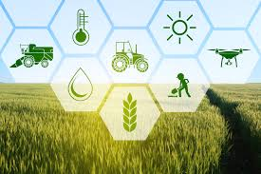
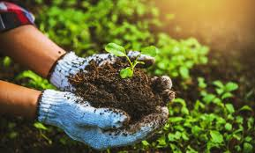
AGRICULTURE
Agriculture is defined with varying scopes, in its broadest sense using natural resources to "produce commodities which maintain life, including food, fiber, forest products, horticultural crops, and their related services".

Slide 3
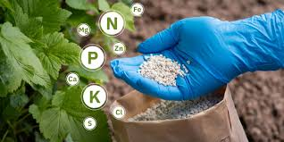
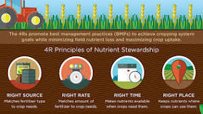
FERTILIZER
Fertilizer, natural or artificial substance containing the chemical elements that improve growth and productiveness of plants. Fertilizers enhance the natural fertility of the soil or replace chemical elements taken from the soil by previous crops.

Slide 4
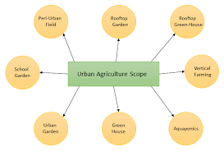
Scope of agriculture
Soil cultivation, crop cultivation and harvesting, animal production, animal product and processing for human consumption are included among them. To save money and increase yields, farmers and others utilize science and technology to collect data, analyses efficiency, and monitor growth and quality, and more.

Slide 5
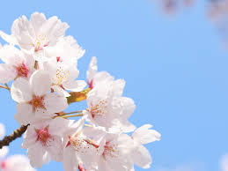
Thank you…

