Slide 1







What skills do we need in future?
Hina Zhou
15th of August 2024

Slide 2



OUTLINE
Executive Summary
Introduction
Methodology
Results
Visualization – Charts
Dashboard
Discussion
Findings & Implications
Conclusion
Appendix

Slide 3

EXECUTIVE SUMMARY
Data Collection
Collection with APIs
Collection with Web scraping
Data Wrangling
Missing Values
Duplication
Normalization
Data Exploration
Distribution
Outliers
Correlation
Data Visualization

Slide 4

INTRODUCTION
The change in technologies makes the job market competitive.
Collect the data from the job postings
Identify the skills required the most in the job postings in the US job market
Find out the relationship between skills and
Databases
Platforms
Web Frames
Overview of the data distribution, outliers and correlations.

Slide 5

METHODOLOGY
API web scraping
Web scraping using Beautiful Soup from Python Lib
Data Wrangling
Find and remove duplicate data
Identify and replace missing values
Data Normalization
Data Exploration with Seaborn
Identify data distribution
Identify and remove outliers
Identify the correlation between the attributes
Data Visualization with SQL

Slide 6
RESULTS
The mean of the Age is 30.77.
The Man earns more than the woman.
Most technology workers are professional developers.
The salary is not affected by age but by the working hours.
The top five languages required in the job postings:
- HTML/CSS
- Java & Python
- Bash/Shell/PowerShell
- JavaScript
- SQL

Slide 7
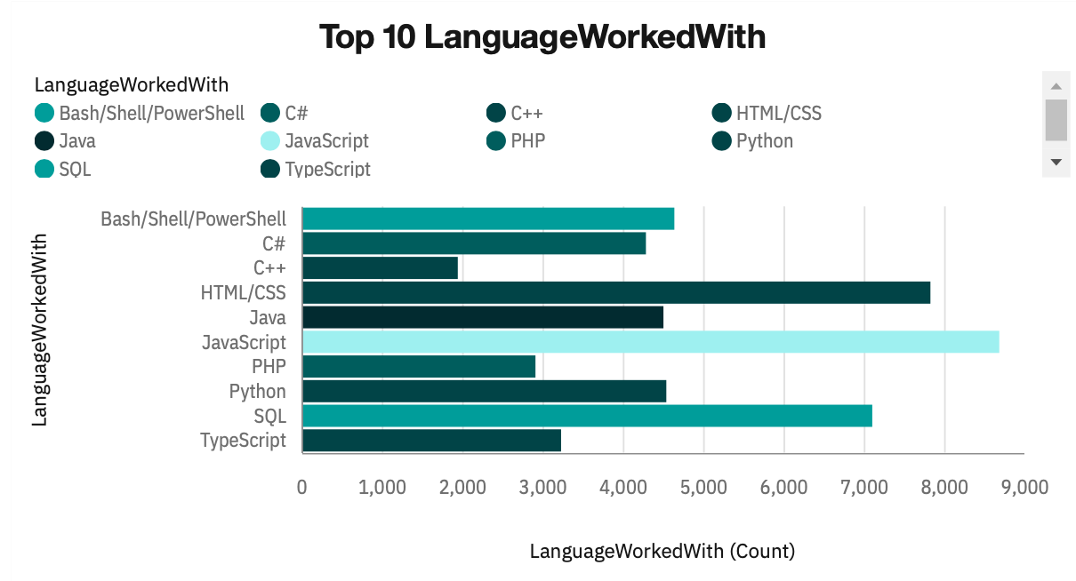
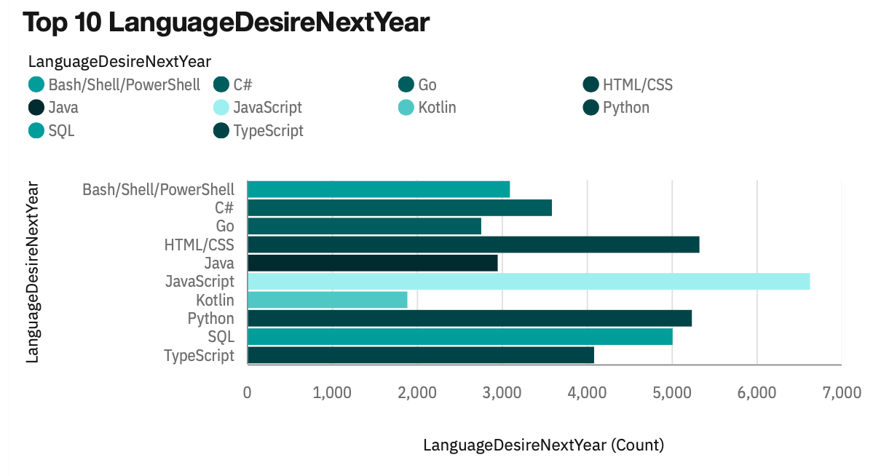
PROGRAMMING LANGUAGE TRENDS
Current Year
Next Year

Slide 8
PROGRAMMING LANGUAGE TRENDS - FINDINGS & IMPLICATIONS
Findings
New language – Kotlin & Go
Python become more popular
The C language family demand is in regression
Implications
New developed programming languages get popular in the job market.
Python become the common programming language.
Java language has declined.

Slide 9
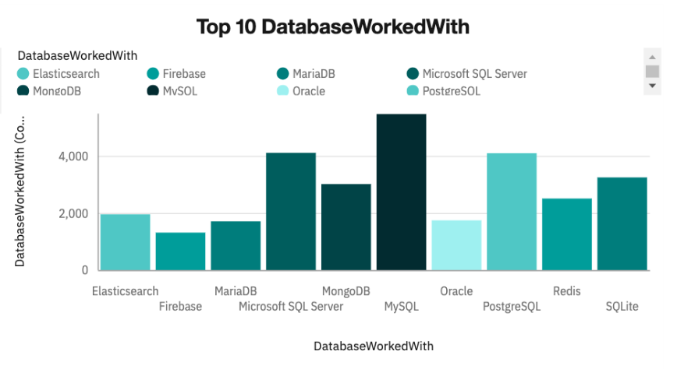
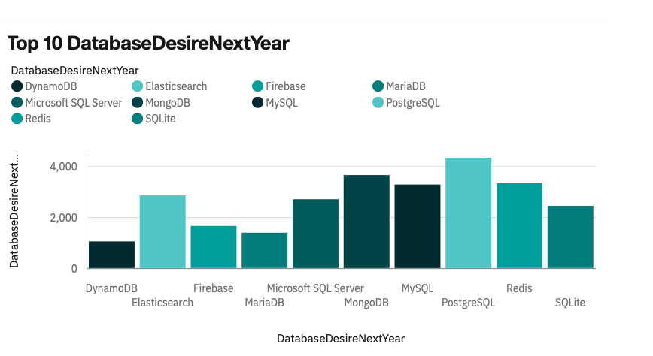
DATABASE TRENDS
Current Year
Next Year

Slide 10
DATABASE TRENDS - FINDINGS & IMPLICATIONS
Findings
PostgreSQL will be the most popular database next year.
DynamoDB replaced Oracle became one of the top ten databases.
Implications
Fewer people use SQL reduces the requirement of MySQL.
Oracle no longer dominate the database and other database systems become competitive.

Slide 11

DASHBOARD
IBM Congo
https://github.com/Momomana/Coursera-Data-Analytics-Capstone-Project/blob/main/DA%20Assignment%20Part%20A.pdf
Looker Studio
https://github.com/Momomana/Coursera-Data-Analytics-Capstone-Project/blob/main/Building_a_dashboard_with_Google_Looker_studio.pdf

Slide 12
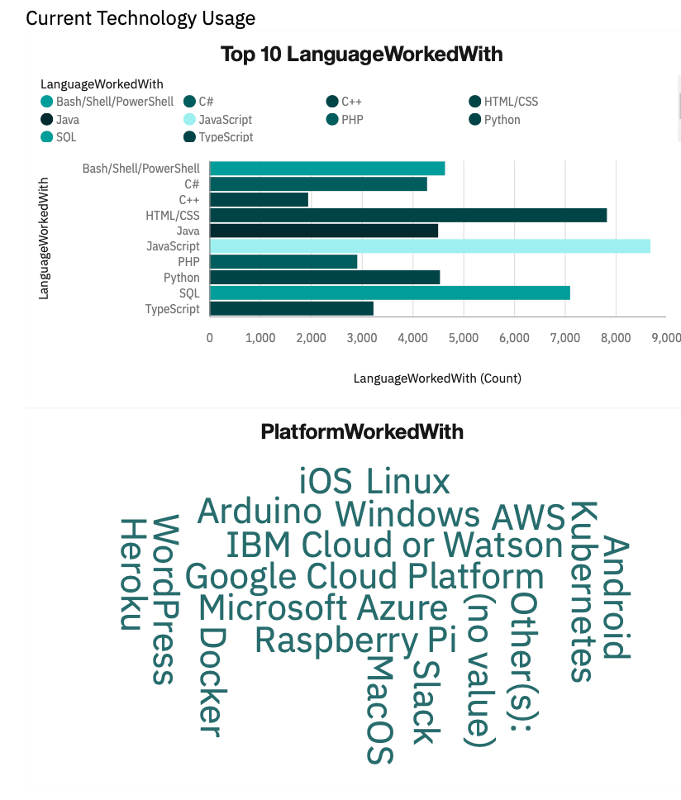
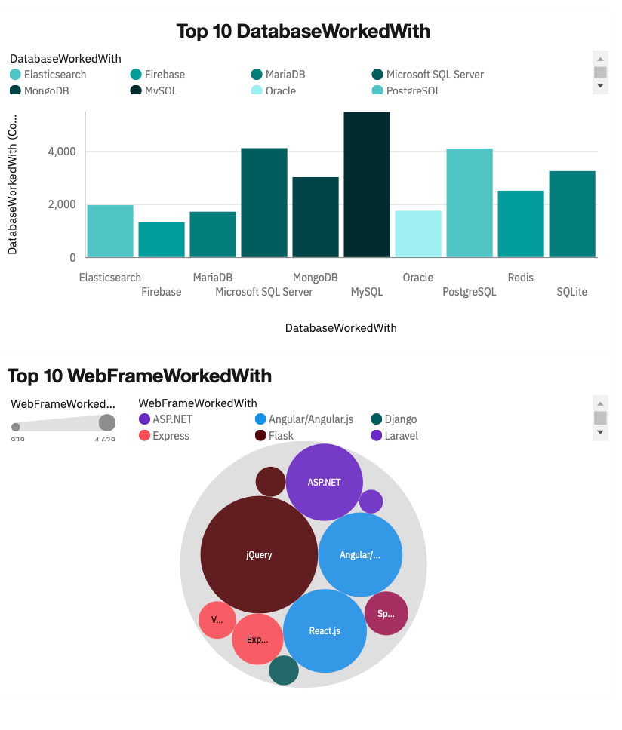
DASHBOARD Current Technology Usage

Slide 13
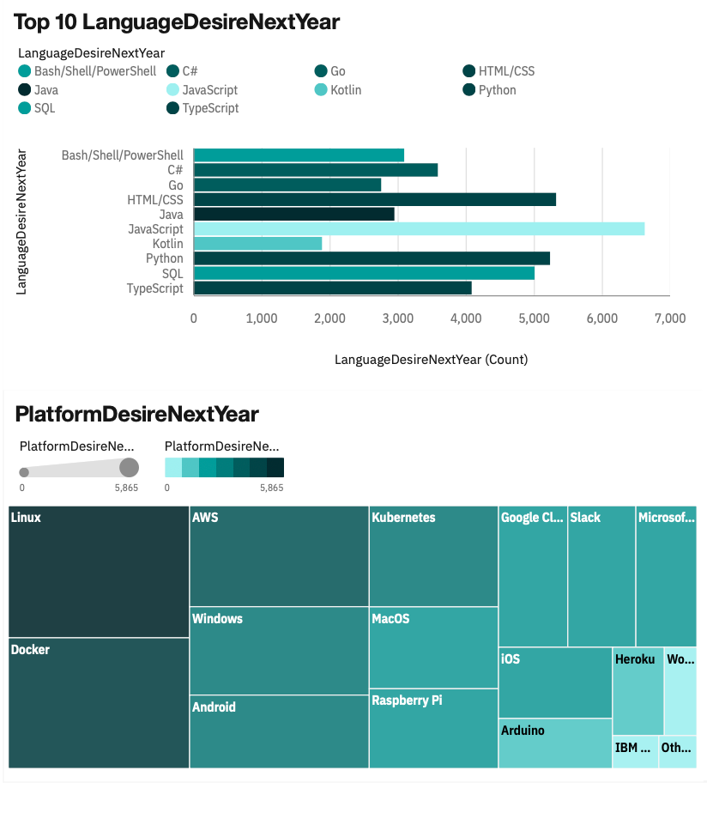
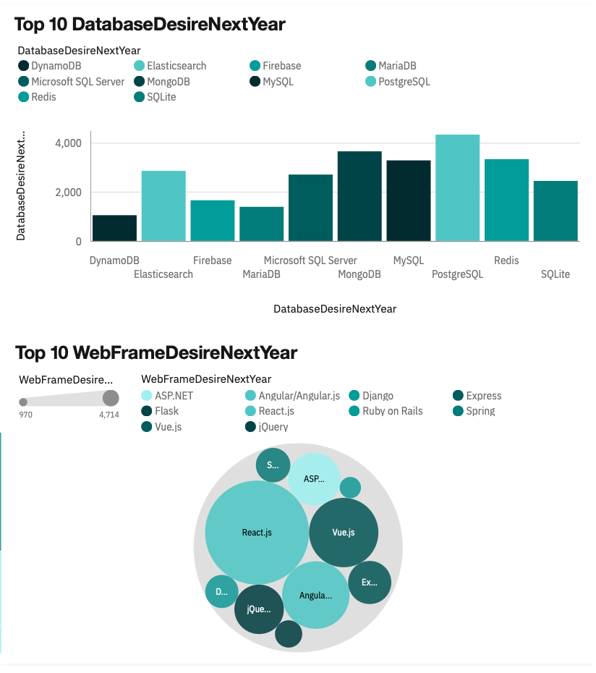
DASHBOARD Future Technology Trend

Slide 14
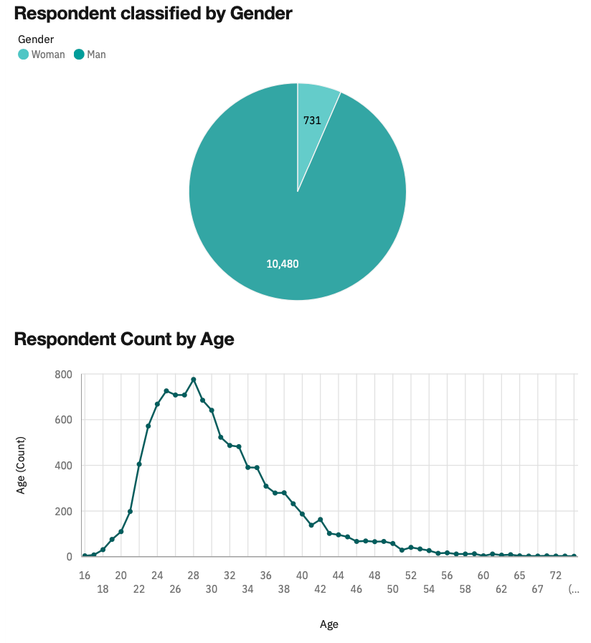
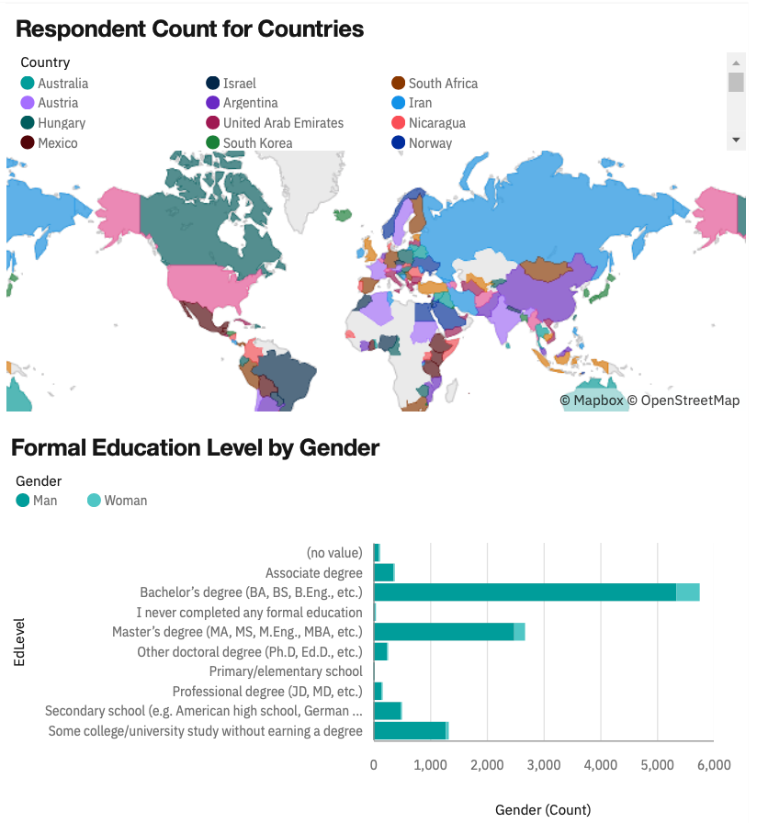
DASHBOARD Demographics

Slide 15
DISCUSSION
Following the rapid growth of programming languages and systems, whether these job will be replaced by AI or not?

Slide 16
OVERALL FINDINGS & IMPLICATIONS
Findings
Python and SQL become popular.
New languages get developed and slowly replace the old languages.
Database systems tend more competitive.
Implications
The usage of SQL has increased and led more companies to develop new database systems
Since Python is widely used in many industries, more IT companies tend to develop new languages.

Slide 17

CONCLUSION
Programming languages tend to change and develop timely.
Data solution becomes the core of the business.

Slide 18
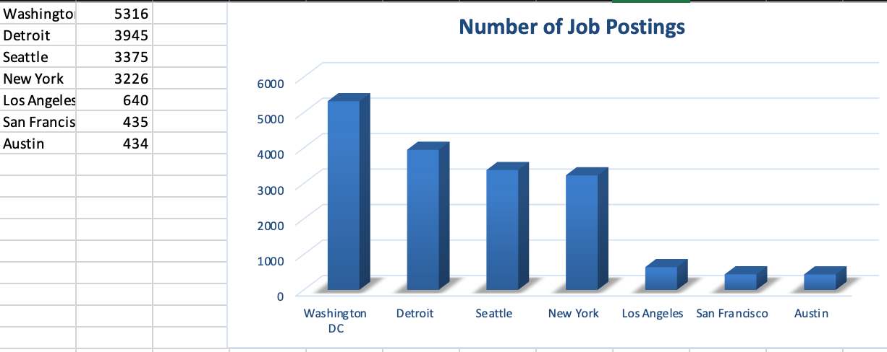
JOB POSTINGS

Slide 19
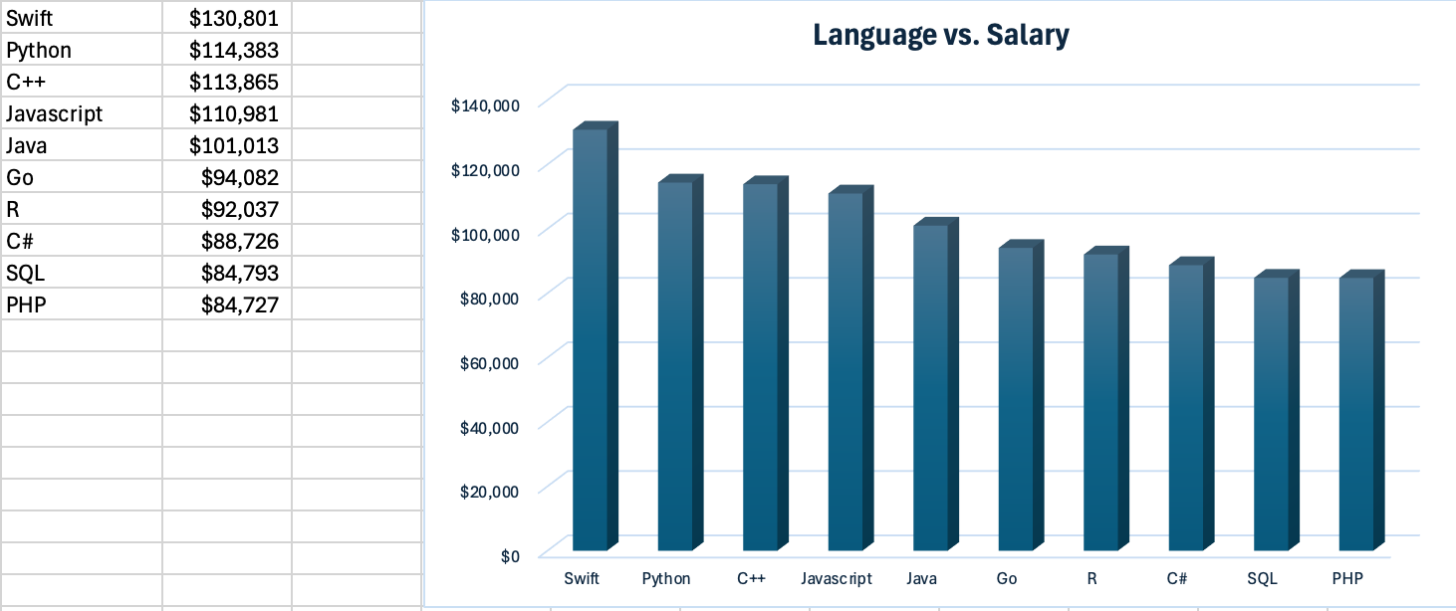
POPULAR LANGUAGES

