Slide 1
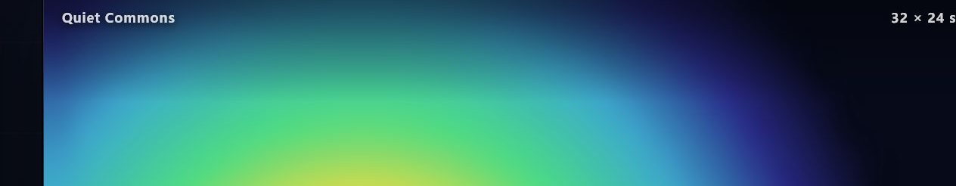
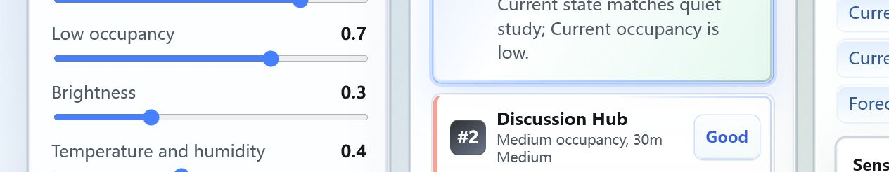
Privacy-Preserving
Study Space Advisor
NUS SCHOOL OF COMPUTING
Find the right place to study — without cameras or identity tracking.
Summer Workshop 2026 / Group [GROUP_NUMBER] / [MEMBERS]
PROBLEM & SOLUTION
PROBLEM
SOLUTION
Students spend time searching for a space that fits their study mode. Current availability is only one part of the decision. Occupancy alone cannot describe quietness, comfort or whether discussion is appropriate. Camera monitoring adds unnecessary privacy risk.
Camera-free sensing combines low-resolution thermal data, relative light, climate and non-reconstructable sound summaries. Edge processing produces anonymous room features before the backend. The dashboard presents room status, history, short-horizon forecasts and a recommendation workflow.
PROTOTYPE HARDWARE
PRIVACY BY DESIGN
HARDWARE PANORAMA
[HARDWARE_PHOTO]
MLX90640 32×24 array
HW-486 relative light
DHT11 temperature / RH
ESP32 sensor hub
Raspberry Pi 5
Laptop microphone — local RMS/std/peak summaries only
No RGB cameras or facial recognition
No raw audio storage or upload
No identity or trajectory tracking
Thermal previews expire and are not persisted
SYSTEM ARCHITECTURE
MLX90640
HW-486 · DHT11
ESP32
sensor hub
Raspberry Pi 5
edge processing
Privacy-safe
features + room-state
prototype
FastAPI
+ SQLite
Status · history
15/30-min forecast
React workflow
Laptop microphone
Local summary
agent
AI & DATA INTELLIGENCE
PRIVACY BOUNDARY — ONLY AGGREGATE FEATURES LEAVE THE EDGE
RESULTS / VALIDATION
PROTOTYPE
Room-state prototype
4
36
176
IMPLEMENTED
Forecast APIs
real scenario
sessions
five-second
windows
MLX90640
thermal frames
IN PROGRESS
Recommendation workflow
Gate A automated end to end
Real sensor summaries captured
Four sessions privacy-validated
Independent evaluation in progress
Anonymous summaries only — no faces, identities or speech content.
LIVE DEMONSTRATION • UI PROTOTYPE
Thermal view · mock data
Recommendation UI · mock data
Group [GROUP_NUMBER] / [MEMBERS] / NUS School of Computing / Summer Workshop 2026
[QR_CODE]
Designed to support space-level decisions, not to monitor individuals.
Notes:
[Sources]
User poster brief, 2026-07-27.
Repository: README.md; origin/main:README.md; docs/module-specs/00_SHARED_CONTRACT.md; shared/contracts/*.schema.json; edge/hardware/MODULE1_HANDOFF.md; origin/main:edge/hardware/REAL_DATASET_GUIDE.md; origin/main:edge/hardware/MODEL_TRAINING_READINESS_REPORT.md; backend/README.md; backend/MODULE3_HANDOFF.md; origin/main:backend/PERFORMANCE.md; frontend/MODULE4_HANDOFF.md; tests/integration/GATE_A_HANDOFF.md.
Screenshots: local repository UI at /?mode=mock and /thermal?room=room_a&mode=mock, captured 2026-07-27.
No externally sourced images. Hardware panorama not supplied; editable placeholder retained.
Metrics: 4 real sessions / 36 five-second windows / 176 thermal frames. 32.82 ms is localhost Observation-write P95 under the narrow conditions documented in backend/PERFORMANCE.md. No model accuracy is claimed.

