Slide 1
Evaluation of High-Speed Universal Shift Register with 4-bit ALU
Name | ID
Sumaiya Afrose | 19-40580-1
Khalid Mahmud Niloy | 19-40610-1
Md Shahriar Kabir | 19-40593-1
Momtahin Ahammed | 19-40698-1
Mohammad Mamunur Rashid | 19-40716-1
Submitted to: Farhadur Arefin

Slide 2
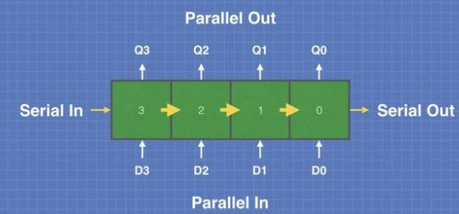
A sequential logic circuit that can be used to store or transfer binary data.
share a single clock signal, which causes the data stored in the system to shift from one location to the next.
What is Shift Register?
Fig. 1. shift register

Slide 3
Serial In − Serial Out shift register.
Serial In − Parallel Out shift register.
Parallel In − Serial Out shift register.
Parallel In − Parallel Out shift register.
Types of shift register

Slide 4
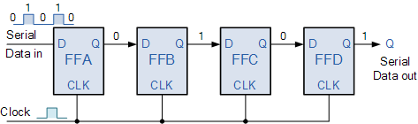
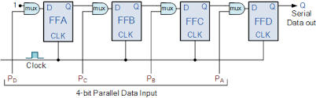
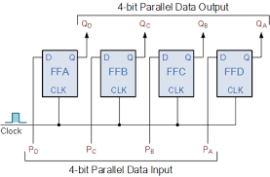
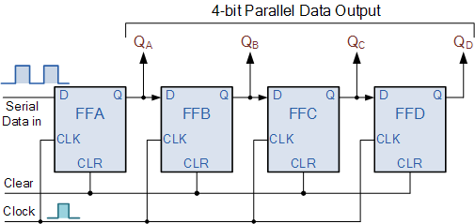
Fig. 2. SISO register
Fig. 3. PISO register
Fig. 4. SIPO register
Fig. 5. PIPO register

Slide 5
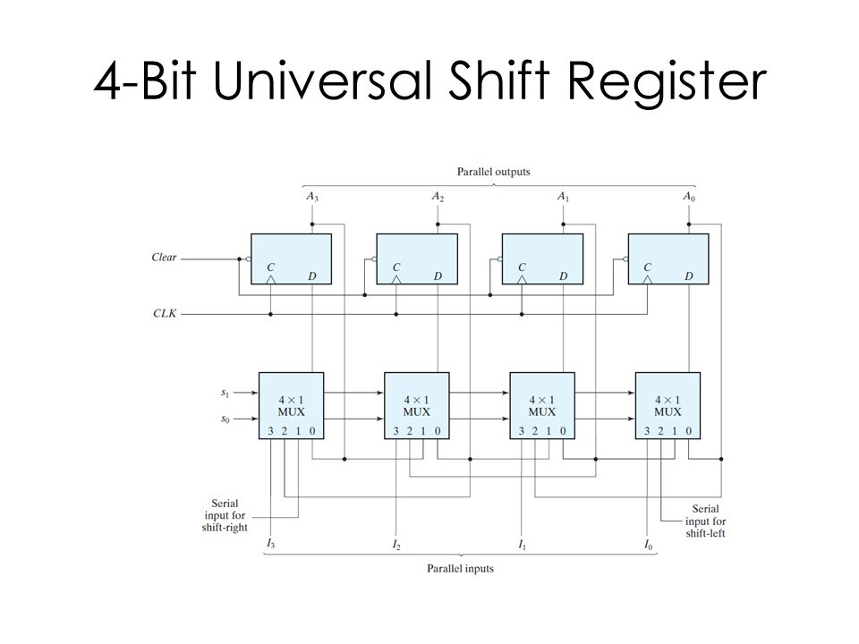
Universal shift register

Slide 6
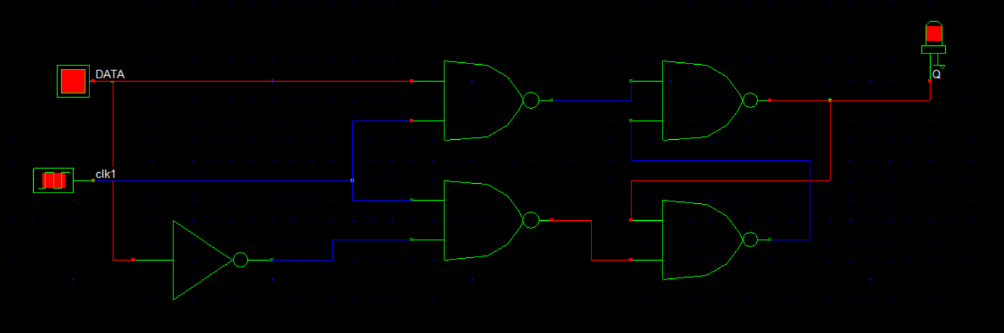
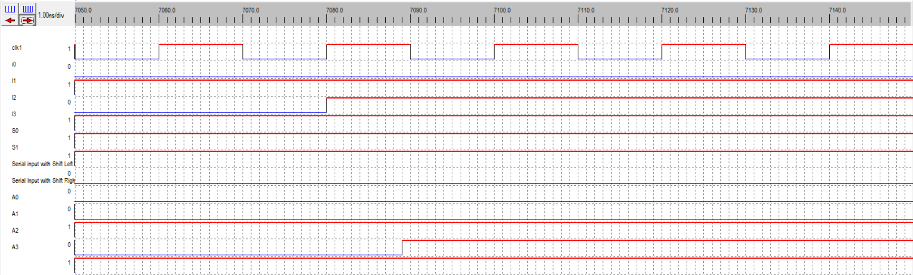
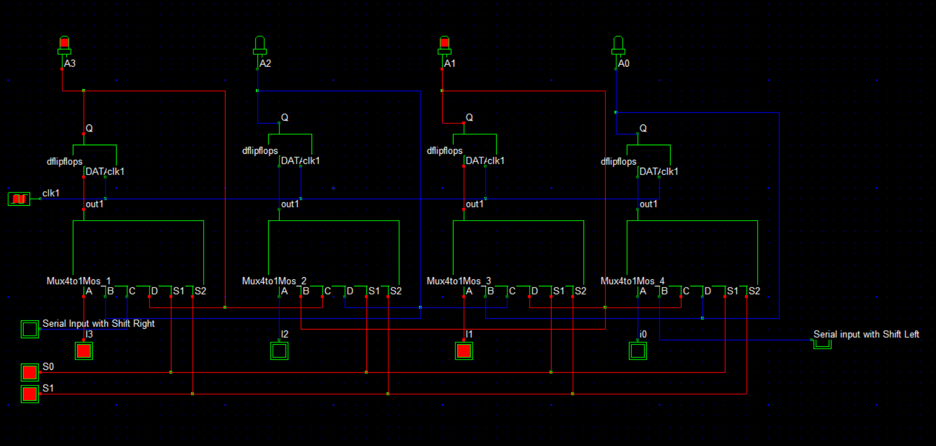
d
Different types of Flip-flops for universal shift register
Fig. 6. D flip flop

Slide 7
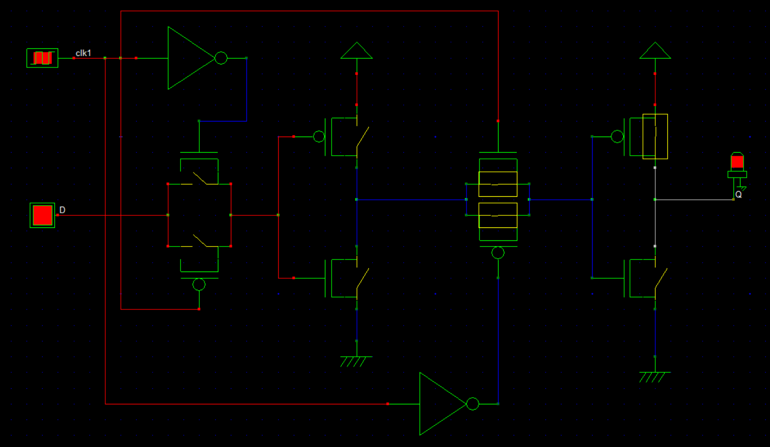
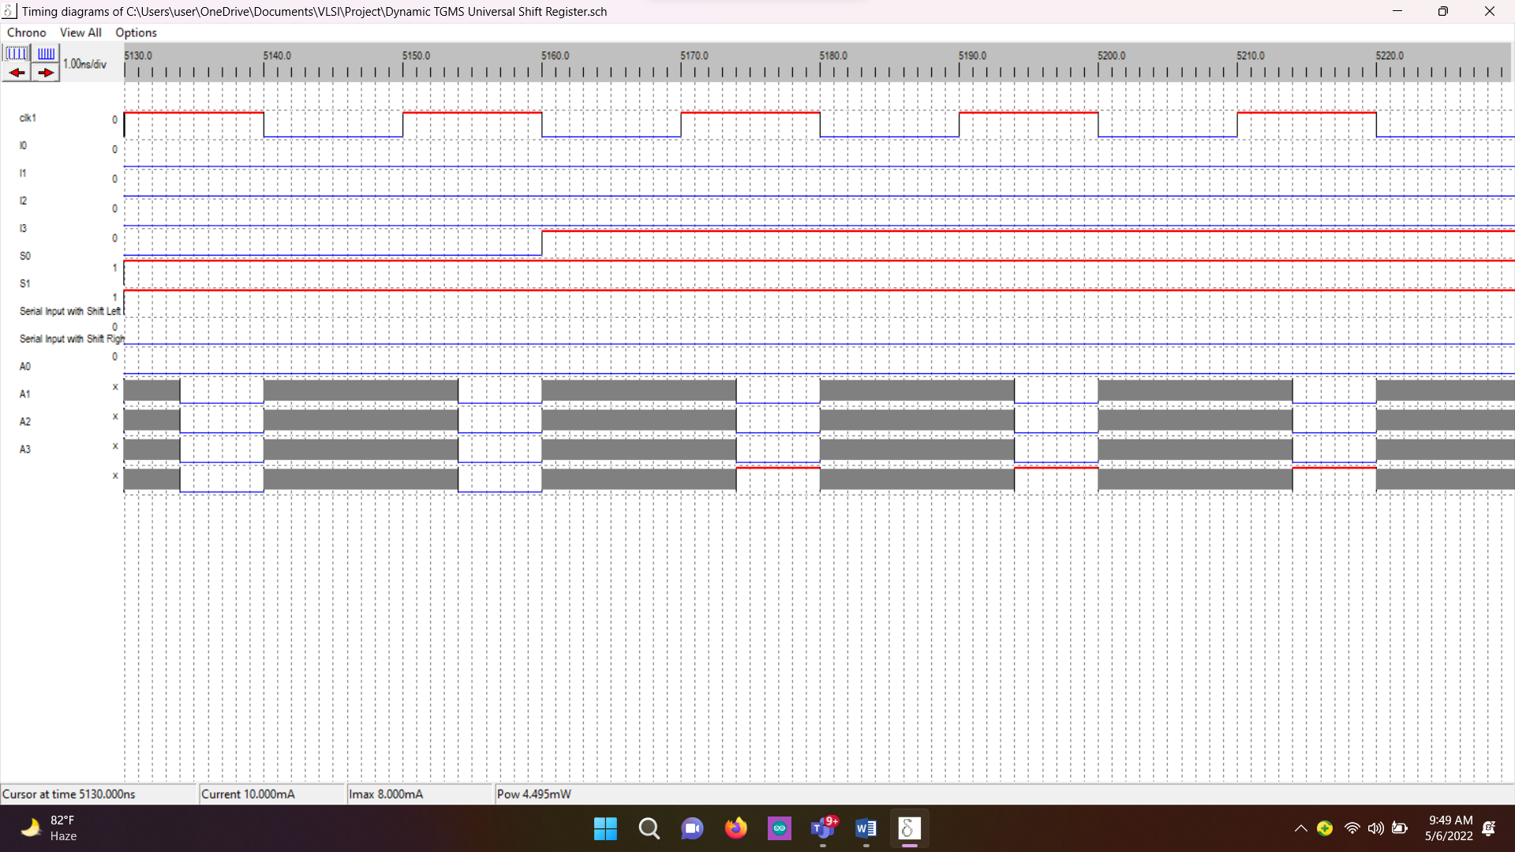
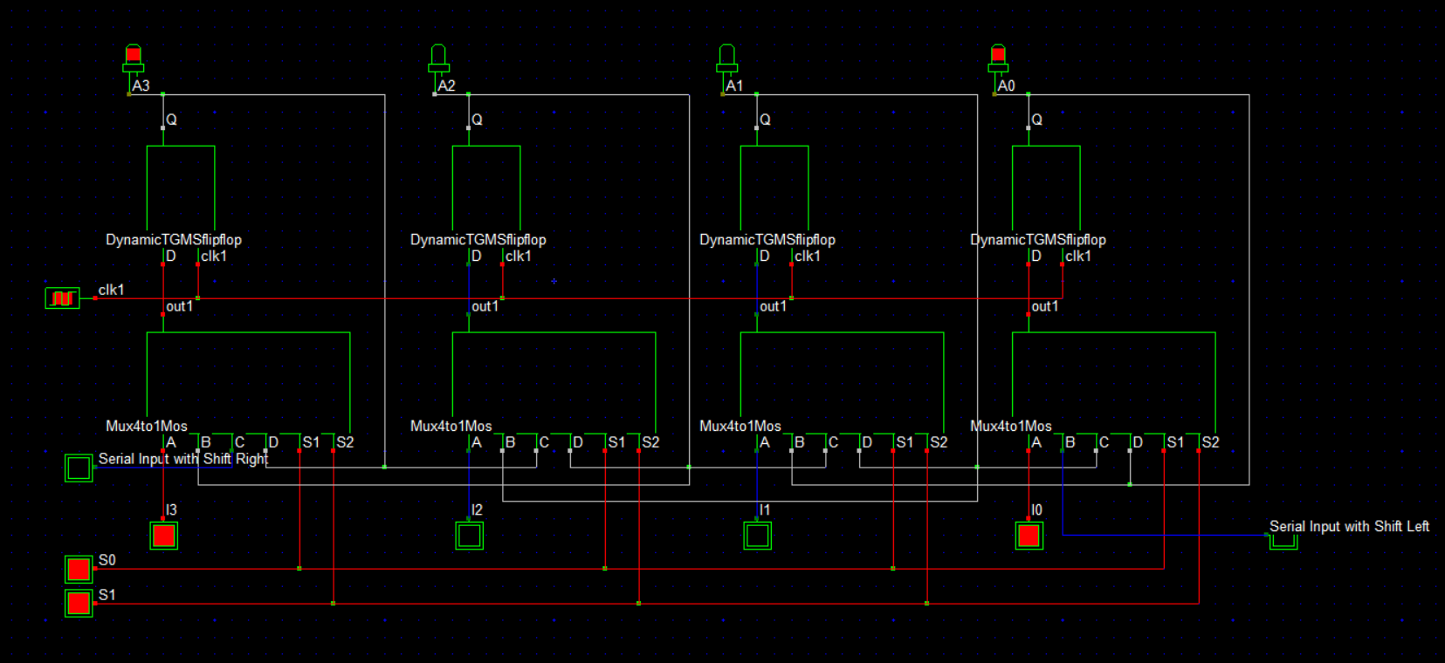
Fig. 7. Dynamic TGMS flip flop

Slide 8
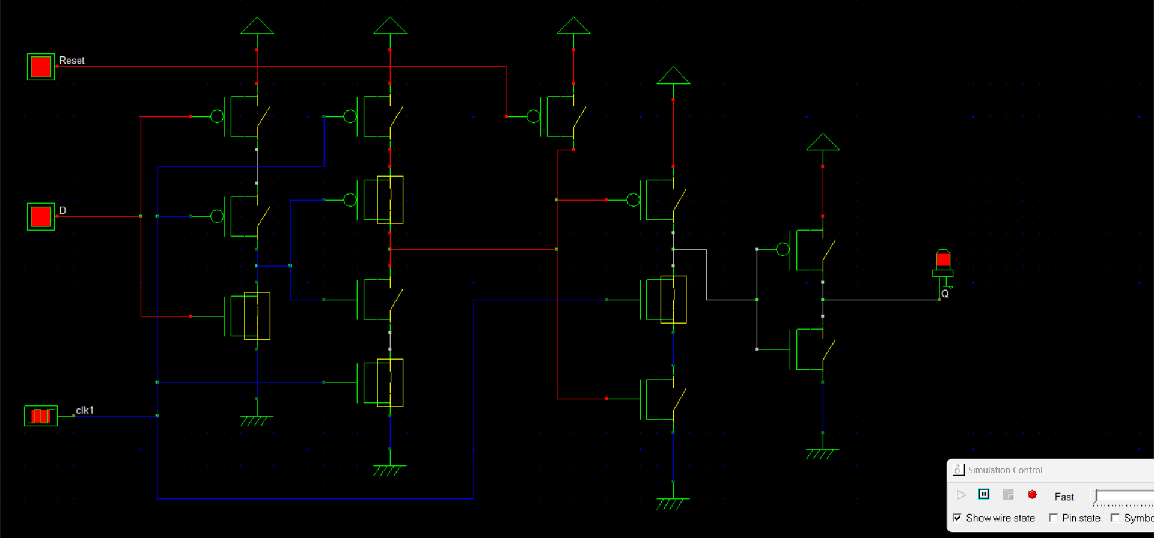
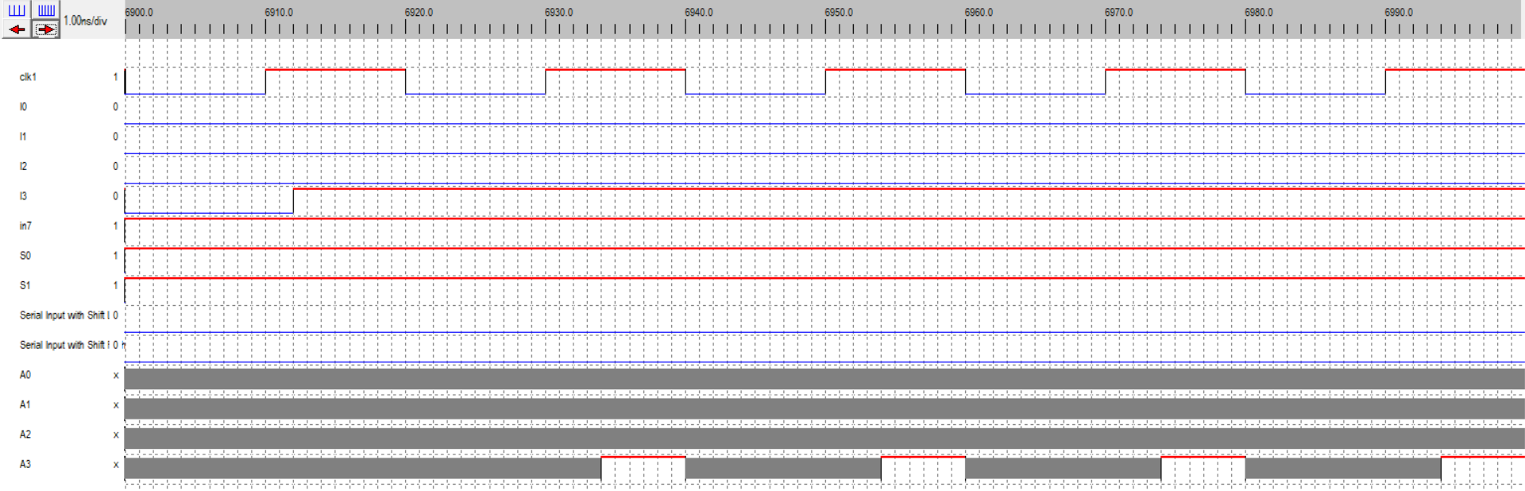
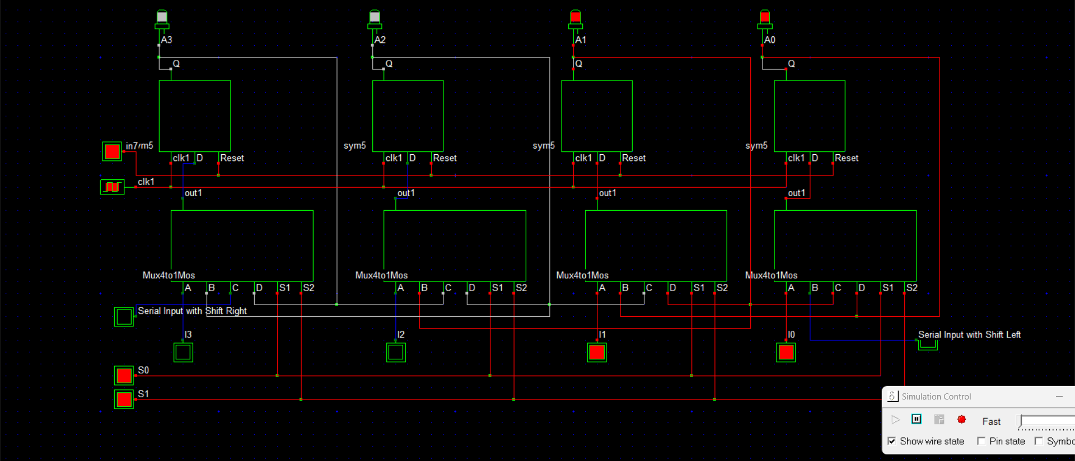
Fig. 8. MTSPC double-edge triggered flip flop

Slide 9
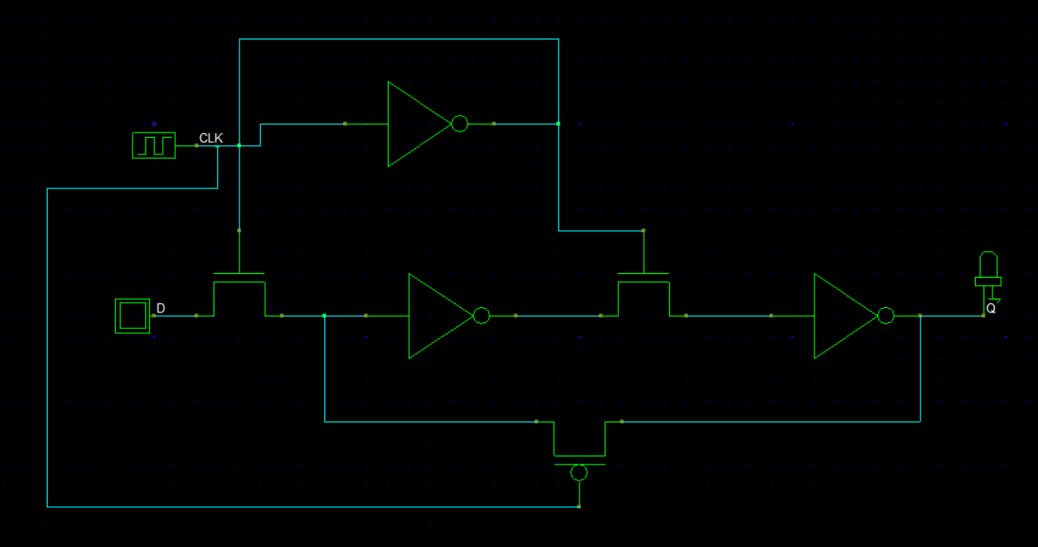
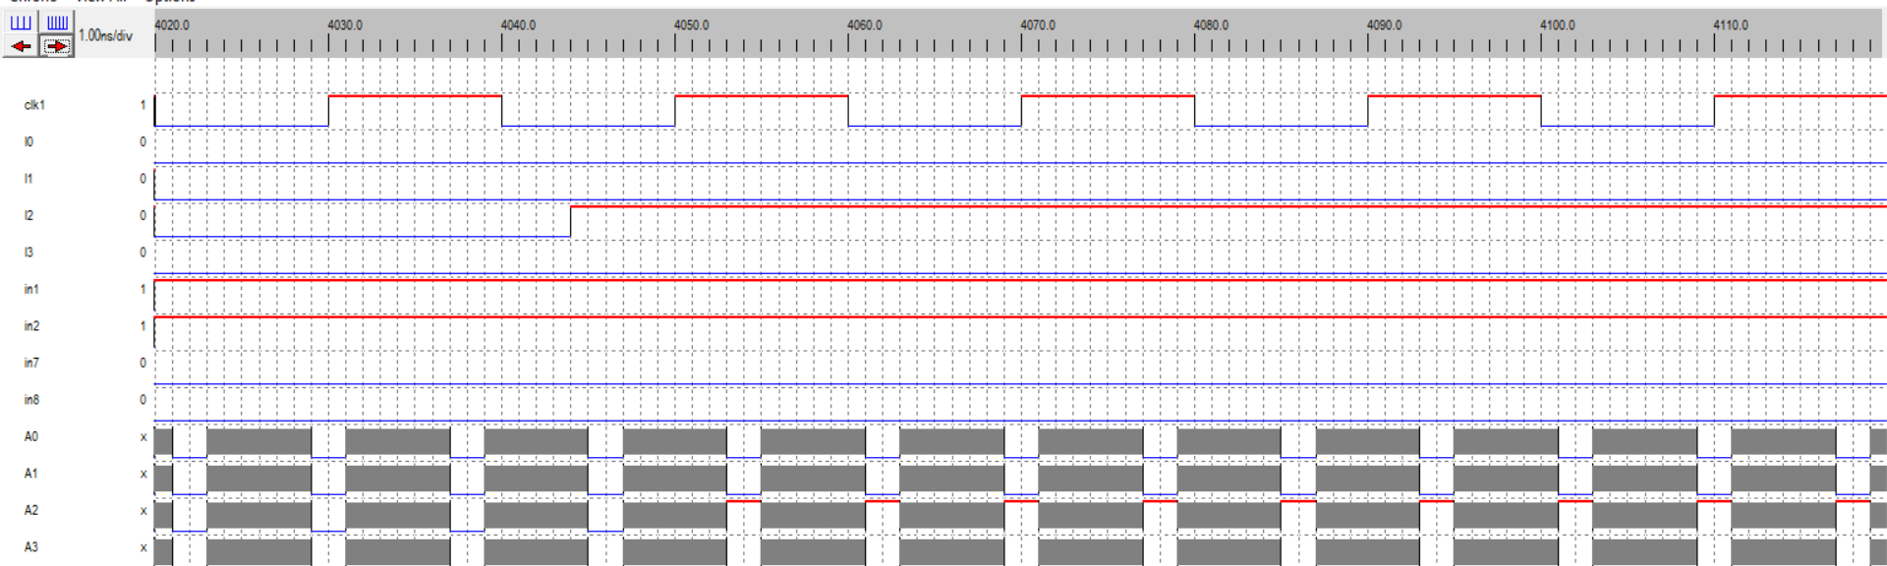
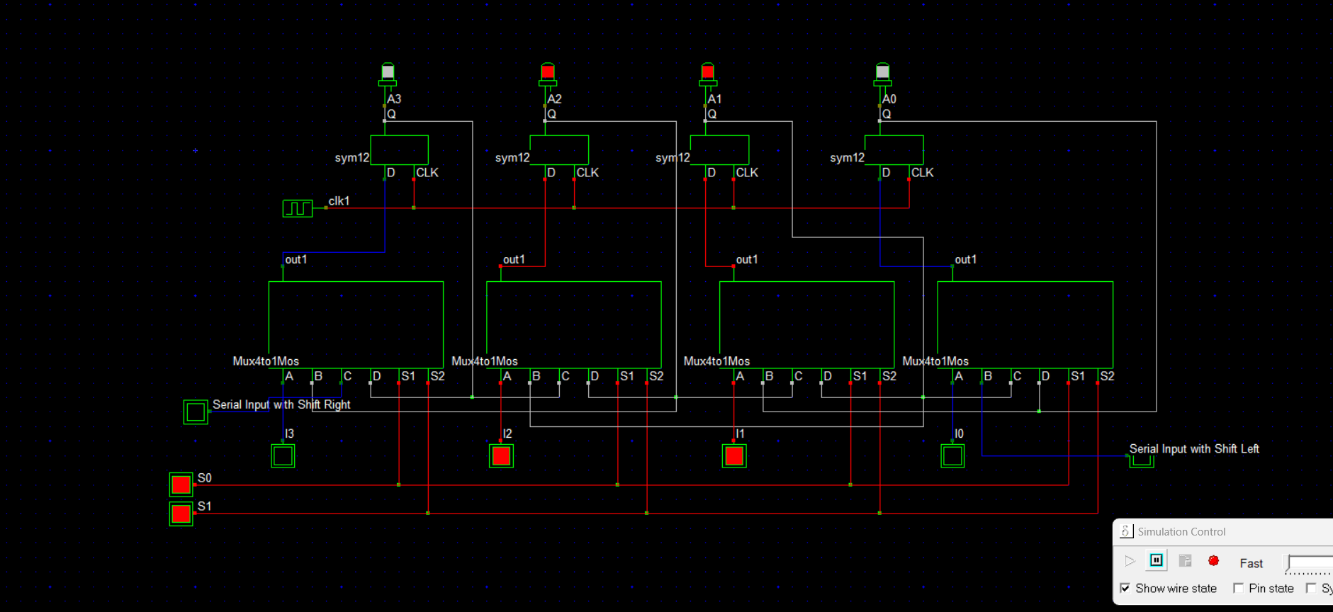
Fig. 9. TGMS D flip flop

Slide 10
Comparison
Universal Shift registers | Speed (Delay=output time-input time)
D flip flop based | 9ns
Dynamic TGMS | 14 ns
MTSPC double-edge triggered | 22 ns
TGMS | 9 ns

Slide 11
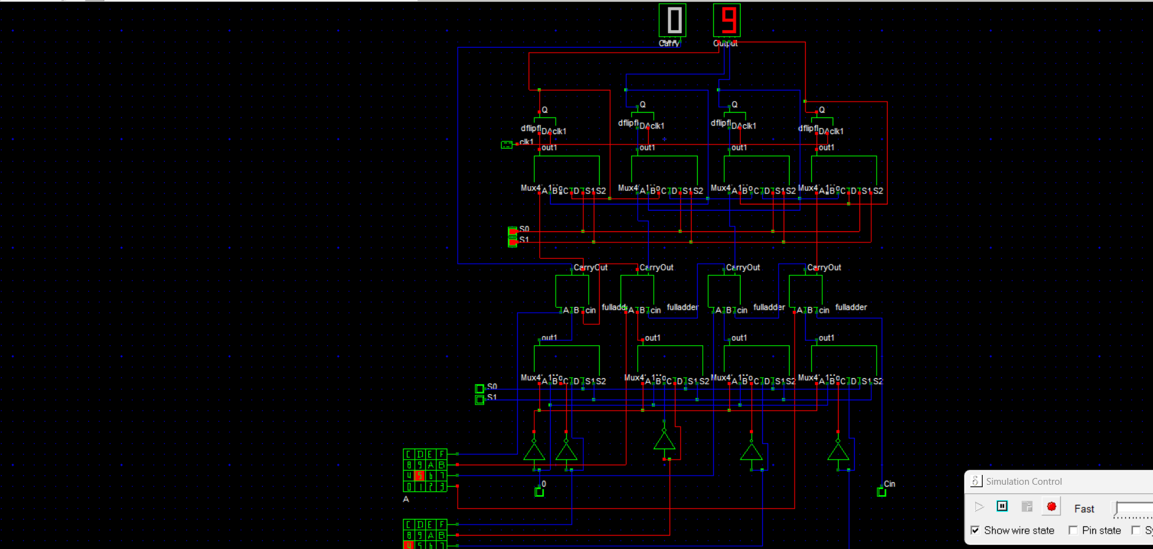
Shift register with 4 bit ALU to make memory system
Fig. 10. Memory system with D flip-flop

Slide 12
Conclusion
THANK YOU

