Slide 1


Py

Slide 2


Pre-processing
Estimate missing parameter values
Minimal usage
Holos CLI inputs
Holos CLI
User inputs
General infos
Beef
Dairy
Sheep
Fields
Holos CLI input data
General infos
Beef
Dairy
Sheep
Fields
>_
CSV
Launching
Daily weather
Post-processing

Slide 3
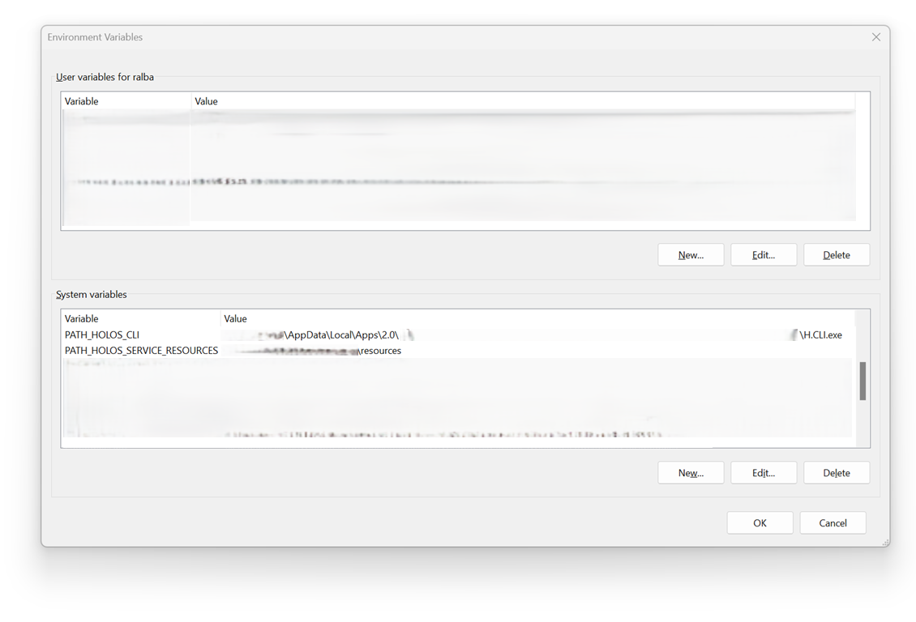
Path to the Holos CLI executable
Path to the data files of the Soil Landscapes of Canada (SLC)

