Slide 1



Suicides in Poland in 2018-2022
Monika Etrych

Slide 2
Research questions
At what age do people most often attempt suicide?
How has the number of suicide attempts changed in recent years among the youngest?
What is the trend of change in the overall number of suicide attempts in 2022 compared to 2018?
Which method was the most frequently chosen?
Which method was the most effective?
Who attempted to kill themselves more often? Women or men?
What is the trend of changes in the number of suicide attempts by gender?
Where is the number of suicides increasing faster? In the countryside or in the city?

Slide 3
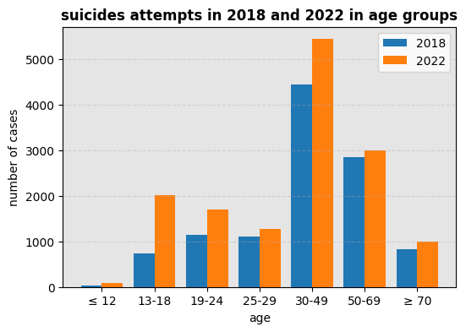
At what age do people most often attempt suicide?

Slide 4
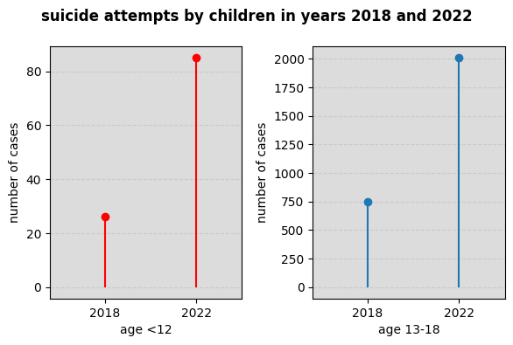
2. How has the number of suicide attempts changed in recent years among the youngest?

Slide 5
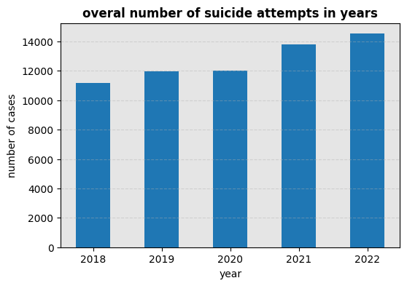
3. What is the trend of change in the overall number of suicide attempts in 2022 compared to 2018?

Slide 6
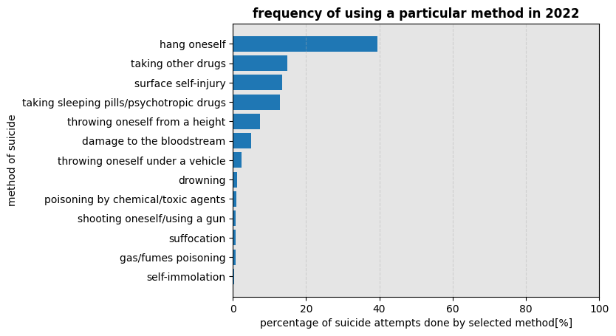
4. Which method was the most frequently chosen?

Slide 7
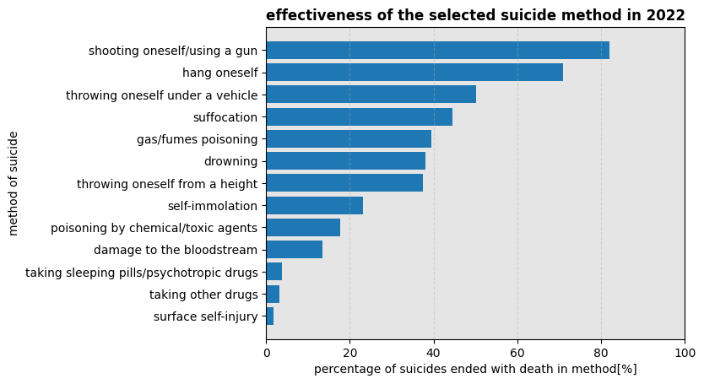
5. Which method was the most effective?

Slide 8
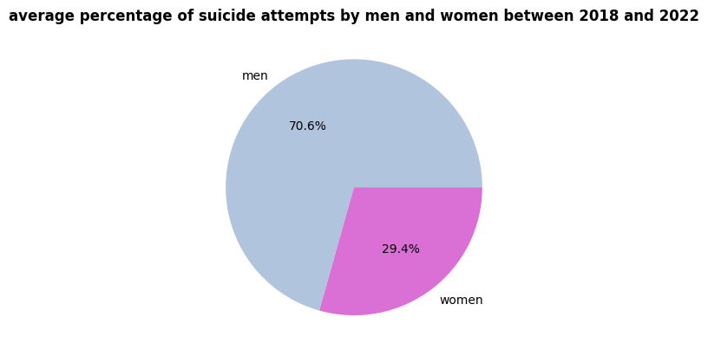
6. Who attempted to kill themselves more often? Women or men?

Slide 9
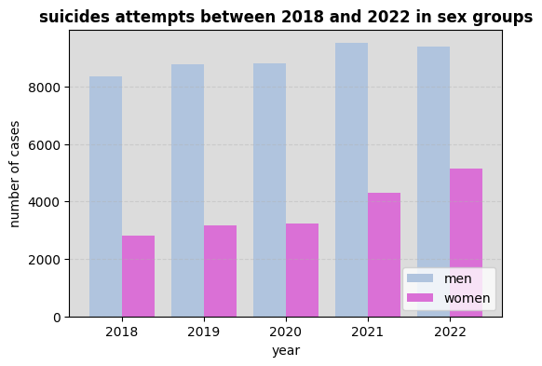
7. What is the trend of changes in the number of suicide attempts by gender?

Slide 10
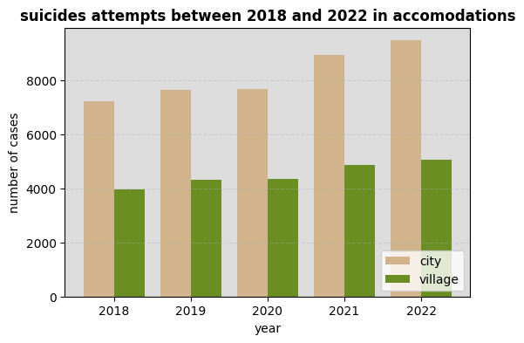
8. Where is the number of suicides increasing faster? In the countryside or in the city?

Slide 11

the end

