Slide 1


MONA LISA
MONitoring Agents using a Large Integrated Services Architecture
Ramiro Voicu
July 2003

Slide 2
Design Considerations
  Act as a true dynamic service and provide the necessary functionally to be used by any other services that require such information
  (Jini, UDDI - WSDL / SOAP)
    - mechanism to dynamically discover all the "Farm Units" used by a community
    - remote event notification for changes in the system
    - lease mechanism for each registered unit
  Allow dynamic configuration and the list of monitor parameters.
  Integrate existing monitoring tools ( SNMP, LSF, Ganglia, Hawkeye …)
  It provides:
- single-farm values and details for each node
- network aspect
- real time information
- historical data and extracted trend information
- listener subscription / notification
- (mobile) agent filters and alarm triggers
algorithms for prediction and decision-support

Slide 3
JAVA RMI & JINI
Distributed Object Systems
The Stub is linked to the Client.
The Client must know about the
service from the beginning and needs the right stub for it
“Traditional” Distributed Object Models
(CORBA, DCOM)
Server
Skeleton
CLIENT
Lookup
Lookup
Stub
Service
Service
“IDL” Compiler
Service
Stub
(Proxy)
CLIENT
Lookup
Service
Stub
(Proxy)
Lookup
Service
Dynamic Code Loading
Less Protocols !!
Any service can be used dynamically

Slide 4
Distributed Object Systems
Web Services WSDL/SOAP
UDDI
Registration
Discovery
SOAP
Server
CLIENT
WSDL
Lookup
Interface
Service
Lookup
Service
The client can dynamically generate the data structures and
the interfaces for using remote objects based on WSDL
Platform independent

Slide 5


Monitoring: Data Collection
Dynamic
Thread Pool
Other tools
(Ganglia, MRTG…)
PULL
SNMP get & walk
rsh | ssh remote scripts
End-To-End measurements
Farm
Monitor
Configuration Control
Trap
Listener
PUSH
snmp trap
WEB Server
Dynamic loading of
modules or agents
Trap Agent
(ucd – snmp) perl

Slide 6
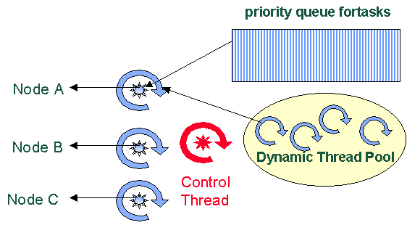
The Muti-Threaded Execution Architecture
Each request is done in an independent thread
A slow agent / busy node does not perturb the measurements of an entire system
Ex: Monitor 300 nodes @ 30 seconds interval →10-15 Threads are running in parallel

Slide 7
Farm Monitor UNIT & Data Handling
Monitor
Data Stores
Client
(other service)
Web client
Config
Lookup
Service
WEB
Service
WSDL
SOAP
Status
Discovery
Registration
Data
data
Client
(other service)
Java
Data Cache
Service
InstantDB
MySQL
Postgres…
Predicates & Filter Agents
Farm
Monitor
Other tools
Configuration Control
MySQL
User defined loadable
Modules to write /sent data
MDS

Slide 8
Data Handling
Data Model
Configuration Farm , Function (Cluster), Node, Module
Monitored Values {Parameter, Value}
(Automatic) Mapping of the Data Model in :
    XML, SQL, SOAP, …
Configuration & Results objects are store in a DB
    (dynamically configurable for InstanDB, Postgres, MySQl, Oracle … )
Subscription to results objects matching a template / predicate
Clients can load filter objects into the Data Cache service and generate any derived (or aggregate) data structures and register to receive them.
Monitored parameters have a life time
TIME

Slide 9
Data Collection Modules
MonaLisa is a monitoring Framework:
SNMP (walk and get )
Scripts , dedicated application (programs) which may be invoked on remote systems
Interface to Ganglia
Interface to LSF and PBS
Interface to Hawkeye (Wisconsin)
Interface to LDAP ( MDS ) ( Florida)
Specialized modules for VRVS

Slide 10
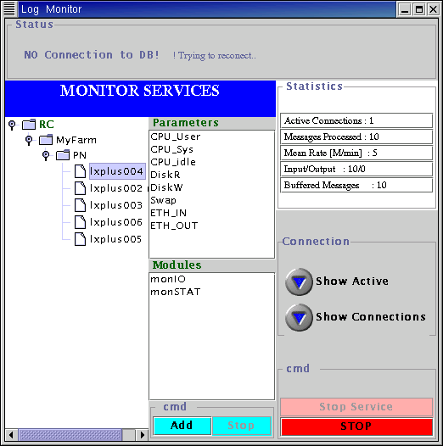
RC Monitoring Service
Registration with several Lookup discovery services
Lookup
Service
Discovery
Client
(other service)
Lookup
Service
Proxy
RC
Monitor
Service
Component Factory
GUI marshaling
Code Transport as “service attribute”
RMI data access
Farm
Monitor
Farm
Monitor

Slide 11
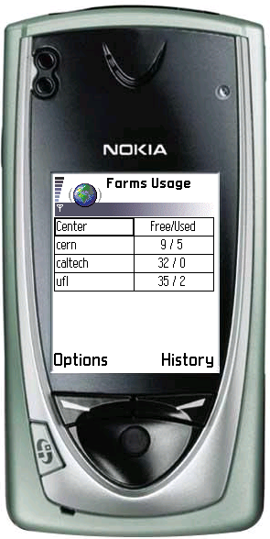
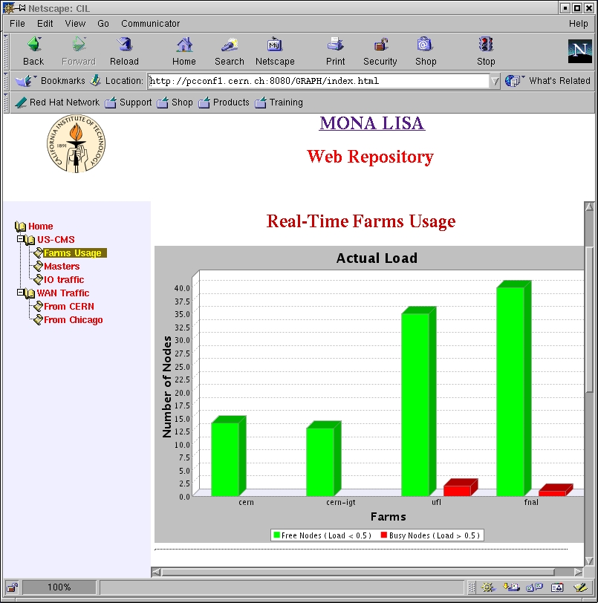
Pseudo – Clients & Dedicated Repositories
Lookup
Service
MySQL
IDB
MonaLisa
Service
Discovery
WAP
Filter Agents / Data
TOMCAT
JSP/servlets
Pseudo Client
WEB
Filter Agents / Data
MySQL
MySQL
IDB
MonaLisa
Service
Lookup
Service

Slide 12
Secure – Automatic Update Mechanism
for Services and Clients
Lookup
Service
Key store
MonaLisa
Service
Web Server
Sign Distribution
Discovery
download
Update Signal SSL
download
Admin Client
Update Signal SSL
Key
Key store
MonaLisa
Service
All running services are update using the discovery mechanism
At startup each service check if it an update is done at a set of Web Servers
Clients use the Web Start mechanism
Lookup
Service

Slide 13
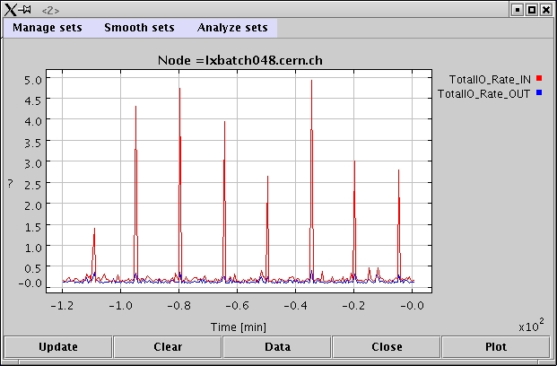
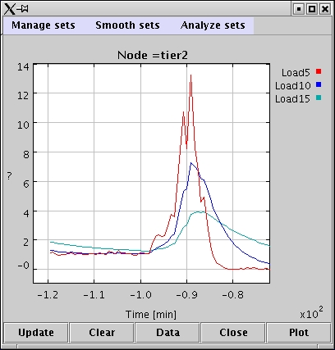
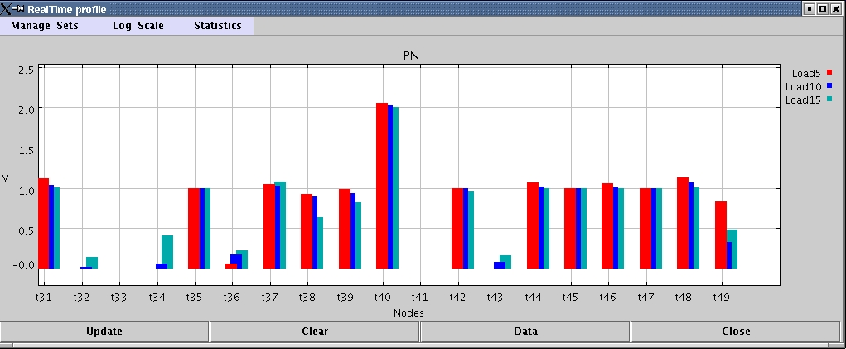
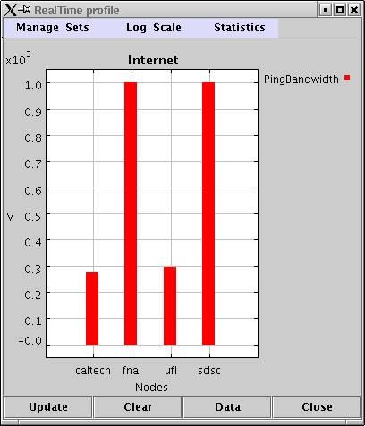
Access to historical and real-time values
Past values are presented and the GUI
remains a registered listener and
the new vales are added
Real Time Histograms for various parameters

Slide 14
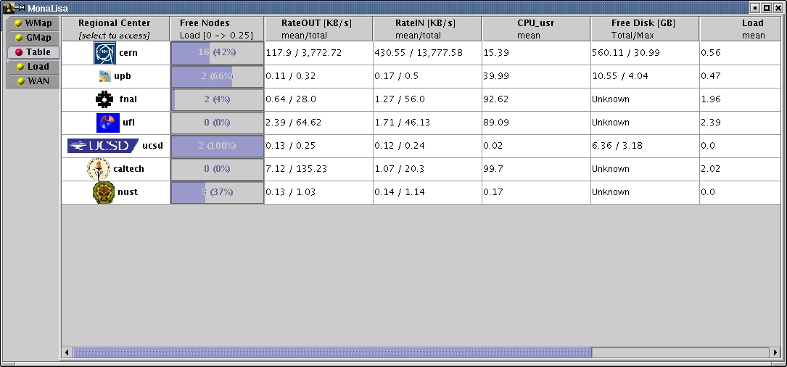
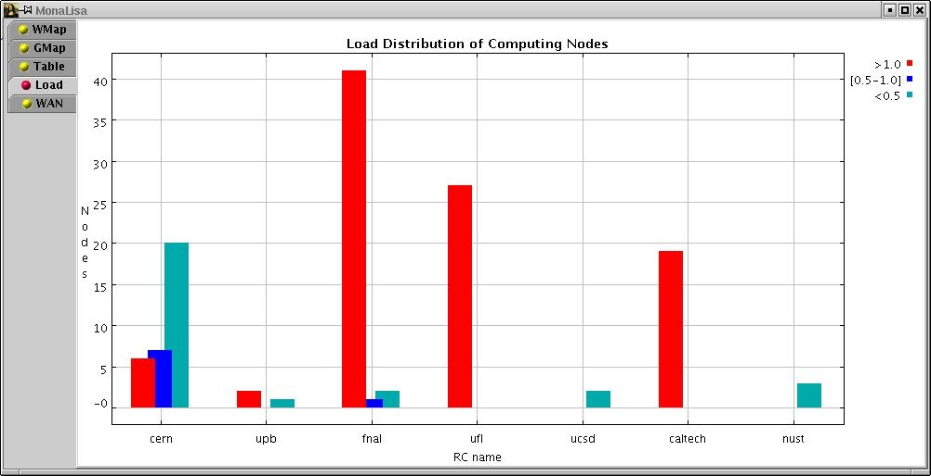
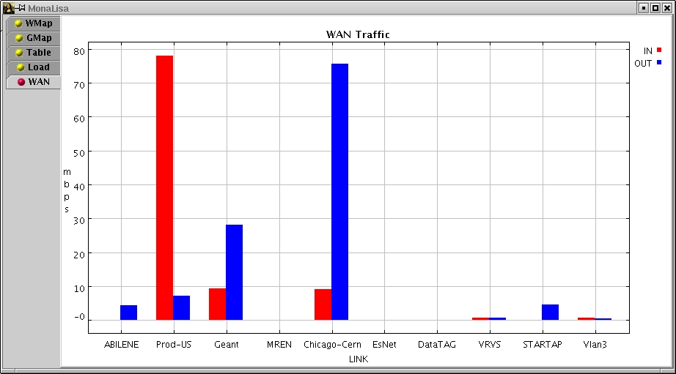
Global Views : CPU, IO, Disk, Internet Traffic …

Slide 15
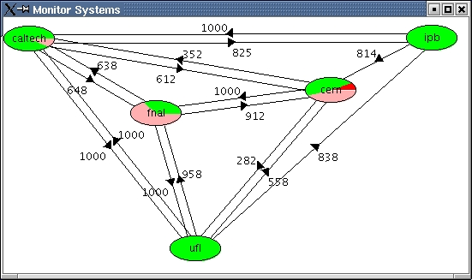
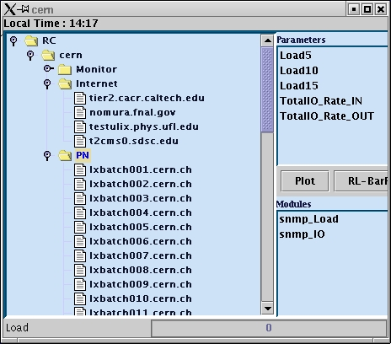
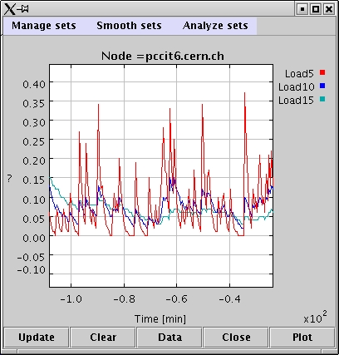
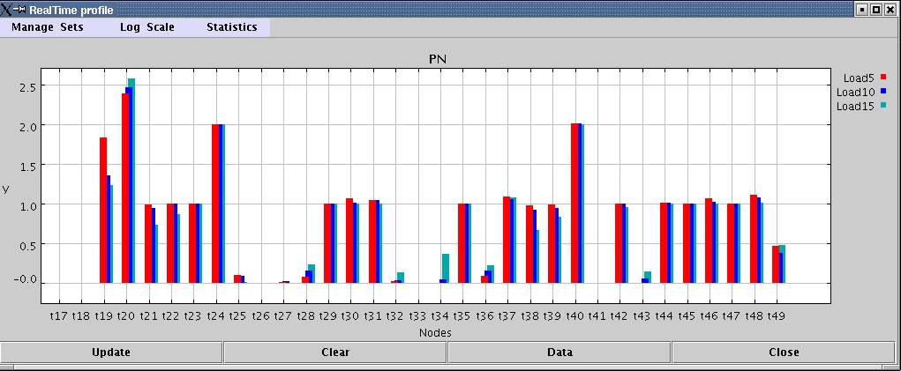
Regional Centers Discovery & Data access

Slide 16
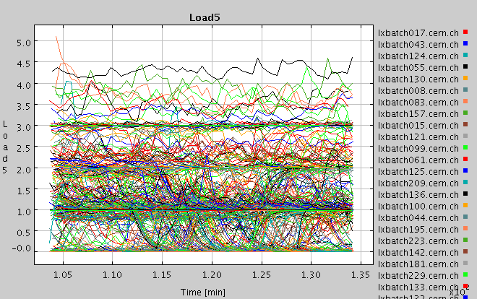
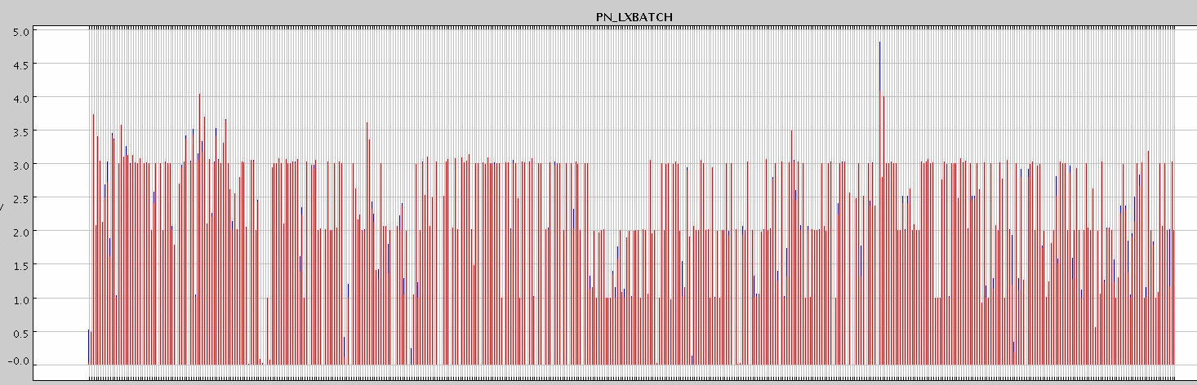
Real-time Data for Large Systems
“lxshare” cluster at cern ~ 600 ndoes

Slide 17
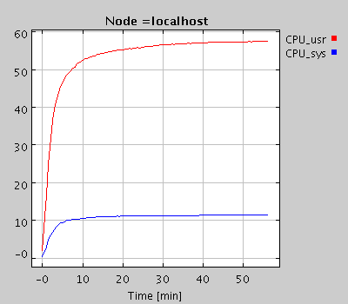
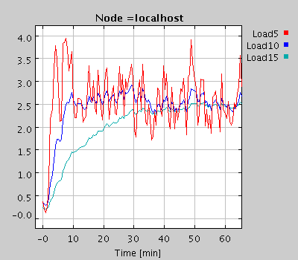
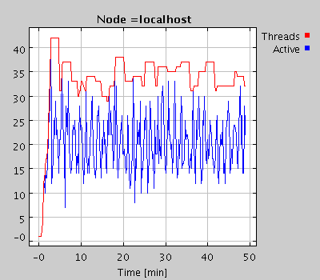
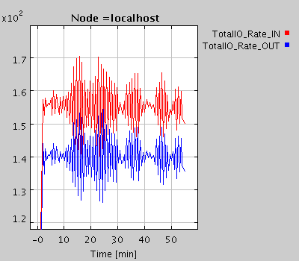
Performance Test: a large snmp query
(~200 metrics values) on a 500 nodes farm every 60 s.
~ 1600 metrics values collected per second.
Dell I8100
~ 1GHz
CPU Usage
Load
IO
Threads

Slide 18
SUMMARY
MonaLisa is able to dynamically discover all the "Farm Units" used by a community and through the remote event notification mechanism keeps an update state for the entire system
Automatic & secure code update (services and clients) .
Dynamic configuration for farms / network elements. Secure Admin interface.
Access to aggregate farm values and all the details for each node
Selected real time / historical data for any subscribed listeners
Active filter agents to process the data and provided dedicated / customized information to other services or clients.
Dynamic proxies and WSDL pages for services.
Embedded SQL Data Base and can work with any relational DB. Accepts multiple customized Data Writers (e.g. to LDAP) as dynamically loadable modules.
Embedded SNMP support and interfaces with other tools ( LSF, Ganglia, Hawkeye…) . Easy to develop user defined modules to collect data.
Dedicate pseu-clients for repository or decision making units
It proved to be a stable and reliable service

Slide 19
CONCLUSIONS
MonaLisa is NOT a monitoring or graphic tool. The aim is to provide a flexible and reliable MONITORING SERVICE for higher level services in distributed systems.
Code mobility paradigm provides the mechanism for a consistent, correct invocation of components in large, distributed systems. Filters and trigger agents can be dynamically deployed to any service unit to provide the required monitoring information to clients or other services.
MonaLisa is a prototype service under development. Suggestions to improve it, to better describe network elements and computing systems are welcome.
http://monalisa.cacr.caltech.edu/

