Slide 1


RESEARCH METHODOLOGY
Literature Review in Research
Student name: Monirojjaman Ayoive
Department of ICT, MBSTU
Notes:
Today we will look at what a literature review does and how its main parts fit together. We will also compare a few fictional study examples to see how comparison can reveal limits and gaps.

Slide 2
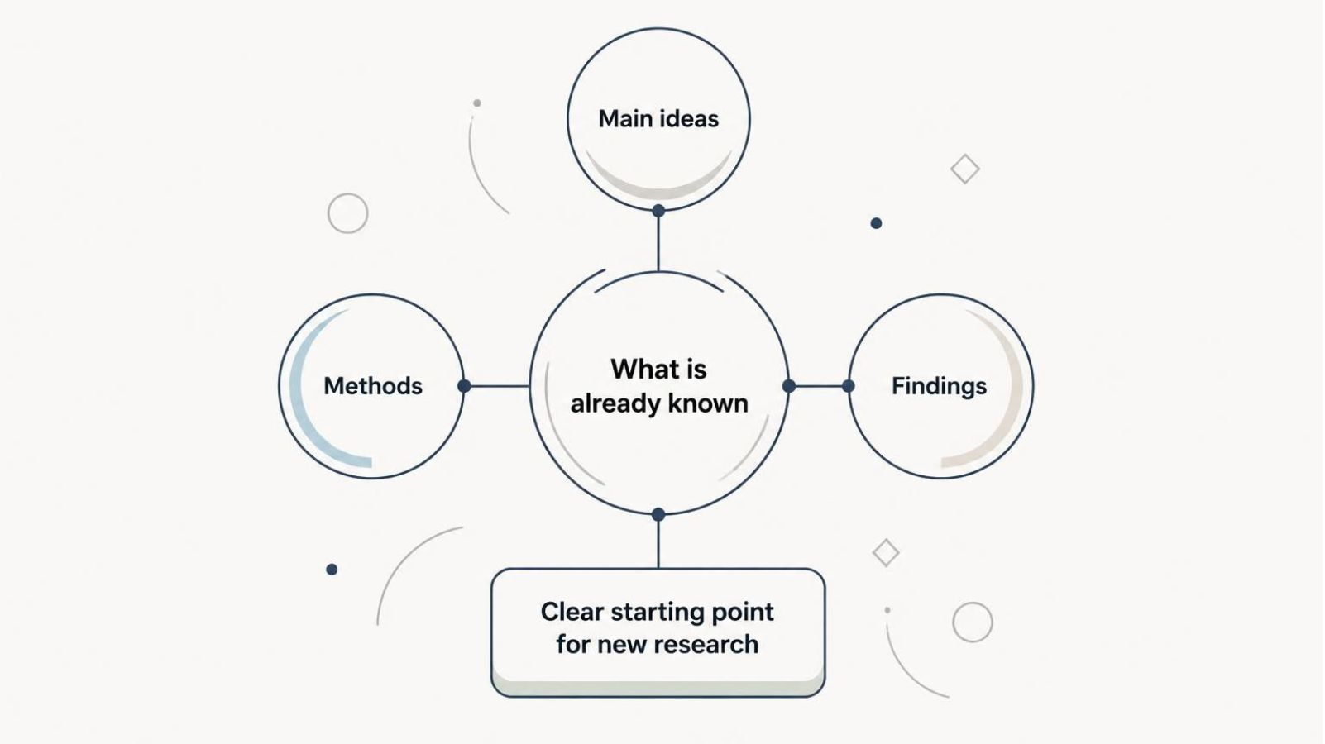
THE BASIC IDEA
A literature review studies what is already known
It brings earlier research together to show what a field has learned so far.
Notes:
A literature review is a review of previous research about a topic. It brings together the main ideas, methods, and findings. This helps readers understand the research area and gives new research a clear starting point.

Slide 3






WHY IT MATTERS
A literature review gives new research a strong foundation
Understand previous research
Find existing knowledge
Avoid repeating the same work
Identify limits in earlier studies
Find research gaps
Build a foundation for new research
Notes:
The review does more than describe earlier studies. It helps us understand the field, avoid repeating work, and notice limits. Those limits can point to a research gap. The gap then helps shape a new study.

Slide 4
CHAPTER MAP
Five parts organize the literature review
Together, they guide readers from the review’s purpose to its main takeaway.
01
02
03
04
05
Introduction
Theoretical background
Related work
Research gap
Summary
Sets the topic and scope.
Reviews earlier studies.
Names what is missing.
Brings the chapter together.
Explains key ideas.
Notes:
These five parts give the chapter a clear route. First, tell readers what the review covers. Then explain the ideas behind the topic and examine related studies. Use that review to identify a gap. End by bringing the main points together.

Slide 5
PART 1 · INTRODUCTION
The introduction tells readers what this review covers
A good introduction gives readers a map before they enter the chapter.
Set the direction
Draw the boundary
Give a brief overview of the chapter. State the topic and purpose so readers know why this review matters.
Define the scope: what the review includes. Explain how the chapter is organized so readers know what comes next.
Notes:
The introduction is a short guide to the chapter. It names the topic and purpose, gives a brief overview, and explains the review’s scope. It also shows how the chapter is organized, so readers can follow the discussion.

Slide 6
PART 2 · THEORETICAL BACKGROUND
Theoretical background explains the ideas behind the topic
Move from shared language to the ideas and models that help explain the research topic.
01
02
03
04
Definitions
Theories
Models
Connection
Clarify important terms readers need to understand.
Introduce the key theories and concepts linked to the topic.
Describe useful models or frameworks.
Show how these ideas relate to the research topic.
Notes:
This section gives readers the ideas they need to understand the topic. Start with clear definitions. Then explain the key theories, concepts, and useful models. Most importantly, show how those ideas connect to the research topic.

Slide 7



PART 3 · RELATED WORK
Related work shows what other researchers have done
Compare each study across the same questions to make its contribution and limits clear.
Problem and question
What issue did the study examine?
Method
How did the researchers investigate it?
Dataset or study area
What information or setting did they use?
Findings
What did the study report?
Limitations
What could the study not answer?
Notes:
Related work examines what other researchers have done. For each study, ask what problem it addressed, which method it used, and what data or study area it covered. Then note its findings and limitations. This makes it easier to compare studies instead of treating them as a list.

Slide 8
PART 3 · COMPARING STUDIES
Example Studies: compare research, do not only list it
FICTIONAL EXAMPLES · FOR DEMONSTRATION ONLY · NOT REAL RESEARCH
Author & Year | Problem | Method | Dataset | Result | Limitation
Rahman (2022) | Low student app use | Survey | 120 students | Use increased with reminders | One university
Sultana (2023) | Slow image labeling | Simple model | Small image set | Labeling time fell | Small dataset
Karim (2024) | Weak online support | Interviews | 15 teachers | Support needs were mapped | Short study period
Notes:
These fictional examples show how a comparison table works; they are not real studies. The shared columns make differences easy to see. Each example has a different problem and method, and each has a limitation. Comparing those limits can help a researcher decide what to examine next.

Slide 9
PART 4 · RESEARCH GAP
A research gap is the missing part in existing knowledge
Ask what is missing, weak, unclear, or not tested in previous research. The gap points toward useful new research.
1
2
3
4
5
Previous research
Limitations
Missing area
Research gap
New research
What are its limits?
What remains unclear?
What needs attention?
How can a study respond?
What has been studied?
Notes:
A research gap is not simply a topic that has never been studied. It can also be something that is weak, unclear, or not yet tested. Read earlier research closely, note its limits, and identify what is missing. That gap can guide a new study.

Slide 10
PART 5 · SUMMARY
The summary brings the chapter together
Close by connecting the ideas and evidence that lead to the research gap.
Main ideas
Earlier research
Limits and gap
Recall the theories and concepts that frame the topic.
Bring together the important studies and their findings.
Show what earlier studies could not answer and what remains open.
A clear review connects what we know with what we still need to learn.
Notes:
The summary should bring the chapter’s main theories, concepts, studies, and findings together. Remind readers of the limits in earlier work, then restate the gap your research will address. That connection gives the next chapter or study a clear starting point.

