Slide 1


About
Internship
IOT Based Smart Paper Weight
Project By – 1) RISHIKESH KIRDE
2) MONAL MESHRAM
3) AMIT TAVASKAR
4) HRISHIKESH MEHTRE
Under The Guidance
Of
PROFESSOR VINOD JADAV
Sponsored By

Slide 2
About
Project

Slide 3
Concept

Slide 4

How It Works?
Bulb

Slide 5
Bulb

Slide 6
Bulb

Slide 7

Fan
Bulb

Slide 8
Fan
Bulb

Slide 9
Fan
Bulb

Slide 10
Fan
Bulb

Slide 11
Fan
Bulb

Slide 12
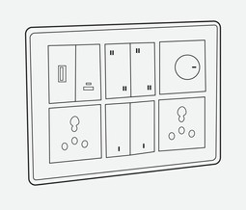

System Diagram
Fan
Bulb
Receiver
Transmitter

Slide 13
Arduino Nano
Transmitter Block Diagram
GYRO
RGB LED
System Diagram
Receiver
Transmitter
nRF
Touch Sensor
Battery
Wireless Charging Coil
BMS

Slide 14
Receiver
Block Diagram
Relay
System Diagram
Transmitter Block Diagram
nRF
Arduino Nano
GYRO
RGB LED
Touch Sensor
nRF
Wireless Charging Coil
BMS
Battery
Receiver
Transmitter
Corel Draw
Proteus
Fusion 360
Arduino IDE
Arduino Nano
Servo Motor

Slide 15
Arduino Nano
Required Software
GYRO
RGB LED
Transmitter Block Diagram
Receiver
Block Diagram
Arduino Nano
nRF
Corel Draw
Proteus
Relay
Fusion 360
Arduino IDE
Servo Motor
nRF
Touch Sensor
Wireless Charging Coil
Battery
BMS

Slide 16
Required Hardware
Required Software
Receiver
Block Diagram
Arduino IDE
Fusion 360
Fecl3
PCB
Corel Draw
Acrylic
Proteus
Drilling
Components
Soldering

Slide 17
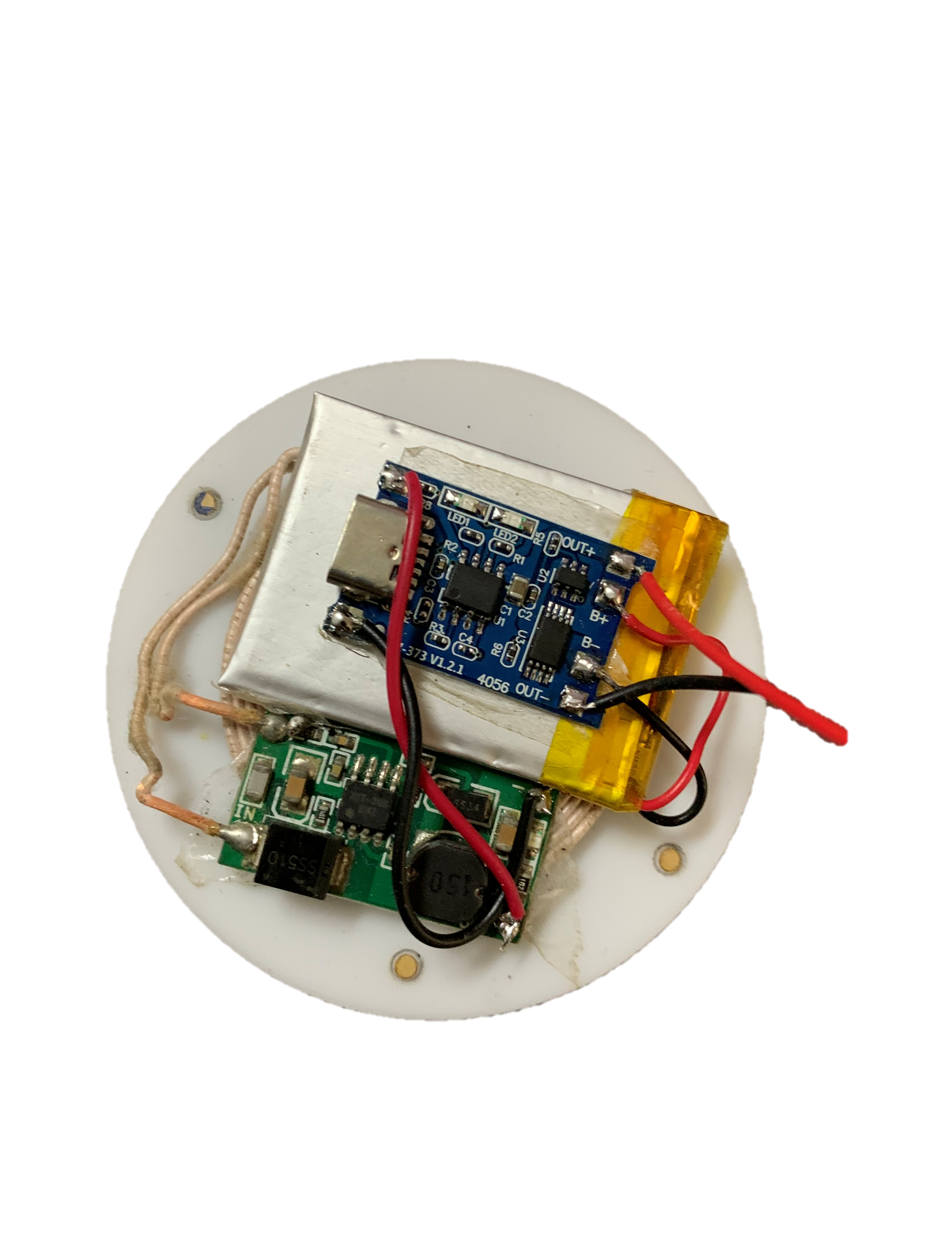
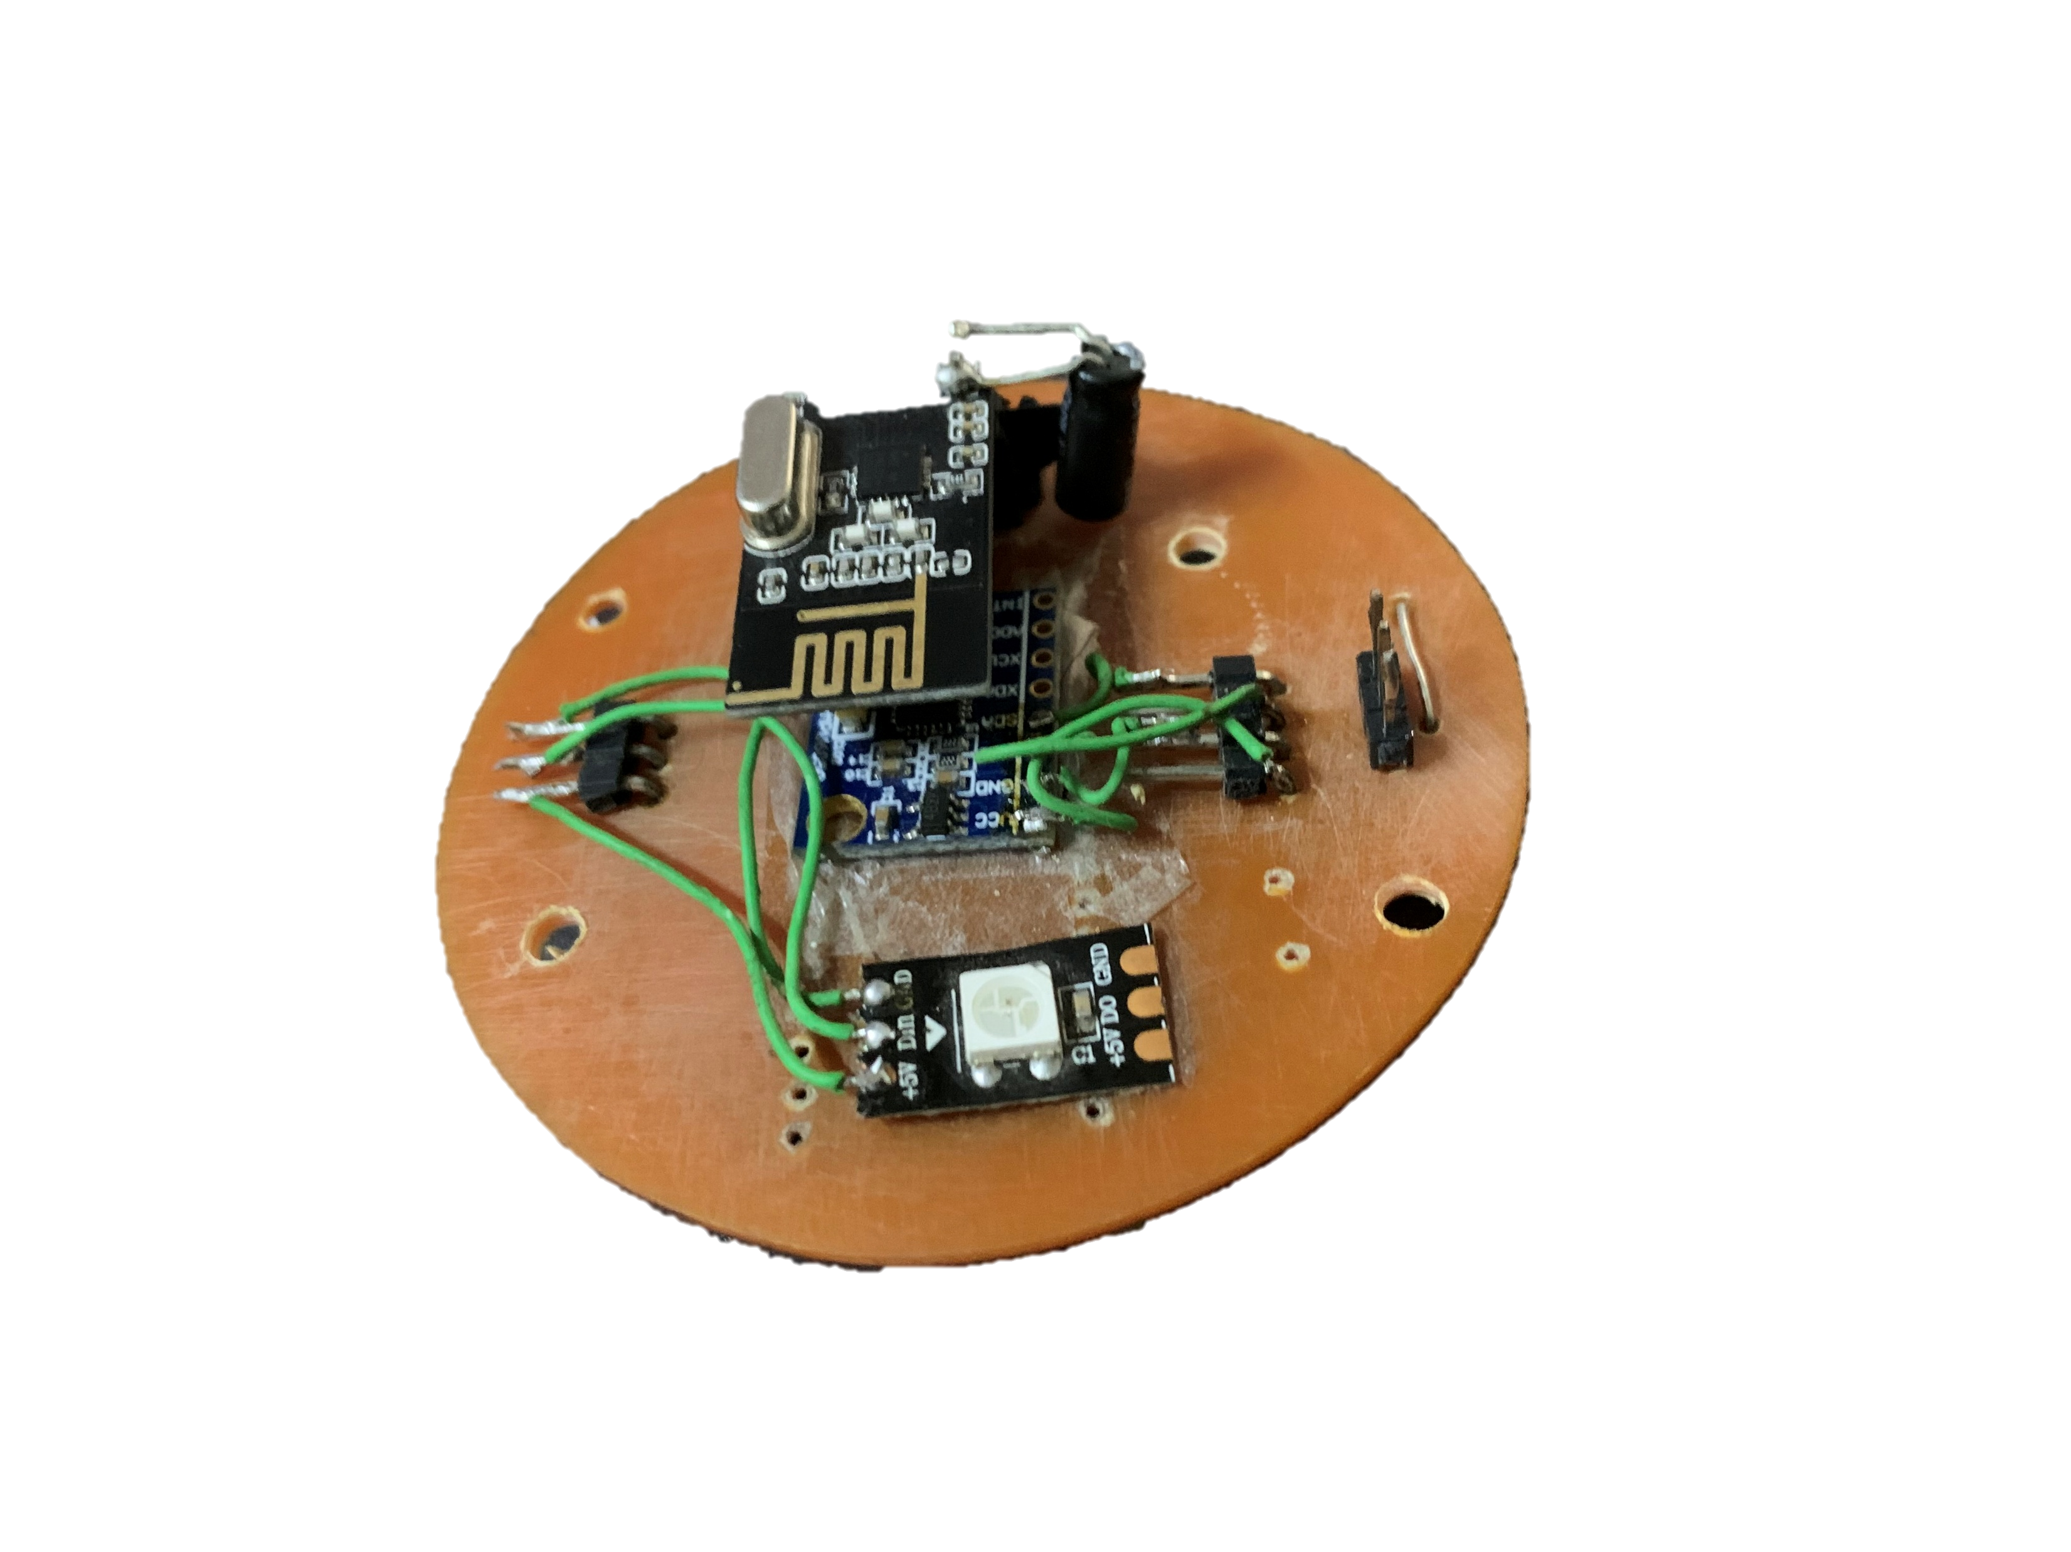
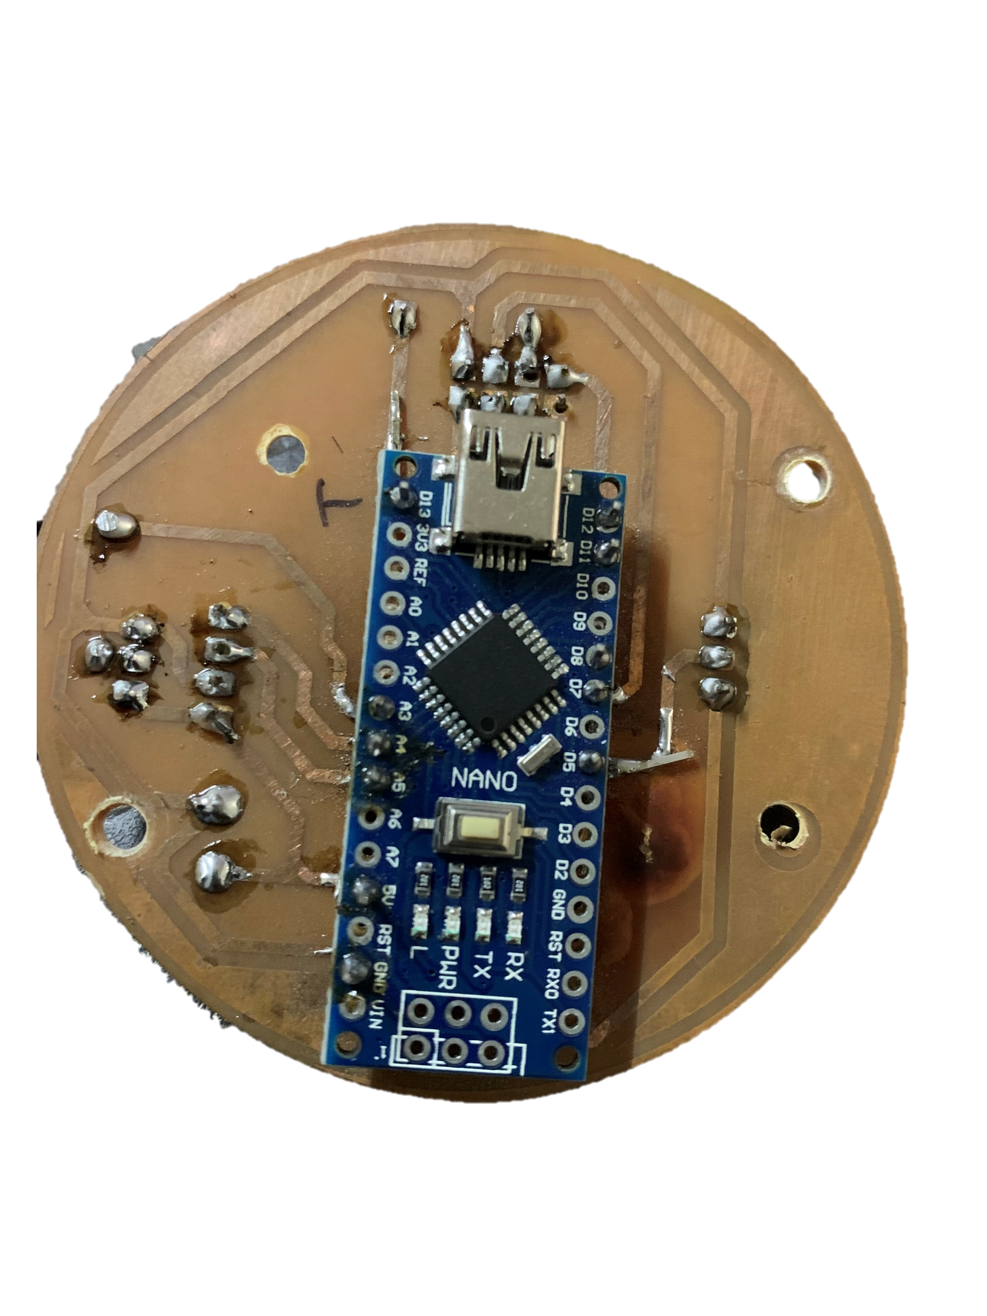
Conclusion
Required Hardware
Required Software
PCB
Drilling
Soldering
Fecl3
Components
Acrylic

Slide 18
Thank You
Conclusion
Required Hardware

Slide 19

Thank You
Conclusion
We would specially like to thank Jadhav Sir for guidance and effective support

