Slide 1

Credit Analysis
-By Monalisa Shekhawat

Slide 2
Project analysis slide 2
Problem Statement
The loan providing companies find it hard to give loans to the people due to their insufficient or non-existent credit history. Because of that, some consumers use it as their advantage by becoming a defaulter.
When the company receives a loan application, the company has to decide for loan approval based on the applicant’s profile.
When the company receives a loan application, the company has to decide for loan approval based on the applicant’s profile. Two types of risks are associated with the bank’s decision:
If the applicant is likely to repay the loan, then not approving the loan results in a loss of business to the company
If the applicant is not likely to repay the loan, i.e. he/she is likely to default, then approving the loan may lead to a financial loss for the company.

Slide 3
Project analysis slide 3
Steps
MISSING
VALUES
OUTLIERS
DATA
IMBALANCE
ANALYSIS
CONCLUSION
Check for the missing value in data , identify missing values and steps to handle
Identify outliers and erroneous data and ways to handle the data
Identify data imbalance and its ratio with respect to target columns and other variables
Perform univariant, bivariant analysis and find correlation between variables
Draw meaningful insights from the data to help better understanding of data and decide on actions needed.

Slide 4
Project analysis slide 4
Missing Value
50-100
Drop column
Median
Skew data for numerical data type
Data Type
Null Value
15-50
Create new category
Mean
Normalized data for numericall data type
Mean
Identify datatype of each column in data frame
Find Percentage of null value in each columns
Impute mean/
median / mode
0-15
For Categorical dtaa
Mode

Slide 5
Project analysis slide 4
Missing Value Recommendation
High level of missing value (threshold >50 percent)
Total columns to recommended to drop 41.
Column list
['OWN_CAR_AGE', 'EXT_SOURCE_1', 'APARTMENTS_AVG', 'BASEMENTAREA_AVG', 'YEARS_BUILD_AVG', 'COMMONAREA_AVG', 'ELEVATORS_AVG', 'ENTRANCES_AVG’,
'FLOORSMIN_AVG', 'LANDAREA_AVG', 'LIVINGAPARTMENTS_AVG', 'LIVINGAREA_AVG', 'NONLIVINGAPARTMENTS_AVG', 'NONLIVINGAREA_AVG', 'APARTMENTS_MODE’,
'BASEMENTAREA_MODE', 'YEARS_BUILD_MODE', 'COMMONAREA_MODE', 'ELEVATORS_MODE', 'ENTRANCES_MODE', 'FLOORSMIN_MODE', 'LANDAREA_MODE’,
'LIVINGAPARTMENTS_MODE', 'LIVINGAREA_MODE', 'NONLIVINGAPARTMENTS_MODE', 'NONLIVINGAREA_MODE', 'APARTMENTS_MEDI', 'BASEMENTAREA_MEDI’,
'YEARS_BUILD_MEDI', 'COMMONAREA_MEDI', 'ELEVATORS_MEDI', 'ENTRANCES_MEDI', 'FLOORSMIN_MEDI', 'LANDAREA_MEDI', 'LIVINGAPARTMENTS_MEDI’,
'LIVINGAREA_MEDI', 'NONLIVINGAPARTMENTS_MEDI', 'NONLIVINGAREA_MEDI', 'FONDKAPREMONT_MODE', 'HOUSETYPE_MODE', 'WALLSMATERIAL_MODE']
2. Few level of missing value (threshold >15 and threshold <=50)
Total columns to recommended to drop 10.
Column list
['OCCUPATION_TYPE', 'EXT_SOURCE_3', 'YEARS_BEGINEXPLUATATION_AVG', 'FLOORSMAX_AVG', 'YEARS_BEGINEXPLUATATION_MODE', 'FLOORSMAX_MODE', 'YEARS_BEGINEXPLUATATION_MEDI', 'FLOORSMAX_MEDI', 'TOTALAREA_MODE', 'EMERGENCYSTATE_MODE']

Slide 6
Project analysis slide 4
Missing Value Recommendation
3. Very few level of missing value (threshold >0 and threshold <=15)
Total columns to recommended to impute 16 columns with mean/median/mode.
If column belongs to categorical data type , use mode to impute as that’s the most frequent occurring value
If column belongs to numerical data type , check if mean > median or mean< median ,representing data is positively skewed or negatively skewed. If Data is skewed , mean represent correct representation of missing value .If there is no major difference between mean or mode , represent normally distributed data and can use mean to impute.
Column list
['AMT_ANNUITY', 'AMT_GOODS_PRICE', 'NAME_TYPE_SUITE', 'CNT_FAM_MEMBERS', 'EXT_SOURCE_2', 'OBS_30_CNT_SOCIAL_CIRCLE', 'DEF_30_CNT_SOCIAL_CIRCLE', 'OBS_60_CNT_SOCIAL_CIRCLE', 'DEF_60_CNT_SOCIAL_CIRCLE', 'DAYS_LAST_PHONE_CHANGE', 'AMT_REQ_CREDIT_BUREAU_HOUR', 'AMT_REQ_CREDIT_BUREAU_DAY', 'AMT_REQ_CREDIT_BUREAU_WEEK', 'AMT_REQ_CREDIT_BUREAU_MON', 'AMT_REQ_CREDIT_BUREAU_QRT', 'AMT_REQ_CREDIT_BUREAU_YEAR']

Slide 7
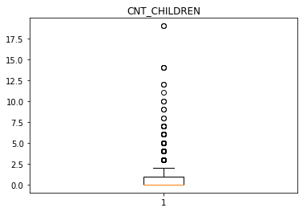
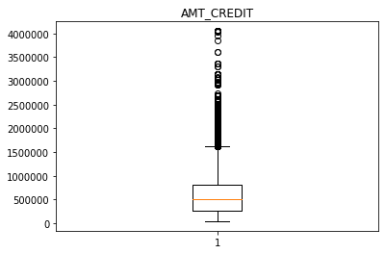
Project analysis slide 4
Outlier(Box Plot)
Outliers with value greater than 3 children
1st quartile is at zero and median is also zero.
Outliers with value greater than 3 children
1st quartile is smaller than 3rd meaning most of the client present in 3rd quartile.

Slide 8
Project analysis slide 4
Outlier(Box Plot)
Outliers with value greater than 3 children
1st quartile is at zero and median is also zero.
Outliers with value greater than 3 children
1st quartile is smaller than 3rd meaning most of the client present in 3rd quartile.

Slide 9
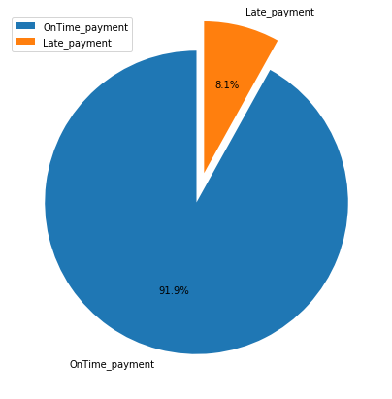
Project analysis slide 4
Data Imbalance
Defaulter are 8.1 % of the total population for credit
Imbalance ratio is 11.39

Slide 10
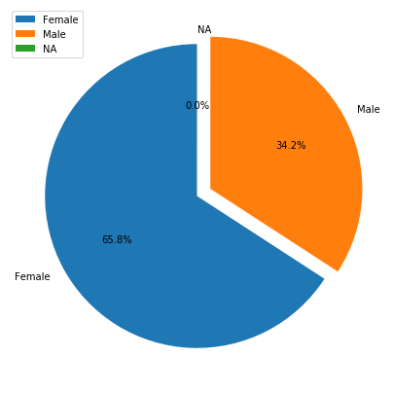
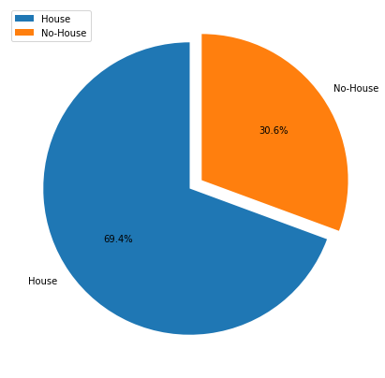
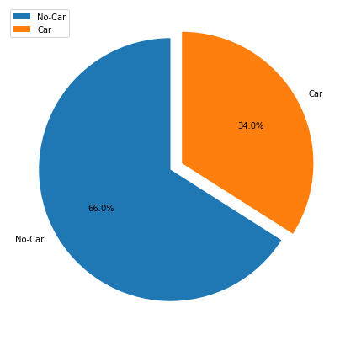
Project analysis slide 4
Data Imbalance
Data Imbalance in Gender ,House ownership and car ownership
Gender
House Ownership
Car Ownership

Slide 11
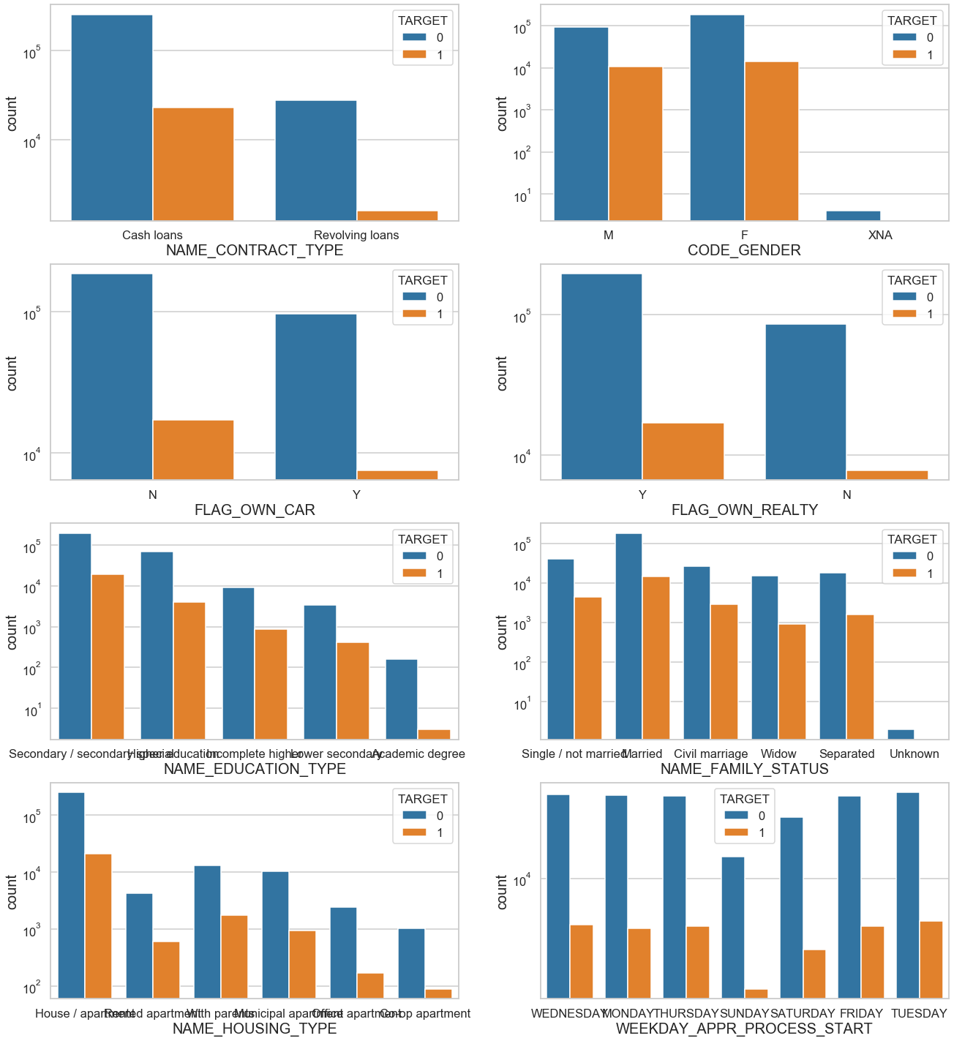
Categorical Univariant Analysis
Univariant Analysis for Categorical Columns
Majority of the defaulters are people with Medium total income
Higher credit people are less likely to default
People starting application process on Sunday are less likely to default
Less loan applications on Saturday and Sunday
People with house or apartment tend to take more loans
Married people usually tend to take more Loan as compared to other categories
Secondary/special educated people apply more loans
Real estate tends to take more loans
People without a car tends to take more loans
Female tends to take more loans
People tend to take more cash loans, and default percentage of revolving loans is less

Slide 12
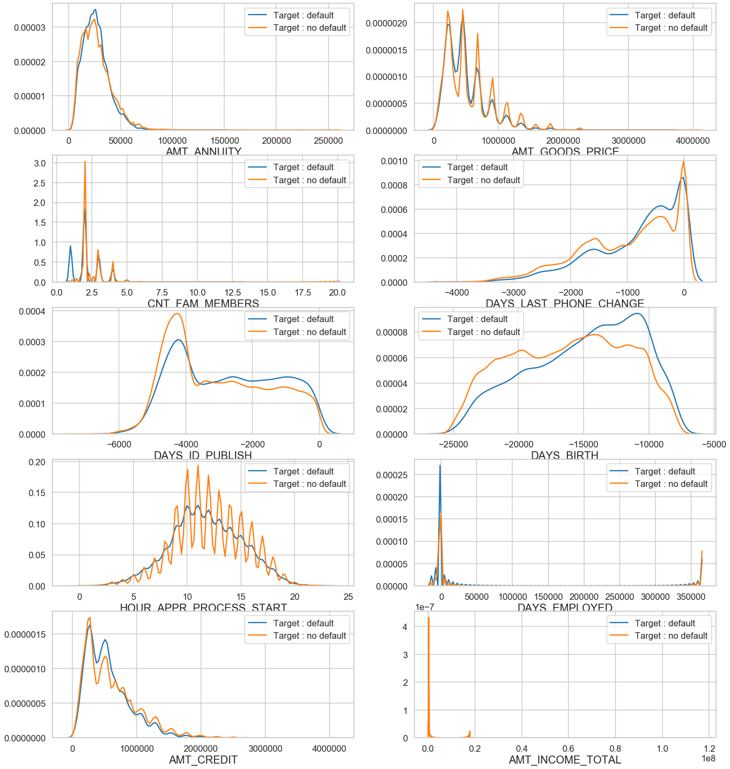
Continuous Univariant Analysis
Univariant Analysis for Continuous Columns
People with lower total income are more likely to default
People who just got employed tends to take more loans
People who retired tends to take more loans
High number of applications are filed in 10 AM to 2 PM
People with age between 27yrs(10000-days) and 41(15000-days) yrs tend to take more loans
People whose id(s) got published between 4000 days and 5000 days ago tend to take more loans
nuclear family tends to take more loans
for less goods amount people take loans
low amount annuity has high number of loans

Slide 13
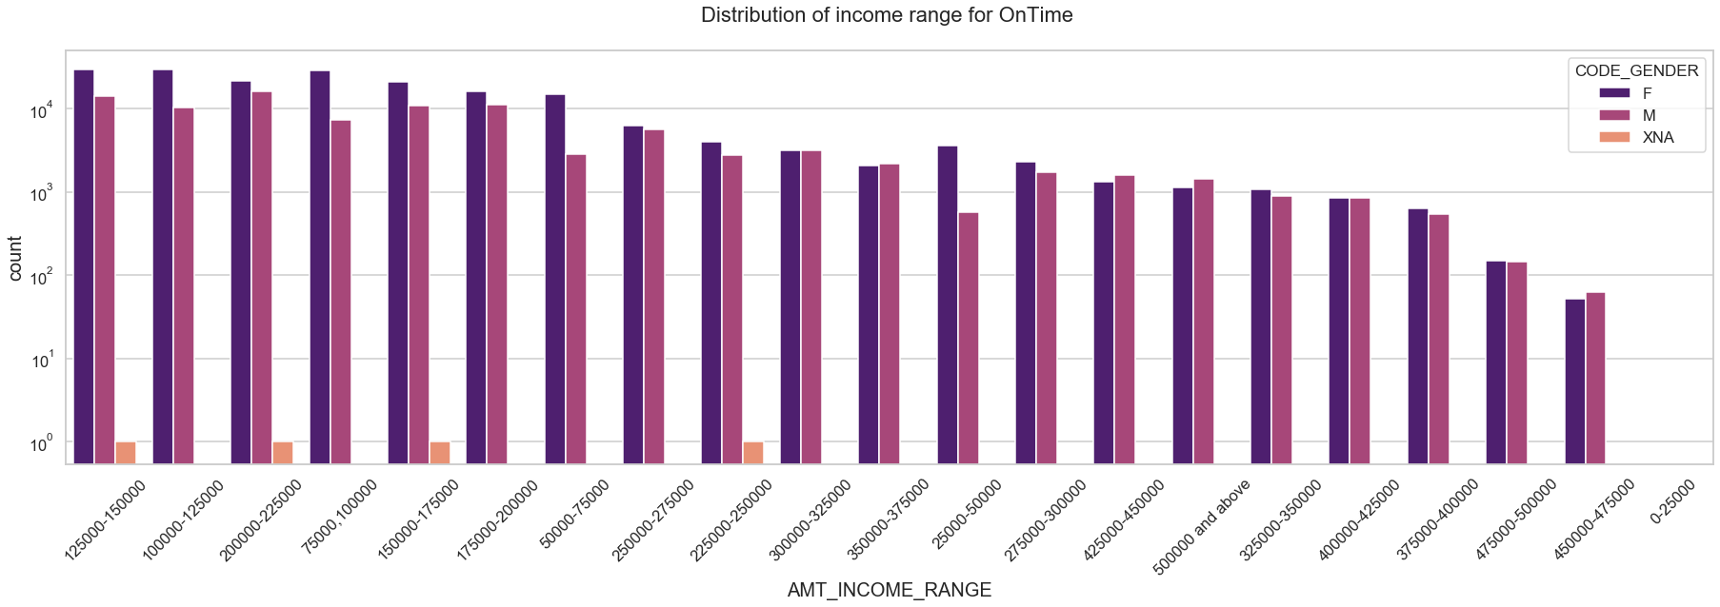
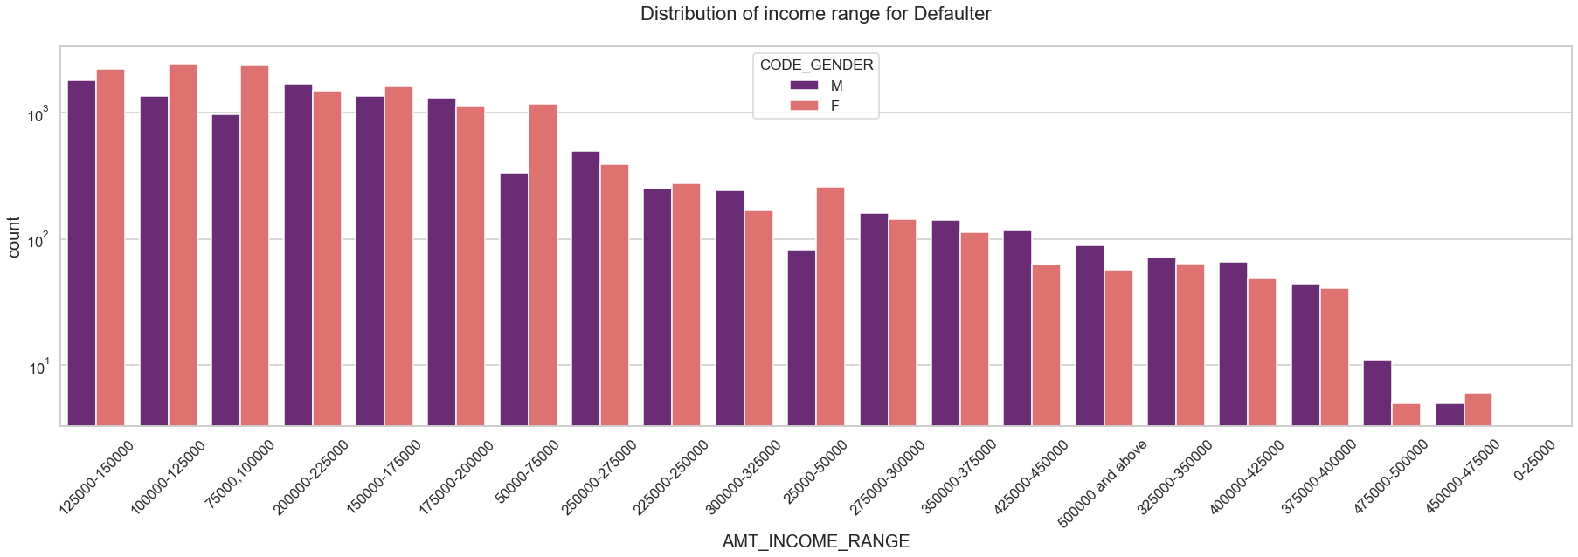
Univariant Analysis
Income range for Defaulters and on Time
Female count is higher for on time payment where as male count is more for defaulters.
Income range from 100000 to 200000 is having more number of credits for both meaning people with income in this range tends to more apply for loan .
Very less for income range above 400000
Female seem to have more success rate in paying amount on time that males.

Slide 14
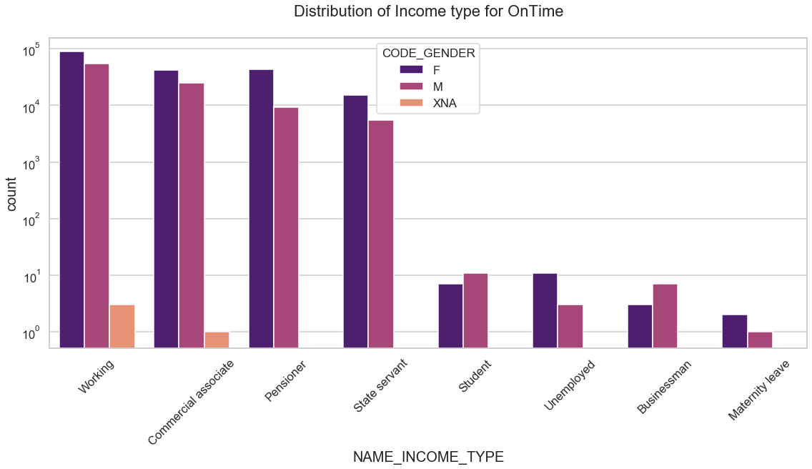
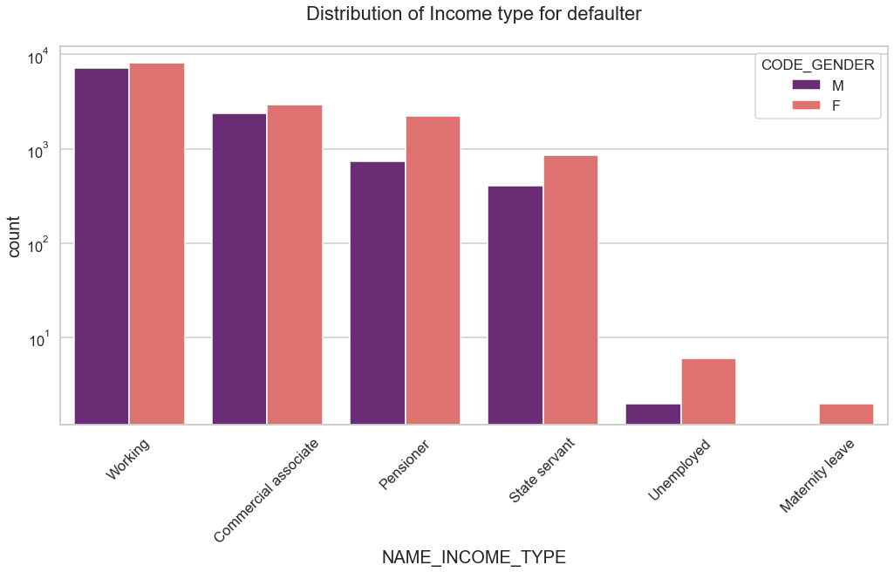
Univariant Analysis
Income Type for Defaulters and on Time
Female count is higher for on time payment.
For income type ‘working’, ’commercial associate’, ‘Pensioner’ and ‘State Servant’ the number of credits are higher than others.
Less number of credits for income type ‘Maternity leave’ and ‘Unemployed’
For defaulters: There is no income type for ‘student’ and ‘Businessman’ which means they don’t do any late payments.

Slide 15
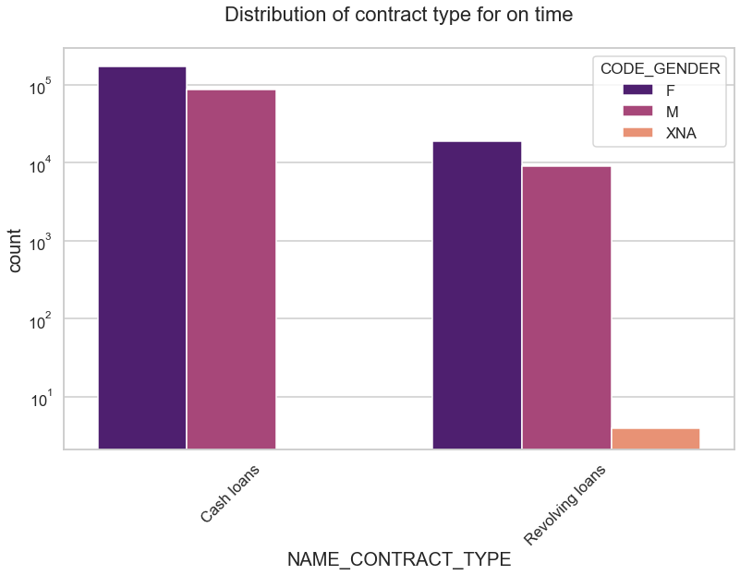
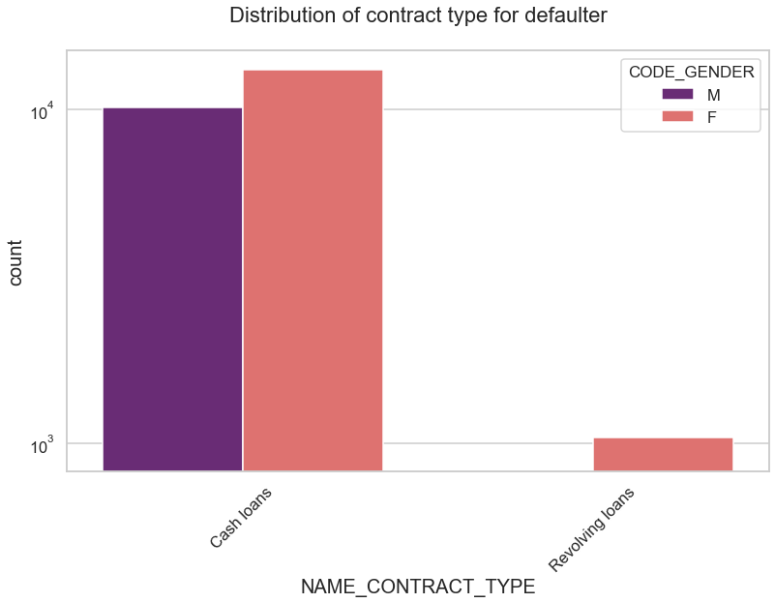
Univariant Analysis
Contract Type for Defaulters and on Time
Female count is having more credit.
For contract type ‘cash loans’ is having higher number of credits than ‘Revolving loans’ contract type.
Only Female are there for defaulters for ‘Revolving loans’

Slide 16
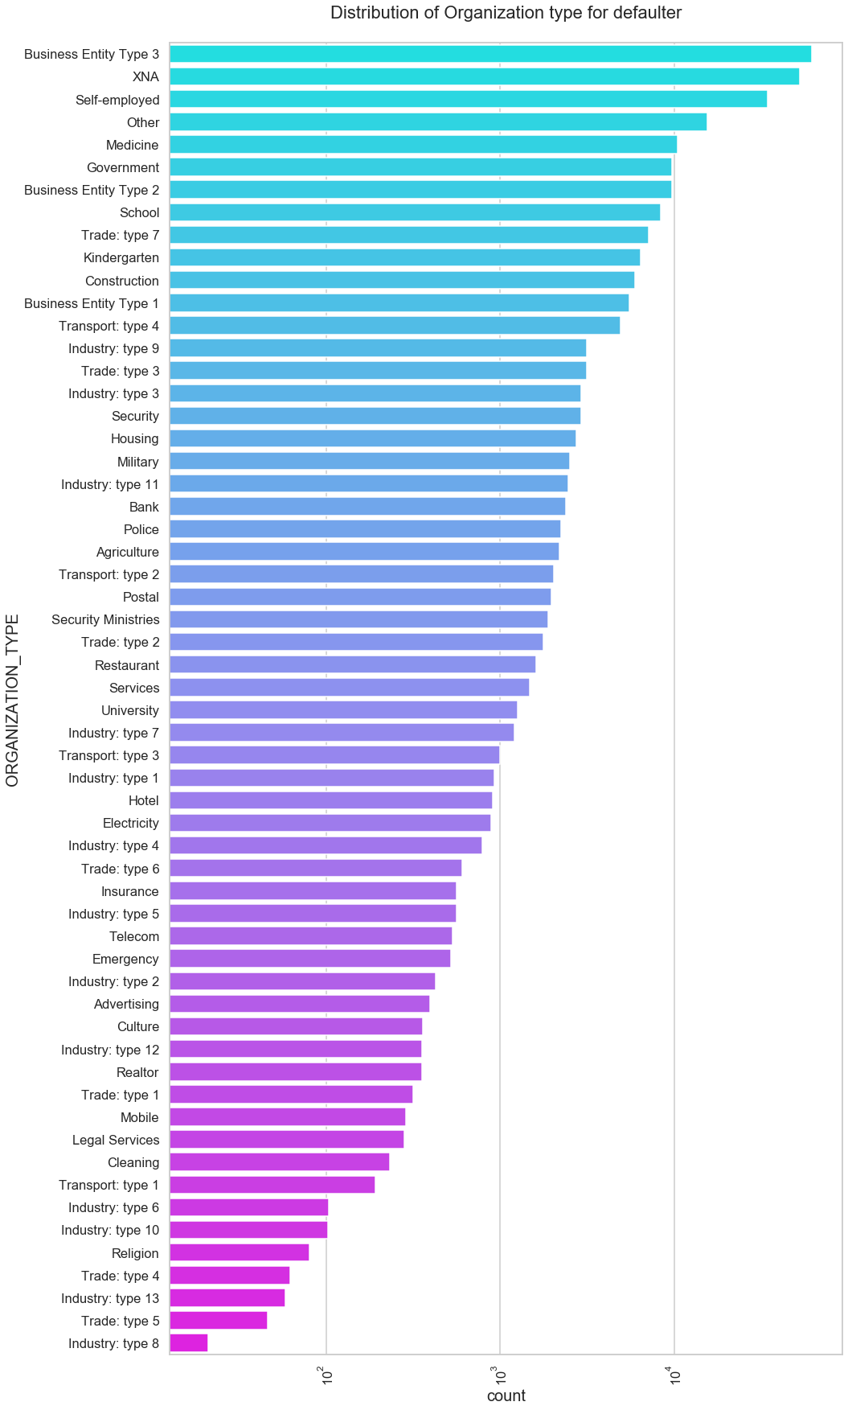

Univariant Analysis
Contract Type for Defaulters and on Time
Clients which have applied for credits are from most of the organization type ‘Business entity Type 3’ , ‘XNA’, ‘Self employed’ , ‘Other’ , ‘Medicine’ and ‘Government’.
Less clients are from Industry type 8,type 6, type 10, religion and trade type 5, type 4.
Same distribution for defaulter and non-defaultor

Slide 17
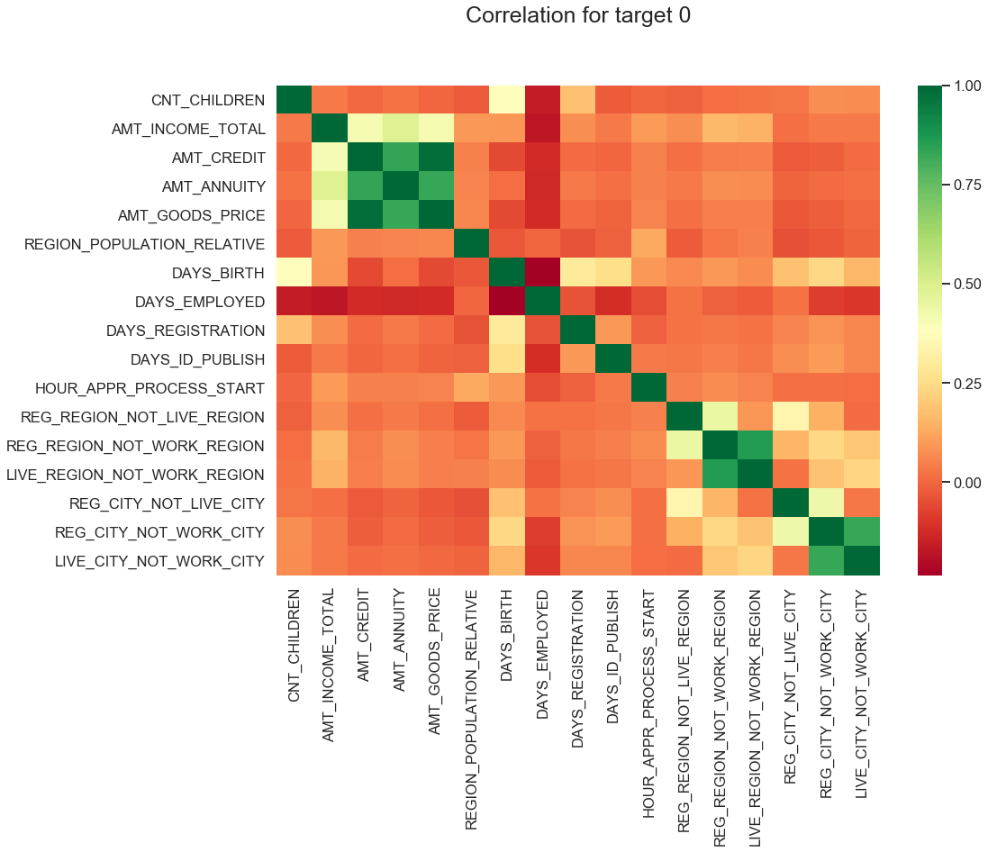
Correlation for On Time
Correlation of variables for Target=0
Total income is inversely proportion to employed days(as employed days are negative), higher employed day, higher total income.
if client work address is not equal to permeant address , day of employment is less(negatively) or to say more number of days.
Higher income and credit amount in relative populated region

Slide 18
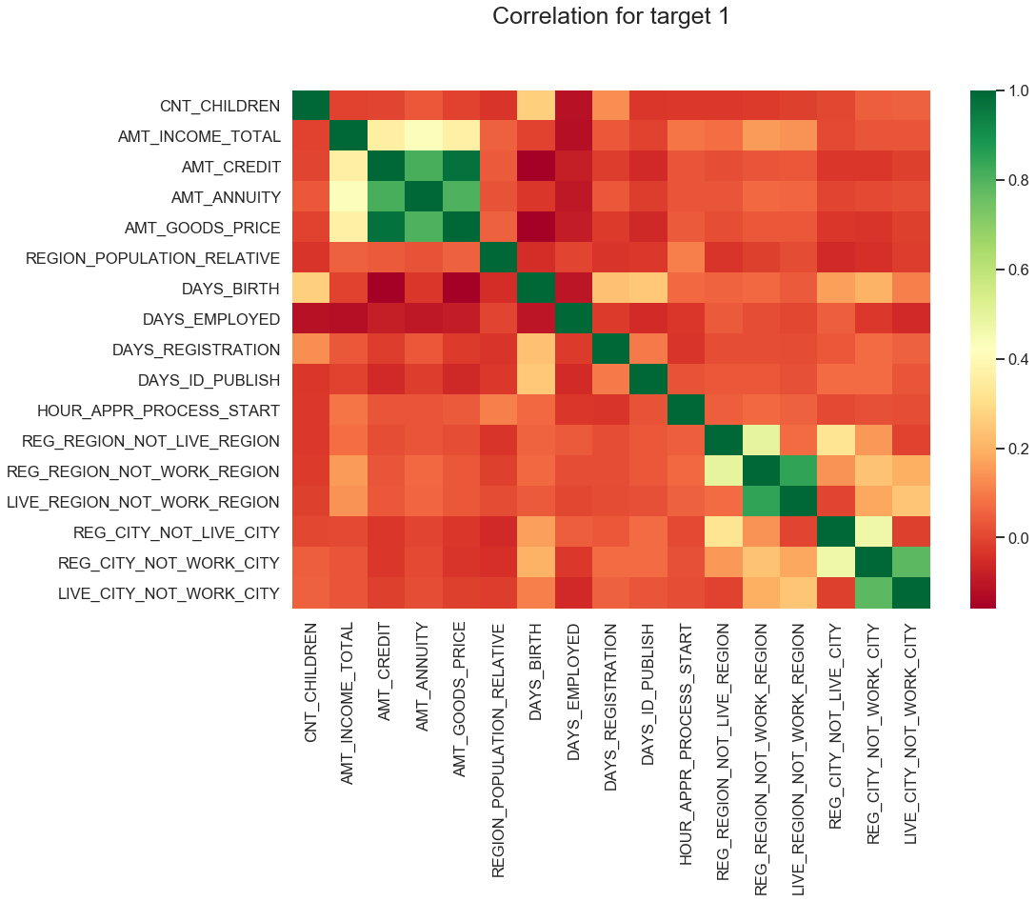
Correlation for On Time
Correlation of variables for Target=1
Total income is inversely proportion to employed days(as employed days are negative), higher employed day, higher total income.
if client work address is not equal to permeant address , day of employment is less(negatively) or to say more number of days.
Less number to children will have more number of employee days
Less children in highly populated region

Slide 19
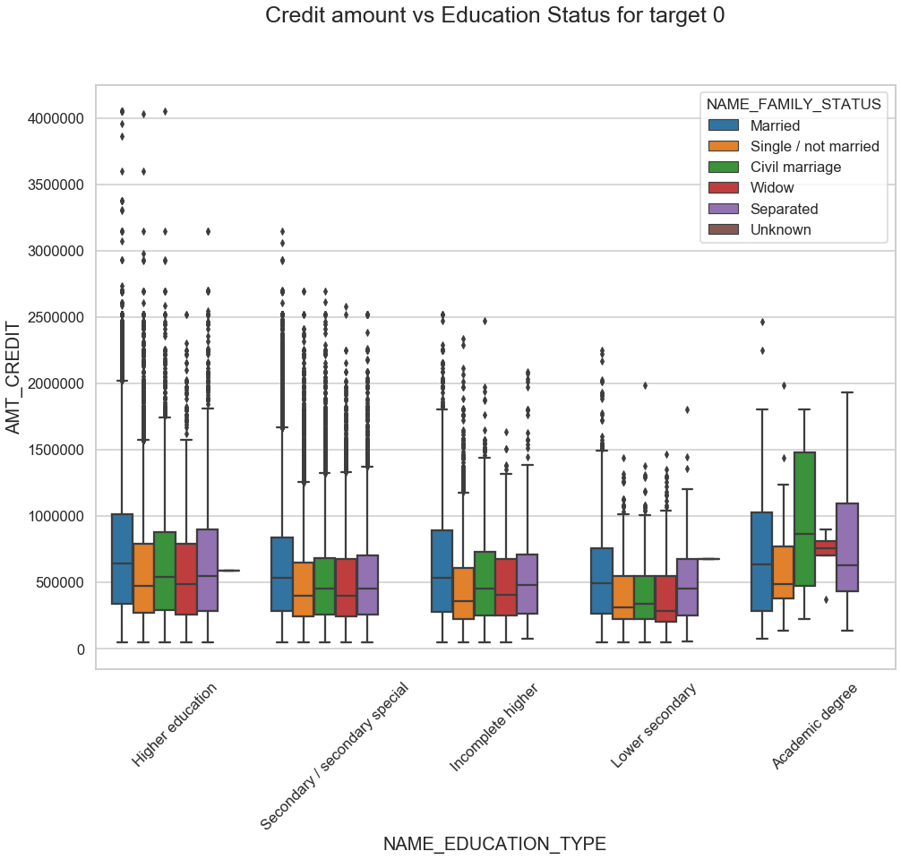
Bivariant Analysis
Credit amount vs Education Status for target =0
Family status ‘married have max number of outliers
Family status of 'civil marriage', 'marriaged' and 'separated' of Academic degree education are having higher number of credits than others.
Higher education of family status of 'marriage', 'single' and 'civil marriage' are having more outliers.
Civil marriage for Academic degree is having most of the credits in the third quartile.
Academic Degree have higher credit with minimum outliers.

Slide 20
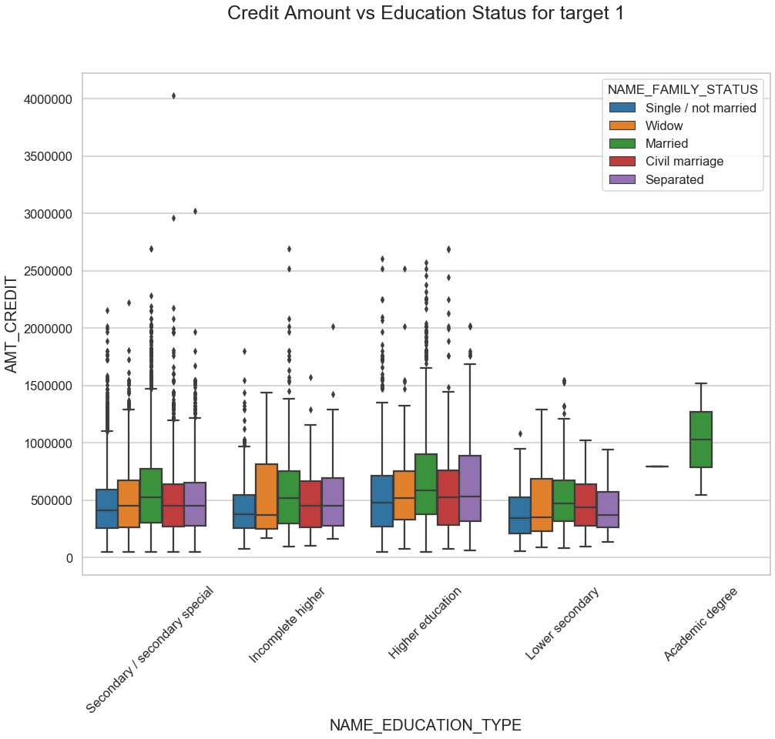
Bivariant Analysis
Credit amount vs Education Status for target =1
Only Married people default credit with education status as ‘Married’.
Separated people have major credit in 3rd quartiles across all family status

Slide 21
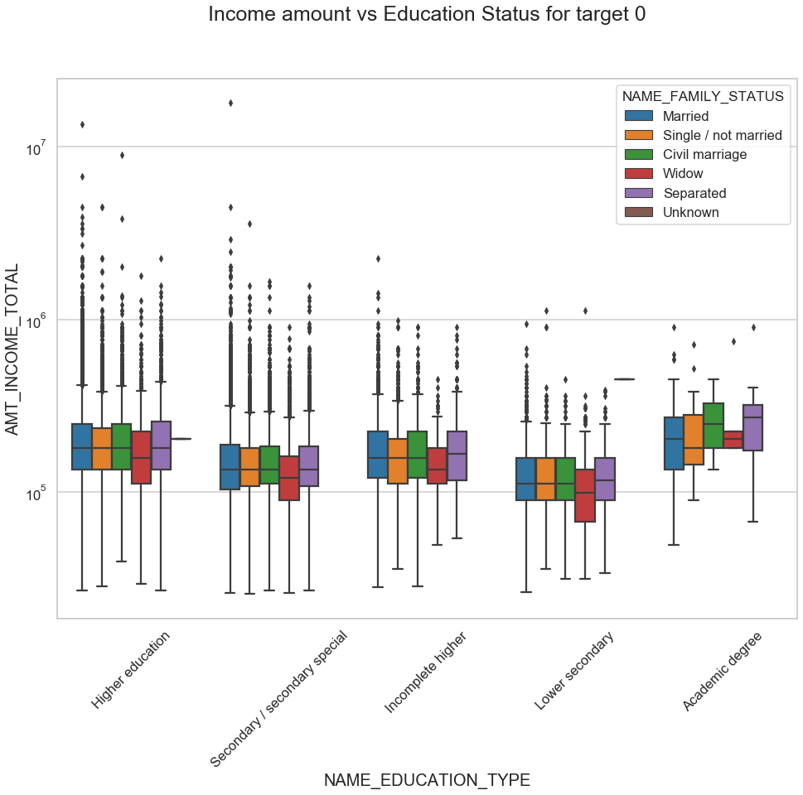
Bivariant Analysis
Income amount vs Education Status for target =0
Family status ‘married have max number of outliers
Family status of 'civil marriage', 'married' and 'separated' of Academic degree education are having higher number of credits than others.
Higher education of family status of 'marriage', 'single' and 'civil marriage' are having more outliers.
Civil marriage for Academic degree is having most of the credits in the third quartile.
Academic Degree have higher credit with minimum outliers.

Slide 22
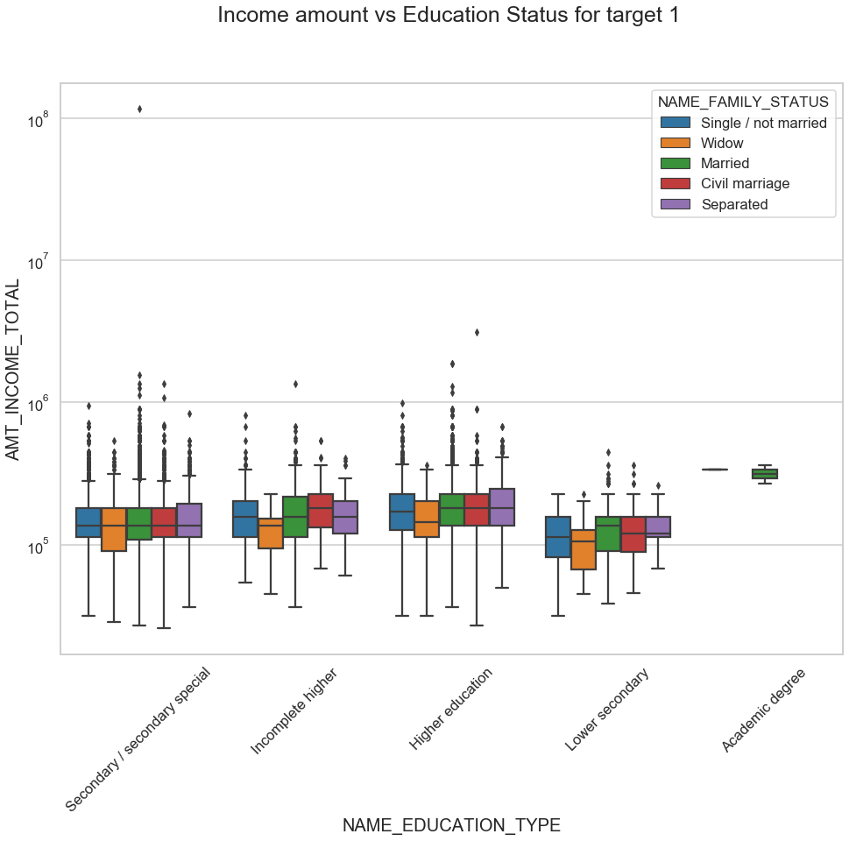
Bivariant Analysis
Income amount vs Education Status for target =1
Nearly same income for family status for secondary/secondary special education but large number of outlier.
Only Married defaulter for academic degree.

Slide 23
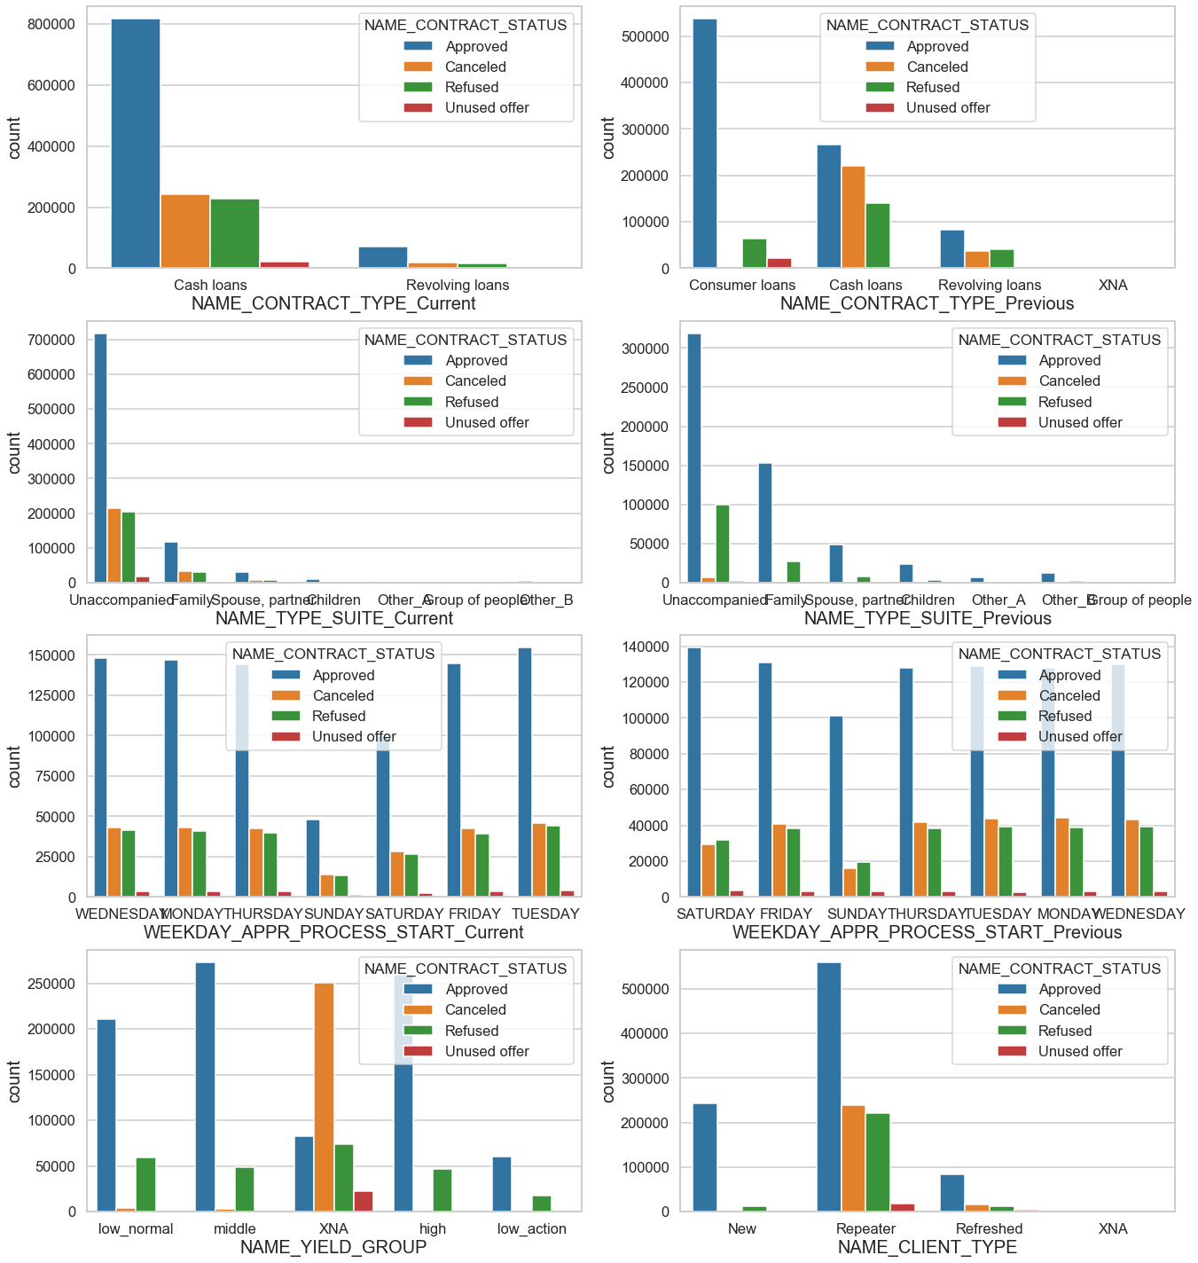
Univariant Analysis Merge Data
Categorical columns
Repeater has highest number of approved loans.
Middle NAME_YIELD_GROUP has highest approval.
has the highest approval rate.
but in current application it is Tuesday.
both in Name_Type_suite_Previous and Name_Type_suite_Current unaccompanied has the highest number.
currently bank is only giving two types of loans -Cash and Revolving Loans.
Previously bank was providing Cash, Revolving and Consumer loans.
Number of consumer loans were highest previously and now highest number is Cash loans.

Slide 24
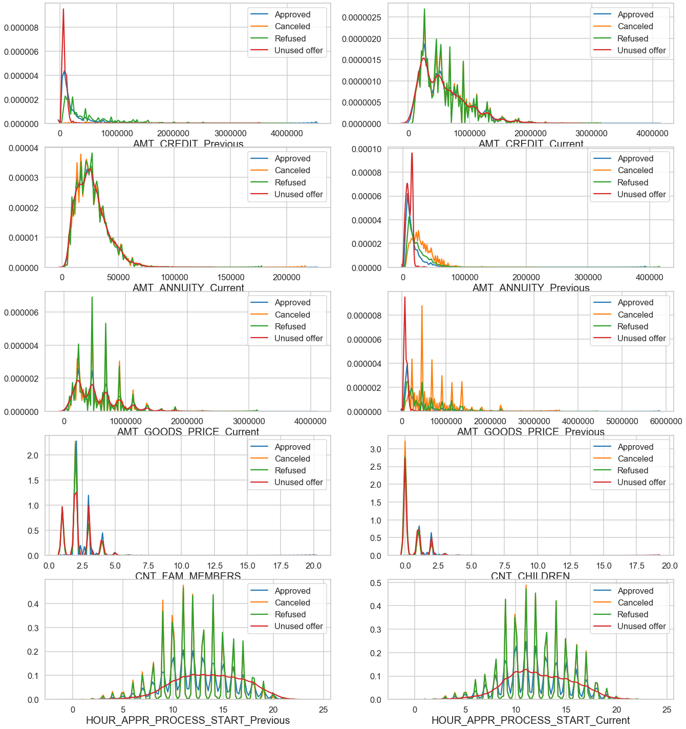
Univariant Analysis Merge Data
Continuous columns
High number of applications are filed in 9 AM to 2 PM for both Current and Previous data.
So busiest hours for bank are form 9 AM to 2 PM.
nuclear family tends to take more loans.
Previously bank had high unused offers but currently refused is high incase of AMT_GOODS_PRICE.
Previously bank had high unused offers and currently cancelled/refused offers are similar for AMT_ANNUITY.
Previously bank had high unused offers and currently high number of refused offers for AMT_CREDIT.

Slide 25
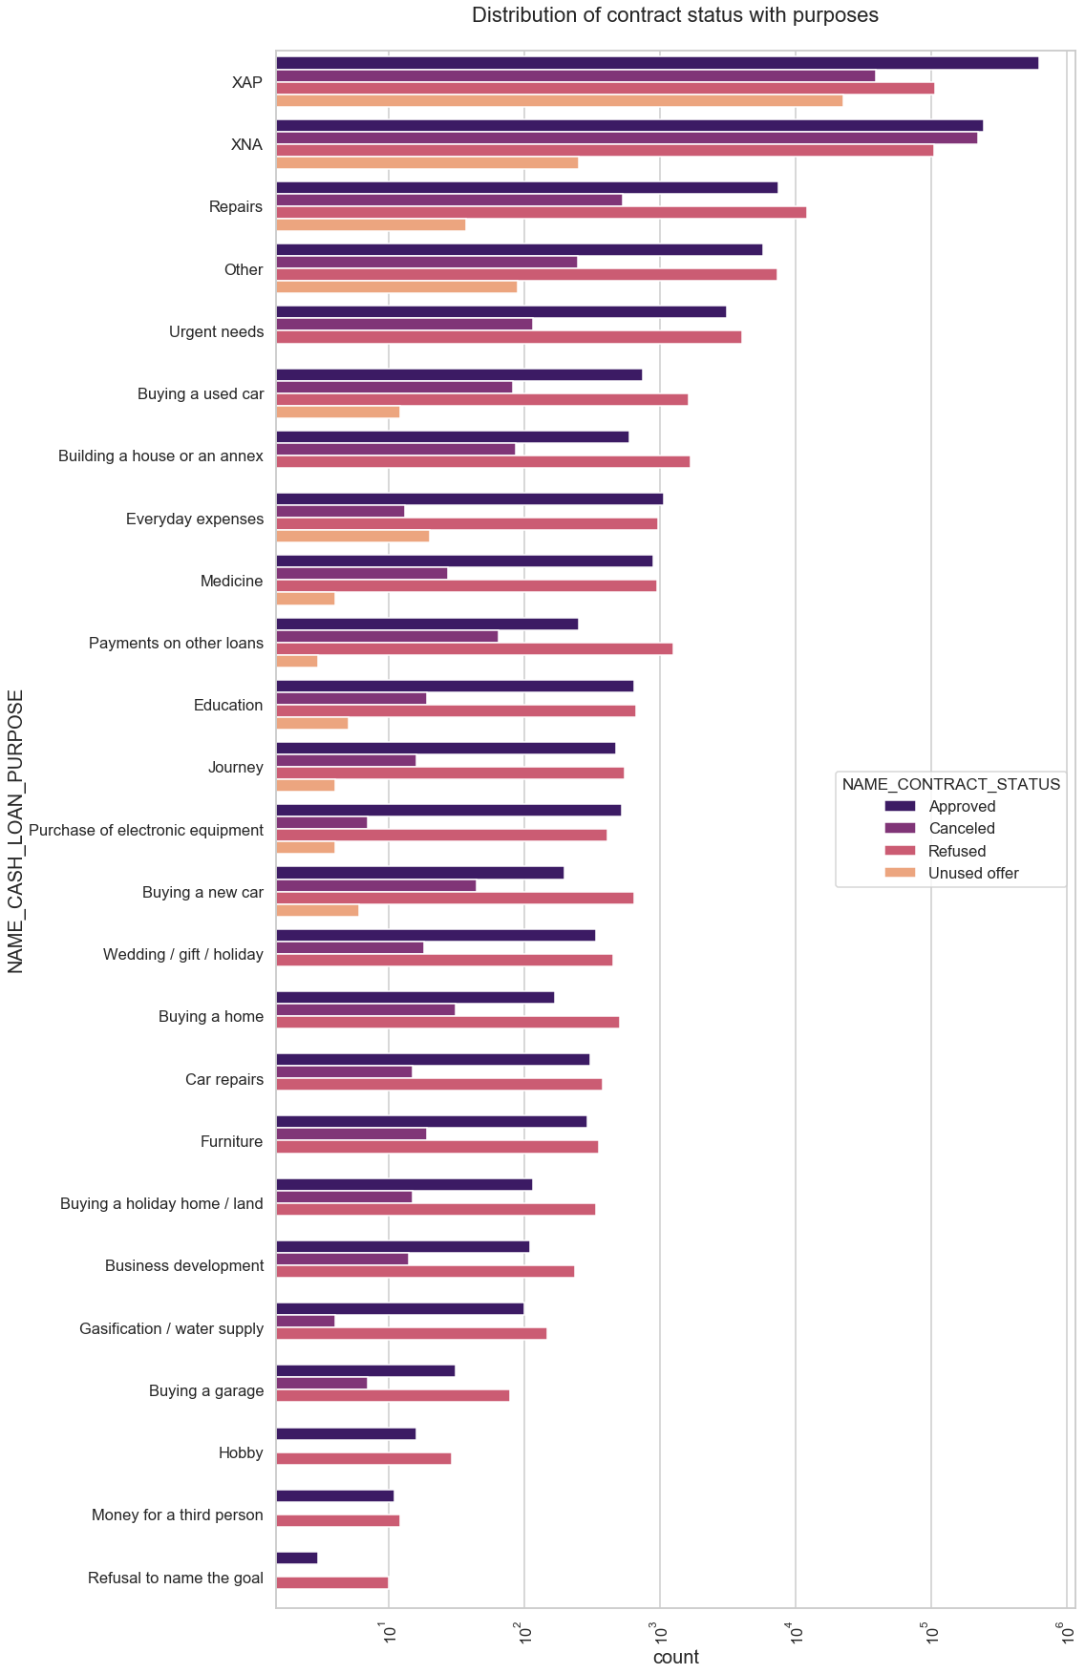
Univariant Analysis Merge Data
Distribution of contract status with purposes
Most rejection of loans came from purpose ‘XAP’,’XNA’
Paying other loans, building a house and buying a new car is having significant higher rejection than approves.

Slide 26
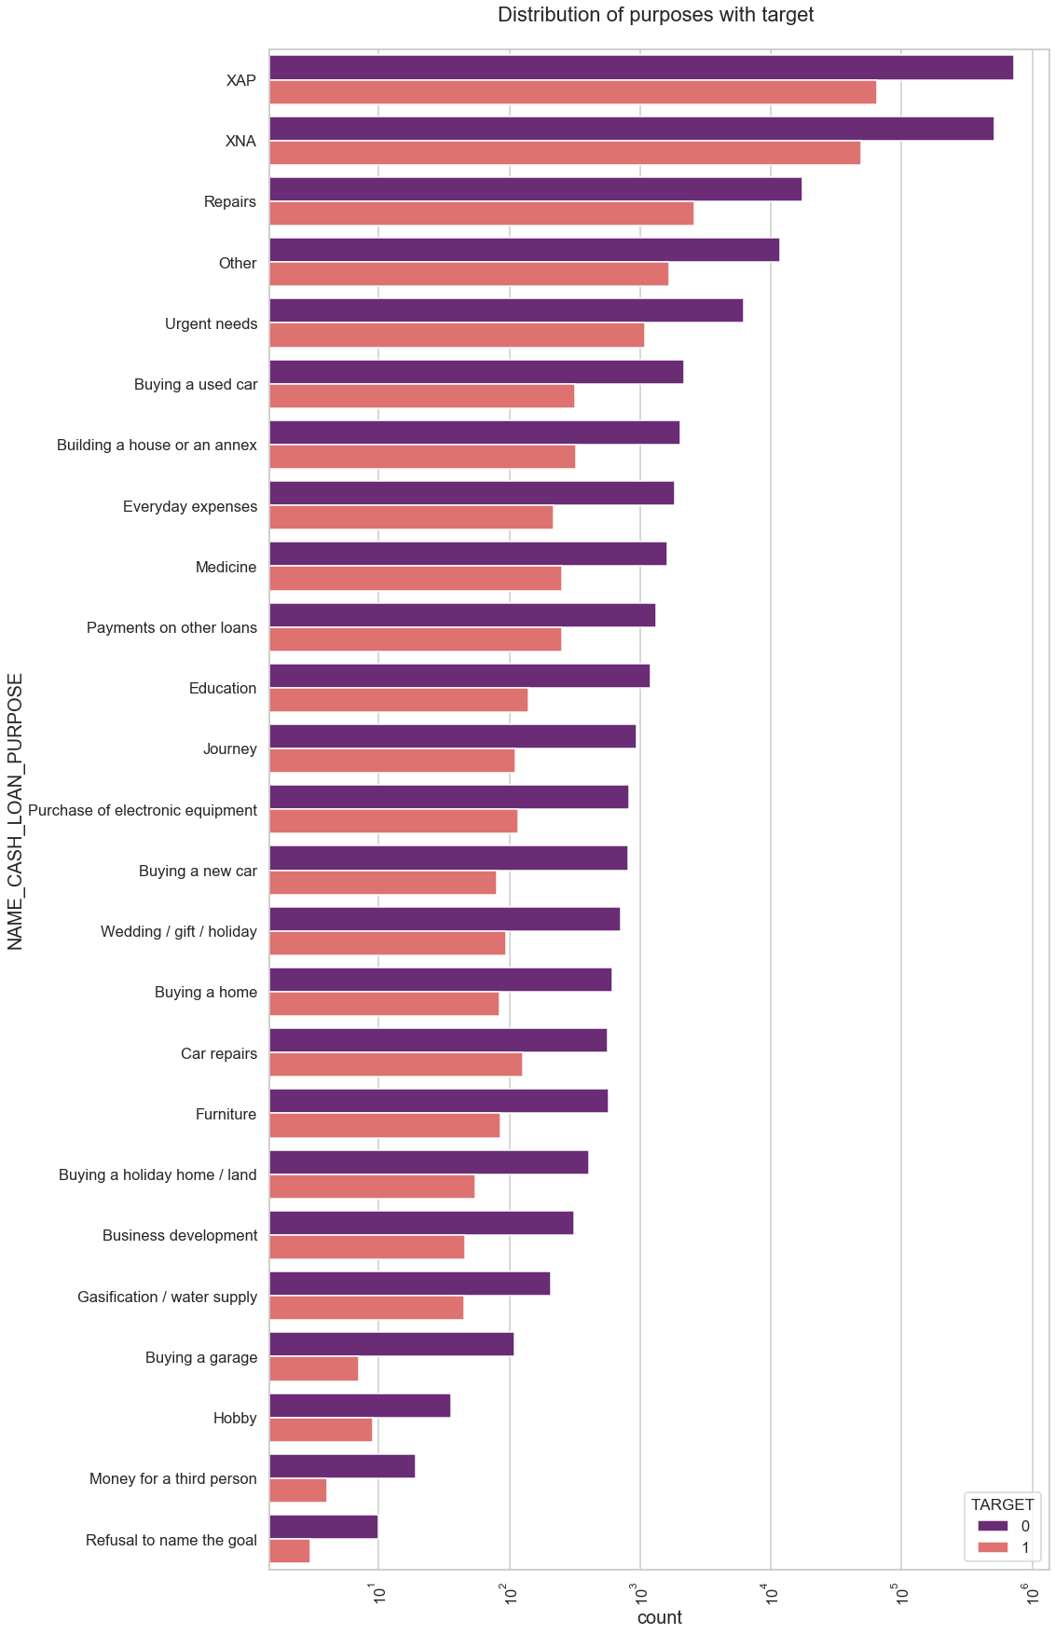
Univariant Analysis Merge Data
Distribution of purposes with target
Loan purposes with 'Repairs' are facing more difficulties in payment on time after ‘XAP’ and ‘XNA’.
There are few places where loan payment is significant higher than facing difficulties. They are 'Buying a garage', 'Business development', 'Buying land’, 'Buying a new car' and 'Education' Hence we can focus on these purposes for which the client is having for minimal payment difficulties.

Slide 27
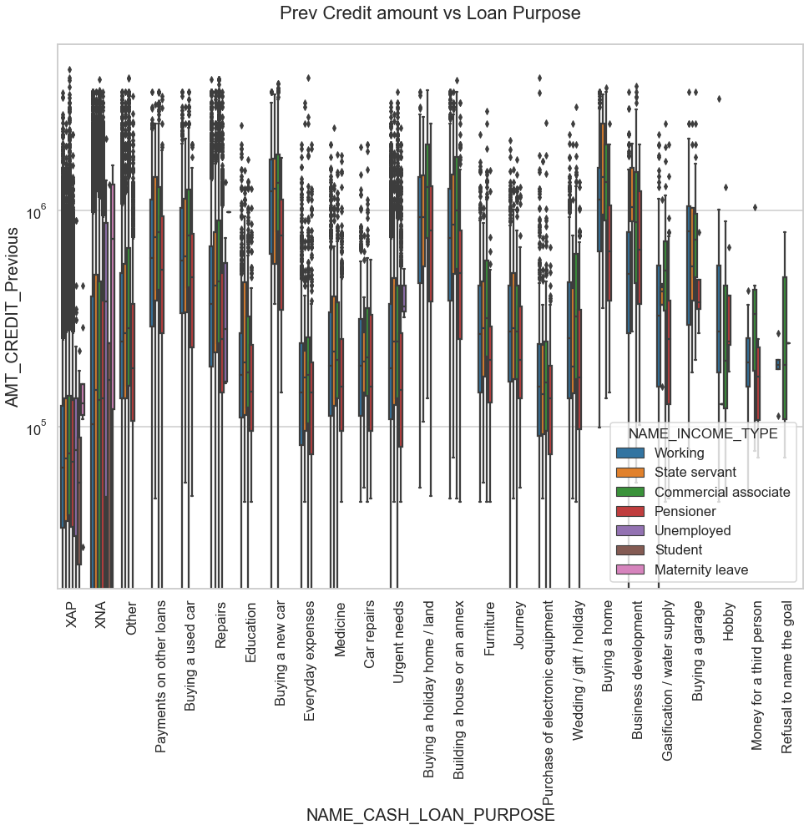
Bivariant Analysis Merge Data

Slide 28
Bivariant Analysis Merge Data
The credit amount of Loan purposes like 'Buying a home’, ’Buying a land’, 'Buying a new car' and ‘Building a house' is higher.
Income type of state servants have a significant amount of credit applied
Money for third person or a Hobby is having less credits applied for.

Slide 29
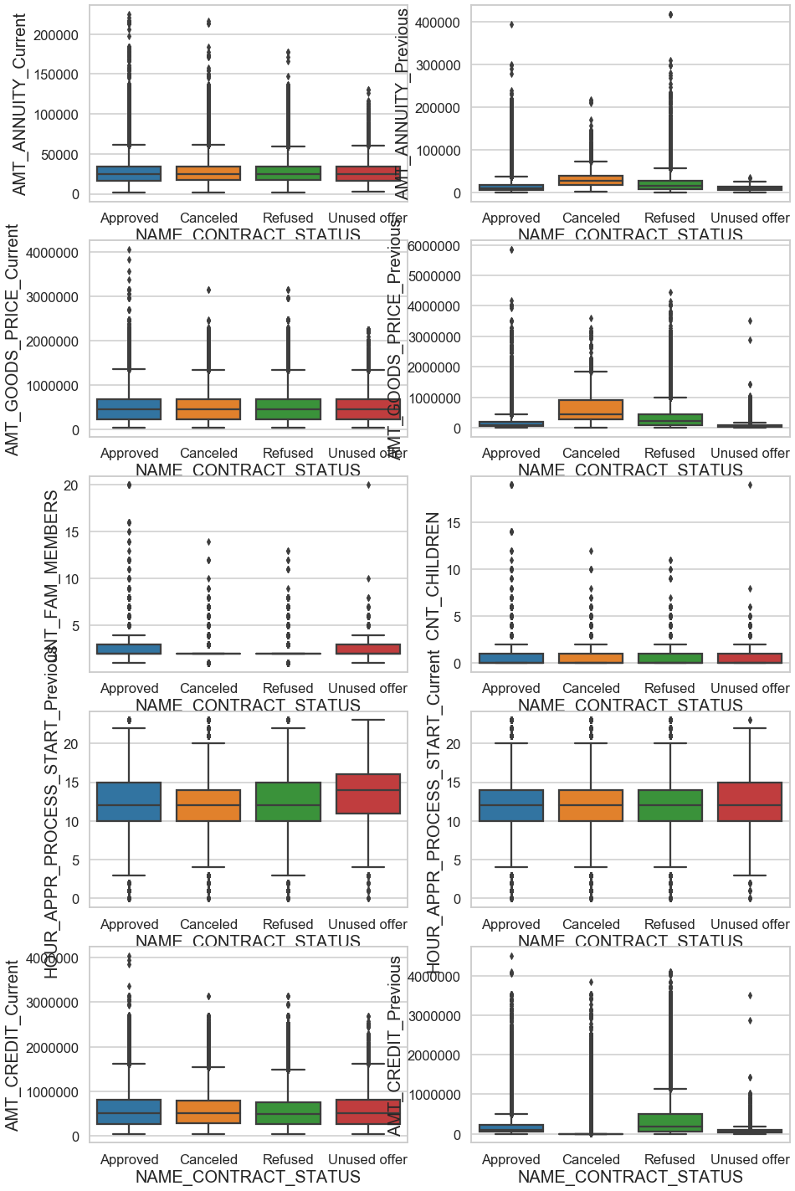
Bivariant Analysis Merge Data
Bivariant analysis for continuous columns
AMT_CREDIT_Previous has highest refused cases and AMT_CREDIT_Current is similar for all 4 cases.
time spent in unused offer is higher as compared to other categories.
So bank should reduce time spent on unused offer.
nuclear family(2-3 people in family) get highest approval.
Previously most of the applications were cancelled or refused
but now Refused/Cancelled/Approved/Unused all four have similar situation for AMT_GOODS_PRICE.

Slide 30
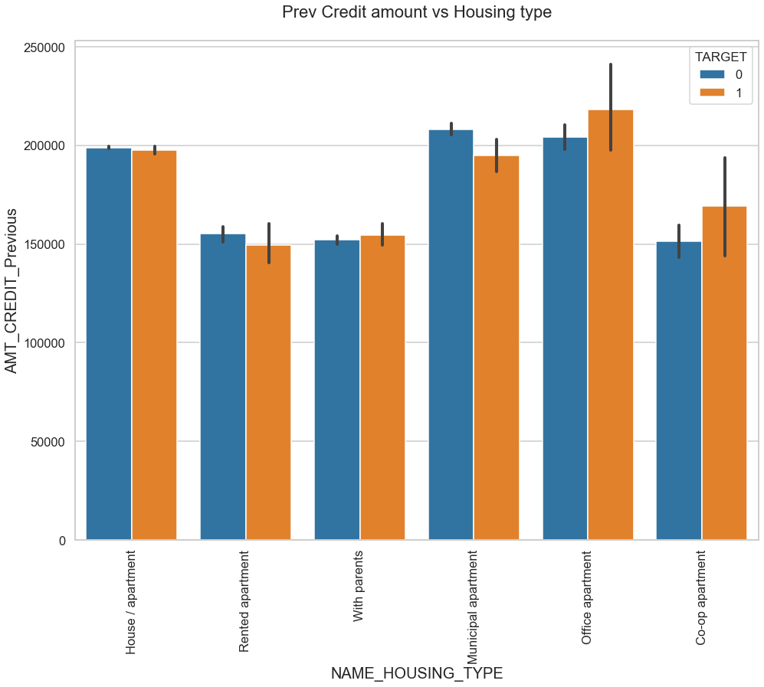
Bivariant Analysis Merge Data
Previous Credit amount vs Housing type
Here for Housing type, office apartment is having higher credit of target 0 and co-op apartment is having higher credit of target 1.
So, we can conclude that bank should avoid giving loans to the housing type of co-op apartment as they are having difficulties in payment.
Bank can focus mostly on housing type with parents or House\apartment or municipal apartment for successful payments.

Slide 31
Conclusion
Banks defaulters are approx. 8.1 %.
Banks provides more loans for females.
Revolving loans have more success rate than cash loans.
Banks should focus more on contract type ‘Student’ ,’pensioner’ and ‘Businessman’ with housing ‘type other than ‘Co-op apartment’ for successful payments.
Banks should focus less on income type ‘Working’ as they are having most number of unsuccessful payments.
Also with loan purpose ‘Repair’ is having higher number of unsuccessful payments on time.
Get as much as clients from housing type ‘With parents’ as they are having least number of unsuccessful payments.
Major columns effecting prediction to minimize risk: NAME_EDUCATION_TYPE,AMT_INCOME_TOTAL,DAYS_BIRTH,AMT_CREDIT,DAYS_EMPLOYED,AMT_ANNUITY, NAME_INCOME_TYPE,CODE_GENDER,NAME_HOUSING_TYPE

Slide 32
Thank You

