Slide 1
Agenda
Project Name & Our Team members
Market Research
Project Structure
Methods of Implementation.
Project Outcomes.
Challenges.
Learned lessons.

Slide 2

Implementing Oracle EBS Purchasing Module in 3MS pharmaceutical company
29-04-2025

Slide 3

Team Members
Hend Yehia
Gehad Fahim
Mona Al Saadawi
Youstina Yousry

Slide 4
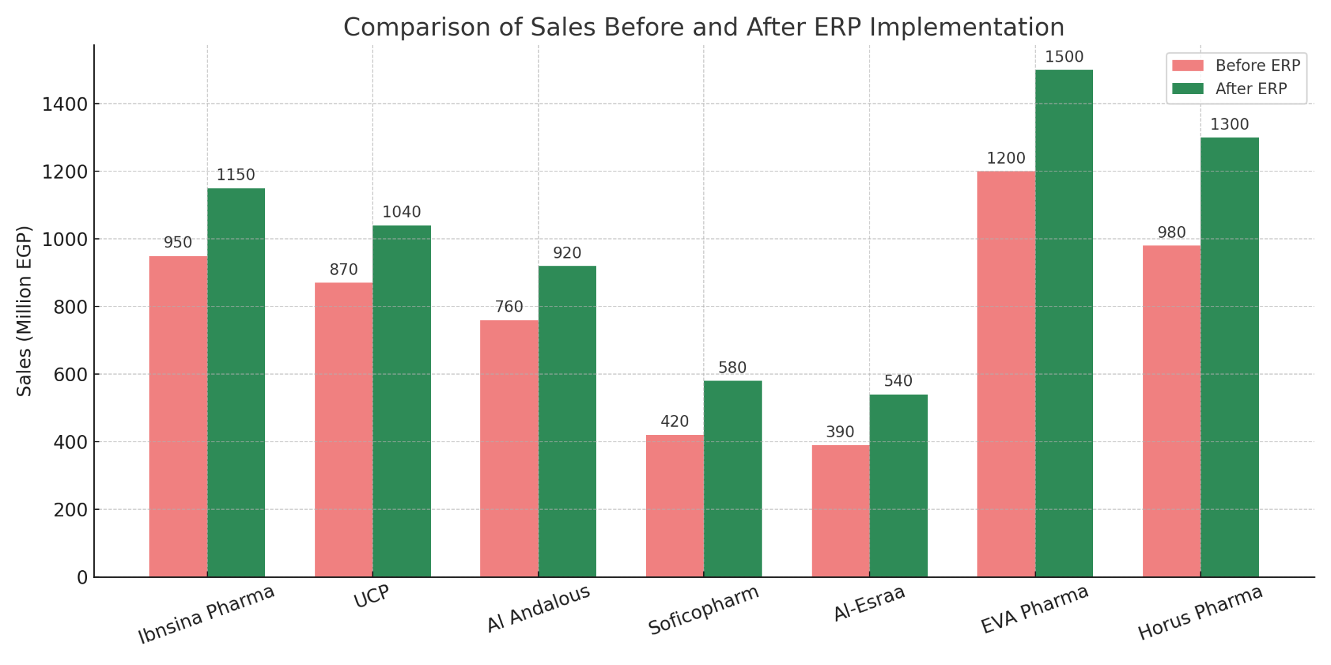
Market Survey

Slide 5
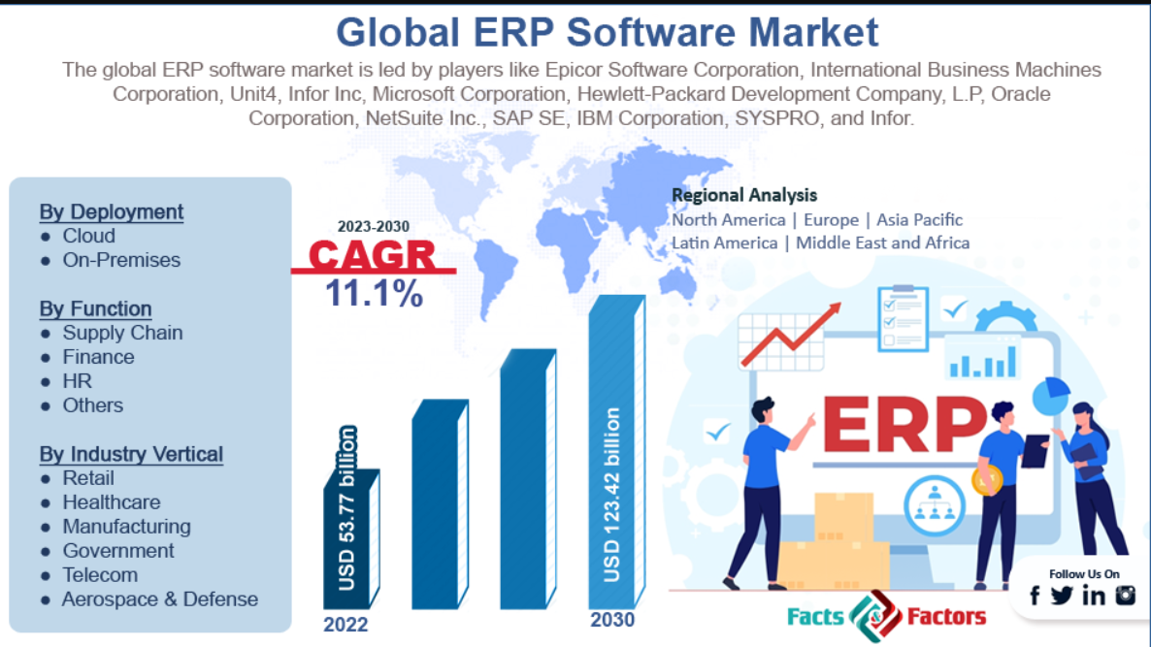
Market Survey

Slide 6
Project Structure
1. Project Initiation
2. Requirements Gathering
3. Demo & Stakeholder Acceptance
4. Execution
5. Training & Documentation
6. Testing & Validation
7. Go-Live & Post-Go-Live Support
.

Slide 7
1-Project initiation
Kickoff Meeting: [1-1-2025]
Project Objectives.
Project Scope.
Project Timeline
Define Stakeholders
General Manager (Mr. Ahmed Hassan )
Financial Manager (Mr. Zaki Ahmed)
Supply Chain Manager (Mr. Amir Fakry)
Logistics Manager (Mr. Samy Ahmed)
Methods of implementation (Hybrid)
Water Fall
Agile

Slide 8
Project Objectives
Streamline Procurement Processes.
Enhance Supplier Management.
Optimize Inventory Control.
Improve Cost Efficiency.

Slide 9
Project Scope
Limited to
The implementation of
The Oracle EBS Purchasing Module.

Slide 10
Methods of Implementation
A hybrid implementation methodology,
Requirements Gathering (Waterfall Approach).
Configuration and Customization (Agile Approach)

Slide 11
2-Requirements Gathering
Purchasing Requirements
Auto-generating Document Numbering by the system
Requisitions
RFQs
Quotations
Purchase Orders
Receipt Number
Never cancel a Requisition unless the requester cancels it.
Notify the buyer if a Blanket PO Agreement exists.
Price tolerance % between PR & PO doesn’t exceed 2% only.
The ability to hold Supplier if Payables asked.
Enforce Buyer Name.

Slide 12
2-Requirements Gathering
Receiving Requirements
Automatic Receipt Number Generation.
Default Receipt Routing: Standard without inspection.
Don’t allow unordered receipts.
Allow receiving goods either 2 days earlier or 2 days later.
Give a warning message only if the Receipt days exceed two days.
The percentage variance allowed before a shipment is automatically closed for receiving is 5%. (Receipt Close Tolerance).
We ask the Accounts Payable to provide us with these accounts to complete the configuration of receiving options
Receiving Inventory Account
Clearing Account

Slide 13
2-Requirements Gathering
Finance Requirements
We asked the Payable Accountant to provide us with the Accounts required for creating Procure to Pay journals:-
Liability Account
Prepayment Account
Bills Payable Account
Discount taken Account
PO Rate Variance Gain Account
PO Rate Variance Loss Account
Expense AP Accrual Account
Receiving Inventory Account
Clearing Account
Match the Approval Level between Invoice, Purchase Order, and Goods Receipt Note.
Create a Journal at receipt for Accrue Expense items & Inventory Items.

Slide 14
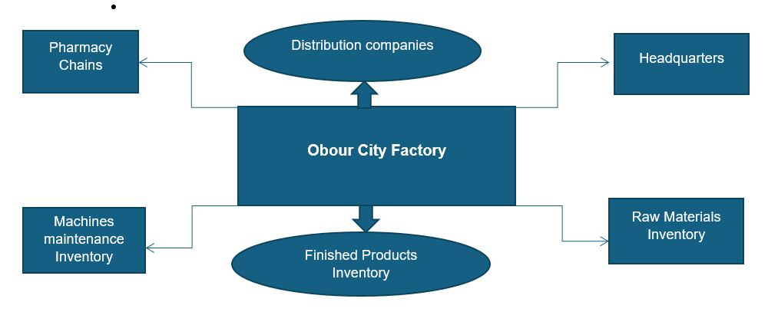
3MS pharmaceutical Company Structure

Slide 15
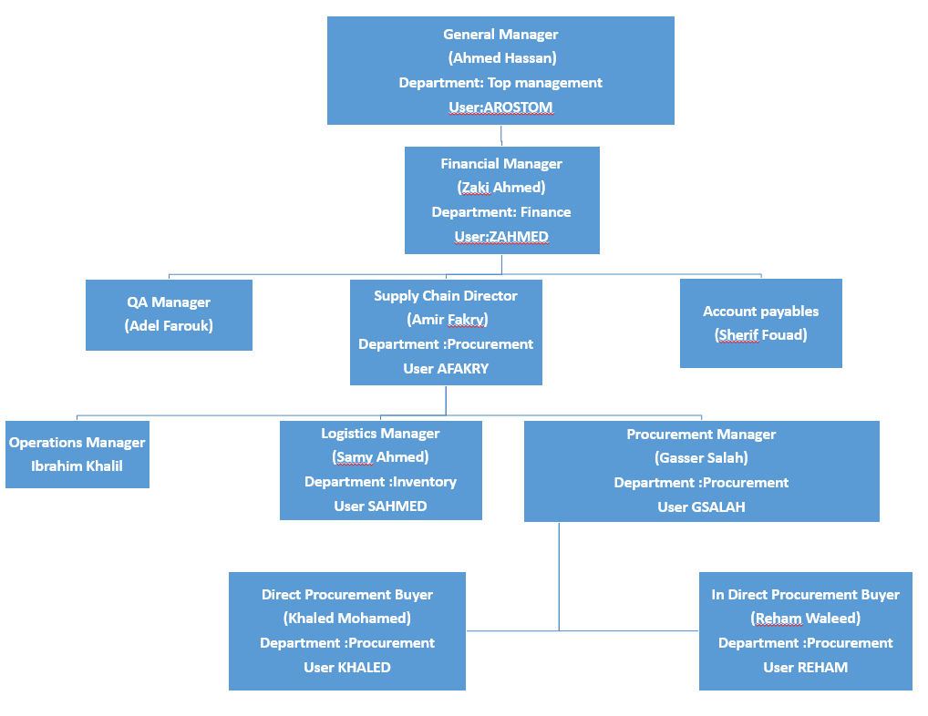

Slide 16
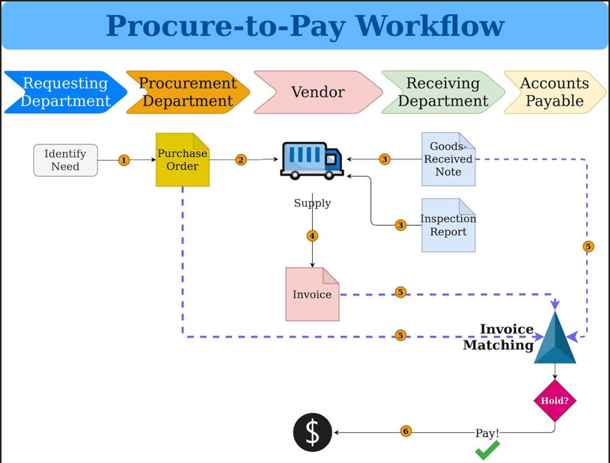

Slide 17

3. Demo & Stakeholders Sign off Approval Document

Slide 18
4-Execution
Creating the Operating Unit 3MS (Company Name)
Legal location (Al Abour City).
Using Vision Corporate as a Business Group.
Using Vision Corporate as a Legal Entity.
Using Vision operations (USA) Ledger.
Creating a Master Item Organization (MAS).
Creating an Inventory organization (M01).
3 Sub-inventory organizations (RAW, Spare Parts, FGs).
.

Slide 19
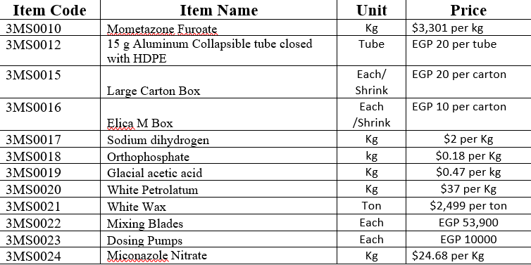
4-Execution
Defining items in the Master Item Organization and assigning them to M01 Inventory Organization.
.

Slide 20
4-Execution
Define company departments as HR organizations.
Top Management
Finance
Inventory
Procurement
Define users as employees in the HR Module.
General Manager
Financial Manager
Supply Chain Manager
Procurement Manager
2 Buyers
Inventory Manager
.

Slide 21
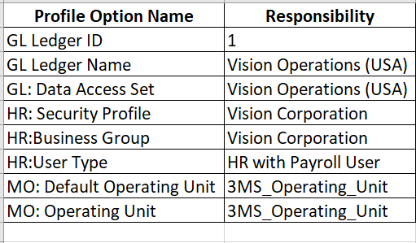
4-Execution
Customizing responsibilities.
Purchasing responsibility without the setup menu (New_Purchasing).
Requesting Responsibility includes Purchase requisition (PR_Purchasing)
Defining 8 System Profile options.
.

Slide 22
4-Execution
Approval Groups
1 Million
2 Million
3 Million
Unlimited
Assigning Approval groups to each position
Position Hierarchy Approval Cycle
Purchase Requisitions
Standard Purchase orders.
Blanket Purchase Orders.
3-way matching
Purchase order
Receipt Note
Invoice.
.

Slide 23
5-Training Business Users & Documentation
Training Business Users & Documentation
Train procurement teams
Procurement Managers.
Buyers.
Develop a user guide for all procurement processes.

Slide 24
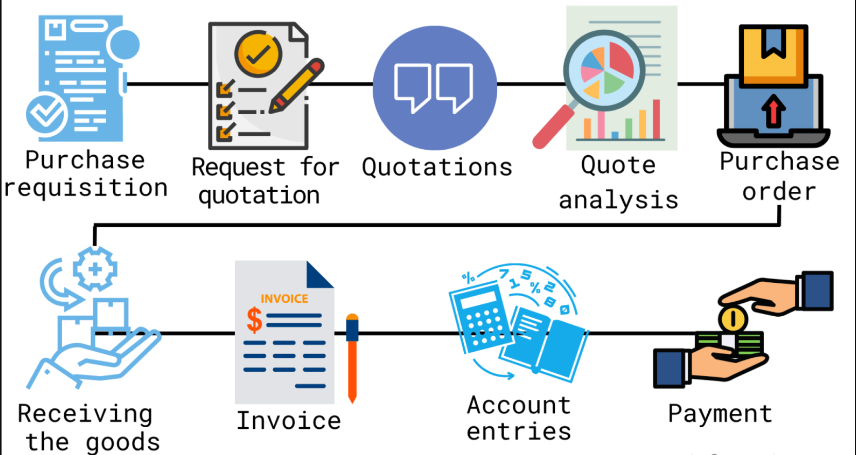

Slide 25
6-Testing & Validation
Create Test Scenarios (Test Environment)
Procure to Pay Complete Cycle
Requisition No.:20251000010
Approved Supplier List
Bid RFQ No.:20252000005
Quotations
Approved Quotation:20254000007
Unapproved Quotation:20254000008
Converting quotation to Standard Purchase order
Standard Purchase Order No.: 20253000038
Requisition to Purchase Order :
Requisition No.: 20251000007
Standard PO No.:20253000027
Return to Supplier after inspection.
Standard PO No.:20253000026
Receipt No.: 20255000001
Item No: 3MS0017

Slide 26
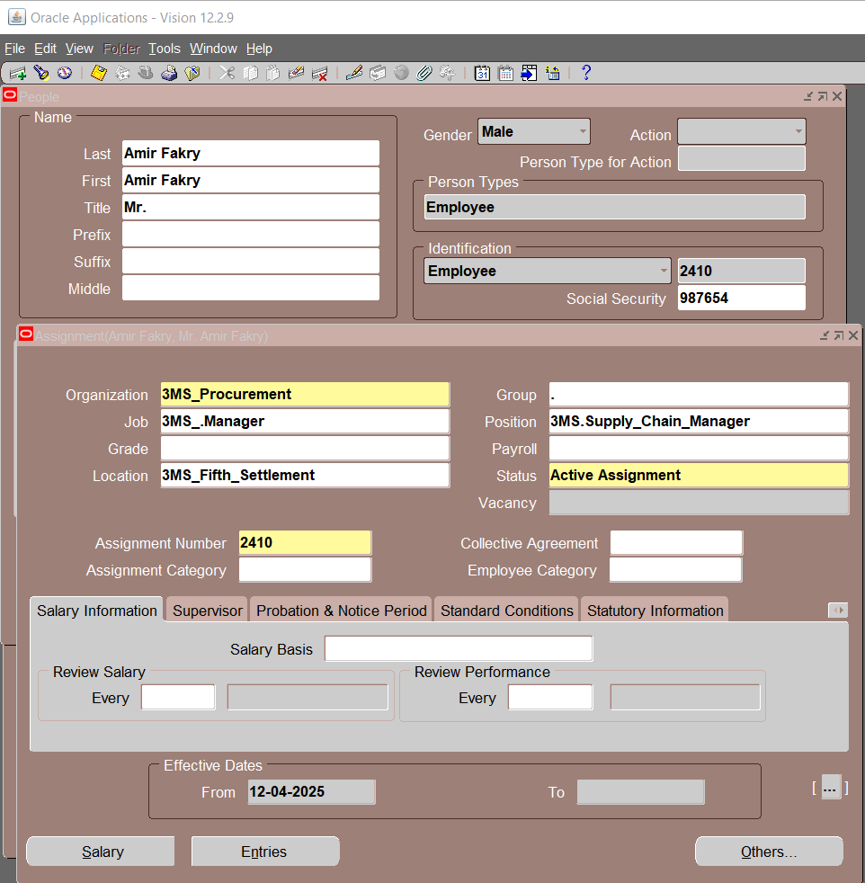

Slide 27
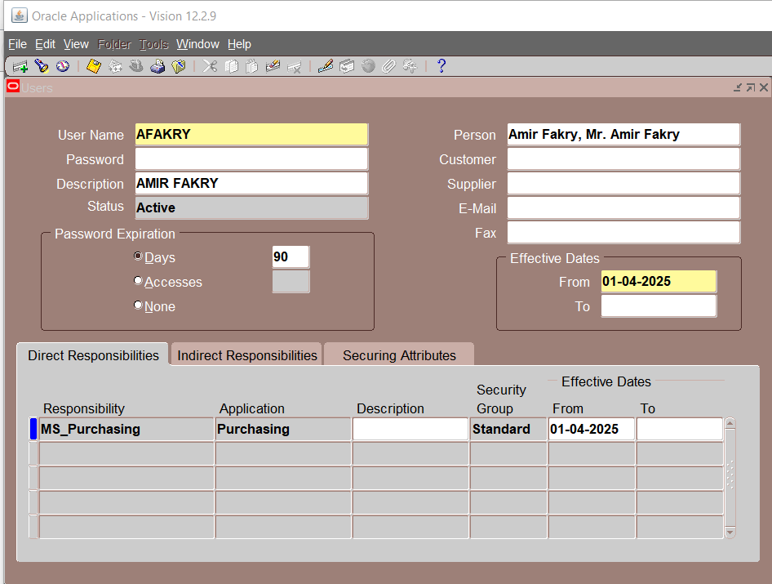

Slide 28
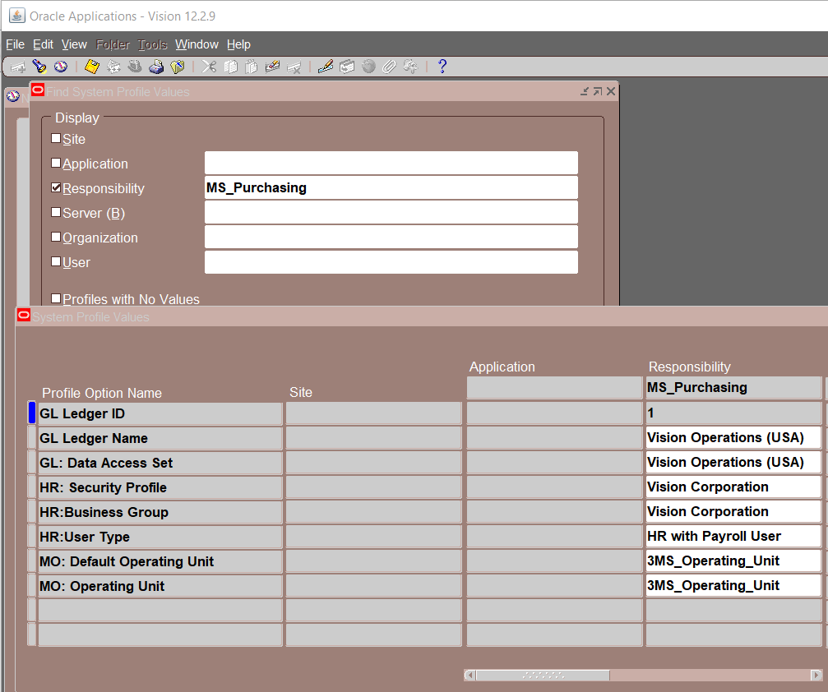

Slide 29
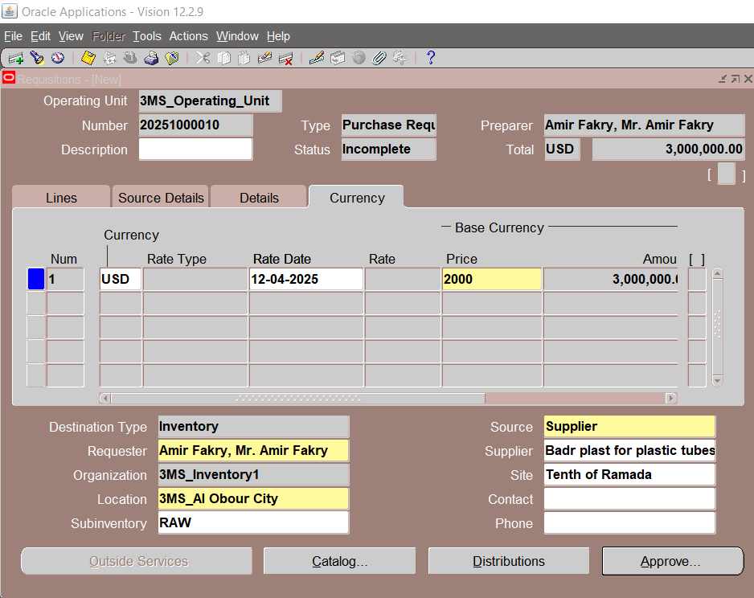

Slide 30
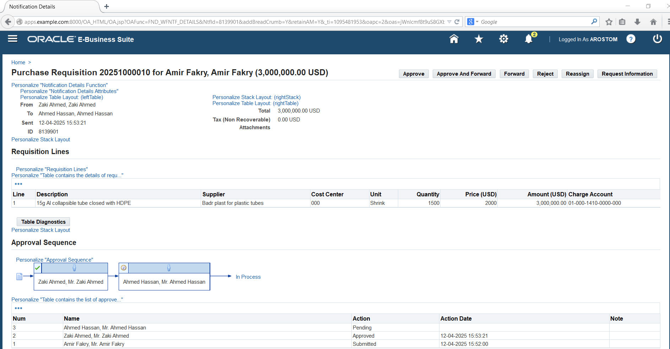

Slide 31
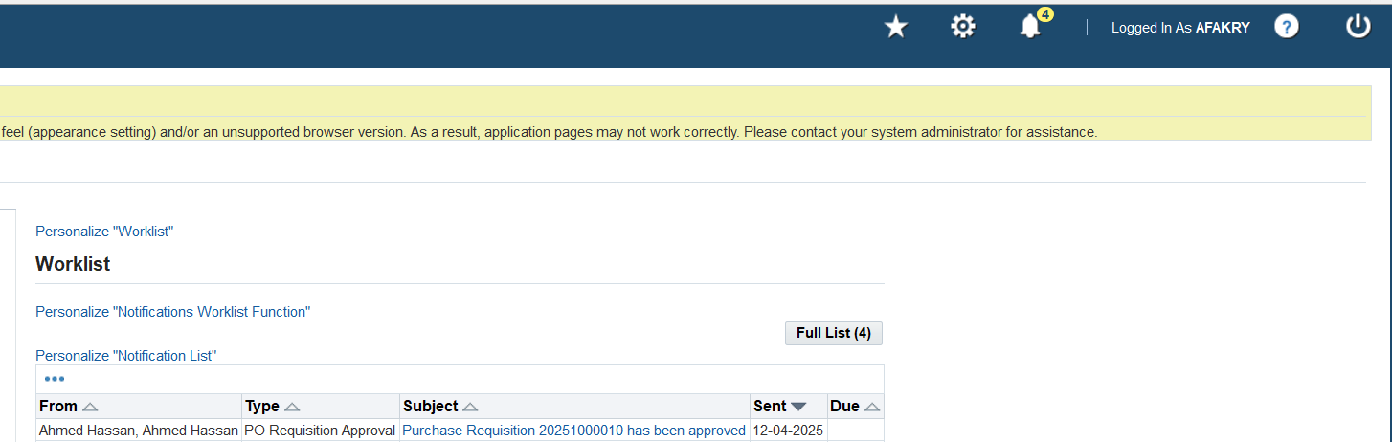

Slide 32
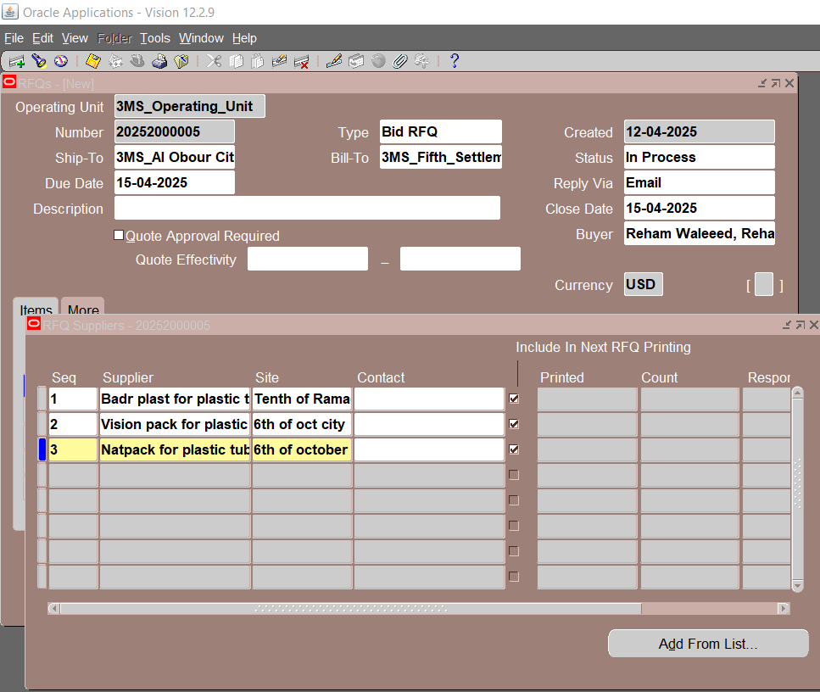

Slide 33
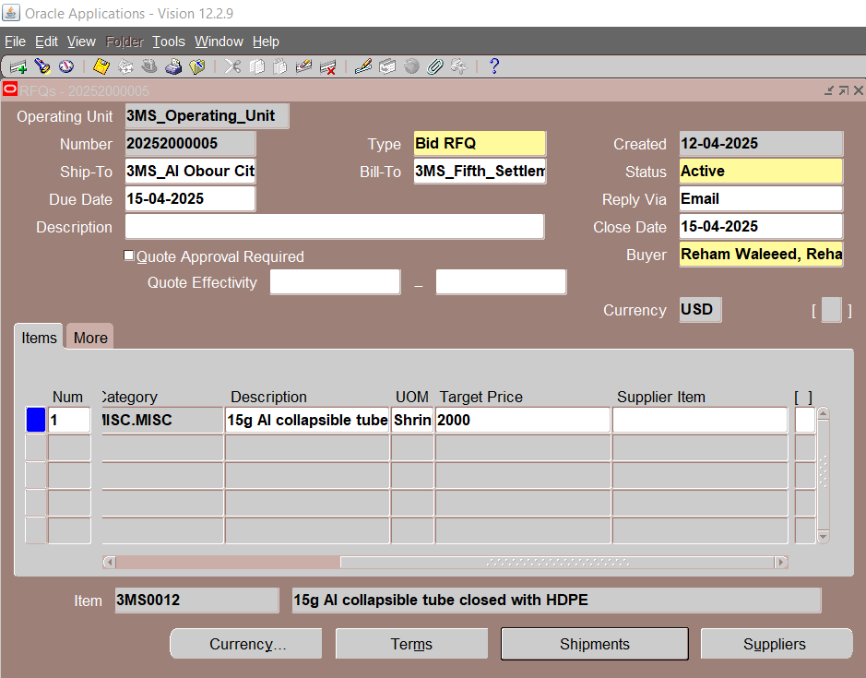

Slide 34
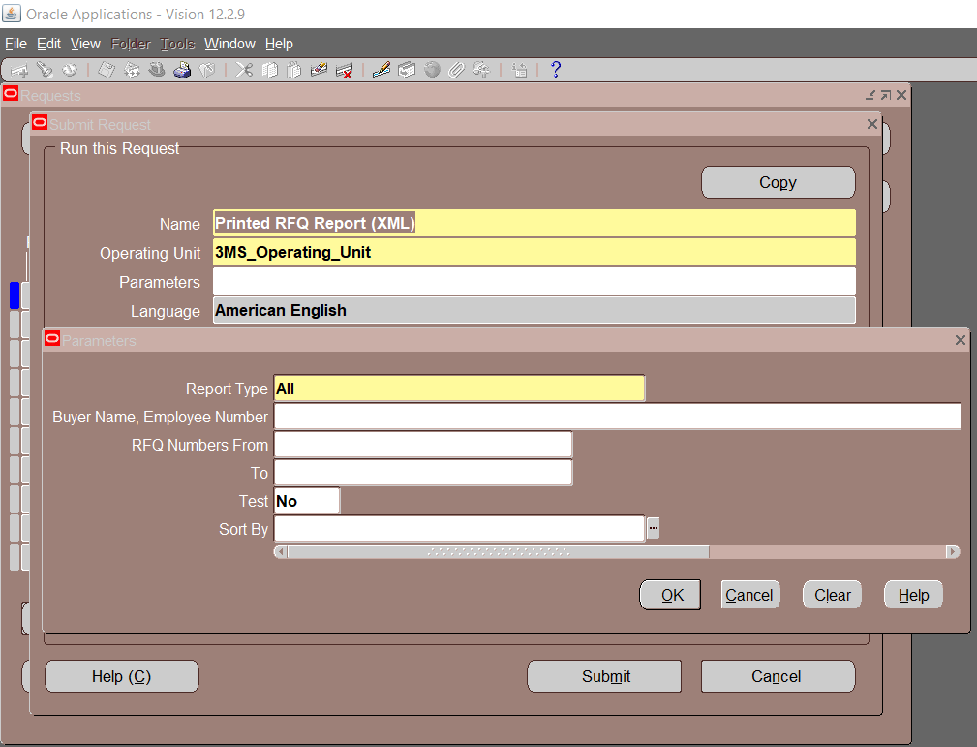

Slide 35
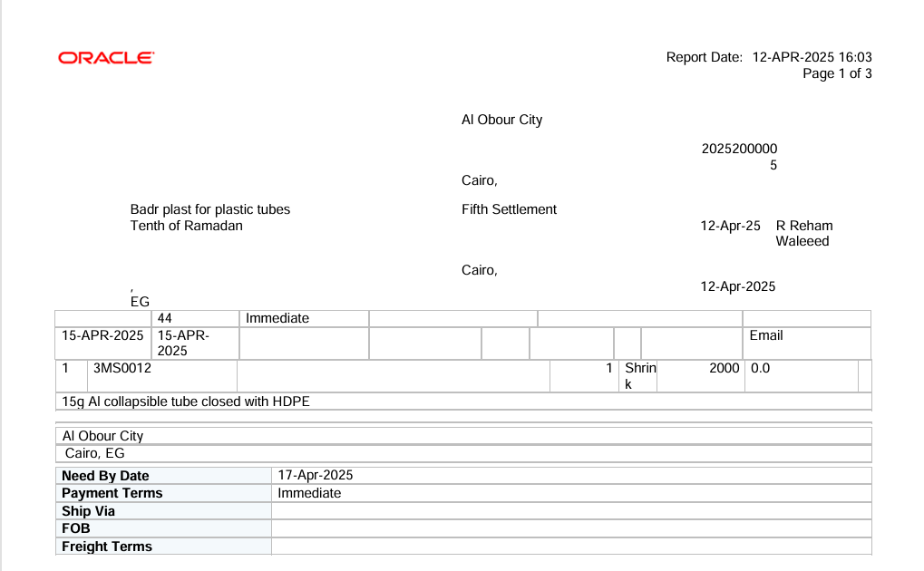

Slide 36
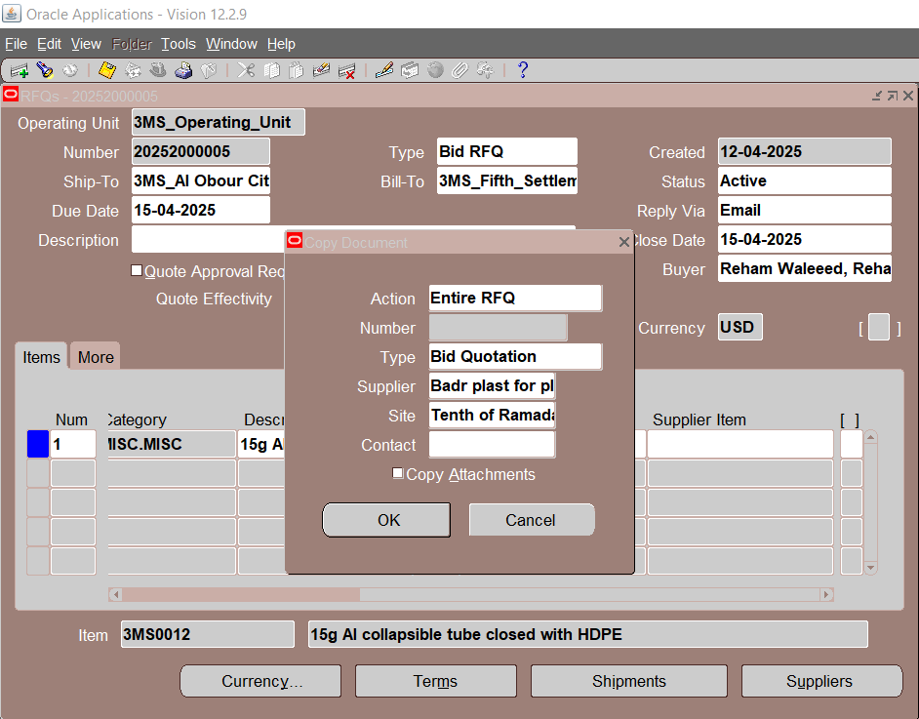

Slide 37
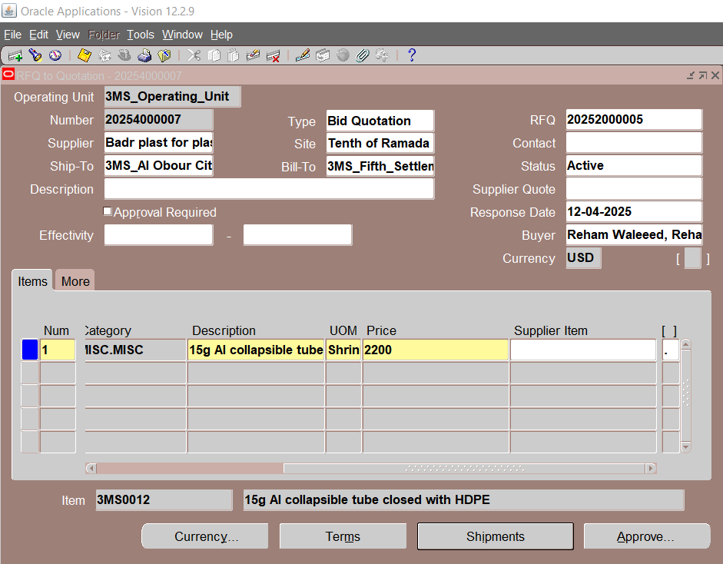

Slide 38
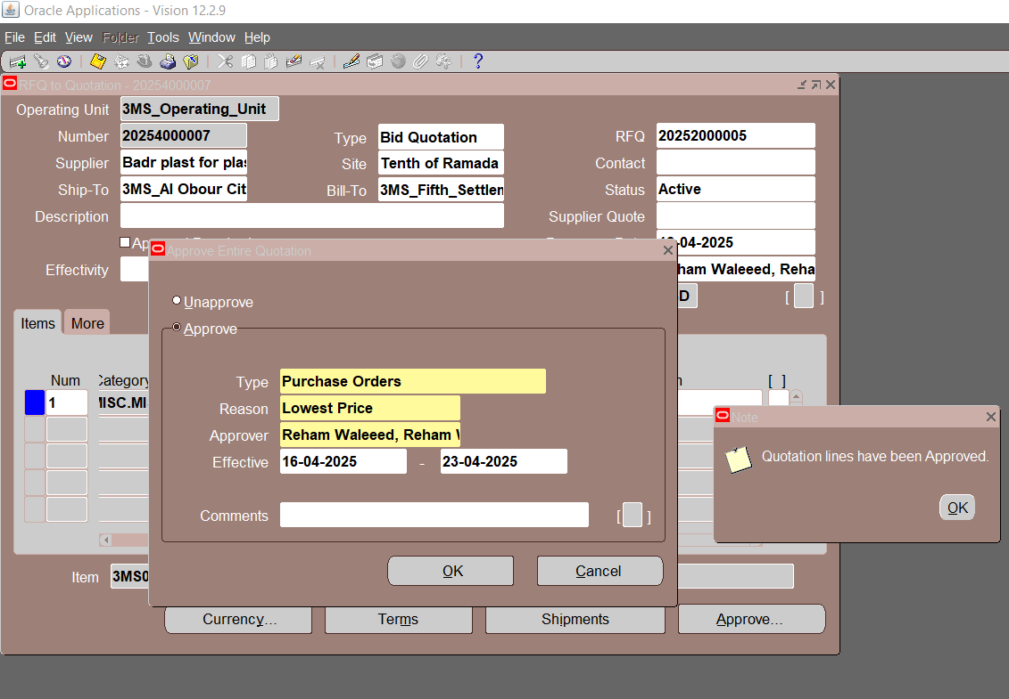

Slide 39
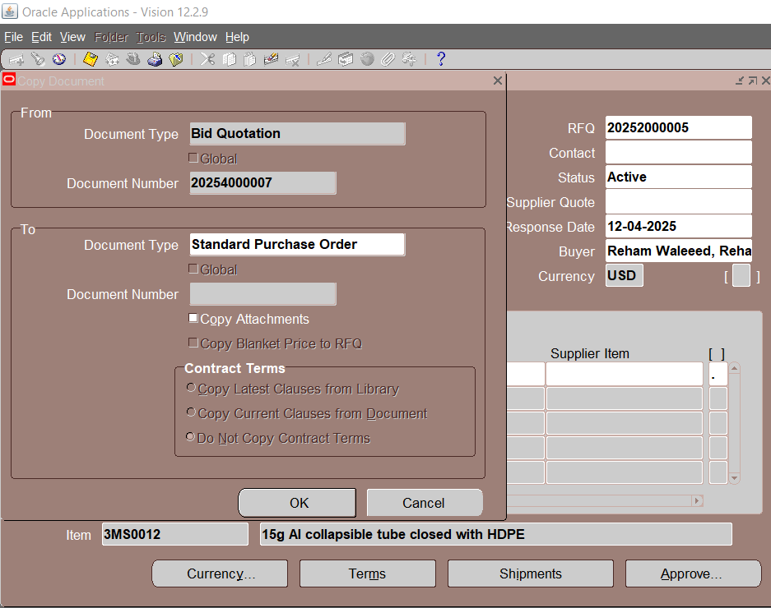

Slide 40
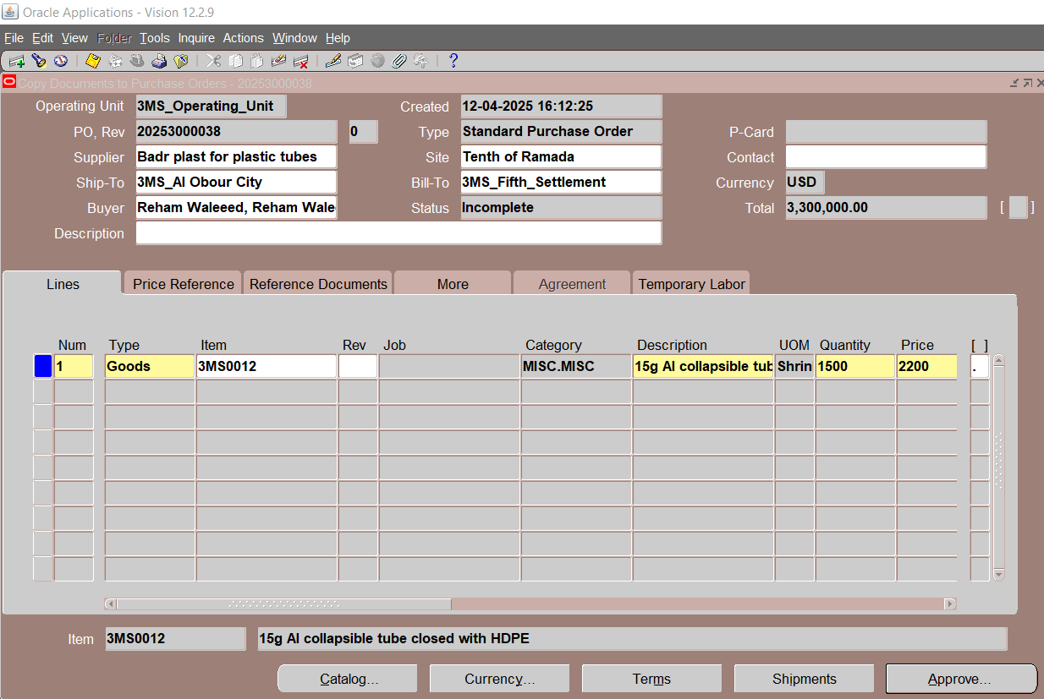

Slide 41
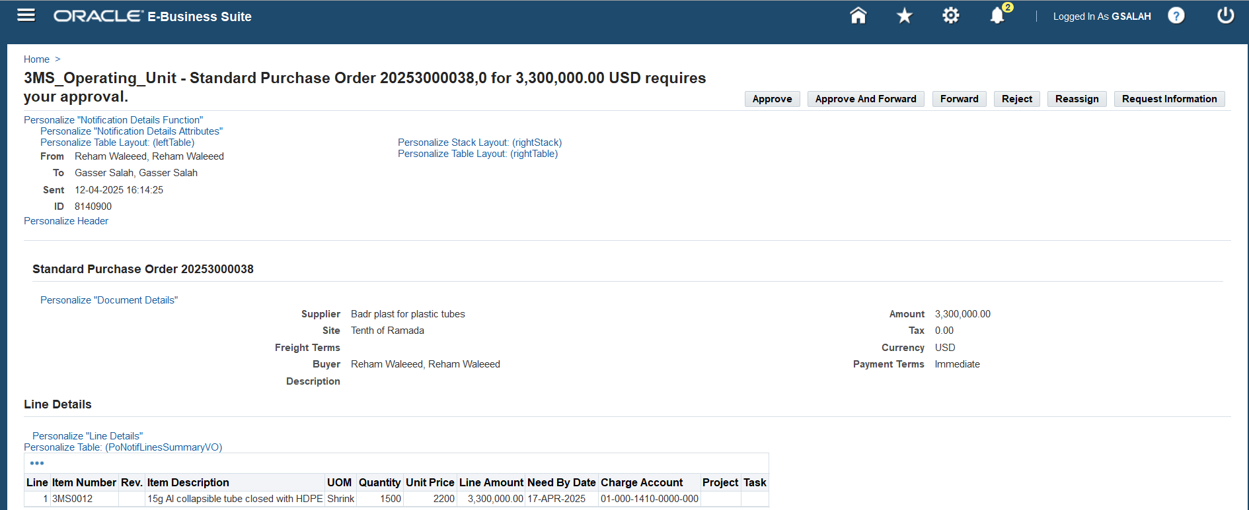

Slide 42
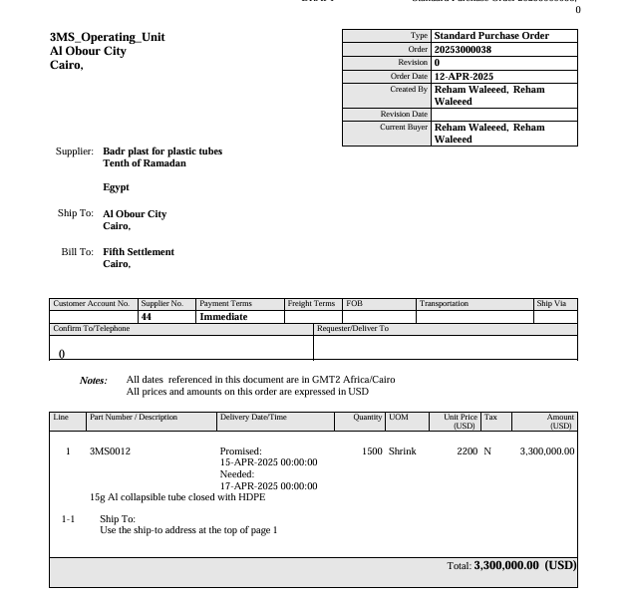

Slide 43
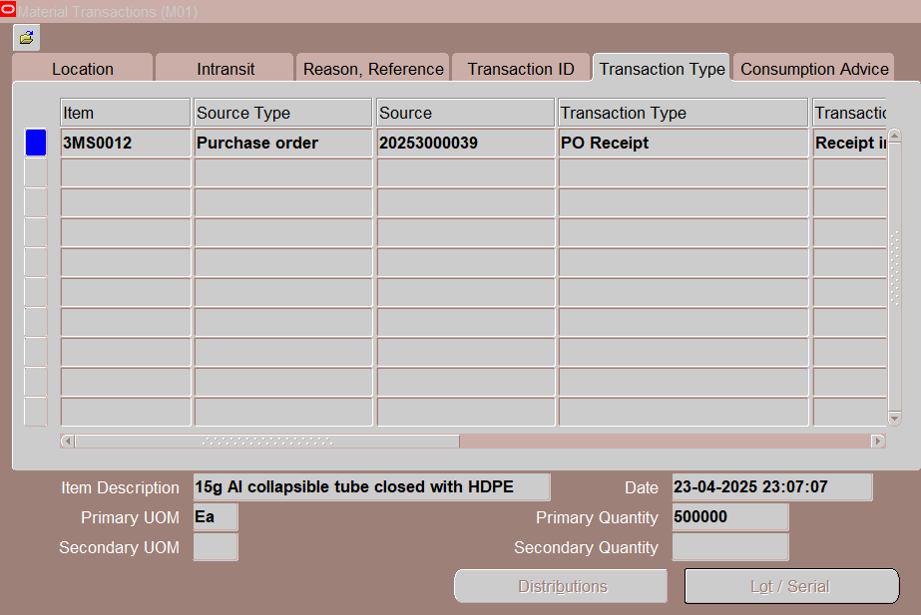

Slide 44
Sign-Off User Acceptance Test (UAT)
User Acceptance Test (UAT) Sign-Off:
After successful testing, the customer signs off on the UAT document to confirm functionality.

Slide 45

6-Go-Live & Post-Go-Live Support
Migrate configurations and customizations from the testing environment to the production environment.
Go-Live.
Provide post-go-live support for a predefined period (30 days) to resolve any immediate issues.

Slide 46
Project Outcomes from Stakeholders Feedback
1. Operational Impact
Order processing time decreased by 60%, improving customer service.
Procurement cycle time reduced by 80%, streamlining vendor management.
Inventory accuracy improved to 95%, preventing stock variations.
2. User Adoption & System Usability
85% of employees reported improved efficiency in daily tasks.
70% adoption rate within the first month, with ongoing training for remaining users.
90% reduction in manual data entry errors, enhancing accuracy.

Slide 47
Implementation Challenges Faced our team
Challenge 1: Data Migration Issues
Data Quality: Inaccuracy and completeness of data being migrated.
Challenge 2: User Adoption
Resistance to Change: Some employees resist changes to their established workflows and processes.

Slide 48
Learned Lessons
1. Clear Communication with Business Users
Explain the benefits of the ERP system, addressing concerns about job security, workflow changes, and efficiency improvements.
2. Comprehensive Training Programs
Provide hands-on training tailored to different user roles to ensure employees feel confident using the new system.
3. Structured Data Migration Plan
Develop a detailed data migration plan that includes data cleansing and validation.
Perform multiple rounds of data migration testing to identify and resolve issues before go-live.

Slide 49
Thank you
Questions?

