Slide 1
Information System Security
CCCS 402
Introduction to Computer Security
Module 1
Mona Taghavi

Slide 2
Session Overview
Course Introduction
Define computer security as well as basic computer security terms
Introduce the C-I-A Triad
Introduce basic access control terminology
Explain basic threats, vulnerabilities, and attacks
Show how controls map to threats

Slide 3
What Is Computer Security?
The protection of the assets of a computer system
  Hardware
  Software
  Data
From Security in Computing, Fifth Edition, by Charles P. Pfleeger, et al. (ISBN: 9780134085043). Copyright 2015 by Pearson Education, Inc. All rights reserved.

Slide 4
Assets
Hardware
Computer
Software
Operating System
Data
Documents
Devices (disk drives, memory, printer
Network Gear
Utilities (antivirus)
Commercial applications (word processing, photo editing)
Individual applications
Photos
Music, Videos
Email
Class Projects

Slide 5
Values of Assets
Off the shelf; easily replaceable
Hardware
Software
Data
  Computer
  Devices (disk drives, memory, printer
  Network Gear
  Operating System
  Utilities (antivirus)
  Commercial applications (word processing, photo editing)
  Individual applications
  Documents
  Photos
  Music, Videos
  Email
  Class Projects
Individual Applications
Unique; Irreplaceable

Slide 6
Information Security Definition
  The preservation of confidentiality, integrity and availability of information; in addition, other properties such as authenticity, accountability, non-repudiation and reliability can also be involved. (ISO27000 Information Security Management Systems - Overview and Vocabulary)

Slide 7
Basic Terms
Threat
Vulnerability
Risk
Attack
Countermeasure or control

Slide 8
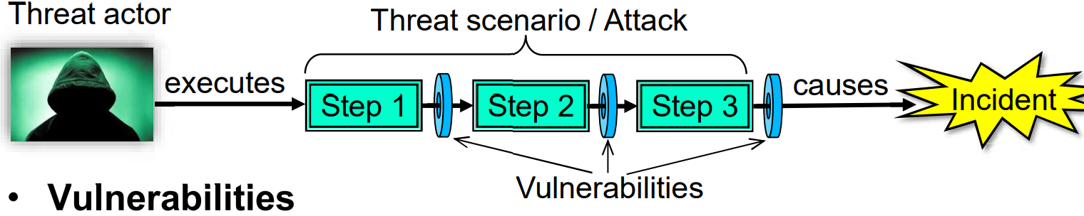
Threat
A potential negative action or event enabled by a vulnerability that results in an unwanted impact to a computer system.
Threat Actor: An active entity which can execute a threat scenario.
Threat Scenario: The set of steps executed in a potential cyber attack.

Slide 9
Vulnerability, Risk and Control
Vulnerabilities: Weaknesses or opportunities allowing a threat scenario to be executed
Security Risk: Likelihood (ease of executing a threat scenario), combined with the potential damage in case of an incident (successful attack)
Security Control: A method for removing vulnerabilities and reducing security risk

Slide 10
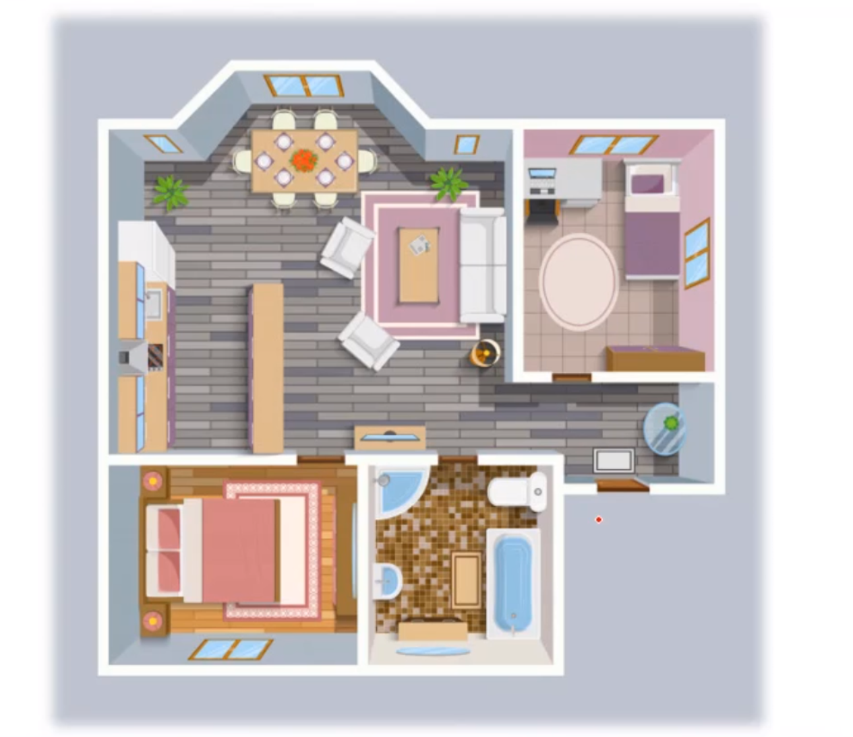
Identify vulnerabilities, security risk and control:

Slide 11
Discussion
You use it as a tool to performing tasks, therefore, you expect it to be available for use when you want it.
You rely on the computer’s integrity.
  If you save a file, you trust that the file will reload exactly as you saved it.
You expect the personal aspect of a personal computer to stay personal
  You want it to protect your confidentiality.
What does make your computer valuable to you?

Slide 12
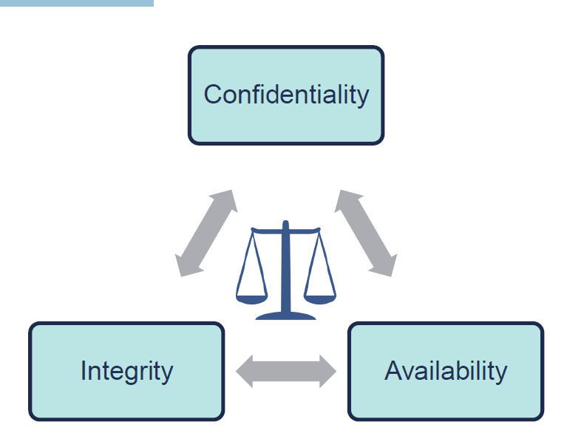
C-I-A Triad
Confidentiality
Integrity
Availability

Slide 13
Information security consists:
Provision of the following three services
  Confidentiality
    concealment of data from unauthorized parties
  Integrity
    assurance that data is genuine
  Availability
    system still functions efficiently after security provisions are in place

Slide 14
Example
  Confidentiality
    An employee should not know others’ salary (maybe)
  Integrity
    An employee should not be able to modify his/her own salary
  Availability
    Paychecks should be printed on time as stipulated by law

Slide 15
Attacks
Compromise systems in ways that affect services of information security
  attack on confidentiality:
    unauthorized disclosure of information
  attack on integrity:
    destruction or corruption of information
  attack on availability:
    disruption or denial of services

Slide 16
Types of Threats

Slide 17
Ways for Achieving Security
Prevent it, by blocking the attack or closing the vulnerability
Deter it, by making the attack harder but not impossible
Deflect it, by making another target more attractive (or this one less so)
Mitigate it, by making its impact less severe
Detect it, either as it happens or some time after the attack
Recover from its effects

Slide 18
Access Control
Prevention is establishment of policy and access control
who: identification, authentication, authorization
what: granted on “need-to-know” basis
The kind of access such as read, write, or execute
Policy:
Who+What+How=Yes/No
Person, process, or a program
Data Item
Object (What)
Mode of Access (How)
Subject (Who)

Slide 19
Detection
Determine that either an attack is underway or has occurred and report it
Real-time monitoring
  or, as close as possible
  monitor attacks to provide data about their nature, severity, and results
Intrusion verification and notification
  intrusion detection systems (IDS)
  typical detection systems monitor various aspects of the system, looking for actions or information indicating an attack
    example: denial of access to a system when user repeatedly enters incorrect password

Slide 20
Response
Stop an attack
  must be timely!
    incident response plan developed in advance
Assess and repair any damage
Resumption of correct operation
Evidence collection and preservation
  very important
    identifies vulnerabilities
    strengthens future security measures

Slide 21
Controls/Countermeasures
We can group controls into three largely independent classes.
The following list shows the classes and several examples of each type of control.
  Physical controls stop or block an attack by using something tangible too, such as walls and fences
  Procedural or administrative controls use a command or agreement
  Technical controls counter threats with technology (hardware or software)
From Security in Computing, Fifth Edition, by Charles P. Pfleeger, et al. (ISBN: 9780134085043). Copyright 2015 by Pearson Education, Inc. All rights reserved.

Slide 22
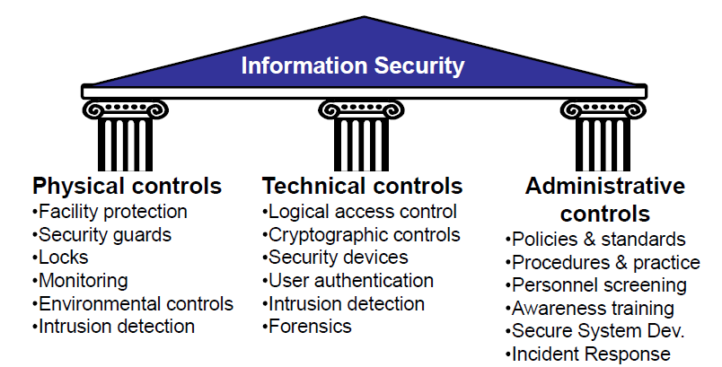
Security control categories

Slide 23
Controls/Countermeasures

Slide 24
Session Summary
Vulnerabilities are weaknesses in a system; threats exploit those weaknesses; controls protect those weaknesses from exploitation
Confidentiality, integrity, and availability are the three basic security primitives
Different controls address different threats; controls come in many flavors and can exist at various points in the system

