Slide 1
Information System Security
CCCS 402
Introduction to Computer Security
Module 2
Mona Taghavi

Slide 2
Session Overview
Authentication mechanisms
Available access control implementation options
Strengths, weaknesses, and history of each encryption techniques
Certificates
Certificate authorities

Slide 3
What is authentication?
The act of proving that a user is who she says she is
Methods:
  Something the user knows
  Something the user is
  Something user has

Slide 4
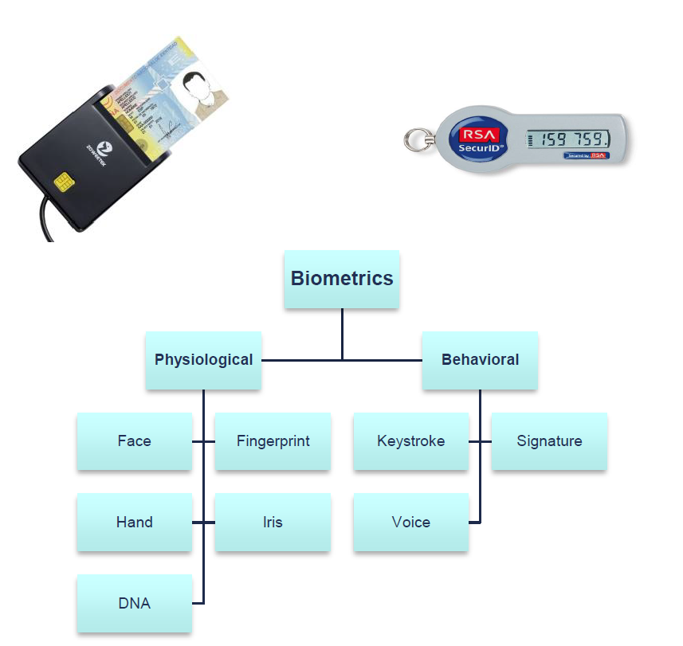
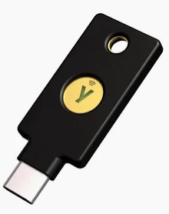
Three Factors of Authentication
Something You Know
  Password
  Security questions
Something You Have
  Smart Card
  RSA Token
  Hardware authentication device(Yubikey)
Something You Are
  Biometrics

Slide 5
Something You Know
Attacks on “something you know”:
  Dictionary attacks
  Inferring likely passwords/answers
  Guessing
  Defeating concealment
  Exhaustive or brute-force attack
  Rainbow tables

Slide 6
Something You Know
Attacks on “something you know”:
  Dictionary attacks
  Inferring likely passwords/answers
  Guessing
  Defeating concealment
  Exhaustive or brute-force attack
  Rainbow tables

Slide 7
Distribution of Password Types

Slide 8
Something You Know
Attacks on “something you know”:
  Dictionary attacks
  Inferring likely passwords/answers
  Guessing
  Defeating concealment
  Exhaustive or brute-force attack
  Rainbow tables

Slide 9
Something You Know
Attacks on “something you know”:
  Dictionary attacks
  Inferring likely passwords/answers
  Guessing
  Defeating concealment
  Exhaustive or brute-force attack
  Rainbow tables

Slide 10
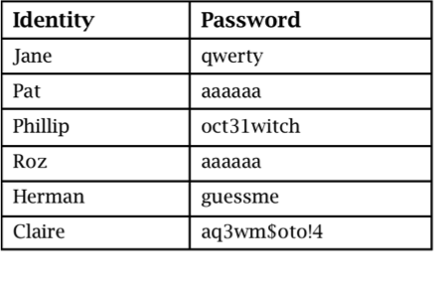
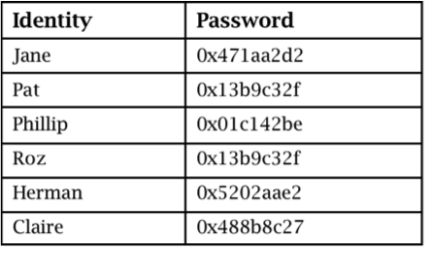
Password Storage
Plaintext
Concealed

Slide 11
Something You Know
Attacks on “something you know”:
  Dictionary attacks
  Inferring likely passwords/answers
  Guessing
  Defeating concealment
  Exhaustive or brute-force attack
  Rainbow tables

Slide 12
Something You Know
Attacks on “something you know”:
  Dictionary attacks
  Inferring likely passwords/answers
  Guessing
  Defeating concealment
  Exhaustive or brute-force attack
  Rainbow tables

Slide 13
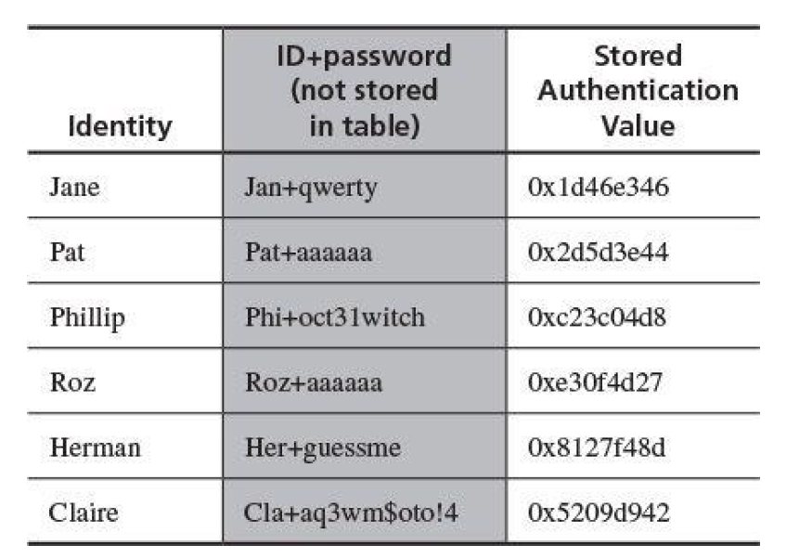
Password Storage

Slide 14
User Identification and Authentication
Identification: Not the same as authentication.
  Before you give out credentials, you “Identity Proof” somebody.
  Validates someone’s identity before credentials are issued
  Method: Passport, name, biometrics
User authentication
  Prove that you are the one you claim to be
Main threat: Spoofed identity and false login

Slide 15
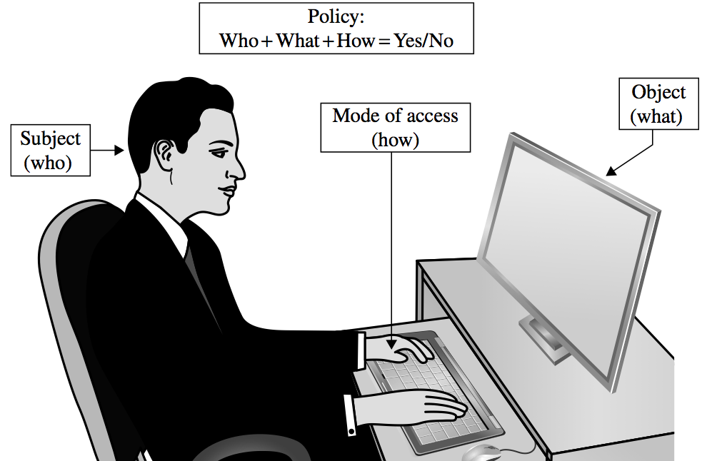
Access Control
Policy:
Who+What+How = Yes/No
Object (What)
Mode of Access
(How)
Subject (Who)

Slide 16
Implementing Access Control
Reference monitor
Access control directory
Access control matrix
Role-based access control
Etc.

Slide 17
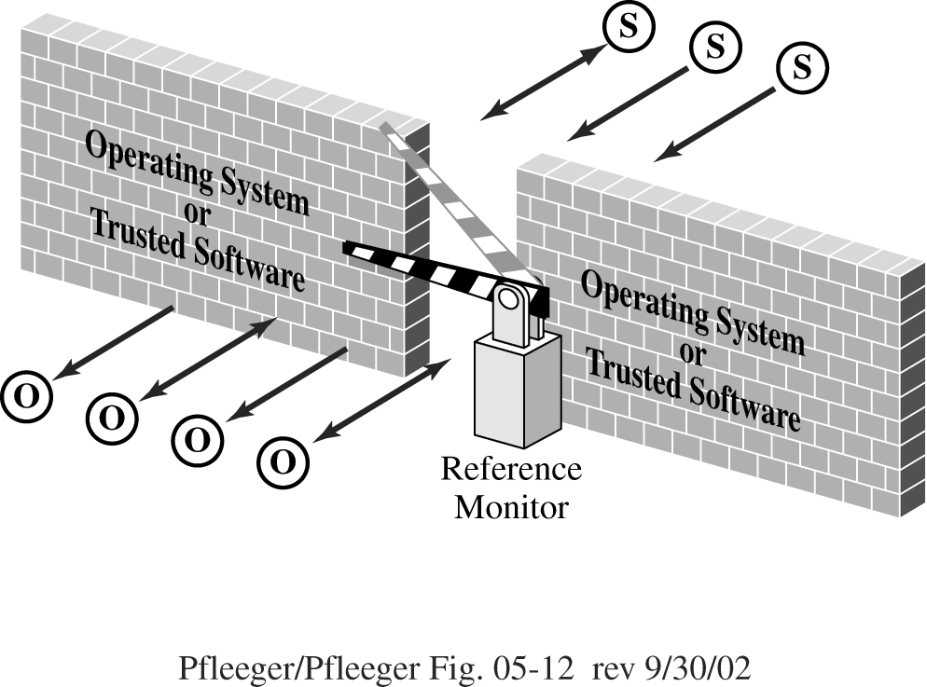
Reference Monitor

Slide 18
Access Control Directory

Slide 19
Access Control Matrix
Objects
 | File A | Printer | System Clock
User W | Read Write Own | Write | Read
Admin |  | Write Control | Control
Subjects

Slide 20
Role-based access control
Role-based access control lets us associate privileges with groups, such as all administrators can have significant privileges, and others such as regular users or guests to have lower privileges.
Administering security is easier if we can control access by job demands, not by person.

Slide 21
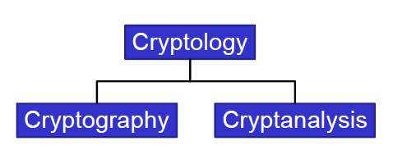
Cryptography Terminology
Greek Word: “Krypto” = Hidden / Secret
Cryptography is the science of secret writing with the goal of hiding the meaning of a message.

Slide 22

Cryptography Goals
Eve
y
Alice
x
y
y
Bob
x
e
d
Insecure Channel
Encryption – Prevent Eve from intercepting message
Authentication – Prevent Eve from impersonating Alice

Slide 23
Kerckhoffs’ Principle
The security of an encryption system must depend only on the key, not on the secrecy of the algorithm.
  Nearly all proprietary encryption systems have been broken (Enigma, zipcrack).
  Secure systems use published algorithms.

Slide 24
Provable Security
There is no such thing as a provably secure system.
Proof of unbreakable encryption does not prove the system is secure.
Systems are believed secure only when many people try and fail to break them.

Slide 25
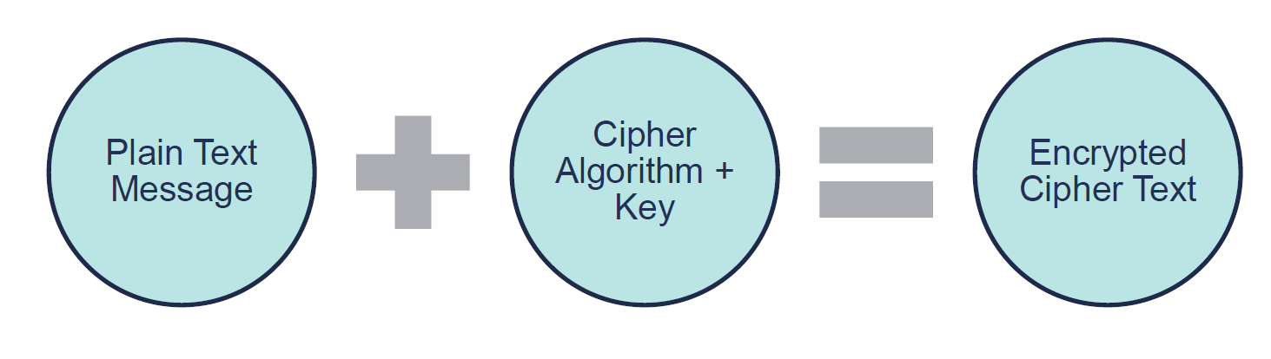
Encrypting a Message

Slide 26
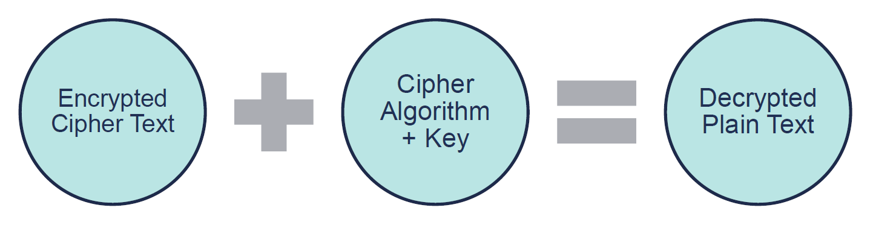
Decrypting a Message

Slide 27
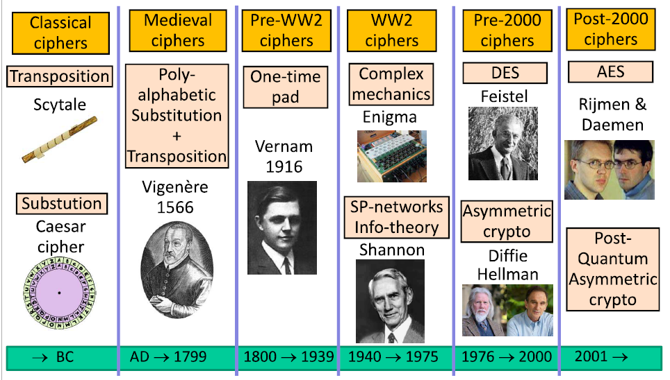
Evolution of Ciphers

Slide 28
Caesar’s Cipher
Key: k = no. between 0 and 25.
Encryption: encode the i^{th} letter as the (i+k) ^{th} letter.
Decryption: decode the j^{th} letter to the (j-k) ^{th} letter.
Plain-text:
S E N D R E I N F O R C E M E N T
Key: 2
Cipher-text:
U G P F T G K P H Q T E G O G P V
Problem: only 26 possibilities for key – can be broken in short time.
Kerchoff’s Principle (1883): System should be secure even if algorithms are known, as long as key is secret.
In other words: “security through obscurity” does not work.

Slide 29
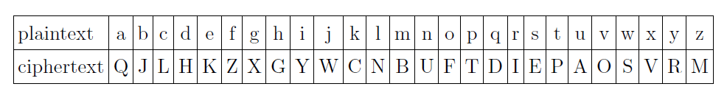
Substitution cipher
Encrypt the word `pelican’.
Decrypt the cipher message `FEPIYLG'

Slide 30
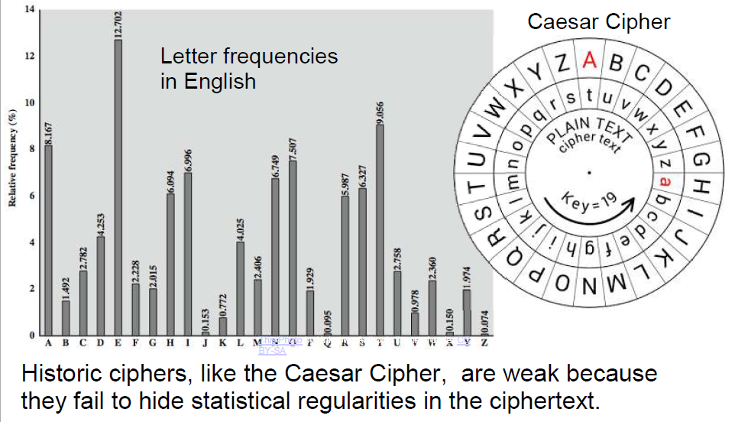
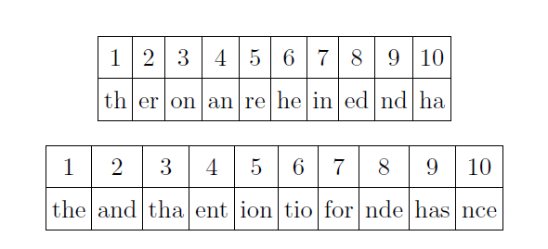
Letter Frequencies

Slide 31
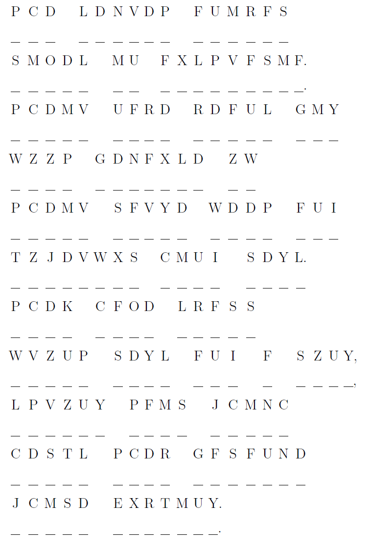
The follow cipher is a clue to a secret animal. What is it?

Slide 32

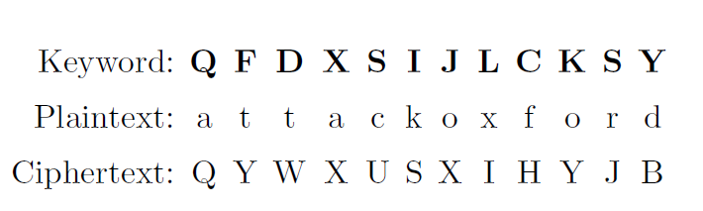
One Time Pad cipher

Slide 33
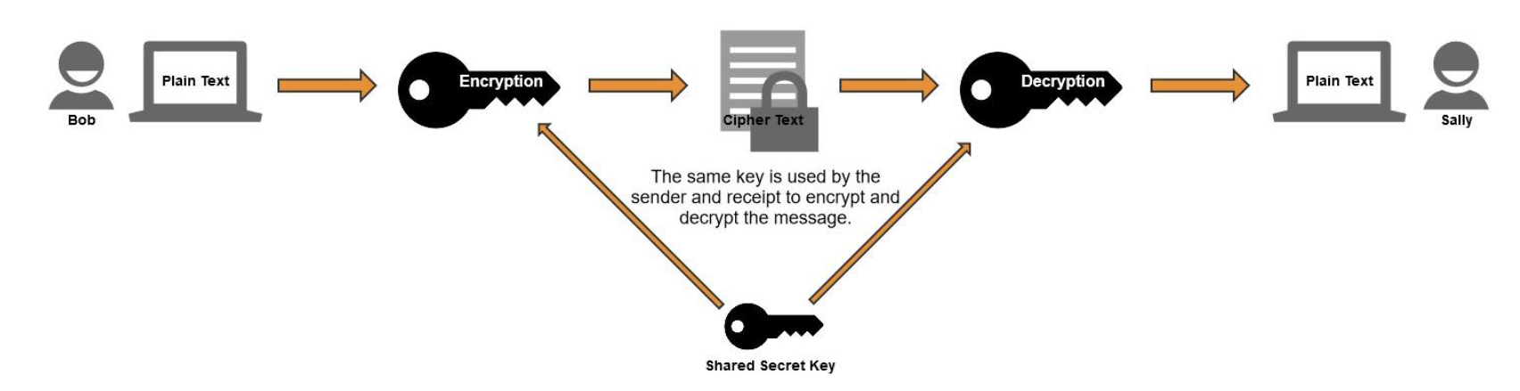
Symmetric (Private Key) Encryption
Symmetric encryption uses a single key for encryption and decryption.
Both the sender and receiver have the same key and use it to encrypt and decrypt all messages.
It’s also known as secret-key encryption or private-key encryption.

Slide 34
Symmetric (Private Key) Encryption
Symmetric encryption is much more efficient at encrypting large amounts of data than its counterpart, asymmetric encryption.
The downside of symmetrical encryption is that it makes it hard to initiate communication the first time.
How do you securely transmit the private key to each user?

Slide 35
Asymmetric Encryption
Asymmetric encryption uses two keys, a public key and a private key created as a matched pair.
  Private Key: Kept secret and never shared.
  Public Key: Shared with others.
Commonly referred to as:
  Public Key Encryption
  Public Key Infrastructure (PKI) Encryption

Slide 36
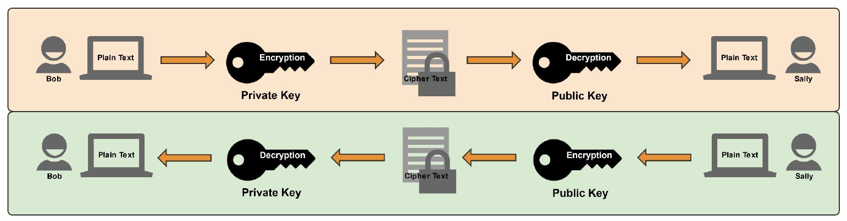
How Public Key Encryption Works
Anything encrypted with the private key can only be decrypted with the matched public key.
Anything encrypted with the public key can only be decrypted with the matched private key.

Slide 37
Session Summary
Users can authenticate using something they know, something they are, or something they have
Systems may use a variety of mechanisms to implement access control
Encryption helps prevent attackers from revealing, modifying, or fabricating messages
Symmetric and asymmetric encryption have complementary strengths and weaknesses

