Slide 1
Information System Security
CMIS 422
Weaknesses in Programs
Module 4
Mona Taghavi

Slide 2
Session Overview
Memory organization, buffer overflows
Common programming bugs such as race conditions
Malware and malware capabilities
Countermeasures - Defensive programming

Slide 3
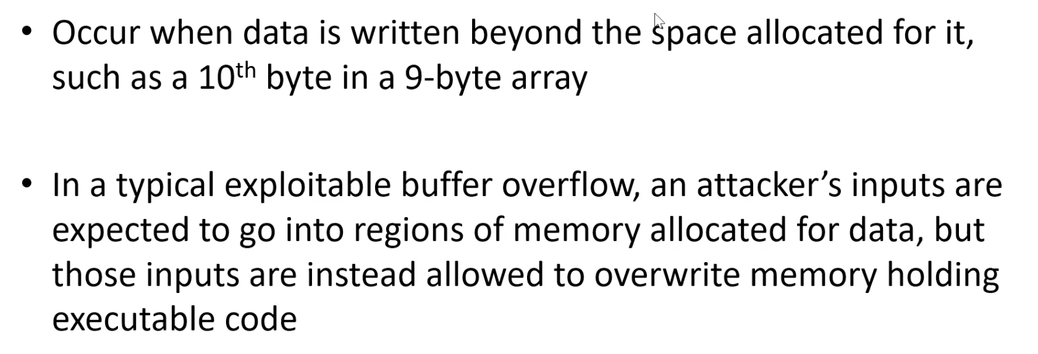
Buffer Overflow

Slide 4
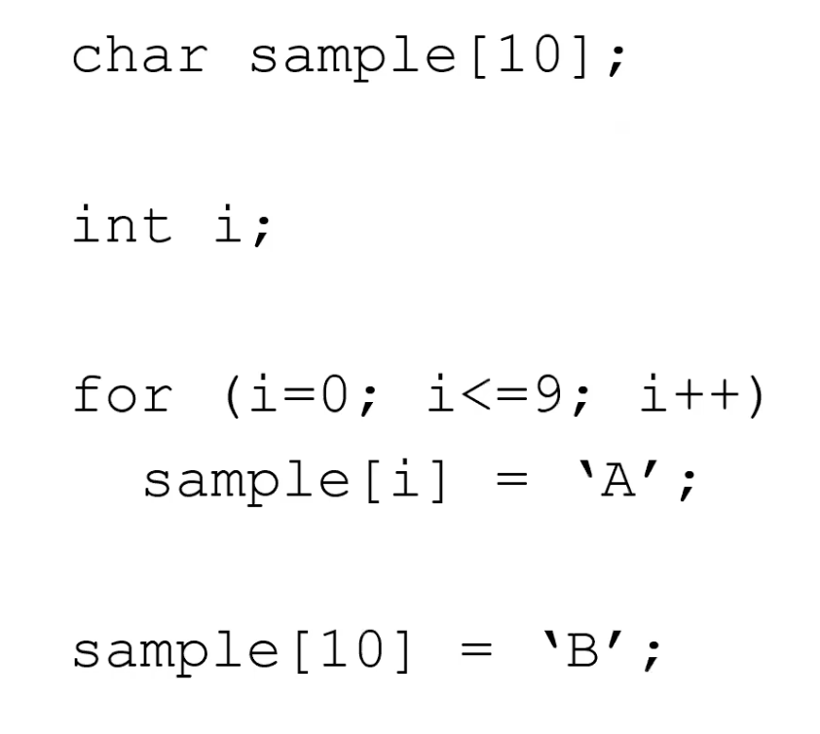
Buffer Overflow

Slide 5
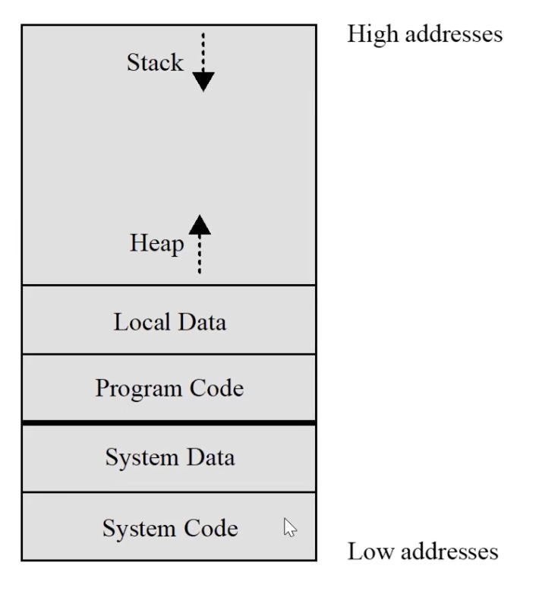
Memory organization

Slide 6
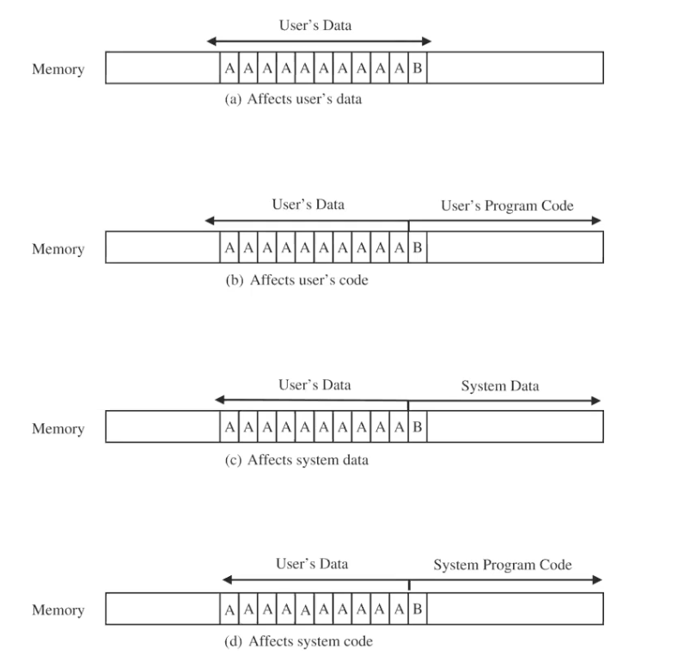
Where a buffer can overflow

Slide 7
Time-of-Check to Time-of-Use

Slide 8
Race Conditions

Slide 9
Race Conditions

Slide 10
Malware
What is a Malware?
Programs planted by an agent with malicious intent to cause unanticipated or undesired effects

Slide 11
Malwares
      Malware is the general term for malicious software.
      Malware can do a lot of damage:
        Erase files
        Deny access to files
        Create popups
        Track keystrokes
        Turn computer into spam email server
        Disable computer completely
      Malware can be spread through:
        Email attachments
        USB drives
        Programs downloaded off the internet
        Hackers exploiting vulnerabilities in programs running on your computer

Slide 12
Malware Features
Infectious:
  Viruses, worms
Concealment:
  Trojan horses, logic bombs, rootkits
Malware for stealing information:
  Spyware, keyloggers, screen scrapers
Malware for profit:
  Dialers, scarewares, ransomware
Malware as platform for other attacks
  Botnets, backdoors (trapdoors)
Many malwares have characteristics of multiple types

Slide 13
Malware
What is a Virus?
A program that can replicate itself and pass on malicious code to other nonmalicious programs by modifying them

Slide 14
Virus Detection
Virus scanners look for signs of malicious code infection using signatures in program files and memory
Traditional virus scanners have trouble keeping up with new malware—detect about 45% of infections
Detection mechanisms:
  Known string patterns in files or memory
  Execution patterns
  Storage patterns

Slide 15
Malware
What is a Worm?
A program that spreads copies of itself through a network

Slide 16
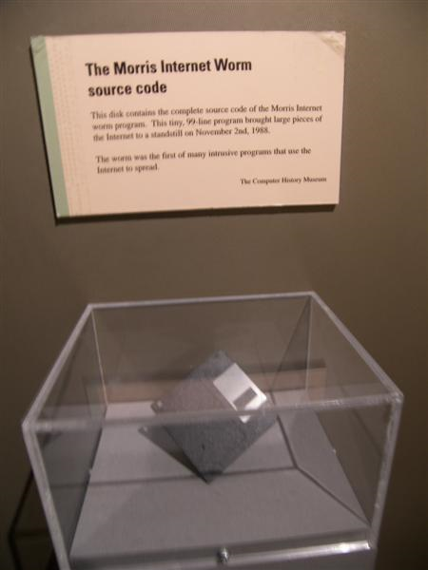
Morris Worm (November 1988)
First major worm
Written by Robert Morris
  Son of former chief scientist of NSA’s National Computer Security Center
  Infected approximately 6,000 machines
    10% of computers connected to the Internet
  cost ~ $10 million in downtime and cleanup

Slide 17
Email Worms: Spreading as Email Attachments
Love Bug worm (ILOVEYOU worm) (2000):
  May 3, 2000: 5.5 to 10 billion dollars in damage
MyDoom worm (2004)
  First identified in 26 January 2004:
  On 1 February 2004, about 1 million computers infected with Mydoom begin a massive DDoS attack against the SCO group
Storm worm & Storm botnet (2007)
  Identified on January 17
  gathering infected computers into the Storm botnet.
  By around June 30th infected 1.7 million computers,
  By September, has between 1 and 10 million bots

Slide 18
Malware
What is a Trojan horse?
Code that, in addition to its stated effect, has a second, nonobvious, malicious effect

Slide 19
Logic Bomb
Embedded in legitimate programs
Activated when specified conditions met
  E.g., presence/absence of some file; Particular date/time or particular user
When triggered, typically damages system
  Modify/delete files/disks

Slide 20
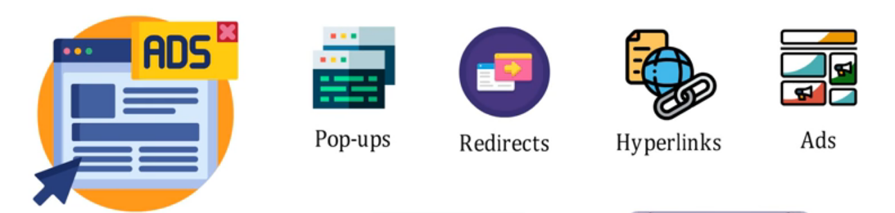
Adware
Serves advertisements in the computer of the user
  Earn revenues by clicks or visits
  It can records the users activities and act as spyware

Slide 21
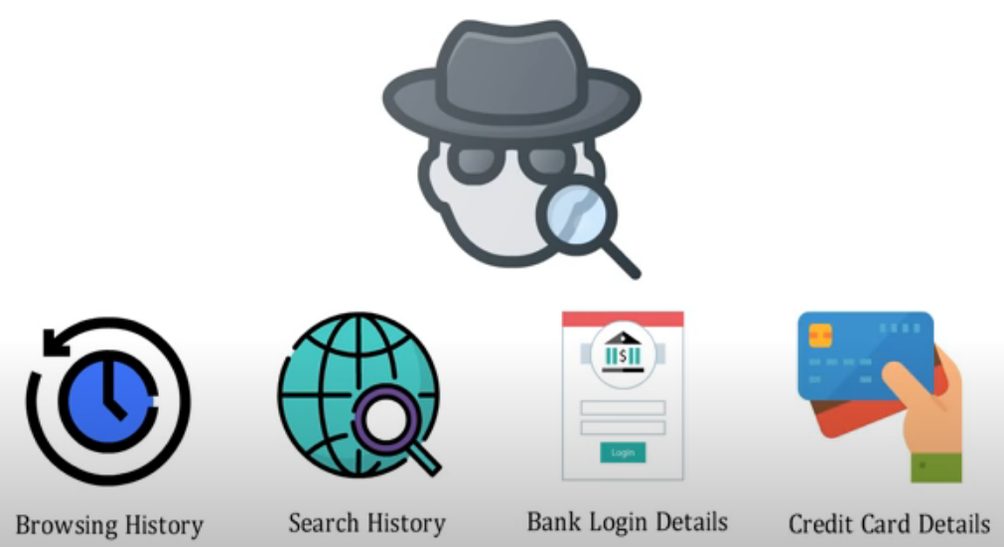
Spyware
Malware that collects little bits of information at a time about users without their knowledge
  Keyloggers: stealthly tracking and logging key strokes
  Screen scrapers: stealthly reading data from a computer display
  May also tracking browsing habit
  May also re-direct browsing and
  display ads

Slide 22
Scareware
Malware that scares victims into take actions that ultimately end up compromising our own security.
  E.g., paying for and installing fake anti-virus products

Slide 23
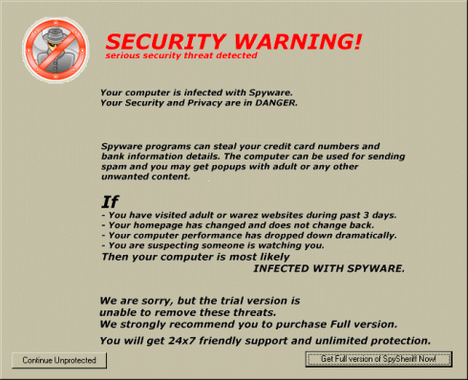

Slide 24

Ransomware
Holds a computer system, or the data it contains, hostage against its user by demanding a ransom.
  Disable an essential system service or lock the display at system startup
  Encrypt some of the user's personal files, originally referred to as cryptoviruses, cryptotrojans or cryptoworms
Victim user has to
  enter a code obtainable only after
  wiring payment to the attacker

Slide 25
Countermeasures for Users
Use software acquired from reliable sources
Test software in an isolated environment
Only open attachments when you know them to be safe
Treat every website as potentially harmful
Create and maintain backups

Slide 26
Countermeasures for Developers
Defensive programming
Modular code: Each code module should be
  Single-purpose
  Small
  Simple
  Independent
Encapsulation
Information hiding

Slide 27
Defensive Programming
Defensive Programming is a technique where you assume the worst from all input.
  Also known as Proactive Debugging.
Let's look at Alex's three rule of Defensive Programming.

Slide 28
First Rule
The first rule of defensive programming is :
Never Assume Anything!
A lot of problems in applications can be attributed to unexpected input.
Another common source of error is the programmer assuming something about a programming language.

Slide 29
Input Validation
As previously mentioned, data from the user cannot be trusted.
As such, all input must be validated.
For each input:
  Define the set of all legal input values.
  When receiving input, validate against this set.
  Determine the behavior when input is incorrect:
    Terminate
    Retry
    Warning

Slide 30
Second Rule
The second rule of defensive programming is to use Standards.
Proper coding standards address weaknesses in the language standard and/or compiler design.
They also defines a format or “style” used for writing code.
Every software development team should have an agreed-upon and formally documented coding standard.

Slide 31
Magic Numbers
Never use constant values in your code.
  Makes the code difficult to understand.
  Makes the code difficult to maintain.
int friction = (4.3563 / 5.463) * x;
Use constant variable instead.
const int PI = 3.14159265
int surface = PI * r * r;

Slide 32
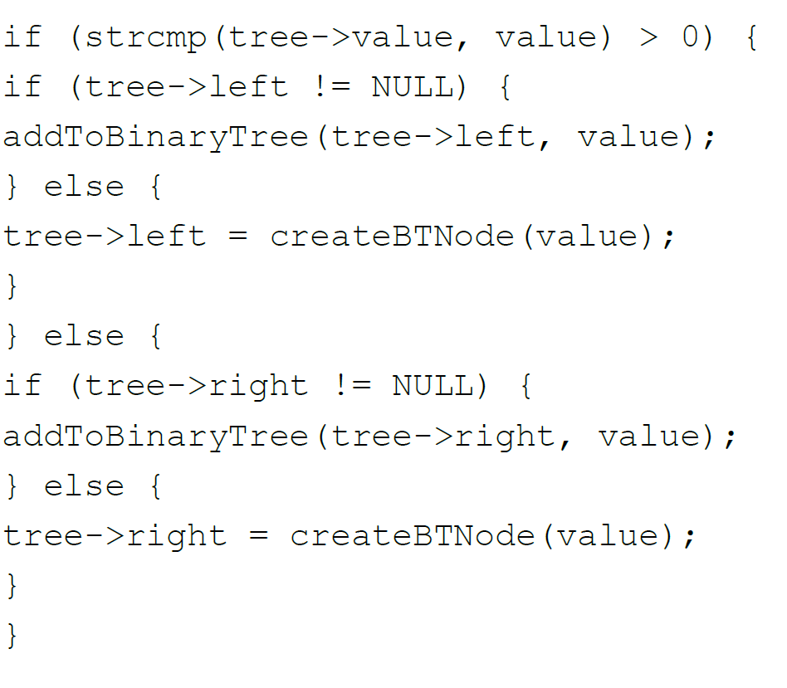
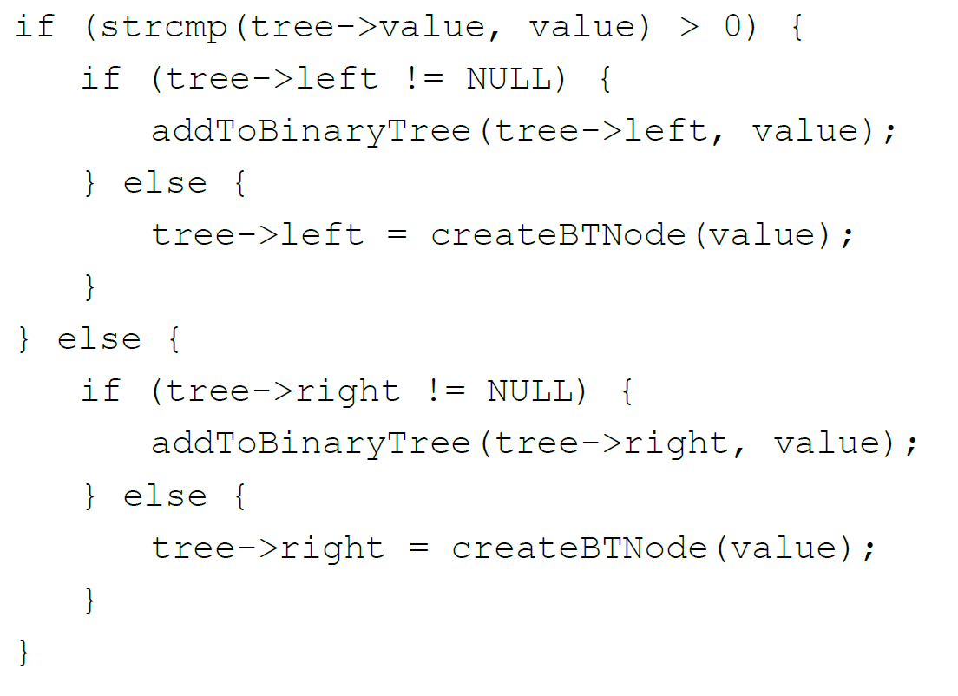
Proper indentation
Proper indentation is key to making your code readable.

Slide 33
Third Rule
The third rule of Defensive Programming is to keep your code as simple as possible.
Software should only contain the features it needs.

Slide 34
Refactoring
Refactoring is a disciplined technique for restructuring an existing body of code, altering its internal structure without changing its external behavior.
By itself, refactoring is not a bug-fixing technique.
However, refactoring is a good technique to battle feature creep:
  Features are often added during development.
  These features are more often the source of problems.
  Refactoring fights this by forcing the programmer to reevaluate the structure of his/her program.
Refactoring can help you keep you application simple.

Slide 35

Modularity
A complex system must be broken down into smaller modules

Slide 36
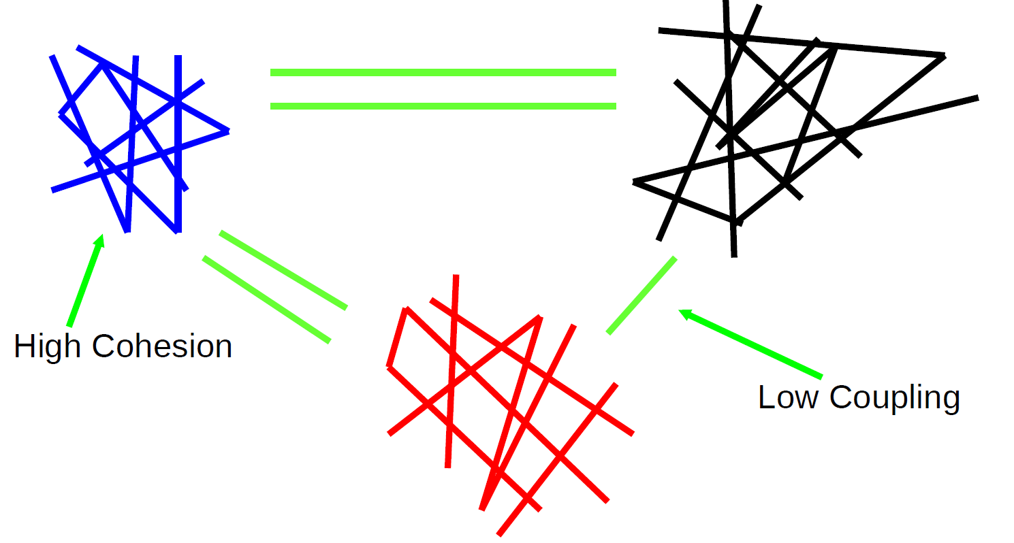
Two Essential Properties

Slide 37
Cohesion
It measures how closely the elements within a module are related to each other and how well they work together to achieve a common purpose.
Cohesion is a desirable design component attribute as when a change has to be made, it is localized in a single cohesive component

Slide 38
Coupling
A measure of the strength of the inter-connections between system components
Loose coupling means component changes are unlikely to affect other components
Shared variables or control information exchange lead to tight coupling
Loose coupling can be achieved by component communication via parameters or message passing

Slide 39
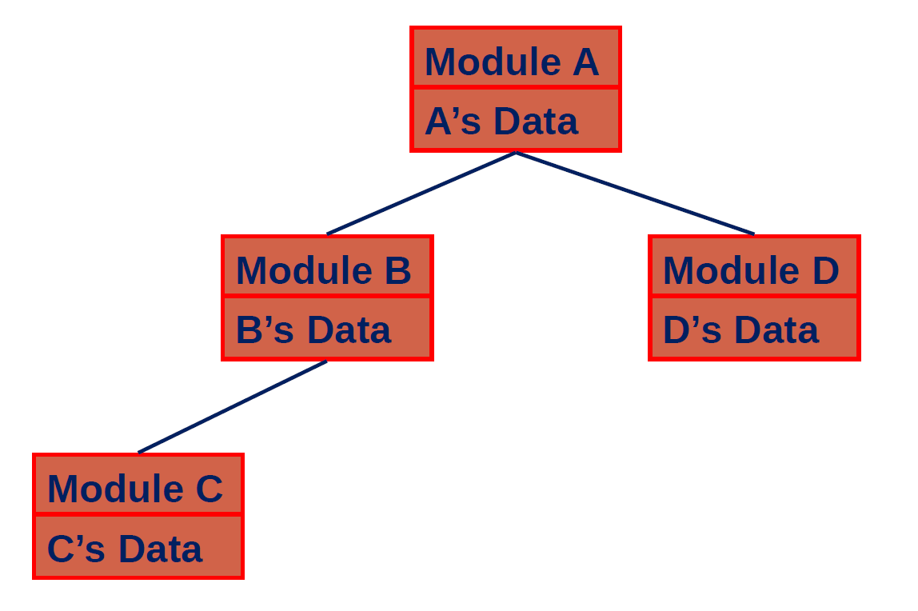
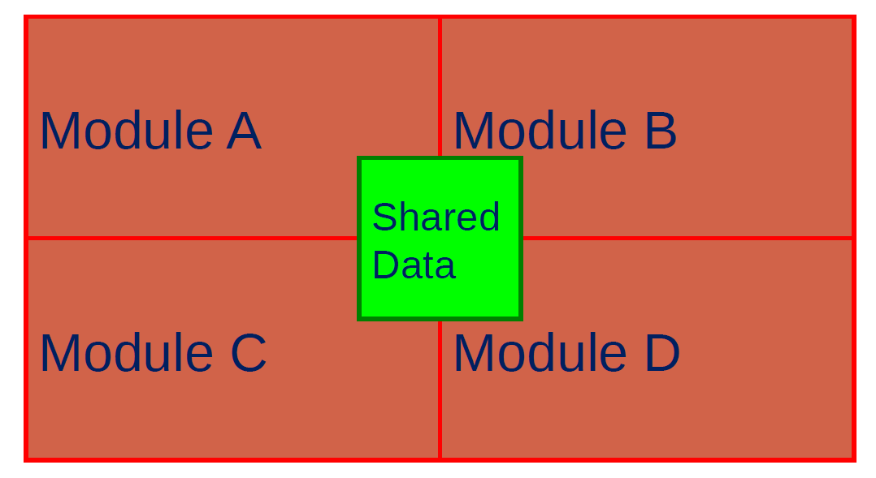
Tight or loose coupling?

Slide 40
Information Hiding
Put the complexity inside a “black box”
  Hide it from the user of the box
  The user does not need to know “how” the box works, just “what” it does
Greatly reduces the amount of information the designer needs to understand at once
Example:
Notes:
○ Examples
▪ Functions, macros, classes, libraries

Slide 41
Data Encapsulation
Encapsulate the data (or information) a module is working on
  Protect the data from unauthorized access
  Nobody else can mess with the data
  If it gets corrupted, it must have been done in this module
Makes the design more robust
Chances are that new additions will not mess up your old code

Slide 42
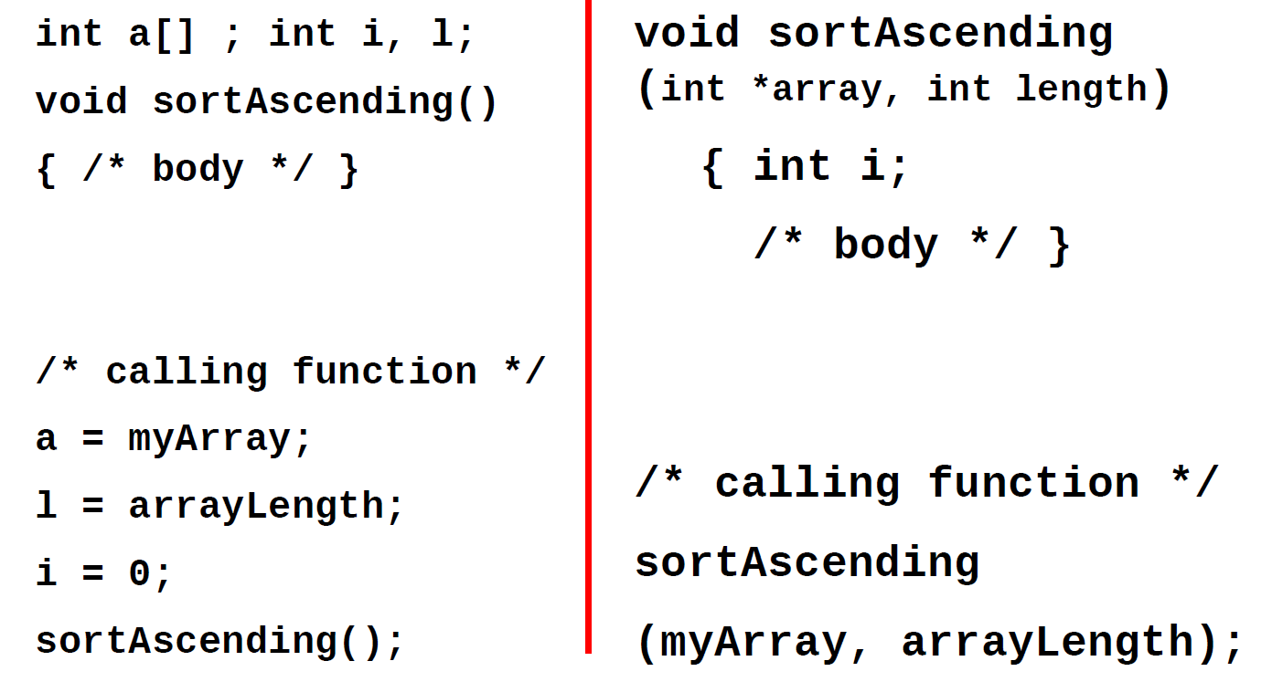
Data Encapsulation

Slide 43
Session Summary
Buffer overflow attacks can take advantage of the fact that code and data are stored in the same memory in order to maliciously modify executing programs
Malware can have a variety of harmful effects depending on its characteristics, including resource usage, infection vector, and payload
Developers can use a variety of techniques for writing and testing code for security

