Slide 1
Information System Security
CMIS 422
Operating Systems security
Module 6
Mona Taghavi

Slide 2
Session Overview
Basic security functions provided by operating systems
System resources that require operating system protection
Operating system design principles
How operating systems control access to resources

Slide 3
Operating systems
What is an operating system?
An operating system is an executive or supervisor for a piece of computing machinery.

Slide 4
Operating System Functions

Slide 5
Protected Objects
The rise of multiprogramming meant that several aspects of a computing system required protection:
  Memory
  Sharable I/O devices, such as disks
  Serially reusable I/O devices, such as printers
  Sharable programs and subprocedures
  Networks
  Sharable data

Slide 6
Operating systems
Operating System is designed to protect objects.
Operating systems are not monolithic but are instead composed of many individual routines.
A well-structured operating system also implements several levels of function and protection.

Slide 7
OS Layered Design

Slide 8
Functions Spanning Layers

Slide 9
Operating System tools to implement security function
The operating system must protect itself in order to protect its users and resources.
Operating system is design for self-protection.
Some of the tools and techniques that operating systems use to enforce protection:
  Virtualization
  Separation and Sharing
  Hardware Protection of Memory

Slide 10
Virtualization
What is virtualization?

Slide 11
Virtualization
With virtualization, the OS presents each user with just the resources that user should see
The user has access to a virtual machine (VM), which contains those resources
The user cannot access resources that are available to the OS but exist outside the VM
Virtualization: presenting a user the appearance of a system with only the resources the user is entitled to use

Slide 12
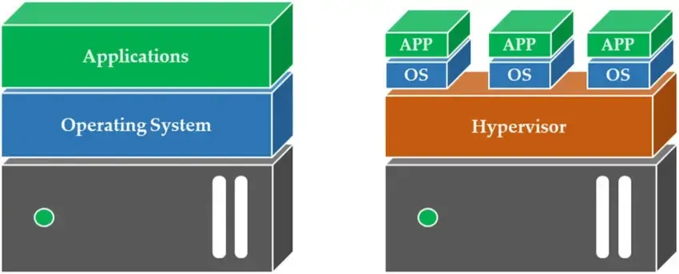
Virtualization

Slide 13
Virtualization - Hypervisor
What is a Hypervisor?

Slide 14
Virtualization - sandbox
What is a Sandbox?

Slide 15

Virtualization - honeypot
What is a Honeypot?

Slide 16
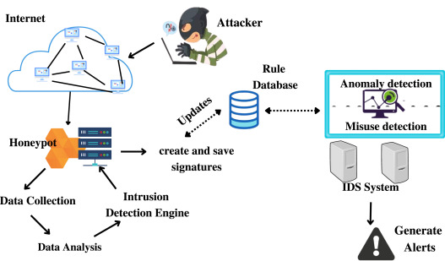
Honeypot

Slide 17
Separation and Sharing
Separation Keep one user's objects separate from other users Methods of separation:
  Physical
    Use different physical resources for different users
    Easy to implement, but expensive and inefficient
  Temporal
    Execute different users' programs at different times
  Logical
    User is given the impression that no other users exist
  Cryptographic
    Encrypt data and make it unintelligible to outsiders

Slide 18
Separation and Sharing
Methods of supporting separation/sharing:
  Do not protect
  Isolate
  Share all or share nothing
  Share but limit access
  Limit use of an object

Slide 19
Memory protection
Memory protection implements both separation and sharing.
  Fence
  Base/Bound register
  Tagged architecture
  Segmentation
  Paging

Slide 20
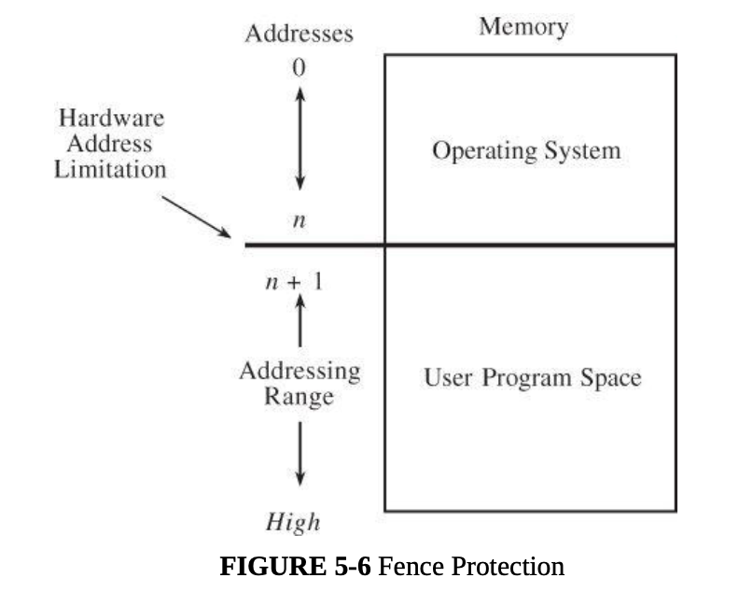
Fence

Slide 21
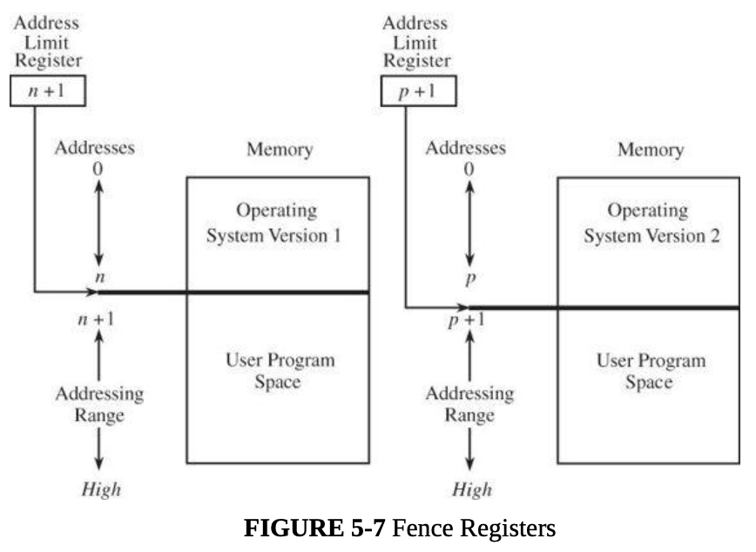
Fence Register

Slide 22
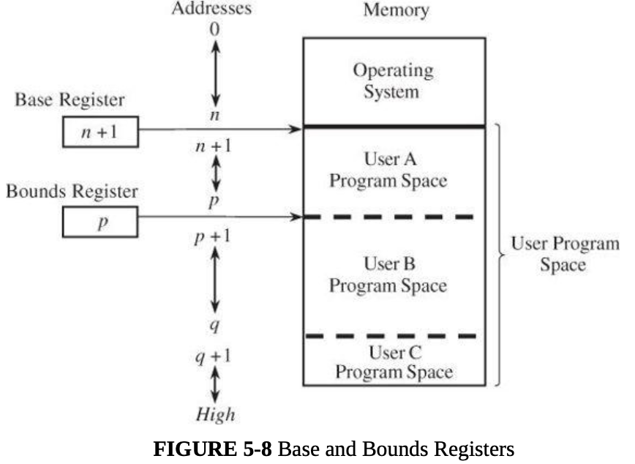
Base/Bounds Registers

Slide 23
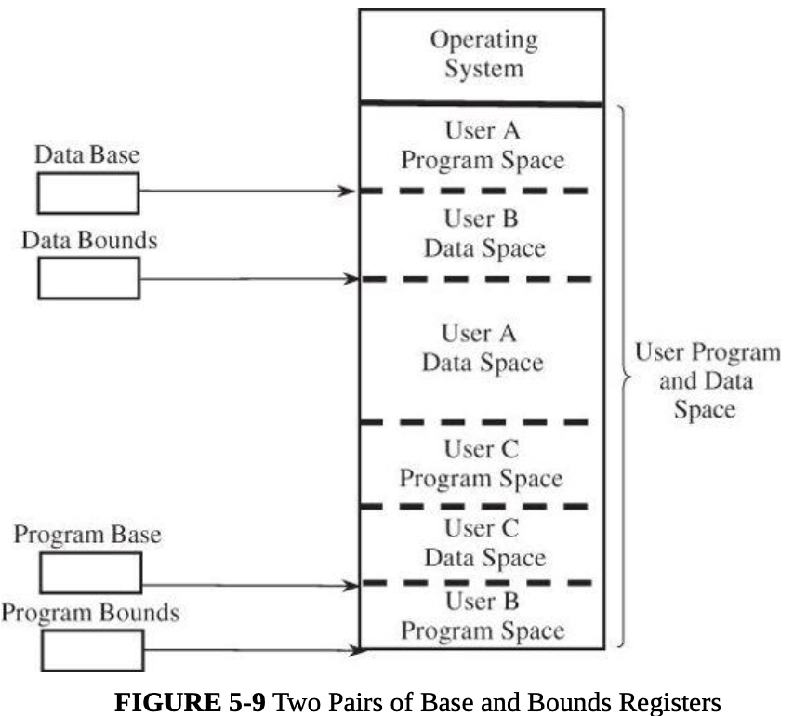
Two Pairs of Base/Bounds Registers

Slide 24
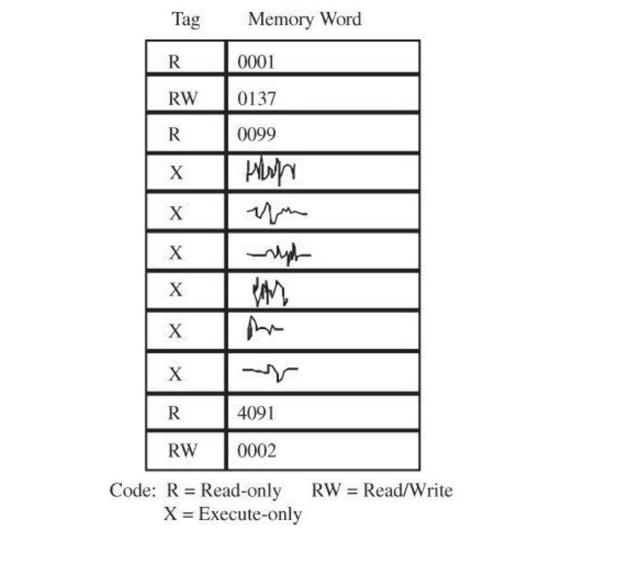
Tagged Architecture

Slide 25
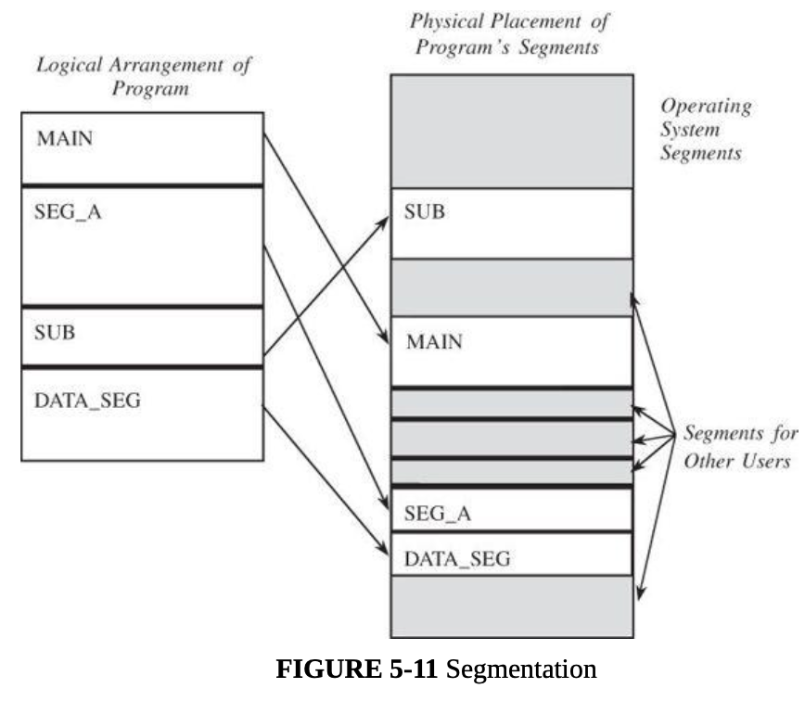
Segmentation

Slide 26
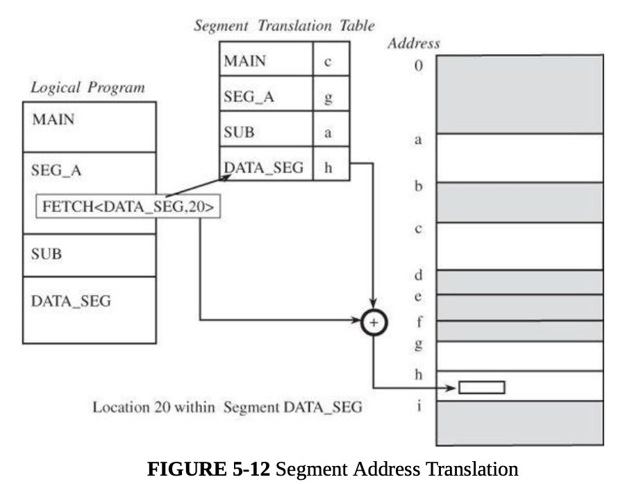
Segmentation

Slide 27
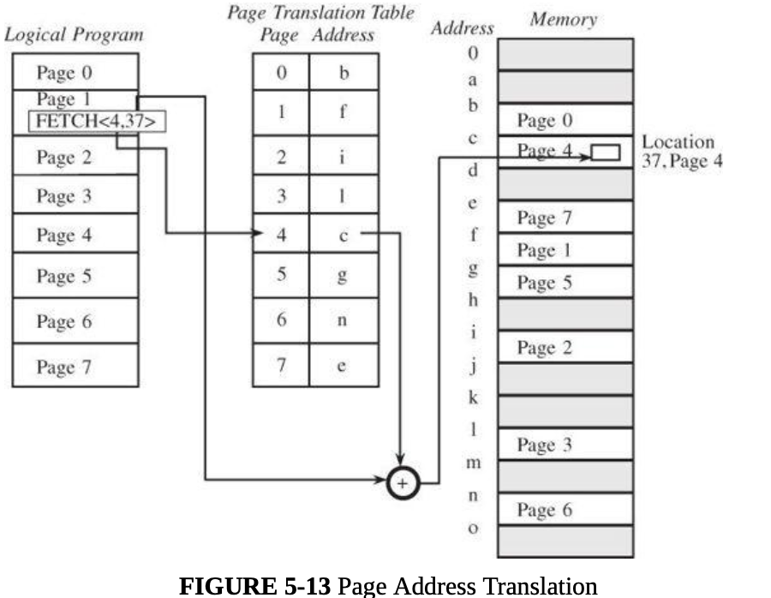
Paging

Slide 28
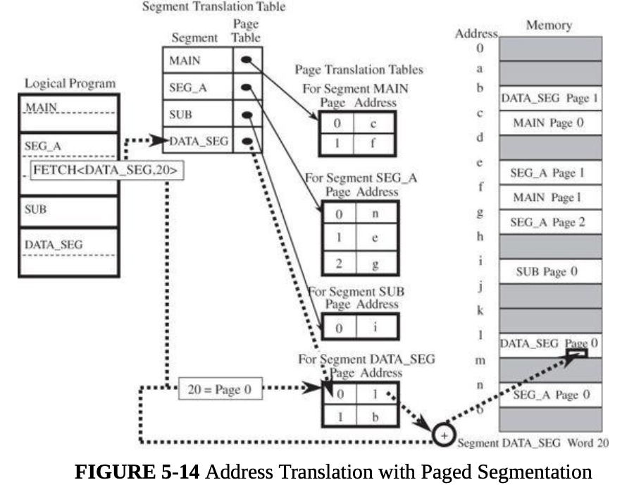
Paged segmentation

Slide 29
Principles of Secure OS Design
Simplicity of design
  OSs are inherently complex, and any unnecessary complexity only makes them harder to understand and secure
Layered design
  Enables layered trust
Layered trust
  Layering is both a way to keep a design logical and understandable and a way to limit risk
  Example: very tight access controls on critical OS functions, fewer access controls on important noncritical functions, and few if any access controls on functions that aren’t important to the OS

Slide 30
Session Summary
OSs have evolved from supporting single users and single programs to many users and programs at once
Resources that require OS protection: memory, I/O devices, programs, and networks
OSs use layered and modular designs for simplification and to separate critical functions from noncritical ones
Resource access control can be enforced in a number of ways, including virtualization, segmentation, hardware memory protection, and reference monitors

