Slide 1
Information System Security
CMIS 422
Strategic network defenses
Module 8
Mona Taghavi

Slide 2
Session Overview
Network encryption concepts and tools
SSL and TSL
Types of firewalls and what they do
Intrusion detection and prevention systems
Denial-of-service attacks

Slide 3
Strategic Defenses: Security Countermeasures
Encryption is a strong tool for preserving both confidentiality and integrity in networks.
  two specific applications of cryptography to networking:
    encrypted communication between a browser and its websites, called SSL/TLS encryption
    encrypted links within a network, called a virtual private network or VPN.
Firewall is a network-protection tool which is really just an instantiation of the familiar reference monitor.
An intrusion detection or protection system monitors network traffic to identify and counter specific malicious network threats, such as DoS and DDoS.

Slide 4
Network and Browser Encryption
Encryption protects only what is encrypted
Encryption is no more secure than its key management.
Encryption is not a silver bullet.

Slide 5
Modes of Network Encryption
Encryption can be employed in a network through two general modes: link and end-to-end.
We start with basic discussion of link encryption and end-to-end encryption, and then go into various tools that are commonly used for implementing network encryption.

Slide 6
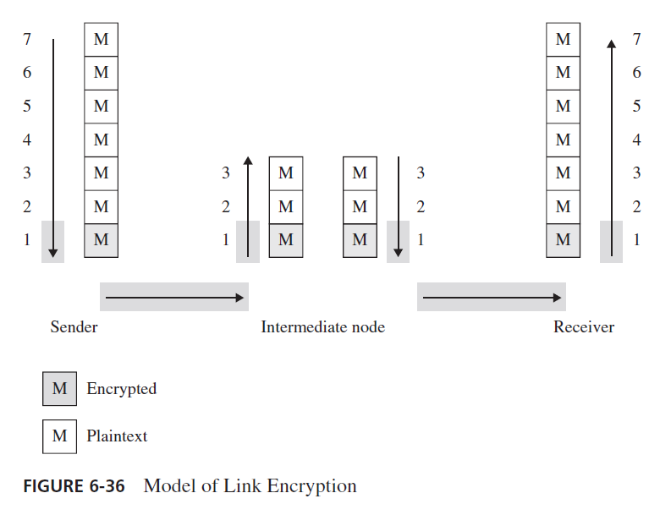
Link Encryption

Slide 7
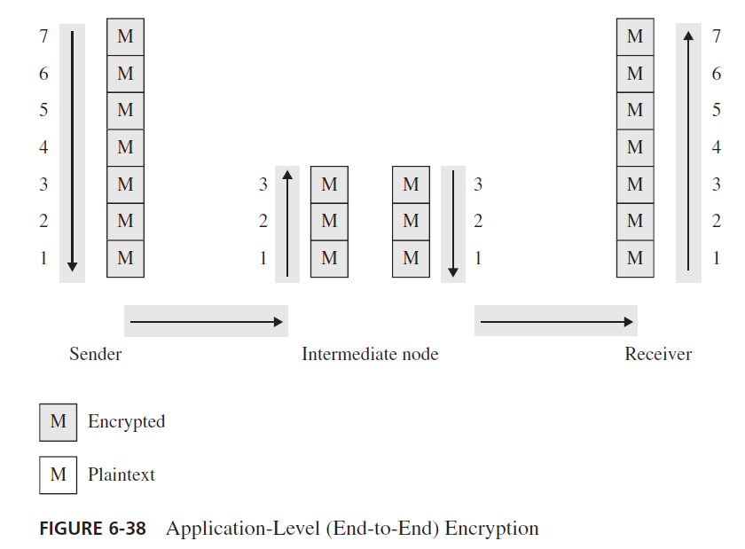
End-to-End Encryption

Slide 8
Onion Routing
As we described both link and end-to-end encryption, the data portion of the communication was secured for confidentiality. However, the addressing data were exposed. Thus, someone monitoring traffic between points A and B would know the volume of traffic communicated.
Onion routing prevents an eavesdropper from learning source, destination, or content of data in transit in a network
This is particularly helpful for evading authorities, such as when users in oppressive countries want to communicate freely with the outside world
Notes:
As we described both link and end-to-end encryption, the data portion of the communication
was secured for confidentiality. However, the addressing data were exposed.
Thus, someone monitoring traffic between points A and B would know the volume of
traffic communicated.
Paul Syverson and colleagues [SYV97] introduced the concept of onion routing.
That model uses a collection of forwarding hosts, each of which knows only from where
a communication was received and to where to send it next. Thus, to send untraceable
data from A to B, A picks some number of forwarding hosts, call them X, Y, and Z.
A begins by encrypting the communication under B’s public key. A then appends a
header from Z to B and encrypts the result under Z’s public key. A then puts a header
on that from Y to Z and encrypts that under Y’s public key. A then puts a header on that Upon receiving the package, X decrypts it and finds instructions to forward the inner
package to Y. Y then decrypts it and finds instructions to forward the inner package to Z.
Z then decrypts it and finds instructions to forward the inner package to B. The package
is deconstructed like peeling the layers from an onion, which is why this technique is
called onion routing.

Slide 9
Onion Routing
Uses asymmetric cryptography, as well as layers of intermediate hosts, so that
  The intermediate host that sends the message to the ultimate destination cannot determine the original sender, and
  The host that received the message from the original sender cannot determine the ultimate destination

Slide 10


HTTP and TLS Protocols
if the client visits a website then the data
will be fetched from the server with
Hypertext Trasfer Protocol (HTTP) is used for
viewing web pages. It is a request-response protocol
in the client-server computing model
every single website is stored on a so-called server
(images, texts and all the data)

Slide 11
HTTP and TLS Protocols
The problem with standard HTTP is that it does not use any cryptographic related encryption algorithm
All information is sent in plain text format (without encryption)
Usernames, passwords and credit card related details are public
THIS IS WHY WE NEED MORE SECURE APPROACHES and this is exactly why HTTPS came to be.

Slide 12
HTTP and TLS Protocols
HTTPS is Secure Hypertext Transfer Protocol
It encrypts the data that is being retrieved by HTTP
There are several public key and private key cryptography realted approaches it supports (RSA, ECC, AES, DES etc.)
Https uses protocols to ensure data security: ssl and tls
SSL stands for secure socket layer
It is no longer secure this is why back in 1999 it was updated to become Transport Layer Security (TLS)

Slide 13
Transport Layer Security
1994: Netscape Communications developed the network authentication protocol Secure Sockets Layer, SSLv2.
  Badly broken, officially deprecated 2011
1995: Netscape release their own improvements SSLv3.
  Broken, officially deprecated 2015
In January 1999, RFC 2246 was issued by the IETF,
Transport Layer Security Protocol: TLS 1.0
  Similar to, but incompatible with SSLv3
  Followed by TLS 1.1 (2006) and TLS 1.2 (2008)
  Current version: TLS 1.3 (2018), removes all old/insecure features/algorithms

Slide 14
TLS: Overview
TLS is a cryptographic services protocol based on the Browser PKI and is commonly used on the Internet.
  Each server has a server certificate and private key installed
  Allows browsers to establish secure sessions with web servers.
Port 443 is reserved for HTTP over TLS/SSL and the protocol https is used with this port.
  http://www.xxx.com implies using standard HTTP using port 80.
  https://www.xxx.com implies HTTP over TLS/SSL with port 443.

Slide 15

Handshake Protocol
The handshake protocol
  Negotiates the encryption to be used
  Establishes a shared session key
  Authenticates the server
  Authenticates the client (optional)
After the handshake, application data is transmitted securely

Slide 16
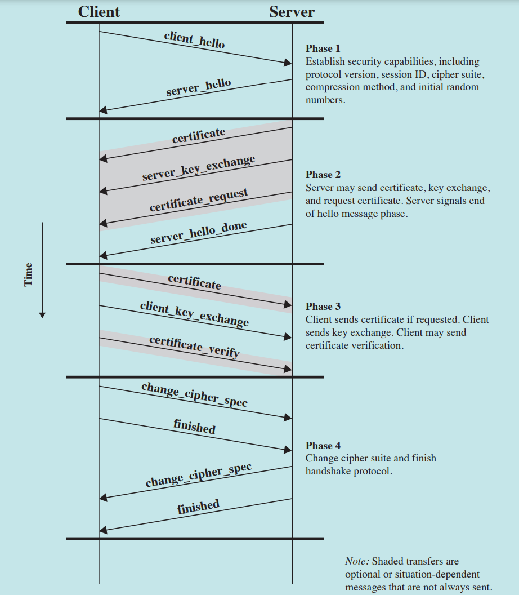
SSL Handshake Protocol

Slide 17
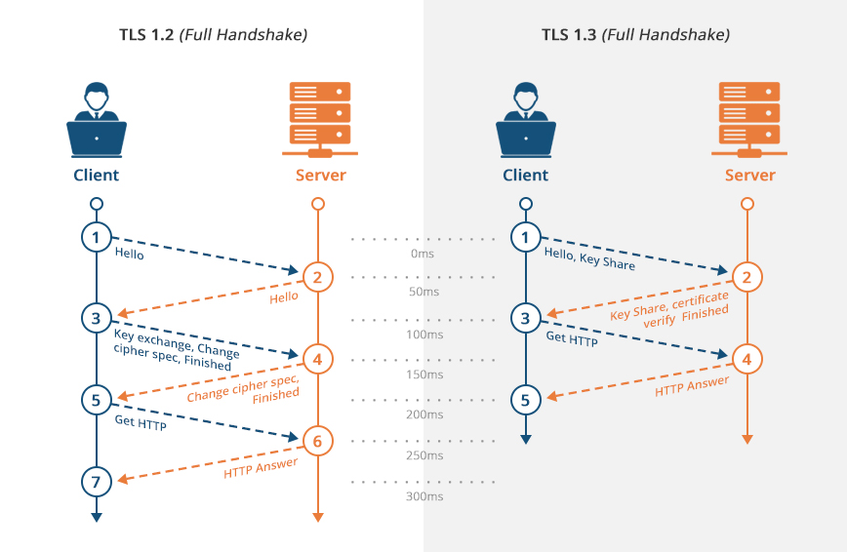
TLS Protocols

Slide 18
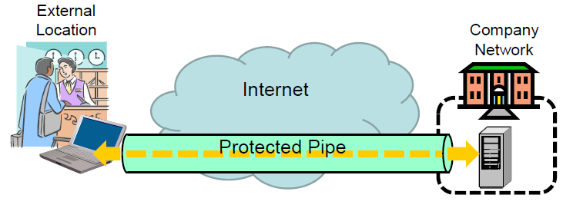
VPN
TLS secures only a single TCP connection
Sometimes:
  all communication from a computer shall be secured
  also non-TCP communication shall be secured
Typical application:
  VPN tunnel into a company network
  Tunnel can only be established after authentication
  All communication is routed (and secured) through the tunnel
  Client is virtually part of the local company network
  Client gets access to internal services

Slide 19
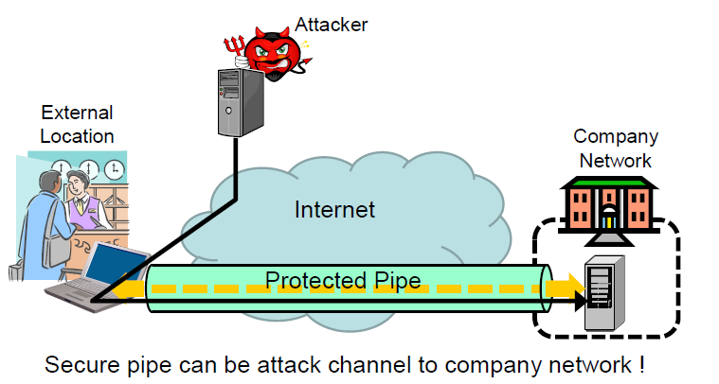
Risk of using VPN

Slide 20
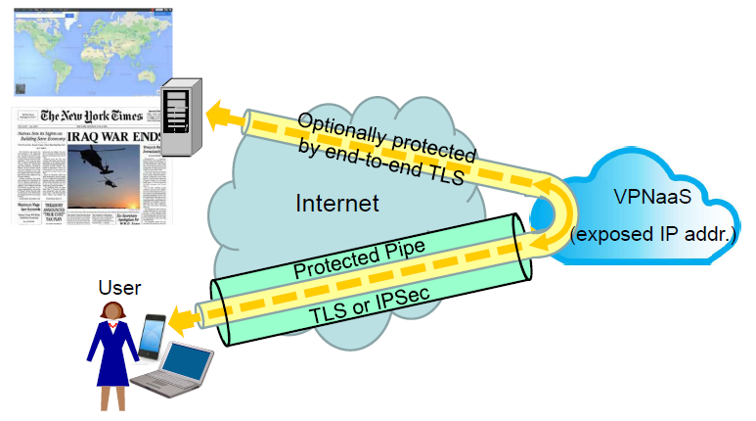
VPN Browsing via VPN Proxy
Usage Examples:
  Access to services subscribed by own organization
  Hide users true location

Slide 21
What is a firewall?

Slide 22
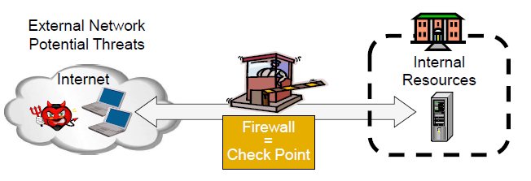
Firewalls
A firewall is a check point that protects the internal networks against attack from outside networks
The check point decides which traffic can pass in & out based on security policies

Slide 23
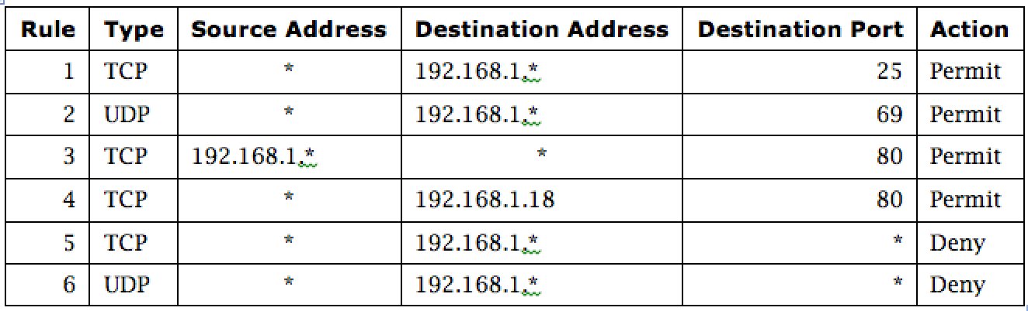
Firewall Security Policy
A security policy is a set of rules that determine what traffic can or cannot pass through the firewall.

Slide 24
Firewall
If the risk of having a connection to the Internet is unacceptable, the most effective way of treating the risk is to avoid the risk altogether and disconnect completely.
If disconnection from the Internet is not practical, then firewalls may provide an effective level of protection that can reduce the risk to an acceptable level.
Firewalls are often the first line of defense against external attacks but should not be the only defense.

Slide 25
Firewall
Firewalls are the foundation of a defense-in-depth network security strategy.
They’re designed to protect organizations from network-based attacks. Firewalls do this by filtering data packets that go through them.
The network owner must define criteria for what is (un)authorized
The effectiveness of firewalls depends on specifying authorized traffic in terms of rules
  The rules defines what to let pass through;
  The rules defines what to block.
They can be a standalone network device or software on a computer system, meaning network-based (hardware) or host-based(software).

Slide 26
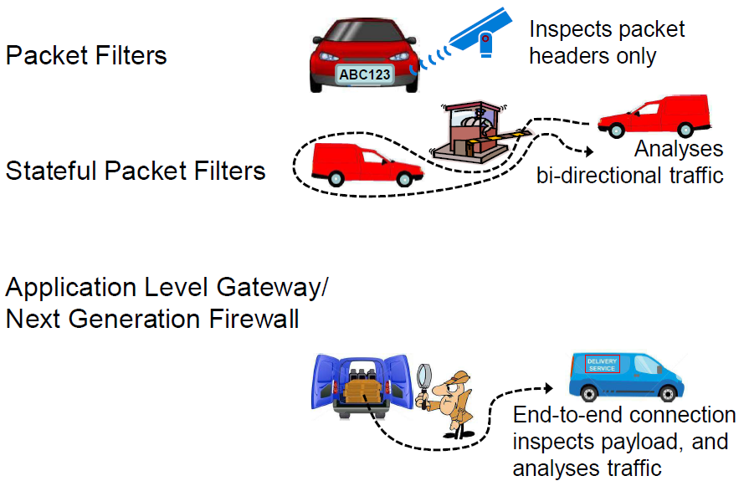
3 Common Types of Firewalls

Slide 27
1st Gen: Packet Filtering Firewalls
1st generation and most basic type of firewall.
They inspect all data packets that attempt to traverse it, and based on predefined rules, packets are either allowed or denied.
These predefined rules are commonly called an Access Control List (ACL).
Considered Stateless Firewalls.
Packet filtering rules are common TCP/IP packet attributes:
  IP Address
    Source IP Address
    Destination IP Address
  TCP/UDP Port
    Source TCP/UDP Port
    Destination TCP/UDP Port
  Inbound or Outbound
    Inbound Firewall Network Interface
    Outbound Firewall Network Interface

Slide 28
1st Gen: Packet Filtering Firewalls
Widespread packet filter software (Linux):
  iptables / netfilter
  nft / nttables
Examples (iptables)
  iptables -A FORWARD -s 131.234.142.33 -j ACCEPT
  All packets from source IP Address 131.234.142.33 are accepted
  iptables -A FORWARD -p tcp d 10.0.0.56 --dport 22 -j ACCEPT
  All packets using transport protocol and destination address 10.0.0.56 and destination port 22 are accepted

Slide 29
Problems with Stateless Filtering
Assume a typical security policy
  Access from internal to external allowed
  Access from external to internal prohibited
It must investigate all the packets coming in or going out the network.
Naive packet filter configuration:
  outgoing packet forward
  incoming packet reject

Slide 30
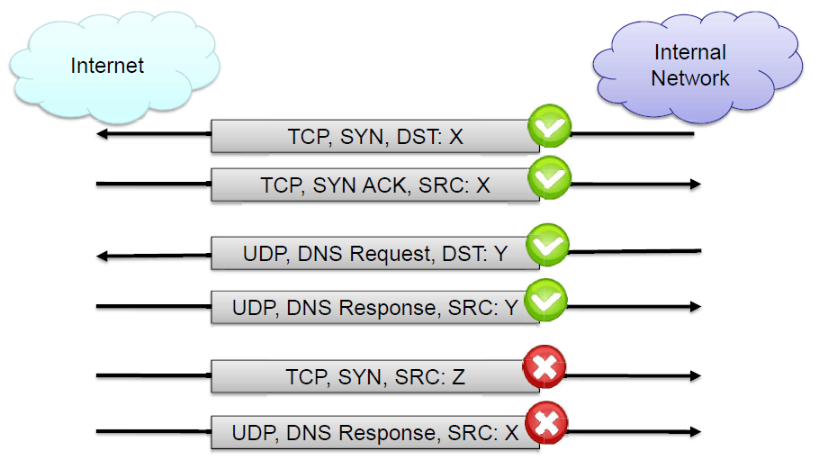
2nd Gen: Stateful Inspection Firewalls
Operate at the Transport Layer of the OSI Model (Layer 4) and monitor TCP sessions.
Determine the legitimacy of a requested session by monitoring the 3-way handshake between packets.
Valid TCP sessions are allowed to pass, while invalid and terminated sessions are not.

Slide 31
(Stateful) Packet Filter: Evaluation
Strengths:
  Low overhead and high throughput
  Supports almost any application
Weaknesses:
  Unable to interpret application layer data/commands
  may allow insecure operations to occur
  Allows direct connection between hosts inside & outside firewall

Slide 32
3rd Gen: Application-Level Firewalls
Also known as proxy servers, these firewalls operate at the Application Layer of the OSI Model (Layer 7).
Can be configured to filter specific user applications
  E.g. Facebook, Youtube, LinkedIn
  Can filter detailed elements in each specific user application
Can provide intrusion detection and intrusion prevention
Very high processing load in firewall
  High volume needs high performance hardware, or else will be slow

Slide 33
3rd Gen: Application-Level Firewalls
Specifically, proxy servers can provide the following services:
  Filter: Filters packets based on an application or service (FTP, SMTP, etc.).
  Caching: Provides caching services, for example:
    When you request a page from a website, the proxy server will retrieve it and then cache it in its memory.
    The next time someone requests that website, the proxy server can retrieve it from its cache.
    This saves Internet bandwidth.
  Logging: Has the ability to log user activity for auditing purposes.

Slide 34
3rd Gen: Application-Level Firewalls
Strengths:
  Easy logging and audit of all incoming traffic
  Provides potential for best security through control of application layer data/commands
Weaknesses:
  May require some time for adapting to new applications
  Much slower than packet filters
  Much more expensive than packet filters

Slide 35
What Firewalls Can and Cannot Do
Firewalls can protect an environment only if they control the entire perimeter
Firewalls do not protect data outside the perimeter
Firewalls are the most visible part of an installation to the outside, so they are an attractive target for attack
Firewalls must be correctly configured, that configuration must be updated as the environment changes, and firewall activity reports must be reviewed periodically for evidence of attempted or successful intrusion
Firewalls exercise only minor control over the content admitted to the inside, meaning that inaccurate or malicious code must be controlled by means inside the perimeter

Slide 36
Intrusion Detection and Prevention
Intrusion
  Actions aimed at compromising the security of a target network (confidentiality, integrity, availability of resources)
Intrusions have many causes, such as malware (worms, spyware, etc…), attackers gaining unauthorized access to systems from the Internet, and authorized users of systems who misuse their privileges or attempt to gain additional privileges for which they are not authorized.
Although many intrusions are malicious in nature, many others are not; for example: a person might mistype the address of a computer and accidentally attempt to connect to a different system without authorization.

Slide 37
Intrusion Detection and Prevention
Intrusion detection
  The identification of possible intrusion through intrusion signatures and network activity analysis
  IDS: Intrusion Detection Systems
Intrusion prevention
  The process of both detecting intrusion activities and managing automatic responsive actions throughout the network
  IPS: Intrusion Prevention Systems
  IDPS: Intrusion Detection and Prevention Systems
IPSs combine IDSs and improved firewall technologies, they make access control decisions based on application content, rather than IP address or ports as traditional firewalls had done.

Slide 38
Intrusion Detection and Prevention
IDPSs are primarily focused on:
  Identifying possible incidents, logging information about them, attempting to stop them, and reporting them to security administrators.
  Identifying problems with security policies
  Documenting existing threats
  Deterring individuals from violating security policies.

Slide 39
IPS
IPSs respond to a detected threat by attempting to prevent it from succeeding. They use several response techniques:
The IPS stops the attack itself. Examples:
  Terminate the network connection or user session that is being used for the attack. Block access to the target (or possibly other likely targets) from the offending user account, IP address, or other attacker attribute. Block all access to the targeted host, service, application, or other resource.

Slide 40
IPS
The IPS changes the security environment. The IPS could change the configuration of other security controls to disrupt an attack. Such as reconfiguring a network device (e.g., firewall, router, switch) to block access from the attacker or to the target, and altering a host-based firewall on a target to block incoming attacks. Some IPSs can even cause patches to be applied to a host if the IPS detects that the host has vulnerabilities.
The IPS changes the attack’s content. Some IPS technologies can remove or replace malicious portions of an attack to make it benign. An example is an IPS removing an infected file attachment from an e-mail and then permitting the cleaned email to reach its recipient.

Slide 41
Classes of detection methodologies:
Signature-based: compares known threat signatures to observed events to identify incidents.
This is very effective at detecting known threats but largely ineffective at detecting unknown threats and many variants on known threats. It has fewer false positive alarms.
Signature-based detection cannot track and understand the state of complex communications, so it cannot detect most attacks that comprise multiple events.
Example:
  An e-mail with a subject of “Free pictures!” and an attachment filename of “freepics.exe”, which are characteristics of a known form of malware

Slide 42
Classes of detection methodologies:
Anomaly-based detection: Using a model of normal system behavior, try to detect deviations and abnormalities
Anomaly-based detection can detect new types of attacks.
Requires much more overhead and processing capacity than signature-based .
May generate many false positives.

Slide 43
Classes of detection methodologies:
Anomaly detection example: a profile for a network might show that Web activity comprises an average of 13% of network bandwidth at the Internet border during typical workday hours. The IDPS then uses statistical methods to compare the characteristics of current activity to thresholds related to the profile, such as detecting when Web activity comprises significantly more bandwidth than expected and alerting an administrator of the anomaly. Profiles can be developed for many behavioral attributes, such as the number of e-mails sent by a user, the number of failed login attempts for a host, and the level of processor usage for a host in a given period of time.

Slide 44
Stateful protocol analysis: A key development in IDPS technologies was the use of protocol analyzers.
Protocol analyzers can natively decode application-layer network protocols, like HTTP or FTP. Once the protocols are fully decoded, the IPS analysis engine can evaluate different parts of the protocol for anomalous behavior or exploits against predetermined profiles of generally accepted definitions of benign protocol activity for each protocol state.
Problems with this type include that it is often very difficult or impossible to develop completely accurate models of protocols, it is very resource-intensive, and it cannot detect attacks that do not violate the characteristics of generally acceptable protocol behavior.

Slide 45
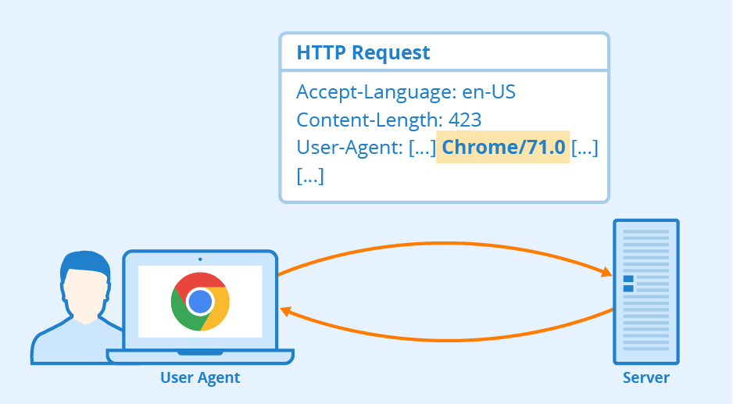
For example: the existence of a large binary file in the User-Agent field of an HTTP request would be very unusual and likely an intrusion. A protocol analyzer could detect this anomalous behavior and instruct the IPS engine to drop the offending packets.
IDPS technologies cannot provide completely accurate detection. When an IDPS incorrectly identifies benign activity as being malicious, a false positive has occurred. When an IDPS fails to identify malicious activity, a false negative has occurred. It is not possible to eliminate all false positives and negatives; in most cases, reducing the occurrences of one increases the occurrences of the other.

Slide 46
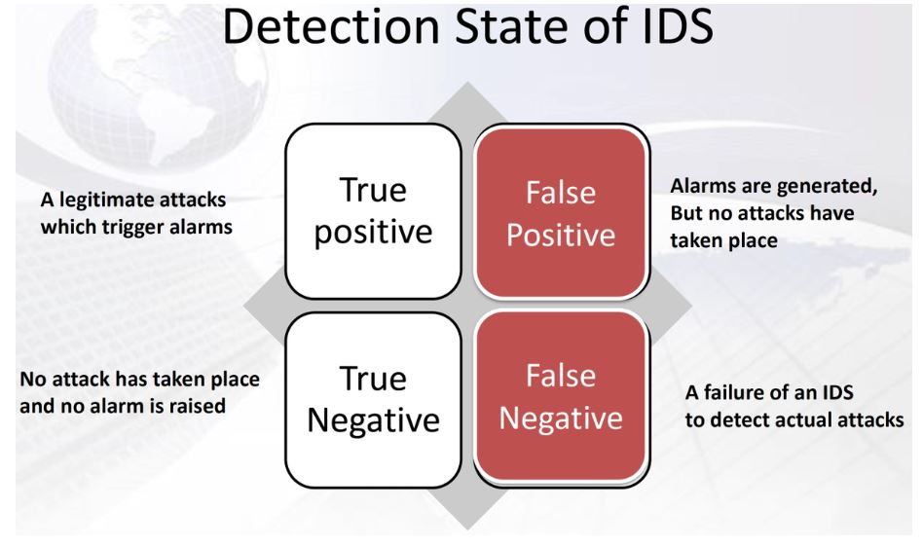
Intrusion Detection Errors
False negatives: attack is not detected
  Big problem in signature-based misuse detection
False positives: harmless behavior is classified as attack
  Big problem in statistical anomaly detection
Both types of IDS suffer from both error types

Slide 47
Many organizations choose to decrease false negatives at the cost of increasing false positives, which means that more malicious events are detected but more analysis resources are needed to differentiate false positives from true malicious events. Altering the configuration of an IDPS to improve its detection accuracy is known as tuning.
Most alarms are false positives
  Requires automated screening and filtering of alarms
Most true positives are trivial incidents
  can be ignored,
  the attacks will never be able to penetrate any system

Slide 48
What is a DOS Attack?
How can we prevent it?

Slide 49
How Service Is Denied
volumetric attacks
application-based attack
cut or disabled communications
hardware or software failure

Slide 50
Flooding
An attacker can try for presenting commands more quickly than a server can handle them; servers often queue unmet commands during moments of overload for service when the peak subsides, but if the commands continue to come too quickly, the server eventually runs out of space to store the demand. Such an attack is called an overload or flood.
The most common malicious DoS attack type is flooding.
Flooding occurs because the incoming bandwidth is insufficient or resources— hardware devices, computing power, software, or table capacity—are inadequate.

Slide 51
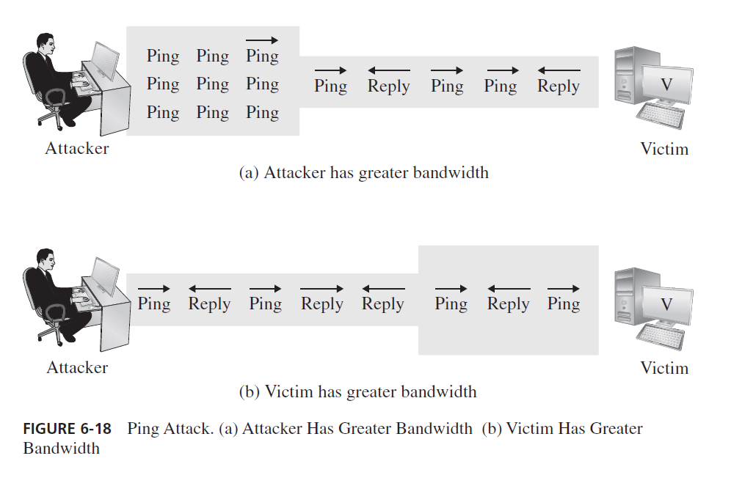
DoS attack: Ping of Death

Slide 52
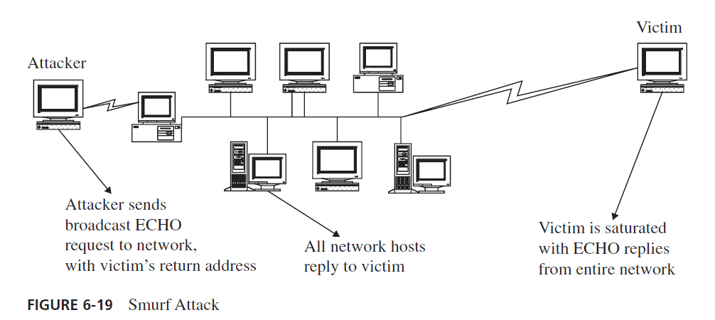
DoS attack: Smurf

Slide 53
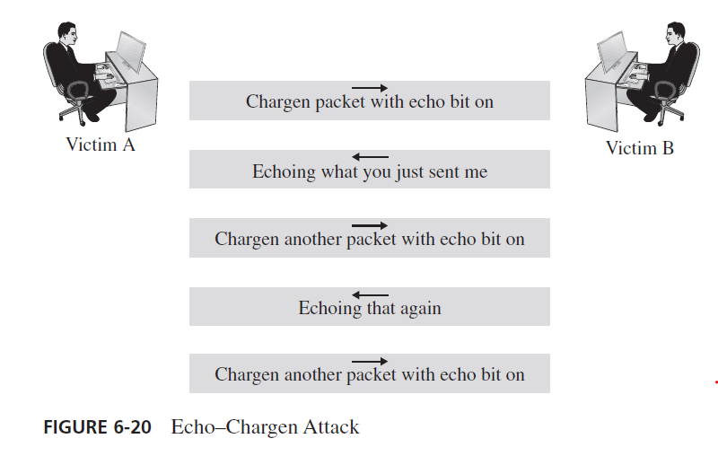
DoS attack: Echo-Chargen

Slide 54
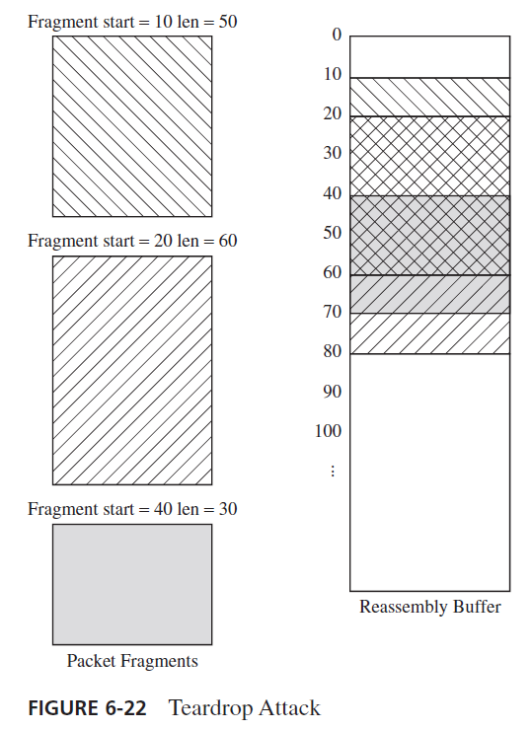
DoS attack: Teardrop

Slide 55
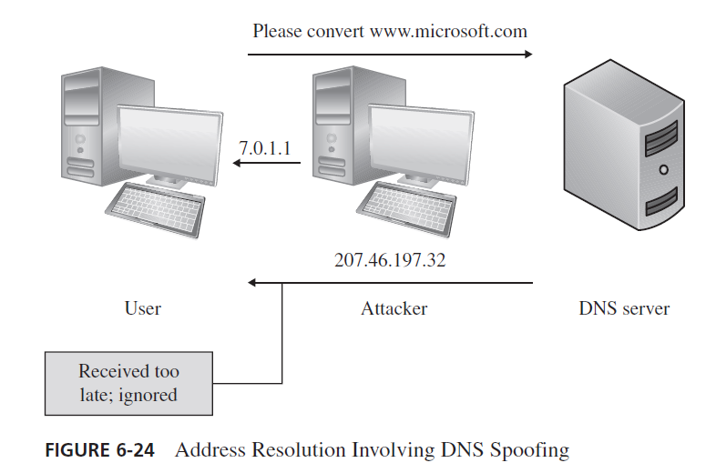
DoS attack: DNS Spoofing

Slide 56
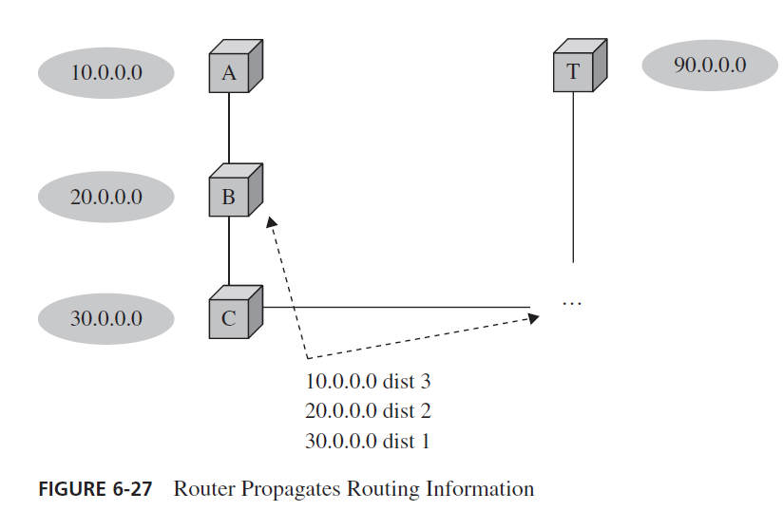
DoS attack: Rerouting routing

Slide 57
Zombie & Botnet in DDoS attack
Secretly takes over another networked computer by exploiting software flows
Builds the compromised computers into a zombie network or botnet
  a collection of compromised machines running programs, usually referred to as worms, Trojan horses, or backdoors, under a common command and control infrastructure.
Uses it to indirectly launch attacks
  E.g., DDoS
Notes:
Ddos requires huge bandwith

Slide 58



Detailed Steps (1)
Attacker scans
Internet for unsecured systems that can be compromised
1
Unsecured Computers
Attacker
Internet

Slide 59
Detailed Steps (2)
Zombies
Attacker secretly
installs zombie agent programs, turning unsecured computers
into zombies
2
Unsecured Computersbie
Attacker
Internet

Slide 60
Detailed Steps (3)
Zombie agents
``phone home’’
and connect to a
master server
3
Zombies
Attacker
Master
Server
Internet

Slide 61
Detailed Steps (4)
Attacker sends commands
to Master Server to launch a DDoS attack against
a targeted system
4
Zombies
Attacker
Master
Server
Internet

Slide 62
Detailed Steps (5)
Master Server
sends signal to zombies to launch
attack on targeted
system
5
Zombies
Attacker
Master
Server
Internet
Targeted
System
System

Slide 63
Detailed Steps (6)
Targeted system is
overwhelmed by zombie requests,
denying requests
from normal users
6
Zombies
Attacker
Master
Server
Internet
Request Denied
Targeted
System
System
User

Slide 64
Session Summary
DoS attacks come in many flavors, but malicious ones are usually either volumetric in nature or exploit a bug
A wide variety of firewall types exist, ranging from very basic IP-based functionality to complex application-layer logic, and both on networks and hosts
There are many flavors of IDS, each of which detects different kinds of attacks in very different parts of the network

