Slide 1
Information System Security
CMIS 422
Database security
Module 9
Mona Taghavi

Slide 2
Session Overview
Basic database terminology
SQL injection attack
Security requirements for databases
Implementing access controls in databases
Protecting sensitive data
Data mining and big data

Slide 3
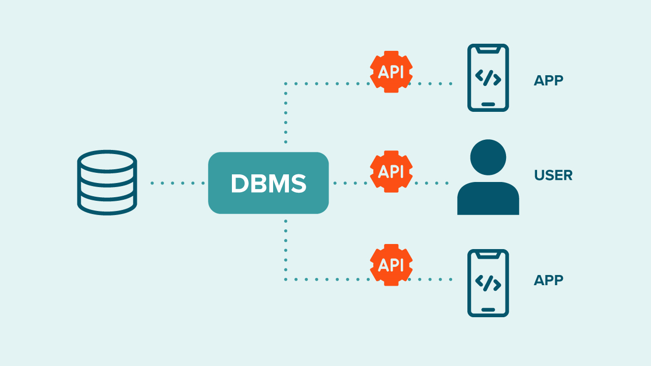
DBMS

Slide 4
Queries
What is a Query?
A query is a command that tells the database to retrieve, modify, add, or delete a field or record
The most common database query language is SQL

Slide 5
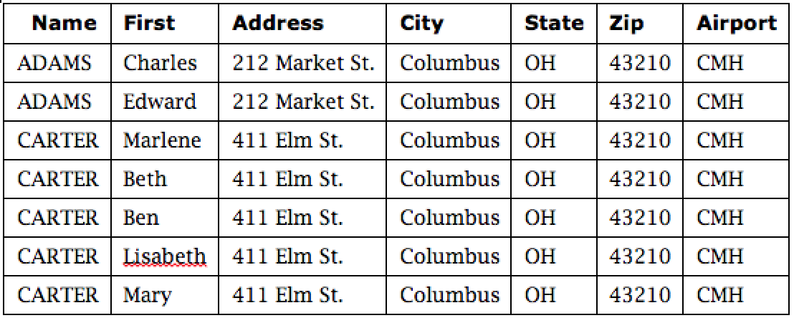
Example SQL Query
SELECT ZIP=‘43210’

Slide 6
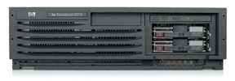
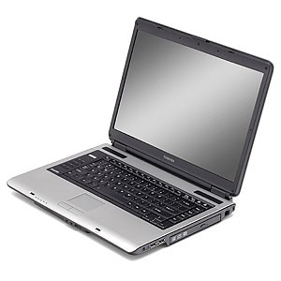
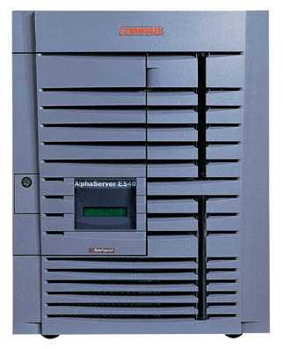
SQL Injection: Basic Idea
Victim server
post malicious form
Attacker
1
2
3
receive data from DB
unintended query
Victim SQL DB

Slide 7
Typical Query Generation Code
$selecteduser = $_GET['user'];
$sql = "SELECT Username, Key FROM Key " .
"WHERE Username='$selecteduser'";
$rs = $db->executeQuery($sql);
What if ‘user’ is a malicious string that changes the meaning of the query?
slide 7

Slide 8
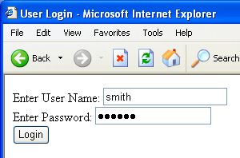
Typical Login Prompt

Slide 9
User Input Becomes Part of Query
Enter
Username
&
Password
SELECT passwd
FROM USERS
WHERE uname
IS ‘$user’
Web
browser
(Client)
Web
server
DB

Slide 10
Normal Login
Enter
Username
&
Password
SELECT passwd
FROM USERS
WHERE uname
IS ‘smith’
Web
browser
(Client)
Web
server
DB

Slide 11
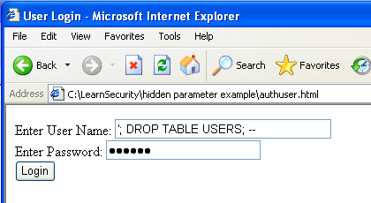
Malicious User Input

Slide 12
SQL Injection Attack
SELECT passwd
FROM USERS
WHERE uname
IS ‘’; DROP TABLE
USERS; -- ’
Enter
Username
&
Password
Web
browser
(Client)
Web
server
DB
Eliminates all user accounts

Slide 13
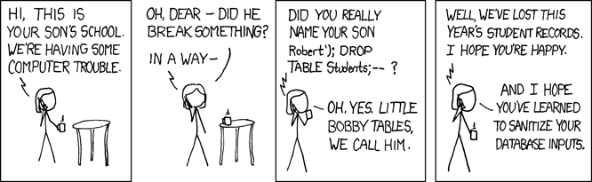
Exploits of a mom
Sanitizing user input involves cleaning the data to remove any potentially harmful characters or sequences that could be interpreted as SQL commands.

Slide 14
Using SQL Injection to Log In
User gives username ′ OR 1=1 --
Web server executes query
set UserFound=execute(
SELECT * FROM UserTable WHERE
username=‘’ OR 1=1 -- … );
Now all records match the query, so the result is not empty ⇒ correct “authentication”!
Always true!
Everything after -- is ignored!

Slide 15
Preventing SQL Injection
Validate all inputs
  Filter out any character that has special meaning
    Apostrophes, semicolons, percent symbols, hyphens, underscores, …
  Check the data type (e.g., input must be an integer)
Whitelist permitted characters
  Blacklisting “bad” characters doesn’t work
    Forget to filter out some characters
    Could prevent valid input (e.g., last name O’Brien)
  Allow only well-defined set of safe values
    Implicitly defined through regular expressions
slide 15

Slide 16
Database Security Requirements
Physical integrity
Logical integrity
Element integrity
Auditability
Access control
User authentication
Availability

Slide 17
Reliability and Integrity
Reliability
Database integrity
Element integrity and accuracy
Main concern is that the database system would fail in the middle of an update, leaving the database in a partially updated and inconsistent state.

Slide 18
Two-Phase Update
If the computing system fails in the middle of data modification, the database manager must determine what (if anything) needs correction or restoration to its previous state.
Phase 1: Intent
Phase 2: Write
If the DBMS fails during either phase 1 or phase 2, it can be restarted and repeat that phase without causing harm

Slide 19
Two-Phase Update Example
Consider a database that contains the inventory of a company’s office supplies. The company’s central stockroom stores paper, pens, paper clips, and the like, and different departments requisition items as they need them.
Each department has a budget for office supplies, so a charging mechanism can recover the cost of supplies from the department that uses them. Also, the central stockroom monitors quantities of supplies on hand so that new supplies can be ordered when stock becomes low.
Suppose the accounting department requisitions 50 boxes of paper clips. Assume that there are 107 boxes in stock, and the stockroom policy specifies that a new order is placed when the quantity in stock falls below 100.

Slide 20
Two-Phase Update Example
Intent:
1. Check the value of COMMIT-FLAG in the database. If it is set, this phase cannot be performed. Halt or loop, checking COMMIT-FLAG until it is clear.
2. Compare number of boxes of paper clips on hand to number requisitioned; if more are requisitioned than are on hand, halt.
3. Compute TCLIPS = ONHAND − REQUISITION.
4. Obtain BUDGET, the current supplies budget remaining for accounting department.
Compute TBUDGET = BUDGET − COST, where COST is the cost of 50 boxes of clips.
5. Check whether TCLIPS is below reorder point; if so, set TREORDER = TRUE;
else set TREORDER = FALSE.
Commit:
1. Set COMMIT-FLAG in database.
2. Copy TCLIPS to CLIPS in database.
3. Copy TBUDGET to BUDGET in database.
4. Copy TREORDER to REORDER in database.
5. Prepare notice to deliver paper clips to accounting department. Indicate transaction completed in log.
6. Clear COMMIT-FLAG.

Slide 21
Other Database Security Concerns
Error detection and correction codes to protect data integrity
For recovery purposes, a database can maintain a change log, allowing it to repeat changes as necessary when recovering from failure
Databases use locks and atomic operations to maintain consistency
  Writes are treated as atomic operations
  Records are locked during write so they cannot be read in a partially updated state

Slide 22
Sensitive Data
Some databases contain what is called sensitive data.
  As a working definition, let us say that sensitive data are data that should not be made public.
Nothing sensitive and everything sensitive are the easiest to handle, because they can be covered by access controls to the database as a whole.
  Someone either is or is not an authorized user.
  These controls can be provided by the operating system.
The more difficult problem, which is also the more interesting one, is the case in which some but not all of the elements in the database are sensitive

Slide 23
Types of Disclosure
Exact data
Bounds
Negative result
Existence
Probable value
Direct inference
Inference by arithmetic
Aggregation
Hidden data attributes

Slide 24
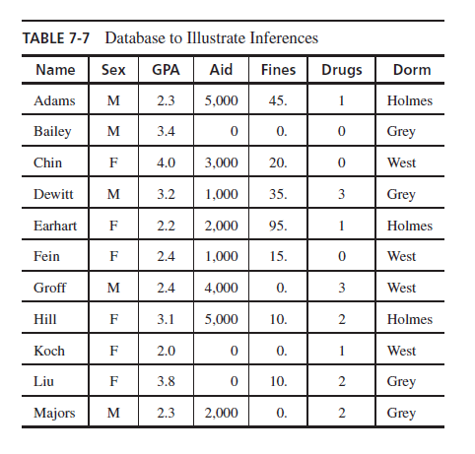

Direct Inference

Slide 25
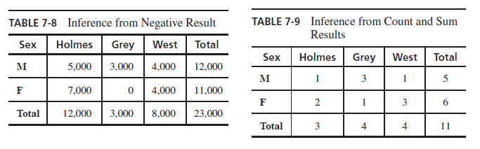
Inference by arithmetic

Slide 26
Preventing Disclosure
Suppress obviously sensitive information
Keep track of what each user knows based on past queries
Disguise the data
Data suppression blocks release of sensitive data; data concealing releases part or an approximation of sensitive data.

Slide 27
Security vs. Precision

Slide 28
Suppression Techniques
Limited response suppression
  Eliminates certain low-frequency elements from being displayed
Combined results
  Ranges, rounding, sums, averages
Random sample
Blocking small sample sizes
Random data perturbation
  Randomly add or subtract a small error value to/from actual values
Swapping
  Randomly swapping values for individual records while keeping statistical results the same

Slide 29
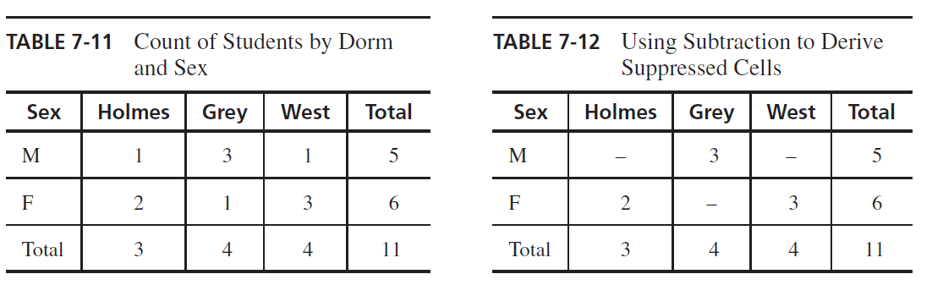
Limited response suppresion

Slide 30
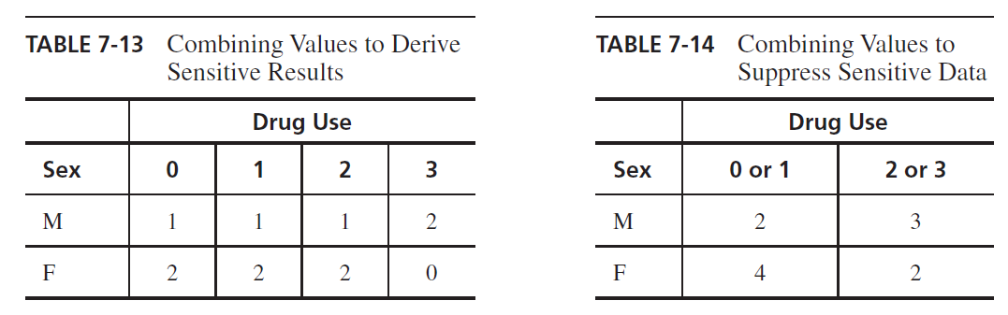
Combined results

Slide 31
Data Mining
Data mining uses statistics, machine learning, mathematical models, pattern recognition, and other techniques to discover patterns and relations on large datasets
The size and value of the datasets present an important security and privacy challenge, as the consequences of disclosure are naturally high

Slide 32
Data Mining Challenges
Correcting mistakes in data
  Correcting mistakes is a problem because data is often moved to more databases before the original database can be corrected—if the need for correction is ever discovered
Preserving privacy
Granular access control

Slide 33
Data Mining Challenges
Secure data storage
  Data storage is an issue because data may be collected globally and through cloud providers, where security details are largely unknown to users
Transaction logs
  Tracking access is expensive, especially if accesses are numerous; detailed access auditing is uncommon for big data.

Slide 34
Session Summary
Database security requirements include:
  Physical integrity
  Logical integrity
  Element integrity
  Auditability
  Access control
  User authentication
  Availability
There are many subtle ways for sensitive data to be inadvertently disclosed, and there is no single answer for prevention

