Slide 1
Information System Security
CMIS 422
Privacy
Module 10
Mona Taghavi

Slide 2
Session Overview
Privacy and fundamental computer-related privacy challenges
Email privacy
Social engineering

Slide 3
What is Privacy?
Privacy is the right to control who knows certain information about you, your communications, and your activities

Slide 4
What types of data is private?

Slide 5
Can you name some US and non-Us privacy laws?

Slide 6
What are web cookies? Do they threat the users privacy?

Slide 7
Authentication vs Identification
What is Authentication? And What is Identification?

Slide 8
Authentication vs Identification
This second question (who is this?) is much harder to answer than the first (is this X?).
Authentication is confirming an asserted identity. Inferring an identity from authentication data is far harder and less certain.

Slide 9
Data Mining
Private sector data mining is a lucrative and rapidly growing industry.
The more data are collected, the more opportunities open for learning from various aggregations.
Determining trends, market preferences, and characteristics may be good because they lead to an efficient and effective market.
But people become sensitive or may even be harmed if their private information becomes known without permission

Slide 10
Privacy-Preserving Data Mining
Removing identifying information from data doesn’t work
  Even if the identifying information can be removed, identification from remaining data is often possible
Data mining usually employs two approaches—correlation and aggregation.
  We examine techniques to preserve privacy with each of those approaches.

Slide 11
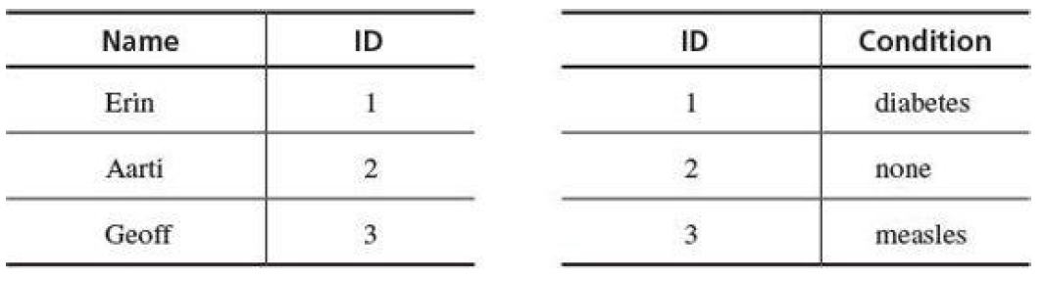
Privacy for Correlation
Correlation involves joining databases on common fields.
As with protecting the sensitive link between Erin and diabetes, privacy preservation for correlation attempts to control that linkage.

Slide 12
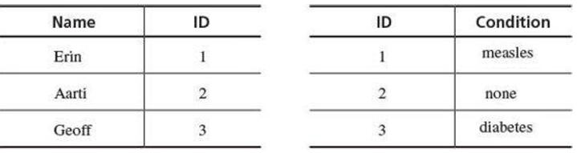
Privacy for Correlation
One form of data perturbation involves swapping data fields to prevent linking of records.
    Swapping the condition values Erin and Geoff (but not the ID values) breaks the linkage of Erin to diabetes.

Slide 13
Privacy for Correlation
Other properties of the databases are preserved: Three patients have actual names and three conditions accurately describe the patients.
    Swapping all data can prevent useful analysis, but limited swapping balances privacy and accuracy.

Slide 14
Privacy for Aggregation
Data perturbation can be used to reduce the risk from aggregation.
  Perturbation does not limit the ability of researchers to work with the statistics of a dataset; it just prevents linking of individual identities with specific data items, thereby preserving privacy.

Slide 15
Where Does Email Go?
When Janet sends an email to Scott, the message is transferred via simple mail transfer protocol (SMTP)
The message is transferred through multiple ISPs and servers before it arrives at Scott’s post office protocol (POP) server
Scott receives the email when his email client logs into the POP server on his behalf
Any of the servers in this chain of communication can see and keep Janet’s email
Email is subject to interception and modification at many points from sender to recipient.

Slide 16
Where Does Email Go?
Popular mail handlers such as Outlook, Mail (from Apple), gmail, and others protect email from the client’s workstation through mail agents, across the Internet, and to the recipient’s workstation.
That protection is considered end-to-end, meaning from the sender to the recipient.
Encrypted email protection is subject to the strength of the encryption and the security of the encryption protocol.

Slide 17
Anonymous or Disappearing Email
Obtain one, use it for a while, and discard it.
  For example: employees sending tips or complaining to management may want to do so anonymously.
  Disposable email addresses from sites like mailinator.com

Slide 18
Anonymous or Disappearing Email
Another solution is a remailer.
  A remailer is a trusted third party to whom you send an email message and indicate to whom you want your mail sent.
  The remailer strips off the sender’s name and address, assigns an anonymous pseudonym as the sender, and forwards the message to the designated recipient.

Slide 19
Anonymous or Disappearing Email
Another solution is a remailer.
  The third party keeps a record of the correspondence between pseudonyms and real names and addresses.
  If the recipient replies, the remailer removes the recipient’s name and address, applies a different anonymous pseudonym, and forwards the message to the original sender.
    Such a remailer knows both sender and receiver, so it provides pseudonymity, not anonymity.

Slide 20
Anonymous or Disappearing Email
Multiple remailers to gain stronger anonymity
  The sender selects three remailers
  he encrypts the message with each of their public keys in succession
  he then sends the message through them in the reverse of that order, with each one’s public key being able to open only one layer of message.

Slide 21
Anonymous or Disappearing Email
Disappearing email
  Because email travels through so many servers, it cannot be made to truly disappear.
  Email copies can remain with the recipient and at intermediate points for an unlimited time.
  Messaging services like Snapchat, which claims to make messages disappear, cannot guarantee that recipients will not be able to save those messages

Slide 22
Social Engineering
Social Engineering (SE), however, isn’t a technical skill, though it is seen as the skill of hacking the human; compromising the most complex computer on the planet...the human brain!
There are numerous definitions of SE but for the purpose of this lesson we've defined it as follows “convincing someone to do something for you that will ultimately lead you to achieve your desired goal, usually without them realizing it.”
Exploiting vulnerabilities in the user, not the network or device
Notes:
22

Slide 23
Social Engineering
Passwords, firewalls, security policies, security doors, man traps, biometric scanners, security guards...all of these security controls are useless against a skilled social engineer. Because social engineers prey on the weakest link in the security chain – the human!
SE requires a completely different set of skills than any type of hacking you may have ever done. As a SE, you must be convincing, able to think quickly, look the part you are playing, know your target well enough to move around their environment without acting suspicious, and you must be able to control your own fears. Hackers tend to have poor social skills.
Society has trained most people to be polite, be obedient, help others, avoid conflict and also to trust and believe what they are told.
Notes:
23

Slide 24
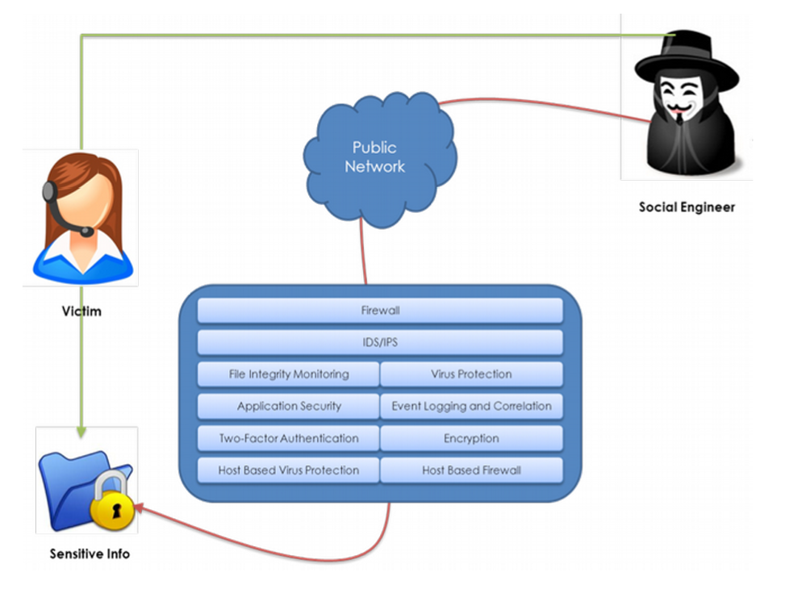
Why Use Social Engineering
Notes:
24

Slide 25
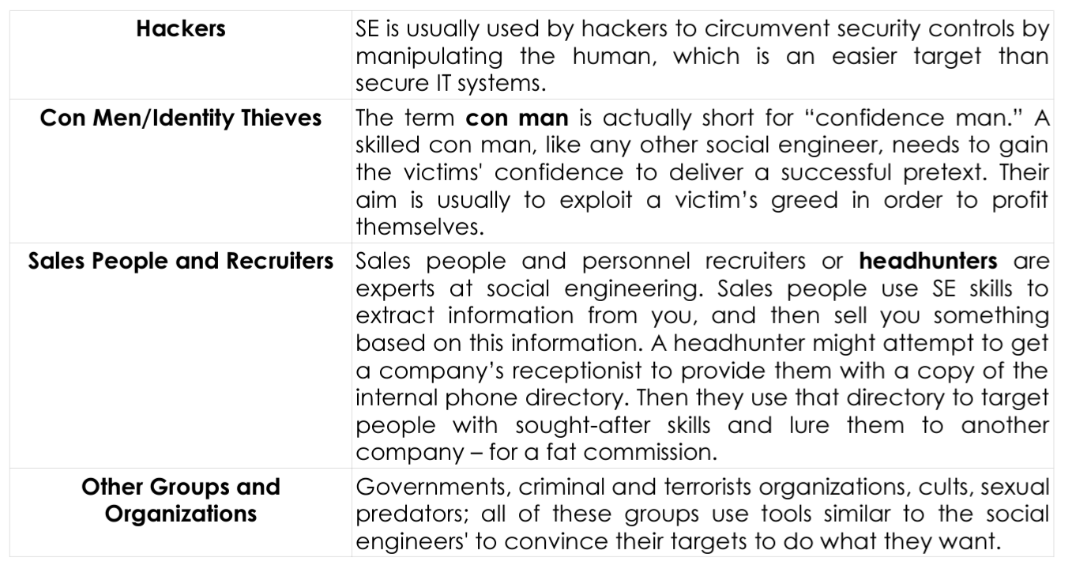
Who Uses Social Engineering
Notes:
25

Slide 26
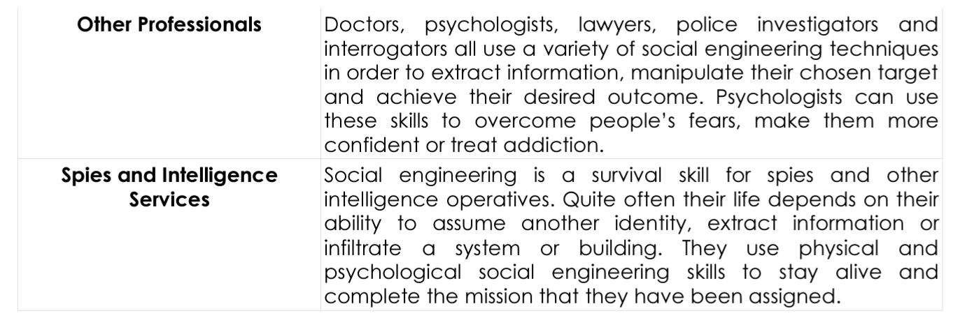
Who Uses Social Engineering
Notes:
26

Slide 27
Spoofing
Making a fake version of something in order to trick a user
Often used as part of a social engineering scam
Example:
  You get an email saying something is wrong with your ebay account.
  It provides a link to a website www.ebayaccounts.com
  The website is fake but can look completely real
Can be done with email addresses and calling trees
Notes:
27

Slide 28
Preventing Social Engineering
Don’t trust anyone or any information that you can’t verify
  Don’t give critical info to unverified websites/phone
  numbers
  2. Don’t accept anything (i.e. programs) from unverified
  sources
This may be inconvenient
  If your bank calls, you should call them back at a known
  Number
  2. Can’t purchase online from unknown vendors
  3. Be careful about freeware/shareware
Notes:
28

Slide 29
Exercise:
Create a list of three organizations that you would love to gain access to, stroll around, look at their internal network settings, and eat their donuts. The target organizations must be private, military, or “Mission Impossible” level, so choose well.
Describe several ways you might be able to gain access to each organization without going through the front door and not using any technology beyond a cell phone. Each organization requires at least one different approach to gain access.
If you must go through the building front door, you need to explain how you are going to get past the twenty-five burly security guards, their hungry attack dogs, and the eyes that never blink (security cameras). Be realistic. You are not a magician and the laws of physics apply. Your budget for each breach is $1,575 US. No, you do not own a helicopter or inviso-spray.

Slide 30
Session Summary
What data is considered private is subjective
Privacy laws vary widely by jurisdiction
Email has little privacy protection by default

