Slide 1
Information System Security
CMIS 422
Managing Incidents
Module 11
Mona Taghavi

Slide 2
Session Overview
Contents of a good security plan
Plan for business continuity and responding to incidents
The steps and best practices of risk analysis

Slide 3
Security Plan
A security plan is a document that describes how an organization will address its security needs.
  policy
  current state
  security requirements
  recommended controls
  accountability
  timetable
  maintenance

Slide 4
Security Policy
A security policy documents an organization’s security needs and priorities.
The policy statement must answer three essential questions about each type of security:
  Who should be allowed access?
  To what system and organizational resources should access be allowed?
  What types of access should each user be allowed for each resource?

Slide 5
Assessment of Current Security Status
The organization can determine the vulnerabilities by performing a risk analysis: a systematic investigation of the system, its environment, and the things that might go wrong.
The status portion of the plan also defines the limits of responsibility for security. It describes not only which assets are to be protected but also who is responsible for protecting them and the boundaries of responsibility.

Slide 6
Security Requirements
The heart of the security plan is its set of requirements: functional or performance demands placed on a system to ensure a desired level of security.
The requirements are usually derived from organizational needs. Sometimes these needs include the need to conform to specific security mandates imposed from outside, such as by a government agency or a commercial standard.

Slide 7
Inputs to the Security Plan

Slide 8
Business Continuity Planning
A business continuity plan documents how a business will continue to function during or after a computer security incident.
  An ordinary security plan covers computer security during normal times and deals with protecting against a wide range of vulnerabilities from the usual sources.
Addresses situations having two characteristics:
  Catastrophic situations, in which all or a major part of a computing capability is suddenly unavailable
  Long duration, in which the outage is expected to last for so long that business will suffer

Slide 9
Continuity Planning Activities
The key to coping with such disasters is advance planning and preparation, identifying activities that will keep a business viable when the computing technology is disabled.
The steps in business continuity planning are these:
  Assess the business impact of a crisis.
  Develop a strategy to control impact.
  Develop and implement a plan for the strategy

Slide 10
Incident Response Plans
A security incident response plan tells the staff how to deal with a security incident
In contrast to a business continuity plan, the goal of incident response is handling the current security incident without direct regard for the business issues
An incident response plan should
  Define what constitutes an incident
  Identify who is responsible for taking charge of the situation
  Describe the plan of action

Slide 11
CSIRTs
Many organizations name and maintain a team of people trained and authorized to handle a security incident
Computer Security Incident Response Teams (CSIRT) or Computer Emergency Response Teams (CERTs) are teams trained and authorized to handle security incidents.

Slide 12
CSIRTs
Responsibilities of a CSIRT include
  Reporting
  Detection
  Triage
  Response
  Postmortem
  Education

Slide 13
Risk Analysis
Risk analysis is an organized process for identifying the most significant risks in a computing environment, determining the impact of those risks, and weighing the desirability of applying various controls against those risks.
A risk is a potential problem that the system or its users may experience.

Slide 14
Risk Characteristics
Risk impact
Risk likelihood
Risk control

Slide 15
Risk Dealing Strategies
Avoid
Transfer
Assume

Slide 16

Risk Analysis
Risk exposure: quantify the effects of a risk by multiplying the risk impact by the risk probability.
Risk leverage is the amount of benefit per unit spent:
Risk analysis is the process of examining a system and its operational context to determine possible exposures and the potential harm they can cause.

Slide 17
Steps of a Risk Analysis
1. Identify assets.
2. Determine vulnerabilities.
3. Estimate likelihood of exploitation.
4. Compute expected annual loss.
5. Survey applicable controls and their costs.
6. Project annual savings of control.

Slide 18
Step 1: Identify Assets
Hardware
Software
Data
What else?

Slide 19
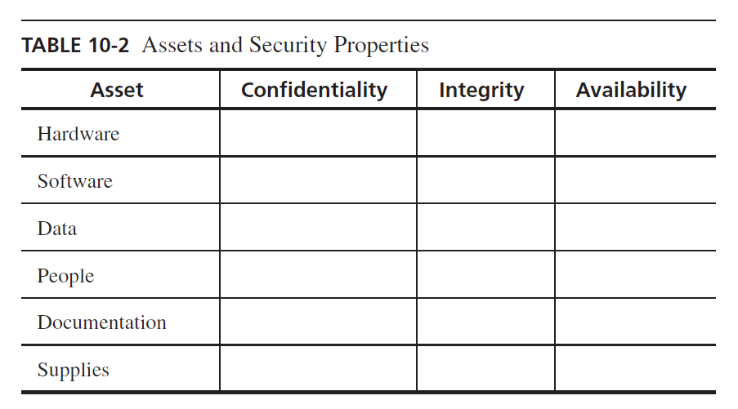
Step 2: Determine Vulnerabilities

Slide 20
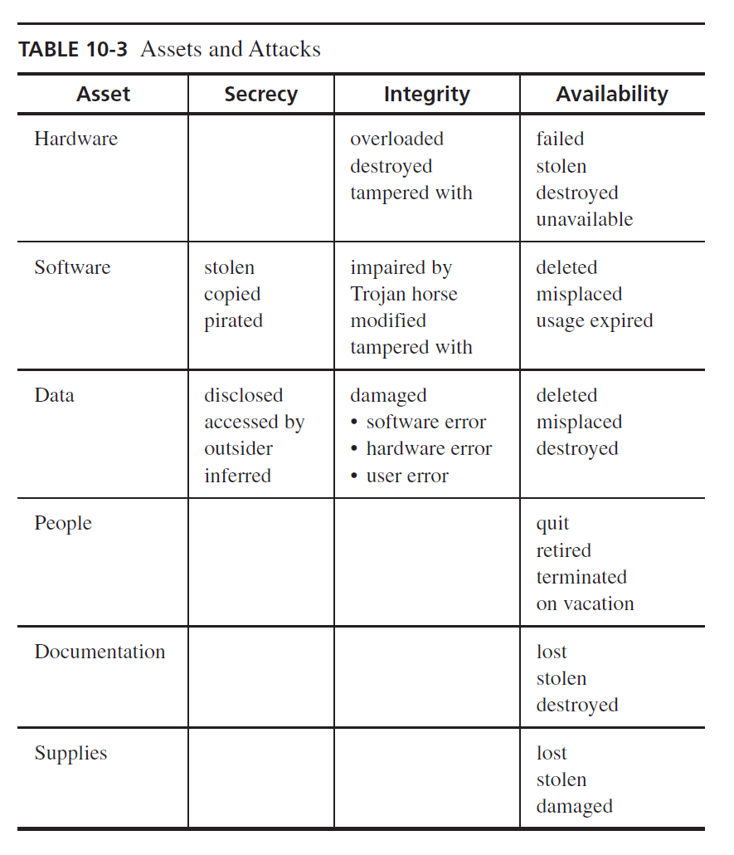
Step 2: Determine Vulnerabilities

Slide 21
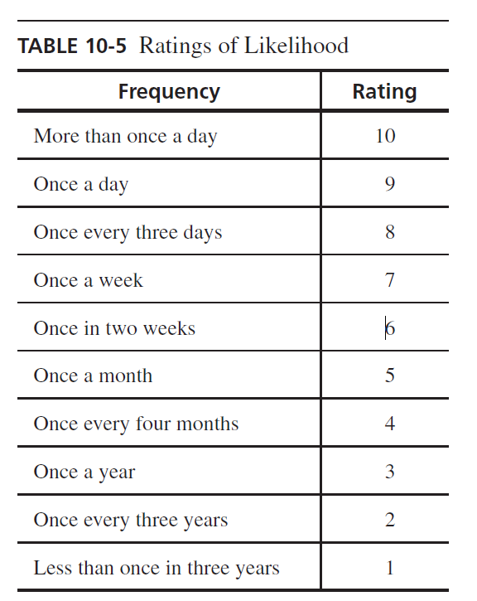
Step 3: Estimate Likelihood of Exploitation
Determining how often each exposure is likely to be exploited.
Quantitative risk analysis: meaning that numbers can be assigned to various risks. Some people prefer so-called
Qualitative risk analysis: descriptive adjectives are used to rate risks

Slide 22
Step 4: Compute Expected Loss
We must determine the likely loss if the exploitation does indeed occur. Some costs, such as the cost to replace a hardware item, are easy to obtain. However, we must take care to include hidden costs in our calculations.

Slide 23
Step 5: Survey and Select New Controls
We want to match each vulnerability with at least one appropriate security technique. Once we do that, we can use our expected loss estimates to help us decide which controls, alone or in concert, are the most cost effective for a given situation.

Slide 24
Step 6: Project Costs and Savings
to determine whether the costs outweigh the benefits of preventing or mitigating the risks.
The effective cost of a given control is the actual cost of the control (such as purchase price, installation costs, and training costs) minus any expected savings from using the control (such as administrative or maintenance costs

Slide 25
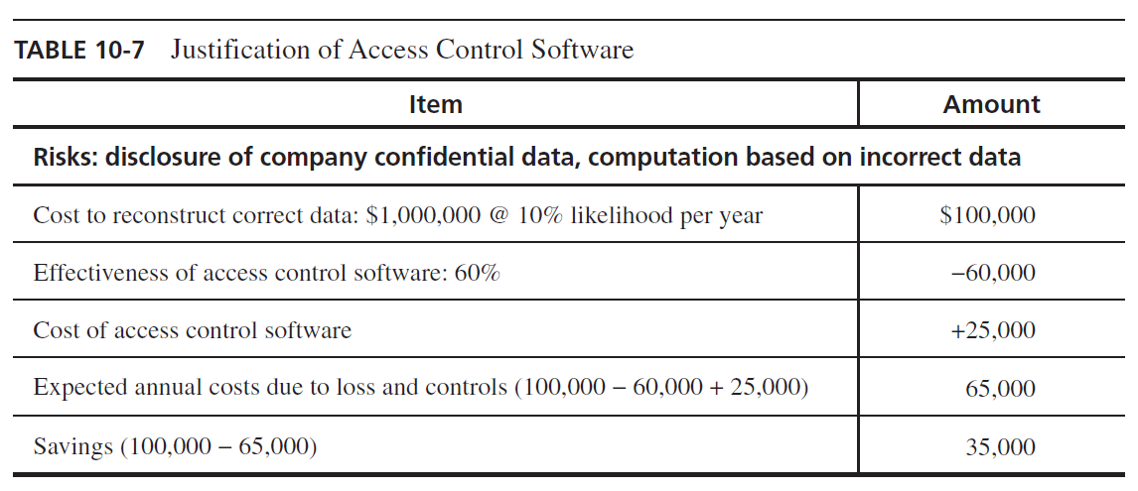
Step 6: Project Costs and Savings

Slide 26
Natural Disasters
Examples
  Flood
  Fire
  Earthquake
Natural disasters can neither be predicted nor prevented; that does not excuse failing to prepare for them.

Slide 27
Natural Disasters
Mitigations
  Develop contingency plans so that people know how to react in emergencies and business can continue
  Insure physical assets—computers, buildings, devices, supplies—against harm
  Preserve sensitive data by maintaining copies in physically separated locations
  Prevent power loss using uninterruptable power supplies and surge suppressors

Slide 28
Contingency Planning
Failover
  Depending on the nature of the computation, it may be important to be able to quickly recover from a crisis and resume computation.
    Cold site
      A cold site or shell is a facility with power and cooling available, in which a computing system can be installed to begin immediate operation.
    Hot site
      A hot site is a computer facility with an installed and ready-to-run computing system.

Slide 29
Session Summary
A security plan is both an official record of current security practices and a blueprint for orderly change to improve those practices
Business contingency and incident response planning help establish an orderly, carefully considered response to emergencies and other security incidents
Risk analysis is a complex and imperfect process but forces an organization to carefully consider important assets, vulnerabilities, risks, and control options
Prepare for disasters by contingency planning, insuring assets, backing up data, and deploying failover sites

