Slide 1
Information System Security
CMIS 422
Security in cloud computing
Module 12
Mona Taghavi

Slide 2
Session Overview
Cloud services, including types and service models
Cloud storage encryption considerations
Major federated identity management standards and how they differ

Slide 3
What is cloud computing?

Slide 4
Cloud computing
NIST – National Institute of Standards and Technology:
  “Cloud computing is a model for enabling convenient, on-demand network access to a shared pool of configurable computing resources (e.g., networks, servers, storage, applications, and services) that can be rapidly provisioned and released with minimal management effort or service provider interaction. This cloud model promotes availability and is composed of five essential characteristics, three service models, and four deployment models.”

Slide 5
Five characteristics of cloud computing
On-demand self-service
  Cloud computing resources can be provisioned without human interaction from the service provider.
Broad network access
  Cloud computing resources are available over the network and can be accessed by diverse customer platforms.
Multi-tenancy and resource pooling
  Multi-tenancy allows multiple customers to share the same applications or the same physical infrastructure.
Rapid elasticity and scalability
  The ability to quickly provision resources in the cloud as organizations need them.
Measured service
  Cloud computing resources usage is metered and organizations pay for what they have used.

Slide 6
What are cloud service models?

Slide 7
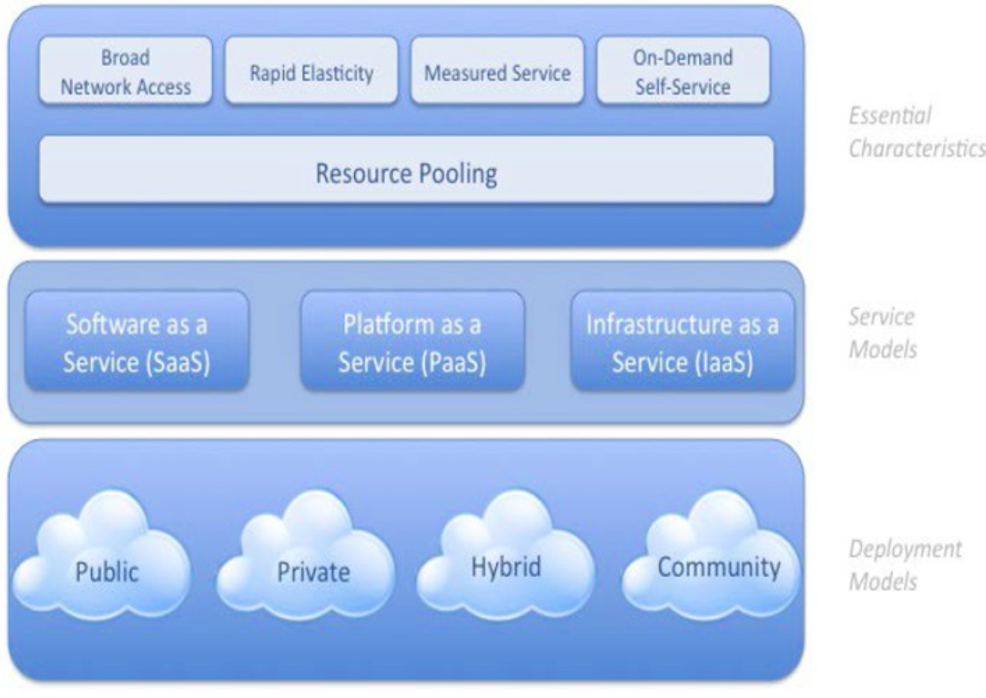

Slide 8
Service Models

Slide 9
Deployment Models
Private cloud
  Infrastructure that is operated exclusively by and for the organization that owns it
Community cloud
  Shared by several organizations with common needs, interests, or goals
Public cloud
  Owned by a cloud service provider and offered to the general public
Hybrid cloud
  Composed of two or more types of clouds, connected by technology that enables data and applications to balance loads among those clouds

Slide 10
Cloud Storage
By default, most cloud storage solutions either store users’ data unencrypted or encrypt all data for all customers using a single key and therefore don’t provide strong confidentiality
Some cloud services provide better confidentiality by generating keys on a per-user basis based on that user’s password or some other secret
For maximum confidentiality, some cloud providers embrace a trust no one (TNO) model in which even the provider does not have the keys to decrypt user data

Slide 11
Lastpass TNO Implementation
Lastpass, a SaaS product, has a good technical approach for implementing TNO.
Lastpass is a password manager, which means it allows customers to store the login information they use to access other websites.
Password managers serve a valuable security purpose—helping users create complex and varied passwords without having to remember them all—but only if the login information (“password database”) users store in them remains confidential.

Slide 12
Lastpass TNO Implementation

Slide 13
Boxcryptor TNO Implementation

Slide 14
Cloud Application Security
Attacks against shared resources
  Shared computing resources change the threat landscape.
  Sharing a system with a vulnerable application may result in those shared resources becoming compromised and consequently spreading attacks to your applications.

Slide 15
Cloud Application Security
Attacks against shared resources
  There are also attacks, such as cryptographic side-channel attacks, that specifically target shared resource environments.
  Cryptographic side-channel attacks use incidental information—processor and memory response, temperature, and so on—to reduce the search space of cryptographic keys.
    Timing Information: The time it takes to perform certain operations (e.g., encryption or decryption) can leak information about the cryptographic key.
    Power Consumption: Variations in the device's power usage during cryptographic operations can reveal information about the data being processed.
    Acoustic Emissions: Sounds generated by hardware components (like a CPU) during computations can sometimes reveal data.
    Cache Behavior: Cache access patterns during cryptographic operations may expose information about the algorithm's internal state.

Slide 16
Cryptographic side-channel attack
Why Cryptographic side-channel attacks are particularly relevant and dangerous in cloud computing environments?

Slide 17
Federated Identity Management (FIdM)

Slide 18
Security Assertion Markup Language
Two prerequisites make FIdM work:
  Trust
  Standardization
    SAML
    OAuth

Slide 19
Security Assertion Markup Language (SAML)
An XML-based standard that defines a way for systems to securely exchange user identity and privilege information
Commonly used when a company wants to give its employees access to corporate cloud service subscriptions
If an employee leaves the company, his corporate login credentials are disabled and, by extension, so are his login rights to the cloud service

Slide 20
SAML Authentication Process
The SAML standard specifies XML messages that parties can use to exchange identity information, as well as protocols and rules for those exchanges.
SAML defines three parties who participate in identity exchanges:
  The Service Provider (SP) or Relying Party: A SAML-enabled service that needs to obtain identity information from a third party
  The Subject: The entity, be it user or system, that is attempting to log in to the SP
  The Identity Provider (IdP) or Asserting Party: A SAML-enabled system that can authenticate the Subject and make assertions about the Subject’s identity

Slide 21
SAML Authentication Process

Slide 22
Oauth (Open Authorization Framework)
Whereas SAML is an authentication standard, OAuth is an authorization standard
OAuth enables a user to allow third-party applications to access APIs on that user’s behalf
When Facebook asks a user if a new application can have access to his photos, that’s Oauth
OAuth allows users to give third-party applications access to only the account resources they need, and to do so without sharing passwords; users can revoke access at any time

Slide 23
Securing IaaS
Shared storage
  When you deallocate shared storage, it gets reallocated to other users, potentially exposing your data. Encrypted storage volumes are the most reliable mitigation.
Shared network
  Typical practice among IaaS providers prevents users from sniffing one another’s network traffic, but the safest bet is to encrypt all network traffic to and from virtual machines whenever possible

Slide 24
Securing IaaS
Host access
  Require two-factor authentication
  Enforce the principle of least privilege
  Use OAuth rather than passwords to give applications access to API interfaces
  Use FIdM wherever possible so as to only manage one set of accounts

Slide 25
Session Summary
Cloud storage encryption options vary widely—confidentiality requirements are a key consideration.
FIdM, including SAML, OAuth, provides strong security benefits by centralizing account and authorization management
Cryptographic side-channel attack is common against shared cloud resources.

