Slide 1
Digital Diary
“Where Teaching Meets Technology”

Slide 2
Presented by:
Shireen Jalal Khan (CU-2265-2021) Ahmed Khan (CU-2082-2021)
BSCS-2021-A

Slide 3
Introduction
Traditional paper-based diaries are often hard to maintain, prone to errors and lack the efficiency and convenience of digital systems.
Our project proposes a digital solution for managing educational workflows.
It offers a range of features that optimize the management of personal and professional schedules.

Slide 4
Problem Statement
Teachers face numerous challenges in managing their workflows, including lesson planning, attendance tracking and assignment management.
These tasks often involve excessive paperwork, time-consuming manual processes, and fragmented tools, leading to inefficiencies and a lack of centralized data access.

Slide 5
Objective
To develop a digital tool that helps teachers organize their daily tasks, track student progress, manage lesson plans and ensure easy access to records.

Slide 6
Target Audience
Teachers who need an organized platform to manage their teaching resources, track student progress and plan lessons.
Computer Science department of CECOS University.

Slide 7
Features Overview
Intuitive Dashboard
Lesson Planning
Student Progress Tracking
Digital Notes
Reminders and Notifications
User Support and Tutorials

Slide 8
Literature Review
P. M. Elisabeta and M. R. Alexandru, "Comparative Analysis of E-Learning Platforms on The Market," 2018 10th International Conference on Electronics, Computers and Artificial Intelligence (ECAI), Iasi, Romania, 2018, pp. 1-4, doi: 10.1109/ECAI.2018.8679004.
URL: https://ieeexplore.ieee.org/document/8679004
A. Guo and J. Ma, "A Smartphone-Based System for Personal Data Management and Personality Analysis," 2015 IEEE International Conference on Computer and Information Technology; Ubiquitous Computing and Communications; Dependable, Autonomic and Secure Computing; Pervasive Intelligence and Computing, Liverpool, UK, 2015, pp. 2114-2122, doi: 10.1109/CIT/IUCC/DASC/PICOM.2015.314.
URL: https://ieeexplore.ieee.org/document/7363360
S. F. M. Abraar, D. T. Thuduhenage, V. P. Balasubramaniyam, S. R. Mohanraj, G. Wimalaratne and S. Rajapaksha, "SMART DIARY: Autonomous System for Daily Diary Creation and Prioritization of Daily Activities for Improved Well-Being Using Neural Networks and Machine Learning," 2022 4th International Conference on Advancements in Computing (ICAC), Colombo, Sri Lanka, 2022, pp. 78-83, doi: 10.1109/ICAC57685.2022.10025129.
URL: https://ieeexplore.ieee.org/document/10025129

Slide 9
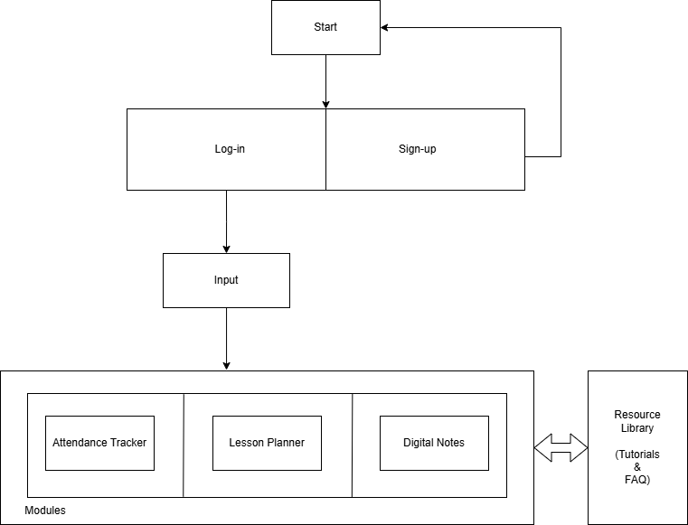
Block Diagram

Slide 10
Components Used
Front-end: HTML (structuring), CSS (styling), JavaScript (interactivity)
Back-end: PHP (server-side logic), MySQL (database management system)
IDE: Visual Studio Code

Slide 11
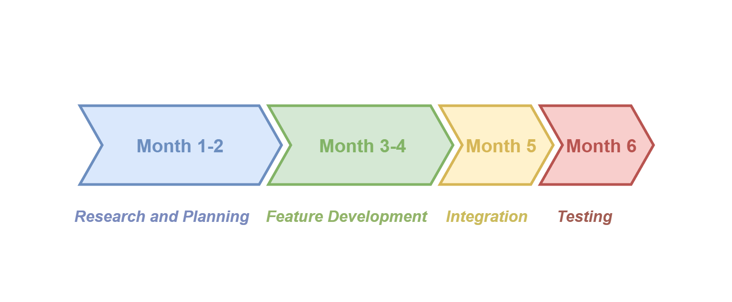
Timeline

Slide 12
Technical Approach
Using Iterative method of development.
Two group members and one supervisor.
Back-end and Front-end to be developed simultaneously.
Feedback to be evaluated and implemented appropriately.

Slide 13
System Architecture
Web application for:
Personal Computers
Mobile Devices

Slide 14
Conclusion
Teacher’s Digital Diary transforms traditional teaching by enabling smarter, more efficient education management.
Its adoption requires addressing challenges like accessibility and privacy.

Slide 15
-END-

