Slide 1

Smart Diary – Teachers’ Personal Digital Assistant
“Where Teaching Meets Technology”
03/12/2024

Slide 2
Shireen Jalal Khan (CU-2265-2021)
Ahmed Khan (CU-2082-2021)
BSCS-2021-A
Presented by:

Slide 3
Introduction
Traditional paper-based diaries are often hard to maintain, prone to errors and lack the efficiency and convenience of digital systems.
Our project proposes a digital solution for managing educational workflows.
It offers a range of features that optimize the management of personal and professional schedules.

Slide 4
Problem Statement
Teachers face numerous challenges in managing their workflows, including lesson planning, attendance tracking and assignment management.
These tasks often involve excessive paperwork, time-consuming manual processes, and fragmented tools, leading to inefficiencies and a lack of centralized data access.

Slide 5
Objective
Target Audience
To develop a digital tool that helps teachers organize their daily tasks, track student progress, manage lesson plans and ensure easy access to records.
Teachers who need an organized platform to manage their teaching resources, track student progress and plan lessons.
Computer Science department of CECOS University.

Slide 6
Features Overview
Daily Task Management
Resource Library
Calendar Integration
To-Do List
Reminders/Notifications
Classroom Management
Links & Files
Tutorials at hand
Sync Calendar
Lesson Timetables

Slide 7

Features & Capabilities
Customization Options
Assignment Tracker
Theme Selection
Personalization
Assignment Log
Student Progress
Smart Diary boasts a user-friendly interface, secure infrastructure and ease of access to features.
Journal
Analytics / Emotional Tracker
Jot down notes
Productivity Insights

Slide 8
Classroom Settings
Classroom Name
Each class can have its own settings with support to integrate Google Classroom.
Teacher Portal
Calendar
Documents
Attendance
Analytics
Messaging

Slide 9
Alerts and Reminders
[Reminder❗]
Class due in 30 minutes at GF-06!
Set reminders for upcoming deadlines or tasks.
[Alert❗]
Assignment submitted by student!

Slide 10
Components Used
Front-end: HTML (structuring), CSS (styling), JavaScript (interactivity)
Back-end: PHP (server-side logic), MySQL (database management system)
IDE: Visual Studio Code

Slide 11
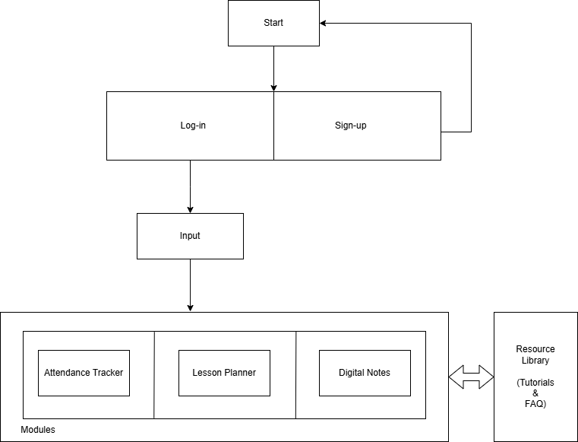
Block Diagram

Slide 12
Timeline
Final Testing +
User Feedback Collection
Design Mockups, Framework Setup
Progress Report
Final project checkpoint and close
Project approval and defense
Feature Development
Week 1
3
5
7
9
11
13
15
Research and Planning
Integration and Testing
Initial Rollout

Slide 13
Literature Review
P. M. Elisabeta and M. R. Alexandru, "Comparative Analysis of E-Learning Platforms on The Market," 2018 10th International Conference on Electronics, Computers and Artificial Intelligence (ECAI), Iasi, Romania, 2018, pp. 1-4, doi: 10.1109/ECAI.2018.8679004.
URL: https://ieeexplore.ieee.org/document/8679004
A. Guo and J. Ma, "A Smartphone-Based System for Personal Data Management and Personality Analysis," 2015 IEEE International Conference on Computer and Information Technology; Ubiquitous Computing and Communications; Dependable, Autonomic and Secure Computing; Pervasive Intelligence and Computing, Liverpool, UK, 2015, pp. 2114-2122, doi: 10.1109/CIT/IUCC/DASC/PICOM.2015.314.
URL: https://ieeexplore.ieee.org/document/7363360
S. F. M. Abraar, D. T. Thuduhenage, V. P. Balasubramaniyam, S. R. Mohanraj, G. Wimalaratne and S. Rajapaksha, "SMART DIARY: Autonomous System for Daily Diary Creation and Prioritization of Daily Activities for Improved Well-Being Using Neural Networks and Machine Learning," 2022 4th International Conference on Advancements in Computing (ICAC), Colombo, Sri Lanka, 2022, pp. 78-83, doi: 10.1109/ICAC57685.2022.10025129.
URL: https://ieeexplore.ieee.org/document/10025129

Slide 14
Conclusion
Teacher’s Digital Diary transforms traditional teaching by enabling smarter, more efficient education management.
It will be a Web Application for both Personal Computers and Mobile Devices.
Date
School Name

