Slide 1
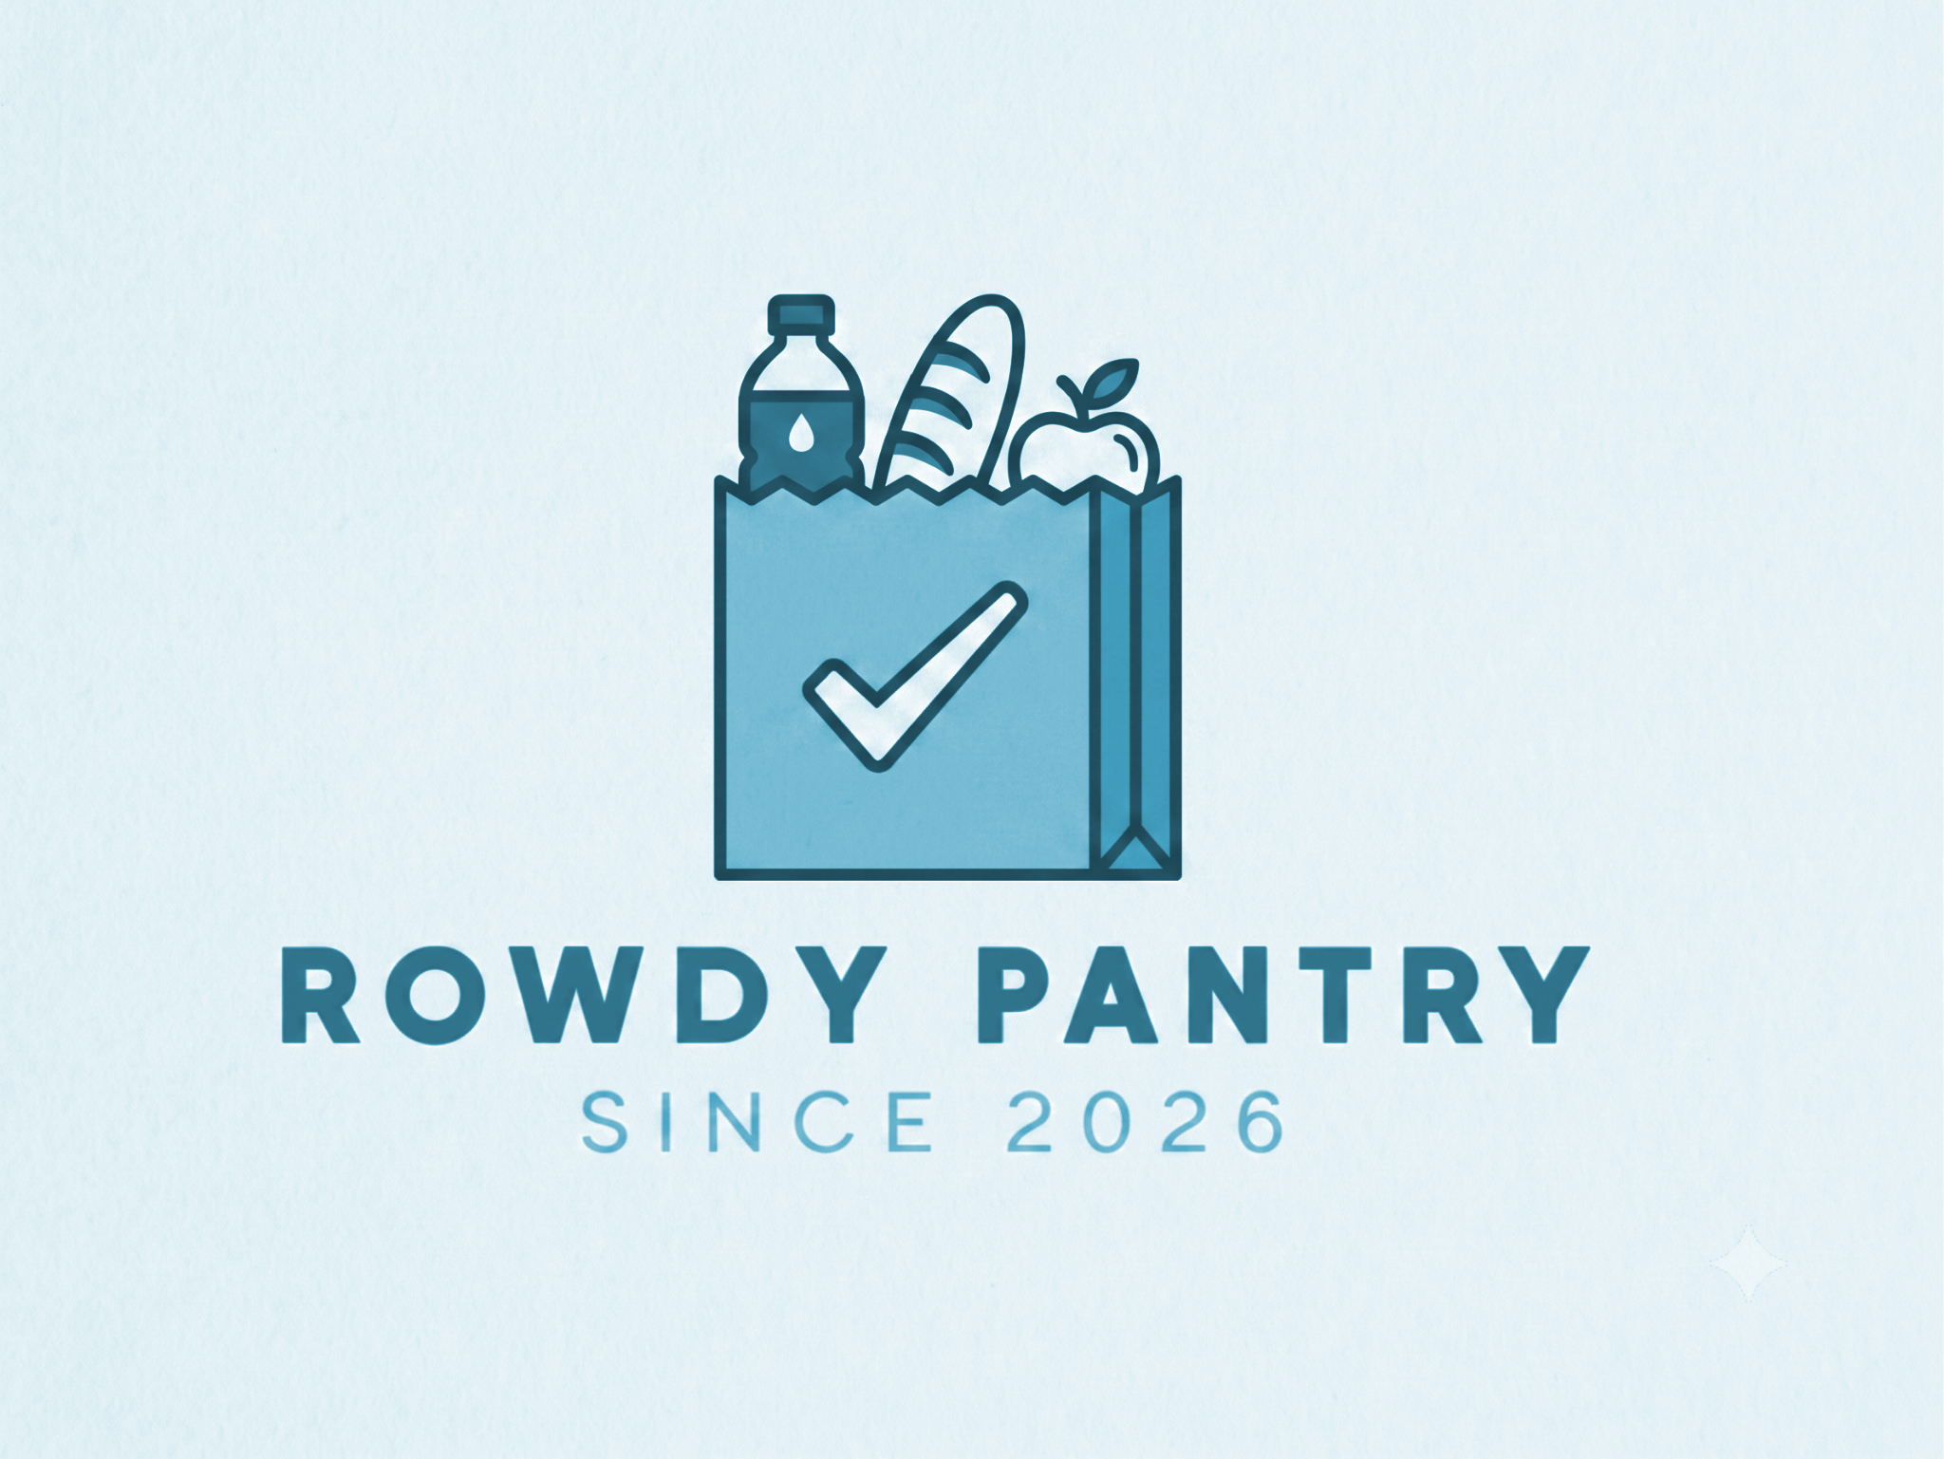
Online Grocery Store Portal: Rowdy Pantry
Group 7 - Madison, Leigh, Ire, Georgie

Slide 2
TABLE OF CONTENTS
01
02
OVERVIEW
REQUIREMENTS
03
04
05
SYSTEM DESIGN
DEMO & ISSUES
CONCLUSIONS
Problem statement, portal features, and key objectives
Testable user stories and test case specifications
UML class diagram, and object state diagrams
Feature walkthrough video, challenges encountered
Team member reflections and lessons learned

Slide 3
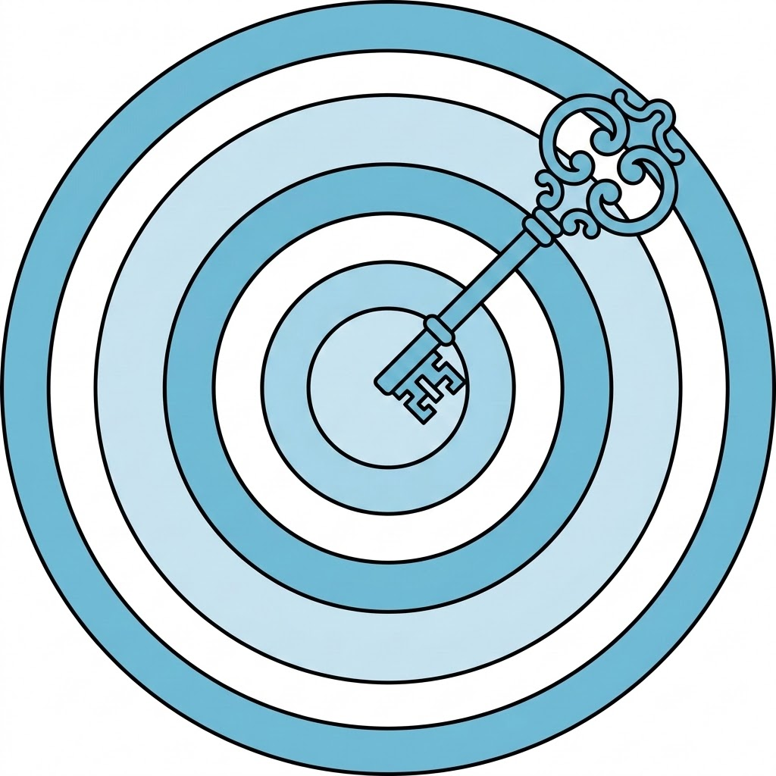
01
OVERVIEW
Problem statement, portal features, key objectives

Slide 4
Product Overview
Problem Statement : Shoppers need an intuitive, accessible online platform to browse grocery inventory, manage custom shopping carts, and select flexible checkout and delivery choices.
Key Features : A customer portal handling user account registration/login, product catalog browsing and filtering, cart calculations, order history tracking, and checkout/delivery options.
Tech Stack :
Backend : Java 17 Eclipse Temurin with Spring Boot, packaged with a custom Dockerfile
Database/Hosting : Clever Cloud for mySQL hosting, paired with Render for backend deployment
Frontend : HTML, JavaScript, CSS, Bootstrap
Architecture : Mix of Model-Controller-View and Repository/API

Slide 5

02
REQUIREMENTS
Testable user stories and test case specifications

Slide 6
User Stories
As a registered customer, I want to log in so that I can access my shopping cart and order history.
Test Case 1: Given that a customer has a valid account, when they enter the correct email and password, then the system should log them in.
Test Case 2: Given that a customer enters an incorrect password, when they try to log in, then the system should display an error message.
As a customer, I want to add a delivery address so that I can choose where my grocery order should be delivered.
Test Case 1: Given that a customer is logged in, when they enter a valid address and save it, then the system should store the address with their account.
Test Case 2: Given that a customer leaves required address fields blank, when they submit the address form, then the system should display a validation message.
As a customer, I want to search for products by item name or description so that I can find specific grocery items quickly.
Test Case 1: Given that a customer enters a product keyword in the search bar, when matching products exist, then the system should display only matching products.
Test Case 2: Given that no products match the search keyword, when the customer searches, then the system should display a message saying no products were found.

Slide 7

03
SYSTEM DESIGN
UML class diagram, and object state diagrams

Slide 8
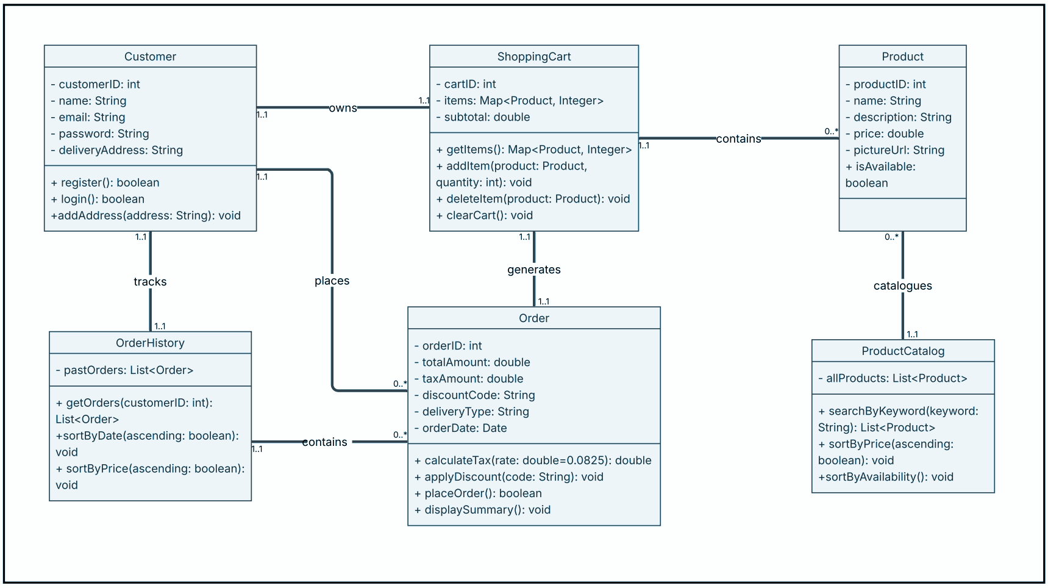
Original Model UML Design

Slide 9
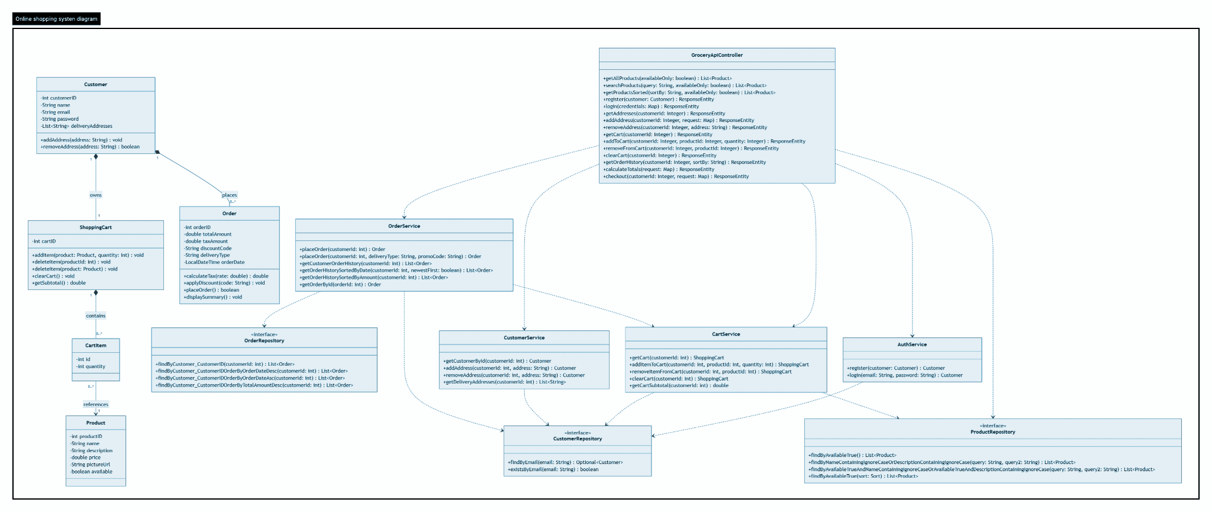
Updated UML Design

Slide 10
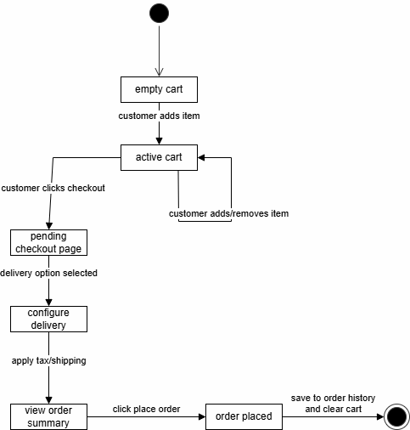
Object State Diagram

Slide 11

04
DEMO & ISSUES
Walkthrough video, challenges encountered

Slide 12
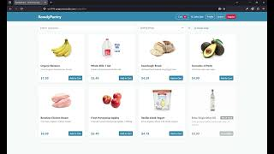
Demo

Slide 13
Challenges encountered
Issue : Updating our database on Clever Cloud and allowing our code to communicate without storing sensitive information in the code
Solution : Used environment variables in Spring Boots application.properties so that our local computers and Render can connect to our database.
Issue : The initial design stored shopping cart items as a generic mapping (Map<Product, Integer>) which made enforcing key constraints hard with JPA
Solution : Refactored the architecture to introduce an explicit intermediate entity, CartItem. This established a 1-to-Many relationship with ShoppingCart and a Many-to-One reference to Product.
Issue : Ordering requires multiple database interactions so if any step fails part of the way through, could be left with a partial database entry.
Solution : Wrapped core operations across AuthService, CartService, CustomerService, and OrderService with Spring's @Transactional annotation.

Slide 14
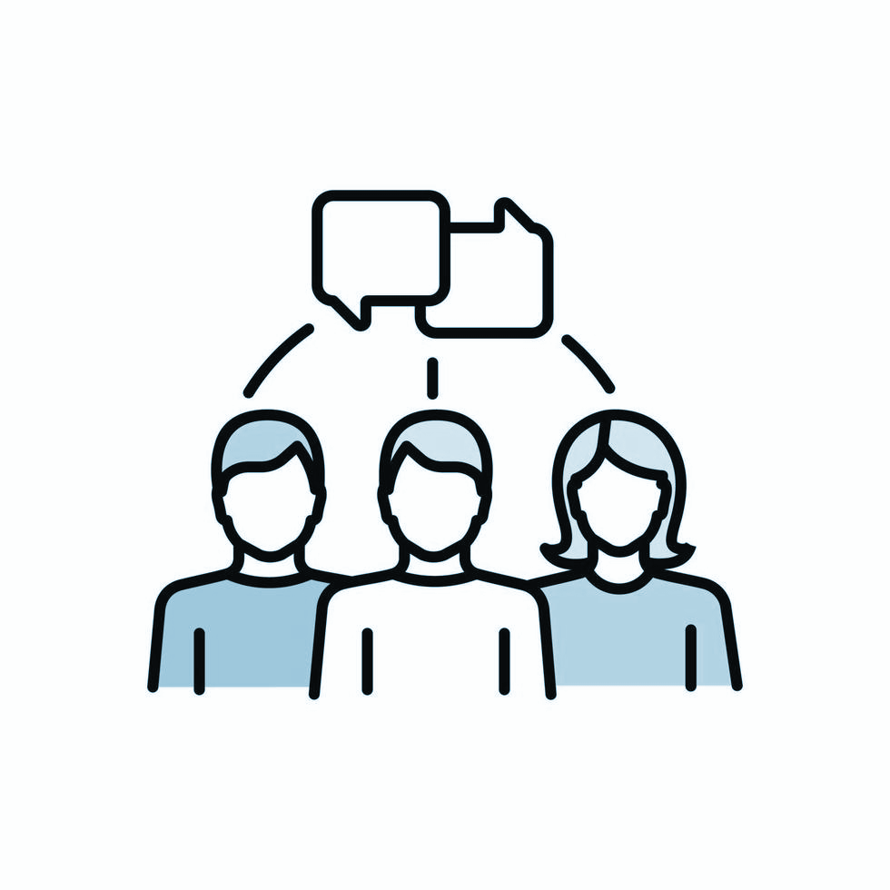
05
CONCLUSIONS
Team member reflections and lessons learned

Slide 15
Team Reflections
Madison
Leigh
Ire
Georgie
This was a great challenge, setting up the website was a task that required some use of research and AI, but working on the database and UI was fulfilling.
After completing application programming, this was a great refresher and practical way to use what I had learned. Props to Madison for laying the groundwork for the team!
This project helped reinforce the importance of clear planning and communication when building a multi part application as a team.
This project was an enjoyable way to reinforce the concepts from application programming while exploring how to properly work as a team.

Slide 16
THANKS!
DO YOU HAVE ANY QUESTIONS?
CS-3773-01T Software Engineering - Group 7
Please keep this slide for attribution

