Slide 1
Introduction to Web Technologies
HTML

Slide 2
Agenda
Overview of the Web
Addressing: URIs
Architecture of the Internet
Content: HTML, CSS

Slide 3
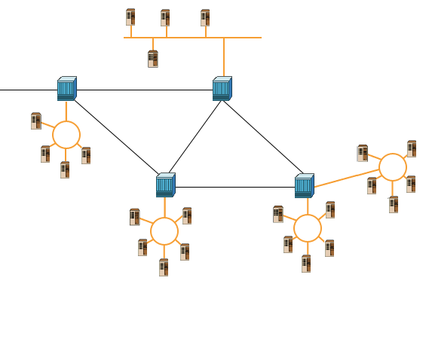
What is Internet ?
Millions of computer networks connected to each other via the ‘Internet Backbone’

Slide 4
What is the World Wide Web?
The World Wide Web (Web) is a network of information resources. The Web relies on three mechanisms to make these resources readily available to the widest possible audience:
A uniform naming scheme for locating resources on the Web (e.g., URIs).
Protocols, for access to named resources over the Web (e.g., HTTP).
Hypertext, for easy navigation among resources (e.g., HTML).

Slide 5
Agenda
Overview of the Web
Addressing: URIs
Architecture of the Internet
Content: HTML, CSS

Slide 6


URL
You type a website address or “URL” into your browser
Serves Data
Requests Data
http://www.Google.com
Client
Server
URL: Uniform Resource Locater
Unique address of a document or a resource on the internet

Slide 7
URL Have two parts:
Domain Name
http://www.Google.com
Protocol Type
HTTP = Hyper Text Transfer Protocol
FTP = File Transfer Protocol
A “Protocol’ is a structured set of communication rules that allows machines to share data.

Slide 8
Agenda
Overview of the Web
Addressing: URIs
Architecture of the Internet
Content: HTML, CSS

Slide 9
Architecture of the Internet
Protocols
Addressing Schemes
Client/Server Architecture

Slide 10
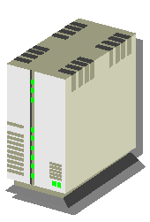



HTTP in Context
Major steps in a "browser process"
http://origin/..
DNS query
DNS server
Client
Origin
server
Establish TCP connection
HTTP request
HTTP
transaction
HTTP response
Optional parallel connections
HTML

Slide 11
Client/ Server architecture

Slide 12
Technologies Overview
Client Side Technologies
HTML, CSS, JavaScript, VBScript
XHTML, DHTML, WML, AJAX
FLASH
Server Side Technologies
ASP, PHP, Perl, JSP
ASP.NET, Java
MySQL, SQL Server, Access

Slide 13
Technologies Overview
Some More Advanced Technologies
XML, XSLT, RSS, Atom
X-Path, XQuery, WSDL
XML-DOM, RDF
Ruby on Rails, GRAIL Framework
REST, SOAP

Slide 14
Agenda
Overview of the Web
Addressing: URIs
Architecture of the Internet
Content: HTML, CSS

Slide 15
HTML (Hyper-text Markup Language)
The publishing language used by the World Wide Web is
HTML (from Hyper-text Markup Language).
Documents
Document = page = HTM file = topic
Content (text, images)
Tags (display commands)

Slide 16
That’s how this…
<html>
<head><title>Welcome onboard</title></head>
<body bgcolor=“#f4f4f4">
<h1>Welcome</h1>
<img src=“dcetech.gif" width=“222" height=“80" alt=“DCETECH" BORDER="0“ />
<h2>A Message from the Speaker </h2>
<p><font color=red>Good evening! Thank you for coming here!</font></p>
<p>Hello and welcome to Web technologies workshop! I'm <b>Ankit Jain,</b>, 4th year Computer Engg <a href=“http://dcetech.com"> Head DCETECH.COM </a>. Dcetech is a student portal and only one of its kind in India.It is not only a technical oriented site which caters only for engineers but its for students from any background! Also students from any educational institution can register and join Dcetech. </p>
. . .
</body>
</html>

Slide 17
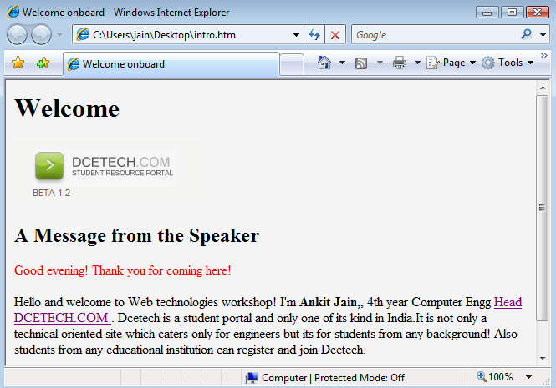
Turns into this…

Slide 18
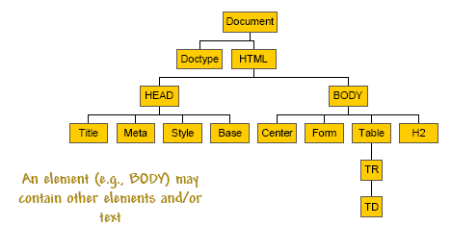
HTML Elements
An HTML page is a tree of html elements

Slide 19
HTML Tags
Begin with a (<); end with a (>)
Most tags are paired into beginning and ending tags; for
example,
<b>Hello</b> world
Hi <i>Ahmed</i> Ali
<hr><br>
<b><i>Hello</i></b> world

Slide 20
Some HTML Tags example
START TAG END TAG
<HTML> </HTML>
<HEAD> </HEAD>
<TITLE> </TITLE>
<BODY> </BODY>
<H1>, <H2>, ... </H1>, </H2>, ...
<IMG ...> </IMG> (optional)
<A ...> </A>
<P> </P>
<BR/> (none; "empty" tag)
<OL> </OL>
<UL> </UL>
<LI> </LI>

Slide 21
Basic Structure of HTML document Example of basic tag positioning
<html>
<head>
<title>Title bar text</title>
</head>
<body>
<p>Look, I'm a paragraph!</p>
</body>
</html>

Slide 22
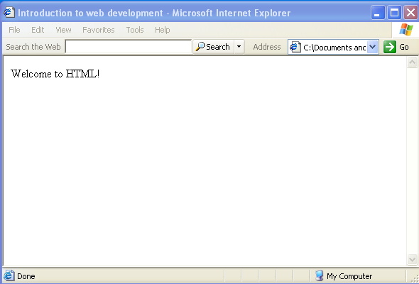
Basic Structure
<html>
<head>
<title> Introduction to web development </title>
</head>
<body>
<p>Welcome to HTML!</p>
</body>
</html>
Title tags
Body tags

Slide 23
What Comes in the Head
Optional elements
<html> <head> <title>Title</title> <base href="..."> Path for relative URLs <script>...</script> Embedded script program <style>...</style> Cascading style sheet <link...> File associations <meta...> Document information <meta Name=“P. Michiardi” Content=“Lecture 1”> </head> <body> </body> </html>

Slide 24
Meta tag
Meta tags are used to store information usually relevant to browsers and search engines.
<META name="DESCRIPTION" content="AN HTML Tutorial">
<META name="KEYWORDS" content="html, webdesign, javascript">
<META name="GENERATOR" content="Frontpage 3.0">
<META name="AUTHOR" content="Bill Gates">
<META http-equiv="REFRESH" content="5; url=http://www.echoecho.com">
<META http-equiv=“expires" content=“Sun, 31 Jan 2005 17:35:00 GMT ">

Slide 25
Body Section
<body bgcolor=“#FFFFFF” link="#C0C0C0" vlink="#808080" alink="#FF0000“>
attributes of body section :
link
vlink
alink
Bgcolor
Background
Bgproperties →fixed
Topmargin / leftmargin / bottommargin / rightmargin

Slide 26
Tags inside BODY SECTION
Text
Formatting
Resizing
Layout
Listing
Images
Inserting images (GIF and jpg)
Adding a link to an image
Links
To local pages
To pages at other sites
To bookmarks
Background
Colors
Images
Fixed Images
Tables
Frames
Forms

Slide 27
TEXT FORMAT
<b>text</b> | writes text as bold
<i>text</i> | writes text in italics
<u>text</u> | writes underlined text
<sub>_{text}</sub> | lowers text and makes it smaller
<sup>^{text} </sup> | lifts text and makes it smaller
<blink>text</blink> | guess yourself! (Note: Netscape only.)
<strike>text</strike> | strikes a line through the text
<pre>text</pre> | writes text exactly as it is, including spaces.
<strong>text<strong> | makes text bold

Slide 28
TEXT SIZE
These are the tags for changing the font size.
<big>text</big> | increase the size by one
<small>text</small> | decrease the size by one
<h1>text</h1> | writes text in biggest heading
<h6>text</h6> | writes text in smallest heading
<font size="1">text</font> | writes text in smallest font size. (8 pt)
<font size="7">text</font> | writes text in biggest font size (36 pt)

Slide 29
TEXT LAYOUT
These tags will let you control the layout.
<p>text</p> | Adds a paragraph break after the text. (2 linebreaks).
<p align="left">text</p> | Left justify text in paragraph.
<p align="center">text</p> | Center text in paragraph.
<p align="right">text</p> | Right justify text in paragraph.
text<br> | Adds a single linebreak where the tag is.
<nobr>text</nobr> | Turns off automatic linebreaks - even if text is wider than the window.
<center>text</center> | Center text.
<div align="center">text</div> | Center text.
<div align="left">text</div> | Left justify text.
<div align="right">text</div> | Right justify text.

Slide 30
HTML Images
Images types used in browsers are : GIF & JPG
<img src="http://www.haneen.com.eg/logo.gif">
<img src="logo.gif">
Resizing
<img src=“logo.gif" width="60" height="60">
Notes:
default aligns the image using the default settings of the Web browser. Same as baseline.
left aligns the image in the left margin and wraps the text that follows the image.
right aligns the image in the right margin and wraps the text that precedes the image.
top aligns the top of the image with the surrounding text.
texttop aligns the top of the image with the top of the tallest text in the line.
middle aligns the middle of the image with the surrounding text.
absmiddle aligns the image with the middle of the current line.
baseline aligns the image with the baseline of the current line.
bottom aligns the bottom of the image with the surrounding text.
absbottom aligns the image with the bottom of the current line.
center aligns the center of the image with the surrounding text.

Slide 31
HTML Images
SPACING AROUND
<img src="rainbow.gif" Hspace="30" Vspace="10">
ALIGNMENT OF IMAGES
You can align images according to the text around it Default, left, right, top, texttop, middle, center
ALTERNATIVE TEXT
<img src=“logo.gif" alt="This is a text that goes with the image">
Notes:
default aligns the image using the default settings of the Web browser. Same as baseline.
left aligns the image in the left margin and wraps the text that follows the image.
right aligns the image in the right margin and wraps the text that precedes the image.
top aligns the top of the image with the surrounding text.
texttop aligns the top of the image with the top of the tallest text in the line.
middle aligns the middle of the image with the surrounding text.
absmiddle aligns the image with the middle of the current line.
baseline aligns the image with the baseline of the current line.
bottom aligns the bottom of the image with the surrounding text.
absbottom aligns the image with the bottom of the current line.
center aligns the center of the image with the surrounding text.

Slide 32
Image map
Possible shapes for areas inside image are
<area shape=rect coords= x1,y1, x2,y2 Href="http://www.domain.com">
<area shape=circle coords= x1,y1, x2,y2 Href="http://www.domain.com">
<area shape=polygon coords= x1,y1, x2,y2, .., xn,yn Href="http://www.domain.com">
Example
<img src="rainbow.gif" usemap = #example border=0>
<map name=example> <area shape=Rect Coords=0,0,29,29 Href="http://www.yahoo.com"> <area shape=Rect Coords=30,30,59,59 Href="http://www.hotbot.com">
</map>

Slide 33
HTML Links
Click <a href="http://www.yahoo.com">here</a> to go to yahoo.
COLORS ON TEXT LINKS
<body link="#C0C0C0" vlink="#808080" alink="#FF0000">
LINK TARGETS
<a href="http://www.yahoo.com" target="_blank">

Slide 34
HTML Links
Image link
<a href="myfile.htm"><img src="rainbow.gif"></a>
<a href="myfile.htm"><img src="rainbow.gif" border="0"></a>
Link to email
<a href="mailto:youremailaddress">Email Me</a>
<a href="mailto:email@hotmail.com?subject=SweetWords">Send Email</a>
<a href="mailto:email@hotmail.com?body=Please send me a copy of your new program!">Send Email</a>
<a href="mailto:email@hotmail.com?subject=SweetWords &body=Please send me a copy of your new program!">Email Me</a>

Slide 35
HTML Links (cont.)
LINK WITHIN A PAGE
To link to an anchor you need to:
Create a link pointing to the anchor
Create the anchor itself.
<a name="chapter4"></a>
Click <a href="#chapter4">here</a> to read chapter 4.
When you link to anchors on external pages use this syntax
<a href="http://www.yahoo.com#YahoosAnchor">blabla</a>

Slide 36
BULLETED LISTS
You have the following bullet options:
disc
circle
square
<ul> <li>text</li> <li>text</li> <li>text</li> </ul> | <ul type="disc"> <ul type="circle"> <ul type="square">

Slide 37
NUMBERED LISTS
You have the following number options:
Plain numbers <ol>
Capital Letters <ol type="A">
Small Letters <ol type="a">
Capital Roman Numbers <ol type="I">
Small Roman Numbers <ol type="i">
<ol> <li>text</li> <li>text</li> <li>text</li> </ol>
<ol start="5">

