Slide 1
Introduction to Web Technologies HTML & CSS Part - 2
HTML

Slide 2
A web page, broken down
Content/Data
Styling
Rules
UI Logic
Web Browser
Website

Slide 3
A web page, broken down
HTML
CSS
Javascript
Web Browser
Website
Notes:
What is the content? What does it look like? How does it function?

Slide 4
HTML Tag Structure
<textarea rows="4" cols="30">
blah blah blah
</textarea>
Tag (Element) name
Attribute name
Attribute value
Tag contents

Slide 5
More HTML Info
More HTML tutorials and examples at
http://www.w3schools.com/Html/

Slide 6
Hexadecimal Colors
#F62BB5

Slide 7
Hexadecimal Colors
Decimal (base 10)
Digit values:
0,1,2,3,4,5,6,7,8,9
Hexidecimal (base 16)
Digit values:
0,1,2,3,4,5,6,7,8,9,A,B,C,D,E,F

Slide 8
Hexadecimal Colors
R G B
#000000
00 = 0
FF = 255

Slide 9
Hexadecimal Colors
R G B
#000000
16^6 = 16,777,216 possible colors

Slide 10
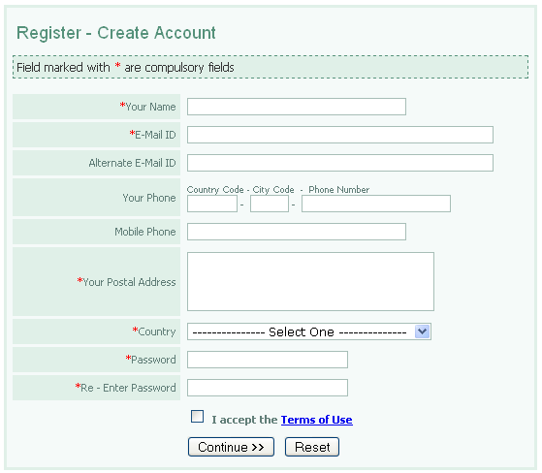
HTML-FORMS

Slide 11
HTML Forms
Used to send data back to the server to be processed.
<form></form>
Contains:
control elements that get data from the user
label elements
Attributes:
action url of page where data is sent
method GET/POST http request method

Slide 12
Form - controls
Controls must have name and value attributes to be submitted.
Controls can be disabled using disabled attribute.
Each control has an initial value and a current value.

Slide 13
Form- Control Types
Buttons:
To submit form:
<input type=“submit” />
<button type=“submit”></button>
To reset form:
<input type=“reset” />
<button type=“reset”></button>
Just a button with no default behavior
<input type=“button” />
<button type=“button”></button>

Slide 14
Form- Control Types
Checkboxes:
On/off switches
More than one can share the same name to allow to select several values
Checked attribute is set to make initial value “on”
<input type=“checkbox”/>

Slide 15
Form- Control Types
TextBox:
Single line text input
<input type=“text”/>
Password: Similar to TextBox, but input text is rendered as a series of asterisks or similar characters
But submitted as plain clear text
<input type=“password” />

Slide 16
Form- Control Types
RadioButtons:
On/off switches but are mutually exclusive
More than one share the same name to create a mutually exclusive group
Checked attribute is set to make initial value “on”
<input type=“radio”/>

Slide 17
Form- Control Types
DropDown Lists/Menus:
To choose one/more from multiple options
<select name=“……”></select>
To select multiple options use multiple attribute
<select name=“……” multiple></select>
To define items use
<option></option>
Option can have name, value and selected attributes

Slide 18
Form- Control Types
DropDown Lists/Menus:
To logically group options use optgroup
<optgroup label=“…..”></optgroup>
http://www.w3schools.com/tags/tryit.asp?filename=tryhtml_optgroup
Label attribute is the value that appears in the list

Slide 19
Form- Control Types
File select:
Allow users to select files to be submitted to a form
<input type=“file” />

Slide 20
Form- Control Types
Hidden controls:
Not rendered visually
Values are submitted with the other form data
Can help overcome stateless nature of HTTP
<hidden name=“… ” value=“… ” />

Slide 21
Form- Control Types
Textarea controls:
Multiline text input
Value is the content nested in the control
<textarea>Content </textarea>
Has rows and cols attributes to set size of textarea.

Slide 22
Form- Control Types
Label
Specify a label for controls that don‟t have an implicit label
For attribute MUST match ID value of the control attached to it
Useful for speech synthesizers readers
<label for=“fname”>First Name :</label>
<input type=“text” id=“fname”/>

Slide 23
Structuring Form
Use <fieldset> and <legend> to group related controls and labels

Slide 24
Block vs. Inline Elements
Inline | Block
No newlines before or after it | Newlines appears before and after it.
Page flow is not broken
Has no width and height | Can have a width and height
Takes as much width of the page as the content | Takes the whole page width
Can contain only inline elements | Can contain inline or block elements
Examples:<span>, <a>, <img >, <b>, <em>,<input> | Examples:<p>, <div>

Slide 25
CSS coming up...

Slide 26
CSS
Cascade Style Sheets (CSS)
Cascading = styling rules "cascade“
From parent tags to child tags
Rules can override others
Style = style
Sheet = file

Slide 27
Basic CSS Structure
( tag name/class/id)
{
(rule);
(rule);
...
}

Slide 28
CSS Rules Syntax
Example
Body { background-color:blue;
color:white;
font-size:24pt;
property1: value1;
property2: value2;
}
p { property: value3; color:yellow;
}
http://w3schools.com/css/css_examples.asp

Slide 29
Where to add CSS?
Inline style attribute
Applied to a single element
<p style=“color : pink ; font-size : 30pt ;”
In <head> Applied to an entire single page
<head>
<style> body{ font-family : arial ;
background-color : black ;
color : white ; }
p { color : pink ; }
</style>
</head>

Slide 30
Where to add CSS?
In external sheet (.css)
Applied to any html file linked to it
<head>
<link rel=“stylesheet” type=“text/css”
href=“style.css” />
</head>

Slide 31
CSS Selectors
Simple Selectors
element, class, ID
Select by name of element (h1, p, div, span, …..etc. Example: p { font-size:20pt; }
Group Selectors coma-separated list of selectors

Slide 32
Class Selector
Select an element by the class attributes defined in it
Class is an attribute of most html elements, specifies one or more class names (space-separated list)
Example: .maincontent /*select any element with class=“maincontent” */
H1.headerTitle { font-size : 20pt; } /*select the all h1 with class=“headerTitle” */
.x { color : red; }

Slide 33
ID Selector
Select an element by the ID attributes defined in it
ID is an attribute of all html elements, it must be unique throughout a certain html page
Example: #maincontent /*select the element with id=“maincontent” */ { font-size : 20pt; } h1#headerTitle /*select the only h1 with id=“headerTitle” */
#x { color : red; }

Slide 34
Colors
#-hexadecimal
rgb() and rgba()
hsl() and hsla()
To get full list of color keywords:
https://developer.mozilla.org/en-docs/css/color _ value
http://www.colorcombos.com

Slide 35
Units in CSS
pixel (px) absolute value
em: ratio of context size
percentage: percentage of context size

Slide 36
CSS Text Formatting
color: name|#hex|rgb()|rgba()|hsl()|hsla(); /*foreground color*/
letter-spacing: normal|length (px,%,em);
line-height: normal|number|length|percentage;
text-align: left|right|center|justify;
text-decoration: none|underline|overline|line-through|blink;

Slide 37
CSS Text Formatting
text-indent: length|percentage;
text-transform: capitalize|uppercase|lowercase|none;
text-shadow: rightpx bottompx blurpx color;
direction: ltr | rtl; text-indent: length|percentage;
text-transform: capitalize|uppercase|lowercase|none;
text-shadow: rightpx bottompx blurpx color;
direction: ltr | rtl;

Slide 38
CSS Font
font-family :list of fontnames to chose from
font-style: normal|italic|obliquefont-variant: normal|small-caps
font: font-family font-size font-weight font-style font-variant

Slide 39
Background formatting
background-attachment : scroll | fixed;
background-color : color;
background-image : none/url(path);
background-position: percent|length|(top left
right bottom center)
background-repeat: repeat | repeat-x|
|repeat-y|no-repeat
background-size: length|percentage|

Slide 40
References
http://www.w3.org/TR/html401/ http://www.w3.org/TR/CSS21/
http://www.w3.org/TR/CSS2/ https://developer.mozilla.org/en-US/docs/CSS http://alistapart.com/articles/howtosizetextincss

