Slide 1
INTRODUCTION
There is around the 300k defense force in Bangladesh. So the database of this force would be huge. In this project, we just work with this huge amount of data and show the data to another soldier to minimize ways.

Slide 2
FEATURE’S
Soldiers can send an application for leave;
They can create their own password;
Soldiers are easily operating this database;
If the soldiers want to chat with admin they can;
They can get the notification for their approval;
They will also get Payment notification (upcoming);

Slide 3
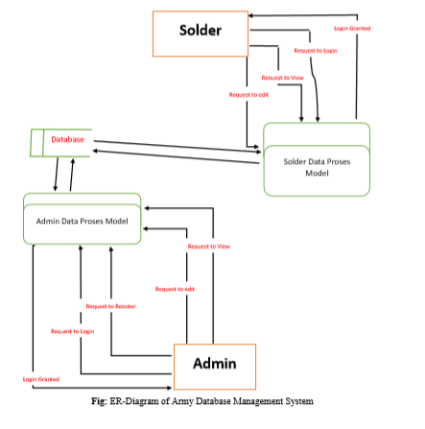
DATA FLOW DIAGRAM(DFD)

Slide 4
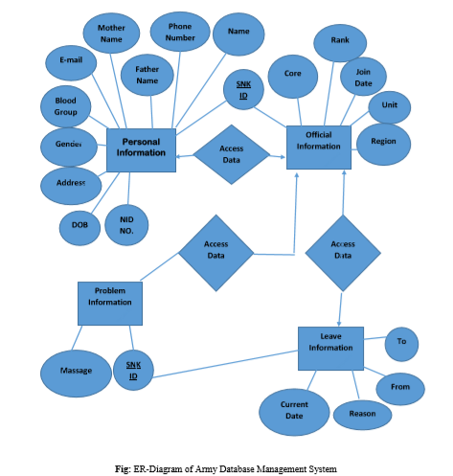
E-R DIAGRAM

Slide 5
SOME DEMO OF OUR PROJECT

Slide 6
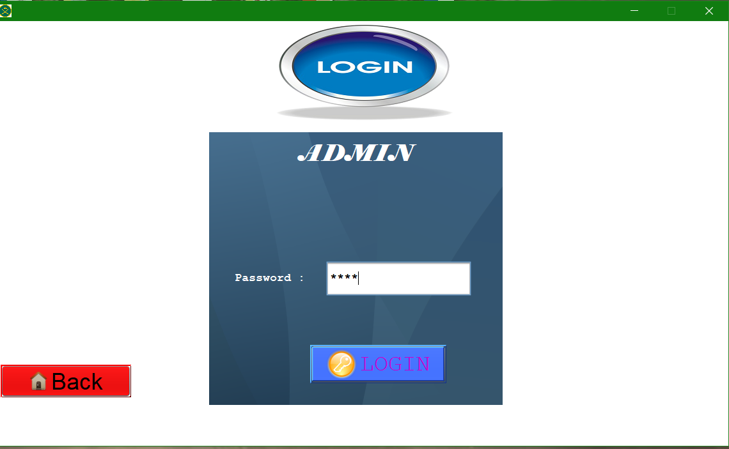
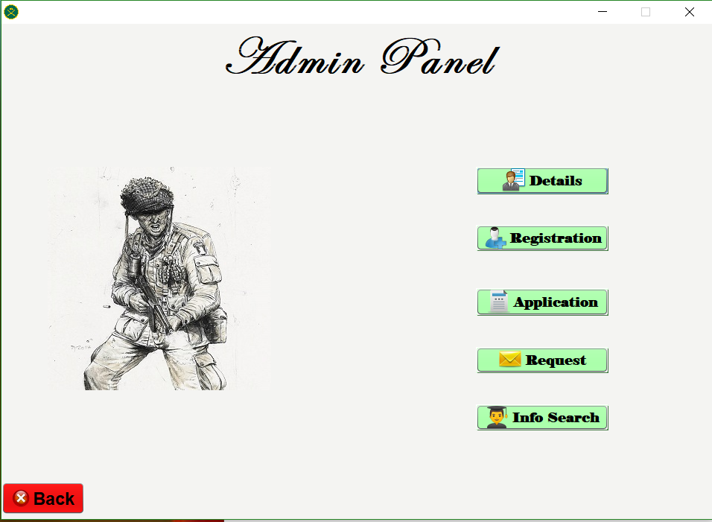

Slide 7
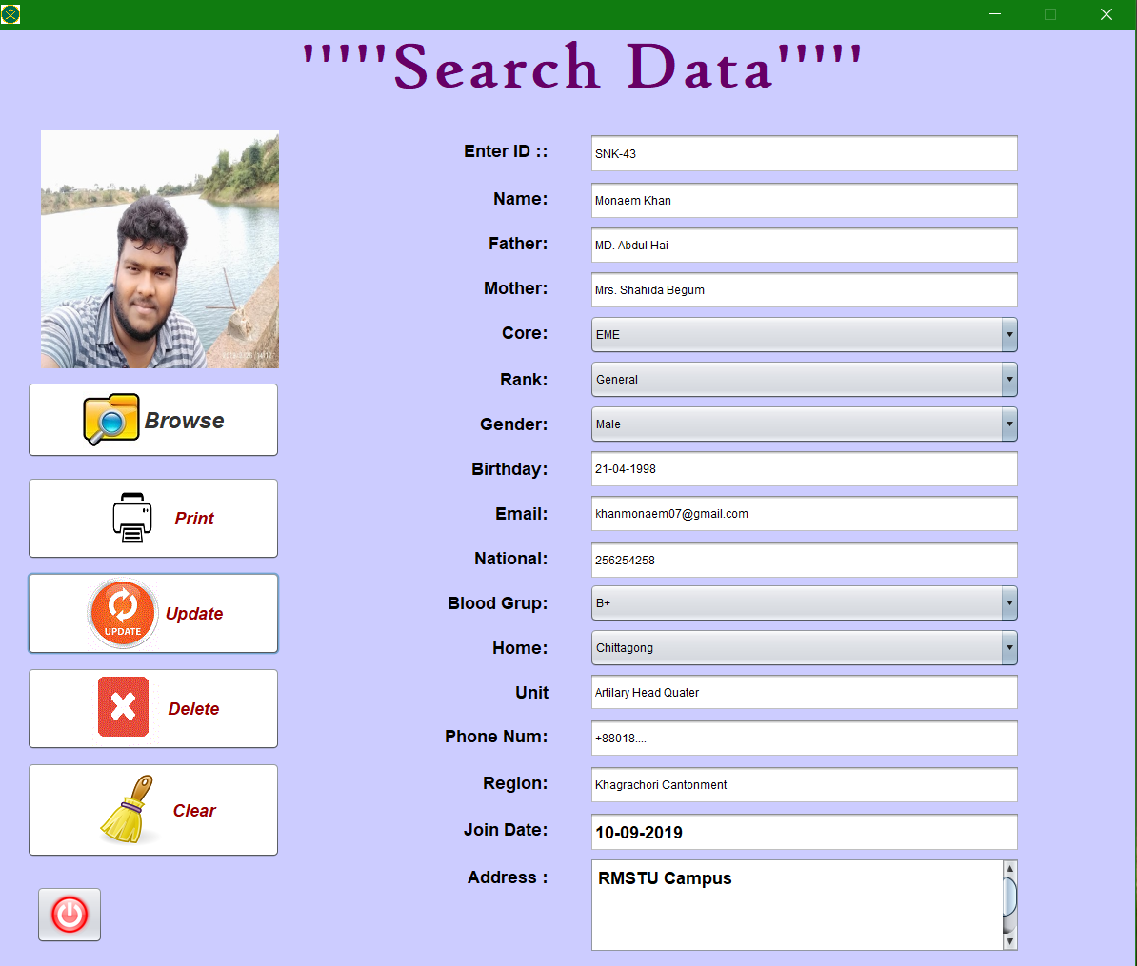
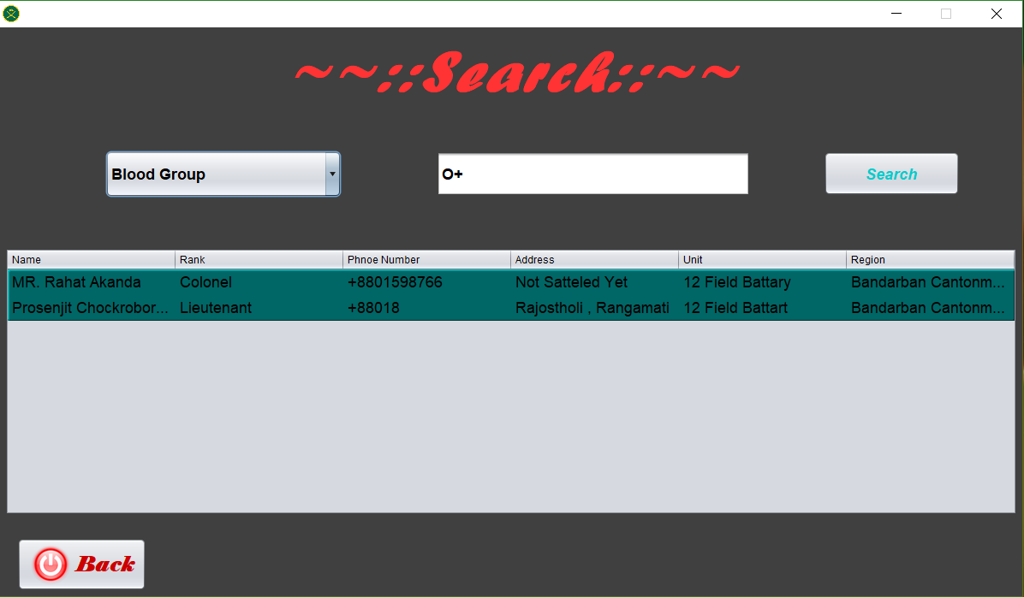

Slide 8
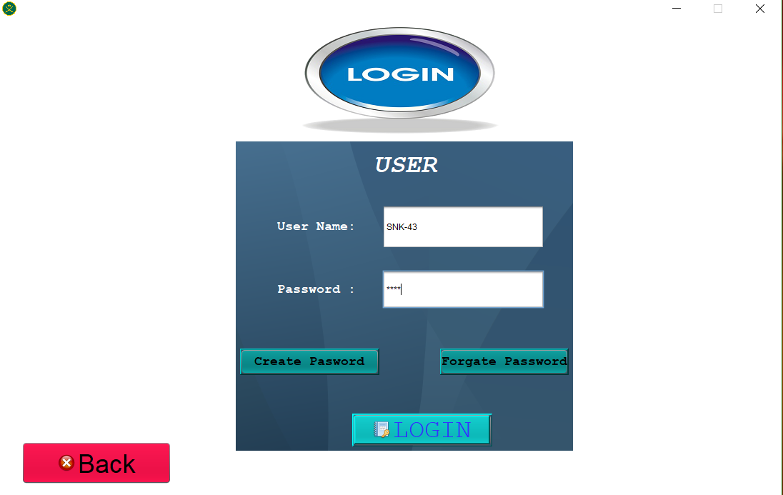
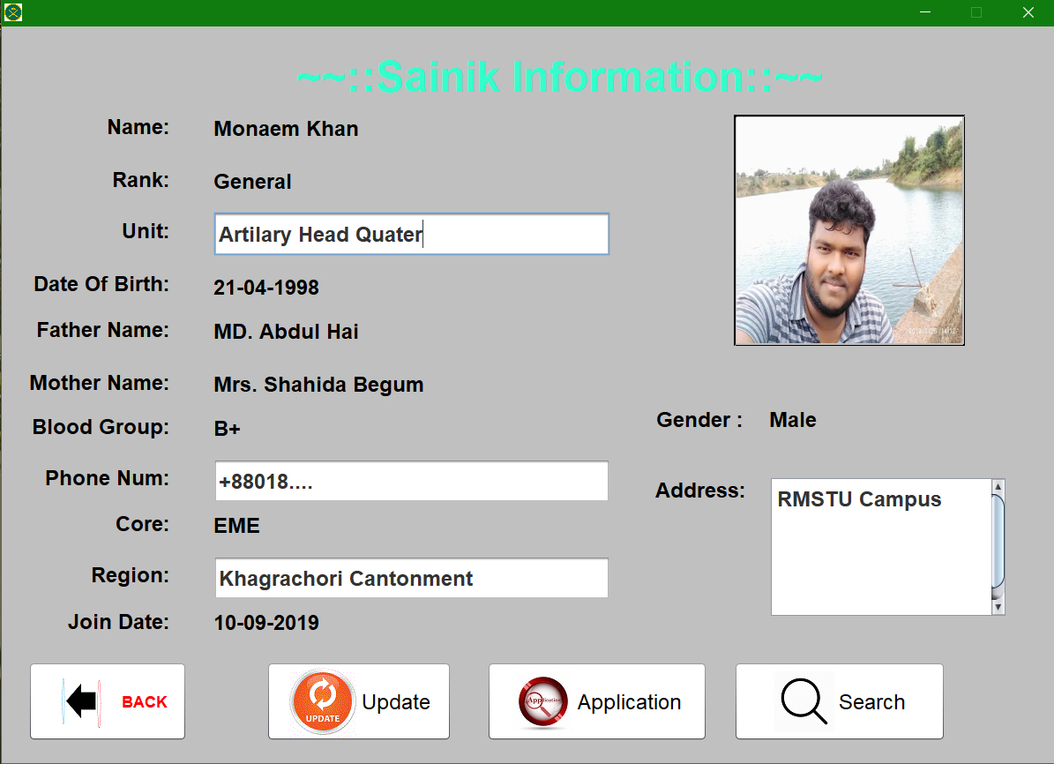

Slide 9
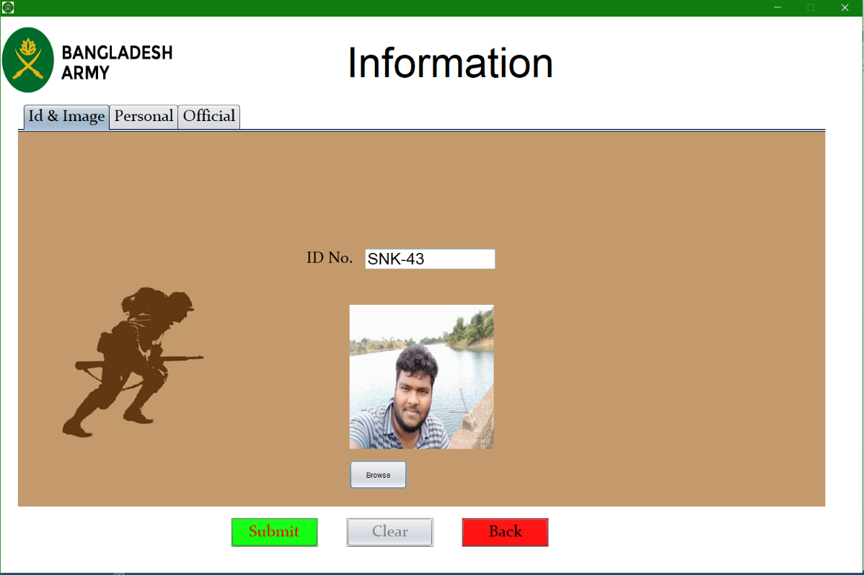
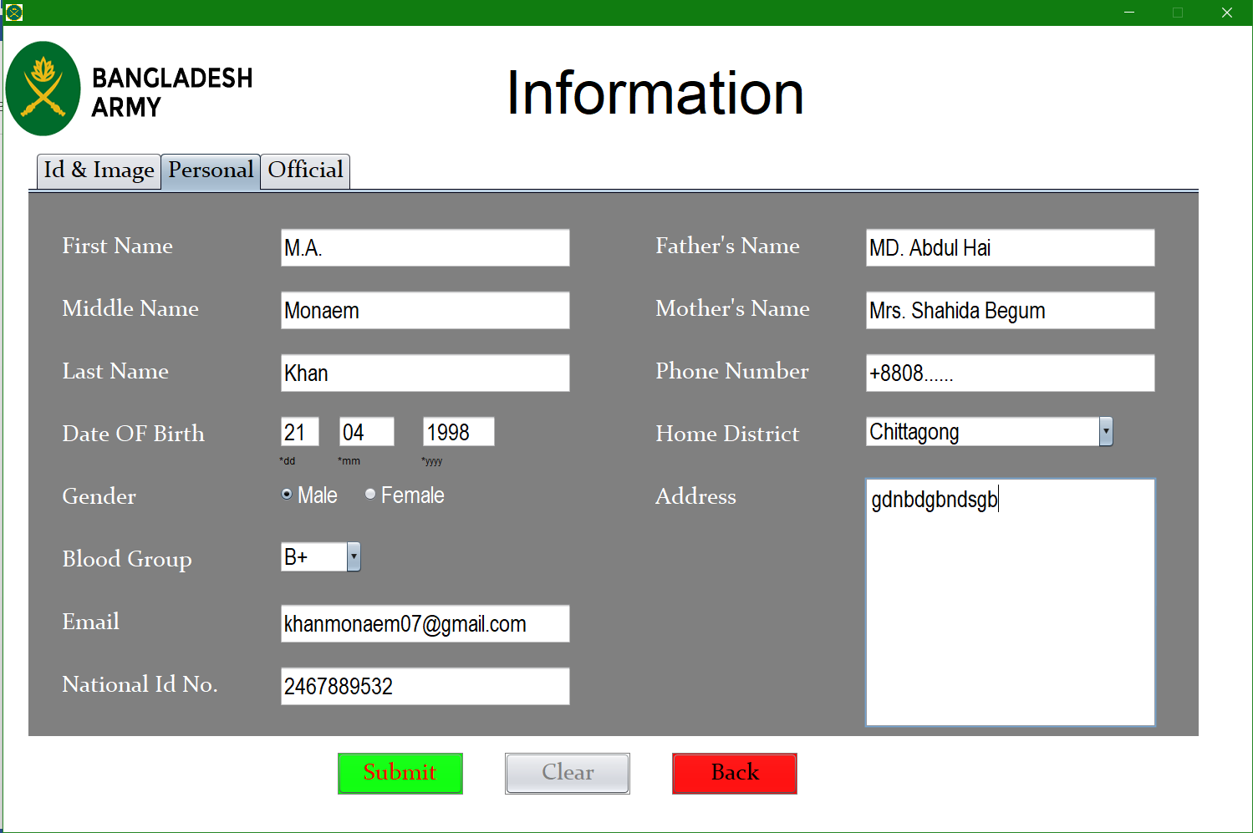
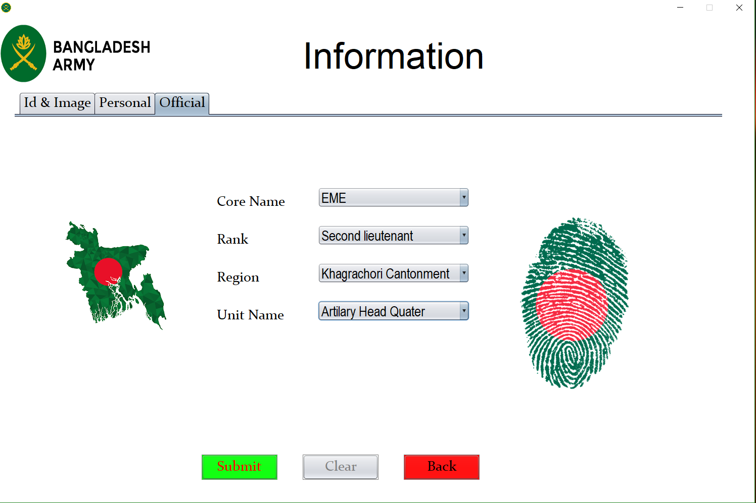

Slide 10
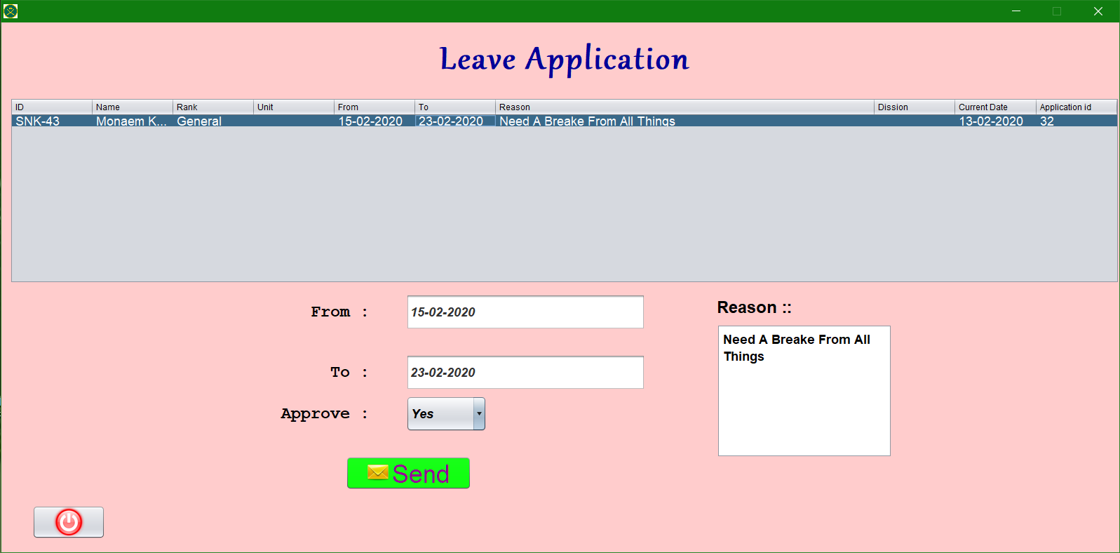
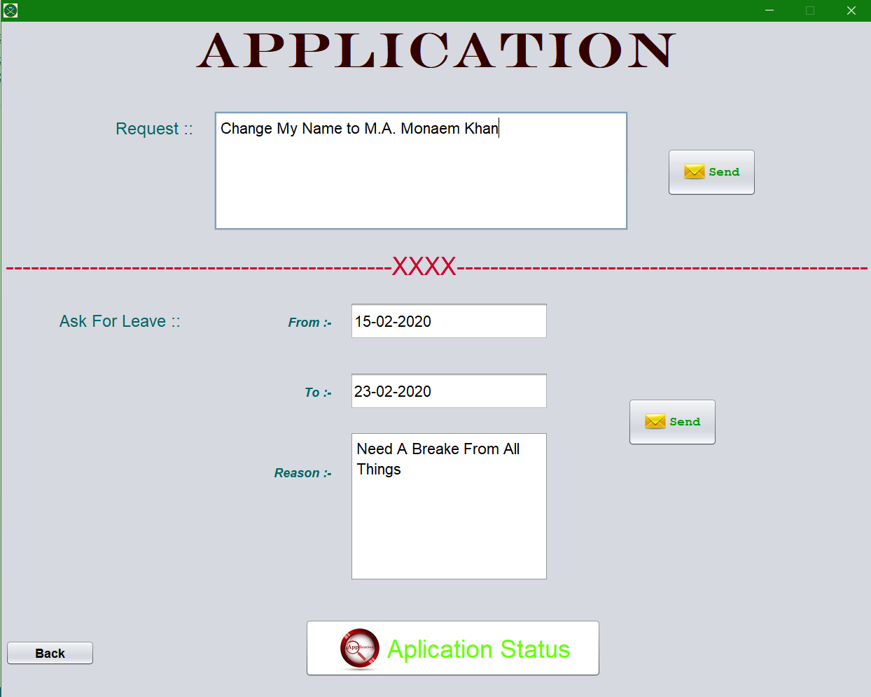
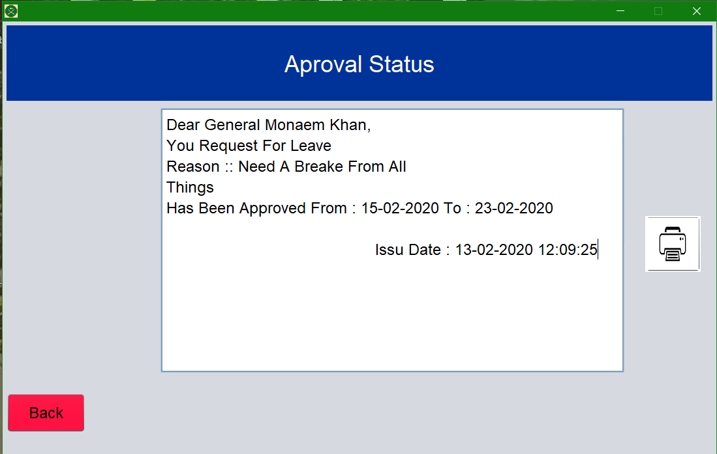

Slide 11
THANK YOU…!

