Slide 1

School of Computing Science & Engineering
Topic-Agricultural Production Optimization
Team Introduction \
Name1-Ashutosh Rana
(20SCSE1010802)
SEM-7
Name2-Monal Raj Singh
(20SCSE1010821)
SEM-7
Project Guide Name:
Mr . Ajay Shankar
Program Name: B.Tech(4th Year)

Slide 2
TOPIC COVER
Introduction
Objectives
Proposed System
KNN(K-Nearest Neighbor) Algorithm
System Architecture
Limitations

Slide 3
Introduction
What is Agricultural Production Optimization?
Agriculture is the best utility region especially inside the developing worldwide areas like India. Usage of records age in agriculture can substitute the circumstance of decision making and Farmers can yield in higher manner. About portion of the number of inhabitants in India relies upon on farming for its occupation however its commitment towards the GDP of India is just 18 percent.One suitable explanation behind this is the deficiency of adequate decision making by farmers on yield prediction. There isn’t any framework in location to suggest farmer what plants to grow. The proposed machine learning approach aims at predicting the best yielded crop for our country by analyzing various factors like rainfall, soil pH and past records of crops grown.

Slide 4
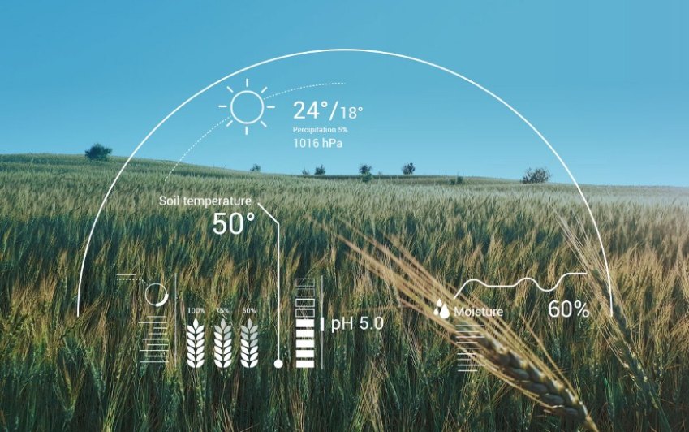
Objectives
1. To use machine learning technique to predict crop yield.
2. To provide easy to use user interface and optimize agricultural production.
3. To increase the accuracy of crop yield prediction.
4. To analyze different parameters for predicting a crop.

Slide 5
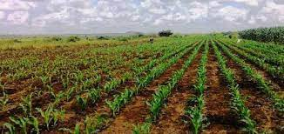
Proposed System
The system aims to help farmers to cultivate proper crop for better yield production. To be precise and accurate in predicting crops, the project analyzes the nutrients present in the soil and the crop productivity based on location. It can be achieved using unsupervised and supervised learning algorithms. A machine learning model is developed considering the various, different sets of data to obtain the output. The system takes input from various sources and uses KNN algorithm to predict the best suitable crop for any given area. The developed user interface is flexible and highly interactive which will encourage the farmers to use it frequently.

Slide 6
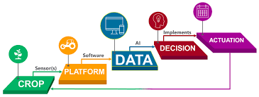
KNN(K-Nearest Neighbor)
K-nearest neighbor method can be used for both regression and classification predictive problems. This method helps in interpret
output, calculate time and predictive power. The Machine learning techniques are used in various fields. KNN is also one of the machine learning methods. This is also called as method of sample-based learning. This will contain the data of past datasets and can be used while predicting the new datasets. This will apply function called as distance function like Manhattan or Euclidean distance. This can be used to compute distance from samples to all other training samples. It calculates the target value for new samples. The target vale will be the weighted sum of target values of the k nearest neighbors. The valve of K can be directly proportional to the prediction. Whenever the valve of K is small this indicates there is high variance and there is low bias. If the value of the K is larger than this indicates that there is low variance and high bias. The main advantage of this KNN is it does not require any training or the optimization. This KNN uses data samples when predicting the new datasets. Hence it is having higher
complexity and also more time consumption.

Slide 7

Limitations
There are some limitations to this project which can be worked upon in the future. Some of them are as follows:
1. Choosing appropriate dataset, after choosing dataset tuning of the parameters which makes project more efficient to get the desired results.
2. Crop genotype and environmental factors changing spatially and temporally makes the yield prediction more challenging.

Slide 8
THANK YOU
THANK YOU

