Slide 1



Telecom Project

Slide 2

Strive not to be a success, but rather to be of value. Albert Einstein

Slide 3

Agenda
InsaidianTelecom
Problem Statement
Data Description
Data Processing
EDA
Story Board
Summary
Actionable Insights

Slide 4

Telecom
InsaidTelecom, one of the leading telecom players, understands that customizing offering is very important for its business to stay competitive
Currently, InsaidTelecom is seeking to leverage behavioral data from more than 60% of the 50 million mobile devices active daily in India
To help its clients better understand and interact with their audiences

Slide 5

Problem Statement
In this consulting assignment, Insaidians are expected to build a dashboard to understand user’s demographic characteristics based on their
mobile usage
geolocation
mobile device properties
Doing so will help millions of developers and Telecom brand advertisers around the world pursue data-driven marketing efforts which are relevant to their users and catered to their preferences

Slide 6

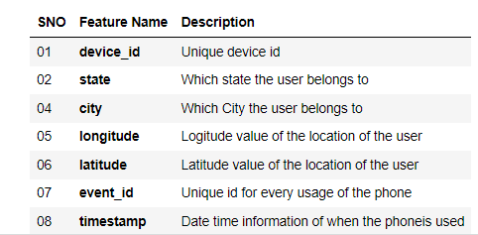
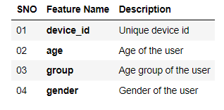
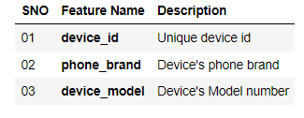
Data Description

Slide 7
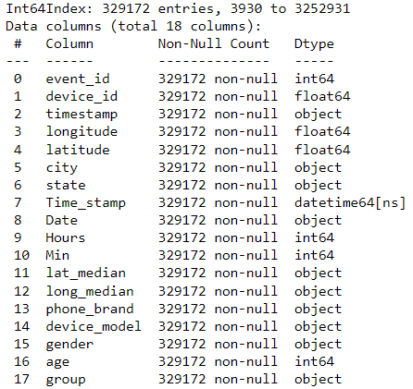
Data Processing
Replacing null values of state
Converting time stamp to date/hour/minute
Group the city data with date and fill the nan values of device_id, latitude, longitude with forward or backward fill
Converting device_id feature of phone_brand and gender_age to float
Merging of all dataframes using inner join on device_id

Slide 8
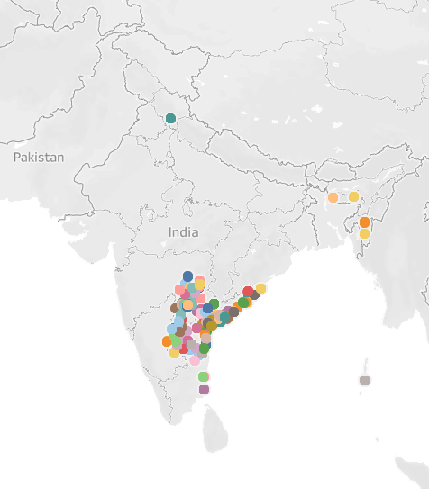
Focussing states distribution
Himachal Pradesh
Meghalaya
Mizoram
Andhra Pradesh
Andaman Nicobar
Pondichery

Slide 9
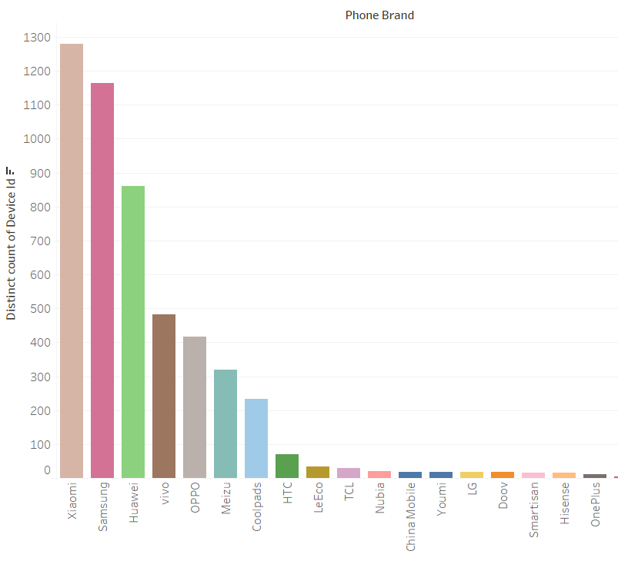
Phone brand distribution
Top 5 brand
Xiaomi
Samsung
Huawei
Vivo
OPPO

Slide 10
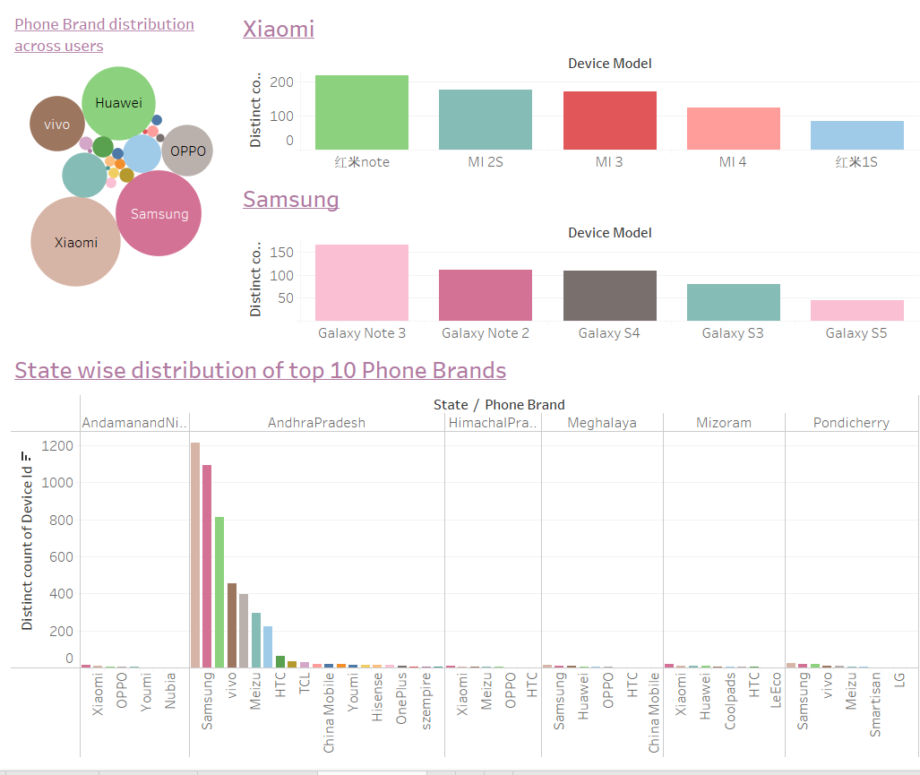
Xiaomi is most used to AndraPradesh, Meghalaya and Pondicherry
Samsung is a major player in Andaman Nicobar, Himachal and Mizoram
Huawei’s ranking is 3rd in most of the states

Slide 11
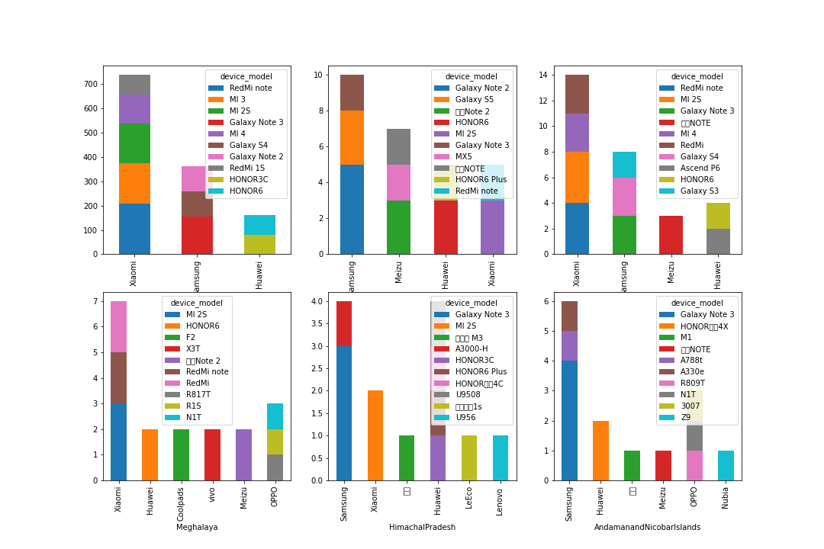

State wise distribution of models for top brands

Slide 12
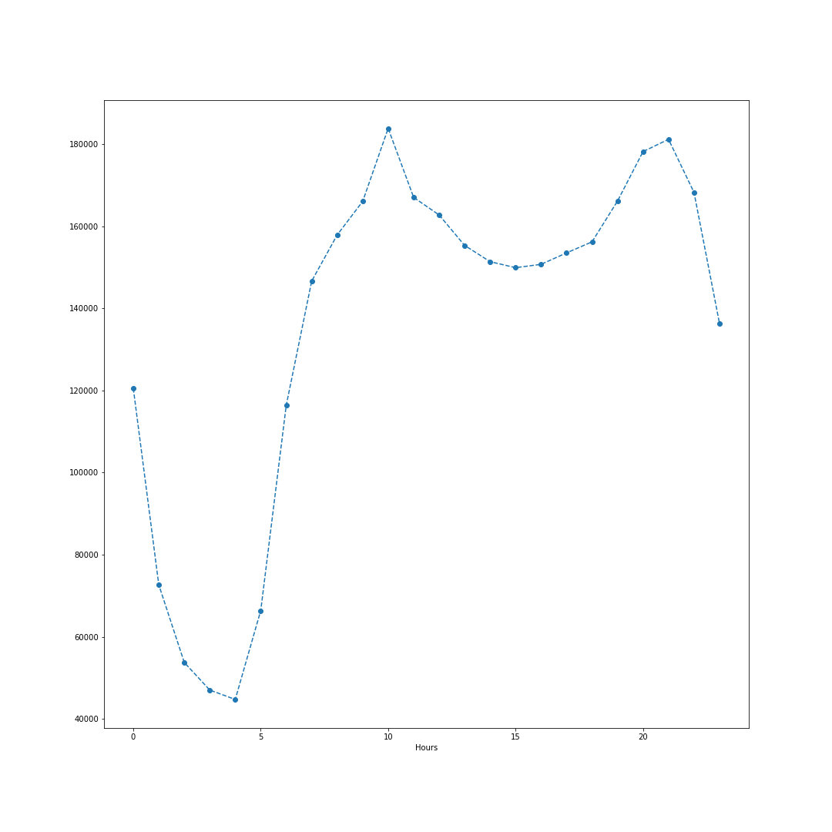
Hourly usage of devices for the whole data

Slide 13
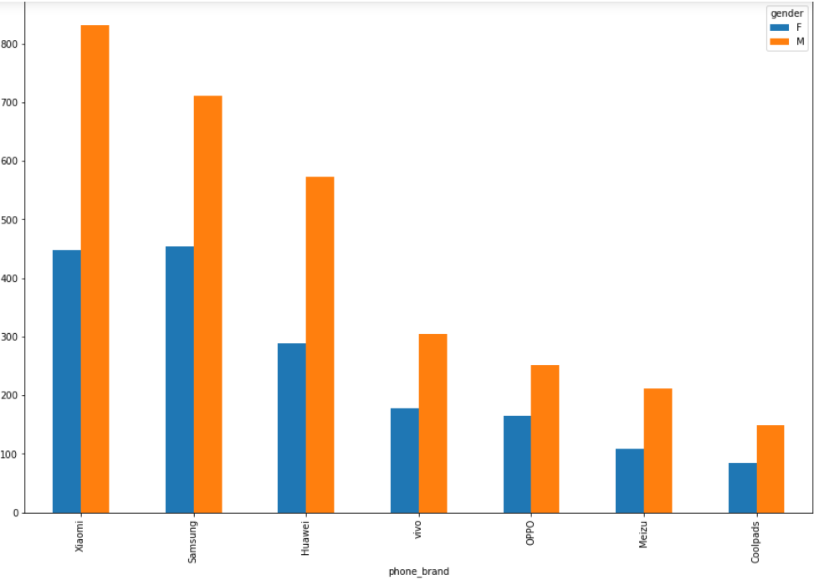
Gender wise distribution for brands:
In Males users, Xiaomi is most preferred than Samsung and Huawei
In Females users, Samsung and Xiaomi are equally popular

Slide 14
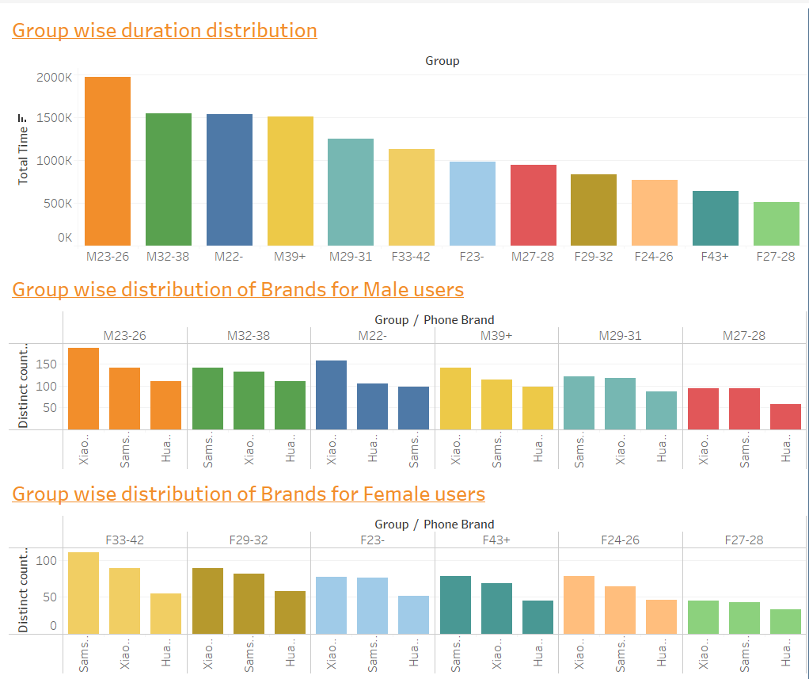
Age group distribution:
Male users are more than Female
Maximum Phone usage is done by Male 23-26
In Females, maximum usage is done by 33-42
Male group distribution:
Most of them use Xiaomi more, except 29-31(Samsung)
Female group distribution:
33-42 and 43+ prefer Samsung over Xiaomi

Slide 15
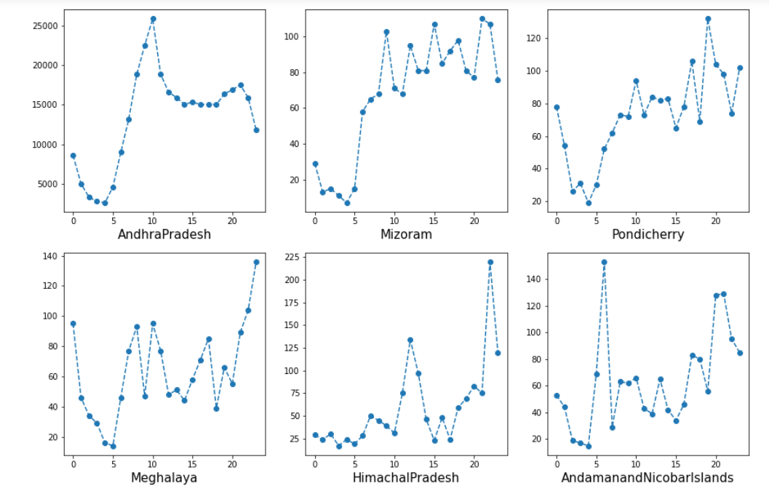
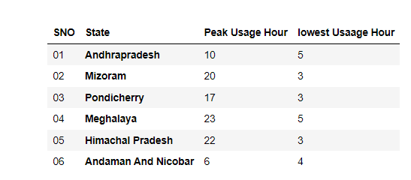
Usage Duration

Slide 16

Summary
Xiaomi has captured Maximum market; main reason can be they are cheaper than Samsung
Samsung and Huawei are making their way to become top but if Samsung wants to beat Xiaomi, it needs to find a way to reduce cost
Brands like OPPO and Vivo need to produce a unique technology at the same time sell at a comparable price as Xiaomi to capture more customers
AndhraPradesh has a greater number of device
Number of Male user are more compared to Female users in all the states
In the state Himachal Pradesh and Andaman and Nicobar users for the mobiles are in the same age group of 23 to 32 and 22 to28 respectively
Whereas there is a huge variation of mobile usage between male and female in state Mizoram, AndhraPrasedh, Meghalaya, Pondicherry
Redmi, Galaxy models from Xiomi and Samsung are the most used models
Peak usage of devices is observed at 10 and 20 hours
Low usage of devices is observed at 3

Slide 17


Actionable Insights
Samsung must try to reduce the cost
Brands must try to understand demand of Indian people
Most import features:
Qualcomm Snapdragon Octa core processor
Long lasting battery life
Awesome camera in a low mid range price segment
One specific feature which separates Redmi from the other brands is their IR blaster sensor
All brands must target age group 31 to 40 which has maximum users
Female users can be targeted by giving special discounts and offers

