Slide 1
scBasset: Sequence-based Modeling Of Single Cell ATAC-seq Using Convolutional Neural Networks
Paper Presentation On
Course – Deep Learning with Medical Informatics (CS 895)
By – Monalika Padma Reddy

Slide 2
INTRODUCTION
Single Cell ATAC-Seq (scATAC-Seq) –
Based on transposase-mediated insertion of sequencing primers into open chromatin regions.
Allows for the identification of genomic regions that are open/accessible at single cell resolution
Identify variations in chromatin accessibility between cell subpopulations within a single sample
Challenges in the analysis of scATAC data –
High dimensionality of accessible peaks
Sparsity of sequencing reads per cell.

Slide 3
EXISTING APPROCHES
Sequence-free
PCA and LSI –
perform a linear transformation of the peak-by cell matrix to project the cells to a low-dimensional space
SCALE and cisTopic –
model the generative process of the data distribution using variational autoencoder
Detect biologically meaningful covariance to effectively represent and cluster or classify cells.
Limitations –
Ignore sequence information
Rely on post-hoc motif matching tools to relate accessibility to transcription factors (TFs)
Sequence dependent
Represent peaks by their TF motif or k-mer content
Aggregate these features across peaks or other regions of interest to learn cell representations
Example – chromVAR, BROCKMAN
Limitations –
Perform worse in learning cell representations due to the loss of information – model simplicity relating sequence to accessibility through position weight matrices
Notes:
JFGKDFGJDK

Slide 4
APPROACH OF THE PAPER
Sequence-dependent model based mainly on deep CNNs is proposed
Deep CNNs are specifically parameterized to take advantage of known spatial structure. To learn the DNA sequence signals of open versus closed chromatin in these cells, a deep CNN is applied
Used to model ATAC data
CNNs predict the peaks from bulk chromatin profiling assays
Explicit embeddings of the sequences underlying peaks are computed using the convolution layers
Basset architecture is extended to predict the single cell chromatin accessibility from sequences
Outperforms the state-of-the-art methods for cell representation learning, single cell accessibility denoising and so on

Slide 5
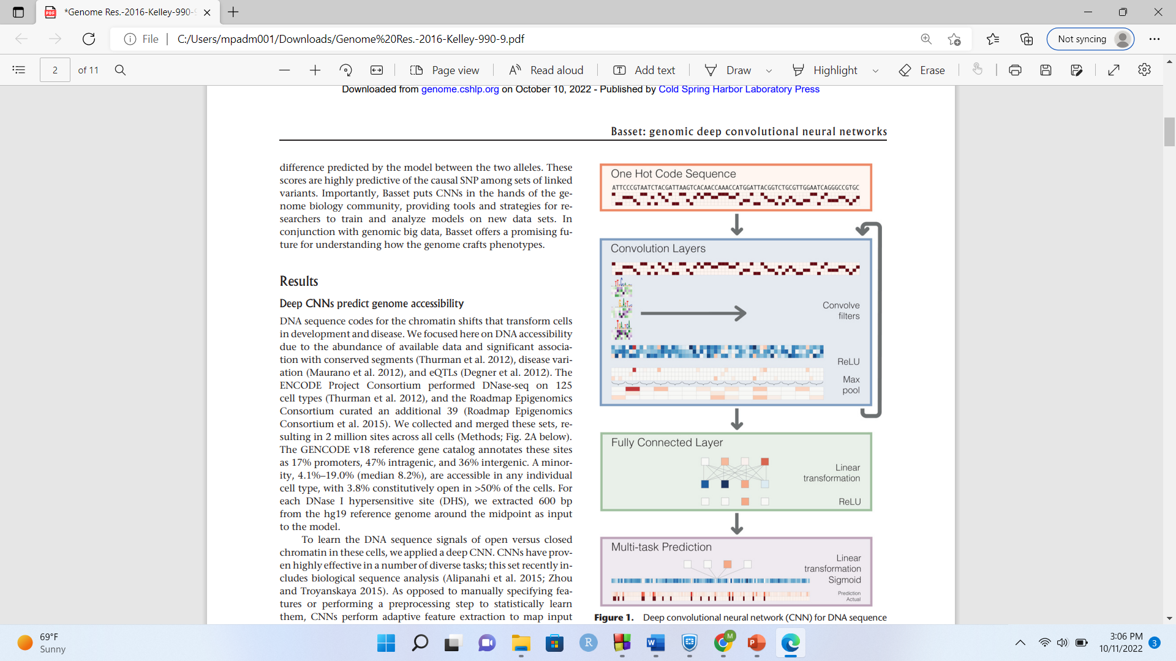
BASSET ARCHITECTURE
Input - For each site include its 600-bp DNA sequence and a binary vector to indicate the presence of a significant peak in each of the 164 cell types
Convert the sequence to a one hot code representation
Convolution Layers –
For DNA sequences, the initial convolution layer corresponds to optimizing the weights of a set of position weight matrices
Position Weight Matrix (PWM) - Commonly used representation of motifs (patterns) in biological sequences.
Row corresponds to one symbol of the alphabet, e.g., amino acids or nucleic acid
Column corresponds to one position in the pattern
PWM filters search for the motifs along the sequence and output a matrix with a row for every filter and column for every position in the sequence.
Rectified Linear Unit (ReLU) - nonlinear transformation
Pooling –
Reduce dimensions and computation required for training
Achieve invariance to small shifts

Slide 6
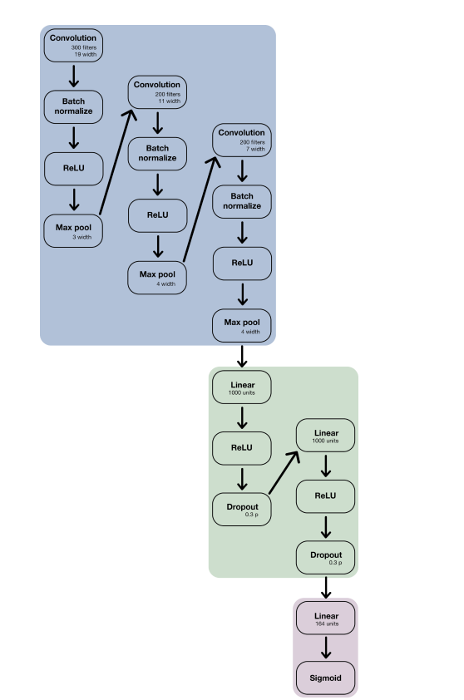
conv_filters 300 weight_norm 7
conv_filters 200 Momentum 0.98
conv_filters 200
conv_filter_sizes 19
conv_filter_sizes 11
conv_filter_sizes 7
pool_width 3
pool_width 4
pool_width 4
hidden_units 1000
hidden_units 1000
hidden_dropouts 0.3
hidden_dropouts 0.3
learning_rate 0.002
Batch Normalization –
Used for making the training of Deep Neural Networks (DNN) faster and more stable.
Dropout Layer –
Nullifies the contribution of some neurons towards the next layer and leaves unmodified all others
Prevents overfitting on the training data
Two fully connected artificial neural network hidden layers
Linear transformation of the matrix into vector (164 elements)
Output - 164 outputs, repesenting the predicted probability of accessibility in each cell type

Slide 7
scBASSET ARCHITECTURE
Predicts binary accessibility vectors for each peak based on its DNA sequence.
Dataset and Preprocessing –
scATAC-seq preprocessing
The count matrix and peak atlas files for the Buenrostro2018 dataset from GEO (Accession GSE96769)
Peaks accessible in less than 1% cells were filtered out.
The final dataset contains 126,719 peaks and 2,034 cells.
10x multiome datasets from 10x Genomics for mouse brain cells.
Genes expressed in less than 5% cells; peaks accessible in less than 5% cells were filtered out.
scRNA-seq preprocessing
For 10x multiome dataset, expression data was processed with scVI version 0.6.5 with n layers=1, n hidden=768, latent=64 and a dropout rate of 0.2
To generate denoised expression profiles, get_sample_scale() is used to sample from the generative model 10 times and take the average
Input -
1344 bp DNA sequence from each peak’s center and one-hot encodes it as a 1344×4 matrix.

Slide 8
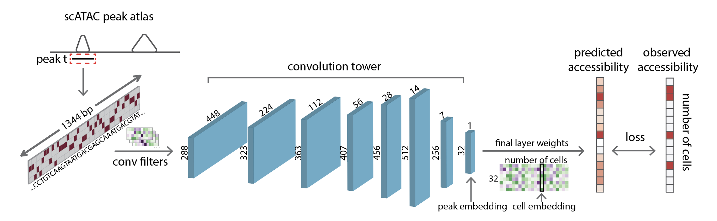
1D convolution layer –
288 filters of size 17×4, followed by batch normalization, Gaussian error linear unit (GELU), and max pooling (3x3) layers,
Output matrix - 488×288
Convolution tower of 6 convolution blocks -
The convolution layers have increasing numbers of filters (288, 323, 363, 407, 456, 512) and kernel width 5.
Output matrix- 14×512.
1D convolution layer -
256 filters with kernel width 1, followed by batch normalization and GELU.
Output matrix -7×256.

Slide 9
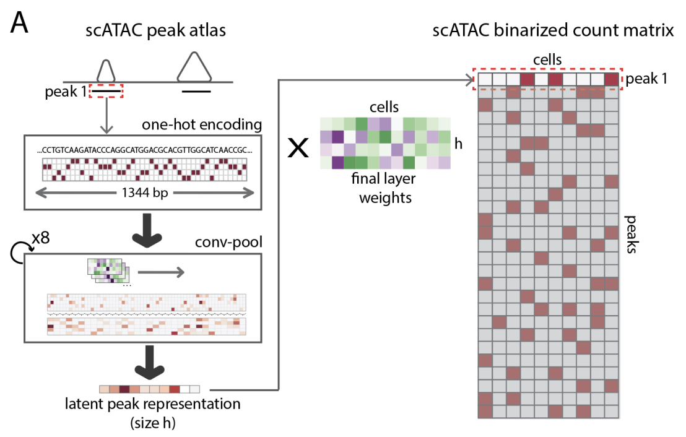
Flattened into a 1×1792 vector.
Dense bottleneck layer - Used to learn low-dimensional representations of the single cells
32 units, followed by batch normalization, dropout (rate=0.2), and GELU.
Output matrix - 1×32 compact peak representation vector
h×cell weight matrix connects bottleneck layer to the predictions
Output - Final dense layer predicting continuous accessibility logits for the peaks in every cell.
Final sigmoid activation to [0,1] accessibility probability.
The total number of trainable parameters in the model is a function of the number of cells in the dataset.
Number of trainable parameters - 4513960+33×n

Slide 10
Model parameters updated using stochastic gradient descent, Adam optimizer
Random search for optimal hyperparameters - batch size, learning rate, beta1, and beta2 for the Adam optimizer.
Best model performance - batch size of 128, learning rate of 0.01, beta 1 of 0.95, and beta 2 of 0.9995, bottleneck size – 32
scBasset - Trained to predict individual cell accessibility from the DNA sequence underlying ATAC peaks
Vector embedding learned to represent the single cells in the process
Advantages of the model –
Output can be used as denoised accessibility profiles, which improves concordance with RNA measurements.
Learns to recognize TF motifs and their influence on accessibility
In silico experiment designed to inject motifs into background sequences to query for TF motif activity in single cells.
Can be applied to predict the influence of mutations
Achieves better performance at learning cell embeddings and inferring TF activity
scBasset benefits from a more expressive CNN model
Learns more sophisticated sequence features, including non-linear relationships.
Achieves better performance in benchmarking tasks and delivers a more interpretable model
can be directly queried for TF activity or identifying regulatory sequences.

Slide 11
RESULTS

Slide 12
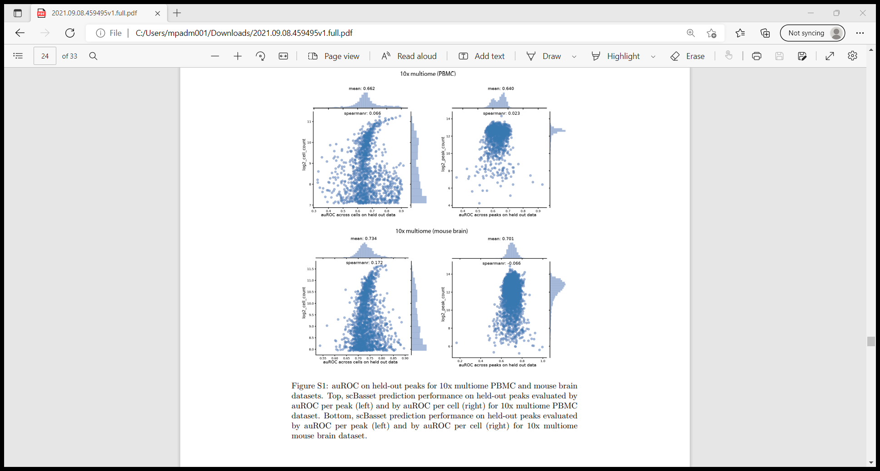
scBasset predicts single cell chromatin accessibility on held-out peaks
scBasset applied on three public datasets:
Buenrostro2018 – provides ground truth cell type labels from flow cytometry
10x Multiome RNA+ATAC PBMC dataset, 10x Multiome RNA+ATAC mouse brain dataset – to validate scATAC methods since they provide independent measurements of gene expression and chromatin accessibility in the same cells
How well scBasset can predict accessibility across cells for held out peak sequences?
To ensure that the model has learned a meaningful relationship between DNA sequence and accessibility using the sparse noisy labels.
Compute the area under the receiver operating characteristic curve (auROC)
across peaks for each cell and averaged across cells (referred to as “per peak”) for held out peaks
across cells for each peak and averaged across peaks (referred to as “per cell”) to evaluate cell type specificity
Accuracy levels of scBasset
Dataset | Per Peak | Per Cell
Buenrostro2018 | 0.734 | 0.740
10x multiome PBMC | 0.662 | 0.640
10x multiome mouse brain | 0.734 | 0.701
In the 10x multiome PBMC and mouse brain datasets, peaks with very high read coverage are easier to predict (Fig.S1).

Slide 13
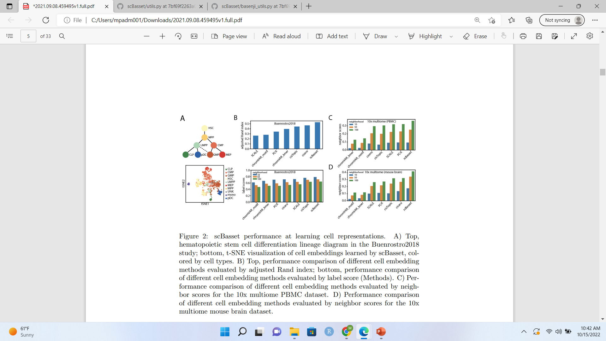
scBasset final layer learns cell representations
h×cell weight matrix connects bottleneck layer to the predictions be used as a low-dimensional representation of the single cells
Buenrostro2018 dataset - visualized the cell embeddings in 2D using t-distributed stochastic neighbor embedding.
differentiation trajectories in the t-SNE space observed.
ARI –
Quantified the correctness of cell embeddings by comparing Louvain clustering results with ground-truth cell type labels using the adjusted rank index (ARI)
Sensitive to the hyperparameter choice and stochasticity in the Louvain algorithm
Label Score –
Alternative method for evaluating cell embeddings.
Computed by building a nearest neighbor graph based on the cell embeddings.
Label scores across a range of neighborhoods computed
scBasset consistently outperforms by learning cell representations that embed cells of the same type near each other
Neighbor Score –
Computed by building independent nearest neighbor graphs from the scRNA and scATAC
Determined percentage of each cell’s neighbors are shared between the two graphs.

Slide 14
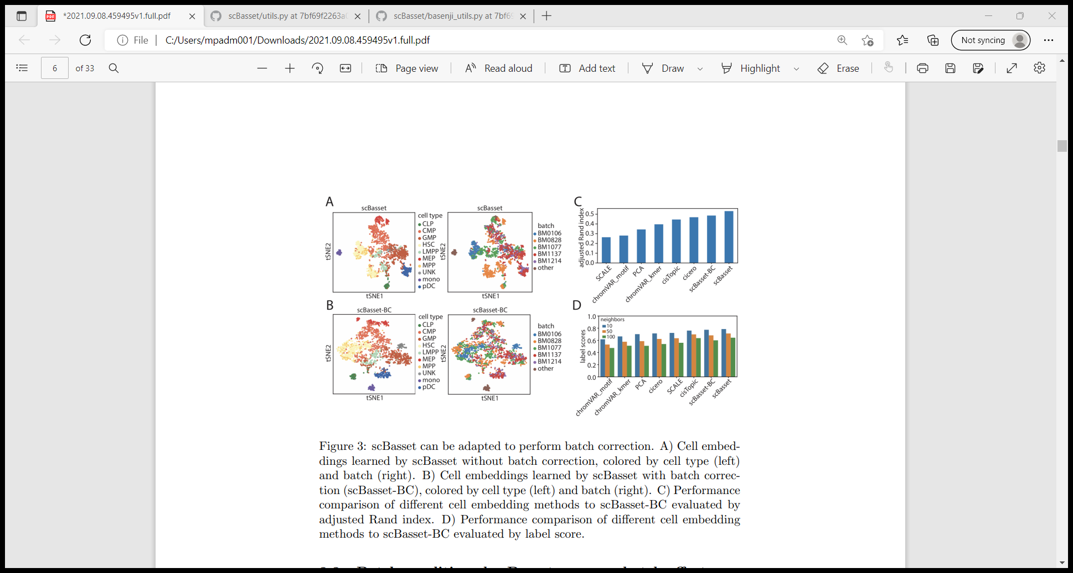
Batch-conditioned scBasset removes batch effects
In the Buenrostro2018 dataset, HSCs cluster into two populations
Caused by a batch effect due to different donors
Modifications to the scBasset architecture -
A second parallel dense layer added to the bottleneck layer to predict batch-specific accessibility.
Batch-specific accessibility is multiplied by the batch-by-cell matrix to compute the batch contribution to accessibility in every cell.
This vector is added to the previous continuous accessibility logits per cell. L2 regularization can be optionally applied to the cell-embedding path or the batch-specific path
Done to tune the contribution of the batch covariate to the predictions.
Output of the batch layer and cell-specific layer is added before computing the final sigmoid
Intuitively, the batch-specific variation would be captured in this path, whereas the original h × cell weight matrix will focus on the remainder of biologically relevant variation
scBasset cell embedding results before and after batch correction is compared
Overall mixing of different batches in the t-SNE space after batch correction is observed
Small decrease in the cluster evaluation metrics after batch correction is observed.
Reason - caused by imbalances in cell type distribution from different donors, which are then learned by the batch layer rather than the cell-specific layer
After batch correction -
Two HSC batches BM0106 and BM0828 merge into one cluster.
pDC cells from BM1137 and BM1214 batches previously fell into two distinct sub-clusters are mixed.

Slide 15
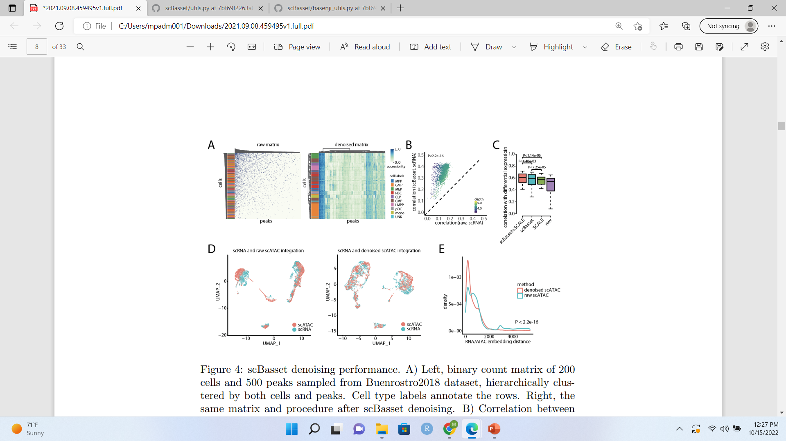
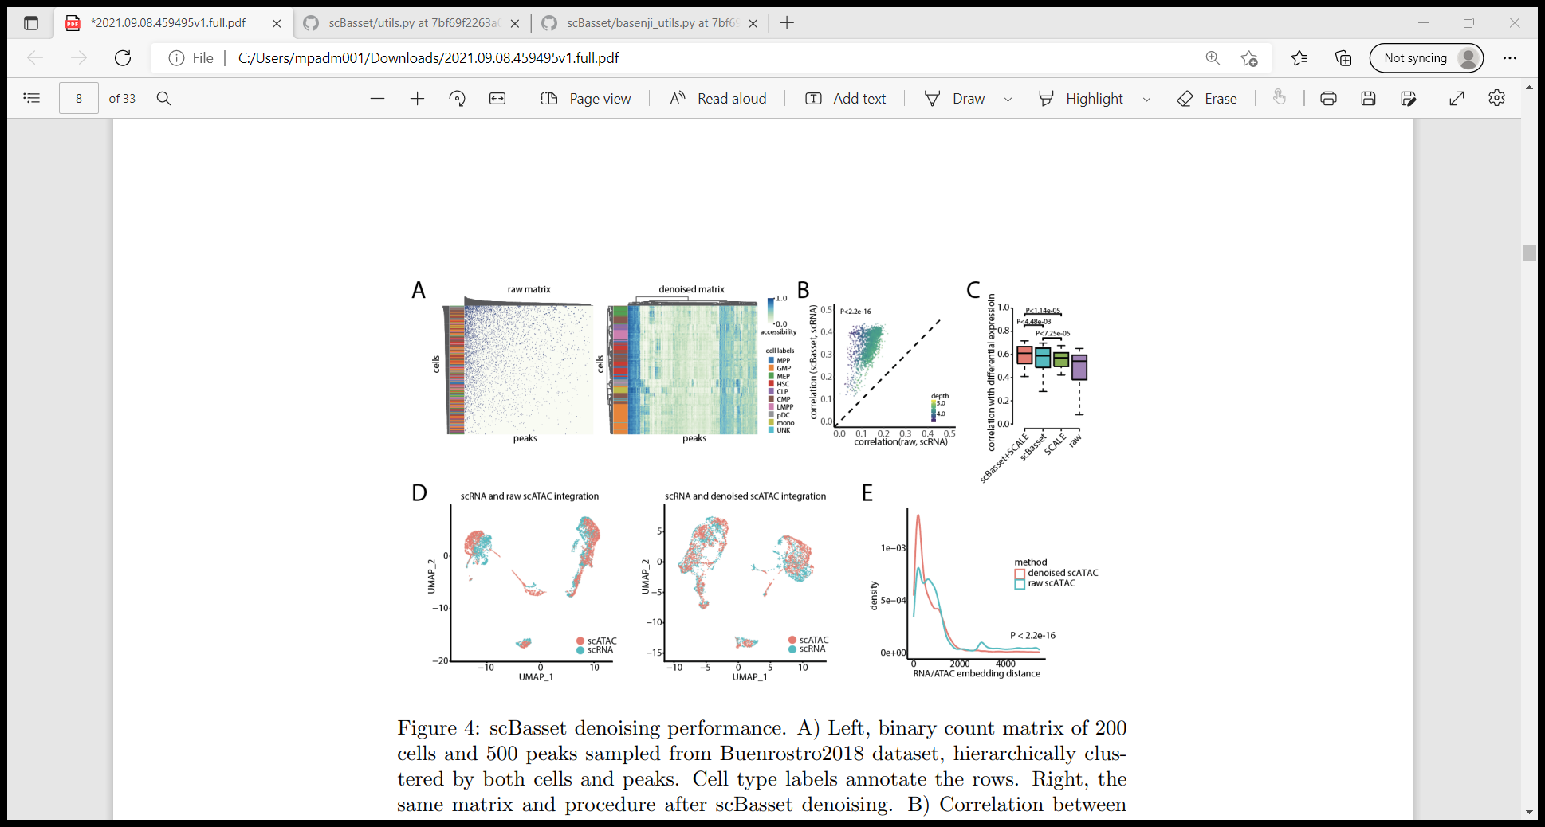
scBasset denoises single cell accessibility profile
scATAC sparsity results in the binary accessibility indicator for any given cell and peak to contain ample false negatives.
Data cannot be studied with true single cell resolution and is usually aggregated across cells
Numeric values to represent the accessibility status at every cell/peak combination
scBasset computes numeric values in its sequence-based predictions.
Buenrostro2018 dataset - Sampled 500 peaks and 200 cells, visualized the raw cell-by-peak matrix v/s the denoised matrix.
In raw count matrix, cells and peaks clustered by sequencing depth, show no biologically relevant patterns
After denoising using scBasset,
Cells of the same cell type share similar accessibility profiles
Hierarchical clustering of cells matched well with ground-truth labels.
Effective denoising to improve the correlation between gene accessibility estimates and the gene’s measured RNA expression in multiome experiments
Computed accessibility scores for each gene - Average predicted accessibility values at all promoter peaks before and after denoising
scBasset denoising improves consistency between gene accessibility and expression, for 10x multiome PBMC and mouse brain datasets
Changes in accessibility and expression correlate better with each other than their absolute values
Useful metric for validating accessibility denoising methods
Evaluated scBasset and SCALE accessibility denoising for consistency between differential expression and differential accessibility
To assess denoising quality, correlation between differential expression and differential accessibility before and after denoising is evaluated
Correlation between
gene accessibility score and gene expression for each cell before (x-axis) and
after denoising (y-axis) for the multiome PBMC dataset.

Slide 16
scBasset significantly outperforms SCALE when evaluated by differential accessibility/expression
Performs better in denoising differential accessibility, which emphasizes cell identity
scATAC denoising would improve scRNA and scATAC integration performance.
To evaluate integration performance, 10x multiome scRNA and scATAC profiles are treated to have originated from two independent experiments.
For the 10x multiome PBMC dataset-
when the scRNA profiles are integrated with the denoised scATAC profiles, the cells achieve better mixing compared to scRNA integrated with raw scATAC profiles
Comparison of denoising performance on multiome PBMC dataset between raw data, scBasset, SCALE, and scBasset+SCALE combine, evaluated by consistency in differential expression log2FC and differential accessibility log2FC.
10x multiome PBMC RNA (blue) and raw ATAC (red) profile embeddings after integration
10x multiome PBMC RNA (blue) and denoised ATAC (red) profile embeddings after integration.

Slide 17
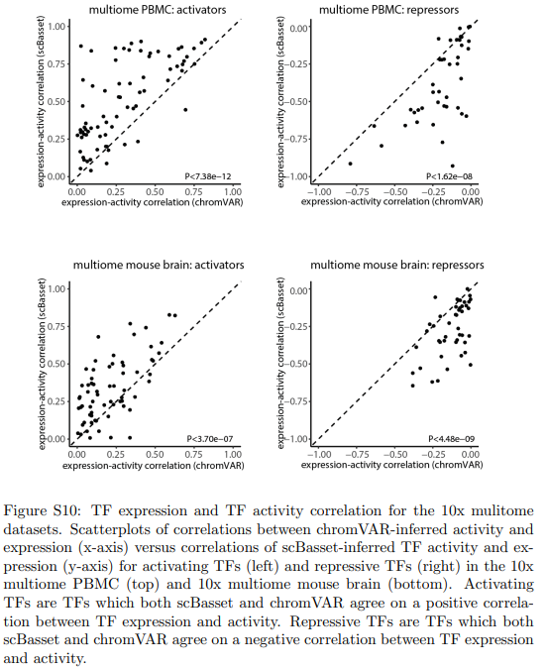
scBasset infers transcription factor activity at single cell resolution
Transcription factor binding - A major driver of chromatin accessibility
scBasset learns to predict accessibility from sequence, the model expected to capture sequence information predictive of TF binding
Synthetic DNA sequences with and without a particular TF motif of interest given to a trained scBasset model
The activity of the motif in each cell based on changes in predicted accessibility is evaluated.
To compare scBasset and chromVAR, the 10x PBMC multiome dataset is analysed.
TF expression measured in the RNA can serve as a proxy for its motif’s activity.
Inferred motif activity for all 733 human CIS-BP motifs using both scBasset and chromVAR
scBasset TF activities correlate significantly better with expression than chromVAR
Evaluated scBasset and chromVAR on activating and repressive TFs separately
For positive TF expression-activity correlation,
scBasset predicted TF activities that have significantly greater correlation with expression than chromVAR predicted activity
For negative TF expression-activity correlation,
scBasset predcited TF activities have a significantly lesser correlation (more negative) with expression than chromVAR predicted activity

Slide 18
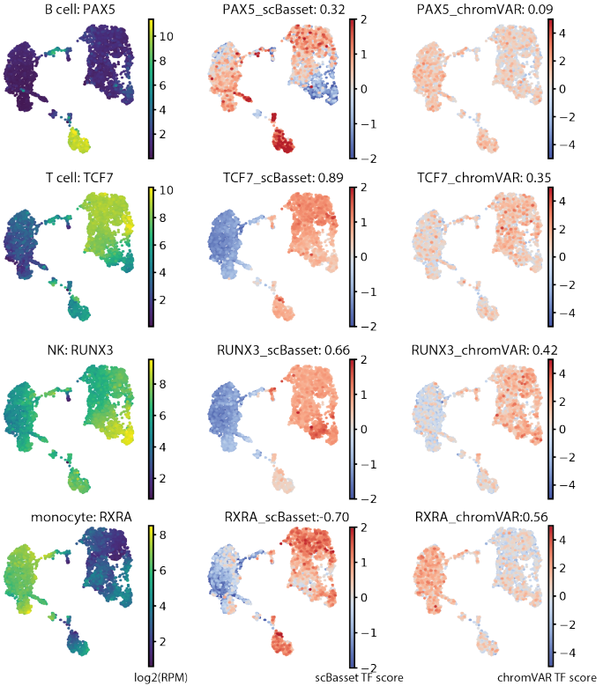
scBasset TF activities have better cell type specificity and correlate better with TF expression than chromVAR
scBasset predicts B cell specific activity of PAX5, which correlates with PAX5 expression (r=0.32), while chromVAR PAX5 activity did not have any cell type specificity or significant PAX5 expression correlation (r=0.09). scBasset-predicted activity of the T cell differentiation regulator TCF7 highly correlates with expression (r=0.89), while chromVAR TCF7 activity has lesser specificity and expression correlation (r=0.35). NK cells have greater expression of RUNX3 and scBasset captures this elevated activity in NK cells (r=0.66) more effectively than chromVAR (r=0.42). For monocytes, both scBasset and chromVAR predicted specific activity of CEBPB, with scBasset activity correlating slightly better with expression (0.75 vs. 0.68, Fig.S11). Interestingly, while scRNAseq suggests monocyte-specific expression of RXRA, scBasset and chromVAR strongly disagree, making opposite predictions for RXRA activity; scBasset predicts RXRA as a repressor (r=-0.70) while chromVAR suggests an activating role (r=0.56).

Slide 19
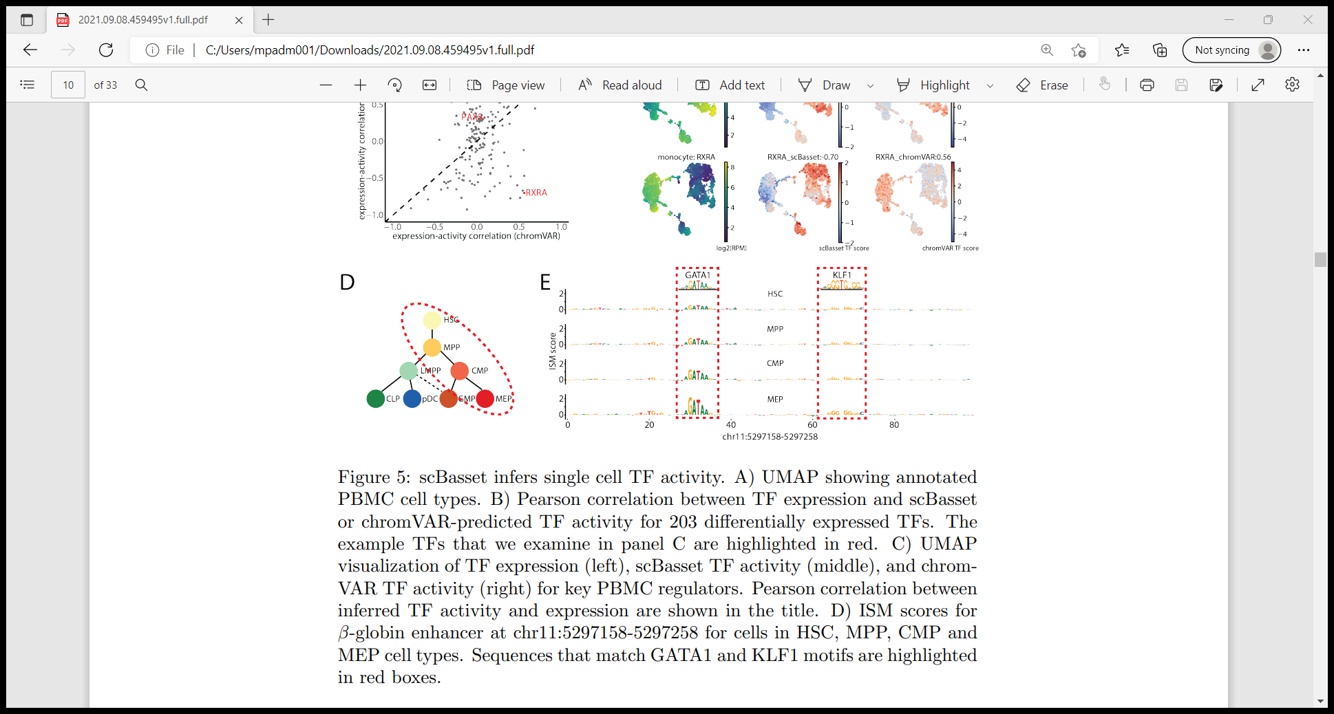
scBasset makes use of an accurate quantitative model that predicts cell type specific accessibility from the DNA nucleotides.
scBasset used to infer TF activity at per-cell per-nucleotide resolution
Examined a known enhancer for the β-globin gene that regulates specific beta-globin expression
Performed in silico saturation mutagenesis (ISM) for this 100 bp sequence
Predicted the change in accessibility in each cell after mutating each position to its 3 alternative nucleotides
Aggregated to a single score for each position by taking the normalized ISM score for each reference nucleotide
Observation –
The most influential nucleotides correspond to GATA1 and KLF1 motifs.
These are TFs known to bind to this enhancer region and regulate β-globin expression
GATA1 and KLF1 motifs contribute more to the accessibility as the cells differentiate in the erythroid lineage
Inference –
scBasset learns the accessibility regulatory grammar at single cell resolution
Used to identify the TFs regulating specific enhancers in individual cells and lineages.
ISM scores for β-globin enhancer at chr11:5297158-5297258 for cells in HSC, MPP, CMP and MEP cell types. Sequences that match GATA1 and KLF1 motifs are highlighted in red boxes

